Slide 1


Department of Artificial Intelligence and Data Science
5G Small Cell Placement-Optimization Analytics
Dr. Suresh Kumar S M.E., Ph.D.,
Mohammed Imran J -231801107
Padmavathy R -231801122
Rohit G -231801131

Slide 2

Problem Statement and Motivation
With the rapid growth of 5G networks, achieving optimal small cell placement is crucial for maximizing coverage and minimizing cost. Traditional placement methods rely on manual analysis or static models that fail to adapt to dynamic urban environments. This project leverages Big Data analytics using Apache Spark to process real-world telecom datasets and propose optimized small cell locations.
Motivation: To enable telecom operators to efficiently plan network expansions using data-driven insights, improving user experience and reducing infrastructure costs.

Slide 3




Existing System
Manual analysis of cell tower and coverage data. .
Static radio planning tools that do not leverage large-scale data.
Limited use of predictive analytics for coverage optimization.
Time-consuming and less adaptable to real-time network demands.

Slide 4





Objectives
Utilize Big Data platforms (Apache Spark) to process large-scale cell tower datasets.
Perform clustering (e.g., K-Means) to identify coverage hotspots and gaps.
Recommend optimized small cell placement locations.
Visualize analytics results through a web-based frontend (React + Flask backend).
Demonstrate a data-driven approach to network optimization.

Slide 5
Abstract
This mini-project presents a 5G Small Cell Placement Optimization Analytics platform developed using Apache Spark. The system analyzes open telecom datasets containing cell tower and geographical data to identify optimal small cell locations. Spark’s distributed processing enables fast clustering and pattern recognition over large-scale geospatial data. The backend, built with Flask, exposes APIs for analytics results, while a React frontend visualizes coverage zones and recommended sites on a map. This approach enhances network planning decisions and demonstrates Big Data’s role in telecom infrastructure analytics.

Slide 6
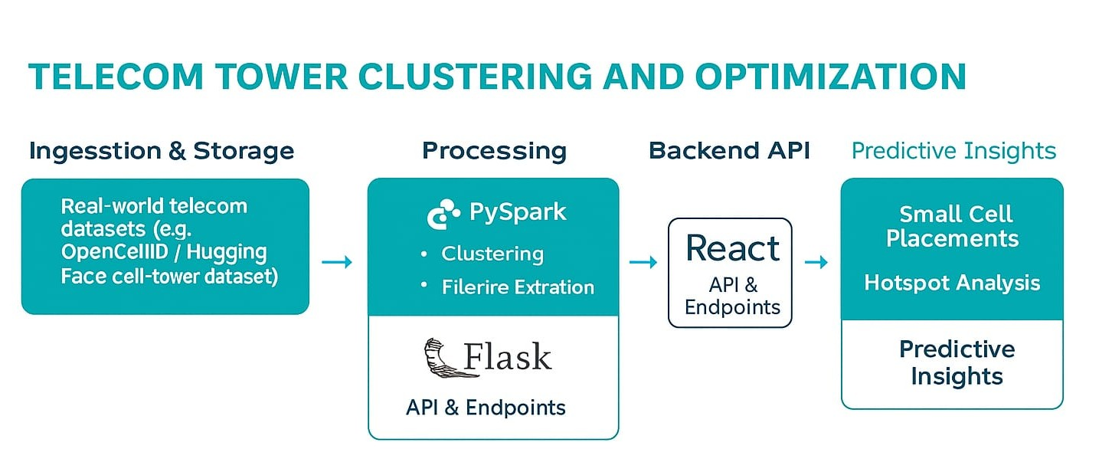
ARCHITECTURE DIAGRAM

Slide 7





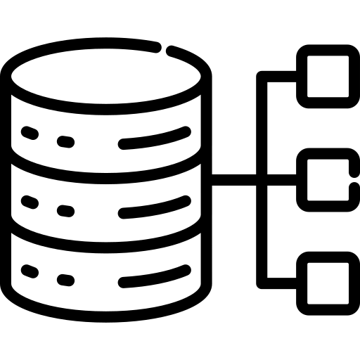
Tools and Technologies
Apache Spark (PySpark) – Big Data processing and clustering.
Flask – RESTful backend service for analytics results.
React.js – Frontend framework for map visualization.
Leaflet / Mapbox – Visualization of tower and hotspot locations.
Pandas, PyArrow – Data handling and integration.
Dataset Source: Hugging Face 'Francesco/cell-towers' (Parquet format).

Slide 8
Results and Outcomes
Identified dense clusters of existing towers using K-Means clustering.
Generated optimized coordinates for small cell placement.
Interactive web interface displaying real towers and suggested small-cell zones.
Demonstrated use of Spark MLlib and real-world datasets for telecom analytics.

Slide 9
Future Enhancements
Integration with live 5G coverage data for real-time optimization.
Incorporate additional constraints (power, terrain, population density).
Use advanced ML algorithms like DBSCAN or reinforcement learning for placement refinement.
Deploy the platform on a cloud-based Spark cluster for scalability.

Slide 10
Thank You

