Slide 1
Chapter 1: Introduction
Silberschatz et al, 9th or higher edition

Slide 2
Regarding Attendance
I will call names, about 10 to 20, in a random manner
You should confirm by saying “PRESENT”.

Slide 3
Outline
What Operating Systems Do
Computer-System Organization
Computer-System Architecture
Operating-System Structure
Operating-System Operations
  Process, Memory and Storage Management
  Protection and Security
Kernel data structures
Computing environments
  Distributed Systems
  Special-Purpose Systems
Computing Environments
Open-Source Operating Systems

Slide 4
What is an Operating System?
A program that acts as an intermediary between a user of a computer and the computer hardware
Operating system goals:
  Execute user programs and make solving user problems easier
  Make the computer system convenient to use
  Use the computer hardware in an efficient manner

Slide 5
Computer System Structure
Computer system can be divided into four components:
  Hardware – provides basic computing resources
    CPU, memory, I/O devices
  Operating system
    Controls and coordinates use of hardware among various applications and users
  Application programs –
    define the ways in which the system resources are used to solve the computing problems of the users
    Examples: Word processors, compilers, web browsers, database systems, video games
  Users
    People, machines, other computers

Slide 6

Four Components of a Computer System

Slide 7
What Operating Systems Do
Depends on the point of view
Users view
  Users want convenience, ease of use
  Don’t care about resource utilization
  But shared computer such as mainframe or minicomputer must keep all users happy
Users of dedicate systems such as workstations have dedicated resources but frequently use shared resources from servers
Handheld computers are resource poor, optimized for usability and battery life
Some computers have little or no user interface, such as embedded computers in devices and automobiles

Slide 8
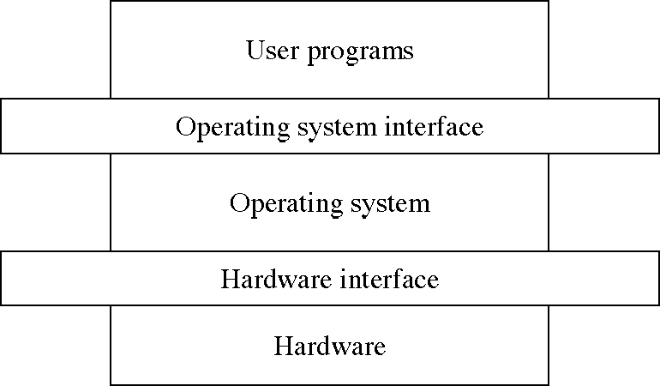
Objectives of this chapter
To provide a grand tour of the major operating systems components
To provide coverage of basics of computer system organization
(To be studied)
This Chapter

Slide 9
Operating System Definition
Systems view
  OS is a resource allocator
    Manages all resources
    Decides between conflicting requests for efficient and fair resource use
  OS is a control program
    Controls execution of programs to prevent errors and improper use of the computer

Slide 10
Operating System Definition(Cont.)
No universally accepted definition
  “Everything a vendor ships when you order an operating system” is good approximation
    But varies wildly
“The one program running at all times on the computer” is the kernel. Everything else is either a system program (ships with the operating system) or an application program.

Slide 11
Computer Startup
bootstrap program is loaded at power-up or reboot
  Typically stored in ROM or EPROM, generally known as firmware
  Initializes all aspects of system
  Loads operating system kernel and starts execution

Slide 12
Outline
What Operating Systems Do
Computer-System Organization
Computer-System Architecture
Operating-System Structure
Operating-System Operations
Process, Memory and Storage Management
Protection and Security
Distributed Systems
Special-Purpose Systems
Computing Environments
Open-Source Operating Systems

Slide 13

Computer System Organization
Computer-system operation
  One or more CPUs, device controllers connect through common bus providing access to shared memory
  Concurrent execution of CPUs and devices competing for memory cycles

Slide 14
Computer-Components
Computer consists of processor, memory, and I/O components, with one or more modules of each type. These modules are connected through interconnection network.
I/O devices and the CPU can execute concurrently.
Each device controller is in-charge of a particular device type.
Each device controller has a local buffer.
CPU moves data from/to main memory to/from local buffers
I/O is from the device to local buffer of controller.
Device controller informs CPU that it has finished its operation by causing an interrupt.

Slide 15
About the Interrupts
In the next few slides, we will study the basics of interrupts by considering the architecture and operation of a simple computer.

Slide 16
Von Neumann architecture
The von Neumann architecture—also known as the von Neumann model or Princeton architecture—is a computer architecture based on a 1945 description by the mathematician and physicist John von Neumann and others in the First Draft of a Report on the EDVAC (Electronic Discrete Variable Automatic Computer). That document describes a design architecture for an electronic digital computer with
  A processing unit that contains an arithmetic logic unit and processor registers
  A control unit that contains an instruction register and program counter
  Memory that stores data and instructions
  External mass storage
  Input and output mechanisms

Slide 17
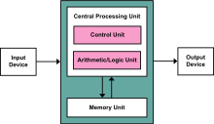
Von Neumann architecture

Slide 18
Architecture of a simple computer
Memory
CPU
Instruction
0
1
.
.
.
n-2
n-1
PC
MAR
System bus
Instruction
MBR
Instruction
IR
I/O AR
Execution
Unit
I/O BR
Data
I/O Module
Data
Data
Buffers

Slide 19
Architecture of a simple computer
Processor: Controls the operation of the computer and performs data processing functions. It is called CPU.
Main memory: Stores data and programs; it is volatile
I/O modules: Moves data between the computer and external environment.
System bus: mechanism of communication among processors, main memory, and I/O modules.

Slide 20
Simple Computer
Operation: Processor controls everything.
  MAR: Memory address register: which specifies the address in memory for the next read or write.
  MBR: Memory buffer register: which contains the data to be written into memory or which receives data read from memory.
  I/O AR: Address of I/O device
  I/O BR: Exchange of data between I/O and computer.

Slide 21
Simple Computer
Processor Registers: Within the processor there is a set of registers that provide a level of memory that is faster and smaller than main memory.
  User visible registers: Available to programmer
    Data registers: Can be used by the programmer.
    Address Registers: Contains Main memory address of data and instructions.
      Index register: Index to base value
      Segment pointer: It contains a reference to a particular segment.
      Stack pointer: Points top of the stack.
  Control and status registers: These are employed to control the operation of the processor. Differ from machine to machine.
    MAR, MBR,I/O AR, and I/O BR
    Program Counter: Contains the address of the instruction to be fetched.
    Instruction Register: Contains the instruction most recently fetched.
    PSW: Program Status word: It is a register or a set of registers.

Slide 22
Simple Computer…
  PSW: Program Status word: It is a register or a set of registers.
    Sign: contains sign bit of last arithmetic operation
    Zero: it is set if the result of arithmetic operation is zero
    Carry: It is set if there is a carry or borrow.
    Equal: If the compare result is equality
    Overflow: It is set if the result is overflow.
    Interrupt enable/disable: Used to disable or enable interrupts.
    Supervisor: Indicates whether the processor is executing in supervisor or user mode.
Instruction execution:
  Program execution is the main function of the computer.
  Instruction fetch and execute
Start
Fetch the next instruction
Execute the next instruction
Halt

Slide 23
Simple computer…
Fetching: Bringing the instructions from the main memory.
  PC: Contains the address of the next instruction to be fetched.
    Incremented unless told otherwise
Execute:
  The processor interprets the instructions and performs the required action.
    Processor-memory: Transfer data from the memory
    Processor-I/O- transfer data from peripheral device from the memory.
    Data processing: Arithmetic and logic operations
    Control: The instructions may specify the sequence of the next instruction to be fetched.

Slide 24
Simple Computer..
Instruction format
  An Example:
0
3
4
15
Address
0
1
15
s
Address
PC: address of the instruction
IR: Instruction being executed
AC: Accumulator: temporary storage
Integer format
Program
LOAD 940
ADD 941
STORE 941
HLT
1=0001=LOAD ADDRESS: Load AC from memory
2=0010=STORE ADDRESS: Store AC to memory
3=0101=ADD ADDRESS: Add AC to memory
300
1 940
301
3 941
302
2 941
940
941

Slide 25
Interrupt processing
To improve the performance, interrupts are provided.
With interrupts, the processor can be engaged in executing other while an I/O operation is in progress.
Interrupt cycle is added to the instruction cycle.
Start
Fetch cycle
Fetch the next instruction
Execute cycle
Interrupts
Disabled
Execute the next instruction
Halt
Interrupts enables
Check for interrupt
Process Interrupt.
Interrupt cycle

Slide 26
Common Functions of Interrupts
Interrupt transfers the control to the interrupt service routine generally, through the interrupt vector, which contains the addresses of all the service routines.
Interrupt architecture must save the address of the interrupted instruction.
Incoming interrupts are disabled while another interrupt is being processed to prevent a lost interrupt.
A trap is a software-generated interrupt caused either by an error or a user request.
An operating system is interrupt driven.

Slide 27
Interrupt Handling
To start I/O operation, CPU loads the appropriate registers within the device controller
The device controller examines the contents of these registers to determine what action to take.
If it s a read operation the controller transfers the data into local buffer.
Then it informs the CPU through interrupt.
The operating system preserves the state of the CPU by storing registers and the program counter.

Slide 28
Interrupt Handling…
Interrupt handler: The CPU hardware has a wire called interrupt request line; that CPU senses after executing every instruction.
When a CPU senses a signal, it saves the PC, and PSW on a stack and jump to the interrupt handler routine at a fixed address in memory.
Interrupt vector: It contains the memory addresses of specialized interrupt handlers.

Slide 29
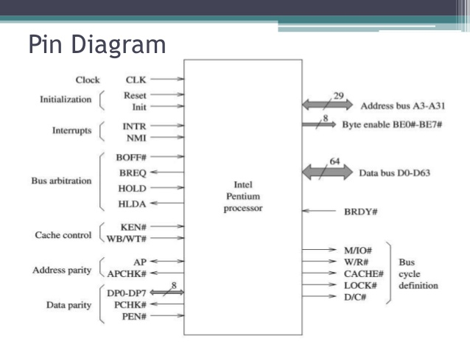

Slide 30
I/O Structure
Two types of I/O
Synchronous I/O: After I/O starts, control returns to user program only upon I/O completion.
  Wait instruction idles the CPU until the next interrupt
  Wait loop (contention for memory access).
  At most one I/O request is outstanding at a time, no simultaneous I/O processing.
Asynchronous I/O: After I/O starts, control returns to user program without waiting for I/O completion.
Device-status table contains entry for each I/O device indicating its type, address, and state.
Operating system indexes into I/O device table to determine device status and to modify table entry to include interrupt.

Slide 31
I/O Structure
Waiting for I/O operation
  Loop: Jump Loop
The above loop continues until interrupt occurs.

Slide 32

Two I/O Methods
Synchronous
Asynchronous

Slide 33

Device-Status Table

Slide 34
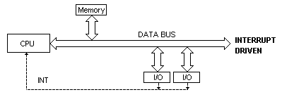
I/O communication techniques
Three kinds of data transfer
  Program data transfer: CPU checks the I/O status
    The I/O module does not interrupt the processor.
    Processor is responsible for extracting the data from main memory and shifting data out of main memory.
    It is a time-consuming process that keeps the processor busy unnecessarily.
  Interrupt driven data transfer: when I/O is ready it interrupts the CPU
    In programmed I/O the processor repeatedly interrogate the status of the I/O module.
    In Interrupt driven data transfer, the I/O module will interrupt the processor to request service when it is ready to exchange data with the processor.

Slide 35
Direct Memory Access (DMA) Structure
DMA:
  Used for high-speed I/O devices able to transmit information at close to memory speeds.
  Device controller transfers blocks of data from buffer storage directly to main memory without CPU intervention.
  Only on interrupt is generated per block, rather than the one interrupt per byte.
DMA: Processor issues a command to DMA module by sending the following information.
  Whether read or write is requested.
  The address of the I/O device involved.
  The starting location of the memory to read from or write to.
  The number of words to be read or written.
The processor continues other work.
The DMA module transfers the data and interrupts the processor.
It takes the control of the bus to transfer data from memory.
The processor becomes slow, or must wait for the bus.

Slide 36
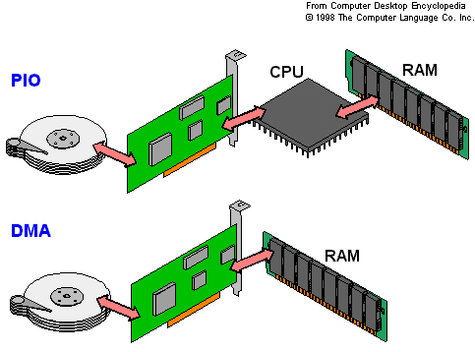

Slide 37

How a Modern Computer (Single Processor System) Works?
A von Neumann architecture

Slide 38
Outline
What Operating Systems Do
Computer-System Organization
Computer-System Architecture
Operating-System Structure
Operating-System Operations
Process, Memory and Storage Management
Protection and Security
Distributed Systems
Special-Purpose Systems
Computing Environments
Open-Source Operating Systems

Slide 39
Operating System Structure
Multiprogramming needed for efficiency
  Single user cannot keep CPU and I/O devices busy at all times
  Multiprogramming organizes jobs (code and data) so CPU always has one to execute
  A subset of total jobs in system is kept in memory
  One job selected and run via job scheduling
  When it has to wait (for I/O for example), OS switches to another job
Timesharing (multitasking) is logical extension in which CPU switches jobs so frequently that users can interact with each job while it is running, creating interactive computing
  Response time should be < 1 second
  Each user has at least one program executing in memory process
  If several jobs ready to run at the same time  CPU scheduling
  If processes don’t fit in memory, swapping moves them in and out to run
  Virtual memory allows execution of processes not completely in memory

Slide 40

Memory Layout for Multiprogrammed System

Slide 41
Operating system operations
Dual mode operation
Process Management
Memory management
Storage management
Protection and Security

Slide 42
About Dual-mode operation
In Early systems, programmers had complete control over the system.
A OSs developed the control was given to OS.
OS started performing many functions such as I/O.
OS started sharing resources among several programs
Multiprogramming put several programs at same time.
Without sharing the error may cause problem to only one program.
With sharing an error may cause problems to many programs.
  Sometimes to OS itself.
  OSs have to be protected from such incorrect programs.
MS-DOS and MAC-OS allow this kind of error.
Protection measures.
  Dual-Mode Operation
  I/O Protection
  Memory Protection
  CPU Protection

Slide 43
Dual-Mode Operation
Sharing system resources requires operating system to ensure that an incorrect program cannot cause other programs to execute incorrectly.
Provide hardware support to differentiate between at least two modes of operations.
  1. User mode – execution done on behalf of a user.
  Monitor mode (also kernel mode or system mode) – execution done on behalf of operating system.
This architectural enhancement is useful for many aspects of system operation.
When system starts, hardware starts in monitor mode.
OS is then loaded and OS starts user processes in user mode.

Slide 44
Dual-Mode Operation (Cont.)
Mode bit added to computer hardware to indicate the current mode: monitor (0) or user (1).
Whenever OS takes control the mode bit is 0.
When an interrupt or fault occurs hardware switches to monitor mode.
This dual-mode operation protects computer from errant users and errant users from other.
This protection can be achieved by designating some of the instructions as privileged instructions.
Privileged instructions can be issued only in monitor mode.
  MS-DOS was written without mode bit
  Pentium provides duel mode operation: so it provides greater protection.
Interrupt/fault
monitor
user
set user mode

Slide 45
I/O Protection
A user program may disrupt the normal operation
  By issuing a illegal I/O operation.
Solution: All I/O instructions are privileged instructions.
Must ensure that a user program could never gain control of the computer in monitor mode
A user program that, as part of its execution, stores a new address in the interrupt vector. How to protect it ?
Answer: Consider Interrupt instructions which modify interrupt vector as privileged instructions.

Slide 46
Memory Protection
Must provide memory protection at least for the interrupt vector and the interrupt service routines.
In order to have memory protection, add two registers that determine the range of legal addresses a program may access:
  Base register – holds the smallest legal physical memory address.
  Limit register – contains the size of the range
Memory outside the defined range is protected.

Slide 47

Use of A Base and Limit Register

Slide 48

Hardware Address Protection

Slide 49
Hardware Protection
When executing in monitor mode, the operating system has unrestricted access to both monitor and user’s memory.
The load instructions for the base and limit registers are privileged instructions.

Slide 50
CPU Protection
Ensures that OS maintains control.
Timer – interrupts computer after a specified period to ensure operating system maintains control.
  Timer is decremented every clock tick.
  When timer reaches the value 0, an interrupt occurs.
Timer commonly used to implement time sharing.
Timer also used to compute the current time.
Load-timer is a privileged instruction.

Slide 51
General system operation
To improve the utilization led to the development of multiprogramming and timesharing.
  Resources of the computers are shared among many programs and processes
Sharing led to allow OS to have control over I/O to provide continuous, consistent and correct operation.
Dual mode of operation is introduced.
I/O instructions and instructions to modify memory management are privileged instructions.
  HLT instruction is privileged
  The instructions to turn-on and turn-off are privileged.
The instructions to change user mode to monitor mode are privileged.
User must ask the monitor to do I/O. Such a request is called system call.
When a system call is executed it is treated by the hardware as a software interrupt.
Control is passed to interrupt vector to a service routine to the OS by setting the mode bit to monitor mode.
The OS examines the request , and passes necessary information and checks correctness and executes the request.
It returns the control to the statement after the system call.

Slide 52

General System Architecture…

Slide 53

Transition from User to Kernel/Supervisor Mode
Timer to prevent infinite loop / process hogging resources
  Set interrupt after specific period
  Operating system decrements counter
  When counter zero generate an interrupt
  Set up before scheduling process to regain control or terminate program that exceeds allotted time

Slide 54
Outline
What Operating Systems Do
Computer-System Organization
Computer-System Architecture
Operating-System Structure
Operating-System Operations
Process, Memory and Storage Management
Protection and Security
Distributed Systems
Special-Purpose Systems
Computing Environments
Open-Source Operating Systems

Slide 55
Process Management
A process is a program in execution. It is a unit of work within the system. Program is a passive entity, process is an active entity.
Process needs resources to accomplish its task
  CPU, memory, I/O, files
  Initialization data
Process termination requires reclaim of any reusable resources
Single-threaded process has one program counter specifying location of next instruction to execute
  Process executes instructions sequentially, one at a time, until completion
Multi-threaded process has one program counter per thread
Typically system has many processes, some user, some operating system running concurrently on one or more CPUs
  Concurrency by multiplexing the CPUs among the processes / threads

Slide 56
Process Management Activities
The operating system is responsible for the following activities in connection with process management:
Creating and deleting both user and system processes
Suspending and resuming processes
Providing mechanisms for process synchronization
Providing mechanisms for process communication
Providing mechanisms for deadlock handling

Slide 57
Memory Management
All data in memory before and after processing
All instructions in memory in order to execute
Memory management determines what is in memory when
  Optimizing CPU utilization and computer response to users
Memory management activities
  Keeping track of which parts of memory are currently being used and by whom
  Deciding which processes (or parts thereof) and data to move into and out of memory
  Allocating and deallocating memory space as needed

Slide 58
Storage Management
OS provides uniform, logical view of information storage
  Abstracts physical properties to logical storage unit - file
  Each medium is controlled by device (i.e., disk drive, tape drive)
    Varying properties include access speed, capacity, data-transfer rate, access method (sequential or random)
1. File-System management
  Files usually organized into directories
  Access control on most systems to determine who can access what
  OS activities include
    Creating and deleting files and directories
    Primitives to manipulate files and dirs
    Mapping files onto secondary storage
    Backup files onto stable (non-volatile) storage media

Slide 59
Mass-Storage Management
Usually disks used to store data that does not fit in main memory or data that must be kept for a “long” period of time
Proper management is of central importance
Entire speed of computer operation hinges on disk subsystem and its algorithms
OS activities
  Free-space management
  Storage allocation
  Disk scheduling
Some storage need not be fast
  Tertiary storage includes optical storage, magnetic tape
  Still must be managed – by OS or applications
  Varies between WORM (write-once, read-many-times) and RW (read-write)

Slide 60
I/O Subsystem
One purpose of OS is to hide peculiarities of hardware devices from the user
I/O subsystem responsible for
  Memory management of I/O including buffering (storing data temporarily while it is being transferred), caching (storing parts of data in faster storage for performance), spooling (the overlapping of output of one job with input of other jobs)
  General device-driver interface
  Drivers for specific hardware devices

Slide 61
Storage Structure
Main memory – only large storage media that the CPU can access directly
  Random access
  Typically volatile
Secondary storage – extension of main memory that provides large nonvolatile storage capacity
Magnetic disks – rigid metal or glass platters covered with magnetic recording material
  Disk surface is logically divided into tracks, which are subdivided into sectors
  The disk controller determines the logical interaction between the device and the computer

Slide 62

Moving-Head Disk Mechanism

Slide 63
Storage Hierarchy
Storage systems organized in hierarchy
  Speed
  Cost
  Volatility
Caching – copying information into faster storage system; main memory can be viewed as a cache for secondary storage

Slide 64

Storage-Device Hierarchy
Decrease in Latency
Increase in cost
Increase in Latency
Decrease in cost

Slide 65
Caching
Important principle, performed at many levels in a computer (in hardware, operating system, software)
Information in use copied from slower to faster storage temporarily
Faster storage (cache) checked first to determine if information is there
  If it is, information used directly from the cache (fast)
  If not, data copied to cache and used there
Cache smaller than storage being cached
  Cache management is an important design problem
  Cache size and replacement policy

Slide 66

Performance of Various Levels of Storage
Movement between levels of storage hierarchy can be explicit or implicit

Slide 67
Protection and Security
Protection – any mechanism for controlling access of processes or users to resources defined by the OS
Security – defense of the system against internal and external attacks
  Huge range, including denial-of-service, worms, viruses, identity theft, theft of service
Systems generally first distinguish among users, to determine who can do what
  User identities (user IDs, security IDs) include name and associated number, one per user
  User ID then associated with all files, processes of that user to determine access control
  Group identifier (group ID) allows set of users to be defined and controls managed, then also associated with each process, file
  Privilege escalation allows user to change to effective ID with more rights

Slide 68
Kernel Data Structures
Lists
  Single, double, circular
Stacks
  Last in first out
Queues
  First in first out
Trees
  Binary search tree, balanced tree (B-tree)
Hash functions and maps
  Input to hash function is data and output is numeric value, which can be used as an index.
Bitmaps
  Status of n items.
  Example: Consider 1000 disk blocks. We use 1000 bits to know the status. Each of 1000 bits represents the status of one block (occupied (1) or unoccupied (0)).

Slide 69
Computer Architectures

Slide 70
Multi-processor systems
Also known as parallel systems or tightly coupled systems
Advantages
  Increased throughput:
    Number of tasks finished per unit time.
  Economy of scale
    Total cost is less due to sharing of resources, like disk, mass storage and power supplies.
  Increased reliability
    One processor will not halt the system
    Graceful degradation
      The service depends on the available hardware
    Fault tolerant
      The service level does not decrease. Duplicate components.
        HP nonstop

Slide 71

Migration of Integer A from Disk to Register
Multitasking environments must be careful to use most recent value, no matter where it is stored in the storage hierarchy
Multiprocessor environment must provide cache coherency in hardware such that all CPUs have the most recent value in their cache
Distributed environment situation even more complex
  Several copies of a datum can exist
  Various solutions covered in Chapter 17

Slide 72

Symmetric Multiprocessing Architecture
Symmetric multiprocessing: each processor performs all tasks
  Solaris
Asymmetric multiprocessing: each processor is assigned a
specific task
Memory access model is changed from Uniformed memory access (UMA) to Non uniformed memory access (NUMA):

Slide 73

Recent Trend: A Dual-Core Design
Including multiple computing cores on a single chip.
  Less power, communication faster
However, it puts a pressure on OS designers and application programmers
Blade servers:
  Each blade server runs the OS independently
  Multiple processor boards are placed in the same chasis.

Slide 74
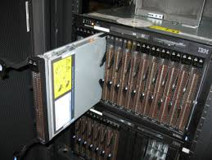
Blade Servers

Slide 75
Clustered Systems
Like multiprocessor systems, but multiple systems working together
  Usually sharing storage via a storage-area network (SAN)
  Provides a high-availability service which survives failures
    Asymmetric clustering has one machine in hot-standby mode
    Symmetric clustering has multiple nodes running applications, monitoring each other
  Some clusters are for high-performance computing (HPC)
    Applications must be written to use parallelization

Slide 76
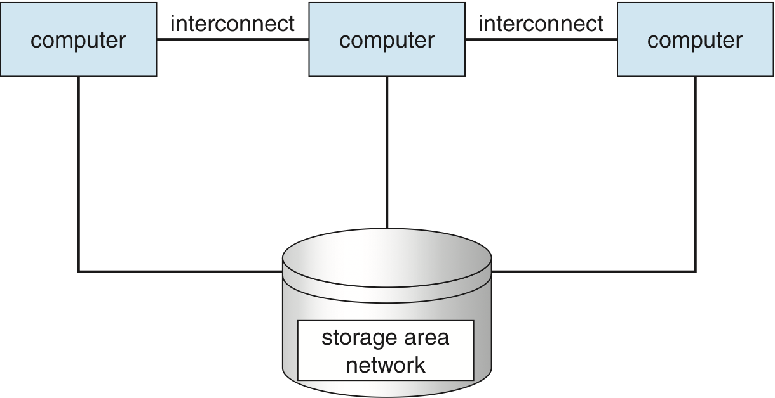
Clustered Systems

Slide 77
Outline
What Operating Systems Do
Computer-System Organization
Computer-System Architecture
Operating-System Structure
Operating-System Operations
Process, Memory and Storage Management
Protection and Security
Distributed Systems
Special-Purpose Systems
Computing Environments
Open-Source Operating Systems

Slide 78
Computing Environments

Slide 79
Distributed Computing
Collection of separate, possibly heterogeneous, systems networked together
  Network is a communications path
      Local Area Network (LAN)
      Wide Area Network (WAN)
      Metropolitan Area Network (MAN)
Network Operating System provides features between systems across network
  Communication scheme allows systems to exchange messages
  Illusion of a single system

Slide 80
Network Environments
Traditional computer
  Blurring over time
  Office environment
    PCs connected to a network, terminals attached to mainframe or minicomputers providing batch and timesharing
    Now portals allowing networked and remote systems access to same resources
  Home networks
    Used to be single system, then modems
    Now firewalled, networked

Slide 81

Client-server computing
Client-Server Computing
  Dumb terminals supplanted by smart PCs
  Many systems now servers, responding to requests generated by clients
    Compute-server provides an interface to client to request services (i.e., database)
    File-server provides interface for clients to store and retrieve files

Slide 82
Real-time embedded systems
Real-time embedded systems most prevalent form of computers
  Vary considerable, special purpose, limited purpose OS, real-time OS
Multimedia systems
  Streams of data must be delivered according to time restrictions
  Quality of service
Handheld systems
  PDAs, smart phones, limited CPU, memory, power
  Reduced feature set OS, limited I/O

Slide 83
Peer-to-Peer Computing
Another model of distributed system
P2P does not distinguish clients and servers
  Instead all nodes are considered peers
  May each act as client, server or both
  Node must join P2P network
    Registers its service with central lookup service on network, or
    Broadcast request for service and respond to requests for service via discovery protocol
  Examples include Napster and Gnutella

Slide 84
Virtualization
It allows one operating system to run as an application of other operating system
Emulation

Slide 85
Cloud Computing
Delivers computing, storage, and applications as a service across network
Employs thousands of servers and network

Slide 86
Web-Based Computing
Web has become ubiquitous
PCs most prevalent devices
More devices becoming networked to allow web access
New category of devices to manage web traffic among similar servers: load balancers
Use of operating systems like Windows 95, client-side, have evolved into Linux and Windows XP, which can be clients and servers

Slide 87
Open-Source Operating Systems
Operating systems made available in source-code format rather than just binary closed-source
Counter to the copy protection and Digital Rights Management (DRM) movement
Started by Free Software Foundation (FSF), which has “copyleft” GNU Public License (GPL)
Examples include GNU/Linux and BSD UNIX (including core of Mac OS X), and many more

Slide 88
End of Chapter 1

