Slide 1

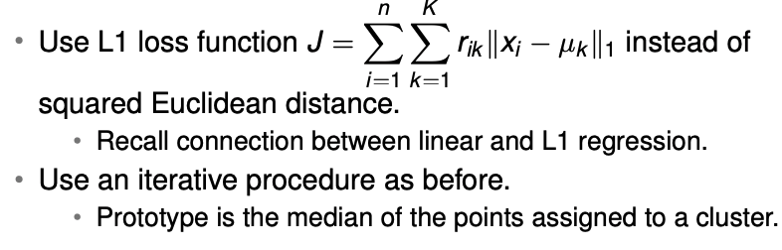
K-mediods

Slide 2
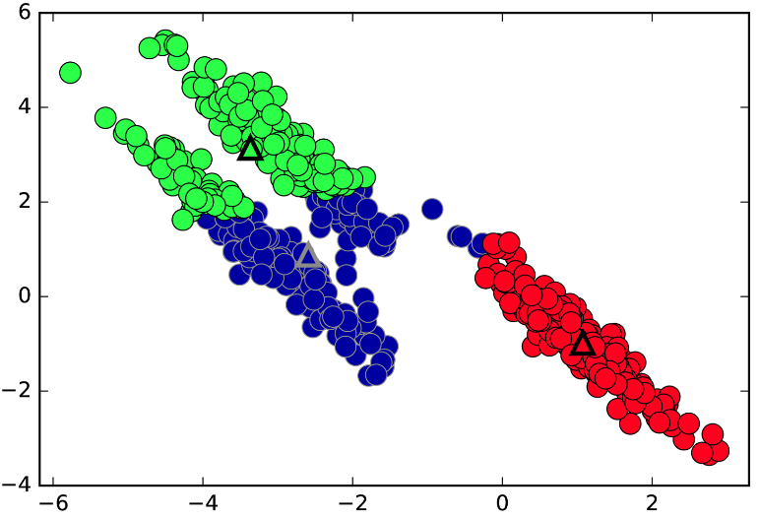
K-means: Additional issues
‘Hard’ assignments
Euclidean ➔ Favours ‘spherical’ clusters of equal ‘contribution’
Sensitive to initialization
Sensitive to outliers
https://amueller.github.io/aml/03-unsupervised-learning/02-clustering-mixture-models.html

Slide 3
Maximum Likelihood Estimation

Slide 4
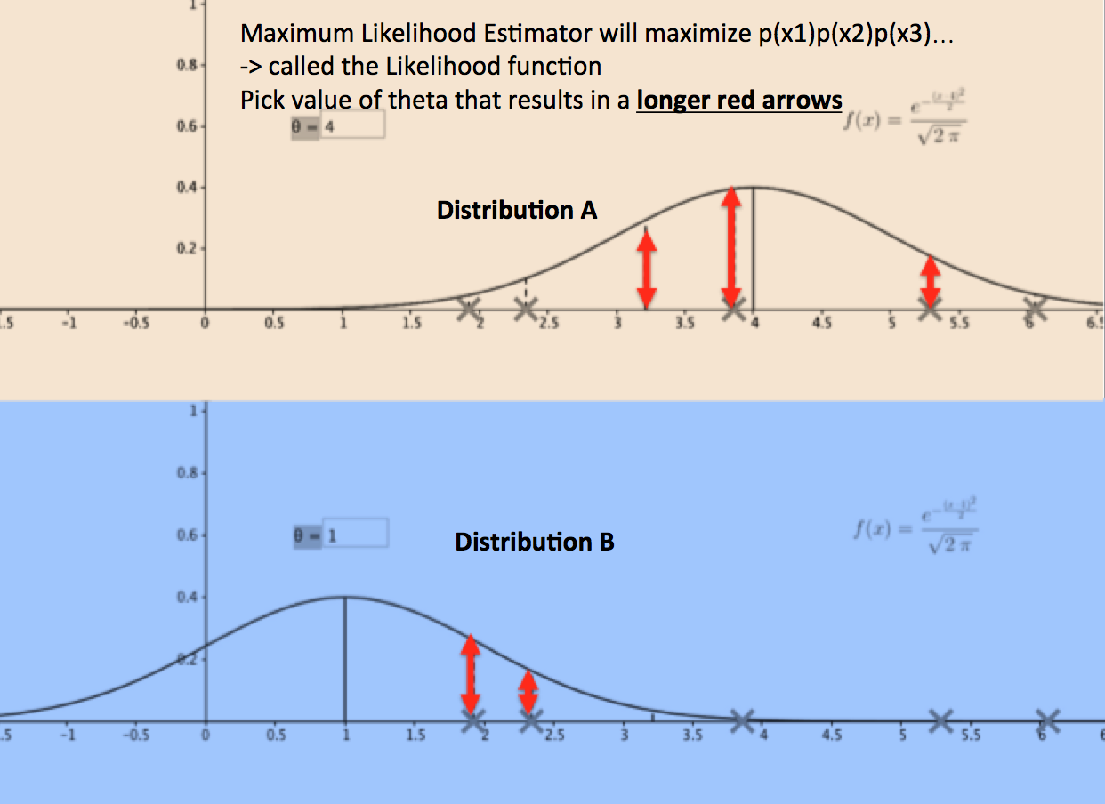
https://pmirla.github.io/2016/07/20/maximum-likelihood-explanation.html

Slide 5
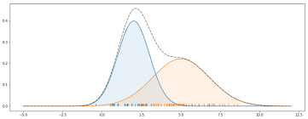

Slide 6
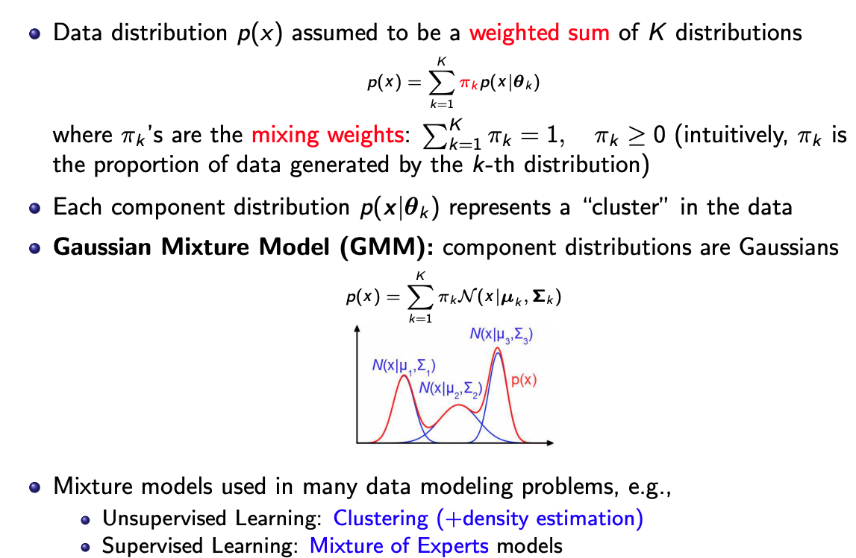
Mixture Models
https://www.cse.iitk.ac.in/users/piyush/courses/pml_winter16/slides_lec7.pdf

Slide 7
Mixture Models
https://www.cse.iitk.ac.in/users/piyush/courses/pml_winter16/slides_lec7.pdf

Slide 8
Mixture Models
https://www.cse.iitk.ac.in/users/piyush/courses/pml_winter16/slides_lec7.pdf

Slide 9
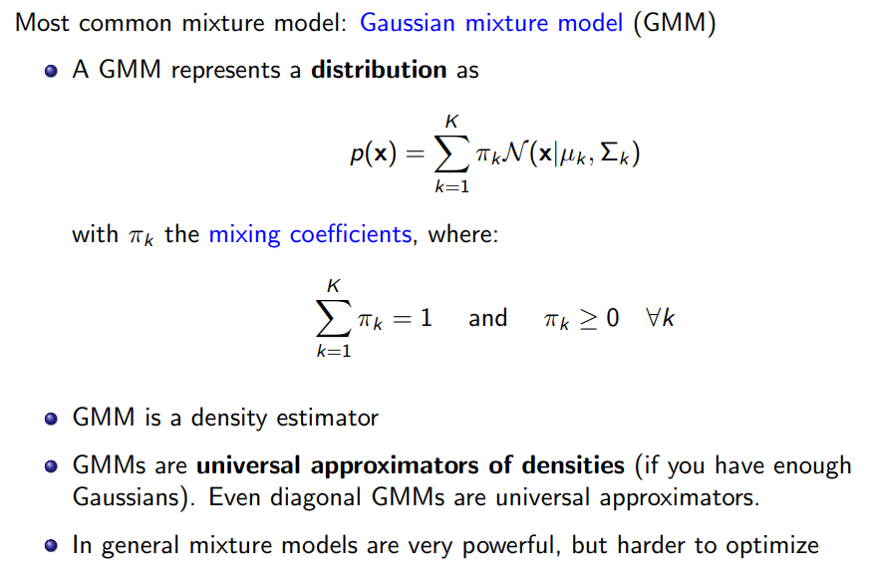
Mixture Models

Slide 10
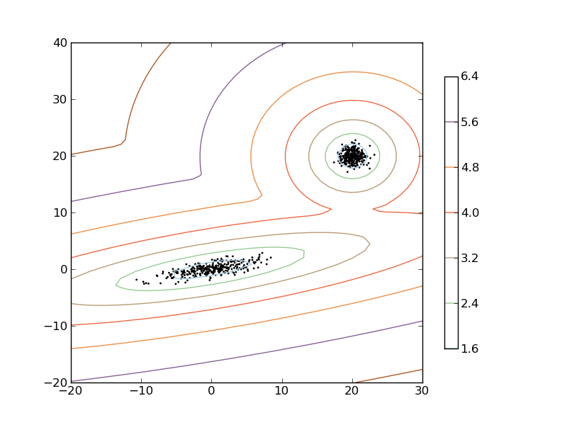
Mixture Models
http://scikit-learn.sourceforge.net/0.5/auto_examples/gmm/plot_gmm_pdf.html

Slide 11
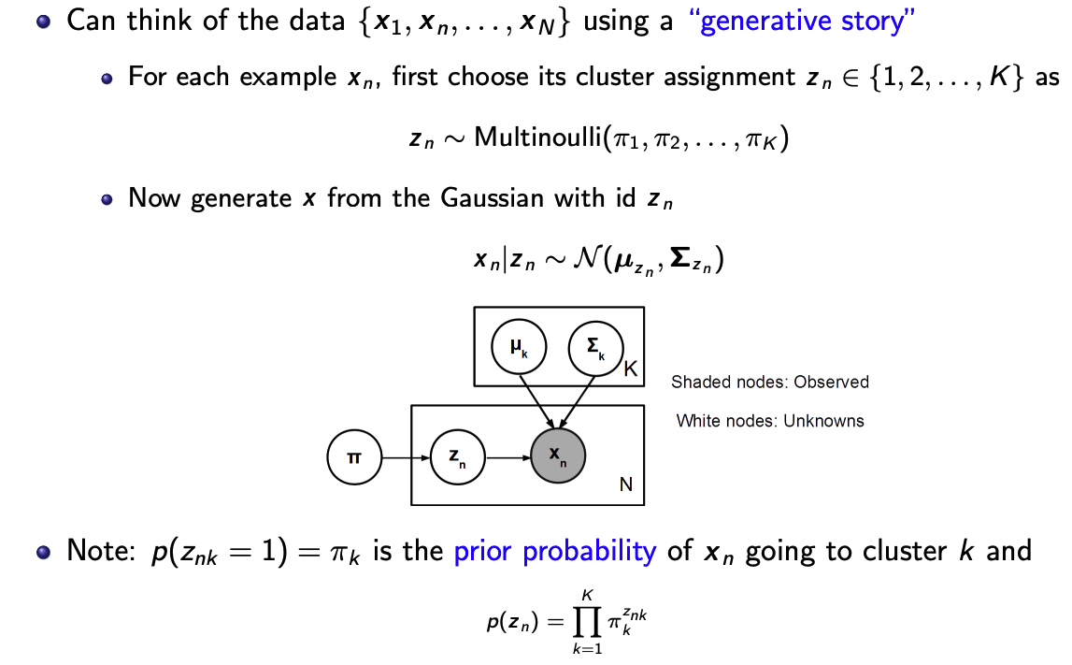
https://www.cse.iitk.ac.in/users/piyush/courses/pml_winter16/slides_lec7.pdf

Slide 12
https://www.cse.iitk.ac.in/users/piyush/courses/pml_winter16/slides_lec7.pdf

Slide 13
https://www.cse.iitk.ac.in/users/piyush/courses/pml_winter16/slides_lec7.pdf

Slide 14
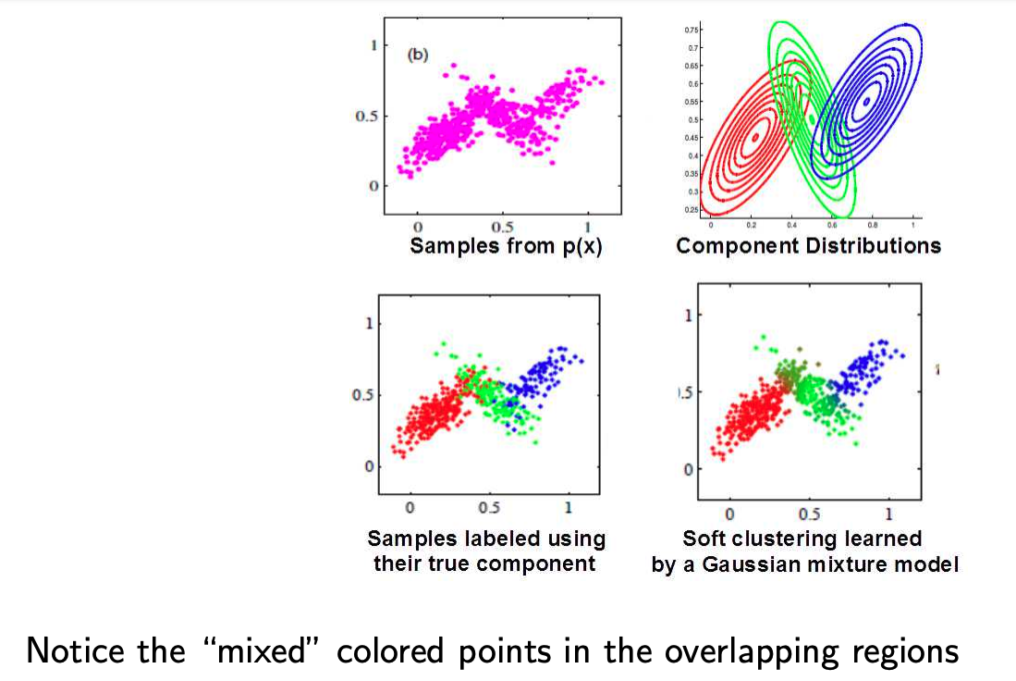
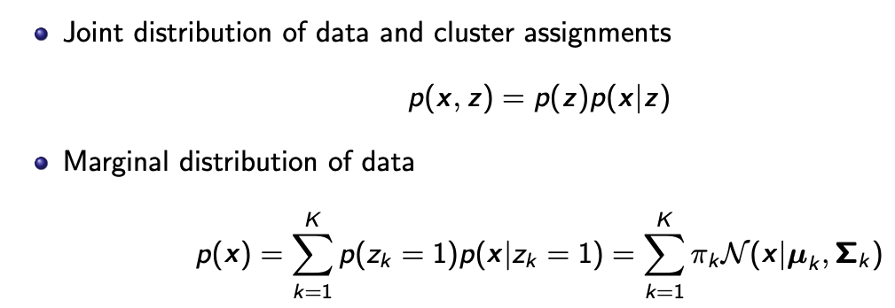
https://www.cse.iitk.ac.in/users/piyush/courses/pml_winter16/slides_lec7.pdf

Slide 15
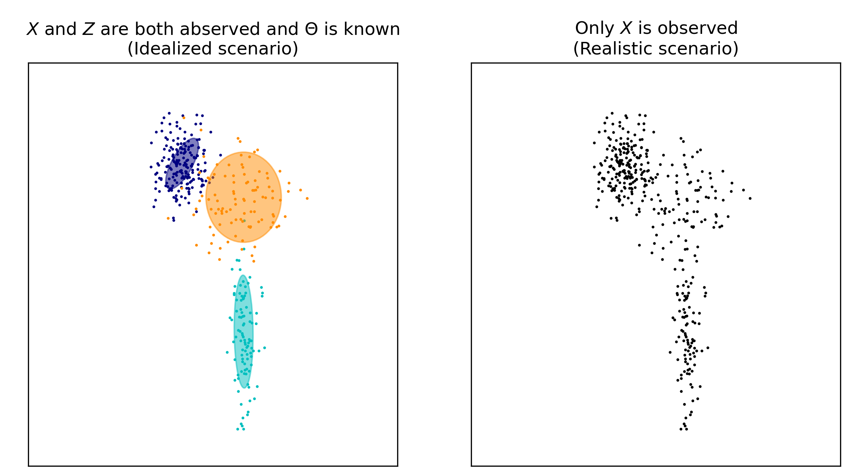
GMM – two scenarios

Slide 16
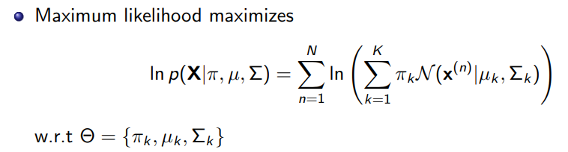
Parameter Estimation in GMMs

Slide 17
GMM – two scenarios

Slide 18

Parameter Estimation in GMMs using EM

Slide 19
Parameter Estimation in GMMs using EM
Strategy: Adjust the model parameters to maximize the observed ‘data’ probability

Slide 20
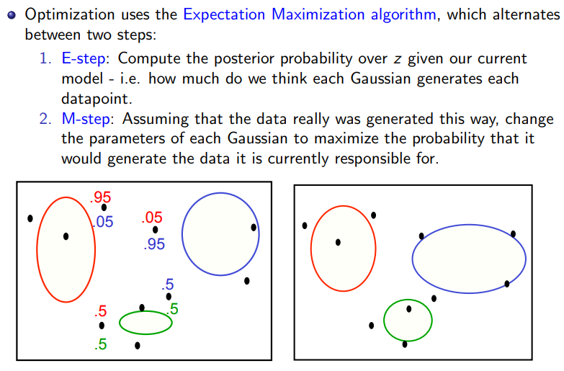

Slide 22
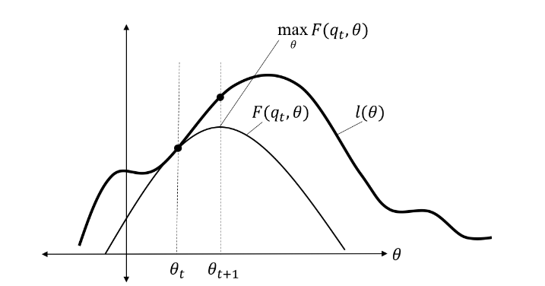
EM visualized
https://mbernste.github.io/posts/gmm_em/

Slide 23
Resources for GMM and EM
Textbook
  PRML (Bishop) – Chapter 9: 9.1,9.2,9.3.2
  Pattern Classification (Duda, Hart, Stork)
    10.4.3,10.6.1,10.7.1,10.7.2,10.8,10.10
Videos
  https://www.youtube.com/watch?v=REypj2sy_5U&list=PLBv09BD7ez_4e9LtmK626Evn1ion6ynrt
  https://www.youtube.com/watch?v=rVfZHWTwXSA
Blog posts/Lecture Notes
  https://www.cse.iitk.ac.in/users/piyush/courses/pml_winter16/slides_lec7.pdf
  https://see.stanford.edu/materials/aimlcs229/cs229-notes8.pdf
  https://www.cs.toronto.edu/~jlucas/teaching/csc411/lectures/lec15_16_handout.pdf
  https://mbernste.github.io/posts/gmm_em/
  https://www.ritchievink.com/blog/2019/05/24/algorithm-breakdown-expectation-maximization/

