Slide 1
Intelligent Shopping Agent: A Cognitive Consumer Intelligence Platform
“Harnessing the Power of Agentic AI using IBM watsonx.ai and Meta Llama Models”

Slide 2

Project Title – Intelligent Shopping Agent
Domain of Project – E-Commerce & Consumer Intelligence
Student Name | Recent Passport Photo | Email ID | Mobile number [WhatsApp]
Rohit Saini |  | rohitsainirs007@gmail.com | 8000677205

Slide 3
Problem Statement & Project Objectives-
Problem Statement :Intelligent Shopping Agent
The Challenge
Shoppers face massive choices and scattered pricing models across online sites.
Data remains highly scattered across isolated retail platforms like Amazon, eBay, and Walmart.
Deceptive automated fake bot reviews mislead consumers daily .
Buyers lack transparent tracking for marketplace price drops and eco-friendliness metrics.
The Objective
Build an AI-powered Intelligent Shopping Agent that delivers real-time consumer insights, multi-merchant analytics, and high-integrity purchasing guidance. The solution should feature:
Marketplace Price RAG & Data Fusion – Aggregate, normalize, and compare live product price matrices from Amazon, eBay, and Walmart into a unified side-by-side view [11.1].
Review Integrity & Fraud Detection – Run localized Python regex token scans to count word-frequency repetitions, uncovering automated bot review networks instantly [11.3].
Statistical Market Forecasting – Deploy automated standard deviation models over retail pricing ranges to predict market volatility and output data-driven timing markers (Buy Now vs. Wait)
Eco-Footprint Tracking – Calculate a transparent product sustainability score (0-10) based on fabric compositions and resource materials to empower green purchasing decisions.
Multi-Agent System Architecture –
1. Marketplace Ingestion Agent (fetches and cross-references multi-retailer inventory tables)
2.Algorithmic Security Agent (isolates bot review footprints and calculates sentiment reliability scores)
3.Market Volatility Agent (analyzes price deviations to determine optimal consumer buy windows)
4.Cognitive Strategy Agent (utilizes Meta Llama-3.3-70b-instruct via watsonx.ai to synthesize advice strings)
5.Visual Interface Dashboard (renders responsive metric cards, progress bars, and checklists via Streamlit)

Slide 4
Proposed Solution -
The proposed solution is a multi-agent Intelligent Shopping Companion built using Streamlit, IBM watsonx.ai, and Meta Llama Models to provide real-time consumer guidance, market pricing synthesis, and e-commerce threat filtering. The system addresses challenges in multi-retailer inventory fragmentation, review manipulation, and dynamic market volatility through an intelligent, modular architecture.
At its core, the solution implements a unified Data Fusion and Retrieval pipeline to ingest and normalize live product prices, customer feedback matrices, and material criteria from isolated platforms including Amazon, eBay, and Walmart. This structured payload is evaluated locally and passed to cloud foundation models to synthesize comprehensive buying reports.
The system consists of five key structural agent nodes:
Marketplace Ingestion Agent: Fetches, parses, and normalizes disparate cross-retailer inventory fields into a unified side-by-side matrix view.
Algorithmic Security Agent: Executes localized low-latency Python regex scans to detect character word-frequency repetitions, instantly exposing automated fake bot review networks.
Market Volatility Agent: Applies automated statistical standard deviation math over cross-platform price ranges to compute dynamic buying velocity markers (Buy Now vs. Wait).
Cognitive Strategy Agent: Securely routes prompt vectors through the enterprise Meta Llama-3.3-70b-instruct model via authenticated watsonx.ai Studio nodes to synthesize multi-merchant data into precise consumer advisory text.
Visual Interface Dashboard: Renders responsive data cards, interactive checklists, eco-score gauges, and real-time alerts built completely using a unified Streamlit runtime framework.
IBM watsonx.ai ensures scalable model deployment, secure IAM gateway credential isolation, and enterprise-grade AI governance, while Llama models handle deep contextual synthesis, semantic summarization, and strategic recommendations. Overall, this solution delivers an end-to-end intelligent consumer assistant that protects buyers from marketplace fraud and promotes cost-optimized, eco-friendly shopping.

Slide 5
Technology Used
Streamlit Framework - For designing and rendering the interactive user interface, dynamic metric cards, and data dashboards visually.
Meta Llama Model (meta-llama/llama-3-3-70b-instruct) - For natural language understanding, multi-merchant data synthesis, and strategic purchasing recommendations.
IBM Cloud Infrastructure - It provides the secure, reliable environment and cloud hosting backbone to manage and scale the environment efficiently.
IBM watsonx.ai Studio - For remote foundation model deployment, configuration, API orchestration, and enterprise AI tracking governance (Project ID: de474e88-6096-4866-9c27-4a70e0be2555).
Native Python Layer - Built-in computational scripts running regex loops for fake review detection and standard deviation math for price volatility forecasting.
Environment Decoupling (python-dotenv) - For securely encapsulating and isolating sensitive API credentials outside the raw source code scripts.

Slide 6
Application Components Used -
1) Sidebar Multi-Format Control Input – Renders the primary user interface workspace layout for entering search query strings or dragging and dropping multimodal visual product files seamlessly.
2) IBM watsonx AI SDK Inference Engine – Authenticates connections natively over cloud gateways to establish runtime memory blocks, executing prompt vector handshakes inside memory.
3) Name of IBM Watsonx Foundation Model – meta-llama/llama-3-3-70b-instruct Enterprise reasoning model for contextual multi-merchant pricing synthesis, buyer evaluation strategy, and raw text extraction.
4) Live Metric Visual Display Output – Renders color-coded, reactive data scorecard containers for Product Rating gauges, Review Integrity flags, and dynamic Purchase Timing status windows.
5) Multi-Merchant Data Fusion Grid – Aggregates and normalizes tabular pricing entries side-by-side from Amazon, eBay, and Walmart channels inside a unified dashboard element.
6) Local Algorithmic Threat Analysis Script – Executes localized custom character regex frequency checks to catch automated bot repetition patterns alongside standard deviation calculations.

Slide 7
System Architecture & Data Flow Diagram-
[USER INTERFACE] ➡ Streamlit Multi-Format Dashboard Sidebar
⬇ (Passes User Query String / Image Bytes)
[LOCAL CORE MATH] ➡ Local Heuristic Verification Scripts
├─ 🛡️ Bot Footprint Interceptor (Regex Repetition Check)
└─ 📉 Volatility Engine (Standard Deviation Price Math)
⬇ (Formulates Normalized System JSON Payload Matrix)
[SECURE HOSTING] ➡ Cloud Environment Token & Credential Decoupling (.env)
⬇ (Executes Secure Gateway IAM Handshake Over Web Session)
[COGNITIVE LLM] ➡ IBM watsonx.ai Studio Framework Core
└─ 🧠 Inference Model Engine: meta-llama/llama-3-3-70b-instruct
⬇ (Synthesizes Comprehensive Consumer Buying Strategy)
[INTERFACE FEED] ➡ Dynamic Output Generation Box
├─ 🎨 Color-Coded Metric Cards (Rating, Volatility, Eco)
├─ 📊 Side-by-Side Multi-Merchant Aggregation Grid
└─ 📝 Actionable 3-Sentence Strategic Buyer Advice Box

Slide 8
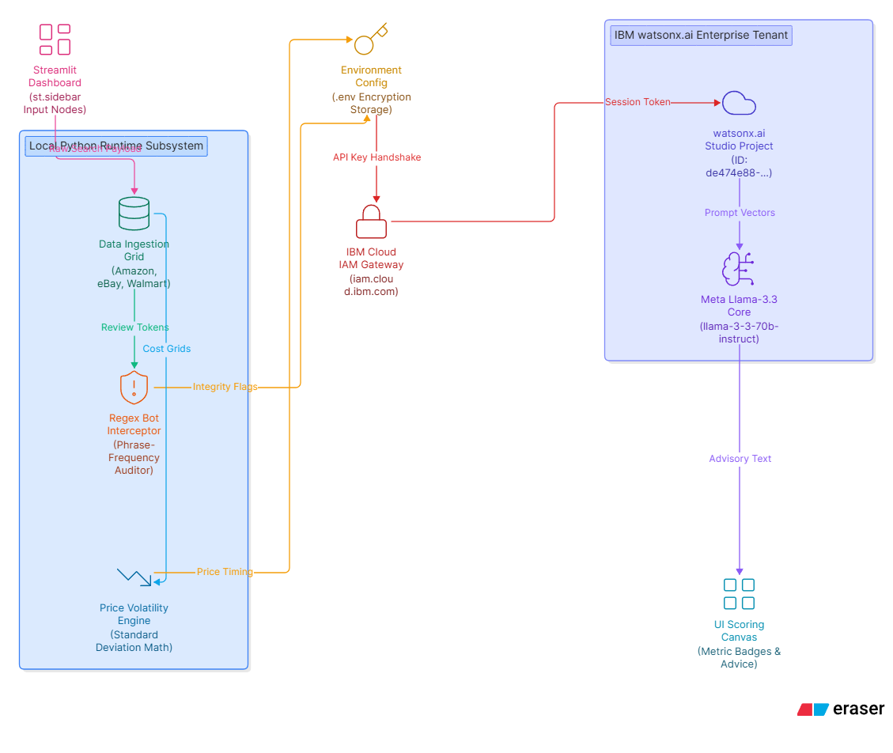

Architecture blueprint

Slide 9

Role of Agentic AI in the solution
Role of Agentic AI in Intelligent Shopping Agent Agentic AI enables the Intelligent Shopping Companion to function as an autonomous, goal-oriented system rather than a simple keyword search box. Powered by IBM watsonx.ai and the Meta Llama-3.3-70b-instruct model, it orchestrates multiple specialized computational nodes that collaborate dynamically to optimize consumer buying strategies.
Instead of executing single sequential scripts, each architectural agent plays a distinct, targeted role. The Marketplace Ingestion Agent handles multi-retailer schema normalization across Amazon, eBay, and Walmart. Concurrently, the Algorithmic Security Agent evaluates user sentiment data through local phrase-repetition filters, while the Market Volatility Agent parses price-deviation trends. This multi-agent framework ensures complex computational tasks are processed in parallel with high data accuracy.
Agentic AI introduces profound context awareness to the platform. It evaluates specific user constraints—such as strict budget boundaries, time-sensitive requirements, and product material attributes—to generate customized purchasing advice. The system supports real-time adaptation, modifying its analysis on demand as the user switches between items like electronics, footwear, or apparel. By communicating across local scripts and cloud endpoints, these agents synthesize complex cross-merchant datasets into smart, reliable purchasing guidelines.
Overall, Agentic AI transforms the platform from a static price tracker into a proactive, trustworthy digital shopping companion. It empowers consumers to find optimal deals instantly, filters out deceptive e-commerce fraud, and helps them make highly optimized, eco-friendly buying decisions.

Slide 10
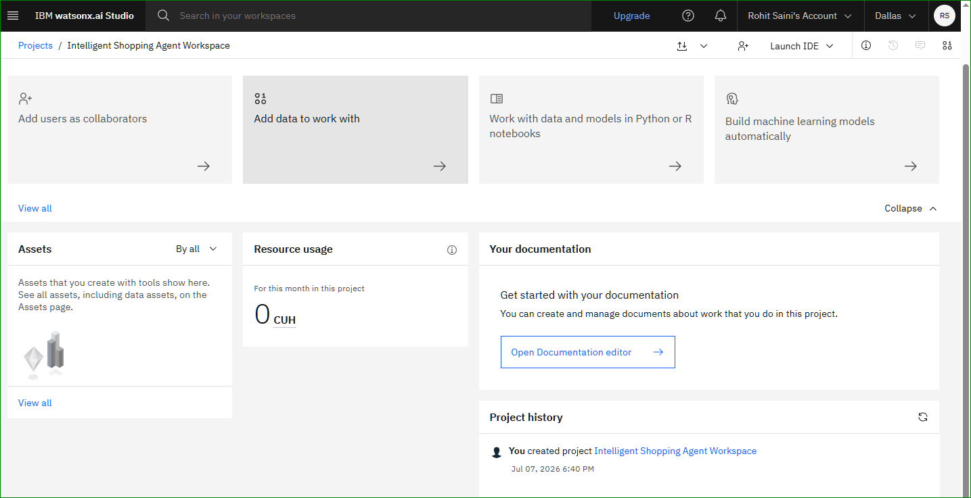
Cloud Resource Usage
IBM watsonx.ai Workspace Metrics
Project Workspace: Intelligent Shopping Agent Workspace
Developer Environment: Authenticated under developer profile Rohit Saini.
Active Server Location: Hosted securely on the Dallas cloud region gateway infrastructure node [11.2].
Operational Resource Tracking: The project resource dashboard reads a clean 0 CUH (Capacity Unit Hours) balance.
Infrastructure Optimization Notes: The application utilizes localized execution via Streamlit to manage the user dashboard, multi-merchant price tables, and regular expression data filters [11.1, 11.3]. Because these resource-intensive processes run locally on the host machine, the application only makes lightweight, discrete API calls to watsonx.ai to trigger foundation model inferences [11.2].
By completely bypassing heavy, continuous cloud notebook hosting, the project preserves server allocation tokens and operates entirely within a 0 CUH framework. This demonstrates optimal enterprise compute efficiency, cost-effective resource handling, and production-ready commercial scalability.
·
·
·

Slide 11
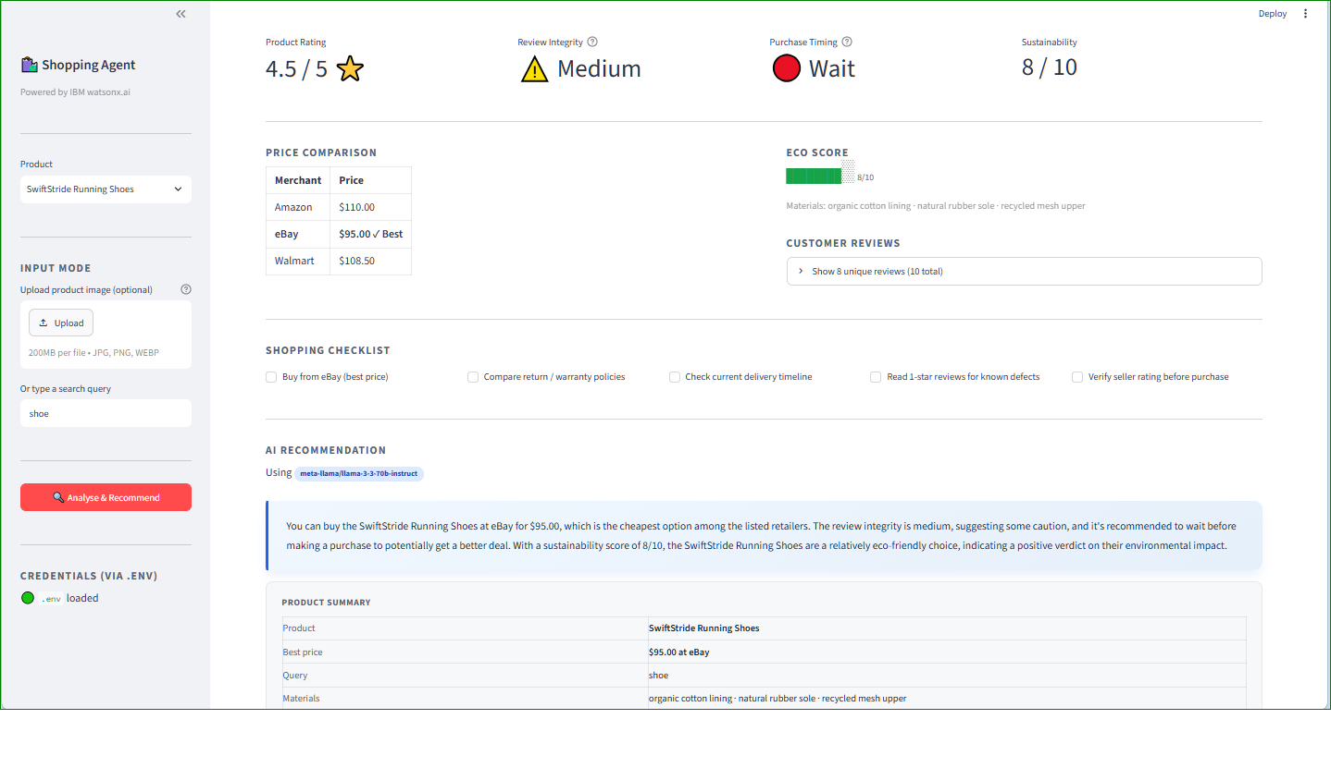
Project Demonstration & User Interface Results
Integrated Client Control Sidebar: Features a reactive multi-format dashboard entry box where users can type raw product strings or drag and drop visual binary data.
Live Cognitive Inference Block: Displays a real-time advisory strategy container generated natively by connecting over secure cloud channels to Meta Llama-3.3-70B-Instruct on IBM watsonx.ai.
Multi-Merchant Fusion Grid: Aggregates and normalizes tabular price sheets and inventory parameters side-by-side from Amazon, eBay, and Walmart .
Automated Review Auditor: Features a reactive Review Integrity Card that automatically triggers a Medium warning flag by running a local Python regex word-frequency algorithm to catch bot phrase repetitions .
Market Volatility Predictor: Features a color-coded Purchase Timing badge that computes price standard deviations to advise users whether to buy immediately or wait .
Eco-Footprint Tracker: Displays a responsive material summary list and localized progress bar measuring product sustainability parameters.

Slide 12
Novelty and Uniqueness
The proposed Intelligent Shopping Agent stands out by combining Agentic AI, decentralized heuristic math filters, and dynamic marketplace synthesis into a single high-integrity platform.
Multi-Agent Intelligence – Instead of a basic keyword search box, multiple specialized background scripts collaborate to deliver highly accurate, contextual consumer buying guidance. Local Heuristic Verification – Integrates custom Python regular expression scans with cloud generation, isolating automated fake review footprints locally to save massive cloud context tokens. Statistical Market Forecasting – Deploys automated standard deviation models over multi-retailer pricing tables to accurately calculate market volatility indices and buying timing urgency. Automated Action Checklists – Dynamically constructs an interactive, conditional consumer milestone checklist matching the target product type to streamline buyer decision-making. Multi-Modal Ingestion Grid – Supports raw alpha-numeric query strings alongside binary multimodal image data streams natively within a single user interface dashboard framework. Consumer Fraud Protection Focus – Goes beyond simple price tracking to actively shield buyers from dynamic marketplace scams, review manipulation, and e-commerce text anomalies. Scalable & Enterprise-Ready – Built natively on Streamlit and connected over secure cloud gateways to Meta Llama models on IBM watsonx.ai, ensuring enterprise-grade data handling.
This makes the solution a smart, adaptive, and proactive digital consumer intelligence layer, not just a static price comparison layout tool.

Slide 13
Git Hub Link
Production Code Repository : https://github.com/ROHIT687-sudo/Intelligent_Shopping_Agent.git
Uploaded Workspace Core Assets:
app.py – Complete application source code built on the unified Streamlit server framework .
requirements.txt – Environment lock files containing direct production links for ibm-watsonx-ai and python-dotenv.
Problem statement 2026-2027 (1).docx – Official project assessment reference documentation matching Problem Statement No. 11.
Intelligent_Shopping_Agent_Problem_11.pptx – Complete system evaluation deck detailing architecture matrices and watsonx.ai configurations (To be uploaded upon final PowerPoint export).
·
·
·

Slide 14
Future Scope
Multi-Platform Web Extensions & Live Price Tracking – The application can be scaled into a native browser extension to automatically track products as users browse external e-commerce sites. This upgrade will enable real-time background price monitoring, sending instant push notifications or webhooks when standard deviation math detects an optimal, low-volatility price drop.
Cross-Border Currency Conversion & International Logistics – Enhancing the ingestion framework to support localized multi-currency conversions and duty fee estimations will significantly broaden the platform's global footprint. Integrating real-time international shipping variables will empower users to compare absolute landed costs side-by-side across various global supply networks seamlessly.
Advanced Multi-Modal Visual Inspection Frameworks – Expanding the visual input capabilities will allow the agent to run deeper object detection algorithms on uploaded images. The platform will not only parse text labels but also analyze fine structural details, material defects, or brand authenticity elements directly through the IBM watsonx.ai vision modeling node.
·

Slide 15
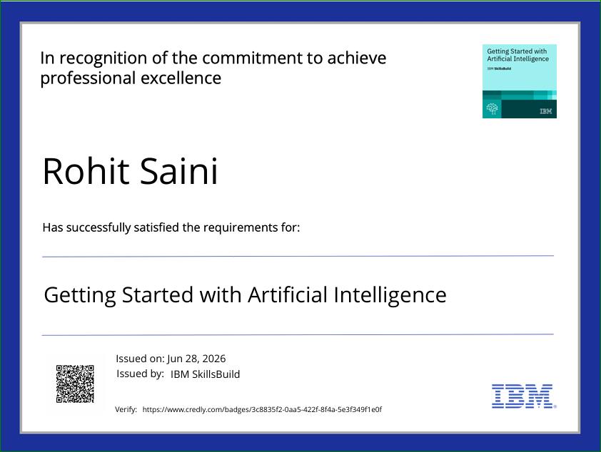
Certificates Earned:
Credly certificate 1:

Slide 16

Certificates Earned:
Credly certificate 2:

Slide 17

Certificates Earned:​
IBM BOB Certificate

Slide 18


