Slide 1
Employee Leave Management System
Team Members: 1)Varun Kumar
2)Rohith
3)siva
4)phani
01 / 17

Slide 2
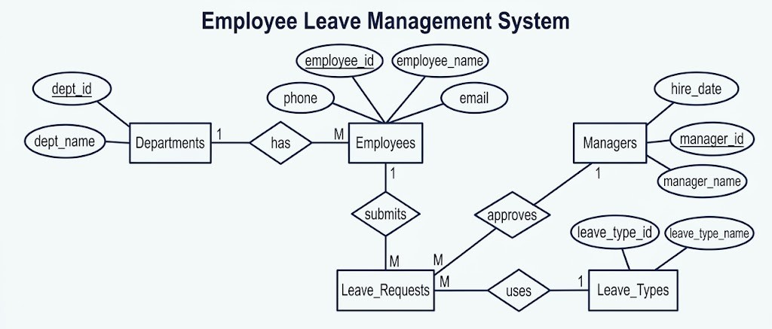
ER Diagram
EMPLOYEE LEAVE MANAGEMENT SYSTEM • SQL DATABASE PROJECT
05 / 17

Slide 3
DQL
Data Query Language reads records
SELECT employee_name, start_date, status
FROM Leave_Requests
WHERE status = 'Pending'
ORDER BY start_date;
DDL
Data Definition Language builds the structure
CREATE TABLE Leave_Types (
leave_type_id INT PRIMARY KEY,
leave_type_name VARCHAR(50) NOT NULL
);
ALTER TABLE Leave_Requests ADD COLUMN reason VARCHAR(200);
6 / 13
7 / 13

Slide 4
DML
Data Manipulation Language: changes rows
INSERT INTO Leave_Requests (employee_id, leave_type_id, start_date, end_date, status)
VALUES (101, 2, '2026-11-10', '2026-11-10', 'Pending');
UPDATE Leave_Requests SET status = 'Approved' WHERE request_id = 1;
DELETE FROM Leave_Requests WHERE request_id = 9;
TCL
Transaction Control Language protects consistency
START TRANSACTION;
UPDATE Leave_Balances SET remaining_days = remaining_days - 2
WHERE employee_id = 101 AND leave_type_id = 1;
SAVEPOINT before_log;
INSERT INTO Leave_Request_Log (request_id, status) VALUES (1, 'Approved');
COMMIT;
8 / 13
9 / 13

Slide 5
Joins: Connecting Tables
SQL | Related records
INNER JOIN
Combines employees with their leave requests.
LEFT JOIN
Keeps employees who have no leave requests.
Related Details
Employee name, leave type, start date, and status in one result.
SELECT e.employee_name,
lt.leave_type_name,
lr.start_date,
lr.status
FROM Employees e
JOIN Leave_Requests lr
ON e.employee_id = lr.employee_id
JOIN Leave_Types lt
ON lr.leave_type_id = lt.leave_type_id;
07 / 17

Slide 6
Aggregate Functions
SQL | Summary metrics
SUM()
Total remaining leave days
MAX() / MIN()
Highest and lowest balances
ROUND(AVG())
Average remaining balance
CASE WHEN can summarize approved and rejected requests.
SELECT SUM(remaining_days) AS total_remaining_days,
MAX(remaining_days) AS highest_balance,
MIN(remaining_days) AS lowest_balance,
ROUND(AVG(remaining_days), 2) AS average_balance
FROM Leave_Balances;
EMPLOYEE LEAVE MANAGEMENT SYSTEM • SQL DATABASE PROJECT
08 / 17

Slide 7
String Functions
SQL | Text formatting
CONCAT()
Combines employee name and leave type.
UPPER()
Displays names in capital letters.
Aliases
AS creates readable output column names.
Example output: Ana Lopez - Annual
SELECT CONCAT(e.employee_name, ' - ',
lt.leave_type_name) AS employee_leave,
UPPER(e.employee_name) AS employee_name_upper
FROM Employees e
JOIN Leave_Requests lr
ON e.employee_id = lr.employee_id
JOIN Leave_Types lt
ON lr.leave_type_id = lt.leave_type_id;
EMPLOYEE LEAVE MANAGEMENT SYSTEM • SQL DATABASE PROJECT
09 / 17

Slide 8
Date & Time Functions
SQL | Date reporting
YEAR()
Extracts the year from start_date.
MONTHNAME()
Returns a month name such as November.
MONTH()
Supports calendar-month grouping and sorting.
The sample project describes 30 requests in November 2026.
SELECT YEAR(start_date) AS year,
MONTHNAME(start_date) AS month,
COUNT(request_id) AS monthly_requests
FROM Leave_Requests
GROUP BY YEAR(start_date),
MONTH(start_date),
MONTHNAME(start_date)
ORDER BY MONTH(start_date);
10 / 17

Slide 9
GROUP BY and HAVING
SQL | Group filtering
GROUP BY
Groups requests for each employee.
COUNT()
Counts the requests per employee.
HAVING
Keeps employees with more than one request.
Useful for identifying frequent leave applicants.
SELECT e.employee_name,
COUNT(lr.request_id) AS total_requests
FROM Employees e
JOIN Leave_Requests lr
ON e.employee_id = lr.employee_id
GROUP BY e.employee_id, e.employee_name
HAVING COUNT(lr.request_id) > 1;
EMPLOYEE LEAVE MANAGEMENT SYSTEM • SQL DATABASE PROJECT
11 / 17

Slide 10
Subqueries
SQL | Nested query
Above Average
Compare each balance with the average balance.
MAX()
Can be used to identify the highest balance.
NOT EXISTS
Can find employees who have no leave requests.
SELECT balance_id, employee_id, remaining_days
FROM Leave_Balances
WHERE remaining_days > (
SELECT AVG(remaining_days)
FROM Leave_Balances
);
EMPLOYEE LEAVE MANAGEMENT SYSTEM • SQL DATABASE PROJECT
12 / 17

Slide 11
Stored Procedure: Approve_Leave
SQL | Transaction-safe approval
Validates Input
Checks available leave days before approval.
Locks Rows
FOR UPDATE helps prevent conflicting balance changes.
All or Nothing
COMMIT on success; ROLLBACK on error.
CREATE PROCEDURE Approve_Leave(
IN p_request_id INT, IN p_emp_id INT,
IN p_type_id INT, IN p_days INT
)
BEGIN
DECLARE v_rem_days INT;
DECLARE EXIT HANDLER FOR SQLEXCEPTION
BEGIN ROLLBACK; RESIGNAL; END;
START TRANSACTION;
SELECT remaining_days INTO v_rem_days
FROM Leave_Balances
WHERE employee_id = p_emp_id
AND leave_type_id = p_type_id FOR UPDATE;
IF v_rem_days < p_days THEN
SIGNAL SQLSTATE '45000'
SET MESSAGE_TEXT = 'Insufficient leave balance';
END IF;
UPDATE Leave_Balances
SET remaining_days = remaining_days - p_days
WHERE employee_id = p_emp_id
AND leave_type_id = p_type_id;
UPDATE Leave_Requests SET status = 'Approved'
WHERE request_id = p_request_id;
COMMIT;
END;
EMPLOYEE LEAVE MANAGEMENT SYSTEM • SQL DATABASE PROJECT
15 / 17

Slide 12
Triggers
SQL | Automated safeguards
After_Leave_Request_Insert
Automatically logs each new leave request.
Before_Leave_Balance_Update
Blocks an update that would make the balance negative.
Triggers enforce rules without relying only on application code.
CREATE TRIGGER After_Leave_Request_Insert
AFTER INSERT ON Leave_Requests
FOR EACH ROW
BEGIN
INSERT INTO Leave_Request_Log (request_id, status)
VALUES (NEW.request_id, NEW.status);
END;
CREATE TRIGGER Before_Leave_Balance_Update
BEFORE UPDATE ON Leave_Balances
FOR EACH ROW
BEGIN
IF NEW.remaining_days < 0 THEN
SIGNAL SQLSTATE '45000'
SET MESSAGE_TEXT =
'Leave balance cannot be negative';
END IF;
END;
EMPLOYEE LEAVE MANAGEMENT SYSTEM • SQL DATABASE PROJECT
16 / 17

Slide 13
THANK YOU
17 / 17

