Slide 1
ECU’s In a Car

Slide 2
what is an ECU?
In the automative industry an electronic control unit(ECU) is an embedded electronic device,basically a digital computer that reads signals coming from sensors placed at various parts and in different components of the car and depending on this information controls various important units e.g engine and other automated operations within the car among many.

Slide 3
TYPES of ECU
with vehicles having multiple ECU they are divided on what tasks they perform.
1.Engine Control Module:
With its sensors,the ECM ensures the amount of fuel and ignition timing necessary to get the most power and economy out of the engine.

Slide 4
2.Brake Control Module:
Used in vehicles with ABS,the BCM makes sure that the
wheels are not skidding and determine when to trigger braking and let go of the brake to ensure the wheels don’t lock up.
3.Transmission Control Module:
Used on an automatic vehicle, the TCM ensures you get the smoothest shifts possible by assessing the engine RPM
and acceleration of the car.

Slide 5
4.Telematic Control Module
It controls the satellite navigation and internet and phone connectivity of the vehicle.
5.Suspension Control Module
Present in Cars with active suspension systems, the SCM ensures the correct ride height and optimal changes to suspension depending on the driving condition.

Slide 6
Airbag System
The airbag system is an important safety device that provides extra protection against head-on crash for the passengers, by giving a soft surface to land on.
An airbag consists of three parts
1.The bag itself-The bag is made up of a thin,nylon fabric that is folded into the streering wheel,dashboard,seat or door.

Slide 7
2.ECU- This is a device that tells the bag to inflate.It receive this information from an accelerometer built into a microchip.
3.The inflation system-Sodium azide(NaN₃) reacts with potassium nitrate(KNO₃) to produce nitrogen gas which inflates the airbag. A second later, the gas dissipates through tiny holes in the airbag giving you room to move.

Slide 8
Working
This system works on commands from the airbag electronic control unit(ECU), which has a microcontroller. The controller gets power from the battery.
ECU include collision type, angle and severity of impact Using this information, the airbag ECU’s crash algorithm determines if the crash event meets the criteria for deployment and triggers various firing circuits to deploy one or more airbag modules within the vehicle.

Slide 9
1.When a car hits something, it starts to decelerate very rapidly.
2.An accelorometer detects the change of speed.
3.If the deceleration is great enough, the accelerometer triggers the airbag circuit.Normal braking doesn’t generate enough force to do this.
4.The airbag circuit passes an electric current through a heating element.
5.The heating element ignites a chemical explosive.

Slide 10
6.As the explosive burns, it generates a massive amount of nitrogen gas that floods into a nylon bag packed behind the steering wheel.
7.As the bag expands, it blows the plastic cover off the steering wheel and inflates in front of the driver.
8.The driver pushes against the bag due to collision.

Slide 11
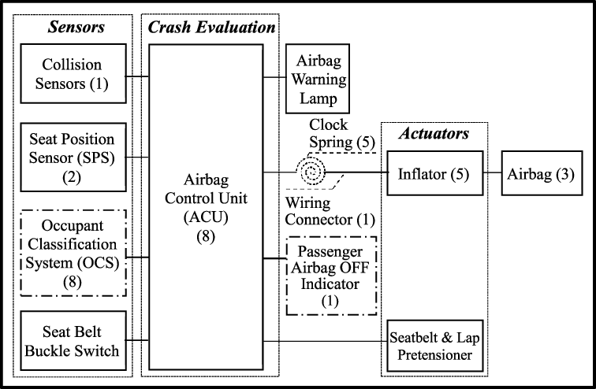
Block Diagram

