Slide 1

Revolutionising PDF Reading and Customer Support with AI Technology
Innovative AI-powered PDF reader and chatbot provide seamless solutions.
Durvesh Teke
Vaibhav Ghutukade
Jash Patel
Ayush Singh

Slide 2
Abstract
The rapid growth of digital documents has necessitated efficient tools for document management and reading. This paper introduces a novel PDF reader chatbot application designed to improve the user experience and interaction with PDF documents. The chatbot leverages natural language processing (NLP) and machine learning techniques to enable users to interact with PDF documents through conversational interfaces. Users can ask questions, request summaries, extract specific information, and navigate through PDFs using intuitive and natural language commands. The chatbot employs text extraction and comprehension mechanisms to provide accurate and relevant responses, enhancing document understanding and accessibility. The proposed PDF reader chatbot aims to streamline document retrieval, comprehension, and navigation, ultimately improving productivity and accessibility for users in various domains.

Slide 3
LITERATURE SURVEY
A new method of information extraction from PDF files by Fang Yuan, & Bo Lu. (2005).
Dataset:-
The training task is supposed to extract information from papers.
Accuracy :-
The author concludes that with the increase of amount of training data, the accuracy of information extraction will increase correspondingly
Advantages:-
The method is effective in extracting information from PDF files.
The method provides a foundation for managing and searching a large amount of PDF files.
The method can be used to extract information from various types of PDF files, including scientific papers, technical reports, and business documents
Disadvantages:-
The PDF file does not mention any specific disadvantages of the new method of information extraction from PDF files.
However, it is worth noting that the accuracy of the method depends on the quality and quantity of the training data
Therefore, if the training data is not representative of the target PDF files, the accuracy of the method may be lower.
Summary:-
The PDF file discusses a new method of information extraction from PDF files based on a tree model and pattern match algorithm. The method is effective in extracting information from various types of PDF files, including scientific papers, technical reports, and business documents. The author concludes that with the increase of amount of training data, the accuracy of information extraction will increase correspondingly.

Slide 4
LITERATURE SURVEY
Topic & Author | Dataset | Advantages | Disadvantages | Accuracy | Summary
A new method of information extraction from PDF files by Fang Yuan, & Bo Lu. (2005). | The training task is supposed to extract information from papers. | The method is effective in extracting information from PDF files. The method provides a foundation for managing and searching a large amount of PDF files. The method can be used to extract information from various types of PDF files, including scientific papers, technical reports, and business documents. | The PDF file does not mention any specific disadvantages of the new method of information extraction from PDF files. However, it is worth noting that the accuracy of the method depends on the quality and quantity of the training data Therefore, if the training data is not representative of the target PDF files, the accuracy of the method may be lower. | The author concludes that with the increase of amount of training data, the accuracy of information extraction will increase correspondingly | The PDF file discusses a new method of information extraction from PDF files based on a tree model and pattern match algorithm. The method is effective in extracting information from various types of PDF files, including scientific papers, technical reports, and business documents. The author concludes that with the increase of amount of training data, the accuracy of information extraction will increase correspondingly.

Slide 5

LITERATURE SURVEY
Chatbot: An automated conversation system on Artificial Intelligence and Natural Language Processing by Mondal, A., Dey, M., Das, D., Nagpal, S., & Garda, K .
Dataset:-
The authors collected around 1500 questions and their corresponding answers from an organization in unstructured form .
Accuracy :-
The PDF file does not provide a specific accuracy score for the proposed chatbot system.
However, the authors do mention that they used weighted and macro-based random forest approaches with K-fold cross-validation to validate the system .
Advantages:-
Chatbots can help reduce the workload of teachers by answering frequently asked questions and providing personalized feedback
Additionally, chatbots can be available 24/7, which can be especially helpful for students who need assistance
Disadvantages:-
One disadvantage is that chatbots may not be able to handle complex or nuanced questions that require human judgment or expertise .
Chatbots may not be able to understand the context of a question or conversation, which can lead to inaccurate or irrelevant responses.
Summary:-
The PDF file discusses the use of chatbots in the educational domain. Chatbots can provide quick and easy access to information for students and teachers, and can be available 24/7. They can also help reduce the workload of teachers and collect data on student performance and engagement. However, chatbots may not be able to handle complex or nuanced questions, understand the context of a conversation, or provide emotional support to students.

Slide 6
LITERATURE SURVEY
Topic & Author | Dataset | Advantages | Disadvantages | Accuracy | Summary
Chatbot: An automated conversation system on Artificial Intelligence and Natural Language Processing by Mondal, A., Dey, M., Das, D., Nagpal, S., & Garda, K . | The authors collected around 1500 questions and their corresponding answers from an organization in unstructured form . | Chatbots can help reduce the workload of teachers by answering frequently asked questions and providing personalized feedback Additionally, chatbots can be available 24/7, which can be especially helpful for students who need assistance | One disadvantage is that chatbots may not be able to handle complex or nuanced questions that require human judgment or expertise . Chatbots may not be able to understand the context of a question or conversation, which can lead to inaccurate or irrelevant responses. | The PDF file does not provide a specific accuracy score for the proposed chatbot system. However, the authors do mention that they used weighted and macro-based random forest approaches with K-fold cross-validation to validate the system . | The PDF file discusses the use of chatbots in the educational domain. Chatbots can provide quick and easy access to information for students and teachers, and can be available 24/7. They can also help reduce the workload of teachers and collect data on student performance and engagement. However, chatbots may not be able to handle complex or nuanced questions, understand the context of a conversation, or provide emotional support to students.

Slide 7
LITERATURE SURVEY
Leveraging GPT-4 for PDF Data Extraction: A Comprehensive Guide by Manish Sharma.
Dataset:- NA
Accuracy :-
The Research Paper mentions that one major issue with ML models for PDF extraction is that they can extract information without knowing whether the extraction is actually accurate and correct .
The Research Paper does not provide specific accuracy metrics for PDF extraction using Chatbot.
Advantages:-
The PDF mentions several advantages of using GPT-4 for PDF data extraction. One advantage is that GPT-4 is a powerful language model that can incorporate a large amount of context, which can lead to more accurate results
Additionally, the ChatGPT API, which seamlessly integrates with any programming language, can be used to further improve downstream tasks
Disadvantages:-
The PDF does not mention any specific disadvantages of using GPT-4 for PDF data extraction. However, it does mention some limitations of current PDF data extraction methods, such as template-based techniques and machine learning techniques.
For example, template-based techniques can only be used on structured documents with a constant structure, while machine learning techniques may not always be accurate and can extract information without knowing whether the extraction is actually correct 3
Summary:-
The PDF is a comprehensive guide on leveraging GPT-4 for PDF data extraction. It discusses the current methods of PDF data extraction, their limitations, and how GPT-4 can be used to perform question-answering tasks for PDF extraction. The PDF also provides a step-by-step guide for implementing GPT-4 for PDF data extraction.

Slide 8
LITERATURE SURVEY
Topic & Author | Dataset | Advantages | Disadvantages | Accuracy | Summary
Leveraging GPT-4 for PDF Data Extraction: A Comprehensive Guide by Manish Sharma. | NA | The PDF mentions several advantages of using GPT-4 for PDF data extraction. One advantage is that GPT-4 is a powerful language model that can incorporate a large amount of context, which can lead to more accurate results Additionally, the ChatGPT API, which seamlessly integrates with any programming language, can be used to further improve downstream tasks | The PDF does not mention any specific disadvantages of using GPT-4 for PDF data extraction. However, it does mention some limitations of current PDF data extraction methods, such as template-based techniques and machine learning techniques. For example, template-based techniques can only be used on structured documents with a constant structure, while machine learning techniques may not always be accurate and can extract information without knowing whether the extraction is actually correct 3 | The Research Paper mentions that one major issue with ML models for PDF extraction is that they can extract information without knowing whether the extraction is actually accurate and correct . The Research Paper does not provide specific accuracy metrics for PDF extraction using Chatbot. | The PDF is a comprehensive guide on leveraging GPT-4 for PDF data extraction. It discusses the current methods of PDF data extraction, their limitations, and how GPT-4 can be used to perform question-answering tasks for PDF extraction. The PDF also provides a step-by-step guide for implementing GPT-4 for PDF data extraction.

Slide 9
Use Cases
1
Education Sector
AI-powered PDF reader makes reading and studying easy, while chatbot feature allows quick student support.
2
Financial Institutions
The AI platform can assist with customer queries, dramatically decreasing wait times on phone lines or emails.
3
Healthcare Industry
Collaborative filtering and trend analysis allows for better management and processing of large amounts of patient data.
4
Sales and Marketing
The chatbot feature can process and analyze customer data to help increase sales efficiency and effectiveness.

Slide 10
Problem Statement
The problem to be addressed is the difficulty many users face in efficiently and effectively managing and extracting information from PDF documents.
Existing PDF readers often lack features that assist users in extracting relevant content or summarizing information.
Thus, the need arises for an intelligent chatbot-based PDF reader web application that simplifies PDF usage and enhances user experience
Customisable
Existing PDF readers do not sufficiently assist users in efficiently locating and extracting specific information.
This poses a problem for users who require a streamlined and intuitive tool to enhance their PDF interaction experience.
Tasks such as content extraction, summarization, and contextual understanding remain arduous within the typical PDF reader interface.

Slide 11
Product Overview
PDF Reader
Chatbot
AI-powered PDF reader that can highlight key information, extract tables, and graphs.
A chatbot powered by machine learning that provides instant customer support.
Integration
Security
PDF reader and chatbot integrate seamlessly with business systems for a quick setup.
Offering end-to-end encryption for all data and secure account access.

Slide 12
Benefits for Users
Convenience
Chatbot feature offers real-time customer service eliminating wait times and improving customer engagement.
1
2
3
Increase Efficiency
Improved Accessibility
AI-powered PDF reader saves time and increases productivity by highlighting only the crucial information.
Users can access the AI-powered platform on any device with ease, anytime and anywhere.

Slide 13



User Experience
PDF Reader
Chatbot
Integration
Easy-to-use, user-friendly interface with an intuitive layout, to make annotations a breeze.
Intuitive chatbot with natural language processing allows quick resolution of customer queries and concerns.
Seamless integration with existing business systems promoting a more connected and efficient workflow.

Slide 14
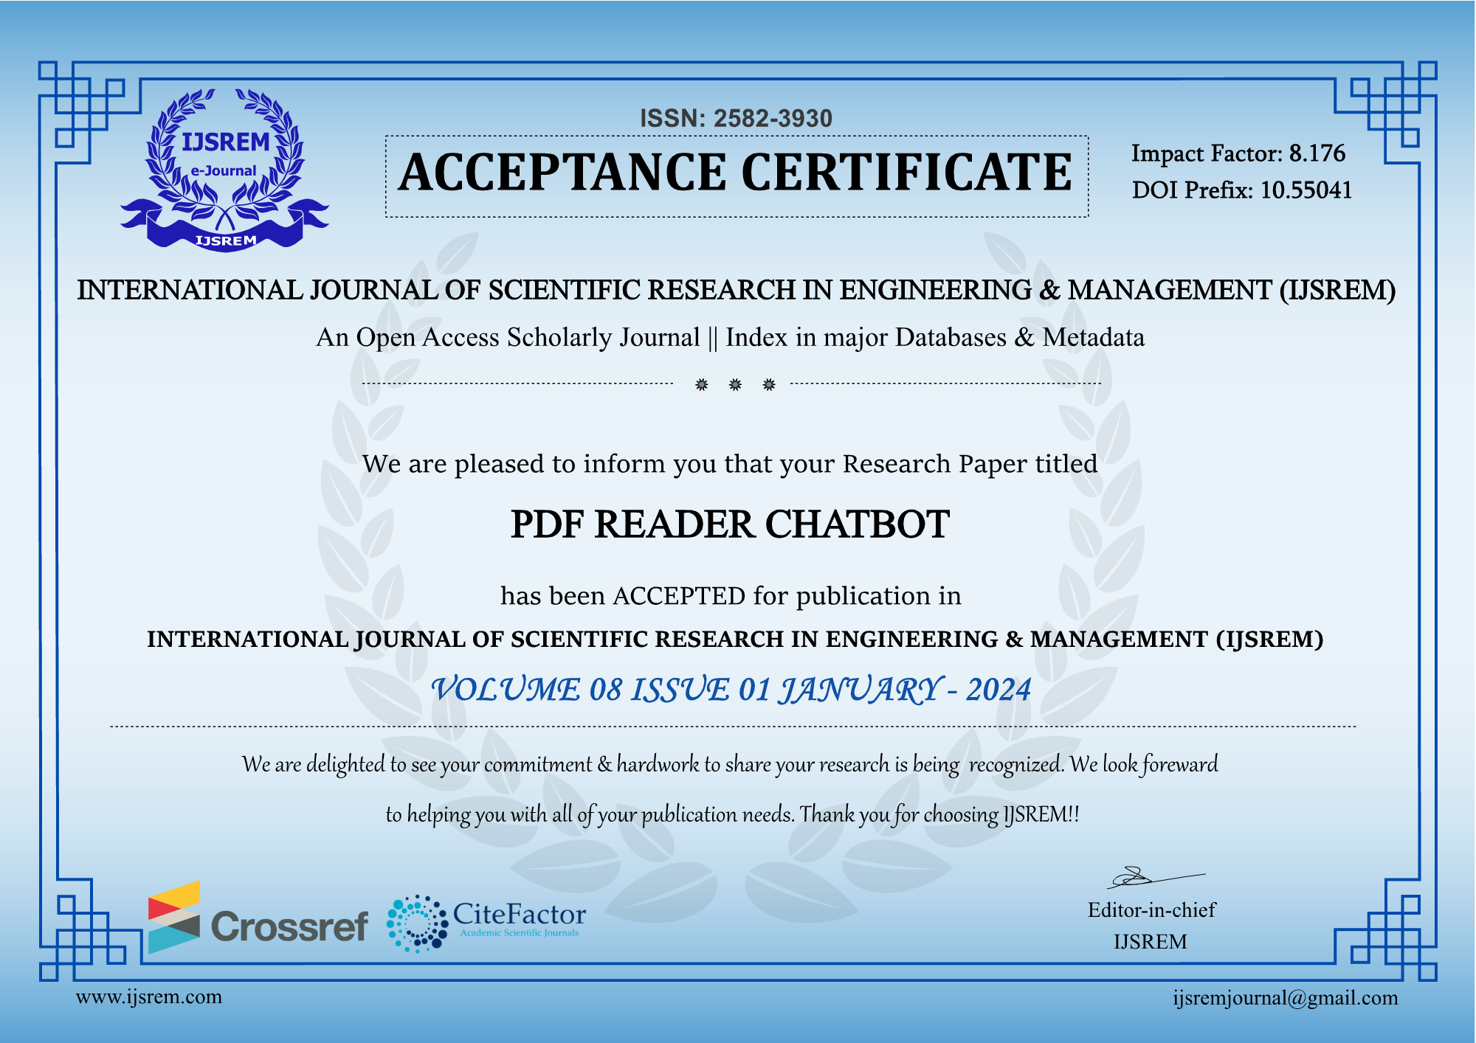
IEEE Publication

