Slide 1

Computer Organization and Architecture Designing for Performance
11th Edition
Chapter 4
The Memory Hierarchy: Cache Memory

Slide 2
Principle of Locality (1 of 2)
Also referred to as the locality of reference
Reflects the observation that during the course of execution of a program, memory references by the processor tend to cluster
Locality is based on three assertions:
During any interval of time, a program references memory location non-uniformly
As a function of time, the probability that a given unit of memory is referenced tends to change slowly
The correlation between immediate past and immediate future memory reference patterns is high and tapers off as the time interval increases
Notes:
One of the most important concepts related to computer systems is principle of
locality [DENN05], also referred to as the locality of reference . The principle reflects
the observation that during the course of execution of a program, memory references
by the processor, for both instructions and data, tend to cluster. Programs typically
contain a number of iterative loops and subroutines. Once a loop or subroutine
is entered, there are repeated references to a small set of instructions. Similarly, operations
on tables and arrays involve access to a clustered set of data words. Over a
long period of time, the clusters in use change, but over a short period of time, the
processor is primarily working with fixed clusters of memory references.
We can put these observations more specifically. As we discuss in Section 4.3,
for different types of memory, memory is accessed and retrieved in units of different
sizes, ranging from individual words to large blocks of cache memory to much
larger segments of disk memory. Denning observed that locality is based on three
assertions [DENN72]:
1. During any interval of time, a program references memory locations
non-uniformly. That is, some units of memory are more likely to be accessed
than others.
2. As a function of time, the probability that a given unit of memory is referenced
tends to change slowly. Put another way, the probability distribution
of memory references across the entire memory space tends to change slowly
over time.
3. The correlation between immediate past and immediate future memory reference
patterns is high, and tapers off as the time interval increases.
Intuitively, the principle of locality makes sense. Consider the following line
of reasoning:
1. Except for branch and call instructions, which constitute only a small fraction
of all program instructions, program execution is sequential. Hence, in most
cases, the next instruction to be fetched immediately follows the last instruction
fetched.
2. It is rare to have a long uninterrupted sequence of procedure calls followed
by the corresponding sequence of returns. Rather, a program remains confined
to a rather narrow window of procedure-invocation depth. Thus, over
a short period of time, references to instructions tend to be localized to a few
procedures.
3. Most iterative constructs consist of a relatively small number of instructions
repeated many times. For the duration of the iteration, computation is therefore
confined to a small contiguous portion of a program.
4. In many programs, much of the computation involves processing data structures,
such as arrays or sequences of records. In many cases, successive references
to these data structures will be to closely located data items.

Slide 3
Principle of Locality (2 of 2)
Two forms of locality
Temporal locality
Refers to the tendency of a program to reference in the near future those units of memory referenced in the recent past
Constants, temporary variables, and working stacks are also constructs that lead to this principle
Spatial locality
Spatial locality
Refers to the tendency of a program to reference units of memory whose addresses are near one another
Also reflects the tendency of a program to access data locations sequentially, such as when processing a table of data
Notes:
Numerous studies, stretching back to the early 1970s, confirm these observations.
[FEIT15] provides a summary of many of these studies.
A distinction is made in the literature between two forms of locality:
1. Temporal locality : Refers to the tendency of a program to reference in the
near future those units of memory referenced in the recent past. For example,
when an iteration loop is executed, the processor executes the same set
of instructions repeatedly. Constants, temporary variables, and working stacks
are also constructs that lead to this principle.
2. Spatial locality: Refers to the tendency of a program to reference units of
memory whose addresses are near one another. That is, if a unit of memory x
is referenced at time t, it is likely that units in the range x - k through x + k
will be referenced in the near future, for a relatively small value of k. This
reflects the tendency of a processor to access instructions sequentially. Spatial
location also reflects the tendency of a program to access data locations
sequentially, such as when processing a table of data.

Slide 4
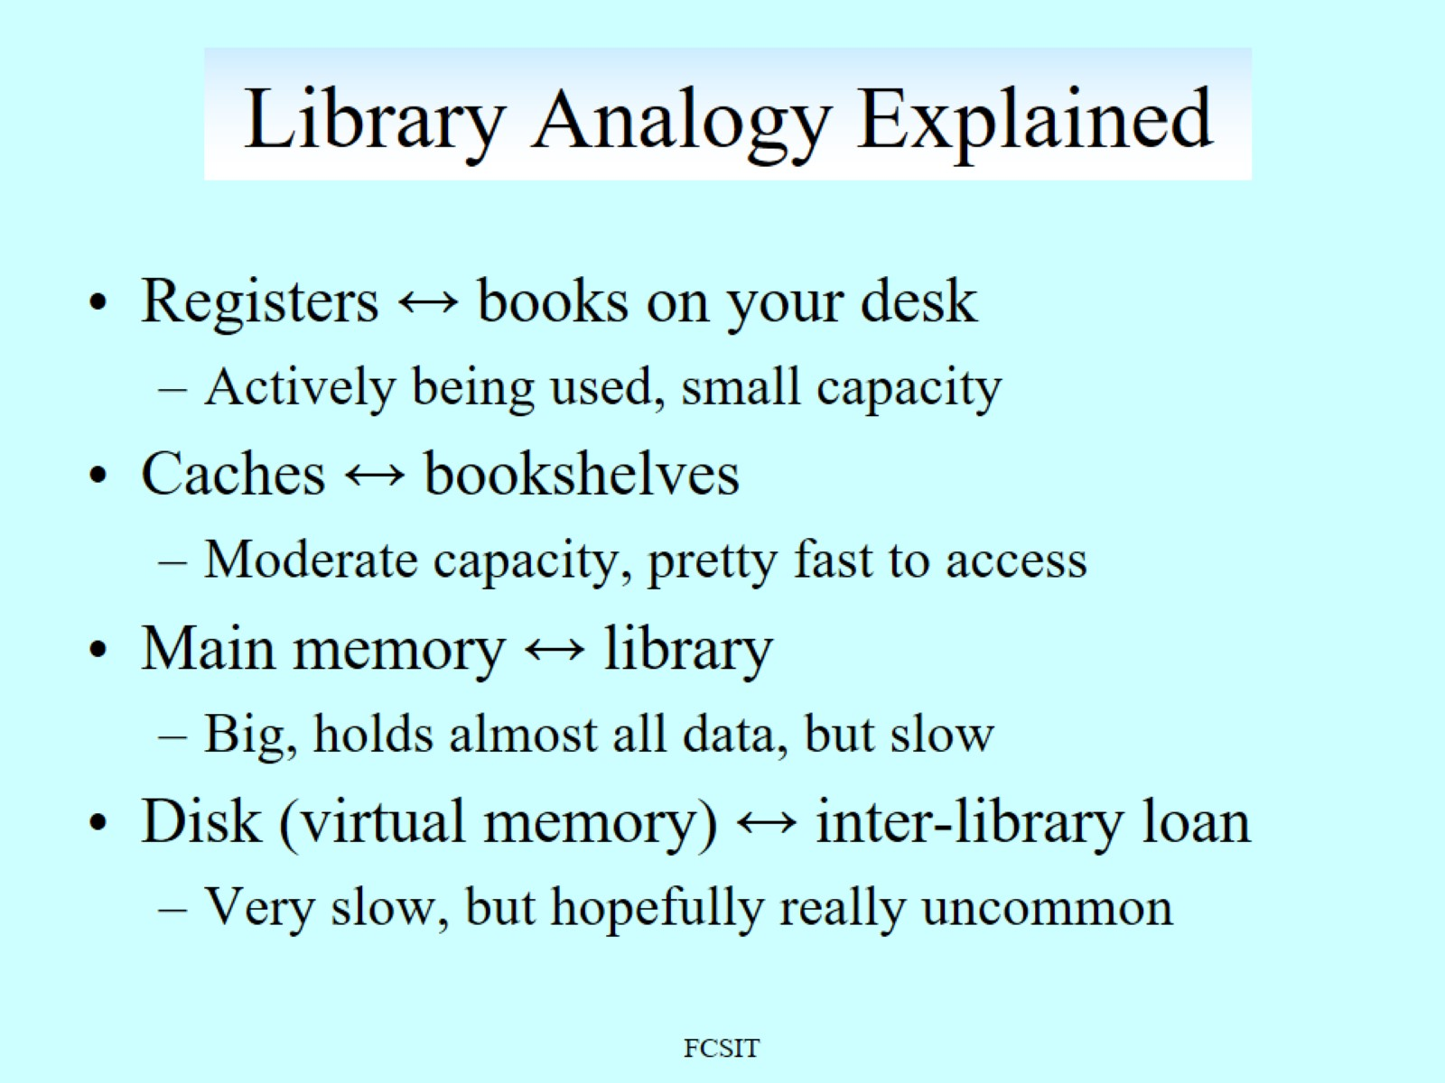
Library Analogy Explained

Slide 5
Table 4.1 Key Characteristics of Computer Memory Systems
Location Internal (e.g., processor registers, cache, main memory) External (e.g., optical disks, magnetic disks, tapes) Capacity Number of words Number of bytes Unit of Transfer Word Block Access Method Sequential Direct Random Associative | Performance Access time Cycle time Transfer rate Physical Type Semiconductor Magnetic Optical Magneto-optical Physical Characteristics Volatile/nonvolatile Erasable/nonerasable Organization Memory modules
Notes:
The complex subject of computer memory is made more manageable if we classify
memory systems according to their key characteristics. The most important of these
are listed in Table 4.1.

Slide 6
Characteristics of Memory Systems
Location
Refers to whether memory is internal and external to the computer
Internal memory is often equated with main memory
Processor requires its own local memory, in the form of registers
Cache is another form of internal memory
External memory consists of peripheral storage devices that are accessible to the processor via I/O controllers
Capacity
Memory is typically expressed in terms of bytes
Unit of transfer
For internal memory the unit of transfer is equal to the number of electrical lines into and out of the memory module
Notes:
The term location in Table 4.1 refers to whether memory is internal and external
to the computer. Internal memory is often equated with main memory. But there
are other forms of internal memory. The processor requires its own local memory, in
the form of registers (e.g., see Figure 2.3). Further, as we shall see, the control unit
portion of the processor may also require its own internal memory. We will defer
discussion of these latter two types of internal memory to later chapters. Cache is
another form of internal memory. External memory consists of peripheral storage
devices, such as disk and tape, that are accessible to the processor via I/O controllers.
An obvious characteristic of memory is its capacity. For internal memory, this is
typically expressed in terms of bytes (1 byte = 8 bits) or words. Common word lengths
are 8, 16, and 32 bits. External memory capacity is typically expressed in terms of bytes.
A related concept is the unit of transfer. For internal memory, the unit
of transfer is equal to the number of electrical lines into and out of the memory
module. This may be equal to the word length, but is often larger, such as 64, 128, or
256 bits. To clarify this point, consider three related concepts for internal memory:
• Word: The “natural” unit of organization of memory. The size of a word is typically
equal to the number of bits used to represent an integer and to the instruction
length. Unfortunately, there are many exceptions. For example, the CRAY
C90 (an older model CRAY supercomputer) has a 64-bit word length but uses
a 46-bit integer representation. The Intel x86 architecture has a wide variety of
instruction lengths, expressed as multiples of bytes, and a word size of 32 bits.
• Addressable units: In some systems, the addressable unit is the word. However,
many systems allow addressing at the byte level. In any case, the relationship
between the length in bits A of an address and the number N of addressable
units is 2^{A} = N.
• Unit of transfer: For main memory, this is the number of bits read out of or
written into memory at a time. The unit of transfer need not equal a word or
an addressable unit. For external memory, data are often transferred in much
larger units than a word, and these are referred to as blocks

Slide 7
Capacity and Performance:
The two most important characteristics of memory
Three performance parameters are used:
Access time (latency)
For random-access memory it is the time it takes to perform a read or write operation
For non-random-access memory it is the time it takes to position the read-write mechanism at the desired location
Memory cycle time
Access time plus any additional time required before second access can commence
Additional time may be required for transients to die out on signal lines or to regenerate data if they are read destructively
Concerned with the system bus, not the processor
Transfer rate
The rate at which data can be transferred into or out of a memory unit
For random-access memory it is equal to 1/(cycle time)
Notes:
From a user’s point of view, the two most important characteristics of memory
are capacity and performance. Three performance parameters are used:
• Access time (latency): For random-access memory, this is the time it takes to
perform a read or write operation, that is, the time from the instant that an
address is presented to the memory to the instant that data have been stored
or made available for use. For non-random-access memory, access time is the
time it takes to position the read–write mechanism at the desired location.
• Memory cycle time: This concept is primarily applied to random-access memory
and consists of the access time plus any additional time required before a second
access can commence. This additional time may be required for transients to die
out on signal lines or to regenerate data if they are read destructively. Note that
memory cycle time is concerned with the system bus, not the processor.
• Transfer rate: This is the rate at which data can be transferred into or out of a
memory unit. For random-access memory, it is equal to 1/(cycle time).

Slide 8
Memory Hierarchy
Design constraints on a computer’s memory can be summed up by three questions:
How much, how fast, how expensive
There is a trade-off among capacity, access time, and cost
Faster access time, greater cost per bit
Greater capacity, smaller cost per bit
Greater capacity, slower access time
Notes:
The design constraints on a computer’s memory can be summed up by three questions:
How much? How fast? How expensive?
The question of how much is somewhat open ended. If the capacity is there,
applications will likely be developed to use it. The question of how fast is, in a sense,
easier to answer. To achieve greatest performance, the memory must be able to
keep up with the processor. That is, as the processor is executing instructions, we
would not want it to have to pause waiting for instructions or operands. The final
question must also be considered. For a practical system, the cost of memory must
be reasonable in relationship to other components.
As might be expected, there is a trade-off among the three key characteristics
of memory: capacity, access time, and cost. A variety of technologies are used to
implement memory systems, and across this spectrum of technologies, the following
relationships hold:
• Faster access time, greater cost per bit
• Greater capacity, smaller cost per bit
• Greater capacity, slower access time
The dilemma facing the designer is clear. The designer would like to use memory
technologies that provide for large-capacity memory, both because the capacity
is needed and because the cost per bit is low. However, to meet performance
requirements, the designer needs to use expensive, relatively lower-capacity memories
with short access times.

Slide 9
Figure 4.6
Notes:
The way out of this dilemma is not to rely on a single memory component or technology,
but to employ a memory hierarchy . A typical hierarchy is illustrated in
Figure 4.6. As one goes down the hierarchy, the following occur:
a. Decreasing cost per bit
b. Increasing capacity
c. Increasing access time
d. Decreasing frequency of access of the memory by the processor

Slide 10
Table 4.2 Characteristics of Memory Devices in a Memory Architecture
Memory level | Typical technology | Unit of transfer with next larger level (typical size) | Managed by
Registers | CMOS | Word (32 bits) | Compiler
Cache | Static RAM (SRAM); Embedded dynamic RAM (eDRAM) | Cache block (32 bytes) | Processor hardware
Main memory | DRAM | Virtual memory page (1 kB) | Operating system (OS)
Secondary memory | Magnetic disk | Disk sector (512 bytes) | OS/user
Offline bulk memory | Magnetic tape |  | OS/User
Table 4.2 Characteristics of Memory Devices in a Memory Architecture
Notes:
Table 4.2 lists some characteristics of key elements of the memory hierarchy. The
fastest, smallest, and most expensive type of memory consists of the registers internal
to the processor. Typically, a processor will contain a few dozen such registers,
although some machines contain hundreds of registers. Next will be typically multiple
layers of cache. Level 1 cache (L1 cache), closest to the processor registers, is
almost always divided into an instruction cache and a data cache. This split is also
common for L2 caches. Most contemporary machines also have an L3 cache and
some have an L4 cache; these two caches generally are not split between instruction
and data and may be shared by multiple processors. Traditionally, cache memory has
been constructed using a technology called static random access memory (SRAM).
More recently, higher levels of cache on many systems have been implemented using
embedded dynamic RAM (eDRAM), which is slower than SRAM but faster than
the DRAM used to implement the main memory of the computer.
Main memory is the principal internal memory system of the computer. Each
location in main memory has a unique address. Main memory is visible to the programmer,
whereas cache memory is not. The various levels of cache are controlled
by hardware and are used for staging the movement of data between main memory
and processor registers to improve performance.

Slide 11
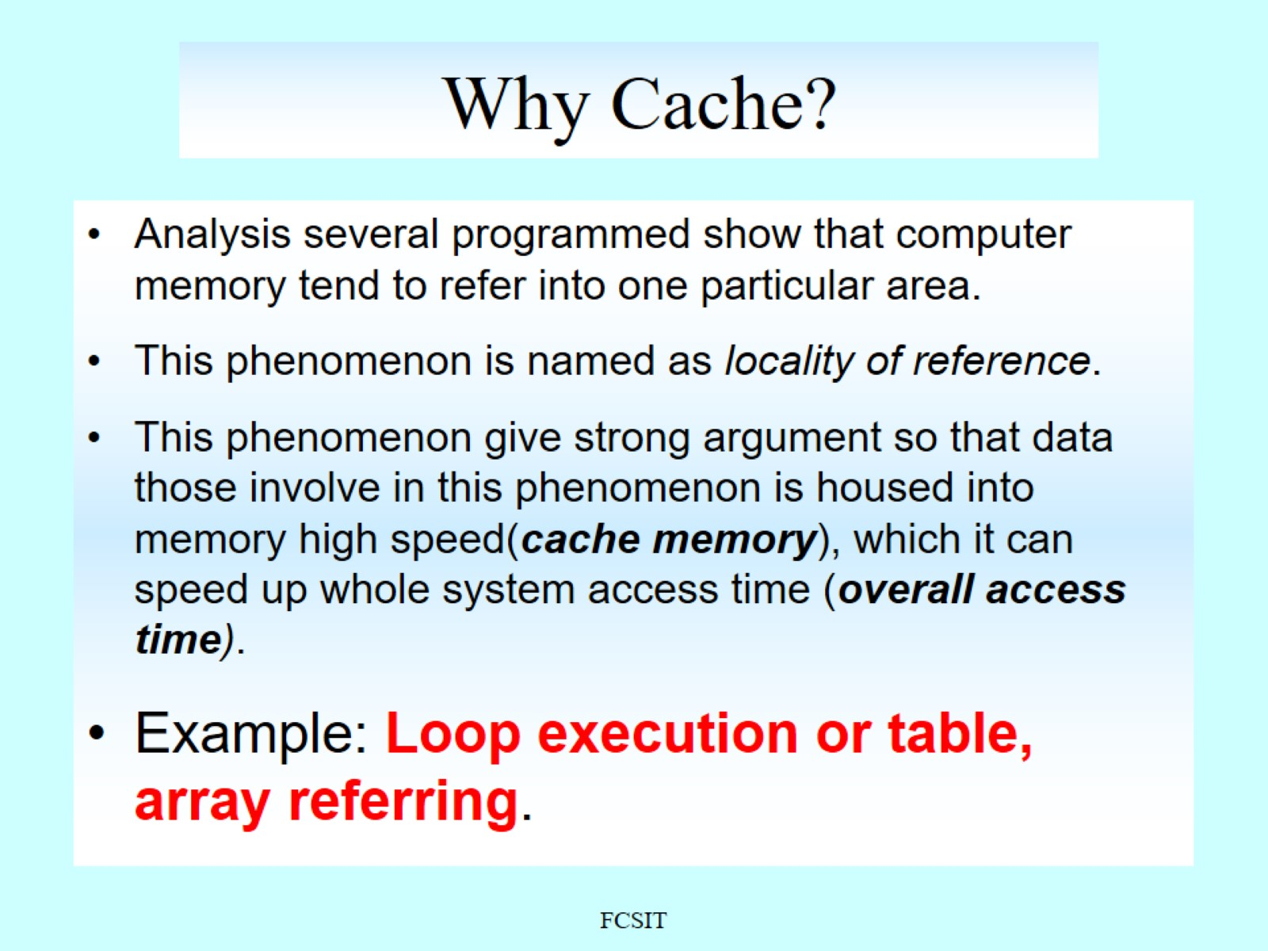
Why Cache?

Slide 12
Figure 5.1 Cache and Main Memory
Notes:
Cache memory is designed to combine the memory access time of expensive, high-
speed memory combined with the large memory size of less expensive, lower-
speed memory. The concept is illustrated in Figure 5.1a. There is a relatively large and slow
main memory together with a smaller, faster cache memory. The cache contains
a copy of portions of the main memory. When the processor attempts
to read a word of memory, a check is made to determine if the word is in the
cache. If so, the word is delivered to the processor. If not, a block of main
memory, consisting of some fixed number of words, is read into the cache
and then the word is delivered to the processor. Because of the phenomenon
of locality of reference, when a block of data is fetched into the cache
to satisfy a single memory reference, it is likely that there will be future
references to that same memory location or to other words in the block.
Figure 5.1b depicts the use of multiple levels of cache. The L2 cache
is slower and typically larger than the L1 cache, and the L3 cache is slower
and typically larger than the L2 cache.

Slide 13
Cache Memory Principles
Block
The minimum unit of transfer between cache and main memory
Frame
To distinguish between the data transferred and the chunk of physical memory, the term frame, or block frame, is sometimes used with reference to caches
Line
A portion of cache memory capable of holding one block, so-called because it is usually drawn as a horizontal object
Tag
A portion of a cache line that is used for addressing purposes
Line size
The number of data bytes, or block size, contained in a line
Notes:
■ Block: The minimum unit of transfer between cache and main memory.
In most of the literature, the term block refers both to the unit of data
transferred and to the physical location in main memory or cache.
■ Frame: To distinguish between the data transferred and the chunk of
physical memory, the term frame, or block frame, is sometimes used
with reference to caches. Some texts and some literature use the term
with reference to the cache and some with reference to main memory. It use is
not necessary for purposes of this text.
■ Line: A portion of cache memory capable of holding one block, so-called
because it is usually drawn as a horizontal object (i.e., all bytes of the line are
typically drawn in one row). A line also includes control information.
■ Tag: A portion of a cache line that is used for addressing purposes, as explained
subsequently. A cache line may also include other control bits, as will be shown.
Main memory consists of up to 2^{n} addressable words, with each word having a
unique n-bit address. For mapping purposes, this memory is considered to consist of
a number of fixed-length blocks of K words each. That is, there are M =2^{n} /K blocks
in main memory. The cache consists of m lines. Each line contains K words, plus a tag.
Each line also includes control bits (not shown), such as a bit to indicate whether the
line has been modified since being loaded into the cache. The length of a line, not
including tag and control bits, is the line size . That is, the term line size refers to the
number of data bytes, or block size, contained in a line. They may be as small as 32 bits,
with each “word” being a single byte; in this case the line size is 4 bytes. The number
of lines is considerably less than the number of main memory blocks (m << M ). At
any time, some subset of the blocks of memory resides in lines in the cache. If a word
in a block of memory is read, that block is transferred to one of the lines of the cache.
Because there are more blocks than lines, an individual line cannot be uniquely and
permanently dedicated to a particular block. Thus, each line includes a tag that identifies
which particular block is currently being stored. The tag is usually a portion of the
main memory address, as described later in this section.

Slide 14
Figure 5.2 Cache/Main Memory Structure
Notes:
Figure 5.2 depicts the structure of a cache/main-memory
system.

Slide 15
Figure 5.3 Cache Read Operation
Notes:
Figure 5.3 illustrates the read operation. The processor generates the read
address (RA) of a word to be read. If the word is contained in the cache (cache hit),
it is delivered to the processor.

Slide 16
Figure 5.4 Typical Cache Organization
Notes:
If a cache miss occurs, two things must be accomplished: the block containing
the word must be loaded in to the cache, and the word must be delivered to the processor.
When a block is brought into a cache in the event of a miss, the block is generally
not transferred in a single event. Typically, the transfer size between cache and main
memory is less than the line size, with 128 bytes being a typical line size and a cache main
memory transfer size of 64 bits (2 bytes). To improve performance, the critical
word first technique is commonly used. When there is a cache miss, the hardware
requests the missed word first from memory and sends it to the processor as soon as
it arrives. This enables the processor to continue execution while filling the rest of the
words in the block. Figure 5.3 shows these last two operations occurring in parallel
and reflects the organization shown in Figure 5.4, which is typical of contemporary
cache organizations. In this organization, the cache connects to the processor via data,
control, and address lines. The data and address lines also attach to data and address
buffers, which attach to a system bus from which main memory is reached. When a
cache hit occurs, the data and address buffers are disabled and communication is only
between processor and cache, with no system bus traffic. When a cache miss occurs,
the desired address is loaded onto the system bus and the data are returned through
the data buffer to both the cache and the processor.

Slide 17
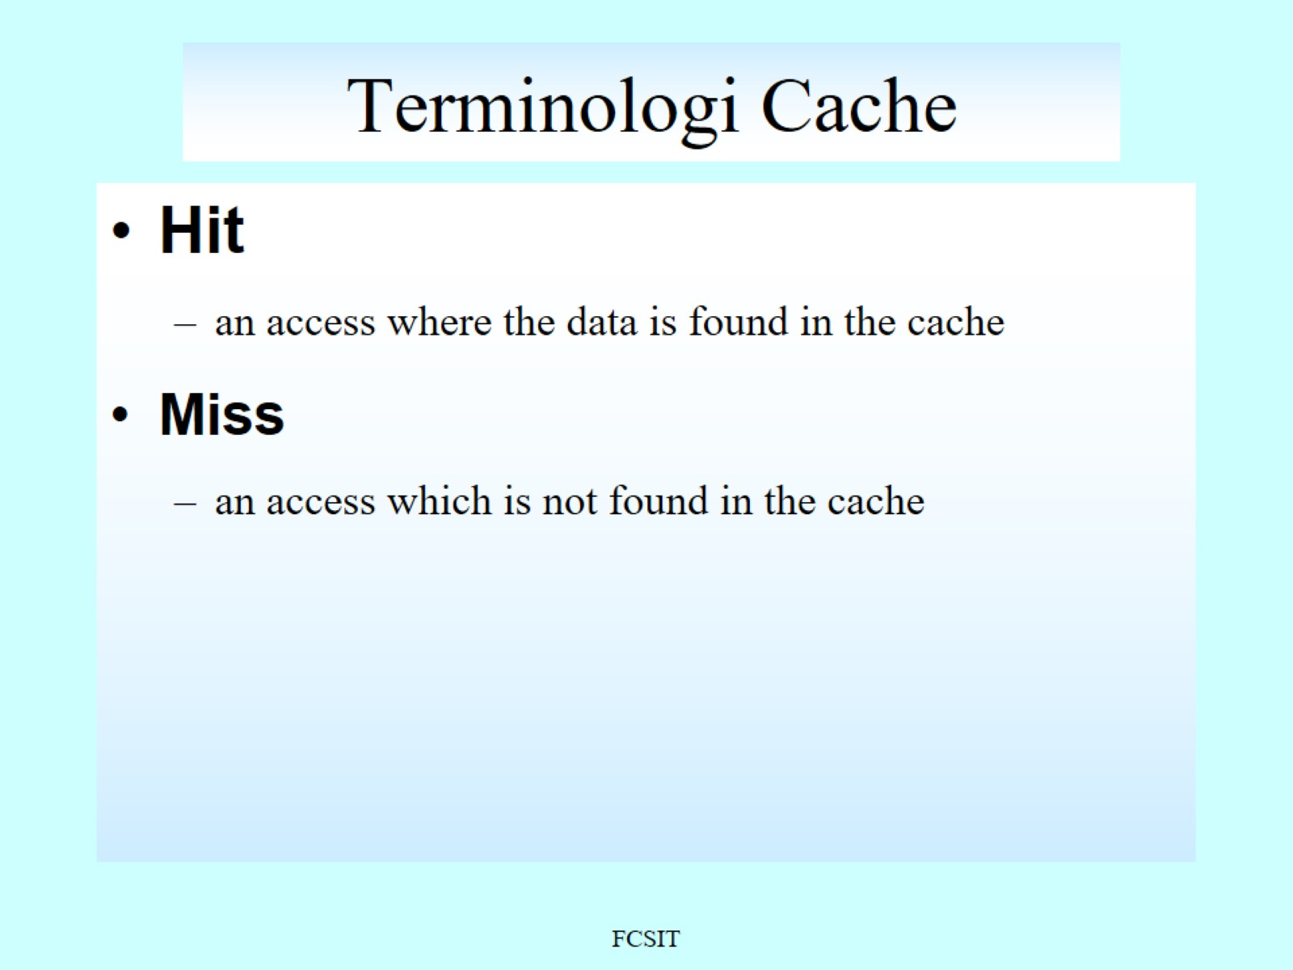
Terminologi Cache

Slide 18
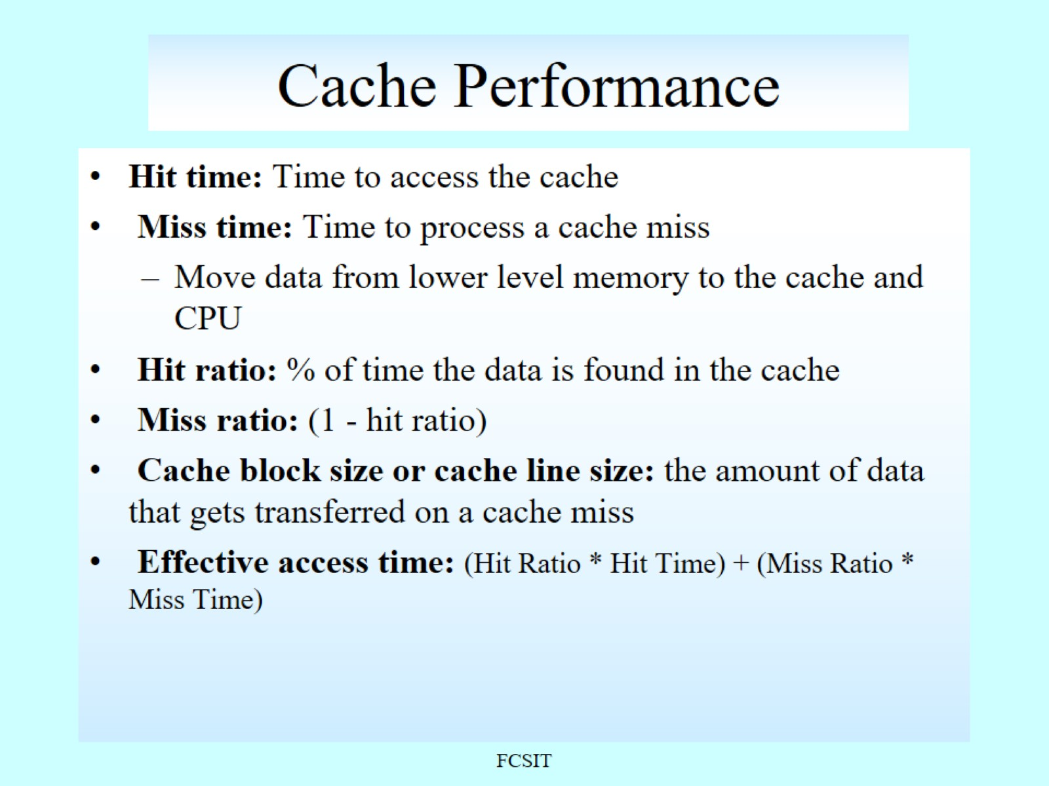
Cache Performance

Slide 19
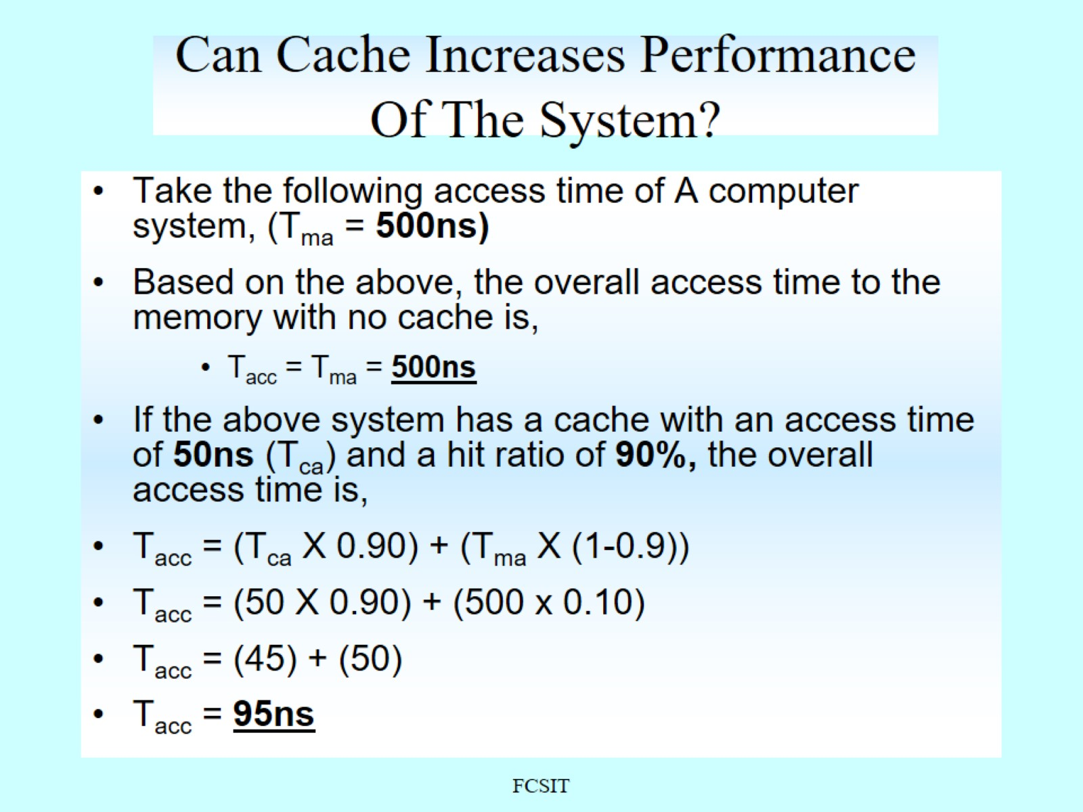
Can Cache Increases Performance Of The System?

Slide 20
Table 5.1 Elements of Cache Design
Cache Addresses Logical Physical Cache Size Mapping Function Direct Associative Set associative Replacement Algorithm Least recently used (LRU) First in first out (FIFO) Least frequently used (LFU) Random | Write Policy Write through Write back Line Size Number of Caches Single or two level Unified or split
Notes:
This section provides an overview of cache design parameters and reports some typical
results. We occasionally refer to the use of caches in high-performance computing
(HPC). HPC deals with supercomputers and their software, especially for scientific
applications that involve large amounts of data, vector and matrix computation, and the
use of parallel algorithms. Cache design for HPC is quite different than for other hardware
platforms and applications. Indeed, many researchers have found that HPC applications
perform poorly on computer architectures that employ caches [BAIL93]. Other
researchers have since shown that a cache hierarchy can be useful in improving performance
if the application software is tuned to exploit the cache [WANG99, PRES01].
Although there are a large number of cache implementations, there are a few
basic design elements that serve to classify and differentiate cache architectures.
Table 5.1 lists key elements.

Slide 21
Cache Size
Preferable for the size of the cache to be:
Small enough so that the overall average cost per bit is close to that of main memory alone
Large enough so that the overall average access time is close to that of the cache alone
Motivations for minimizing cache size:
The larger the cache, the larger the number of gates involved in addressing the cache resulting in large caches being slightly slower than small ones
The available chip and board area also limits cache size
Because the performance of the cache is very sensitive to the nature of the workload, it is impossible to arrive at a single “optimum” cache size
Notes:
The second item in Table 5.1, cache size, has already been discussed. We would
like the size of the cache to be small enough so that the overall average cost per
bit is close to that of main memory alone and large enough so that the overall
average access time is close to that of the cache alone. There are several other
motivations for minimizing cache size. The larger the cache, the larger the number
of gates involved in addressing the cache. The result is that large caches tend to be
slightly slower than small ones—even when built with the same integrated circuit
technology and put in the same place on a chip and circuit board. The available
chip and board area also limits cache size. Because the performance of the cache
is very sensitive to the nature of the workload, it is impossible to arrive at a single
“optimum” cache size.

Slide 22
Table 5.3 Cache Access Methods
Method | Organization | Mapping of Main Memory Blocks to Cache | Access using Main Memory Address
Direct Mapped | Sequence of m lines | Each block of main memory maps to one unique line of cache. | Line portion of address used to access cache line; Tag portion used to check for hit on that line.
Fully Associative | Sequence of m lines | Each block of main memory can map to any line of cache. | Tag portion of address used to check every line for hit on that line.
Set Associative | Sequence of m lines organized as v sets of k lines each (m = v × k) | Each block of main memory maps to one unique cache set. | Line portion of address used to access cache set; Tag portion used to check every line in that set for hit on that line.
Notes:
Because there are fewer cache lines than main memory blocks, an algorithm is needed
for mapping main memory blocks into cache lines. Further, a means is needed for
determining which main memory block currently occupies a cache line. The choice
of the mapping function dictates how the cache is logically organized.
Three techniques can be used: direct, associative, and set-associative. We examine each of these
in turn. In each case, we look at the general structure and then a specific example.
Table 5.3 provides a summary of key characteristics of the three approaches.

Slide 23
Figure 5.6 Mapping from Main Memory to Cache: Direct and Associative
Notes:
The simplest technique, known as direct mapping, maps
each block of main memory into only one possible cache line.
The mapping is expressed as
i = j modulo m
where
i = cache line number
j = main memory block number
m = number of lines in the cache
Figure 5.6a shows the mapping for the first m blocks of main memory.
Each block of main memory maps into one unique line of the cache. The next
m blocks of main memory map into the cache in the same fashion; that is, block B_{m}
of main memory maps into line L₀ of cache, block B_{m+1} maps into line L₁ , and so on.

Slide 24
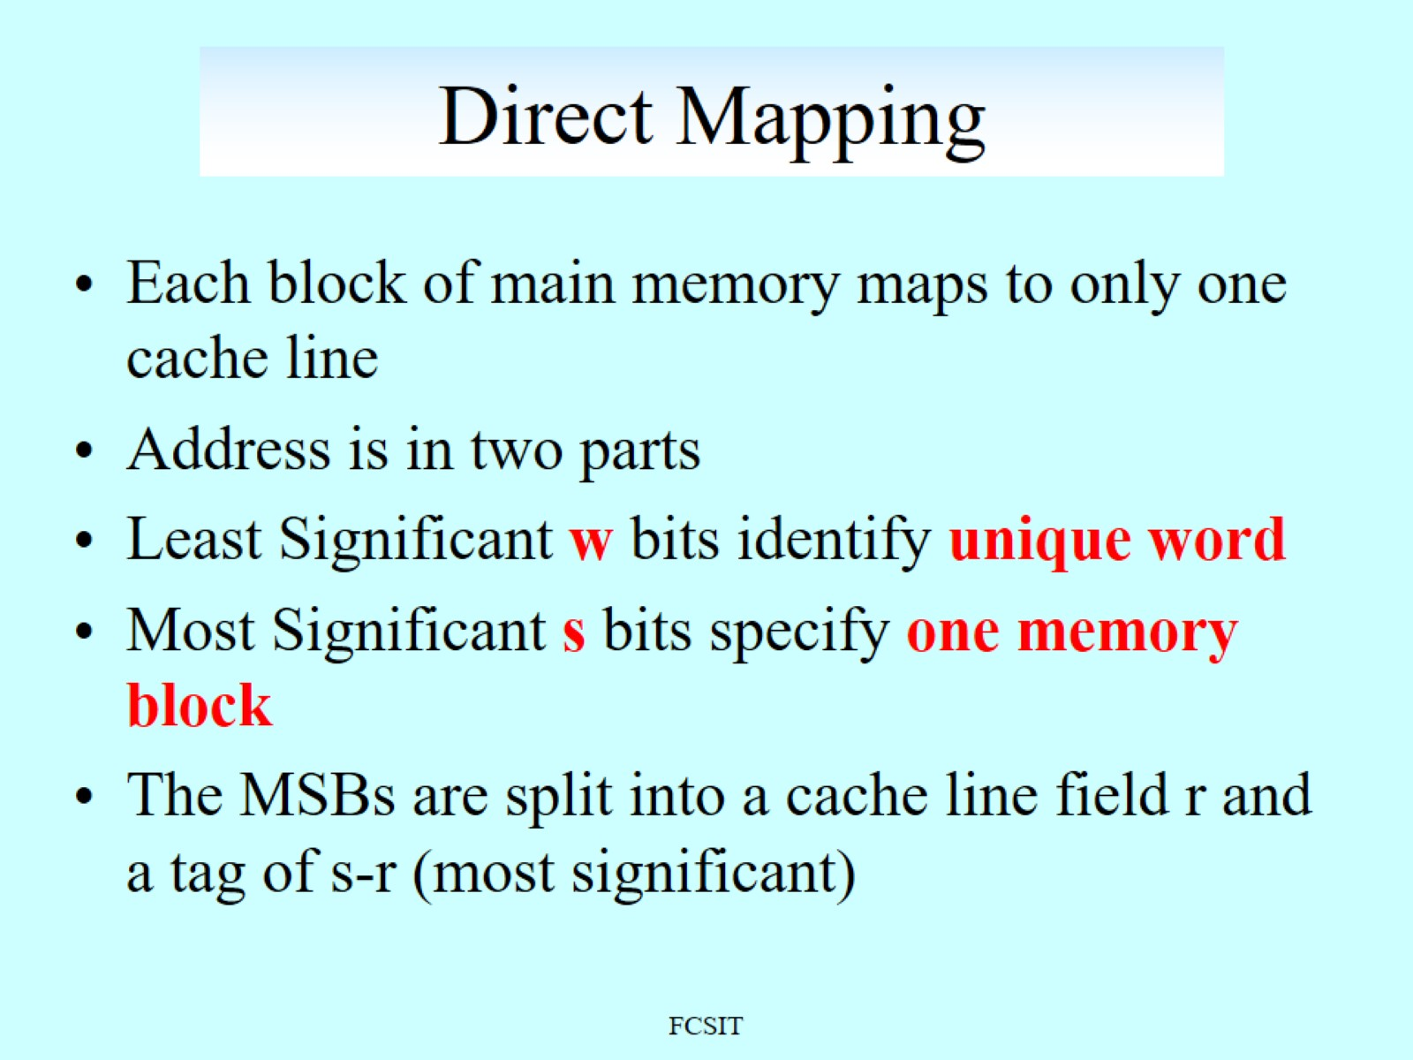
Direct Mapping

Slide 25
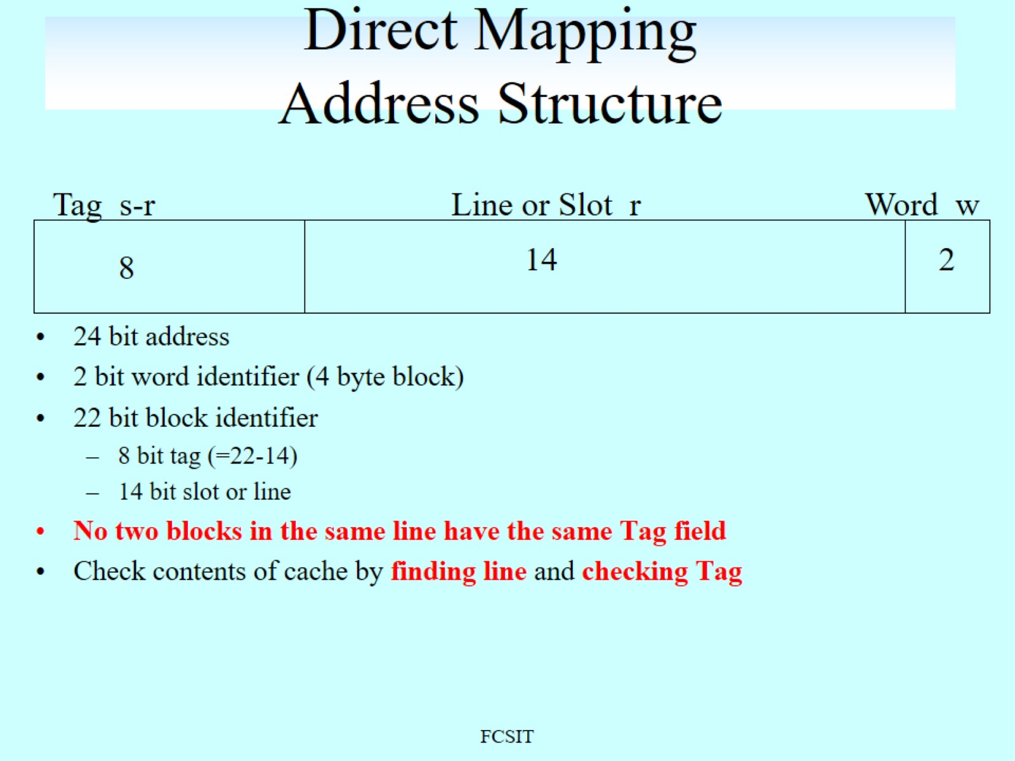
Direct Mapping Address Structure

Slide 26
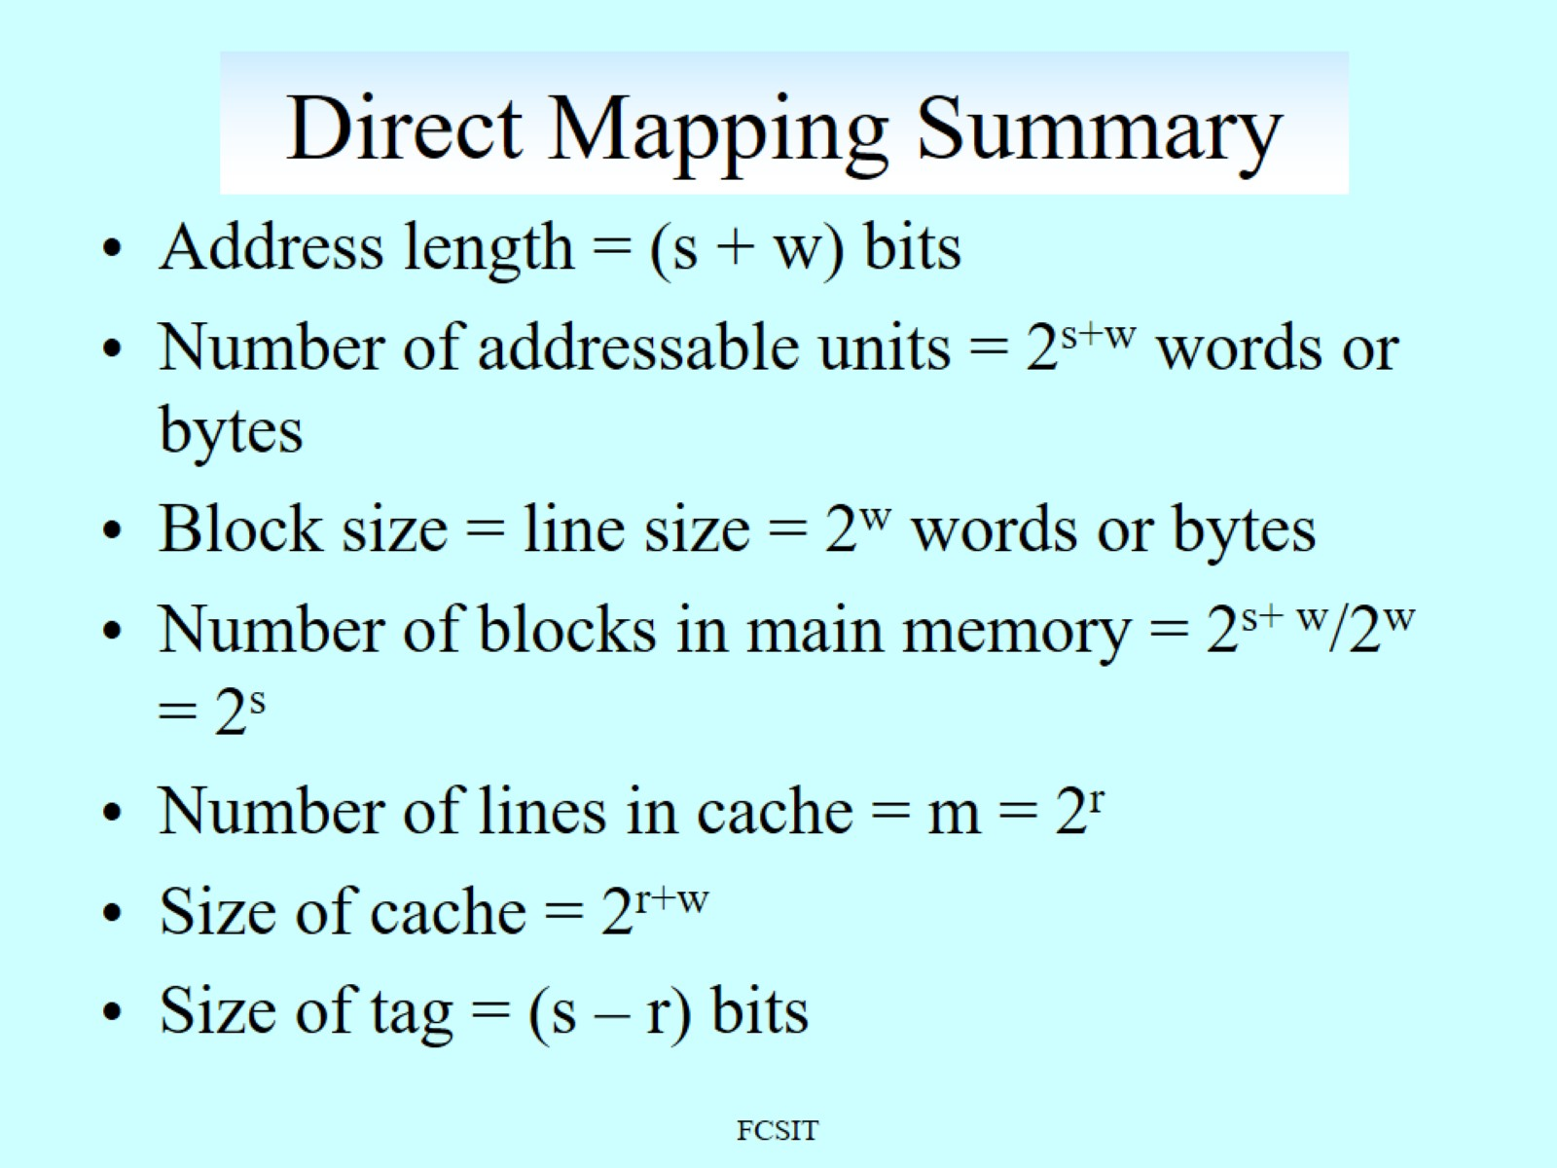
Direct Mapping Summary

Slide 27
Figure 5.8 Direct Mapping Example
Notes:
Figure 5.8. Direct Mapping Example
Figure 5.8 shows our example system using direct mapping. In the example,
m = 16K = 2¹⁴ and i = j modulo 2¹⁴. The mapping becomes
Cache Line Starting Memory Address of Block
0 000000, 010000, …, FF0000
1 000004, 010004, …, FF0004
. .
. .
. .
2¹⁴ - 1 00FFFC, 01FFFC, …, FFFFFC
Note that no two blocks that map into the same line number have the same tag number. Thus,
blocks with starting addresses 000000, 010000, …, FF0000 have tag numbers 00, 01, …, FF, respectively.
Referring back to Figure 5.3, a read operation works as follows. The cache system is presented
with a 24-bit address. The 14-bit line number is used as an index into the cache to access a particular
line. If the 8-bit tag number matches the tag number currently stored in that line, then the 2-bit word
number is used to select one of the 4 bytes in that line. Otherwise, the 22-bit tag-plus-line
field is used to fetch a block from main memory. The actual address that is used for the fetch is the 22-bit
tag-plus-line concatenated with two 0 bits, so that 4 bytes are fetched starting on a block boundary.

Slide 28
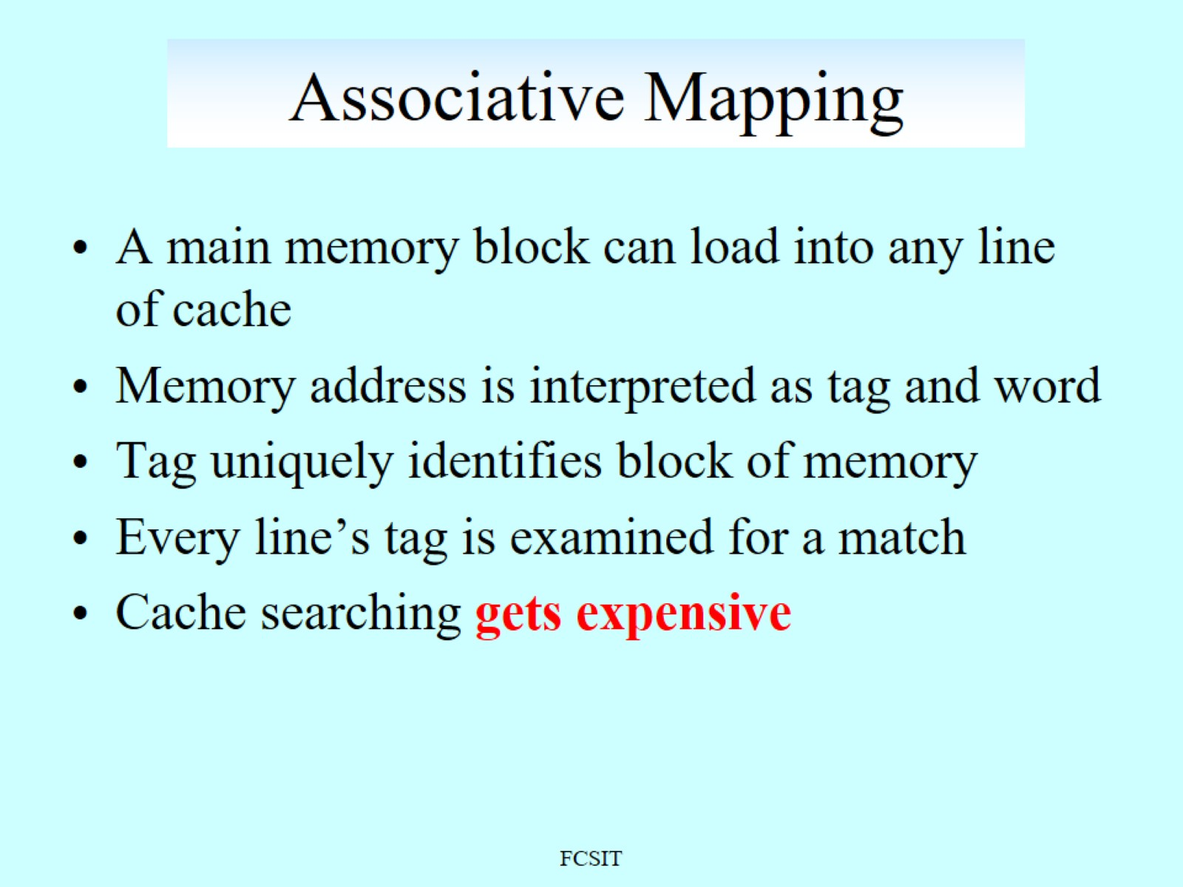
Associative Mapping

Slide 29
Associative Mapping Address Structure
Word
2 bit
Tag 22 bit
22 bit tag stored with each 32 bit block of data
Compare tag field with tag entry in cache to check for hit
Least significant 2 bits of address identify which 8 bit word is required from 32 bit data block
e.g.
Address Tag Data Cache line
FFFFFC 3FFFFF 24682468 3FFF

Slide 30
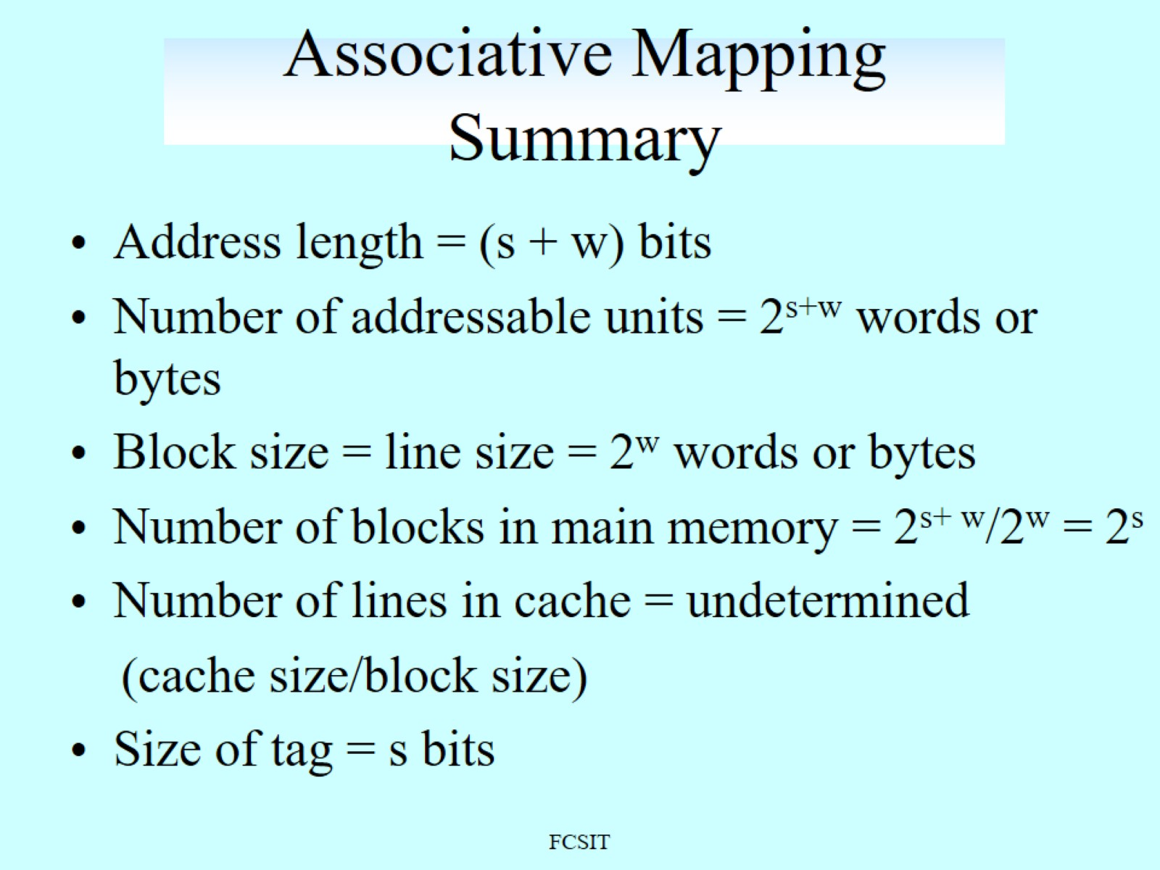
Associative Mapping Summary

Slide 31
Figure 5.11 Associative Mapping Example
Notes:
With associative mapping, there is flexibility as to which block to replace when
a new block is read into the cache. Replacement algorithms, discussed later in this
section, are designed to maximize the hit ratio. The principal disadvantage of associative
mapping is the complex circuitry required to examine the tags of all cache
lines in parallel.
Figure 5.11 shows our example using associative mapping. A main
memory address consists of a 22-bit tag and a 2-bit byte number. The 22-bit tag must be
stored with the 32-bit block of data for each line in the cache. Note that it is the leftmost
(most significant) 22 bits of the address that form the tag. Thus, the 24-bit hexadecimal
address 16339C has the 22-bit tag 058CE7. This is easily seen in binary notation:
memory address 0001 0110 0011 0011 1001 1100 (binary)
1 6 3 3 9 C (hex)
tag (leftmost 22 bits) 00 0101 1000 1100 1110 0111 (binary)
0 5 8 C E 7 (hex)
With associative mapping, there is flexibility as to which block to replace when
a new block is read into the cache. Replacement algorithms, discussed later in this
section, are designed to maximize the hit ratio. The principal disadvantage of associative
mapping is the complex circuitry required to examine the tags of all cache
lines in parallel.

Slide 32
Set Associative Mapping
Compromise that exhibits the strengths of both the direct and associative approaches while reducing their disadvantages
Cache consists of a number of sets
Each set contains a number of lines
A given block maps to any line in a given set
e.g. 2 lines per set
2 way associative mapping
A given block can be in one of 2 lines in only one set
Notes:
Set-associative mapping is a compromise that
exhibits the strengths of both the direct and associative approaches while reducing
their disadvantages.
In this case, the cache consists of a number sets, each of which consists of a
number of lines. The relationships are
m = v* k
i = j modulo v
where
i = cache set number
j = main memory block number
m = number of lines in the cache
v = number of sets
k = number of lines in each set
This is referred to as k-way set-associative mapping. With set-associative
mapping block B_{j} can be mapped into any of the lines of set j.

Slide 33
Figure 5.12 Mapping from Main Memory to Cache: k-Way Set Associative
Notes:
Figure 5.12a illustrates
this mapping for the first v blocks of main memory. As with associative mapping,
each word maps into multiple cache lines. For set-associative mapping, each word
maps into all the cache lines in a specific set, so that main memory block B₀ maps
into set 0, and so on. Thus, the set-associative cache can be physically implemented
as n associative caches. It is also possible to implement the set-associative cache as
k direct mapping caches, as shown in Figure 5.12b. Each direct-mapped cache is
referred to as a way, consisting of v lines. The first v lines of main memory are direct
mapped into the v lines of each way; the next group of v lines of main memory are
similarly mapped, and so on. The direct-mapped implementation is typically used
for small degrees of associativity (small values of k) while the associative-mapped
implementation is typically used for higher degrees of associativity [JACO08].

Slide 34
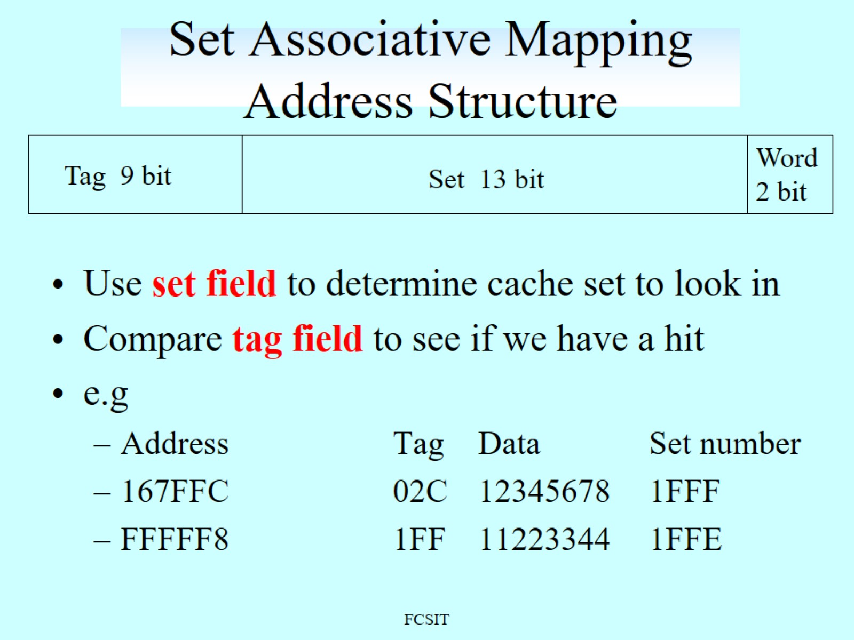
Set Associative Mapping Address Structure

Slide 35
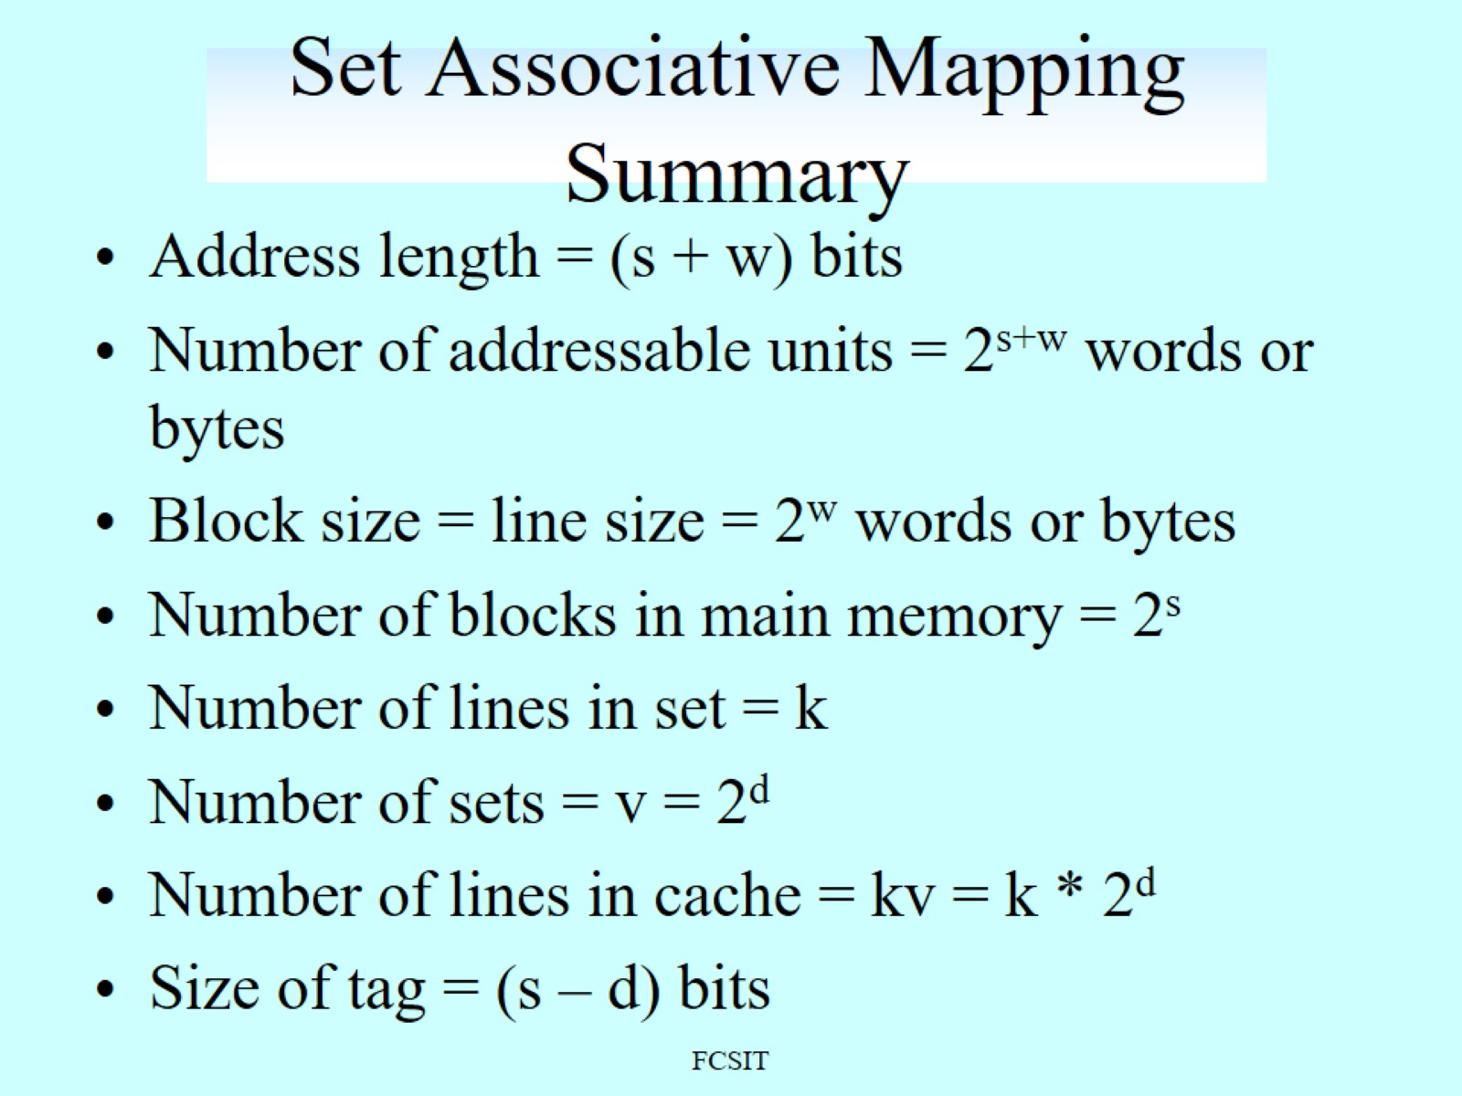
Set Associative Mapping Summary

Slide 36
Figure 5.14 Two-Way Set-Associative Mapping Example
Notes:
Figure 5.14 shows our example using set-associative
mapping with two lines in each set, referred to as two-way
set-associative. The 13-bit set number identifies
a unique set of two lines within the cache. It also gives the number of the block in
main memory, modulo 2¹³. This determines the mapping of blocks into lines. Thus, blocks
000000, 008000, …, FF8000 of main memory map into cache set 0. Any of those blocks can
be loaded into either of the two lines in the set. Note that no two blocks that map into the
same cache set have the same tag number. For a read operation, the 13-bit set number is
used to determine which set of two lines is to be examined. Both lines in the set are examined
for a match with the tag number of the address to be accessed.
In the extreme case of v = m , k = 1, the set-associative
technique reduces to direct mapping, and for v = 1, k = m , it reduces to associative mapping. The use of
two lines per set (v = m /2, k = 2) is the most common set-associative
organization. It significantly improves the hit ratio over direct mapping. Four- way set associative
(v = m /4, k = 4) makes a modest additional improvement for a relatively small
additional cost [MAYB84, HILL89]. Further increases in the number of lines per
set have little effect.

Slide 37
Replacement Algorithms
Once the cache has been filled, when a new block is brought into the cache, one of the existing blocks must be replaced
For direct mapping there is only one possible line for any particular block and no choice is possible
For the associative and set-associative techniques a replacement algorithm is needed
To achieve high speed, an algorithm must be implemented in hardware
Notes:
Once the cache has been filled, when a new block is brought into the cache, one
of the existing blocks must be replaced. For direct mapping, there is only one possible
line for any particular block, and no choice is possible. For the associative
and set-associative techniques, a replacement algorithm is needed. To achieve high
speed, such an algorithm must be implemented in hardware.

Slide 38
The most common replacement algorithms are:
Least recently used (LRU)
Most effective
Replace that block in the set that has been in the cache longest with no reference to it
Because of its simplicity of implementation, LRU is the most popular replacement algorithm
First-in-first-out (FIFO)
Replace that block in the set that has been in the cache longest
Easily implemented as a round-robin or circular buffer technique
Least frequently used (LFU)
Replace that block in the set that has experienced the fewest references
Could be implemented by associating a counter with each line
Notes:
A number of algorithms
have been tried. We mention four of the most common. Probably the most
effective is least recently used (LRU): Replace that block in the set that has been in
the cache longest with no reference to it. For two-way set associative, this is easily
implemented. Each line includes a USE bit. When a line is referenced, its USE bit
is set to 1 and the USE bit of the other line in that set is set to 0. When a block is to
be read into the set, the line whose USE bit is 0 is used. Because we are assuming
that more recently used memory locations are more likely to be referenced, LRU
should give the best hit ratio. LRU is also relatively easy to implement for a fully
associative cache. The cache mechanism maintains a separate list of indexes to all
the lines in the cache. When a line is referenced, it moves to the front of the list.
For replacement, the line at the back of the list is used. Because of its simplicity of
implementation, LRU is the most popular replacement algorithm.
Another possibility is first-in-first-out (FIFO): Replace that block in the set
that has been in the cache longest. FIFO is easily implemented as a round-robin
or circular buffer technique. Still another possibility is least frequently used (LFU):
Replace that block in the set that has experienced the fewest references. LFU could
be implemented by associating a counter with each line. A technique not based on
usage (i.e., not LRU, LFU, FIFO, or some variant) is to pick a line at random from
among the candidate lines. Simulation studies have shown that random replacement
provides only slightly inferior performance to an algorithm based on usage [SMIT82].

Slide 39
Write Policy
When a block that is resident in the cache is to be replaced there are two cases to consider:
If the old block in the cache has not been altered then it may be overwritten with a new block without first writing out the old block
If at least one write operation has been performed on a word in that line of the cache then main memory must be updated by writing the line of cache out to the block of memory before bringing in the new block
There are two problems to contend with:
More than one device may have access to main memory
A more complex problem occurs when multiple processors are attached to the same bus and each processor has its own local cache - if a word is altered in one cache it could conceivably invalidate a word in other caches
Notes:
When a block that is resident in the cache is to be replaced, there are two cases to
consider. If the old block in the cache has not been altered, then it may be overwritten
with a new block without first writing out the old block. If at least one write
operation has been performed on a word in that line of the cache, then main memory
must be updated by writing the line of cache out to the block of memory before
bringing in the new block. A variety of write policies, with performance and economic
trade-offs, is possible. There are two problems to contend with. First, more
than one device may have access to main memory. For example, an I/O module
may be able to read-write directly to memory. If a word has been altered only in the
cache, then the corresponding memory word is invalid. Further, if the I/O device
has altered main memory, then the cache word is invalid. A more complex problem
occurs when multiple processors are attached to the same bus and each processor
has its own local cache. Then, if a word is altered in one cache, it could conceivably
invalidate a word in other caches.

Slide 40
Write Through and Write Back
Write through
Simplest technique
All write operations are made to main memory as well as to the cache
The main disadvantage of this technique is that it generates substantial memory traffic and may create a bottleneck
Write back
Minimizes memory writes
Updates are made only in the cache
Portions of main memory are invalid and hence accesses by I/O modules can be allowed only through the cache
This makes for complex circuitry and a potential bottleneck
Notes:
The simplest technique is called write through. Using this technique, all write
operations are made to main memory as well as to the cache, ensuring that main
memory is always valid. Any other processor–cache module can monitor traffic to
main memory to maintain consistency within its own cache. The main disadvantage
of this technique is that it generates substantial memory traffic and may create a bottleneck.
An alternative technique, known as write back, minimizes memory writes.
With write back, updates are made only in the cache. When an update occurs, a
dirty bit, or use bit, associated with the line is set. Then, when a block is replaced, it
is written back to main memory if and only if the dirty bit is set. The problem with
write back is that portions of main memory are invalid, and hence accesses by I/O
modules can be allowed only through the cache. This makes for complex circuitry
and a potential bottleneck. Experience has shown that the percentage of memory
references that are writes is on the order of 15% [SMIT82]. However, for HPC
applications, this number may approach 33% (vector-vector multiplication) and can
go as high as 50% (matrix transposition).

Slide 41
Write Miss Alternatives
There are two alternatives in the event of a write miss at a cache level:
Write allocate
The block containing the word to be written is fetched from main memory (or next level cache) into the cache and the processor proceeds with the write cycle
No write allocate
The block containing the word to be written is modified in the main memory and not loaded into the cache
Either of these policies can be used with either write through or write back
No write allocate is most commonly used with write through
Write allocate is most commonly used with write back
Notes:
There is another dimension to the write policy when a miss occurs at a cache
level. There are two alternatives in the event of a write miss:
■ Write Allocate: The block containing the word to be written is fetched from
main memory (or next level cache) into the cache and the processor proceeds
with the write cycle.
■ No Write Allocate: The block containing the word to be written is modified in
the main memory and not loaded into the cache.
Either of these policies can be used with either write through or write back.
Most commonly, no write allocate is used with write through. The reasoning is that
even if locality holds and a write will be made to the same block in the near future,
the write-through policy will generate a write to main memory anyway, so bringing
the block into the cache does not seem efficient. For example, the ARM Cortex
processors can be configured to use write allocate or no write allocate with write
back, but only no write allocate with write through.
With write back, write allocate is most commonly used, although some systems,
such as the ARM Cortex, also allow no write allocate. The reasoning for using
write allocate is that subsequent writes to the same block, if the block originally
caused a miss, will hit in the cache next time, setting the dirty bit for the block. That
will eliminate extra memory accesses and result in efficient execution. The write
back, no write allocate option eliminates the time spent in bringing a block into
the cache. Depending on locality patterns for reads and writes, there may be some
advantage to this technique.

Slide 42
Cache Coherency
A new problem is introduced in a bus organization in which more than one device has a cache and main memory is shared
If data in one cache are altered, this invalidates not only the corresponding word in main memory, but also that same word in other caches
Even if a write-through policy is used, the other caches may contain invalid data
Possible approaches to cache coherency include:
Bus watching with write through
Each cache controller monitors the address lines to detect write operations to memory by other bus masters
If another master writes to a location in shared memory that also resides in the cache memory, the cache controller invalidates that cache entry
This strategy depends on the use of a write-through policy by all cache controllers
Hardware transparency
Additional hardware is used to ensure that all updates to main memory via cache are reflected in all caches
If one processor modifies a word in its cache, this update is written to main memory
Noncacheable memory
Only a portion of main memory is shared by more than one processor, and this is designated as noncacheable
All accesses to shared memory are cache misses, because the shared memory is never copied into the cache
The noncacheable memory can be identified using chip-select logic or high-address bits
Notes:
In a bus organization in which more than one device (typically a processor)
has a cache and main memory is shared, a new problem is introduced. If data in one
cache are altered, this invalidates not only the corresponding word in main memory,
but also that same word in other caches (if any other cache happens to have that
same word). Even if a write-through policy is used, the other caches may contain
invalid data. A system that prevents this problem is said to maintain cache coherency.
Possible approaches to cache coherency include the following:
• Bus watching with write through: Each cache controller monitors the address
lines to detect write operations to memory by other bus masters. If another
master writes to a location in shared memory that also resides in the cache
memory, the cache controller invalidates that cache entry. This strategy depends
on the use of a write-through policy by all cache controllers.
• Hardware transparency: Additional hardware is used to ensure that all updates
to main memory via cache are reflected in all caches. Thus, if one processor
modifies a word in its cache, this update is written to main memory. In addition,
any matching words in other caches are similarly updated.
• Non-cacheable memory: Only a portion of main memory is shared by more
than one processor, and this is designated as non-cacheable. In such a system,
all accesses to shared memory are cache misses, because the shared memory
is never copied into the cache. The non-cacheable memory can be identified
using chip-select logic or high-address bits.

Slide 43
Line Size
When a block of data is retrieved and placed in the cache not only the desired word but also some number of adjacent words are retrieved
As the block size increases the hit ratio will at first increase because of the principle of locality
As the block size increases more useful data are brought into the cache
The hit ratio will begin to decrease as the block becomes bigger and the probability of using the newly fetched information becomes less than the probability of reusing the information that has to be replaced
Two specific effects come into play:
Larger blocks reduce the number of blocks that fit into a cache
As a block becomes larger each additional word is farther from the requested word
Notes:
Another design element is the line size. When a block of data is retrieved and placed
in the cache, not only the desired word but also some number of adjacent words are
retrieved. As the block size increases from very small to larger sizes, the hit ratio
will at first increase because of the principle of locality, which states that data in the
vicinity of a referenced word are likely to be referenced in the near future. As the
block size increases, more useful data are brought into the cache. The hit ratio will
begin to decrease, however, as the block becomes even bigger and the probability
of using the newly fetched information becomes less than the probability of reusing
the information that has to be replaced. Two specific effects come into play:
• Larger blocks reduce the number of blocks that fit into a cache. Because each
block fetch overwrites older cache contents, a small number of blocks results
in data being overwritten shortly after they are fetched.
• As a block becomes larger, each additional word is farther from the requested
word and therefore less likely to be needed in the near future.
The relationship between block size and hit ratio is complex, depending on
the locality characteristics of a particular program, and no definitive optimum value
has been found. A size of from 8 to 64 bytes seems reasonably close to optimum
[SMIT87, PRZY88, PRZY90, HAND98]. For HPC systems, 64- and 128-byte cache
line sizes are most frequently used.

Slide 44
Multilevel Caches
As logic density has increased it has become possible to have a cache on the same chip as the processor
The on-chip cache reduces the processor’s external bus activity and speeds up execution time and increases overall system performance
When the requested instruction or data is found in the on-chip cache, the bus access is eliminated
On-chip cache accesses will complete appreciably faster than would even zero-wait state bus cycles
During this period the bus is free to support other transfers
Two-level cache:
Internal cache designated as level 1 (L1)
External cache designated as level 2 (L2)
Potential savings due to the use of an L2 cache depends on the hit rates in both the L1 and L2 caches
The use of multilevel caches complicates all of the design issues related to caches, including size, replacement algorithm, and write policy
Notes:
As logic density has increased, it has become possible to
have a cache on the same chip as the processor: the on-chip cache. Compared with
a cache reachable via an external bus, the on-chip cache reduces the processor’s
external bus activity and therefore speeds up execution times and increases overall
system performance. When the requested instruction or data is found in the on-chip
cache, the bus access is eliminated. Because of the short data paths internal to
the processor, compared with bus lengths, on-chip cache accesses will complete
appreciably faster than would even zero-wait state bus cycles. Furthermore, during
this period the bus is free to support other transfers.
The inclusion of an on-chip cache leaves open the question of whether an
off-chip, or external, cache is still desirable. Typically, the answer is yes, and most contemporary
designs include both on-chip and external caches. The simplest such organization
is known as a two-level cache, with the internal cache designated as level 1 (L1)
and the external cache designated as level 2 (L2). The reason for including an L2 cache
is the following: If there is no L2 cache and the processor makes an access request
for a memory location not in the L1 cache, then the processor must access DRAM or
ROM memory across the bus. Due to the typically slow bus speed and slow memory
access time, this results in poor performance. On the other hand, if an L2 SRAM (static
RAM) cache is used, then frequently the missing information can be quickly retrieved.
If the SRAM is fast enough to match the bus speed, then the data can be accessed
using a zero-wait state transaction, the fastest type of bus transfer.
Two features of contemporary cache design for multilevel caches are noteworthy.
First, for an off-chip L2 cache, many designs do not use the system bus as
the path for transfer between the L2 cache and the processor, but use a separate
data path, so as to reduce the burden on the system bus. Second, with the continued
shrinkage of processor components, a number of processors now incorporate the L2
cache on the processor chip, improving performance.
The potential savings due to the use of an L2 cache depends on the hit rates
in both the L1 and L2 caches. Several studies have shown that, in general, the use
of a second-level cache does improve performance (e.g., see [AZIM92], [NOVI93],
[HAND98]). However, the use of multilevel caches does complicate all of the design
issues related to caches, including size, replacement algorithm, and write policy; see
[HAND98] and [PEIR99] for discussions.

Slide 45
Unified Versus Split Caches
Has become common to split cache:
One dedicated to instructions
One dedicated to data
Both exist at the same level, typically as two L1 caches
Advantages of unified cache:
Higher hit rate
Balances load of instruction and data fetches automatically
Only one cache needs to be designed and implemented
Trend is toward split caches at the L1 and unified caches for higher levels
Advantages of split cache:
Eliminates cache contention between instruction fetch/decode unit and execution unit
Important in pipelining
Notes:
When the on-chip cache first made an appearance,
many of the designs consisted of a single cache used to store references to both data
and instructions. More recently, it has become common to split the cache into two:
one dedicated to instructions and one dedicated to data. These two caches both exist
at the same level, typically as two L1 caches. When the processor attempts to fetch an
instruction from main memory, it first consults the instruction L1 cache, and when the
processor attempts to fetch data from main memory, it first consults the data L1 cache.
There are two potential advantages of a unified cache:
• For a given cache size, a unified cache has a higher hit rate than split caches
because it balances the load between instruction and data fetches automatically.
That is, if an execution pattern involves many more instruction fetches
than data fetches, then the cache will tend to fill up with instructions, and if an
execution pattern involves relatively more data fetches, the opposite will occur.
• Only one cache needs to be designed and implemented.
The trend is toward split caches at the L1 and unified caches for higher levels,
particularly for superscalar machines, which emphasize parallel instruction execution
and the prefetching of predicted future instructions. The key advantage of the
split cache design is that it eliminates contention for the cache between the instruction
fetch/decode unit and the execution unit. This is important in any design that
relies on the pipelining of instructions. Typically, the processor will fetch instructions
ahead of time and fill a buffer, or pipeline, with instructions to be executed. Suppose
now that we have a unified instruction/data cache. When the execution unit performs
a memory access to load and store data, the request is submitted to the unified cache.
If, at the same time, the instruction prefetcher issues a read request to the cache for
an instruction, that request will be temporarily blocked so that the cache can service
the execution unit first, enabling it to complete the currently executing instruction.
This cache contention can degrade performance by interfering with efficient use of
the instruction pipeline. The split cache structure overcomes this difficulty.

Slide 46
Inclusion Policy
Inclusive policy
Dictates that a piece of data in one cache is guaranteed to be also found in all lower levels of caches
Advantage is that it simplifies searching for data when there are multiple processors in the computing system
This property is useful in enforcing cache coherence
Exclusive policy
Dictates that a piece of data in one cache is guaranteed not to be found in all lower levels of caches
The advantage is that it does not waste cache capacity since it does not store multiple copies of the same data in all of the caches
The disadvantage is the need to search multiple cache levels when invalidating or updating a block
To minimize the search time, the highest-level tag sets are typically duplicated at the lowest cache level to centralize searching
Noninclusive policy
With the noninclusive policy a piece of data in one cache may or may not be found in lower levels of caches
As with the exclusive policy, this policy will generally maintain all higher-level cache sets at the lowest cache level
Notes:
Recall from Chapter 4 that we defined the inclusion principle for memory hierarchies
as follows: All information items are originally stored in level Mn , where n is the
level most remote from the processor (lowest level). During the processing, subsets of
Mn are copied into Mn –1. Similarity, subsets of Mn –1 are copied into Mn –2, and so on.
This is expressed concisely as Mi Mi +1. Thus, if a word is found in Mi , then copies of
the same word also exist in all lower layers Mi +1, Mi +2,…, Mn . In a multilevel cache
environment, in which there may be multiple caches at one level that share the same
cache at the next lower level, inclusion between these two levels may not always be
desirable. Three inclusion policies are found in contemporary cache systems:
The inclusive policy dictates that a piece of data in one cache is guaranteed to
be also found in all lower levels of caches. The advantage of the inclusive policy is that
it simplifies searching for data when there are multiple processors in the computing
system. For example, if one processor wants to know whether another processor has
the data it needs, it does not need to search all levels of caches of that other processor
but only the lowest-level cache. This property is useful in enforcing cache coherence,
which is discussed in Chapter 20.
The exclusive policy dictates that a piece of data in one cache is guaranteed
not to be found in all lower levels of caches. The advantage of the exclusive policy
is that it does not waste cache capacity since it does not store multiple copies of
the same data in all of the caches. The disadvantage is the need to search multiple
cache levels when invalidating or updating a block. To minimize the search time, the
higher-level tag sets are typically duplicated at the lowest cache level to centralize
searching.
With the noninclusive policy , a piece of data in one cache may or may not be
found in lower levels of caches. This can be contrasted with the other two policies with
the following examples. Suppose that the L2 line size is a multiple of the L1 line size.
For the inclusive policy, if a block is evicted from the L2 cache, the corresponding multiple
blocks will be evicted from the L1 cache. In contrast, with a noninclusive policy,
the L1 cache my retain portions of a block recently evicted from the L2 cache. For the
same difference in block size, if a portion of a block is promoted from the L2 cache to
the L1 cache, the exclusive policy requires the entire L2 block be evicted. In contrast,
the noninclusive policy does not require this eviction. As with the exclusive policy,
a noninclusive policy will generally maintain all higher-level cache sets at the lowest
cache level.

Slide 47
Summary
Cache
Memory
Chapter 4
Elements of cache design
Cache addresses
Cache size
Logical cache organization
Replacement algorithms
Write policy
Line size
Number of caches
Inclusion policy
Cache memory principles
Cache performance modules
Cache timing model
Design option for improving performance
Notes:
Chapter 5 summary.

Slide 48
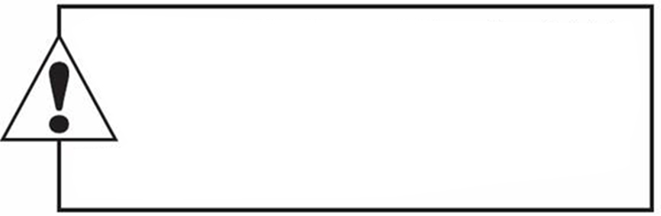
Copyright
This work is protected by United States copyright laws and is provided solely for the use of instructions in teaching their courses and assessing student learning. dissemination or sale of any part of this work (including on the World Wide Web) will destroy the integrity of the work and is not permit- ted. The work and materials from it should never be made available to
students except by instructors using the accompanying text in their classes. All recipients of this work are expected to abide by these
restrictions and to honor the intended pedagogical purposes and the needs of
other instructors who rely on these materials.

