Slide 1
WIA1005 Network Technology Foundation
Chapter 2
Network Protocols and Network Operating Systems

Slide 2
Contents
Rules of Communication
Network Protocols
Data Encapsulation
Data Access
Network Operating Systems
Basic Command

Slide 3
Rules of Communication
Communication begins with a message, or information, that must be sent from a source to a destination. The sending of this message, whether by face-to-face communication or over a network, is governed by rules called protocols.
The protocols used are specific to the characteristics of the communication method, including the characteristics of the source, destination and channel.
Protocol Requirements
  An identified sender and receiver
  Common language and grammar
  Speed and timing of delivery
  Confirmation or acknowledgment requirements

Slide 4
Rules of Communication
Common computer protocols
  message encoding
  message formatting and encapsulation
  message size
  message timing
  message delivery options
Encoding is the process of converting information into another, acceptable form, for transmission. Decoding reverses this process in order to interpret the information.
When a message is sent from source to destination, it must use a specific format or structure. Message formats depend on the type of message and the channel that is used to deliver the message.

Slide 5
Rules of Communication
When communication happen, the messages usually broken into smaller parts or sentences. These sentences are limited in size to what the receiver can process at one time.
Message timing includes the following:
  Flow Control - Flow control defines how much information can be sent and the speed at which it can be delivered.
  Response Timeout - Hosts on the network use network protocols that specify how long to wait for responses and what action to take if a response timeout occurs.
  Access method - This determines when someone can send a message.

Slide 6
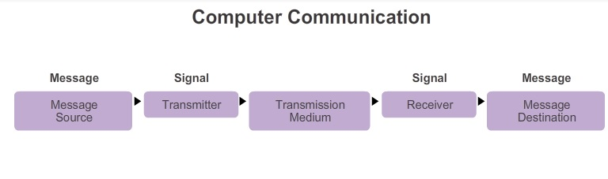
Rules of Communication
A message may need to be best delivered in different ways. Sometimes, a person wants to communicate information to a single individual. At other times, the person may need to send information to a group of people at the same time, or even to all people in the same area.

Slide 7
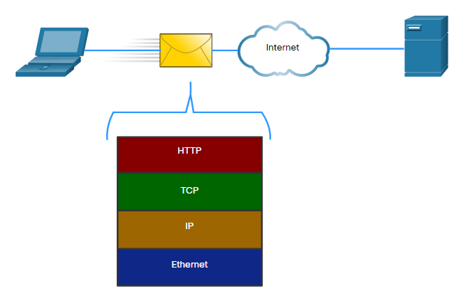
Network Protocols
Networking protocols define a common format and set of rules for exchanging messages between devices.
A message sent over a computer network typically requires the use of several protocols, each one with its own functions and format.

Slide 8
Network Protocols
A group of inter-related protocols necessary to perform a communication function is called a protocol suite.
Protocol suites are implemented by hosts and networking devices in software, hardware or both.
The TCP/IP suite is a suite of protocols required for transmitting and receiving information using the Internet.
A layered model, such as the TCP/IP model, is often used to help visualize the interaction between various protocols. A layered model depicts the operation of the protocols occurring within each layer, as well as the interaction of protocols with the layers above and below each layer.

Slide 9
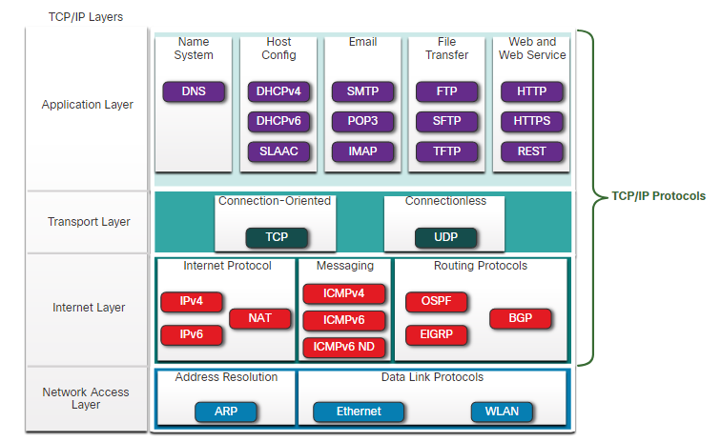
Network Protocols

Slide 10
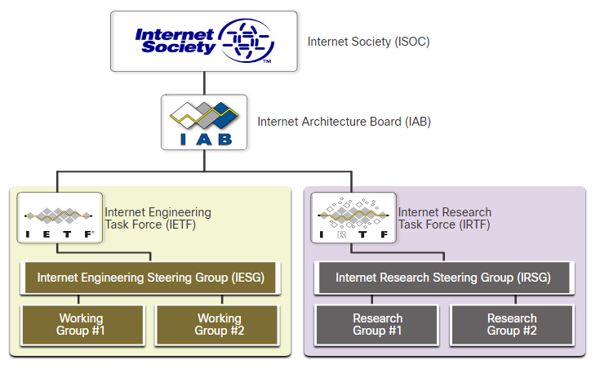
Network Protocols
Standards organizations are usually vendor-neutral, non-profit organizations established to develop and promote the concept of open standards.

Slide 11
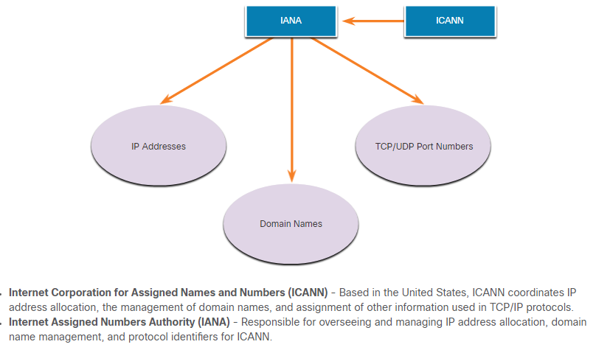
Network Protocols

Slide 12
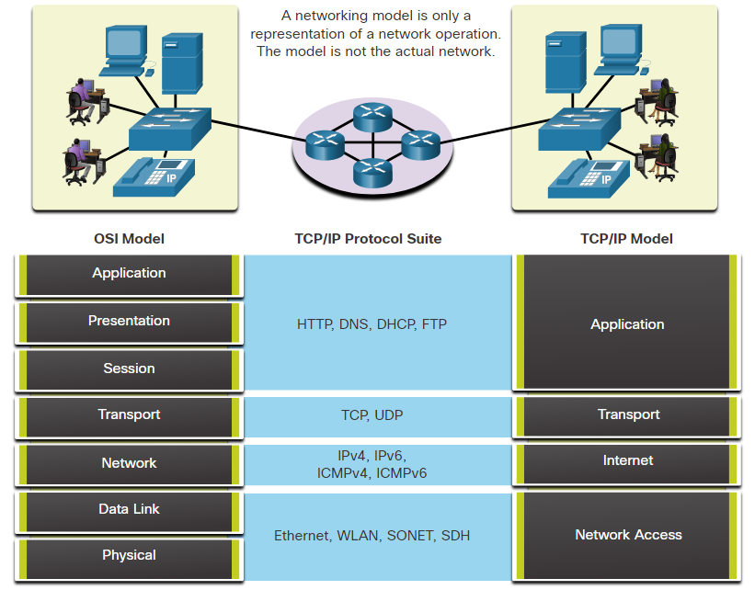
Network Protocols

Slide 13
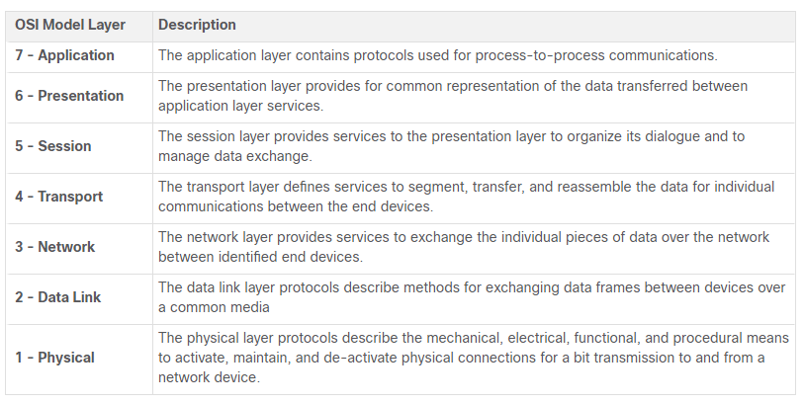
Network Protocols

Slide 14
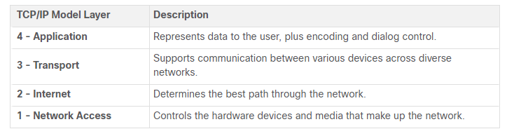
Network Protocols

Slide 15
Data Encapsulation
A single communication, such as a video or an email message with many large attachments, could be sent across a network from a source to a destination as one massive, uninterrupted stream of bits.
However, this would create problems for other devices needing to use the same communication channels or links. These large streams of data would result in significant delays.
Segmentation is the process to divide the data into smaller, more manageable pieces to send over the network. Segmentation can increase the reliability of network communications.

Slide 16
Data Encapsulation
By sending smaller individual pieces from source to destination, many different conversations can be interleaved on the network.
The process used to interleave the pieces of separate conversations together on the network is called multiplexing.
Each segment of the message must go through a similar process to ensure that it gets to the correct destination and can be reassembled into the content of the original message.

Slide 17
Data Encapsulation
As application data is passed down the protocol stack on its way to be transmitted across the network media, various protocols add information to it at each level. This is commonly known as the encapsulation process.
The form that a piece of data takes at any layer is called a protocol data unit (PDU).
  Data – Application layer PDU
  Segment - Transport layer PDU
  Packet - Internet layer PDU
  Frame - Network access layer PDU
  Bits – Physical layer PDU

Slide 18
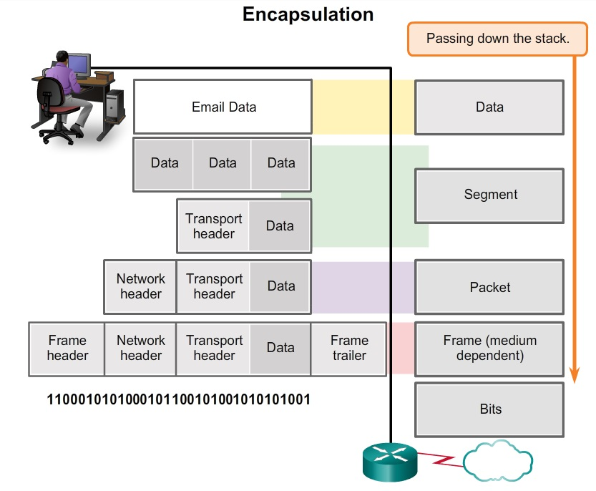
Data Encapsulation

Slide 19
Data Encapsulation
This process is reversed at the receiving host, and is known as de-encapsulation. De-encapsulation is the process used by a receiving device to remove one or more of the protocol headers.
The data is de-encapsulated as it moves up the stack toward the end-user application.

Slide 20
Data Access
The network and data link layers are responsible for delivering the data from the source device to the destination device using different addresses:
Network layer source and destination addresses - Responsible for delivering the IP packet from the original source to the final destination, which may be on the same network or a remote network.
Data link layer source and destination addresses - Responsible for delivering the data link frame from one network interface card (NIC) to another NIC on the same network.

Slide 21
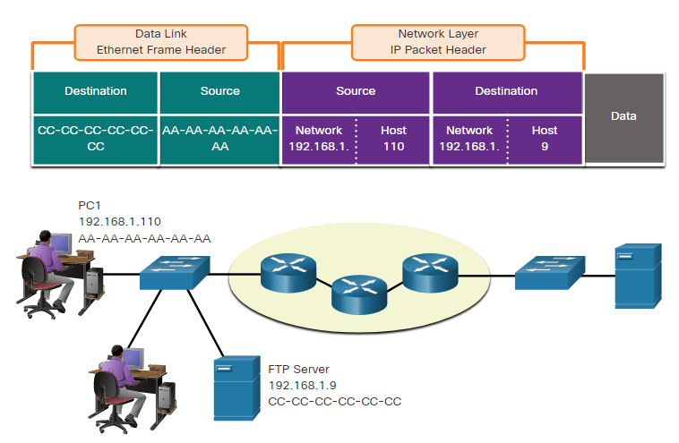
Data Access
In the same network, the data link frame is sent directly to the receiving device. The data link addresses are known as Media Access Control (MAC) addresses in Ethernet

Slide 22
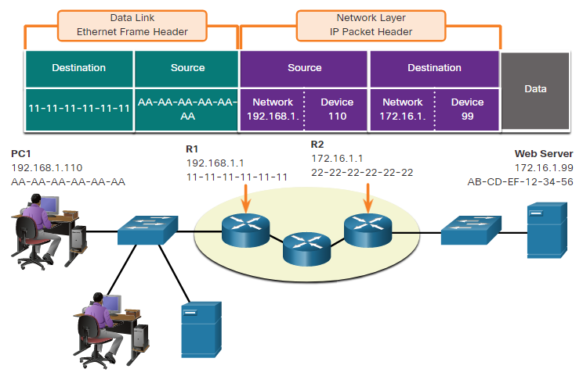
Data Access
When the sender of the packet is on a different network from the receiver, the source and destination IP addresses will represent hosts on different networks. The frame must be sent to another the router or default gateway.

Slide 23
Network Operating Systems
Infrastructure network devices use a network operating system. Network operating systems are in many ways similar to the operating systems of PCs.
The network operating system used on Cisco devices is called the Cisco Internetwork Operating System (IOS).
The IOS file itself is stored in a semi-permanent memory area called flash that provides non-volatile storage.
The IOS is copied from flash into random access memory (RAM) when the device is powered on. The IOS then runs from RAM when the device is operating.
Kernel interacts directly with computer hardware. User can interact with the shell using either the command-line interface (CLI) or graphical user interface (GUI).

Slide 24
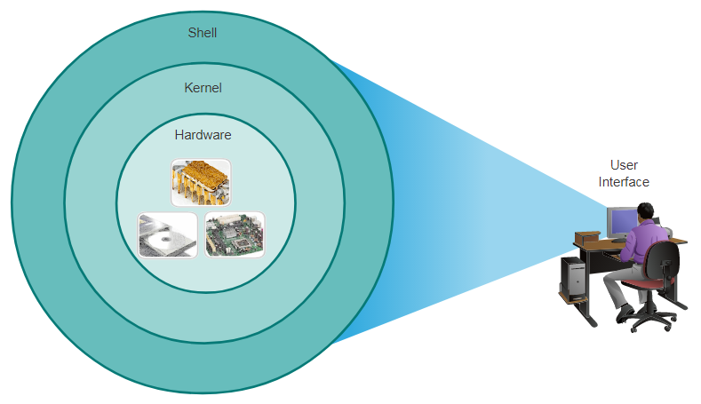
Network Operating Systems

Slide 25
Network Operating Systems
There are several ways to access the CLI environment.
Console
  The console port is a management port that provides out-of-band access. Out-of-band access refers to access via a dedicated management channel that is used for device maintenance purposes only.
AUX
  An older way to establish a CLI session remotely is via a telephone dialup connection using a modem connected to the auxiliary (AUX) port of a router. The AUX method is also an out-of-band connection and does not require any networking services to be configured or available on the device.

Slide 26
Network Operating Systems
Telnet
  Telnet is a method for remotely establishing a CLI session of a device, through a virtual interface, over a network. Unlike the console connection, Telnet sessions require active networking services on the device.
SSH
  The Secure Shell (SSH) protocol provides a remote login similar to Telnet, except that it uses more secure network services. SSH provides stronger password authentication than Telnet and uses encryption when transporting session data.

Slide 27
Network Operating Systems
There are a number of terminal emulation programs to connect to a networking device either by a serial connection over a console port or by a Telnet/SSH connection.
  PuTTY
  Tera Term
  SecureCRT
  HyperTerminal
  OS X Terminal

Slide 28
Network Operating System
The CLI uses a hierarchical structure for the modes. The major modes are:
  User executive (User EXEC) mode
  Privileged executive (Privileged EXEC) mode
  Global configuration mode
  Other specific configuration modes, such as interface configuration mode or line configuration mode

Slide 29
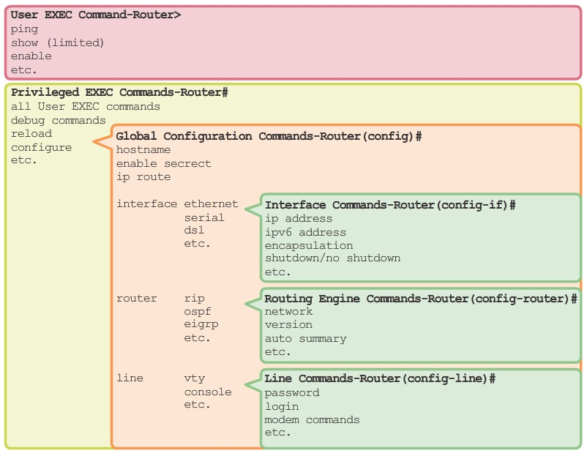
Network Operating System

Slide 30
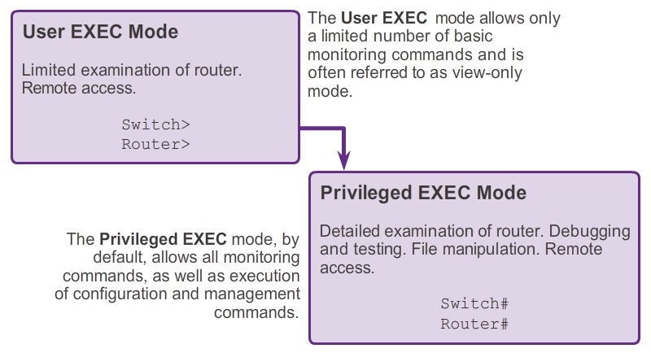
Network Operating System

Slide 31
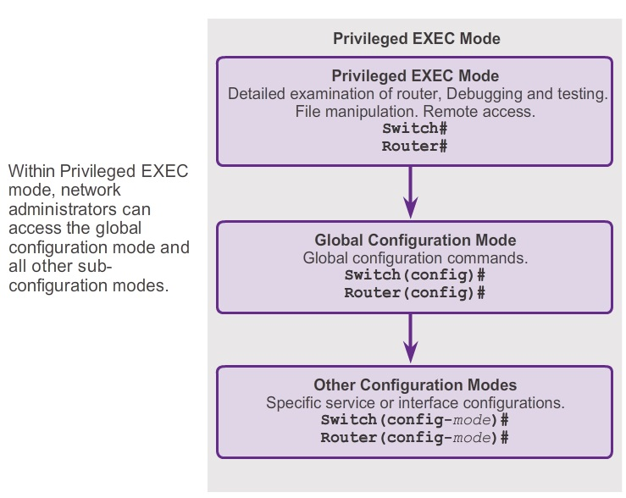
Network Operating System

Slide 32
Basic Command
Hostnames allow devices to be identified by network administrators over a network or the Internet.
Passwords are the primary defense against unauthorized access to network devices.
  Enable password - Limits access to the privileged EXEC mode
  Enable secret - Encrypted, limits access to the privileged EXEC mode
  Console password - Limits device access using the console connection
  VTY password - Limits device access over Telnet

Slide 33
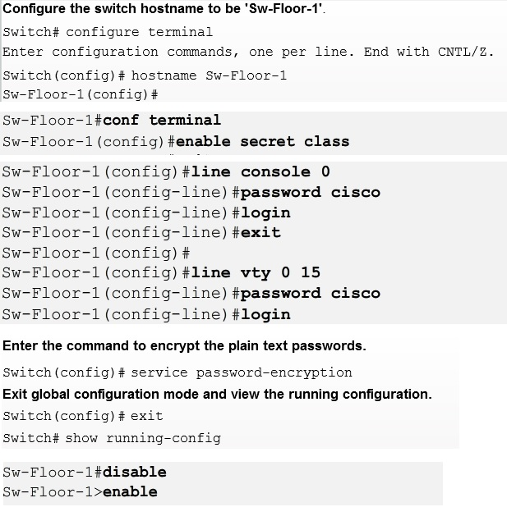
Basic Command

Slide 34
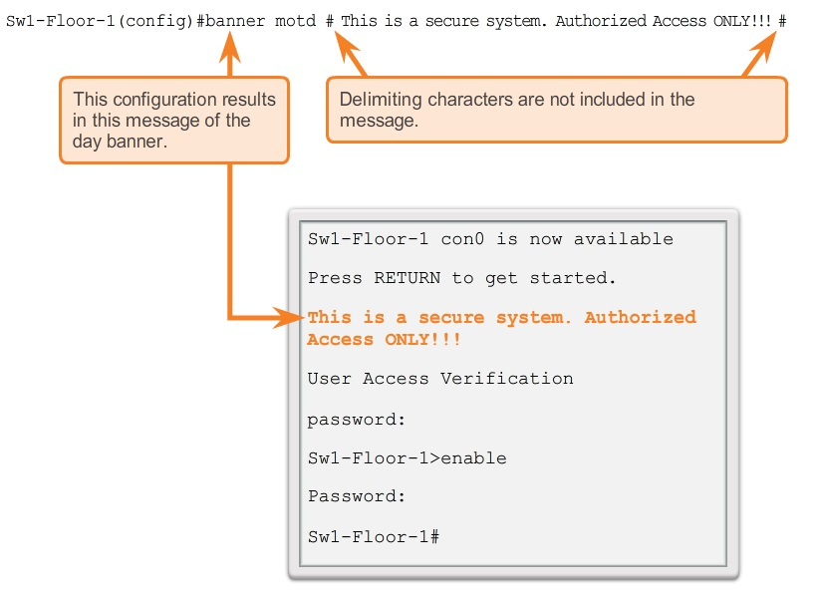
Basic Command

Slide 35
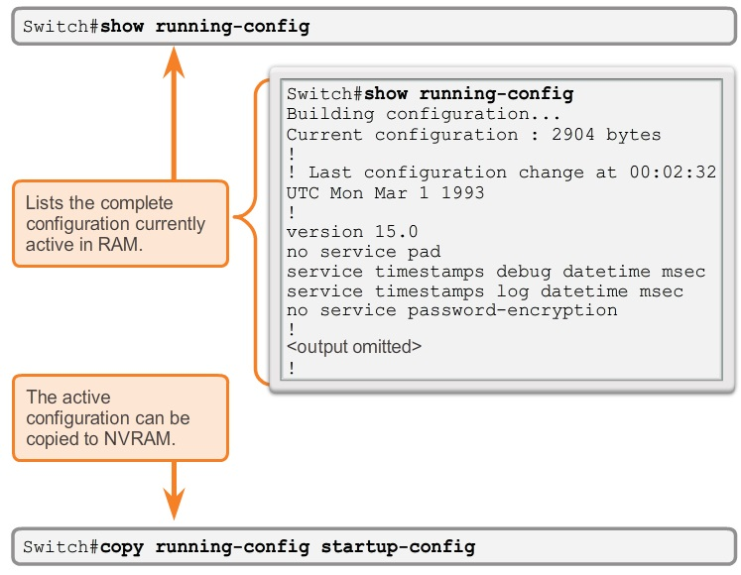
Basic Command

Slide 36
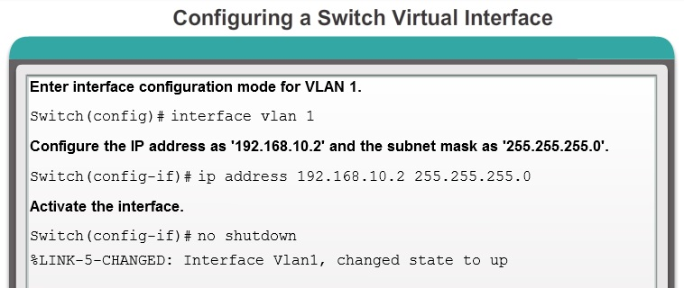
Basic Command

Slide 37
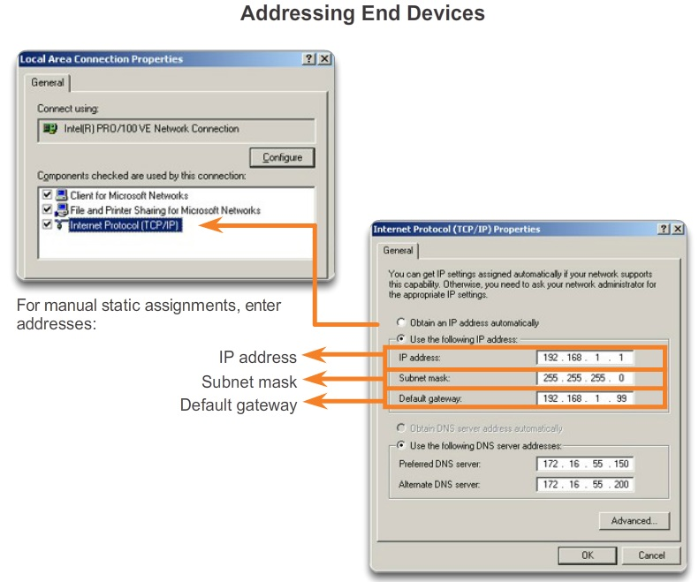
Basic Command

