Slide 1
WIA1005 Network Technology Foundation
Chapter 3
Network Access and Ethernet

Slide 2
Contents
Physical Layer
Network Media
Data Link Layer
Media Access Control
Ethernet
Switching
Address Resolution Protocol

Slide 3
Physical Layer
Physical layer provides the means to transport the bits that make up a data link layer frame across the network media.
This layer accepts a complete frame from the data link layer and encodes it as a series of signals that are transmitted onto the local media.
The physical layer produces the representation and groupings of bits for each type of media as:
  Copper cable: The signals are patterns of electrical pulses.
  Fiber-optic cable: The signals are patterns of light.
  Wireless: The signals are patterns of microwave transmissions.

Slide 4
Physical Layer
The physical layer standards address three functional areas:
Physical Components
  The physical components are the electronic hardware devices, media, and other connectors that transmit and carry the signals to represent the bits.
  Hardware components such as network adapters (NICs), interfaces and connectors, cable materials, and cable designs are all specified in standards associated with the physical layer.

Slide 5
Physical Layer
Encoding
  Encoding is a method of converting a stream of data bits into a predefined "code”. Codes are groupings of bits used to provide a predictable pattern that can be recognized by both the sender and the received.
  The codes can be used for control purposes such as identifying the beginning and end of a frame.
  Manchester encoding: A 0 is represented by a high to low voltage transition and a 1 is represented as a low to high voltage transition.
  Non-Return to Zero (NRZ): A 0 may be represented by one voltage level on the media and a 1 might be represented by a different voltage on the media.

Slide 6
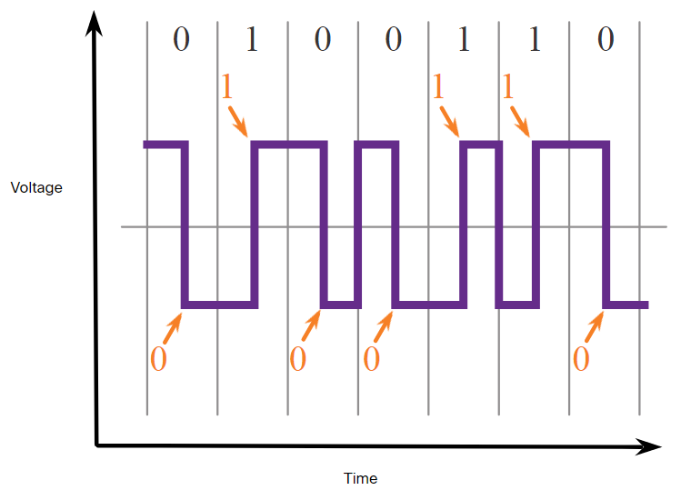
Physical Layer

Slide 7
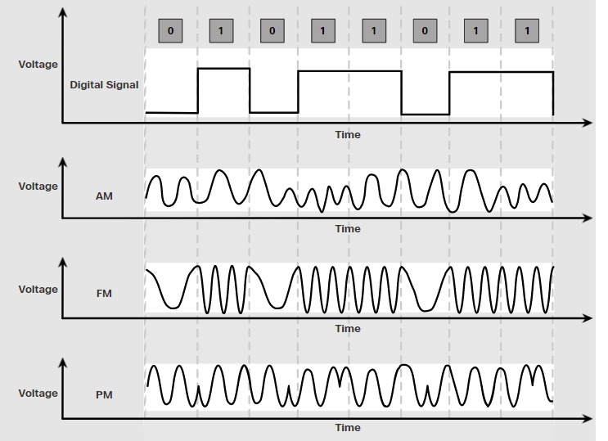
Physical Layer
Signaling
  The method of representing the bits is called the signaling method. The physical layer standards must define what type of signal represents a "1" and what type of signal represents a "0".
  For example, a long pulse might represent a 1 whereas a short pulse might represent a 0

Slide 8
Physical Layer
Bandwidth is the capacity of a medium to carry data. Digital bandwidth measures the amount of data that can flow from one place to another in a given amount of time.
Bandwidth is typically measured in kilobits per second (kbps), megabits per second (Mbps) or or gigabits per second (Gbps).
Throughput is the measure of the transfer of bits across the media over a given period of time. Many factors influence throughput including:
  The amount of traffic
  The type of traffic
  The latency created by the number of network devices encountered between source and destination

Slide 9
Physical Layer
Latency refers to the amount of time, including delays, for data to travel from one given point to another.
Goodput is the measure of usable data transferred over a given period of time.
Goodput is throughput minus traffic overhead for establishing sessions, acknowledgments, encapsulation, and retransmitted bits.
Goodput is always lower than throughput, which is generally lower than the bandwidth.

Slide 10
Network Media
Networks use copper media because it is inexpensive, easy to install, and has low resistance to electrical current. However, copper media is limited by distance and signal interference.
There are three main types of copper media used in networking:
  Unshielded Twisted-Pair (UTP)
  Shielded Twisted-Pair (STP)
  Coaxial
Unshielded twisted-pair (UTP) cabling is the most common networking media terminated with RJ-45 connectors

Slide 11
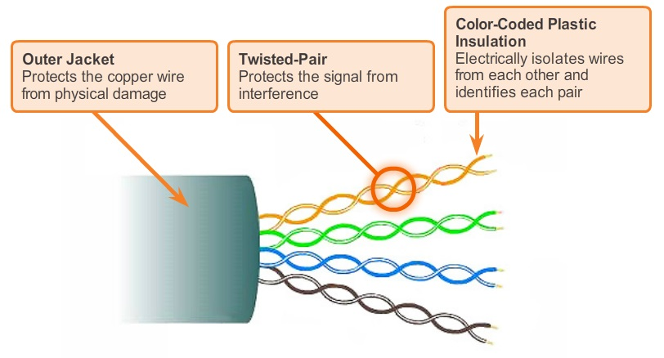
Network Media

Slide 12
Network Media
Shielded twisted-pair (STP) provides better noise protection than UTP cabling. However, compared to UTP cable, STP cable is significantly more expensive and difficult to install. Like UTP cable, STP uses an RJ-45 connector.
Coaxial cables attach antennas to wireless devices. The coaxial cable carries radio frequency (RF) energy between the antennas and the radio equipment. Coaxial cable also used for Cable Internet installations.

Slide 13
Network Media
Different situations may require UTP cables to be wired according to different wiring conventions.
Ethernet Straight-through: The most common type of networking cable. It is commonly used to interconnect a host to a switch and a switch to a router.
Ethernet Crossover: An uncommon cable used to interconnect similar devices together. For example to connect a switch to a switch, a host to a host, or a router to a router. Auto-MDIX cam detect cable type automatically.
Rollover: A Cisco proprietary cable used to connect to a router or switch console port.

Slide 14
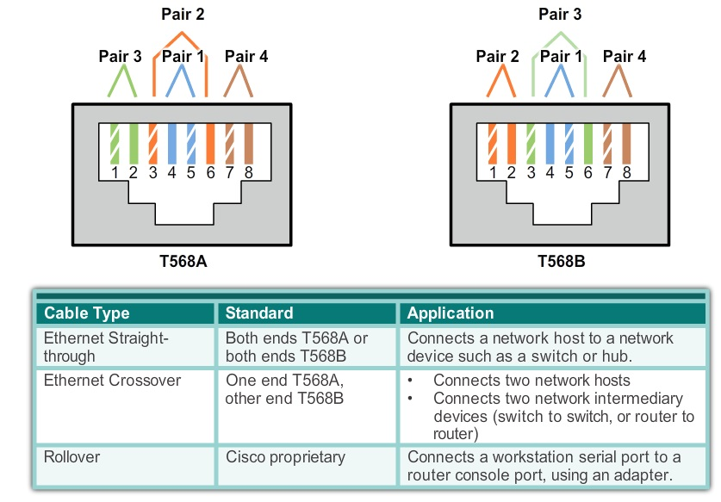
Network Media

Slide 15
Network Media
Optical fiber cable permits the transmission of data over longer distances and at higher bandwidths than any other networking media.
Fiber-optic cabling is used in four types of industry:
  Enterprise Networks
  FTTH and Access Networks: Fiber-to-the-home
  Long-Haul Networks: Networks typically range from a few dozen to a few thousand kilometers and use up to 10 Gbps-based systems.
  Submarine Networks: Special fiber cables are used to provide reliable high-speed, high-capacity solutions capable of surviving in harsh undersea environments up to transoceanic distances.

Slide 16
Network Media
Fiber-optic cables can be broadly classified into two types:
Single-mode fiber (SMF): Consists of a very small core and uses expensive laser technology to send a single ray of light. Popular in long-distance situations spanning hundreds of kilometers such as required in long haul telephony and cable TV applications.
Multimode fiber (MMF): Consists of a larger core and uses LED emitters to send light pulses. Specifically, light from an LED enters the multimode fiber at different angles. Popular in LANs because they can be powered by low cost LEDs. It provides bandwidth up to 10 Gb/s over link lengths of up to 550 meters.

Slide 17
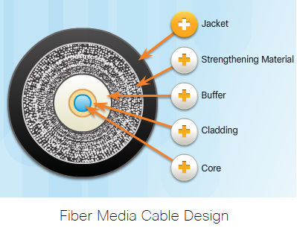
Network Media

Slide 18
Network Media
Fiber-optic connectors include:
Straight-Tip (ST): An older bayonet style connector widely used with multimode fiber.
Subscriber Connector (SC): Sometimes referred to as square connector or standard connector. It is a widely adopted LAN and WAN connector that uses a push-pull mechanism to ensure positive insertion. This connector type is used with multimode and single-mode fiber.
Lucent Connector (LC): Sometimes called a little or local connector, is quickly growing in popularity due to its smaller size. It is used with single-mode fiber and also supports multimode fiber.

Slide 19
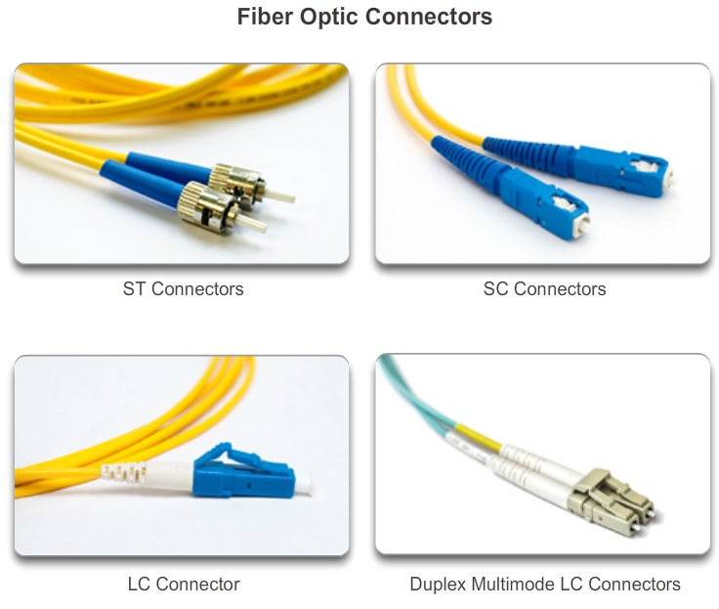
Network Media

Slide 20
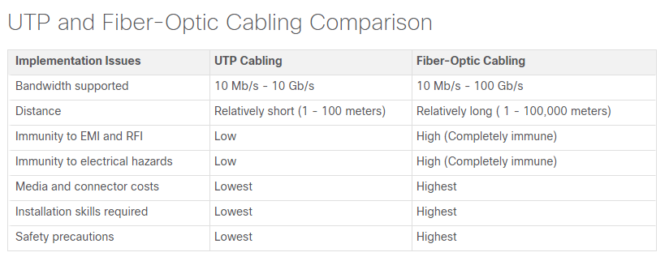
Network Media

Slide 21
Network Media
Wireless media carry electromagnetic signals that represent the binary digits of data communications using radio or microwave frequencies.
Coverage area: Certain construction materials used in buildings and structures, and the local terrain, will limit the effective coverage.
Interference: Wireless is susceptible to interference and can be disrupted by such common devices as household cordless phones, some types of fluorescent lights, microwave ovens, and other wireless communications.
Security: Network security is a major component of wireless network administration.

Slide 22
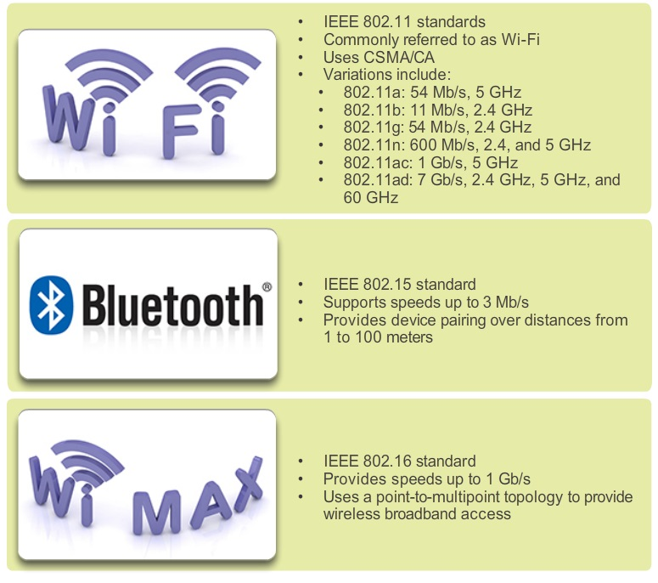
Network Media

Slide 23
Data Link Layer
Data link layer is responsible for the exchange of frames between nodes over a physical network media. It controls media access control and performs error detection.
Data link layer also accepts Layer 3 packets and packages them into data units called frames.
The data link layer is actually divided into two sublayers:
  Logical Link Control (LLC): This upper sublayer defines the software processes that provide services to the network layer protocols.

Slide 24
Data Link Layer
  Media Access Control (MAC): This lower sublayer defines the media access processes performed by the hardware. It provides data link layer addressing and delimiting of data according to the physical signaling requirements of the medium and the type of data link layer protocol in use.
Different media access control methods may be required during the course of a single communication. Each network environment that packets encounter as they travel from a local host to a remote host can have different characteristics.

Slide 25
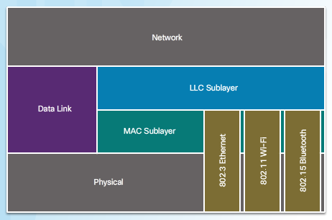
Data Link Layer

Slide 26
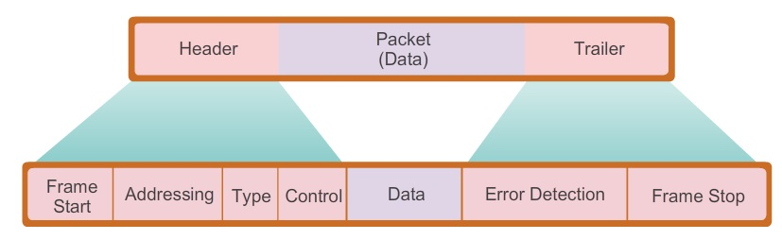
Data Link Layer
Data link layer frame includes:
  Header: Contains control information, such as addressing, and is located at the beginning of the PDU.
  Data: Contains the IP header, transport layer header, and application data.
  Trailer: Contains control information for error detection added to the end of the PDU.

Slide 27
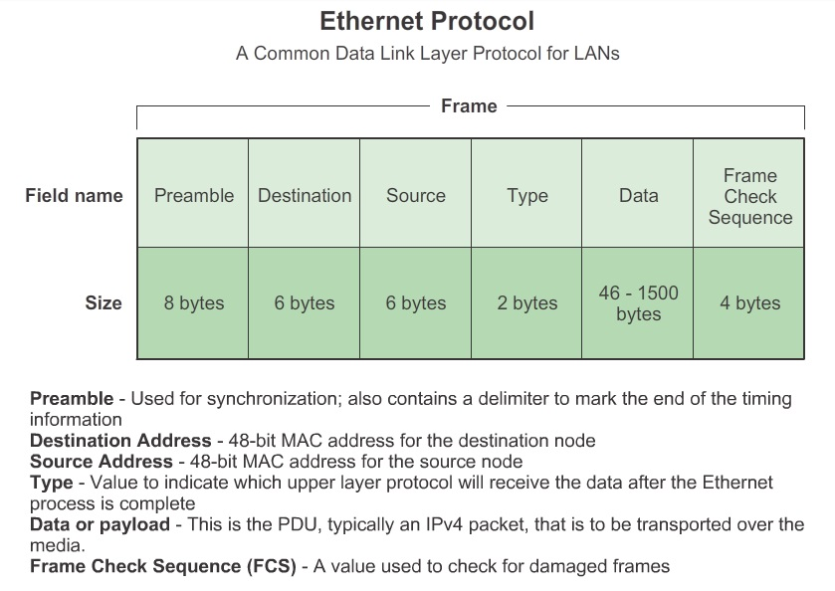
Data Link Layer

Slide 28
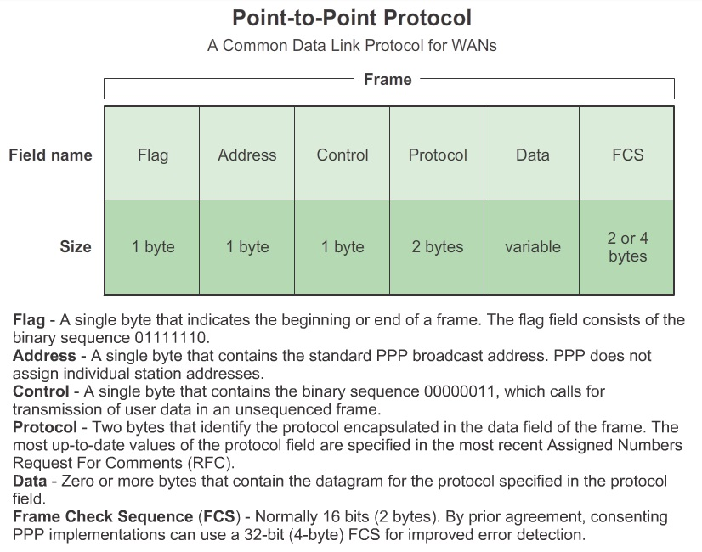
Data Link Layer

Slide 29
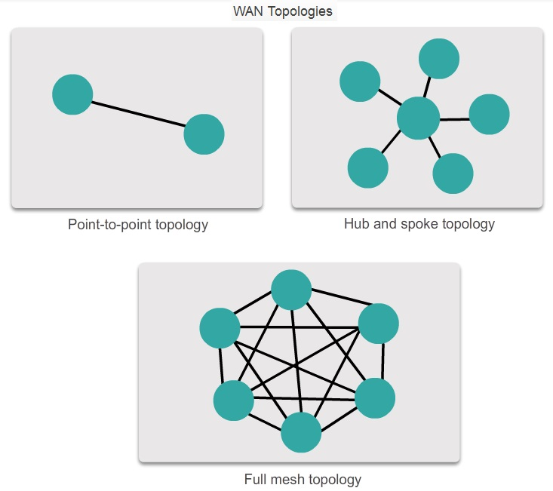
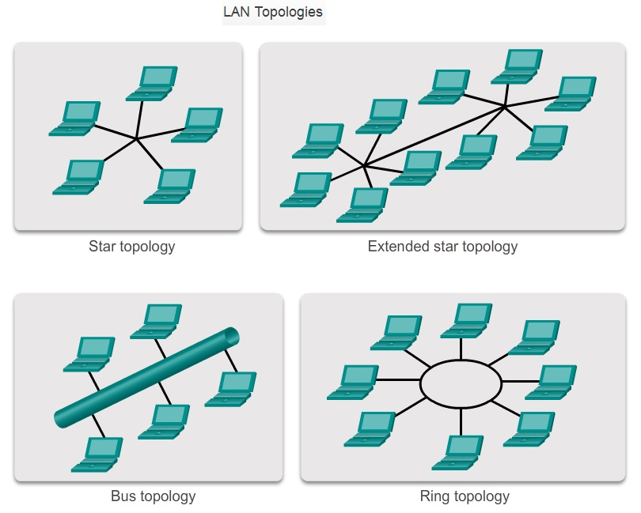
Media Access Control
There are different methods of controlling access to the media. These methods depends on:
  Topology: How the connection between the nodes appears to the data link layer.
  Media sharing: How the nodes share the media.

Slide 30
Media Access Control
There are two basic media access control methods for shared media:
Contention-based access: All nodes compete for the use of the medium but have a plan if there are collisions.
Controlled access: Each node has its own time to use the medium.
The contention-based systems do not scale well under heavy media use. As the number of nodes increases, the probability of collision increases.
CSMA is usually implemented in conjunction with a method for resolving the media contention.

Slide 31
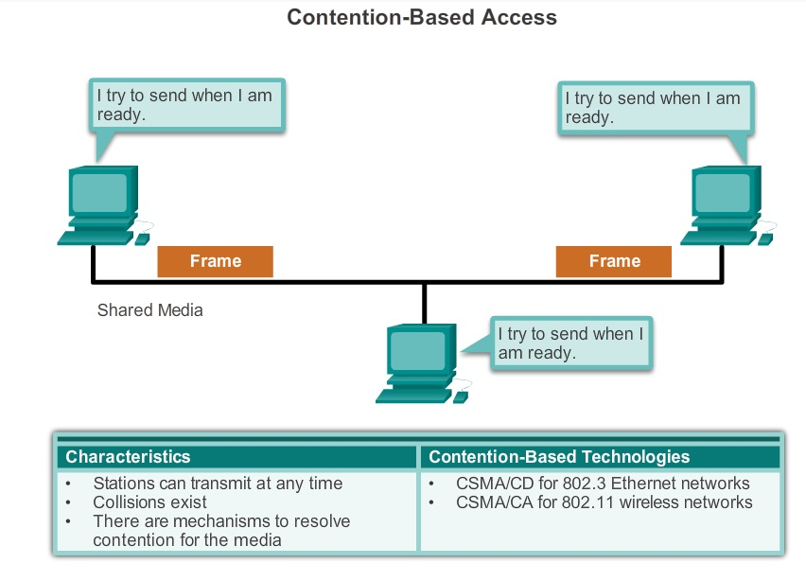
Media Access Control

Slide 32
Media Access Control
Carrier sense multiple access with collision detection (CSMA/CD): The end device monitors the media for the presence of a data signal. If a data signal is absent and therefore the media is free, the device transmits the data. If signals are then detected that show another device was transmitting at the same time, all devices stop sending and try again later.
Carrier sense multiple access with collision avoidance (CSMA/CA): The end device examines the media for the presence of a data signal. If the media is free, the device sends a notification across the media of its intent to use it. Once it receives a clearance to transmit, the device then sends the data.

Slide 33
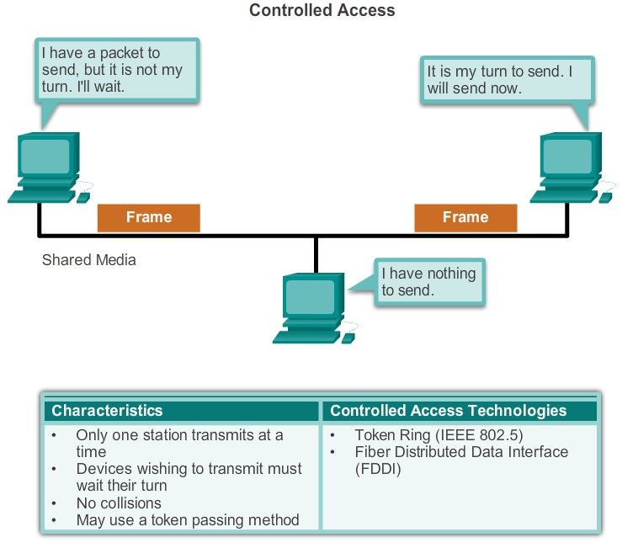
Media Access Control

Slide 34
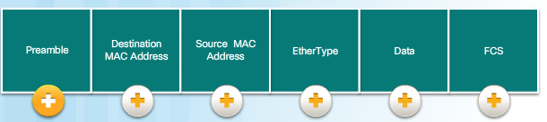
Ethernet
Ethernet is the most widely used LAN technology used today. Ethernet operates in the data link layer and the physical layer. It is a family of networking technologies that are defined in the IEEE 802.2 and 802.3 standards.
Ethernet supports data bandwidths of: 10Mbps, 100Mbps, 1Gbps, 10Gbps, 40Gbps, 100Gbps.
The minimum Ethernet frame size is 64 bytes and the maximum is 1518 bytes.

Slide 35
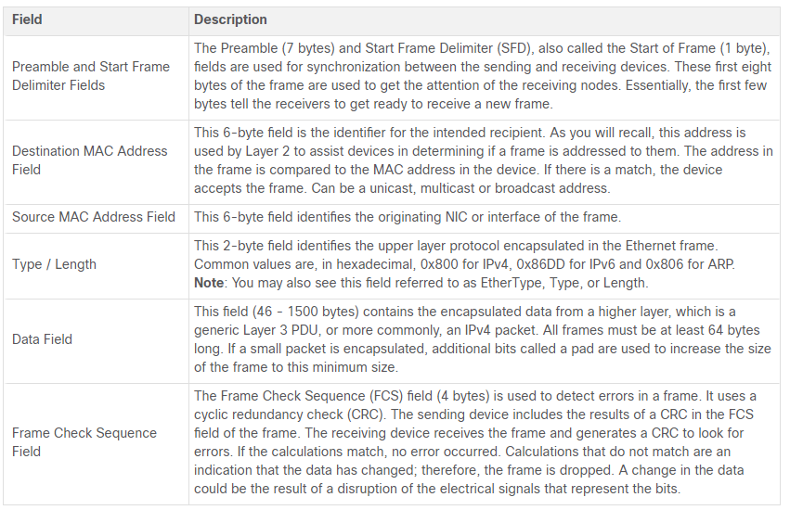
Ethernet

Slide 36
Ethernet
A unique identifier called a MAC address was created to identify the actual source and destination nodes within an Ethernet network. An Ethernet MAC address is a 48-bit binary value expressed as 12 hexadecimal digits (4 bits per hexadecimal digit).
In Ethernet, different MAC addresses are used for Layer 2 unicast, broadcast, and multicast communications.
ipconfig /all command can be used to identify the MAC address of an Ethernet adapter.

Slide 37
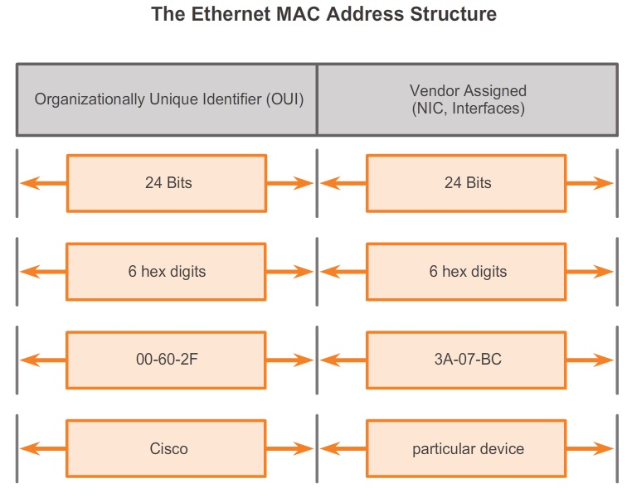
Ethernet

Slide 38
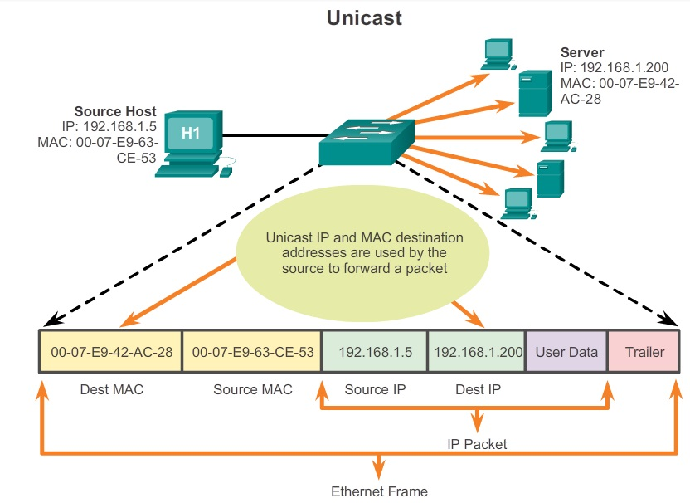
Ethernet

Slide 39
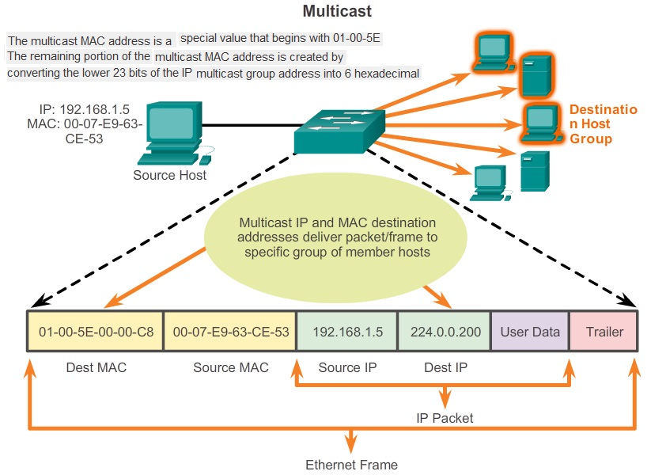
Ethernet

Slide 40
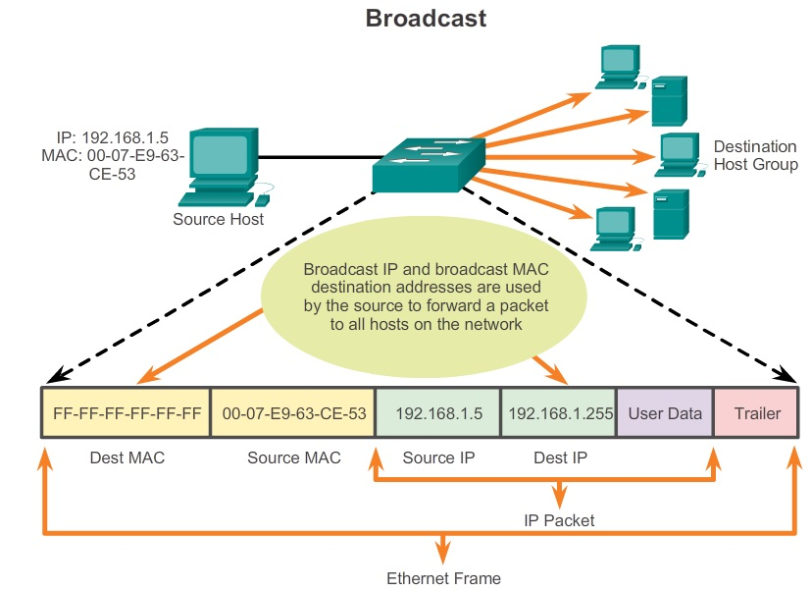
Ethernet

Slide 41
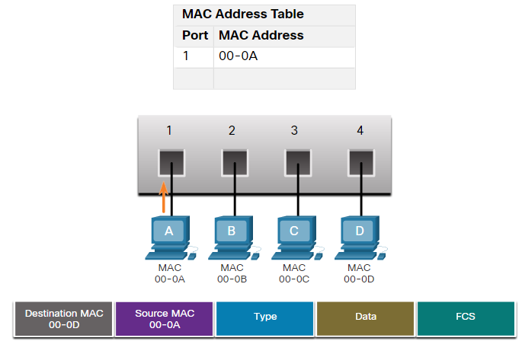
Ethernet
Ethernet switch examines its MAC address table to make a forwarding decision for each frame.
The switch dynamically builds the MAC address table by examining the source MAC address of the frames received on a port.

Slide 42
Switching
Switches used one of the following forwarding methods for switching data between network ports:
  In store-and-forward switching, when the switch receives the frame, it stores the data in buffers until the complete frame has been received. During the storage process, the switch performs an error check using the Cyclic Redundancy Check (CRC)
  In cut-through switching, the switch acts upon the data as soon as it is received, even if the transmission is not complete. There are two variants of cut-through switching:
    Fast-forward switching: Fast-forward switching immediately forwards a packet after reading the destination address.

Slide 43
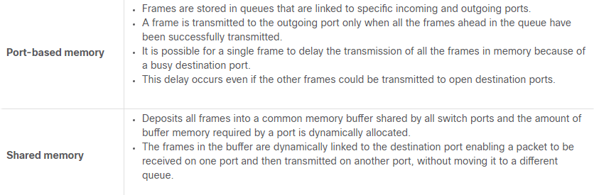
Switching
  Fragment-free switching: In fragment-free switching, the switch stores the first 64 bytes of the frame before forwarding.
An Ethernet switch may use a buffering technique to store frames before forwarding them.
Buffering may also be used when the destination port is busy because of congestion. The switch stores the frame until it can be transmitted.

Slide 44
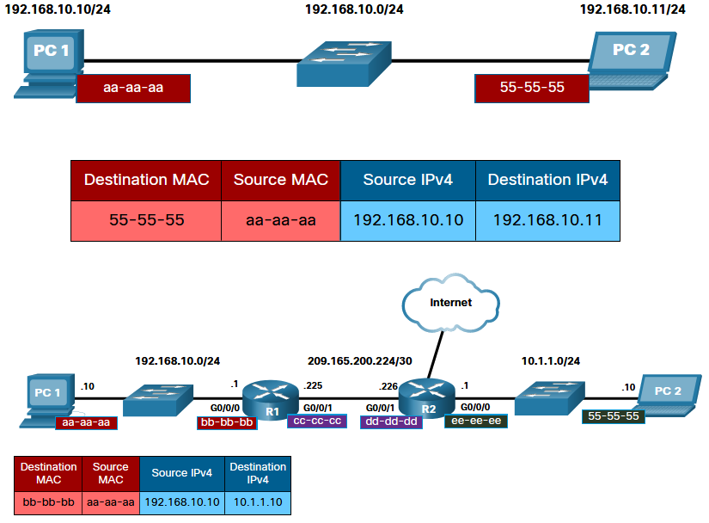
Address Resolution Protocol

Slide 45
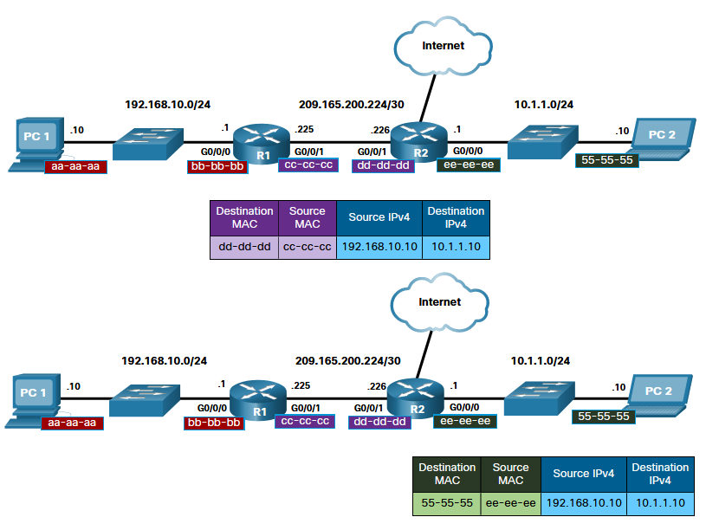
Address Resolution Protocol

Slide 46
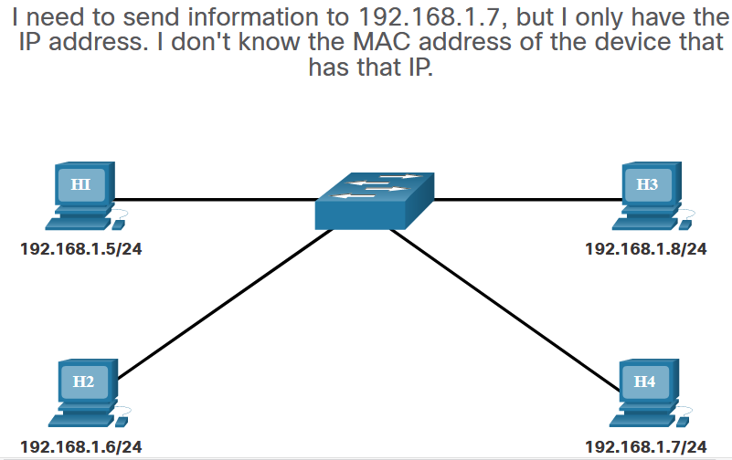
Address Resolution Protocol

Slide 47
Address Resolution Protocol
ARP is used to resolve IPv4 Addresses to MAC Addresses.
To begin the process, a transmitting node attempts to locate the MAC address mapped to an IPv4 destination. If this map is found in the table, the node uses the MAC address as the destination MAC in the frame that encapsulates the IPv4 packet.
If an entry is not found, the ARP processes then send out an ARP request packet (FF-FF-FF-FF-FF-FF) to discover the MAC address of the destination device on the local network. If a device receiving the request has the destination IP address, it responds with an ARP reply. A map is created in the ARP table.

Slide 48
Address Resolution Protocol
If the destination IPv4 address is on a different network than the source IPv4 address, the device will search the ARP table for the IPv4 address of the default gateway.
If no device responds to the ARP request, the packet is dropped because a frame cannot be created.
For each device, an ARP cache timer removes ARP entries that have not been used for a specified period of time. It is between 15 and 45 seconds. (Windows)
ARP Issues
  Overhead on the Media
  Security

Slide 49
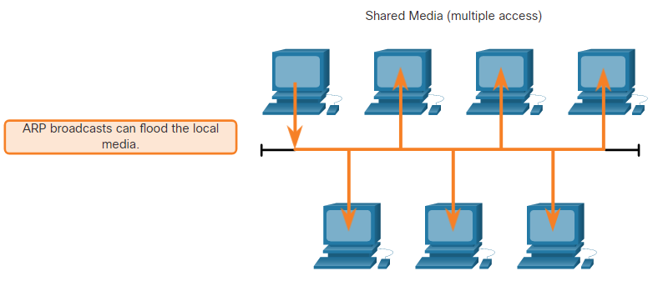
Address Resolution Protocol
As a broadcast frame, an ARP request is received and processed by every device on the local network. If a large number of devices start accessing network services at the same time, there could be some reduction in performance for a short period of time

Slide 50
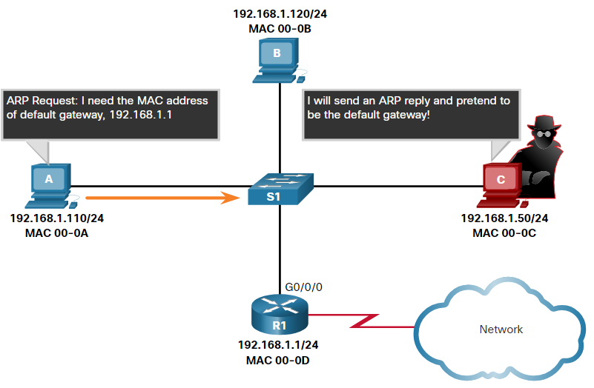
Address Resolution Protocol
A threat actor can use ARP spoofing to perform an ARP poisoning attack. This is a technique used by a threat actor to reply to an ARP request for an IPv4 address belonging to another device, such as the default gateway
The threat actor sends an ARP reply with its own MAC address. The receiver of the ARP reply will add the wrong MAC address to its ARP table and send these packets to the threat actor.

Slide 51
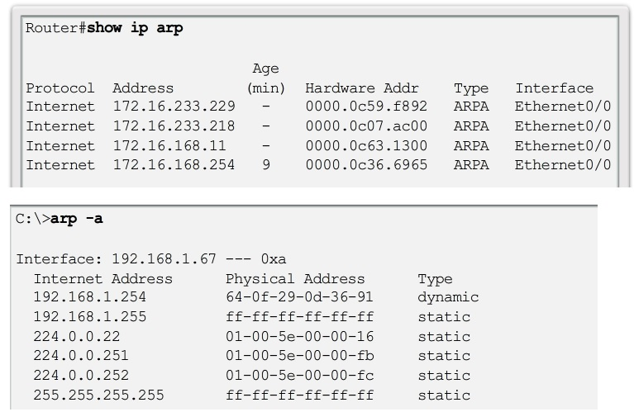
Address Resolution Protocol

