Slide 1
WIA1005 Network Technology Foundation
Chapter 9
VLANs and Inter-VLAN Communication

Slide 2
Contents
Introduction
Type of VLAN
VLAN Configuration
Inter-VLAN Communication
Inter-VLAN Configuration
VLAN Attack

Slide 3
Introduction
Within a switched internetwork, VLANs provide segmentation and organizational flexibility. VLANs are based on logical connections.
VLANs allow an administrator to segment networks based on factors such as function, project team, or application, without regard for the physical location of the user or device.
VLANs improve network performance by separating large broadcast domains into smaller ones.
VLANs enable the implementation of access and security policies according to specific groupings of users.

Slide 4
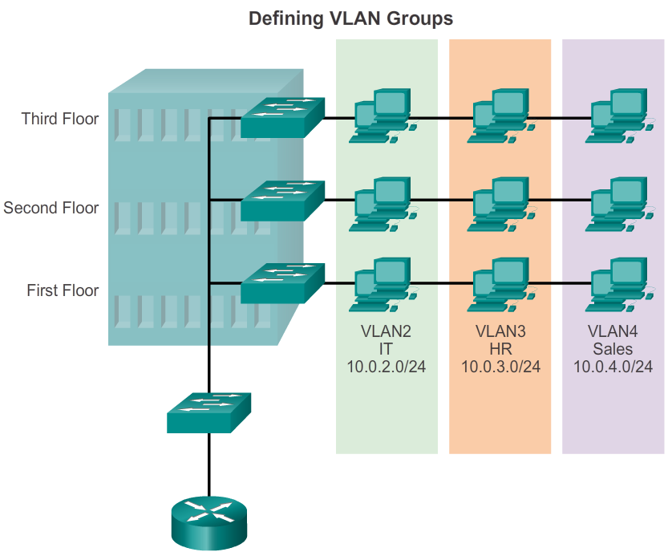
Introduction

Slide 5
Introduction
The primary benefits of using VLANs are as follows:
  Security - Groups that have sensitive data are separated from the rest of the network, decreasing the chances of confidential information breaches.
  Cost reduction - Cost savings result from reduced need for expensive network upgrades and more efficient use of existing bandwidth and uplinks.
  Better performance - Dividing flat Layer 2 networks into multiple broadcast domains reduces unnecessary traffic on the network and boosts performance.
  Shrink broadcast domains - Dividing a network into VLANs reduces the number of devices in the broadcast domain.

Slide 6
Introduction
  Improved IT staff efficiency - VLANs make it easier to manage the network because users with similar network requirements share the same VLAN.
  Simpler project and application management - VLANs aggregate users and network devices to support business or geographic requirements. Having separate functions makes managing a project or working with a specialized application easier.
VLAN design must take into consideration the implementation of a hierarchical network-addressing scheme.

Slide 7
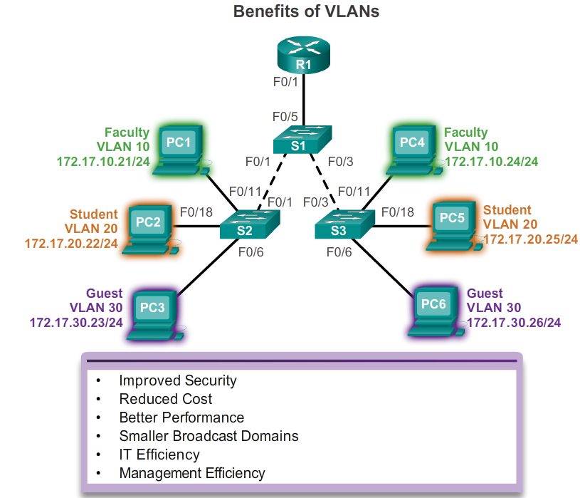
Introduction

Slide 8
Type of VLAN
There are a few distinct types of VLANs used in modern networks.
Data VLAN
  A data VLAN is a VLAN that is configured to carry user-generated traffic.
  They are referred to as user VLANs because they separate the network into groups of users or devices
  A modern network would have many data VLANs depending on organizational requirements.

Slide 9
Type of VLAN
Default VLAN
  All switch ports become a part of the default VLAN after the initial boot up of a switch loading the default configuration. Switch ports that participate in the default VLAN are part of the same broadcast domain.
  The default VLAN for Cisco switches is VLAN 1. By default, all Layer 2 control traffic is associated with VLAN 1.
  The native VLAN is VLAN 1 by default.
  The management VLAN is VLAN 1 by default.
  VLAN 1 cannot be renamed or deleted.

Slide 10
Type of VLAN
Native VLAN
  A switch may also have to send untagged traffic across a trunk link. Untagged traffic is generated by a switch and may also come from legacy devices.
  The 802.1Q trunk port places untagged traffic on the native VLAN.
  Trunk ports are the links between switches that support more than one VLAN.

Slide 11
Type of VLAN
Management VLAN
  A management VLAN is a data VLAN configured specifically for network management traffic including SSH, Telnet, HTTPS, HHTP, and SNMP.
  VLAN 1 is the management VLAN by default.
  To create the management VLAN, the switch virtual interface (SVI) of that VLAN is assigned an IP address and subnet mask, allowing the switch to be managed.

Slide 12
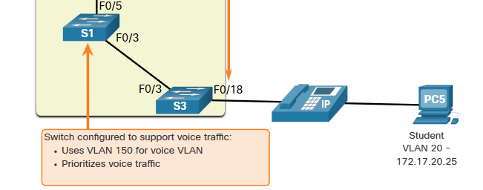
Type of VLAN
Voice VLAN
  A separate VLAN that can support Voice over IP (VoIP) traffic. Assured bandwidth to ensure voice quality
  Transmission priority over other types of network traffic. Ability to be routed around congested areas on the network
  Delay of less than 150 ms across the network

Slide 13
Type of VLAN
A VLAN trunk, or trunk, is a point-to-point link between two network devices that carries more than one VLAN.
VLAN trunks allow all VLAN traffic to propagate between switches, so that devices which are in the same VLAN, but connected to different switches, can communicate without the intervention of a router.
The 802.1Q header includes a 4-byte tag inserted within the original Ethernet frame header, specifying the VLAN to which the frame belongs.
When the switch receives a frame on a port configured in access mode and assigned a VLAN, the switch inserts a VLAN tag in the frame header, recalculates the FCS, and sends the tagged frame out of a trunk port.

Slide 14
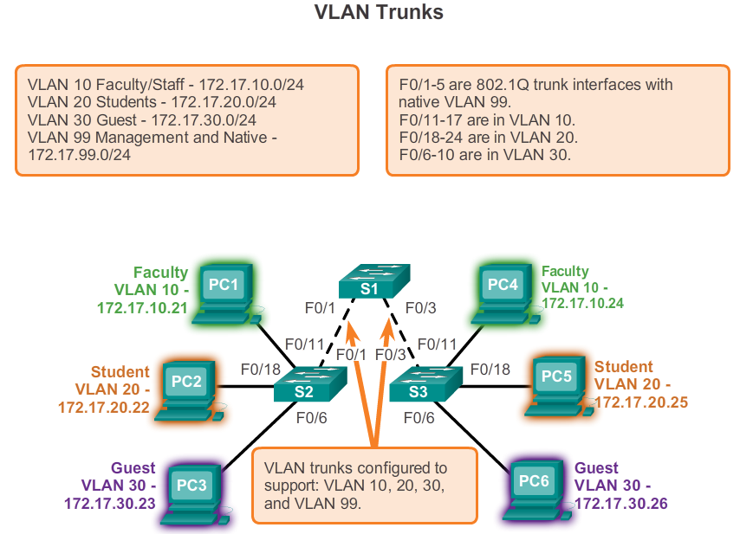
Type of VLAN

Slide 15
Type of VLAN
VLAN Tag Field
  Type - A 2-byte value called the tag protocol ID (TPID) value. For Ethernet, it is set to hexadecimal 0x8100.
  User priority - A 3-bit value that supports level or service implementation.
  Canonical Format Identifier (CFI) - A 1-bit identifier that enables Token Ring frames to be carried across Ethernet links.
  VLAN ID (VID) - A 12-bit VLAN identification number that supports up to 4096 VLAN IDs.

Slide 16
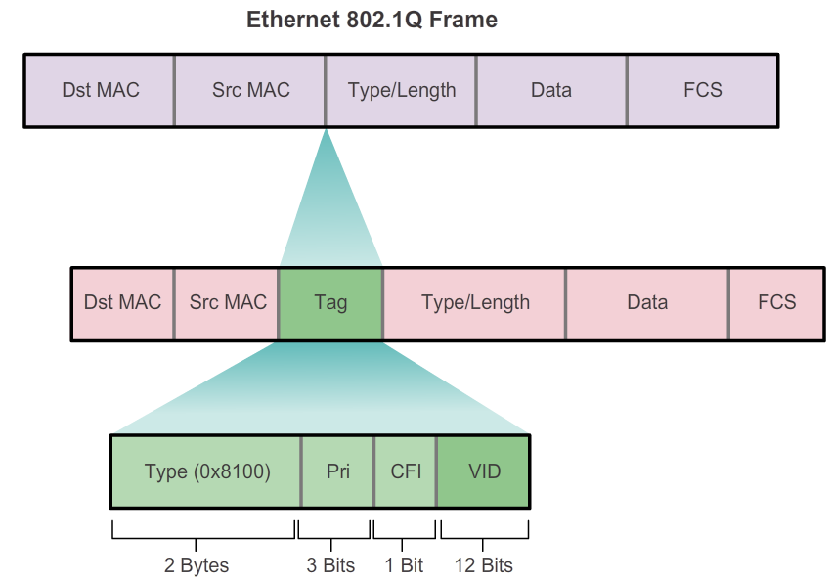
Type of VLAN

Slide 17
Type of VLAN
Tagged Frames on the Native VLAN
  Control traffic sent on the native VLAN should not be tagged. If an 802.1Q trunk port receives a tagged frame with the VLAN ID the same as the native VLAN, it drops the frame.
Untagged Frames on the Native VLAN
  All untagged traffic coming in or out of the 802.1Q port is forwarded based on the PVID value. For example, if VLAN 99 is configured as the native VLAN, the PVID is 99 and all untagged traffic is forwarded to VLAN 99.

Slide 18
VLAN Configuration
Normal Range VLANs
  Used in small- and medium-sized business and enterprise networks.
  Identified by a VLAN ID between 1 and 1005. IDs 1002 through 1005 are reserved for Token Ring and FDDI VLANs. IDs 1 and 1002 to 1005 are automatically created and cannot be removed.
  Configurations are stored within a VLAN database file, called vlan.dat. The vlan.dat file is located in the flash memory of the switch.
  The VLAN Trunking Protocol (VTP), which helps manage VLAN configurations between switches, can only learn and store normal range VLANs.

Slide 19
VLAN Configuration
Extended Range VLANs
  Enable service providers to extend their infrastructure to a greater number of customers.
  Are identified by a VLAN ID between 1006 and 4094.
  Configurations saved in the running configuration file.
  Requires VTP transparent mode configuration to support extended range VLANs.

Slide 20
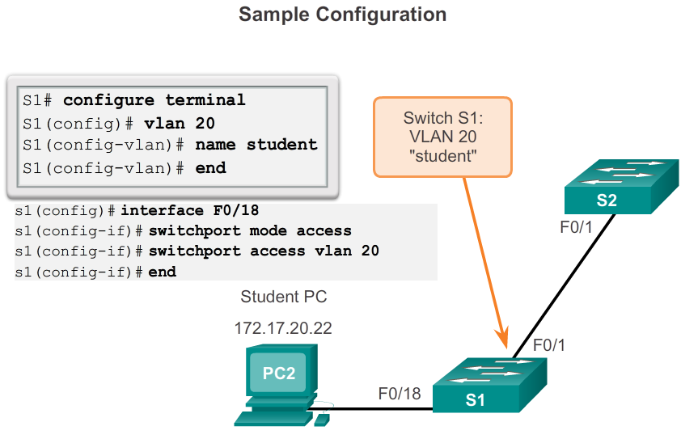
VLAN Configuration

Slide 21
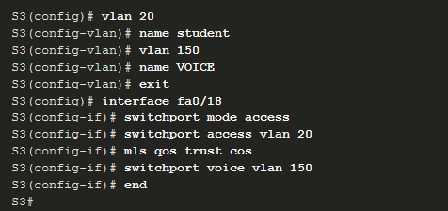
VLAN Configuration
Data and Voice VLAN

Slide 22
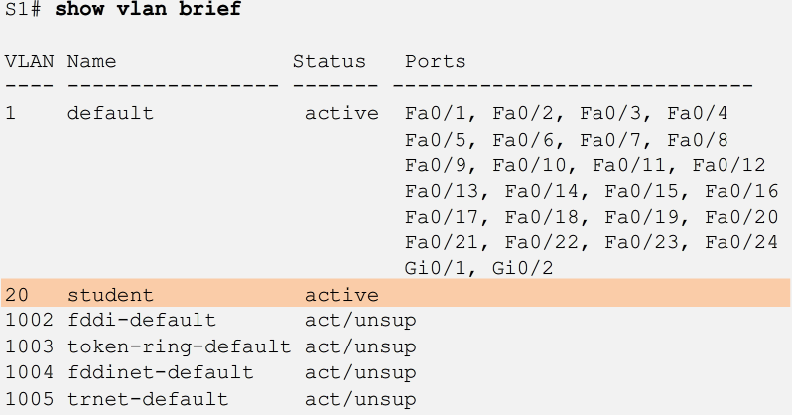
VLAN Configuration
The no switchport access vlan command is used to change VLAN port membership.
The no vlan vlan-id command is used to remove vlan.
The show vlan brief command displays the VLAN assignment and membership type for all switch ports.

Slide 23
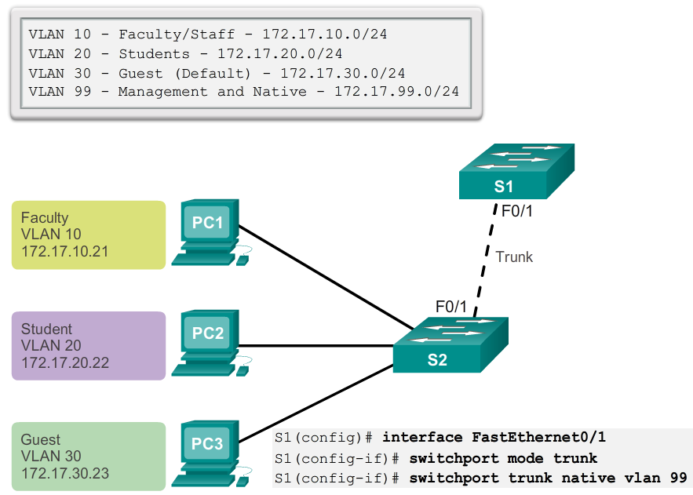
VLAN Configuration

Slide 24
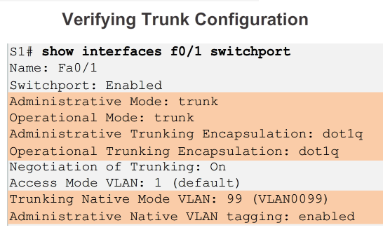
VLAN Configuration

Slide 25
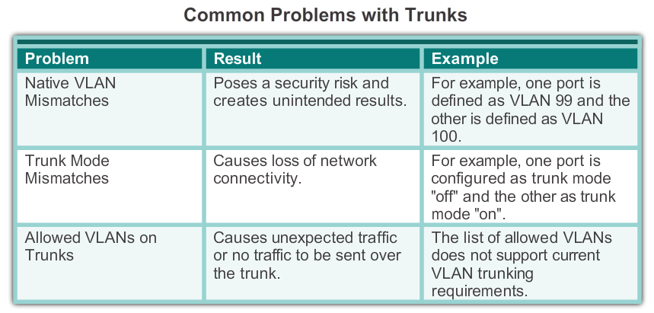
VLAN Configuration

Slide 26
VLAN Configuration
Ethernet trunk interfaces support different trunking modes. An interface can be set to trunking or nontrunking, or to negotiate trunking with the neighbor interface.
Trunk negotiation is managed by the Dynamic Trunking Protocol (DTP), a Cisco proprietary protocol, which operates on a point-to-point basis only, between network devices.
The default DTP configuration for Cisco switches is dynamic auto. To enable trunking from a Cisco switch to a device that does not support DTP, use the switchport mode trunk and switchport nonegotiate commands.

Slide 27
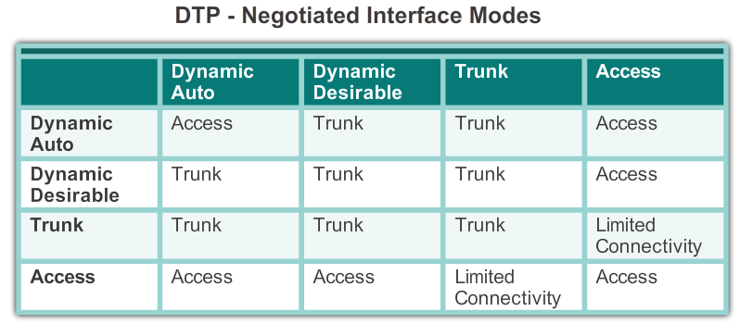
VLAN Configuration

Slide 28
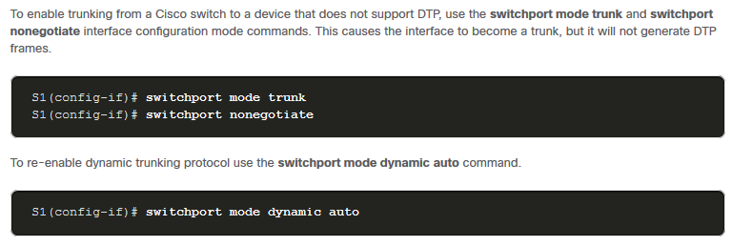
VLAN Configuration

Slide 29
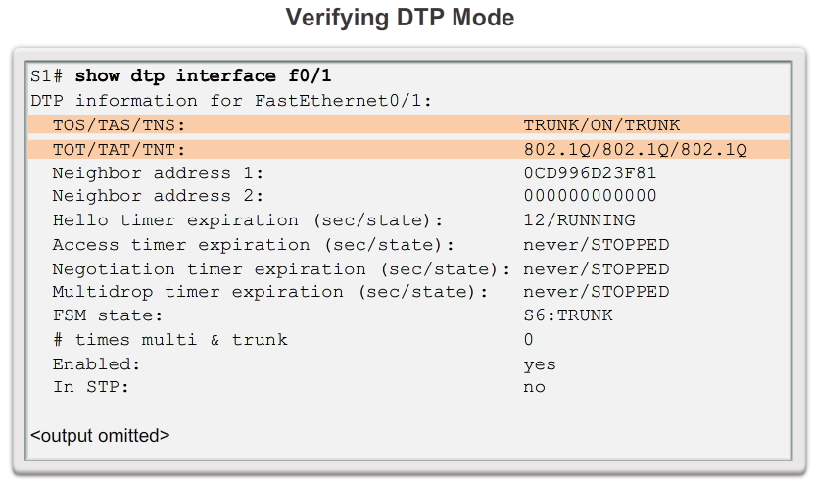
VLAN Configuration

Slide 30
Inter VLAN Communication
A VLAN is a broadcast domain, so computers on separate VLANs are unable to communicate without the intervention of a routing device.
Any device that supports Layer 3 routing, such as a router or a multilayer switch, can be used to perform the necessary routing functionality.
The process of forwarding network traffic from one VLAN to another VLAN using routing is known as inter-VLAN routing.
Historically, the first solution for inter-VLAN routing relied on routers with multiple physical interfaces. Each interface had to be connected to a separate network and configured with a distinct subnet.

Slide 31
Inter VLAN Communication
The switch ports connected to the router are placed in access mode and each physical interface is assigned to a different VLAN.
Each router interface can then accept traffic from the VLAN associated with the switch interface that it is connected to, and traffic can be routed to the other VLANs connected to the other interfaces.
It is not reasonably scalable because routers have a limited number of physical interfaces.

Slide 32
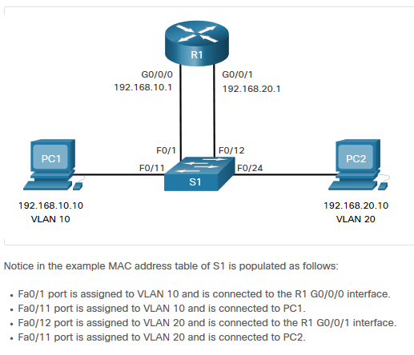
Inter VLAN Communication

Slide 33
Inter VLAN Communication
Router-on-a-stick is a type of router configuration in which a single physical interface routes traffic between multiple VLANs on a network.
The router interface is configured to operate as a trunk link and is connected to a switch port that is configured in trunk mode.
The router performs inter-VLAN routing by accepting VLAN-tagged traffic on the trunk interface coming from the adjacent switch, and then internally routing between the VLANs using sub-interfaces.
The router then forwards the routed traffic, VLAN-tagged for the destination VLAN, out the same physical interface as it used to receive the traffic.

Slide 34
Inter VLAN Communication
Subinterfaces are software-based virtual interfaces, associated with a single physical interface.
Subinterfaces are configured in software on a router and each subinterface is independently configured with an IP address and VLAN assignment.
Subinterfaces are configured for different subnets corresponding to their VLAN assignment to facilitate logical routing.

Slide 35
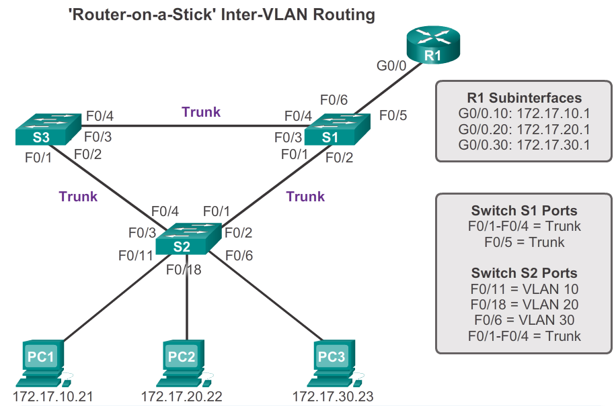
Inter VLAN Communication

Slide 36
Inter VLAN Communication
Multilayer switches can perform Layer 2 and Layer 3 functions, replacing the need for dedicated routers to perform basic routing on a network.
Multilayer switches support dynamic routing and inter-VLAN routing. To enable a multilayer switch to perform routing functions, the multilayer switch must have IP routing enabled.
Multilayer switching is more scalable than any other inter-VLAN routing implementation. With a multilayer switch, traffic is routed internal to the switch device, which means packets are not filtered down a single trunk line to obtain new VLAN-tagging information.

Slide 37
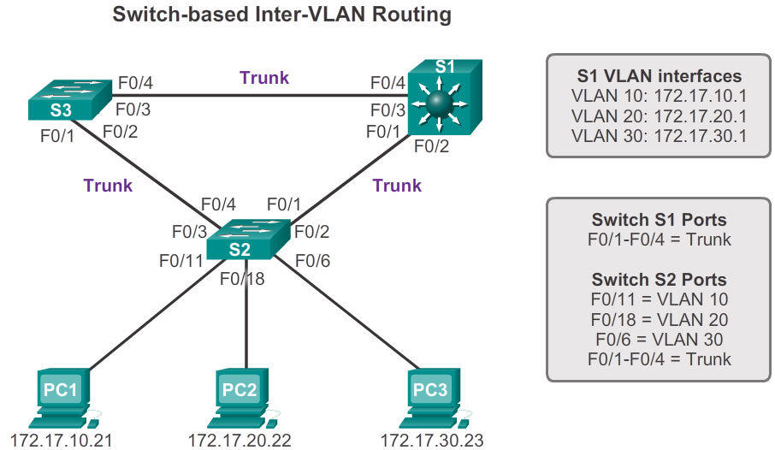
Inter VLAN Communication

Slide 38
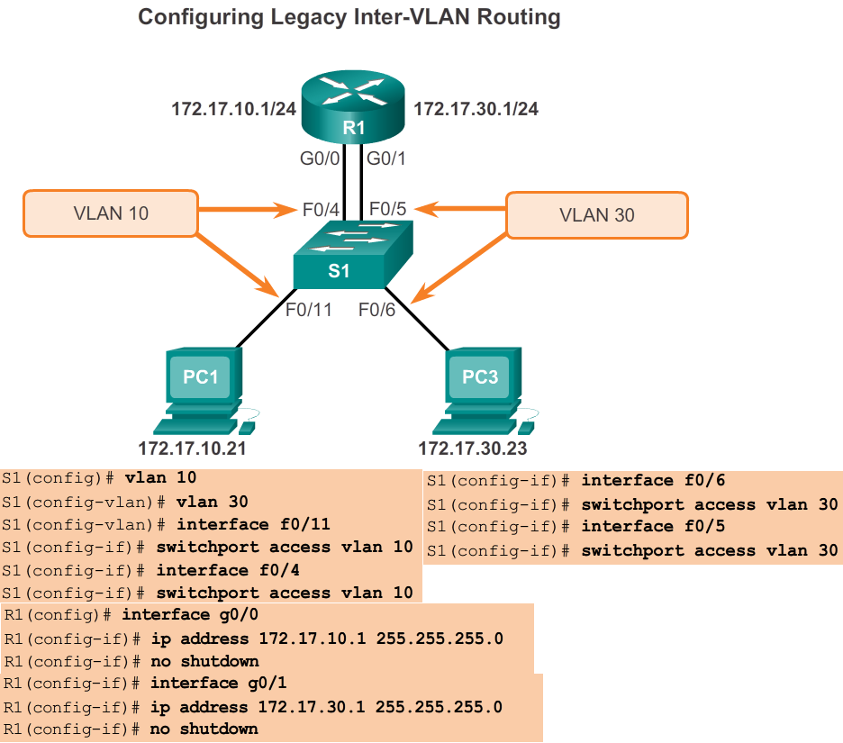
Inter VLAN Configuration

Slide 39
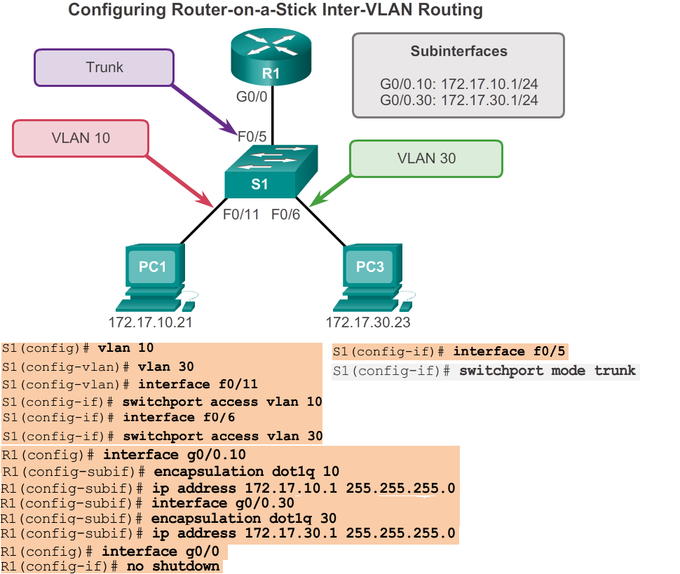
Inter VLAN Configuration

Slide 40
Inter VLAN Configuration
An SVI is a virtual interface that is configured within a multilayer switch. An SVI can be created for any VLAN that exists on the switch.
An SVI is considered to be virtual because there is no physical port dedicated to the interface. It can perform the same functions for the VLAN as a router interface.
By default, an SVI is created for the default VLAN (VLAN 1) to permit remote switch administration. Additional SVIs must be explicitly created.
SVI is created to provide a gateway for a VLAN so that traffic can be routed into or out of that VLAN. SVI also provides Layer 3 IP connectivity to the switch.

Slide 41
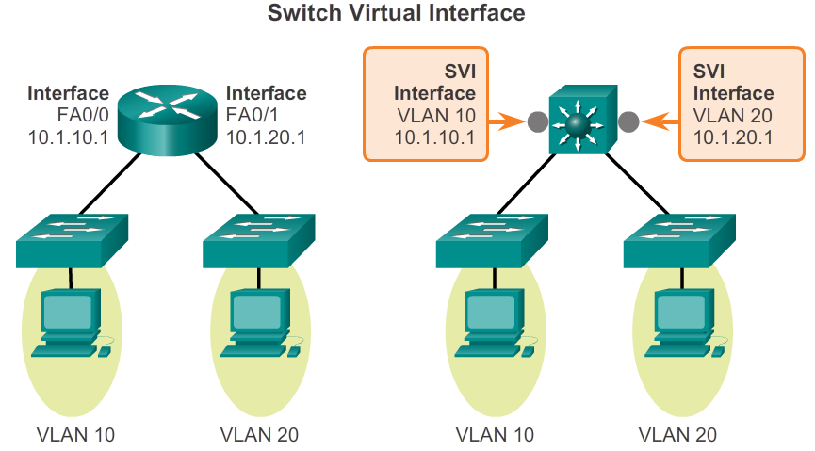
Inter VLAN Configuration

Slide 42
Inter VLAN Configuration
A routed port is a physical port that acts similarly to an interface on a router. Unlike an access port, a routed port is not associated with a particular VLAN. Unlike the router, routed ports on a switch do not support sub-interfaces.
In a switched network, routed ports are mostly configured between switches in the core and distribution layer. To configure routed ports, use the no switchport command on the appropriate ports. Then, assign an IP address and other Layer 3 parameters as necessary.
A multilayer switch can have both SVI and routed ports in a single switch.

Slide 43
Inter VLAN Configuration
The 2960 switch can function as Layer 3 device and route between VLANs and a limited number of static routes.
The sdm lanbase-routing template can be enabled to allow the switch to route between VLANs and to support static routing.
In Figure 1, the show sdm prefer command is entered on switch S1 and the default template is applied. The default template does not support static routing. If IPv6 addressing has been enabled, the template will be dual-ipv4-and-ipv6 default.
The SDM template can be changed in global configuration mode with the sdm prefer command.

Slide 44
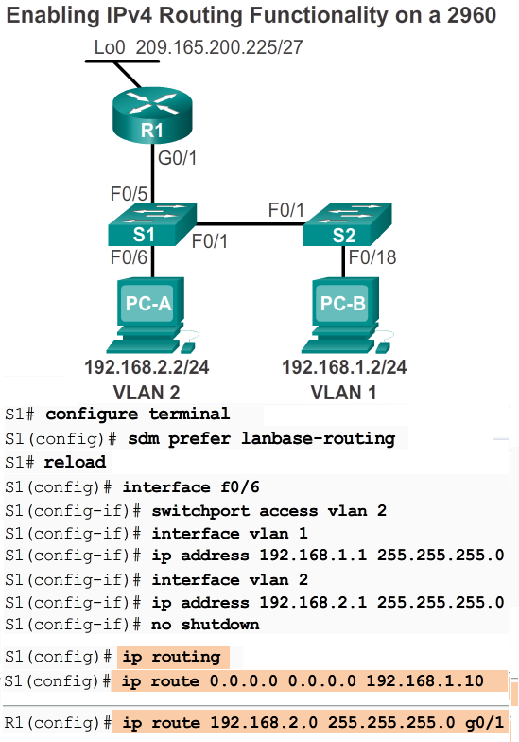

Slide 45
VLAN Attack
A VLAN hopping attack enables traffic from one VLAN to be seen by another VLAN without the aid of a router.
In a basic VLAN hopping attack, the threat actor configures a host to spoof 802.1Q signaling and Cisco-proprietary Dynamic Trunking Protocol (DTP) signaling to trunk with the connecting switch.
If successful, the switch establishes a trunk link with the host and access all the VLANs on the switch. The threat actor can send and receive traffic on any VLAN, effectively hopping between VLANs.

Slide 46
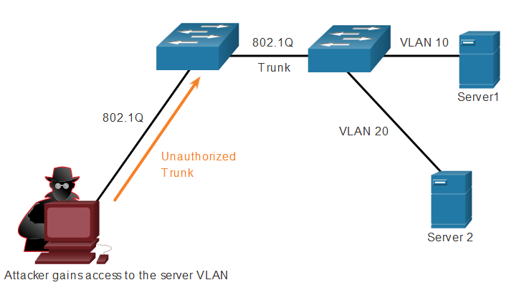
VLAN Attack

Slide 47
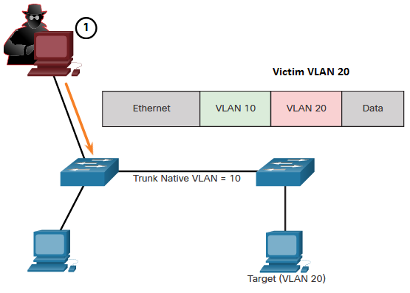
VLAN Attack
A VLAN double-tagging attack allows the attacker to send data to hosts or servers on a VLAN that otherwise would be blocked by some type of access control configuration.
The attack is unidirectional and works only when the attacker is connected to a port residing in the same VLAN as the native VLAN of the trunk port.

Slide 48

VLAN Attack
These attacks can be prevented by implementing the following trunk security guidelines:
  Disable trunking on all access ports.
  Disable auto trunking on trunk links so that trunks must be manually enabled.
  Be sure that the native VLAN is only used for trunk links.

