Slide 1
WIA1005 Network Technology Foundation
Chapter 11
Routing

Slide 2
Contents
Introduction
Packet Forwarding
Routing Table
Static Route
Dynamic Route

Slide 3
Introduction
A router connects multiple networks, which means that it has multiple interfaces that each belong to a different IP network.
The router is responsible for the routing of traffic between networks. When a packet arrives on a router interface, the router uses its routing table to determine how to reach the destination network.
The primary functions of a router are to:
  Determine the best path to forward packets based on the information in its routing table
  Forward packets toward their destination

Slide 4
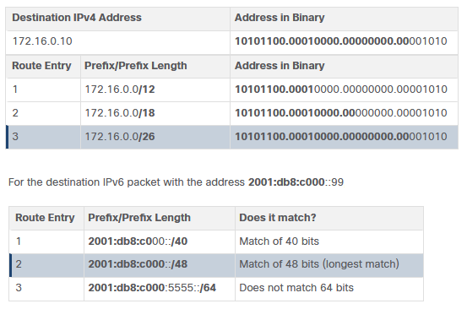
Introduction
The best path in the routing table is also known as the longest match. The longest match is the route in the routing table that has the greatest number of far-left matching bits with the destination IP address of the packet.

Slide 5
Introduction
The routing table of a router stores information about:
  Directly connected routes - These routes come from the active router interfaces directly connected to the router.
  Remote routes - These are remote networks connected to other routers. Routes to these networks can either be statically configured or dynamically configured using dynamic routing protocols.
  Default route - Specifies a next-hop router to use when the routing table does not contain a specific route that matches the destination IP address. The default route can be entered manually or learned automatically from a dynamic routing protocol.

Slide 6
Introduction
Determining the best path involves the evaluation of multiple paths to the same destination network and selecting the optimum or shortest path to reach that network.
The best path is selected by a routing protocol based on the value or metric it uses to determine the distance to reach a network. A metric is the quantitative value used to measure the distance to a given network. The best path to a network is the path with the lowest metric.
When a router has two or more paths to a destination with equal cost metrics, then the router forwards the packets using both paths equally. This is called equal cost load balancing.

Slide 7
Introduction
Different routing protocols use different metric
  Routing Information Protocol (RIP) - Hop count
  Open Shortest Path First (OSPF) - Cost (cumulative bandwidth from source to destination)
  Enhanced Interior Gateway Routing Protocol (EIGRP) - Bandwidth, delay, load, reliability

Slide 8
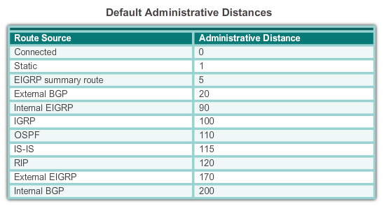
Introduction
Cisco IOS uses the administrative distance (AD) to determine the route to install into the IP routing table.
The AD represents the "trustworthiness" of the route; the lower the AD, the more trustworthy the route source.

Slide 9
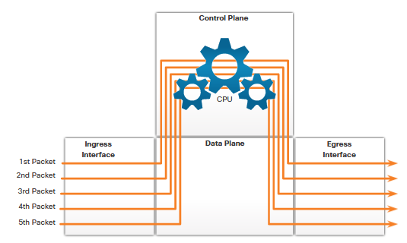
Packet Forwarding
Routers support three packet-forwarding mechanisms:
Process switching
  When a packet arrives on an interface, it is forwarded to the control plane where the CPU matches the destination address with an entry in its routing table, and then determines the exit interface and forwards the packet. Process every packet, very slow.

Slide 10
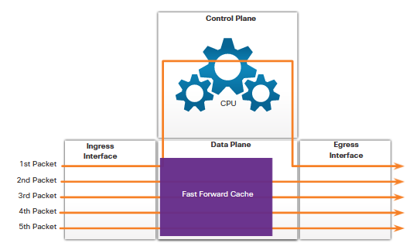
Packet Forwarding
Fast switching
  Uses a fast-switching cache to store next-hop information. If another packet going to the same destination arrives on an interface, the next-hop information in the cache is re-used without CPU intervention.

Slide 11
Packet Forwarding
Cisco Express Forwarding (CEF)
  The preferred Cisco IOS packet-forwarding mechanism. Like fast switching, CEF builds a Forwarding Information Base (FIB), and an adjacency table.
  The FIB contains pre-computed reverse lookups, next hop information for routes including the interface and Layer 2 information.

Slide 12
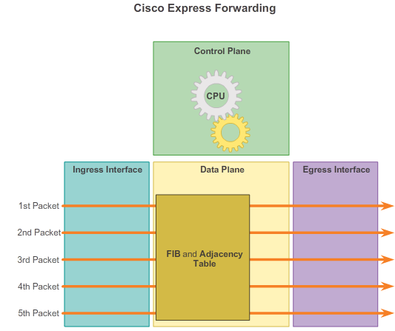
Packet Forwarding

Slide 13
Packet Forwarding
Packet Forwarding Decision
  Forwards the Packet to a Device on a Directly Connected Network
  If the route entry indicates that the egress interface is a directly connected network, this means that the destination IP address of the packet belongs to a device on the directly connected network. Therefore, the packet can be forwarded directly to the destination device.

Slide 14
Packet Forwarding
  Forwards the Packet to a Next-Hop Router
  If the route entry indicates that the destination IP address is on a remote network, this means the destination IP address of the packet belongs to a device on network that is not directly connected.
  Therefore, the packet must be forwarded to another router, specifically a next-hop router. The next-hop address is indicated in the route entry.

Slide 15
Packet Forwarding
  Forwards the Packet to default route
  If no match, the packet will be forwarded to default route.
  Drops the Packet - No Match in Routing Table
  If there is no match between the destination IP address and a prefix in the routing table, and if there is no default route, the packet will be dropped.

Slide 16
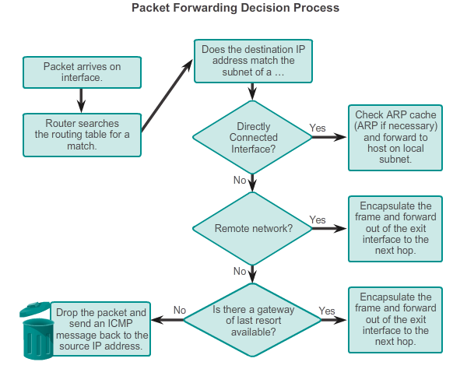
Packet Forwarding

Slide 17
Routing Table
Each route entry identifies the following information:
  1. Route source - Identifies how the route was learned.
  2. Destination network
  3. Administrative distance
  4. Metric
  5. Next-hop - Identifies the IP address of the next router to forward the packet to.
  6. Route timestamp - Identifies how much time has passed since the route was learned.
  7. Outgoing interface - Identifies the exit interface to use to forward a packet toward the final destination.

Slide 18
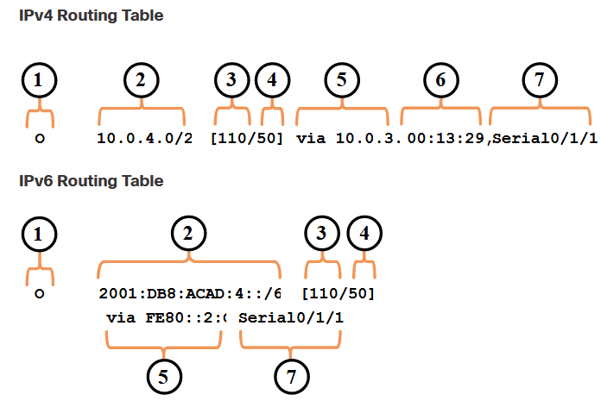
Routing Table

Slide 19
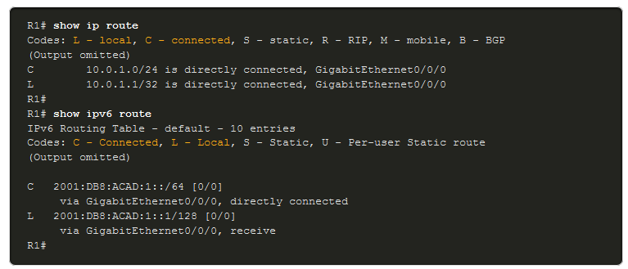
Routing Table

Slide 20
Static Route
Static routes are manually configured. The routes are not automatically updated and must be manually reconfigured if the network topology changes. A static route is identified in the routing table with the code ‘S’.
The benefits of using static routes include improved security and resource efficiency. Static routes use less bandwidth than dynamic routing protocols, and no CPU cycles are used to calculate and communicate routes.
The main disadvantage to using static routes is the lack of automatic reconfiguration if the network topology changes.

Slide 21
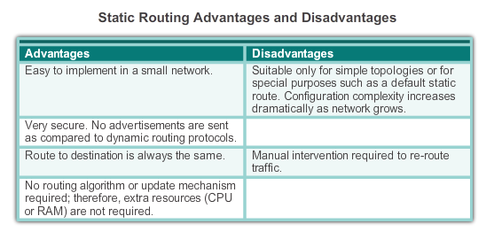
Static Route

Slide 22
Static Route
Static routing has three primary uses:
  Providing ease of routing table maintenance in smaller networks that are not expected to grow significantly.
  Routing to and from stub networks. A stub network is a network accessed by a single route, and the router has only one neighbor.
  Using a single default route to represent a path to any network that does not have a more specific match with another route in the routing table. Default routes are used to send traffic to any destination beyond the next upstream router.

Slide 23
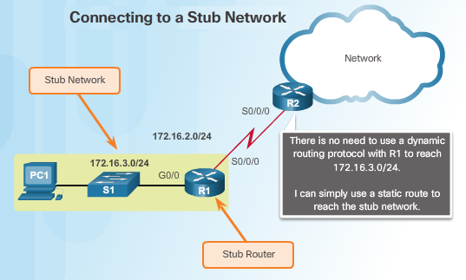
Static Route

Slide 24
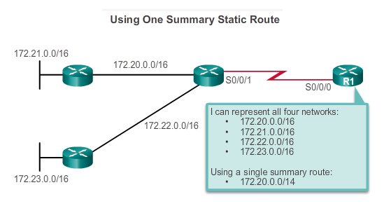
Static Route
Static route can also be used to:
  Reduce the number of routes advertised by summarizing several contiguous networks as one static route
  Create a backup route in case of a primary route link fails. The backup or floating static route is configured with a higher administrative distance than the primary route.

Slide 25
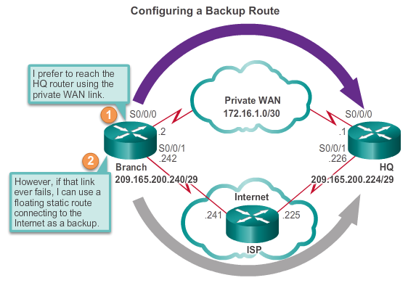
Static Route

Slide 26
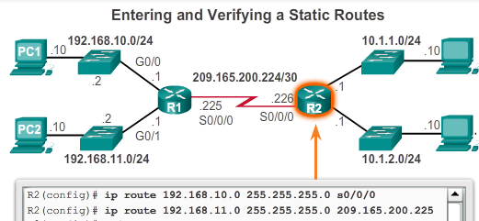
Static Route
There are two common types of static routes in the routing table:
  Static route to a specific network
  Default static route
IPv4 static routes are configured using the ip route network mask {next-hop-ip | exit-intf} global configuration command.

Slide 27
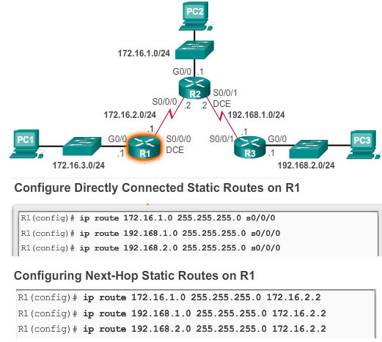
Static Route

Slide 28
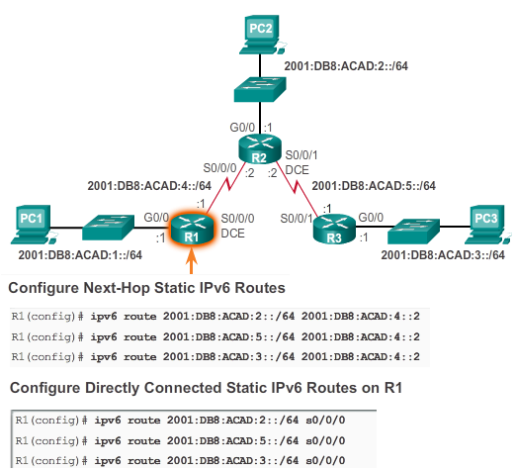
Static Route

Slide 29
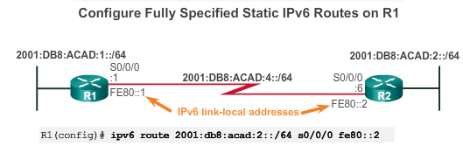
Static Route
If the IPv6 static route uses an IPv6 link-local address as the next-hop address, a fully specified static route including the exit interface must be used.
The reason a fully specified static route must be used is because IPv6 link-local addresses are not contained in the IPv6 routing table. Link-local addresses are only unique on a given link or network.

Slide 30
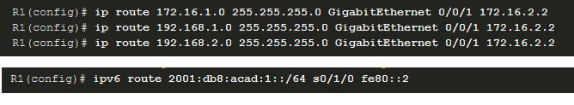
Static Route
A fully specified static route can be configured when the next-hop IP address and exit interface are specified using the ip route network mask exit-intf next-hop-ip command.

Slide 31

Static Route
The default static route specifies the exit point to use when the routing table does not contain a path for the destination network.
A default static route is useful when a router has only one exit point to another router, such as when the router connects to a central router or service provider.
Use the ip route 0.0.0.0 0.0.0.0 {exit-intf | next-hop-ip} global configuration command.

Slide 32
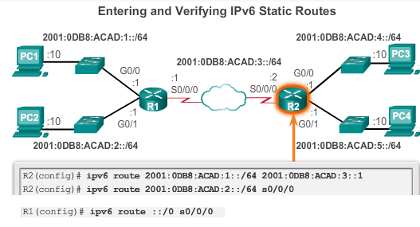
Static Route
IPv6 supports static and default static routes. Static IPv6 routes are configured using the ipv6 route ipv6-prefix/prefix-length {ipv6-address|interface-type interface-number} global configuration command.
To configure a default static IPv6 route, use the ipv6 route ::/0 {ipv6-address | interface-type interface-number} global configuration command.

Slide 33
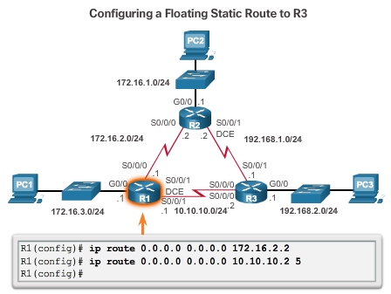
Static Route
Configuring floating static route

Slide 34

Static Route
A host route is an IPv4 address with a 32-bit mask, or an IPv6 address with a 128-bit mask. A host route allows for a more efficient process for packets that are directed to the router itself, rather than for packet forwarding.
When an active interface on a router is configured with an IP address, a local host route is automatically added to the routing table. The local routes are marked with L in the output of the routing table.

Slide 35
Static Route
Common IOS troubleshooting commands include the following:
  ping
  traceroute
  show ip route
  show ip interface brief
  show cdp neighbors detail

Slide 36
Dynamic Route
Dynamic routing protocols are used by routers to automatically share information about the reachability and status of remote networks.
Dynamic routing protocols perform several activities, including network discovery and maintaining routing tables.
The advantages of dynamic routing protocols are the ability to select a best path, and the ability to automatically discover a new best path when there is a change in the topology.

Slide 37
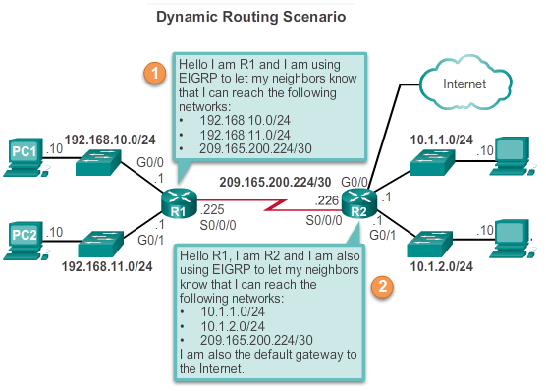
Dynamic Route
During network discovery, routers exchange routes and update their routing tables. Routers have converged after they have finished exchanging and updating their routing tables.

Slide 38
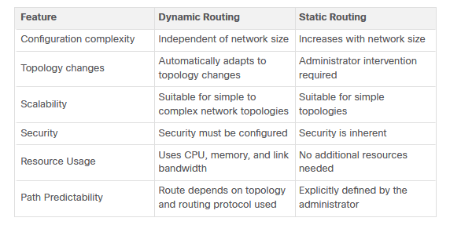
Dynamic Route

Slide 39
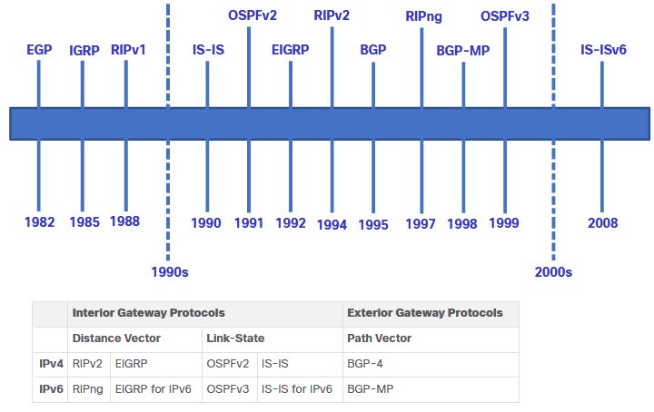
Dynamic Route

Slide 40
Dynamic Route
The main components of dynamic routing protocols include:
Data structures - Routing protocols typically use tables or databases for its operations. This information is kept in RAM.
Routing protocol messages - Routing protocols use various types of messages to discover neighboring routers, exchange routing information, and other tasks to learn and maintain accurate information about the network.
Algorithm - Routing protocols use algorithms for facilitating routing information and for best path determination.

