Slide 1
WIA1005 Network Technology Foundation
Chapter 13
Build and Secure Small Network

Slide 2
Contents
Introduction
Small Network Applications and Protocols
Troubleshooting
Security Threats
Network Attacks
Network Attack Mitigations

Slide 3
Introduction
The design of a small network is usually simple. The number and type of devices included are significantly reduced compared to that of a larger network.
The small network requires a router, a switch, and a wireless access point to connect wired and wireless users, an IP phone, a printer, and a server.
Small networks typically have a single WAN connection provided by DSL, cable, or an Ethernet connection.
Small networks are usually managed by a local IT technician.

Slide 4
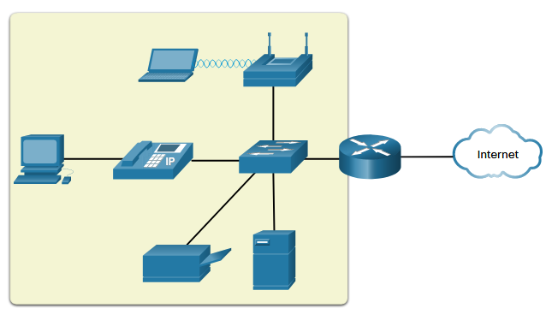
Introduction

Slide 5
Introduction
There are a number of factors that need to be considered when implementing a small network:
  Cost - Cost of intermediary device is determined by its capacity and features. This includes the number and types of ports available and the backplane speed.
  Other factors that influence the cost are network management capabilities, embedded security technologies, and optional advanced switching technologies.
  The expense of cable runs required to connect every device on the network must also be considered.
  Another key element affecting cost considerations is the amount of redundancy to incorporate into the network.

Slide 6
Introduction
  Speed and Types of Ports/Interfaces - Choosing the number and type of ports on a router or switch is a critical decision. Choosing Layer 2 devices that can accommodate increased speeds allows the network to evolve without replacing central devices.
  Expandability
    Expandability – Fixed / Modular. Care must be taken to select the appropriate modules and interfaces for the specific media.
  Operating System Features and Services

Slide 7
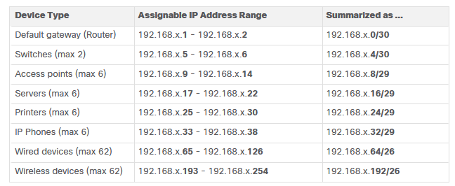
Introduction
When implementing a small network, it is recommended that you plan, document, and maintain an IP addressing scheme based on device type.
The use of a planned IP addressing scheme makes it easier to identify a type of device and to troubleshoot problems.

Slide 8
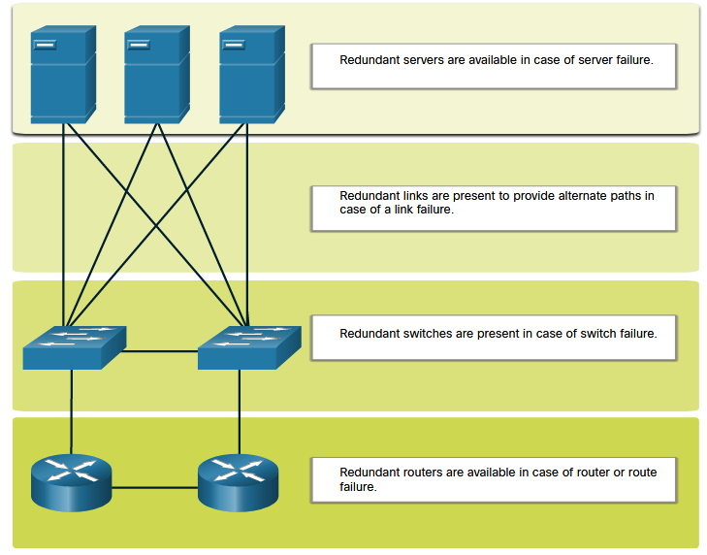
Introduction
Another important part of network design is reliability. Even small businesses often rely heavily on their network for business operation. A failure of the network can be very costly.
In order to maintain a high degree of reliability, redundancy is required in the network design.
Redundancy can be accomplished by installing duplicate equipment, but it can also be accomplished by supplying duplicate network links for critical areas.

Slide 9
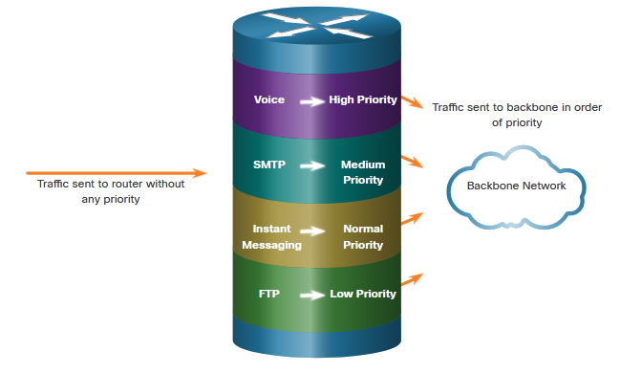
Introduction
The goal for a good network design, even for a small network, is to enhance the productivity of the employees and minimize network downtime.
The network administrator should consider the various types of traffic and their treatment in the network design.

Slide 10
Small Network Applications and Protocols
Network administrators commonly require access to network devices and servers. The two most common remote access solutions are Telnet and Secure Shell (SSH).
SSH is used to establish a secure remote access connection between an SSH client and other SSH-enabled devices:
  Network device - The network device must support SSH to provide remote access SSH server services to clients.
  Server - The server must support remote access SSH server services to clients.

Slide 11
Small Network Applications and Protocols
Businesses today are increasingly using IP telephony and streaming media to communicate with customers and business partners.
Many organizations are enabling their employees to work remotely.
The network administrator must ensure the proper equipment is installed in the network and that the network devices are configured to ensure priority delivery.
Besides, network administrator needs to plan for the growth of the small network.

Slide 12
Small Network Applications and Protocols
To scale a network, several elements are required:
  Network documentation - Physical and logical topology
  Device inventory - List of devices that use or comprise the network
  Budget - Itemized IT budget, including fiscal year equipment purchasing budget
  Traffic analysis - Protocols, applications, and services and their respective traffic requirements should be documented

Slide 13
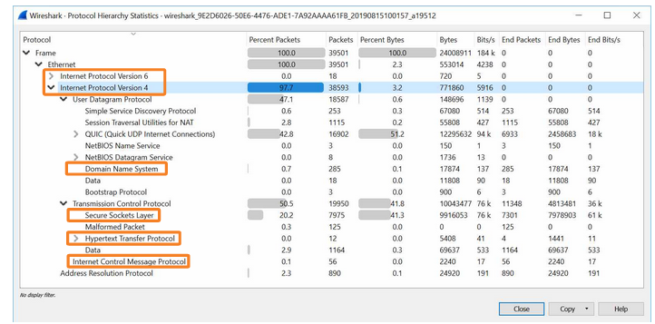
Small Network Applications and Protocols
As the network grows, it becomes important to determine how to manage network traffic. It is important to understand the type of traffic that is crossing the network as well as the current traffic flow.

Slide 14
Small Network Applications and Protocols
To determine traffic flow patterns, it is important to:
  Capture traffic during peak utilization times to get a good representation of the different traffic types.
  Perform the capture on different network segments and devices as some traffic will be local to a particular segment.
A network administrator must be aware of how network use is changing. Documenting snapshots for employees in a small network over a period of time is very useful to identify evolving protocol requirements and associated traffic flows. A shift in resource utilization may require the network administrator to adjust network resource allocations accordingly.

Slide 15
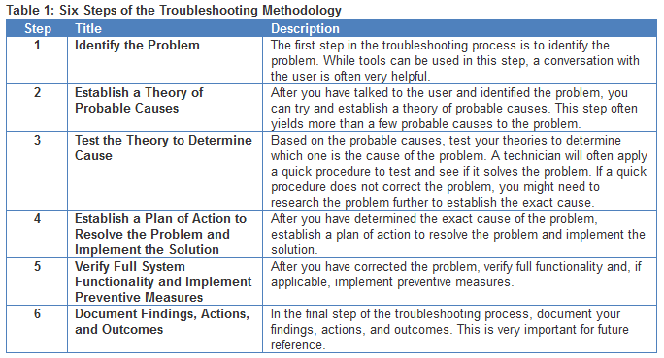
Troubleshooting
Troubleshooting is used to analyse the problem, determine the cause of the error, implement a plan of action, and resolve the network issue.

Slide 16
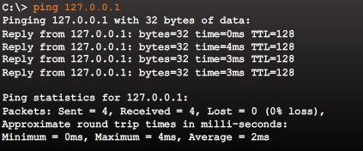
Troubleshooting
When a problem has been solved and a solution implemented, it is important to verify the system operation. ping, traceroute and show are some of the verification commands
ping command is an effective way to test connectivity. The ping command uses the Internet Control Message Protocol (ICMP) and verifies Layer 3 connectivity.

Slide 17
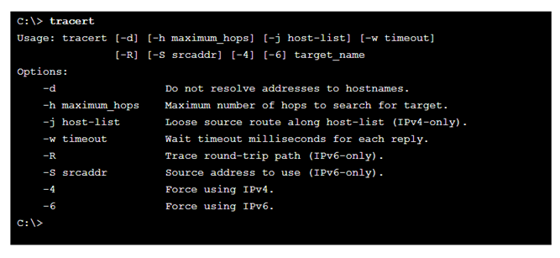
Troubleshooting
Traceroute is useful in troubleshooting routing loops and determining the exact next-hop router.
An ICMP "time exceeded" indicates that a router in the path has seen and discarded the packet. An ICMP "destination unreachable" indicates that a router has received the packet, but discarded it because it could not be delivered.

Slide 18
Troubleshooting
One of the most effective tools for monitoring and troubleshooting network performance is to establish a network baseline.
Creating an effective network performance baseline is accomplished over a period of time.
Measuring performance at varying times and loads will assist in creating a better picture of overall network performance.

Slide 19
Troubleshooting
The show commands display relevant information about the configuration and operation of the device.
  show running-config
  show interfaces / show ip interface
  show arp
  show ip route
  show protocols
  show version
The ipconfig or ipconfig /all commands are used to view IP address. (ifconfig - linux, ifconfig en0 - mac)
The arp –a command lists all devices in ARP cache.

Slide 20
Troubleshooting
Cisco Discovery Protocol (CDP) is a proprietary Layer 2 protocol that is used to gather information about Cisco devices which share the same network.
The device sends periodic CDP advertisements to connected devices. These advertisements share information about the type of device that is discovered, the name of the devices, and the number and type of the interfaces.
CDP can also be used as a network discovery tool to assist in network design decisions, troubleshooting, and making changes to equipment.

Slide 21
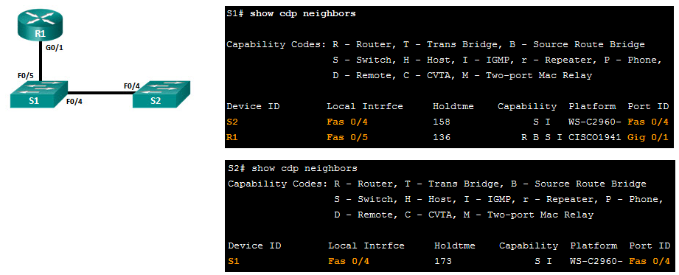
Troubleshooting
show cdp neighbors command provides:
  Device ID
  Port ID
  Device (Switch/Router)
  Platform

Slide 22
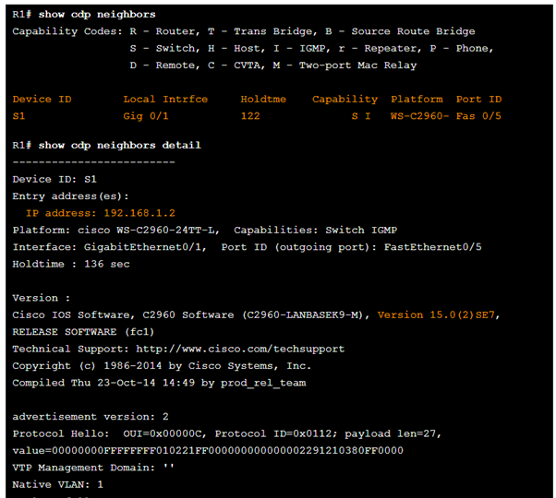
Troubleshooting

Slide 23
Troubleshooting
The IOS debug command provides valuable information when troubleshooting or verifying system operations.
All debug commands are entered in privileged EXEC mode. The filter command is used to include only the relevant information.
Commands such as debug all or debug ip packet a generate a substantial amount of output.
Disable the debugging process when enough data has been captured:
  no debug
  undebug
  undebug all

Slide 24
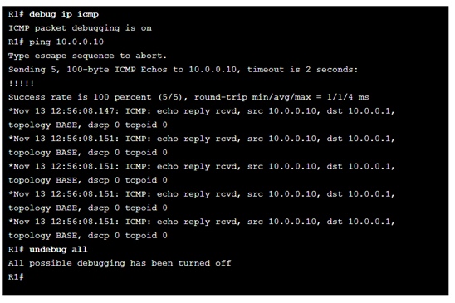
Troubleshooting

Slide 25
Troubleshooting
Administrative can access to a router remotely on virtual console (VTY) lines using SSH or Telnet. However, log messages are not displayed by default on virtual console lines.
To display log messages on a terminal (virtual console)
  terminal monitor
To stop logging messages on a terminal
  terminal no monitor

Slide 26
Security Threats
Information theft is breaking into a computer to obtain confidential information. Information can be used or sold for various purposes.
Data loss and manipulation is breaking into a computer to destroy or alter data records
Identity theft is a form of information theft where personal information is stolen for the purpose of taking over someone’s identity.
Disruption of service is preventing legitimate users from accessing services to which they are entitled.

Slide 27
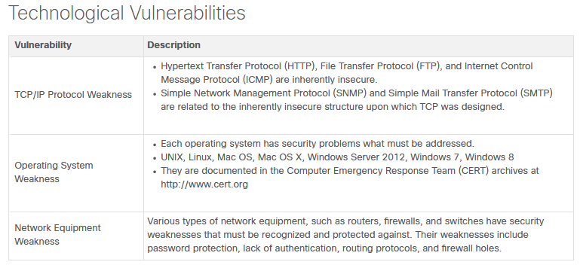
Security Threats
Vulnerability is the degree of weakness in a network or a device.
There are three primary vulnerabilities or weaknesses: technological, configuration, and security policy.

Slide 28
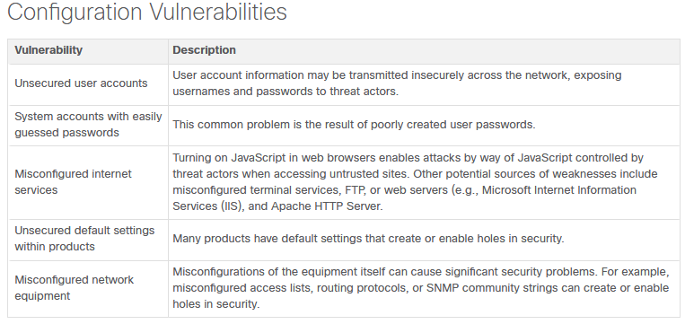
Security Threats

Slide 29
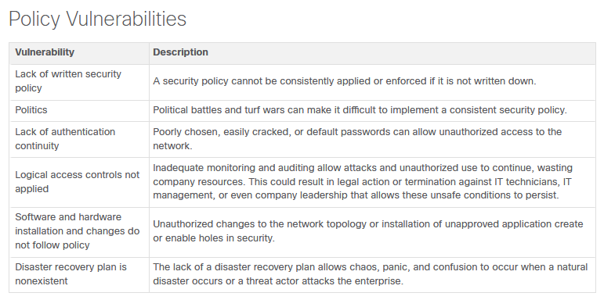
Security Threats

Slide 30
Security Threats
An equally important vulnerable area of the network to consider is the physical security of devices.
The four classes of physical threats are as follows:
  Hardware threats - This includes physical damage to servers, routers, switches, cabling plant, and workstations.
  Environmental threats - This includes temperature extremes (too hot or too cold) or humidity extremes (too wet or too dry).

Slide 31
Security Threats
  Electrical threats - This includes voltage spikes, insufficient supply voltage (brownouts), unconditioned power (noise), and total power loss.
  Maintenance threats - This includes poor handling of key electrical components (electrostatic discharge), lack of critical spare parts, poor cabling, and poor labeling.

Slide 32
Network Attacks
Malware is short for malicious software. It is code or software specifically designed to damage, disrupt, steal, or inflict “bad” or illegitimate action on data, hosts, or networks.
Viruses, worms, and Trojan horses are types of malware.
Viruses - a type of malware that propagates by inserting a copy of itself into, and becoming part of, another program. It spreads from one computer to another, leaving infections as it travels.
Worms – standalone software that replicate functional copies of themselves automatically

Slide 33
Network Attacks
Trojan Horses - It is a harmful piece of software that looks legitimate. Users are typically tricked into loading and executing it on their systems. After it is activated, it can achieve any number of attacks on the host, from irritating the user to damaging the host. It can create back doors to give malicious users access to the system. Trojan horses must spread through user interaction such as opening an email attachment or downloading and running a file from the internet.

Slide 34
Network Attacks
Reconnaissance attacks - The discovery and mapping of systems, services, or vulnerabilities. A threat actor can use internet tools, such as the nslookup and whois utilities, to easily determine the IP address. Then, a threat actor may use a ping sweep tool, such as fping or gping.
Access attacks exploit known vulnerabilities in authentication services, FTP services, and web services to gain entry to web accounts, confidential databases, and other sensitive information. An access attack allows individuals to gain unauthorized access to information that they have no right to view. Access attacks can be classified into four types: password attacks, trust exploitation, port redirection, and man-in-the middle.

Slide 35
Network Attacks
Password Attacks
  Brute-force attacks
  Trojan horse attacks
  Packet sniffers
Trust Exploitation - a threat actor uses unauthorized privileges to gain access to a system
Port Redirection - a threat actor uses a compromised system as a base for attacks against other targets.
Man-in-the-Middle - a threat actor is positioned in between two legitimate entities in order to read or modify the data that passes between the two parties.

Slide 36
Network Attacks
Denial of service (DoS) attacks are the most publicized form of attack and among the most difficult to eliminate. DoS attacks prevent authorized people from using a service by consuming system resources.
A DDoS is similar to a DoS attack, but it originates from multiple, coordinated sources. For example, a threat actor builds a network of infected hosts, known as zombies. A network of zombies is called a botnet.
The threat actor uses a command and control (CnC) program to instruct the botnet of zombies to carry out a DDoS attack.

Slide 37
Network Attack Mitigations
To mitigate network attacks, you must first secure devices including routers, switches, servers, and hosts.
Backing up device configurations and data is one of the most effective ways of protecting against data loss. A data backup stores a copy of the information on a computer to removable backup media that can be kept in a safe place.
Keeping up to date with the latest developments can lead to a more effective defense against network attacks.
Authentication, Authorization, and Accounting (AAA) network security services provide the primary framework to set up access control on network devices.

Slide 38
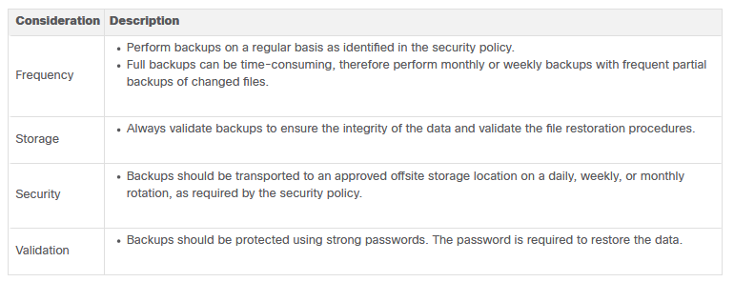
Network Attack Mitigations

Slide 39
Network Attack Mitigations
VPN - A router is used to provide secure VPN services with corporate sites and remote access support for remote users using secure encrypted tunnels.
ASA Firewall - Provides stateful firewall services. It ensures that internal traffic can go out and come back, but external traffic cannot initiate connections to inside hosts.
IPS - An intrusion prevention system (IPS) monitors incoming and outgoing traffic looking for malware, network attack signatures, and more. If it recognizes a threat, it can immediately stop it.

Slide 40
Network Attack Mitigations
ESA/WSA - The email security appliance (ESA) filters spam and suspicious emails. The web security appliance (WSA) filters known and suspicious internet malware sites.
AAA Server - This server contains a secure database of who is authorized to access and manage network devices.

Slide 41
Network Attack Mitigations
Firewall come packaged in various forms as below:
  Packet filtering - Prevents or allows access based on IP or MAC addresses
  Application filtering - Prevents or allows access by specific application types based on port numbers
  URL filtering - Prevents or allows access to websites based on specific URLs or keywords
  Stateful packet inspection (SPI) - Incoming packets must be legitimate responses to requests from internal hosts. Unsolicited packets are blocked unless permitted specifically. Include the capability to recognize and filter out specific types of attacks, such as denial of service (DoS)

Slide 42
Network Attack Mitigations
Endpoint Security - Securing endpoint devices is one of the most challenging jobs of a network administrator because it involves human nature. A company must have well-documented policies in place and employees must be aware of these rules.
Policies often include the use of antivirus software and host intrusion prevention. More comprehensive endpoint security solutions rely on network access control.

Slide 43
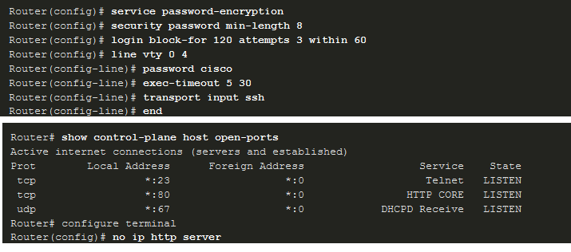
Network Attack Mitigations

