Slide 1
Predicting dry beans classes using machine learning algorithms
Group 10
R Krithika Reddy
Saiteja Reddy Akiti
Sarvani Rallabhandi
Daneesh Gali
Roshan Dappu

Slide 2
Table of contents
Introduction
Abstract
Methodology
Tools
Techniques
Coding phase(Implementation)
Conclusions
Recommendations

Slide 3
Introduction
It is useful to properly name food types in farming studies for numerous reasons, from assessing quality to distributing crops in the market. In this project, a state-of-the-art technique based on machine learning was designed to confront the issue of distinguishing between seven eaten types of dry beans. Lately, conventional methods have difficulty doing this work because entering the types is too adjacent in form, shape, type, and structure. With improvements in computer vision and data processing, a high-resolution camera was used to capture the many photos of 13611 grains from the different kinds of all seven beans listed. From these images, a lot of post-work was required, such as batch processing, segmentation, feature extraction, and cropping, to derive a complete set of 16 unique features. These features included both dimensional and shape-based characteristics and ultimately served as a useful set of information for both training and classification. The objective of this project was to create a robust classifier that can determine and type each kind of dry bean with a unique signature. This new strategy has a lot of future because, when compared to the traditional way of becoming boring and time-consuming, the decisions were impossible for the photographer to make.

Slide 4
Abstarct
In this study, I will focus on how distinct methods of machine learning could be applied to sort eaten types using a dataset of 16 characteristics extracted from high-resolution technical photographs. Once the exploration data analysis was completed, the data was willing to begin the preparation, which involved making the numerical ones consist of categorical factors quantifiable. After this process, the dataset was finally prepared for the training, and testing set, in which the dataset was broken into two sets: the training and testing, and the explanation for the model was trained/tested. For training the model and checking the results of the seven selected classification and identification methods. These were: logistic regression, K-Nearest Neighbors (KNN), Support Vector Machine (SVM), Naïve Bayes, decision tree, and random forest, and XGBoost. The model which had done better achievement on this project was logistic regression and SVM classification and XGBoost classification with high F1 scores and more than 93% accuracy ratio, also in the final, the feature importance was discussed, leading to the land putting different eaten type dry beans into a group of the main objective of the analysis. Overall, this study demonstrates the ability of the SVM and XGBoost classification to correctly classify the distinct types of beans, and the SVM and XGBoost did a great job of this farming classification mission.

Slide 5
Methodology
Data collection
Exploratory Data Analysis
Data preprocessing
Splitting the data(Train and Test)
Applying machine learning algorithms
Evaluating the models

Slide 6
Data collection
We have collected the dataset from UCI machine learning repositiory.
Dataset consists of 13611 rows 17 columns
16 columns are continuous and numerical features
1 column is the categorical column which is our Target variable “Class”
Class variable has 7 types of dry beans
16 numerical columns describes about the values of dry beans types which are Area, perimeter, convex area , solidity, roundness etc.

Slide 7
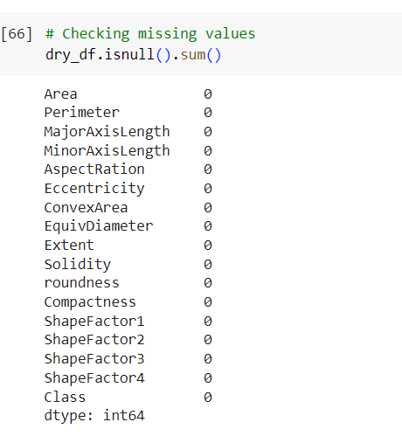
Exploratory Data Analysis
Checking missing values: This dataset has no missing values.

Slide 8
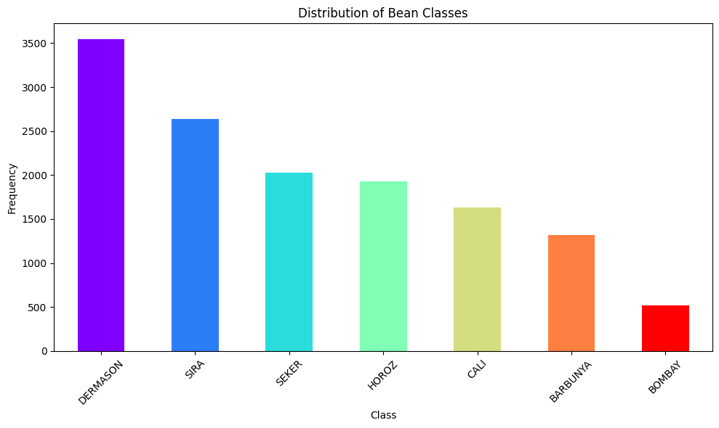
Exploratory Data Analysis
Bar plot for Target variable: We have used this plot for checking whether the data is imbalanced or balanced .
We can observe in the plot our Target variable quite imbalanced.
Dermason has the more samples and Bombay has least samples in this dataset.

Slide 9
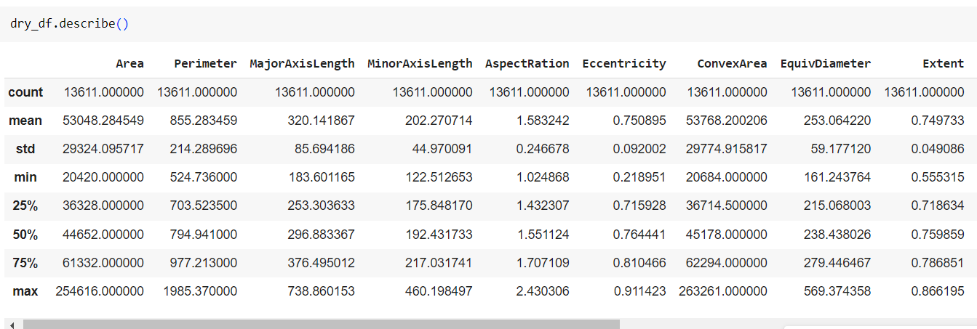
Exploratory Data Analysis
Statstical analysis: We have done statistical distribution using describe function in python programming language.
We can see that all the parameter estimations of numerical columns in the snippet such as mean, standard deviation, min, max and quartile values.

Slide 10
Exploratory Data Analysis
Skewness: It give the values negative and positive . Positive means data distribution towards right and negative means distribution towards left.
We can see that values are small with positive and negative ,it means that data distribution is slightly skewed .

Slide 11
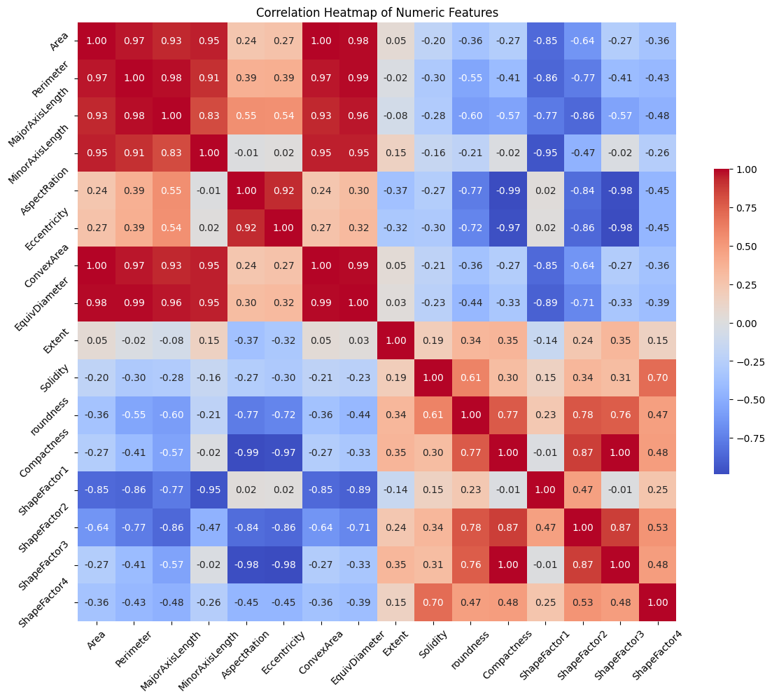
Exploratory Data Analysis
Heatmap: Heatmap shows the correlation between the numerical values.
If the value is towards 1with positive or negative it means that features are strong positive or negative correlation .
Strong correlation features contains the same information.

Slide 12
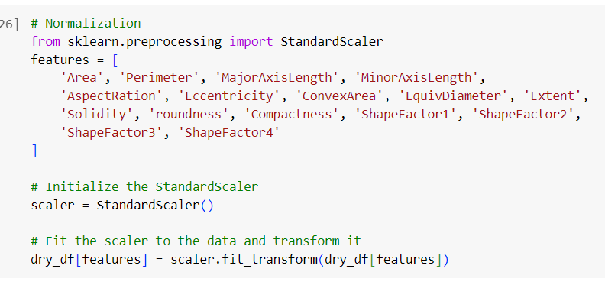
Data preprocessing
Normalization: We have applied standard scaler method to make the all features are in same range.
This is major important for linear models such as logistic regression, KNN, SVM classifiers because these models works based on distance between the samples.

Slide 13
Data preprocessing
Categorical to numerical: We have used label-encoder method to transform the text values into numerical values.
We have dummies one hot encoding method but this can be applied on independent features . In this dataset all the x features are numerical only target variable is categorical so we had to apply label encoder method.

Slide 14
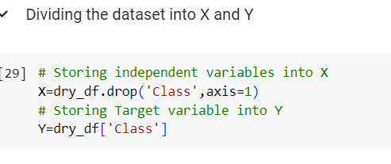
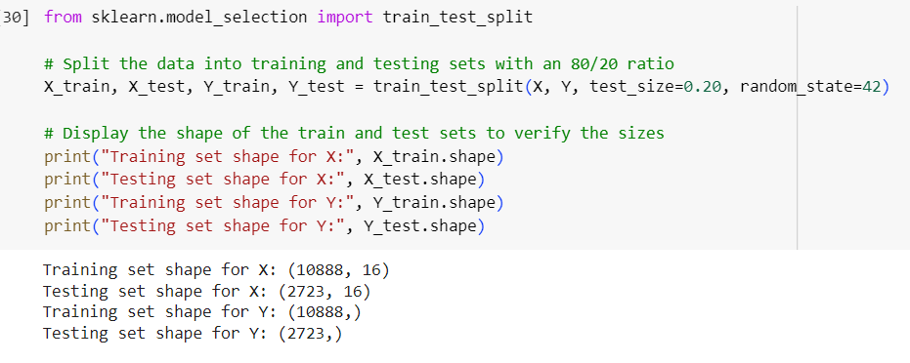
Splitting the data
After the data preprocessing is done we are ready to feed our data to the machine learning models.
Divided the dataset into X and Y.
Splitted dataset into Train and Test using train_test_split method with 80 and 20 ratio. Train data used for model building test data used for evaluating the models.

Slide 15
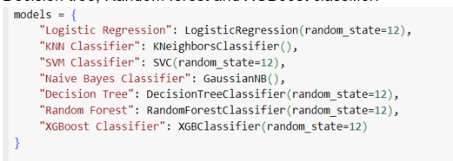
Applying Machine learning algorithms
Initially we have applied Linear models such as Logistic regression, KNN and SVM Classifier.
We have tried Naivebayes classifier also which works based on the bayes theorem and it consider features as independent.
Applied Decision tree , Randomforest and XGBoost classifier on this dataset.

Slide 16
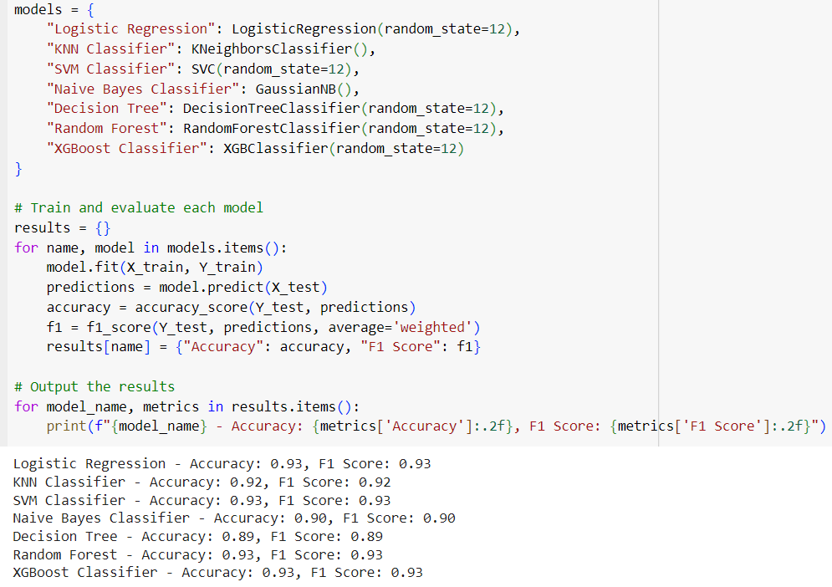
Evaluating models
We have trained all the algorithms with Train data and evaluated on Test data.
We have selected Accuracy and F-one score as this imbalanced dataset.
Logistic regression, SVM , Randomforest and XGB classifier got the 93% accuracy and f-one score.

Slide 17
Evaluating through crossvalidation
Crossvalidation is the best method to prevent overfitting of the machine learning algorithms.
We have used K-fold crossvalidation method to evaluate the performance of the models.
It divides data into folds and every fold is used for Train and test.
This process is used until the each fold is used as test and remaining folds used for train the models.

Slide 18
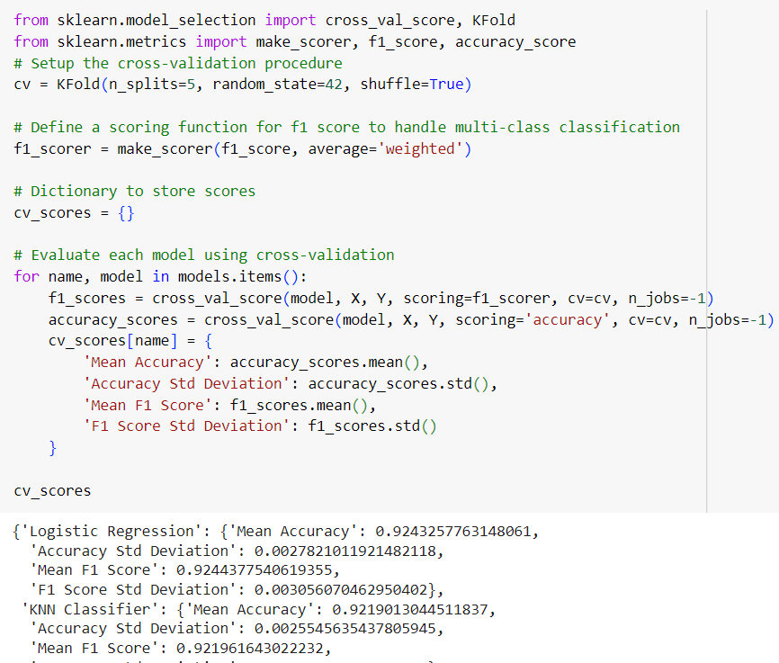
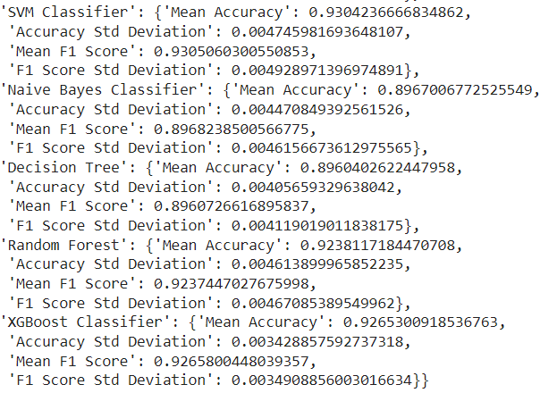
Crossvalidation results

Slide 19
Selecting model
Using test results and crossvalidation results we have selected the logistic regression , svm classifier , randomforest classifier and XGBoost classifier algorithms.
Finally we have used XGBoost Classifier to predict results on new dataset as this as robust ensemble model. We can explain the feature importances using this algorithms. It has the attribute and gives the weights for features while predicting the target variable.
We have tried Gridsearch cv method to improve the model performance but it didn’t work well . We got best hyperparameters as default parameters of the model.

Slide 20
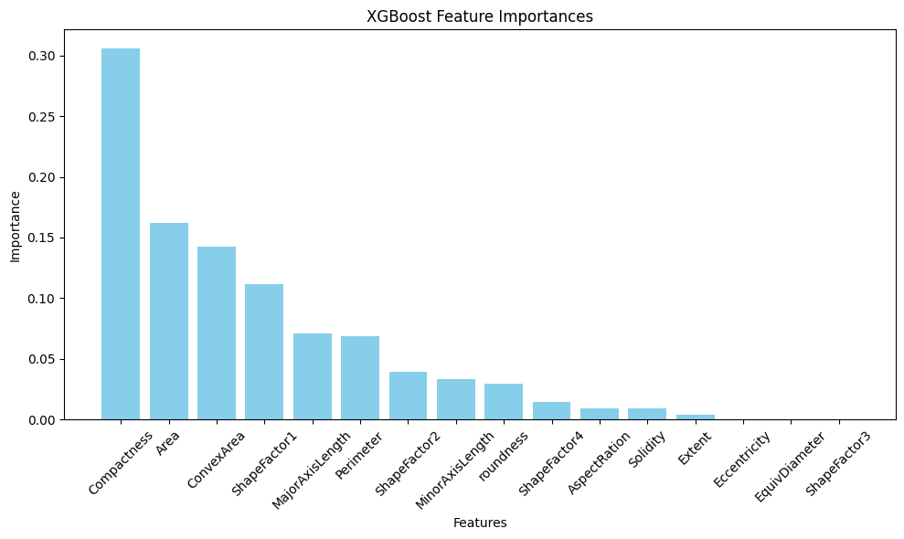
Conclusions
We have selected XGBoost classifier model.
This picture describes about the each feature importance values while predicting dry beans classes.
Compactness is having high correlation for predicting dry beans classes.
Equidiameter and shapefactor3 are less importance for predicting dry beans classes.

Slide 21
Recommendations
Explore the possibilities of new features from already important ones. For instance, combining Area and Convex Area or generating ratios such as Area to Perimeter may bring out some new insights. These new ones might contain certain complex patterns that are not easily visible.
Focus on the best features that measure the dimensions directly – Compactness, Area, and Convex Area. The more finely these dimensions are quantified, the better it may help the model to categorize the data and sort more accurately. Better sorting leads to better grades of beans in the end which means a lot for the industry.

Slide 22
References
IEEE Paper link:
https://ceur-ws.org/Vol-2951/paper3.pdf
Dataset source link:
https://archive.ics.uci.edu/dataset/602/dry+bean+dataset
Murat Koklu, Ilker Ali Ozkan, Multiclass classification of dry beans using computer vision and
machine learning techniques, Computers and Electronics in Agriculture 174 (2020) 105507.
Aurelien Geron, Hands-on Machine Learning with Scikit-Learn, Keras & TensorFlow, O’Reilly,2019.
Francois Chollet, Deep Learning with Python, Manning Publications, 2018.

