Slide 1
PROJECT BASED COMPONENT | CSE4077 RECOMMENDER SYSTEMS
AI Debate-Based Multi-Domain Recommendation System using Large Language Models
Supporter, Critic and Judge agents argue over every candidate, and a deterministic constraint audit keeps them honest.
[FILL IN: Student 1 - Reg. No.]
[FILL IN: Student 2 - Reg. No.]
[FILL IN: Student 3 - Reg. No.]
Faculty: Dr S Vigneshwari (54147)
Slot: A1+TA1
School of Computer Science and Engineering
October 2026
Notes:
Introduce the project, the team, and the one-line idea: LLM agents debate each candidate, but a deterministic audit computed in code is the ground truth they cannot override.

Slide 2
Why single-call LLM recommenders are hard to trust
Free-text requests mix hard limits, soft wishes and genre in one sentence. Handing that to one model and trusting the answer fails in three ways:
Ungrounded
Unauditable
Biased
No retrieval step over a real catalogue, so item facts can be invented and nothing checks them.
One fluent narrative. A person cannot tell which stated reason is true and which is overstated.
LLM rankers show position and popularity bias [9]. LLM judges show verbosity and self-enhancement bias [20], [21].
Idea: let models argue for and against each item, then check the argument against facts computed in code.
DebateRec | CSE4077 Recommender Systems
2
Notes:
A single LLM call gives a fluent ranking. Three problems: no retrieval grounding, no way to audit the stated reason, and known biases in LLM rankers [9] and LLM judges [20],[21].

Slide 3
Problem statement and objectives
Problem
Objectives
Given a natural-language request in one of several domains, build a recommender that extracts hard and soft constraints, retrieves candidates, debates each one adversarially, and returns an explainable ranking, using one architecture for all domains and either a cloud or a fully offline LLM.
Understand free-text requests: hard vs. soft, units, negation
Retrieve candidates from a 7-domain catalogue with hybrid BM25 + TF-IDF
Run a Supporter / Critic / Judge debate bound to a deterministic audit
Serve every domain through one adapter-based architecture
Measure each stage with an ablation and report the limits honestly
DebateRec | CSE4077 Recommender Systems
3
Notes:
Read the problem statement, then the five objectives. Objective 5 is why we report results with their limitations.

Slide 4
Literature survey: 44 references, six themes
Theme | Refs | What they do | What is missing
LLM-based recommenders | [6]-[10] | LLM as encoder, scorer or generator | Single pass, no debate, position bias
Conversational / multi-agent | [11]-[14] | Intent and slots by one model or cooperating agents | Cooperative, not adversarial; one domain
Explainable recommendation | [15] | Single-pass justification per item | No adversarial pros/cons record
Debate and LLM-as-judge | [16]-[21] | Debate lifts factuality; judges are biased | Never applied to item recommendation
Constraint-based | [26]-[28] | Symbolic hard / soft constraints | No language layer, no LLM
Domain, incl. India-affiliated | [29]-[31] | Course and e-learning deep models | Single domain, no explanation
Also: classical CF and surveys [1]-[5]; retrieval [22]-[23]; RAG-style recommenders [24]-[25].
DebateRec | CSE4077 Recommender Systems
4
Notes:
44 references total: 39 from the survey plus five classic recommender papers. Five are India-affiliated. Point out the right-hand column: every theme leaves something open.

Slide 5
Research gap: nobody combines all five
Prior work | Adversarial debate | Deterministic audit | Auditable transcript | Multi-domain | Offline LLM
LLM rankers [9], [10] | no | no | no | no | no
Multi-agent CRS [13] | cooperative | no | no | no | no
Explainable RecSys [15] | no | no | single pass | no | no
Debate / LLM-judge [16]-[21] | yes | no | yes | not RecSys | no
Constraint-based [26]-[28] | no | yes | no | no | n/a
DebateRec (this work) | yes | yes | yes | yes | yes
Gap: debate-based explainable auditing, generalised across domains, deployable offline.
DebateRec | CSE4077 Recommender Systems
5
Notes:
Rows are judged on item recommendation. The debate/judge row is NLP work on QA and NLG evaluation, so it never touches ranked items. DebateRec is the only row with every capability.

Slide 6
System architecture
User: free-text request
1 Understand
2 Retrieve
3 Audit
4 Debate
5 Explain
Domain router, rule parser, LLM extractor
BM25 + TF-IDF fusion, filter, diversify
PASS / FAIL / UNKNOWN per preference, in code
Supporter, Critic, optional rebuttal, Judge
Ranked list: pros, cons, trade-offs, transcript
Debate engine detail
Supporter
argues FOR
Critic
argues AGAINST
Rebuttal
optional
Judge
decides, bound to audit
Pluggable LLM backend (runtime switch): Gemini (cloud) | Ollama llama3.1:8b (offline) | Mock (deterministic, no key)
DebateRec | CSE4077 Recommender Systems
6
Notes:
Walk left to right. The audit sits before the debate so every agent sees the same ground truth. The LLM backend is a runtime switch: Gemini, Ollama or a deterministic mock.

Slide 7
Understanding: from free text to structured constraints
Domain router
Rule-weighted scoring; LLM fallback only below 0.6 confidence
Rule parser
Units (30k, 1.5 lakh, two hours), direction, negation, clause-scoped hard / soft
LLM extractor
JSON schema limited to the domain's facets; adds implicit preferences
Merge policy
Rules win on conflict; LLM may add or harden, never overwrite
Example (movies)
“a funny science-fiction movie from after 2015, preferably under two hours”
Phrase | Constraint | Type
science-fiction | genre = science fiction | soft
funny | tone = funny | soft
after 2015 | year >= 2015 | soft
preferably under two hours | runtime <= 120 min | soft
“must be under 120 minutes” would instead create a hard filter.
DebateRec | CSE4077 Recommender Systems
7
Notes:
Rules are authoritative for any facet they resolve, because they cannot hallucinate a number. The LLM can only add facets the rules missed. Note how 'must' versus 'preferably' changes hard versus soft.

Slide 8
Hybrid retrieval
BM25(q, D) = Σ IDF(t) · f(t,D)(k1+1) / [ f(t,D) + k1(1 − b + b|D|/avgdl) ]
k1 = 1.4, b = 0.72
Fused score
BM25
0.45
TF-IDF word (1-2 gram)
0.35
TF-IDF char (3-5 gram)
0.20
Each scorer max-normalised to [0, 1] before fusion
Optional dense embeddings replace all three; later stages unchanged
DebateRec | CSE4077 Recommender Systems
8
Notes:
BM25 catches exact terms; word TF-IDF catches paraphrase; character n-grams let 'sci-fi' reach 'science fiction'. Dense embeddings are an optional drop-in. The weights are hyperparameters swept in the harness.

Slide 9
Deterministic constraint audit and graded near-misses
Every stated preference becomes PASS, FAIL or UNKNOWN
The Judge must discard any claim that contradicts the audit
Soft misses are graded, not binary:
Live run (target: runtime <= 120 min)
Film | Runtime | Audit | Degree
Everything Everywhere All at Once | 139 min | FAIL | 0.681
The Martian | 144 min | FAIL | 0.597
Spider-Man: No Way Home | 148 min | FAIL | 0.529
d(v, t) = 1 if v ≤ t
d(v, t) = max(0, 1 − (v − t) / S) otherwise
A bigger miss scores lower, so the ranking reflects how far each film is from the request.
S = max − min of that facet across the real catalogue
DebateRec | CSE4077 Recommender Systems
9
Notes:
The audit is computed in plain code before any LLM sees a candidate. The Judge is told to discard any argument that contradicts it. Soft satisfaction decays with the miss, scaled by the real spread of that facet in the catalogue.

Slide 10
Debate protocol
1
Supporter
States the strongest evidence-grounded case for the item
2
Critic
Argues against it after reading the case; flags unsupported claims
3
Rebuttal (optional)
Supporter concedes what the data supports, rebuts the rest
4
Judge
Reconciles both with the audit; outputs score, decision, confidence
Safety: catalogue text is fenced as untrusted data; instruction-like phrases (“ignore previous instructions…”) are neutralised and reported. With no LLM, rule-based heuristics reproduce every role from the audit.
DebateRec | CSE4077 Recommender Systems
10
Notes:
Same fixed rounds for every candidate, which is what makes the stage measurable. One role equals one LLM call, one prompt, one structured output. Dataset text is fenced as untrusted data.

Slide 11
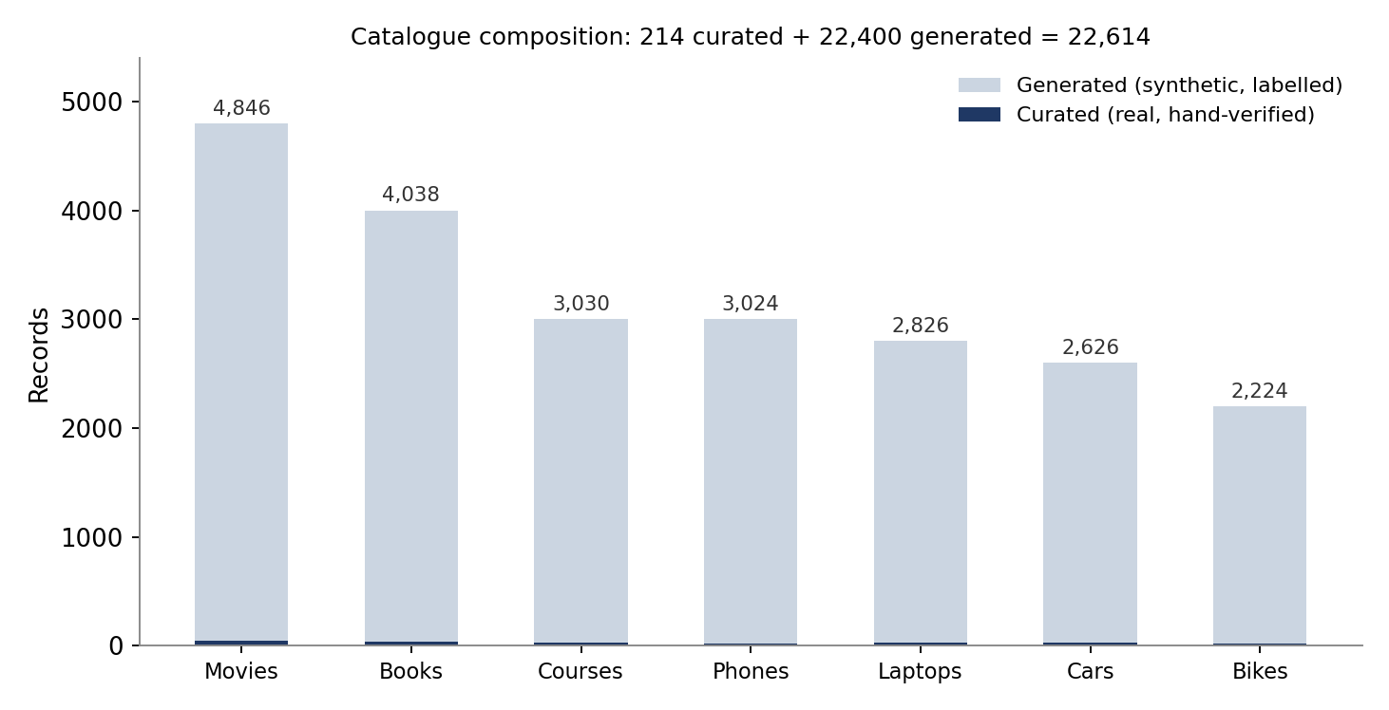
Dataset: 7 domains, one schema each
Seven raw files in seven shapes: nested, pipe- or comma-delimited, PascalCase, price in lakhs
Each adapter normalises to one Item and declares its numeric facets
Synthetic items use invented brands and credits, and are flagged
Quality claims use the 214 curated records only
An eighth domain = one adapter file + one registry line.
DebateRec | CSE4077 Recommender Systems
11
Notes:
No single public dataset covers all seven domains, so we built one. 214 records are hand-curated and real; 22,400 are generated and flagged. All quality claims use the curated pool only. Synthetic items use invented brands and credits.

Slide 12
Evaluation setup: five-condition ablation
Cond. | Pipeline | Queries | LLM
E0 | Popularity only (ignores the query) | 21 | none
E1 | Hybrid retrieval only | 21 | none
E2 | Retrieval + Supporter | 8 | llama3.1:8b
E3 | + Critic | 8 | llama3.1:8b
E4 | Full debate: + Judge | 8 | llama3.1:8b
Metrics
P@5, R@5, NDCG@5, MRR, hit@3, hard-violation rate, diversity, coverage, latency, LLM calls
Stats
Wilcoxon signed-rank + Cohen's d (E4 vs. E1) built into the harness
Environment
Ollama llama3.1:8b Q4_K_M, 8 GB laptop GPU; 5 candidates debated (default 8)
Tests
34 deterministic tests, 34/34 pass in 5.5 s
Hand-labelled queries: 21 queries, all 7 domains, graded relevance, curated pool.
DebateRec | CSE4077 Recommender Systems
12
Notes:
Labels were written from the catalogue before any system ran and are not derived from the constraint checker, so constraint-based methods are not graded against their own output. E2-E4 ran on 8 queries and 5 candidates for local compute.

Slide 13
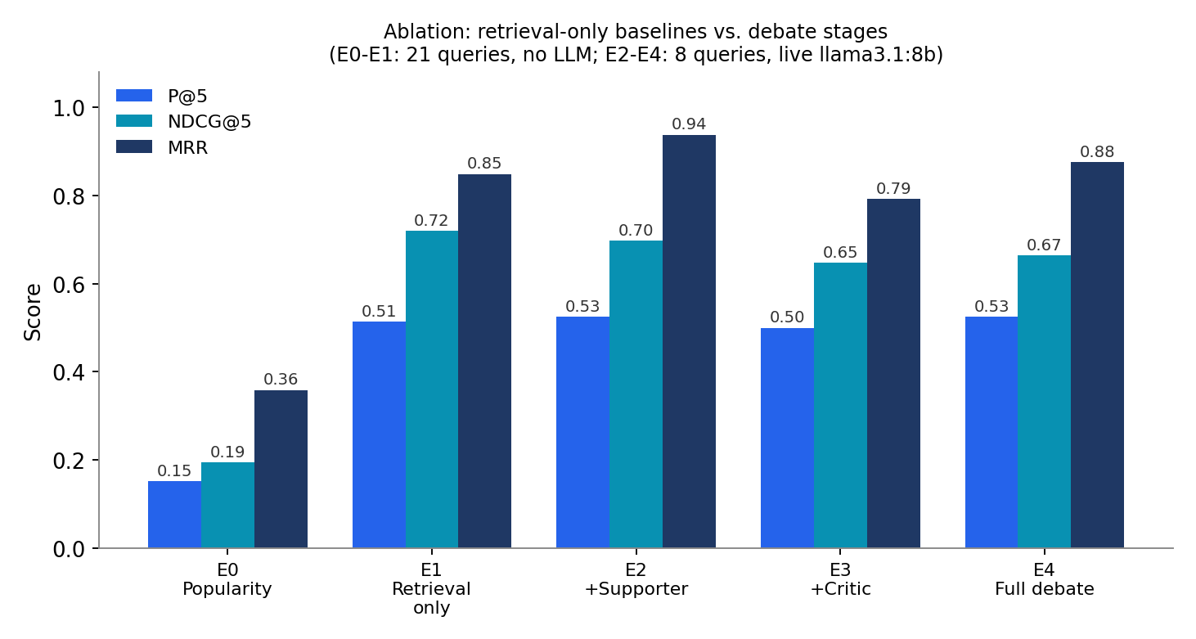
Results: retrieval does the heavy lifting
NDCG@5: 0.194 → 0.720
constraint-aware retrieval vs. popularity
Hard violations: 0.000
in every condition
Debate stages: inconclusive
E4 0.665 vs. E1 0.720 on 8 queries; two runs differed by up to 0.11
E1 and E2-E4 differ in query count and shortlist width, so this is not yet a paired comparison.
DebateRec | CSE4077 Recommender Systems
13
Notes:
State the honest result: retrieval lifts NDCG from 0.194 to 0.720. On the 8-query live subset the debate did not beat retrieval alone; two runs varied by up to 0.11, so this is inconclusive, not negative. The matched 21-query paired run is the next step.

Slide 14
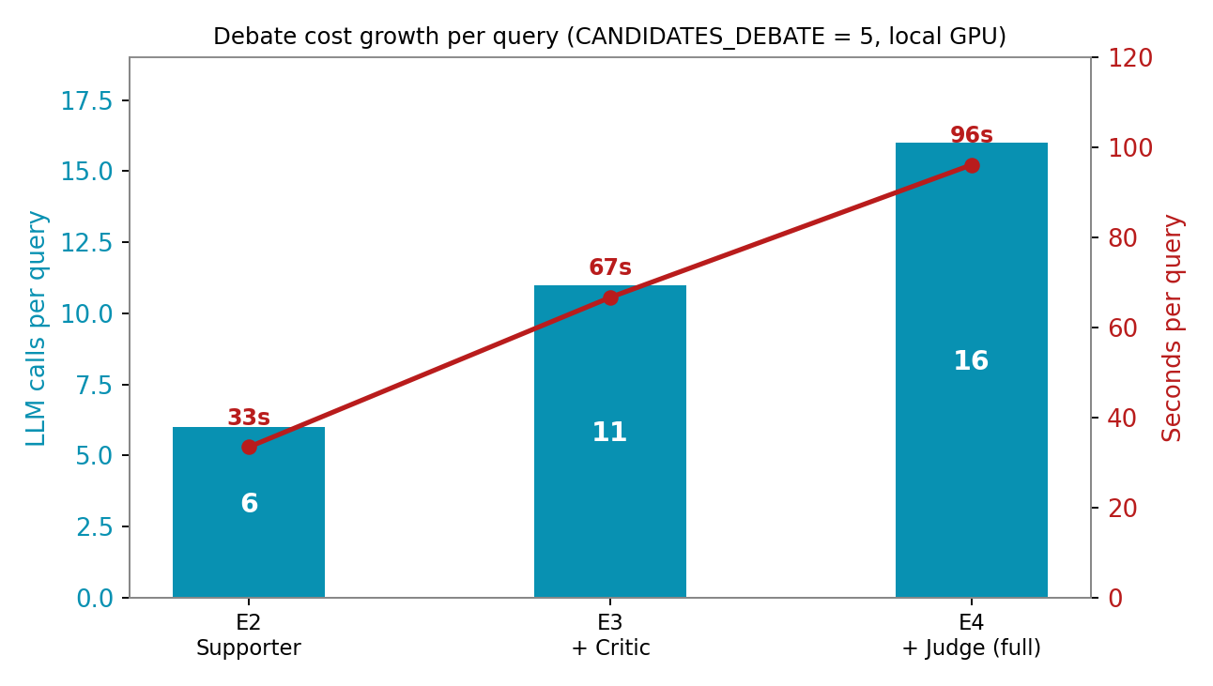
Cost: each agent adds calls and seconds
Cond. | Calls / query | Seconds | Total calls
E2 | 6 | 33.5 | 48
E3 | 11 | 66.7 | 88
E4 | 16 | 96.2 | 128
Retrieval alone: about 0.01 s per query, no LLM.
Call counts recovered from successive differences: the harness's counter is cumulative across a run, a limitation we found and report.
DebateRec | CSE4077 Recommender Systems
14
Notes:
One extraction call plus five calls per added role at five debated candidates. Latency is the main practical cost, which is why the shortlist width is the key tuning knob.

Slide 15
Case study: the Critic catches an overstated claim
“I want a funny science-fiction movie from after 2015, preferably under two hours” → Spider-Man: No Way Home (148 min)
Supporter 6.0 / 10
Critic 4.0 / 10
Judge 0.3 / 10
“It is a science fiction movie, which matches your preferred genre.”
“The film has a funny tone, satisfying your soft preference.”
“FAILs runtime constraint (148 minutes exceeds 120).”
Flags the Supporter: the data lists several genres, “only one of them is Science Fiction.”
Decision: consider (confidence 0.6).
Meets genre and tone, “but falls short on the runtime constraint”; score tracks the audit (FAIL, 0.529).
The audit, not the more flattering argument, set the score.
DebateRec | CSE4077 Recommender Systems
15
Notes:
Live llama3.1:8b transcript. The Supporter overstates the genre match; the Critic notices only one of the listed genres is science fiction. The Judge's score follows the audit (runtime FAIL, 0.529), not the Supporter's framing.

Slide 16
Comparison with existing approaches
Approach | Refs | How DebateRec differs
Classical CF / content-based | [1]-[5] | Adds free-text understanding and a debate-generated explanation
Single-LLM recommenders | [6]-[10] | Adds an adversarial check the model cannot override (deterministic audit)
Conversational recommenders | [11]-[14] | Single-turn here (a limitation), but adds debate and audit
Explainable recommendation | [15] | Auditable pro/con transcript instead of one narrative
Multi-agent debate / LLM-judge | [16]-[21] | First use on constraint-grounded item recommendation in this survey
Constraint-based recommenders | [26]-[28] | Same hard / soft idea, plus language understanding and argumentation
DebateRec | CSE4077 Recommender Systems
16
Notes:
Each row maps to a family from the survey. The common thread: we add an adversarial, auditable stage that earlier families lack.

Slide 17
Limitations and future work
Limitations
Future work
Live debate run covers 8 queries and 5 candidates; results are directional
22,400 of 22,614 records are synthetic
Extraction is single-turn
Eval harness LLM-call counter is cumulative; tests error under a live provider
Matched 21-query, 8-candidate run with Wilcoxon and Cohen's d
Public datasets (MovieLens, TMDB, Goodbooks) via adapters
Dense retrieval vs. lexical default
Multi-turn elicitation and a user study of explanation usefulness
Fix the two tooling bugs
DebateRec | CSE4077 Recommender Systems
17
Notes:
Be upfront: small live subset, synthetic catalogue, single-turn extraction, and two tooling bugs found while experimenting. The future work list answers each one.

Slide 18
Conclusion
Built a debate-based, multi-domain recommender whose Judge is bound to a deterministic constraint audit
Works offline: Gemini, Ollama or a no-key deterministic fallback, switchable at runtime
34/34 tests pass; hybrid retrieval lifts NDCG@5 from 0.194 to 0.720
Live transcripts show the Critic catching an overstated claim
Debate's ranking benefit is inconclusive so far; the matched paired run decides it
DebateRec | CSE4077 Recommender Systems
18
Notes:
Close on the contribution and the honest status: built, tested, evaluated with limits stated.

Slide 19
Selected references
[9] Y. Hou et al., “Large language models are zero-shot rankers for recommender systems,” ECIR, 2024.
[13] J. Huang et al., “A multi-agent conversational recommender system,” arXiv:2402.01135, 2024.
[16] Y. Du et al., “Improving factuality and reasoning in language models through multiagent debate,” ICML, 2024.
[17] T. Liang et al., “Encouraging divergent thinking in LLMs through multi-agent debate,” EMNLP, 2024.
[19] A. Smit et al., “Rethinking the bounds of LLM reasoning: Are multi-agent discussions the key?,” ACL, 2024.
[20] L. Zheng et al., “Judging LLM-as-a-judge with MT-bench and chatbot arena,” NeurIPS, 2023.
[22] S. Robertson and H. Zaragoza, “The probabilistic relevance framework: BM25 and beyond,” FnTIR, 2009.
[26] A. Felfernig and R. Burke, “Constraint-based recommender systems,” ICEC, 2008.
Thank you | Questions and live demo
DebateRec | CSE4077 Recommender Systems
19
Notes:
Full 44-reference list is in the report and the IEEE paper. Invite questions and offer the live demo.

