Slide 1

Affinity Search Engine
-The anime recommendation system

Slide 2
Understanding data
Context:
This data set contains information on user preference data from 73,516 users on 12,294 anime. Each user is able to add anime to their completed list and give it a rating and this data set is a compilation of those ratings.
Content:
Anime.csv(12294 X 7):
anime_id - unique ids of the animes.
name - full name of the anime.
genre - genres for the animes.
type - movie, TV, OVA, etc.
episodes - how many episodes in this show. (1 for the movies).
rating - average rating out of 10 for the anime.
members - number of community members for the specific anime's "group".

Slide 3
Contd.
Rating.csv(7813737 X 3):
user_id - non identifiable randomly generated user id.
anime_id - the anime that this user has rated.
rating - rating out of 10 this user has assigned (-1 if the user watched it but didn't assign a rating).
Acknowledgements:
Thanks to myanimelist.net API for providing anime data and user ratings.
Inspiration:
Building a better anime recommendation system th.

Slide 4
Problem / Input / Output
Problem Statement:
To Find the product recommendations for given user or for given item.
Input:
we considered Anime Name as the input for the Content based recommendation and User Id as the input for Item-Item & User-Item based recommendation.
Desired Output:
Our aim is to provide the Anime recommendations with best match with the user’s taste and preference.

Slide 5
Flow chart:
Data mining
Problem defining
Data Visualization
Deciding the approach
Content Based
CF-Based
Apriori (similar gener)
Cosine similarity (Ratings & Gener)
Item-Item (Cosine similarity)
User-Item (K-Means)
Checking the accuracy of the solution
Implementation

Slide 6
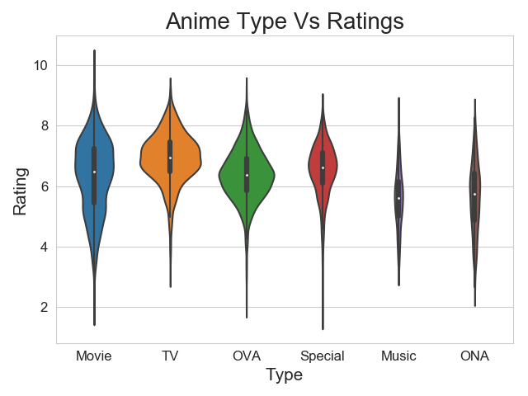
Insights of the Data,
Violin plot

Slide 7
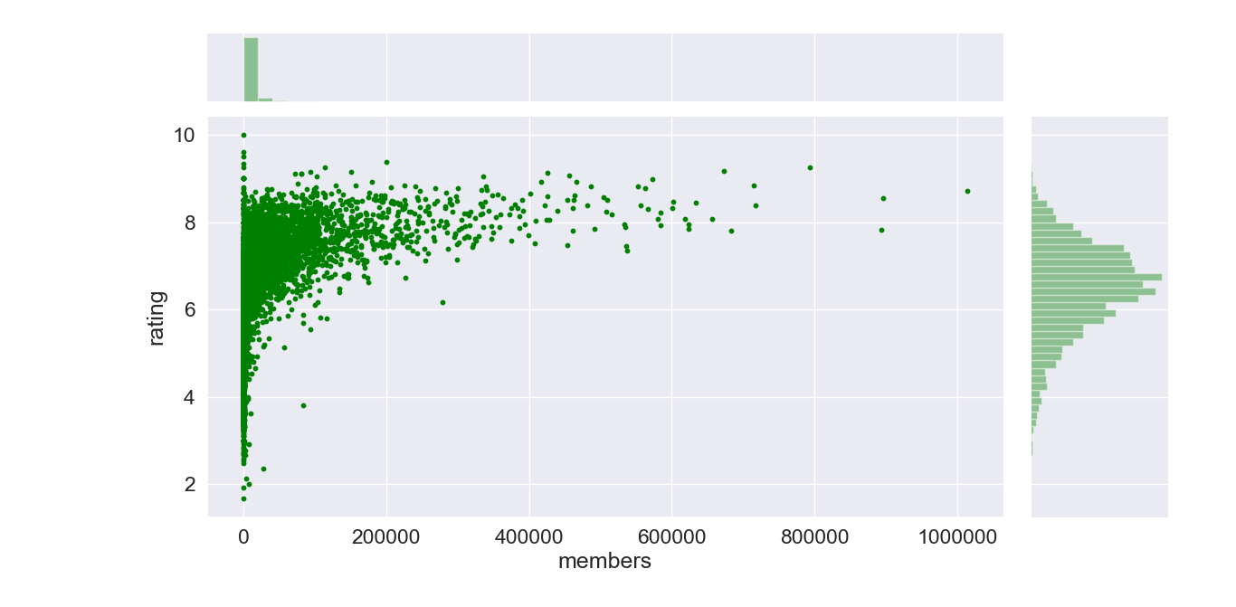
Joint plot: members Vs anime ratings

Slide 8
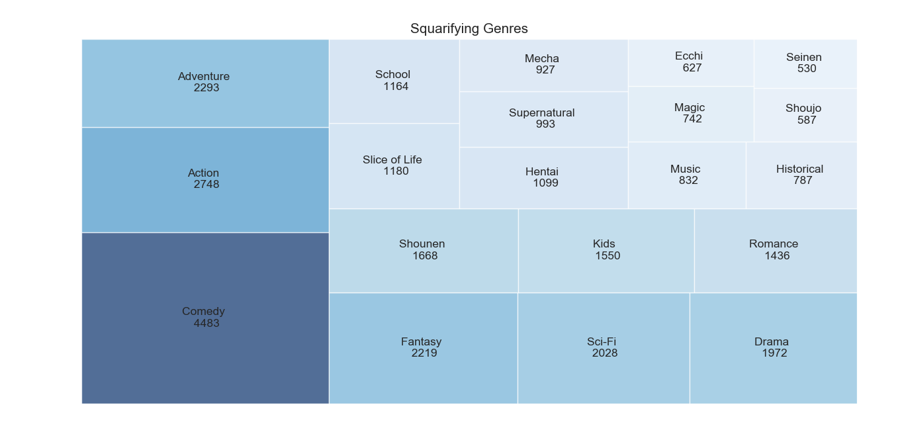
Tree map: top 20 Genres

Slide 9
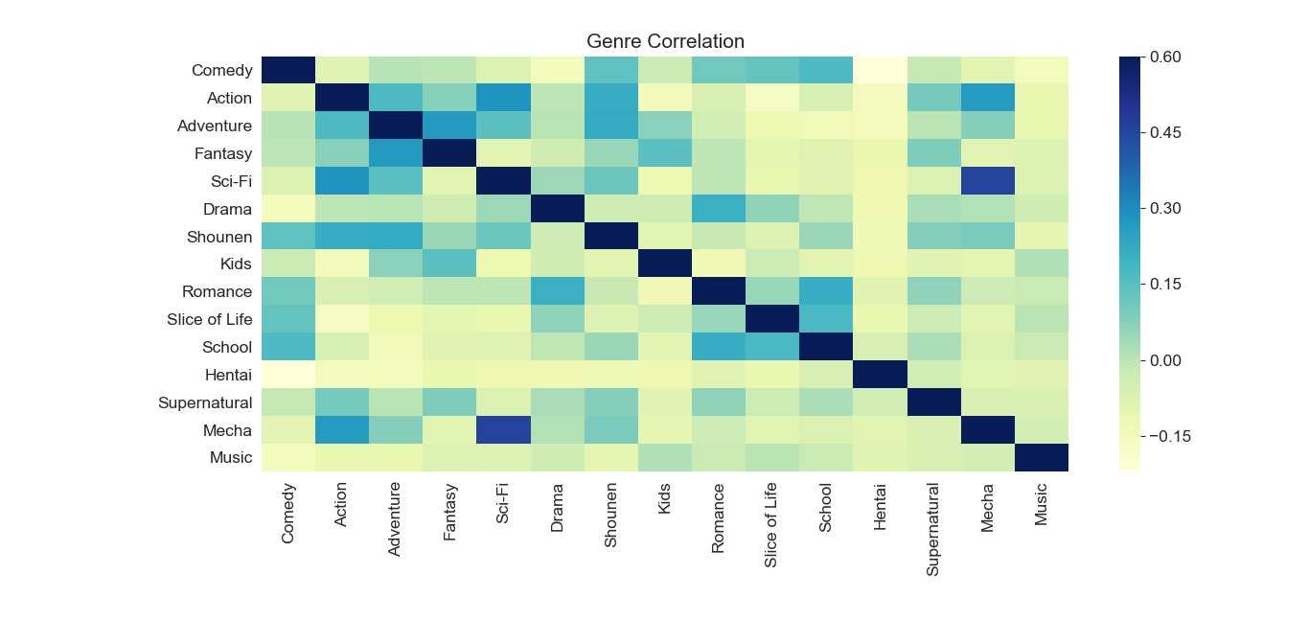
Genre Correlation

Slide 10
Solution, in detail
Content based Filtering(Similar Rating & Genre):
Firstly, we have created the correlation table for User rating and Genre type.
From the above table, we considered only the anime with more than 7000 no. of ratings.
From those animes, we called only top 10 anime recommendations as listed below.
get_recommendation('Kimi no Na wa.')
name | correlation | num of ratings
Shigatsu wa Kimi no Uso | 0.667975 | 9448
Eureka Seven | 0.665077 | 7851
Fruits Basket | 0.660551 | 11130
Zetsuen no Tempest | 0.648267 | 7530
Rurouni Kenshin: Meiji Kenkaku Romantan | 0.64156 | 7900
Haikyuu!! | 0.641257 | 7369
Bakuman. | 0.638062 | 8606
Fate/stay night: Unlimited Blade Works | 0.628938 | 7730
Nanatsu no Taizai | 0.628097 | 8192
Shokugeki no Souma | 0.627877 | 7990

Slide 11
Content based Filtering(Genre of the anime watched by the user):
We are considering only anime genre of the animes watched by the user,
Using Aprior algorithm to get the combination of 4 pair gener of the anime watched by the same user.
Secondly, we sort them by most occurred pairs, from this list we consider the top most one.
Based on the above pair of genre, we recommending the animes of top 10.
recommendation_by_user_common_genre(5010,anime_data,user_data) ->
Genre combination pair -> ('Shounen,Comedy,Adventure,Action', 13)
Recommedation anime name ->
One Piece
JoJo no Kimyou na Bouken: Diamond wa Kudakenai
Samurai Champloo
One Piece Film: Z
InuYasha: Kanketsu-hen
Dragon Ball Z
Fairy Tail (2014)
Fairy Tail
Dragon Ball Kai (2014)
Lupin III (2015)

Slide 12
Item-Item Collaborative Filtering Based Recommendation System:
Here we calculate the similarity between animes.
We have considered top similar animes, with their similarity scores and the ratings by other users for filling sparse matrix for the particular user.
Based on the similarity score, we recommend top 10 animes to the user.
The screenshot of the results shows that the recommended animes are of same type, the genre and the ratings are close to each other.
Anime Name | Type | Rating
Utsunomiko | Movie | 6.35
Enchanted Journey | Movie | 6.32
The monkey king conquers the demon | Movie | 6.67
Xabungle grafitte | Movie | 5.33
Osamu to Musashi | Movie | 6.4
Planetarian: Hoshi no Hito | Movie | 7.38
Tistou Midori no Oyayubi | Movie | 7.1
Toufu Kozou | Movie | 6.15
Mirai Shounen Conan: Tokubetsu-hen - Kyodaiki | Movie | 6.93
Tezuka Osamu no Buddha: Owarinaki Tabi | Movie | 7.11

Slide 13
CF Based Recommendation System using Clustering technique:
Removed those rows where the user rating is less than avg rating, then both anime and user datasets are merged to filter the first 20000 users.
Based on that, we created pivot table between item and the user with rating as values to figure the relationship between the Item and User.
We applied PCA to reduce the dimension to form the clusters using K Means algorithm.
We recommend the top n movies to the users based on the cluster they fall into.
Cluster 0 | Cluster 1 | Cluster 2 | Cluster 3
Steins;Gate | Death Note | Death Note | Shingeki no Kyojin
No Game No Life | Code Geass: Hangyaku no Lelouch | Shingeki no Kyojin | Death Note
Angel Beats! | Code Geass: Hangyaku no Lelouch R2 | Sword Art Online | Sword Art Online
Toradora! | Sen to Chihiro no Kamikakushi | Fullmetal Alchemist: Brotherhood | Angel Beats!
Code Geass: Hangyaku no Lelouch | Fullmetal Alchemist | Code Geass: Hangyaku no Lelouch | No Game No Life
Code Geass: Hangyaku no Lelouch R2 | Cowboy Bebop | Sen to Chihiro no Kamikakushi | Fullmetal Alchemist: Brotherhood
Fullmetal Alchemist: Brotherhood | Tengen Toppa Gurren Lagann | Fullmetal Alchemist | Steins;Gate
Shingeki no Kyojin | Neon Genesis Evangelion | Angel Beats! | Code Geass: Hangyaku no Lelouch
Bakemonogatari | Fullmetal Alchemist: Brotherhood | Code Geass: Hangyaku no Lelouch R2 | Code Geass: Hangyaku no Lelouch R2
Death Note | Mononoke Hime | Naruto | Mirai Nikki (TV)

Slide 14
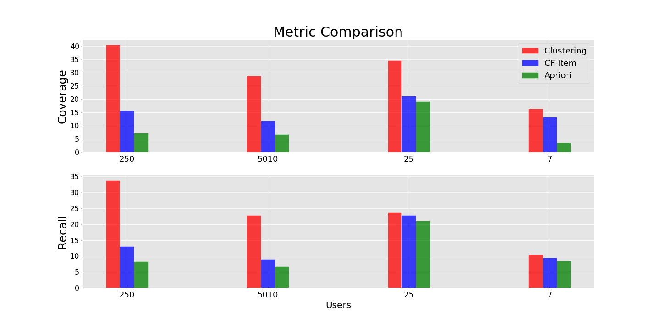
Metric Comparison

Slide 15
Observations / Inferences drawn / Challenges faced and resolved / Learnings
Observation:
Clustering is more suitable technique for recommending the anime.
Challenges faced:
Since our data is not a time dependent, we weren’t able to calculate accuracy and precision in performance calculation.
Learnings:
Different algorithms and techniques for building recommendation system.
Computing performance metric like Coverage and Recall for time-independent data.

Slide 16
Honour Code
We declare that this written submission represents our ideas or words have been included. We also declare that we have adhered to all the principles of academic honesty and integrity and have not misrepresented or fabricated or falsified any idea/data/fact/source in our submission. We understand that any violation of the above will be cause for disciplinary action by the institution and can also evoke penal action from the source which have thus not been properly cited or from whom proper permission has been taken when needed.

Slide 17
Team contribution
Member | Work Done | % Contribution
Raviraj Dixit | UI & Apriori Algo | 25%
Akshay Nimbalkar | Visualization & CBR | 20%
Sangeeth Kumar | CF-Item based | 20%
Harish Fegade | CF-Clustering | 20%
Tamil Selvan | Reports & CF-using SVD | 15%

