Slide 1
Text Mining and Information Retrieval using SVD in LSI (Latent Semantic Indexing)

Slide 2
Introduction
Latent → Hidden
Semantic→ Related to language or Logic
Latent semantic indexing (LSI) is an indexing and information retrieval method.
It helps in finding out the documents which are most relative with the specified keywords.
It also helps the search engines to give most appropriate results for the search query.
..

Slide 3
Linear Algebra Concepts Used.
Singular value decomposition(SVD)
Frobenius norm
Jacobi Method
Transpose
Inverse & Orthogonal Matrices
Matrix Multiplication

Slide 4
Implementation from scratch | Implementation using libraries
Using Jacobi method to find eigenvalues and eigenvectors and then finding singular values and U matrix. | np.linalg.svd()
Normal Matrix Multiplication Approach | np.dot() of numpy
Transpose function | Numpy transpose
Our own documents. | SciKit Learn dataset documents

Slide 5
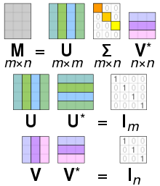
Singular Value Decomposition (SVD)
Singular value decomposition (SVD) is used to find the optimal set of factors which predict the best outcome. It is used in LSI to find the documents related to searched keyword.
We use SVD to compress a matrix by reducing the number of singular values by an integer k.
SVD is used to identify patterns in the relationships between the terms and concepts contained in the form of an unstructured collection of text.

Slide 6


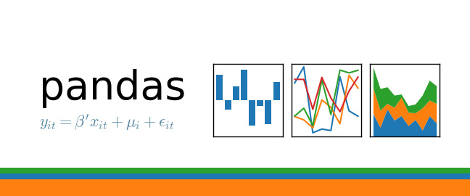


Coding and Simulation
Types of modules and libraries used:
Matplotlib: For plotting graphs
Numpy: For using various functions efficiently (Though they are done by us from scratch too.)
Pandas: For making dataFrames
NLTK: For removing Stopwords
Sci-Kit Learn: For accessing various datasets

Slide 7
STEP-1: Loading and Preprocessing data in text format
We loaded the documents from SciKit learn fetch_20newsgroup dataset (for the program with libraries. For the program made from scratch, we made our own text documents and processed them.
We tokenized the strings from those documents and stored the tokenized words in a 2D list (1 list per document).
We traverse through all docs and remove all words which are ‘stopwords’ and store the resultant data in a BOW(‘Bag of Words’.).
Then we made a wordset (a set of unique words) of bow.

Slide 8
STEP-2: TF-IDF matrix
It stands for “Term Frequency - Inverse Document Frequency”.
First we create a term document matrix - a matrix containing count of each word in each document.
We normalize the document term matrix by using term frequency as (count of a word in a document)/(total words in a document).
We calculated the idf (inverse document frequency)weight of a word as log_{e}(total number of docs/total number of docs containing that word)
Then we multiply term frequency of each word in each document with its idf weight. Thus, we get the term frequency-inverse document frequency matrix.

Slide 9
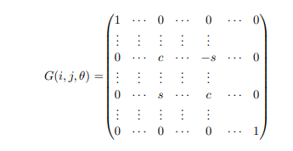

Jacobi Theorem
The Jacobi method can only be applied on symmetric matrices. We used it to find eigenvalues and eigenvectors of A^T*A.
This image is a Givens matrix. Suppose the maximum non-diagonal element of the matrix is located at index i,j. Theta is found by using the below formula.
Then this transformation matrix (Givens matrix) is multiplied with the original matrix to nullify the maximum non diagonal element until we get a diagonal matrix.
The diagonal of the resultant matrix gives us its eigenvalues!

Slide 10
Step 3: Reconstructing the matrix
We found the singular values of l_2d by using SVD.
In the zero_padding function, we pad the first n singular values with zeros in such a way that we get a resultant matrix Sigma which has m*n dimensions.
Suppose s = no. of singular values. We iterate through 1 to s-1 and pad each by using zero_padding() function (here n = i). Then we make a reconstructed matrix and compare it with the original matrix using the frobenius norm.
If we get frobenius(original - reconstructed)/frobenius(original) < 0.35 (a threshold set by us), we use the reconstructed matrix for relevance ranking.
Note: here the reconstructed matrix is the compressed matrix.

Slide 11

Step 4: The Search Function
It takes a string q as input and processes it (removes punctuations and tokenizes the string).
Then it browses through all the unique terms in the dataset. If none of them match any word from the input, we say that no documents matched the search. Otherwise:
It uses the reconstructed (compressed) matrix and multiplies it with a list containing 1’s and 0’s (1 if that word exists in the input string. Else 0) This gives us the relevance score of each document. (higher score means that a document is more relevant)
Using this relevance score, we output the relevance order.

Slide 12
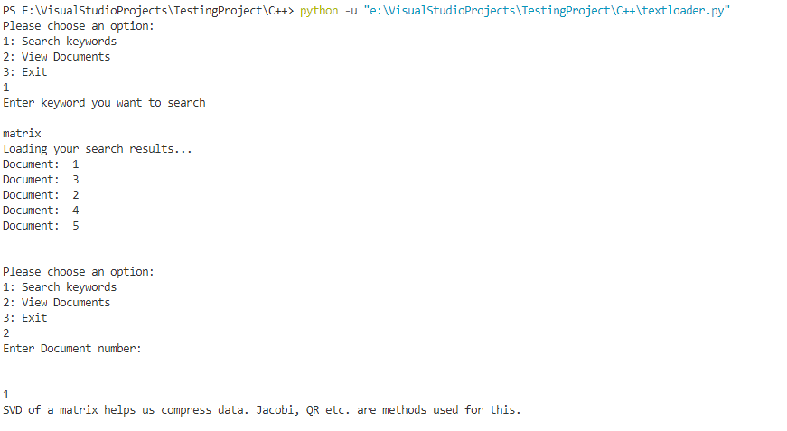
INPUT
We had taken and made datasets of file having some information(strings).
We had asked user to enter a string whose relevance order he wants to find.
We had asked users to write which document they want to see.

Slide 13
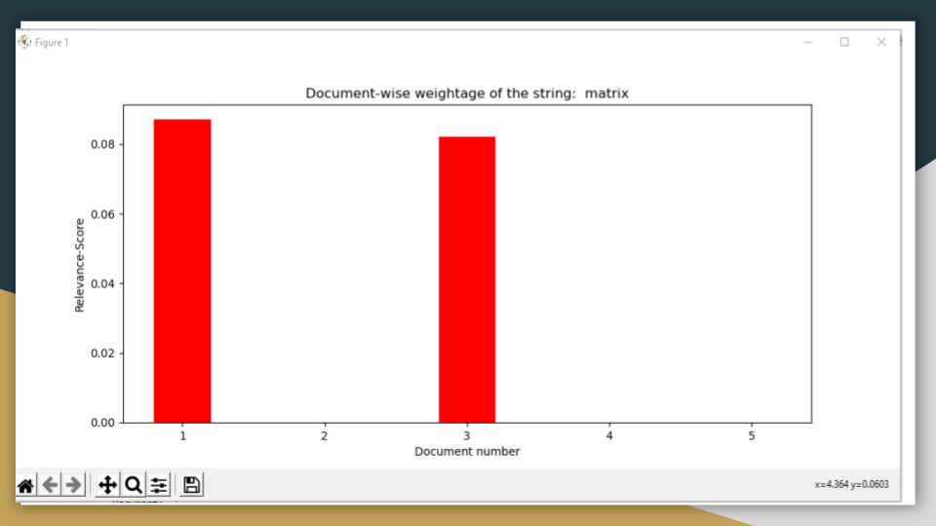
OUTPUT
Sequence of Documents in order with maximum similarity .
To show the document if user want to see.
Graph which shows the similarity of the searched keyword with the documents
Y→ Relevance Score
X→ Number of Documents
Doc1 is:
SVD of a matrix helps us compress data. Jacobi, QR etc. are methods used for this.
Doc3 is:
Solution space of a linear system can be found by reducing a matrix to its row reduced echelon form.

Slide 14
Errors
How we solved it
Wrong EigenValues and EigenVectors.
This was encountered because of some minor errors in implementation of Jacobi.
Numbers were not getting deleted from the input data i.e. rem_nums() function was not working properly.
It was giving error due to minor mistake of syntax.
The numpy array was not having the 2nd dimension for the 1D array.
Incorrect dimensions of matrices while implementing matmul() function.
We checked all functions find_k() was calling inside itself. We found that this was happening because in some cases, the while loop for jacobi theorem was not working properly - it was returning incorrect eigenvalues.
None type error - the find_k() function was failing to return anything.

Slide 15
Errors
How we solved it
When Number of Rows> Number of Columns → We were getting wrong answers for SVD.
We noticed that our method was giving correct answers when number of columns > number of rows. So, we found SVD of A^T (it returned U,Sigma,V^T) and then found SVD of A as V, Sigma^T, U^T.
Precision of numbers were generating too much errors as some numbers which were 0 are given as 0.13149012e-15 etc. Due to this, the Jacobi took too many iterations to output the correct answer.
It was solved by rounding the decimal places of all the numbers.

Slide 16
Errors which we were not able to solve
Relevance Score sometimes comes out to be negative, for that we have converted that value into zero.
If there are same number of keywords in any two documents ,then we get any of those document as output as the best search because of the precision issues in Relevance Score values.
We were not able to make our code as efficient as we wanted it to be. This gave us a learning that how efficient and fast the inbuilt modules are.
We wanted to implement numba for making our code more efficient but we were not able to solve the ‘cannot import name 'jit' from partially initialized module ‘numba’ in Vscode and Jupyter.

Slide 17


