Slide 1

Phaser-Blockly
http://rpnjcoderdojo.com/blockly/blockly-phaser/code/
http://phaser.io

Slide 2
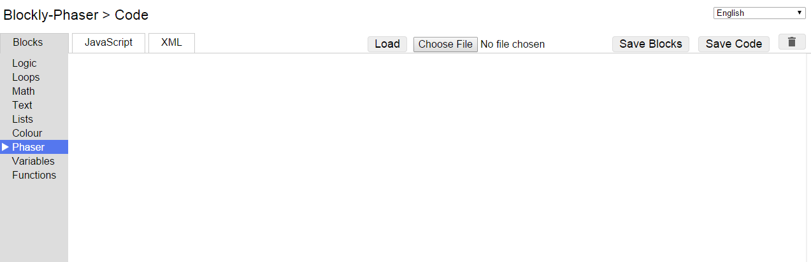
Main Blockly-Phaser Page
Toolbox
Code Panels
Load Blocks
Save Blocks
Save Code

Slide 3
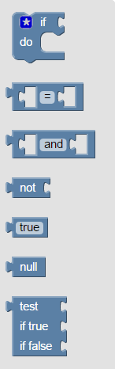
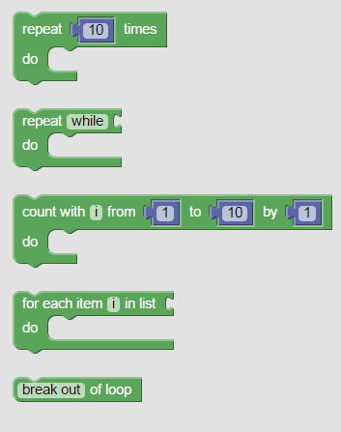
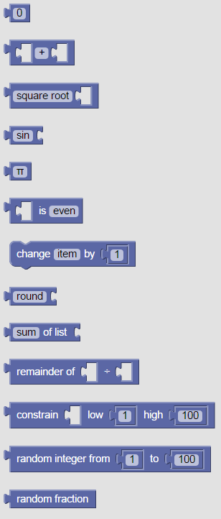
Logic
Loops
Math

Slide 4
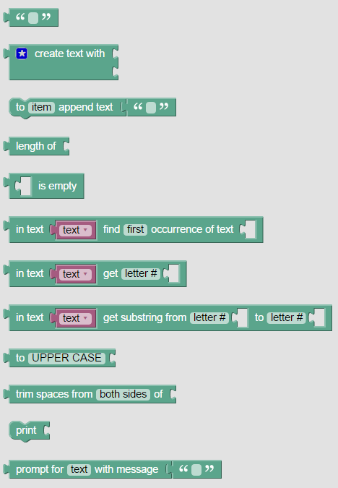
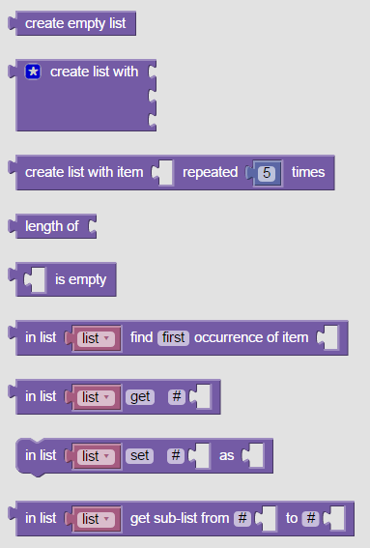
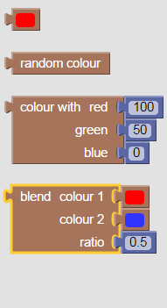
Text
Lists
Color

Slide 5
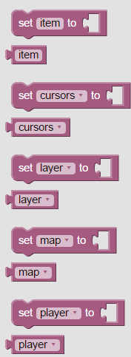
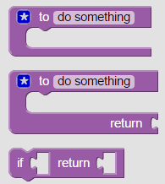
Variables
Functions

Slide 6
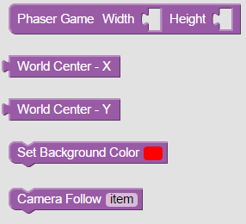
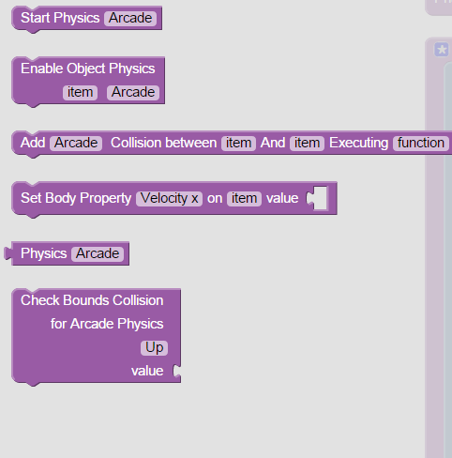
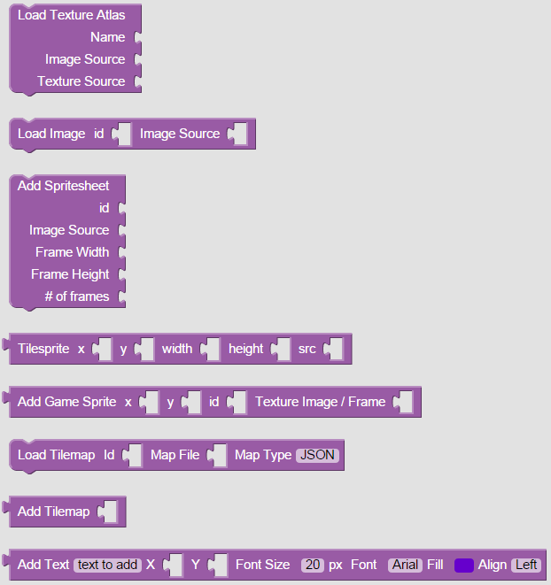
Phaser Blocks
Game
Physics
Assets

Slide 7
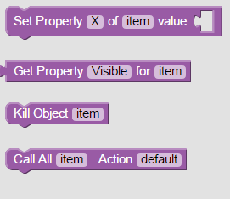
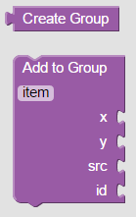
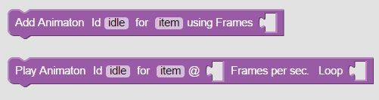
Game Object
Groups
Animation

Slide 8
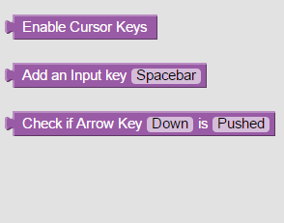
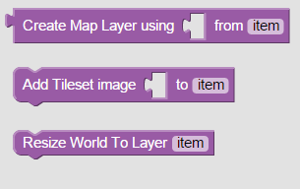
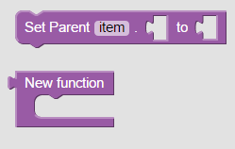
Input
Game Map
Misc

Slide 9
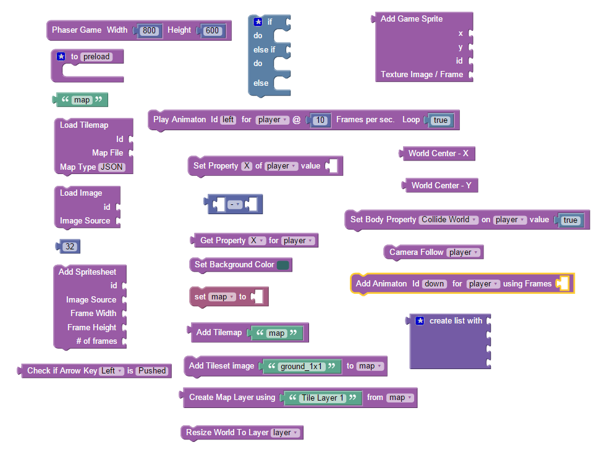
Blocks We will Use to create our starter game

Slide 10
Lets Gets Started
Lets create a sprite graphic for our Hero
Using MMORPG Maker XB Character / Sprite Generator
http://www.mmorpgmakerxb.com/

