Slide 1
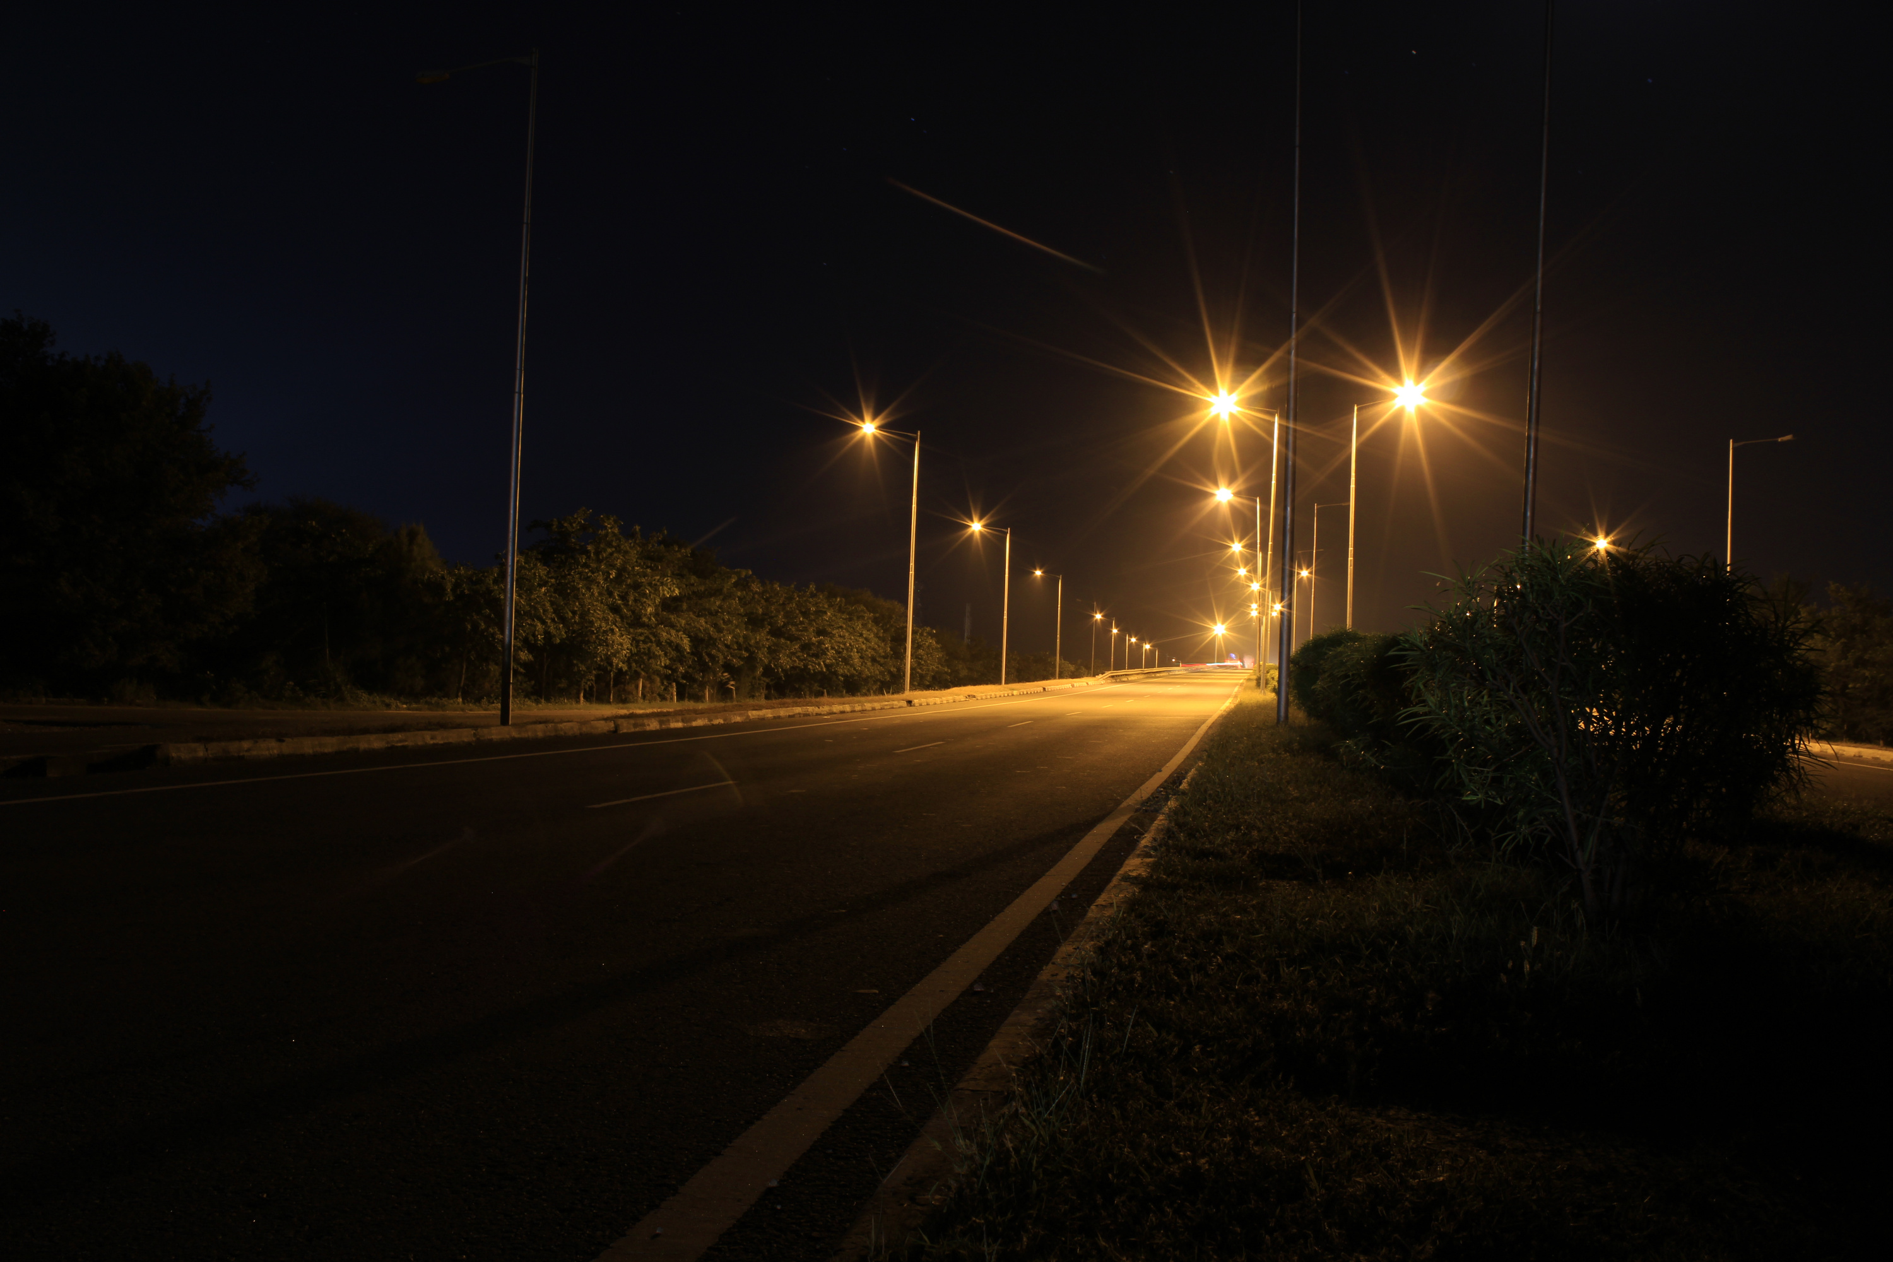






ITMS
INTELLIGENT TRAFFIC
MANAGEMENT USING FUZZY LOGIC & MACHINE LEARNING
Empowering Sri Lanka's traffic with Fuzzy Logic and Machine Learning for a smoother, smarter journey
PROJECT ID : 25-26J-330
1

Slide 2

ITMS
PP2 COMMENTS AND
ACTIONS TAKEN
IT Number | PP2 Comments | Action Taken
IT22925572 | Need to determine the parking violation zones manually once. | Prepared for the final viva.
IT22900890 | Demonstration was not satisfactory | Prepared for the final viva demonstration.
IT22363848 | Fuzzy logic was not properly demonstrated as only one rfid was used on one lane emergency vehicle priority is not simulated clearly. | Added a two-lane setup for emergency vehicle detection and vehicle priority.
IT22337580 | Demonstration was not satisfactory | Prepared for the final viva demonstration.
2

Slide 3
ITMS
PROBLEM IN BRIEF
Severe traffic congestion and delays
Static signal systems (no real-time adaptation)
Cannot handle local traffic (tuk-tuks, buses)
Lack of smart monitoring and control
DESIGN EXCELLENCE
Real-time control using Fuzzy Logic & Machine Learning
Adaptive traffic signals (not fixed-time)
Emergency vehicle prioritization
Integrated system (signals, violations, parking, risk)
3

Slide 4



ITMS
GUNARATHNA R.P | IT22925572
PARKING BEHAVIOUR &
TRAFFIC IMPACT ANALYSIS
Detects illegal parking using AI (YOLOv8 + BoT-SORT)
Tracks vehicles and measures parking duration
Evaluates impact on traffic flow
Applies a dynamic fine system based on duration and impact
Sends real-time alerts
IT22925572 |
Gunarathna R.P |
25-26J-330
05/05/2026
4

Slide 5




ITMS
RANDIMA K.M.G.D | IT22900890
SMART TRAFFIC VIOLATION DETECTION
Detects traffic violations using YOLOv8 (AI-based detection)
Identifies violations and tracks vehicles in real time
Assigns a 100-point driver safety score
Score reduces based on violation severity and resets daily
Sends alerts and generates reports to promote safe driving
IT22900890 |
Randima K.M.G.D |
25-26J-330
05/05/2026
5

Slide 6


ITMS
TENNAKOON I.M.S.R | IT22363848
FUZZY LOGIC CONTROLLER FOR
ADAPTIVE SIGNAL CONTROL
Collects real-time traffic data using IoT sensors (IR, RFID, cameras)
Controls traffic signals dynamically using fuzzy logic (IF–THEN rules)
Adjusts timing based on traffic density (low, medium, high)
Integrates machine learning for adaptive control
Provides emergency vehicle priority and reduces congestion
IT22363848 |
Tennakoon I.M.S.R. |
25-26J-330
05/05/2026
6

Slide 7


ITMS
PALIHAKKARA P.I | IT22337580
ACCIDENT RISK PREDICTION & DASHBOARD
Predicts accident risk using real-time data and AI analysis
Calculates risk using speed and violation history factors
Detects abnormal driving behaviors (sudden stop, lane drift, etc.)
Provides real-time alerts and risk levels (Low–Critical)
Displays insights through an interactive dashboard for monitoring
IT22337580 |
Palihakkara P.I |
25-26J-330
05/05/2026
6

Slide 8
TESTIMONIALS
RESULTS &
ITMS
Results
User Feedback
High accuracy (YOLOv8 ~85%+)
Real-time alerts (<2s)
Improved traffic flow
Easy-to-use dashboard
Faster decision-making
Positive safety impact
Limitations
Future Work
Depends on camera & weather
Prototype-level testing
Real-world deployment
Improve accuracy
Add advanced AI features
8

Slide 9
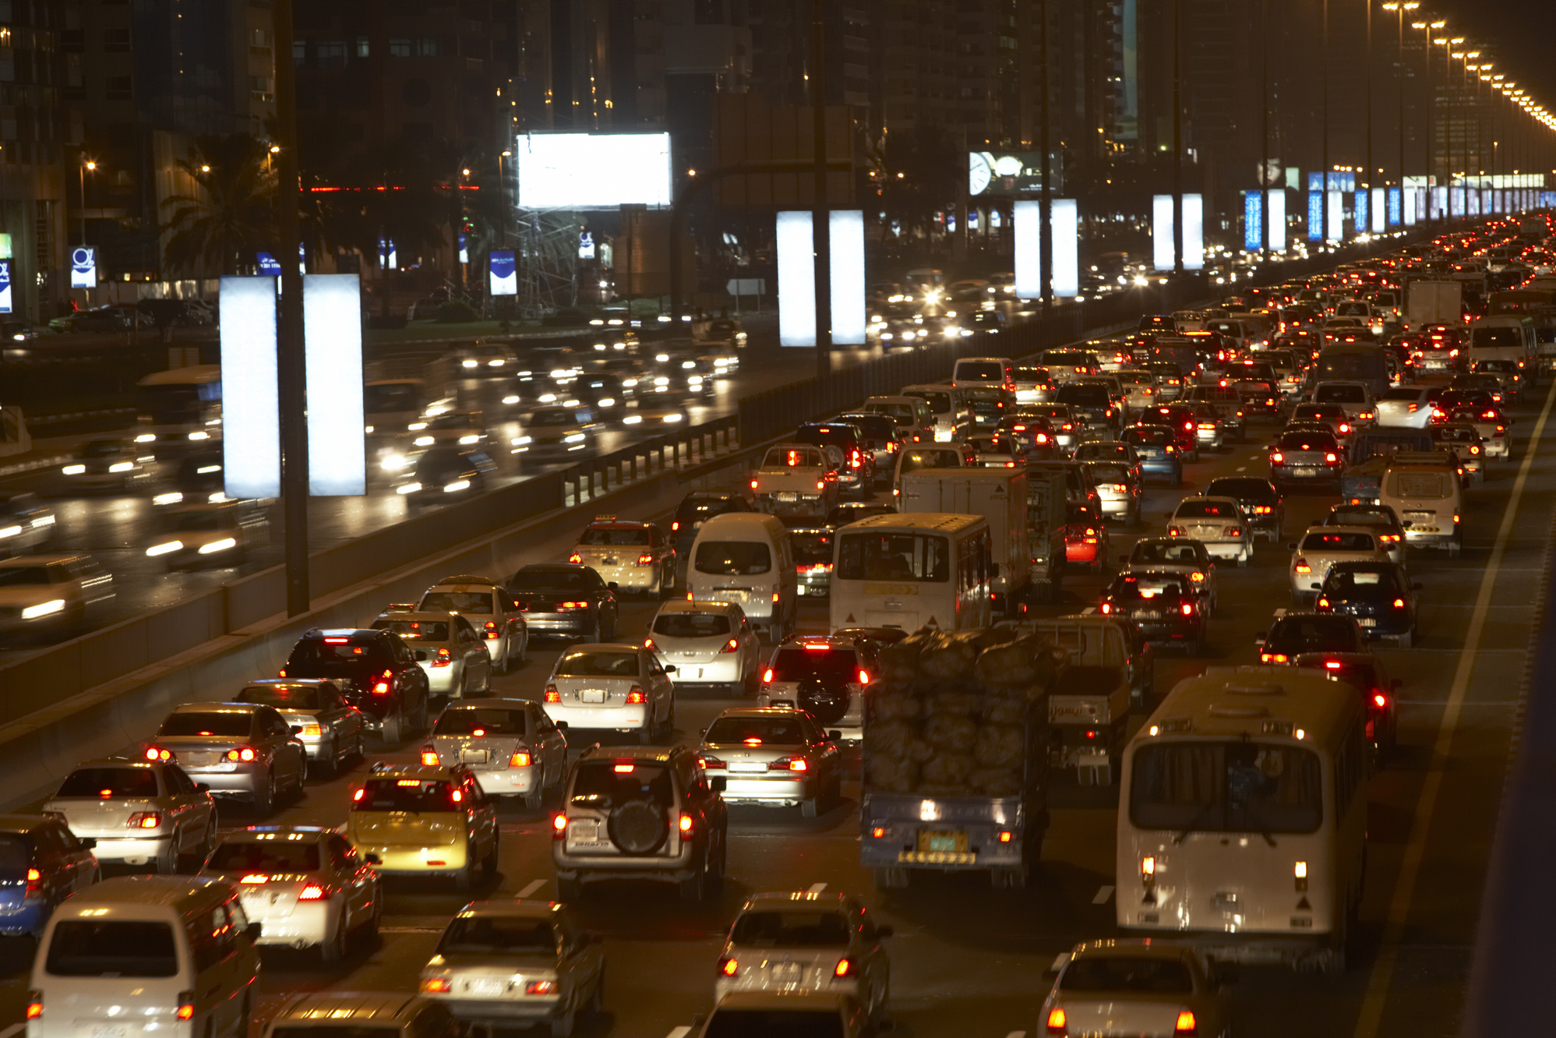

ITMS
THANK YOU
FOR YOUR
ATTENTION

