Slide 1
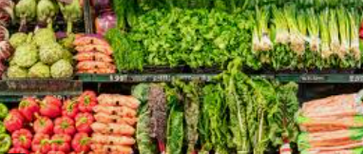
Analysis of Vegetable Prices
By Ruben Juries

Slide 2
Overview
These findings and explanations are based on the Vegetable prices data in csv format found in Kaggle
The data was imported into a notebook using Python for importing, cleaning, analysis and modelling predictions using vs code as the developing and analysing environment
The vegetable prices explained are relative to the dataset and does not explain vegetable prices from data sources outside of the used dataset

Slide 3
Purpose of the project:
The purpose is to analyse the price behaviour of each vegetable over time
The purpose is also to compare the most significant price changes among the vegetables
The purpose is also to use predictive models to forecast the prices of each vegetable for the year ahead of the dataset provided
The 10 Vegetables retrieved in the Dataset for the analysis are as follows:
Bhindi (Ladies finger)
Tomato
Onion
Potato
Brinjal
Garlic
Peas
Methi
Green Chilli
Elephant Yam(Suran)
The price information in the data set is dated for each vegetable from 1 January2023 until 1 January2024

Slide 4
Hypothesis to test the data:
Alternate Hypothesis: Most of these vegetables have a significant increase in prices over time
NULL Hypothesis: There is no significant increase in most of these vegetable prices over time
The findings based on the analysis indicate that there is a general upward trend in most of these vegetables over the time period
The NULL Hypothesis that there is no significant increase in most of these vegetables over time can therefore be rejected
Problem Statement following the Rejection of the NULL Hypothesis:
Vegetable prices have gone up significantly over the past year which can make it harder for people to afford

Slide 5
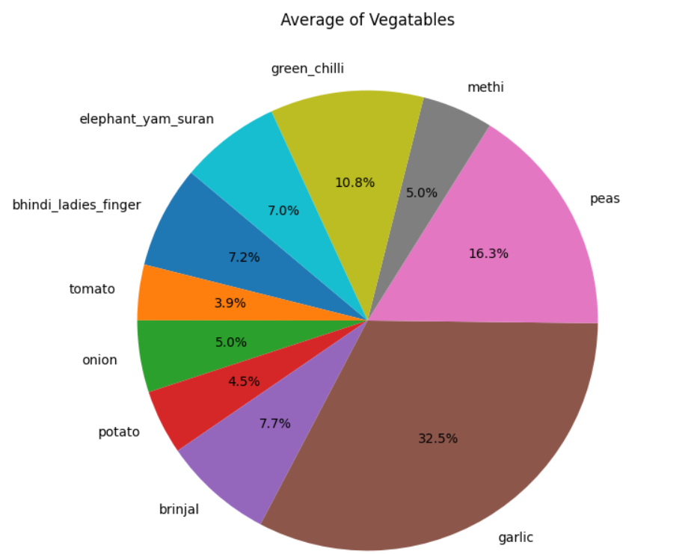
Findings:
A general upward trend with most of the vegetables are experienced
Seasonal price fluctuations are associated with Peas and Methi which can be related to seasonal demand
Tomatoes remain stable over the time period
Garlic is the largest contribution of average prices compared to the rest of the vegetables:
(See Pie chart to the right)

Slide 6
Predictions:
A liner model using time and pricing with predictions was produced
Garlic and Onion predictions were relatively close to the actuals
A few larger errors in the predictions were evident with Bhindi, Peas, Green Chilli and Methi
Following the linear regression model the data was further predicted using the Holt Winters and the ARIMA forecasting models
Parameters such as Additive, Multiplicative and changing ARIMA orders we ran and compared
The best fit model to the dataset was the ARIMA with order (5,1,0) for the forecasting needs of the year ahead of 1January2024
Further alignment of the ARIMA model was done to use the historical daily distributions in the data frame
for the forecast period ahead

Slide 7
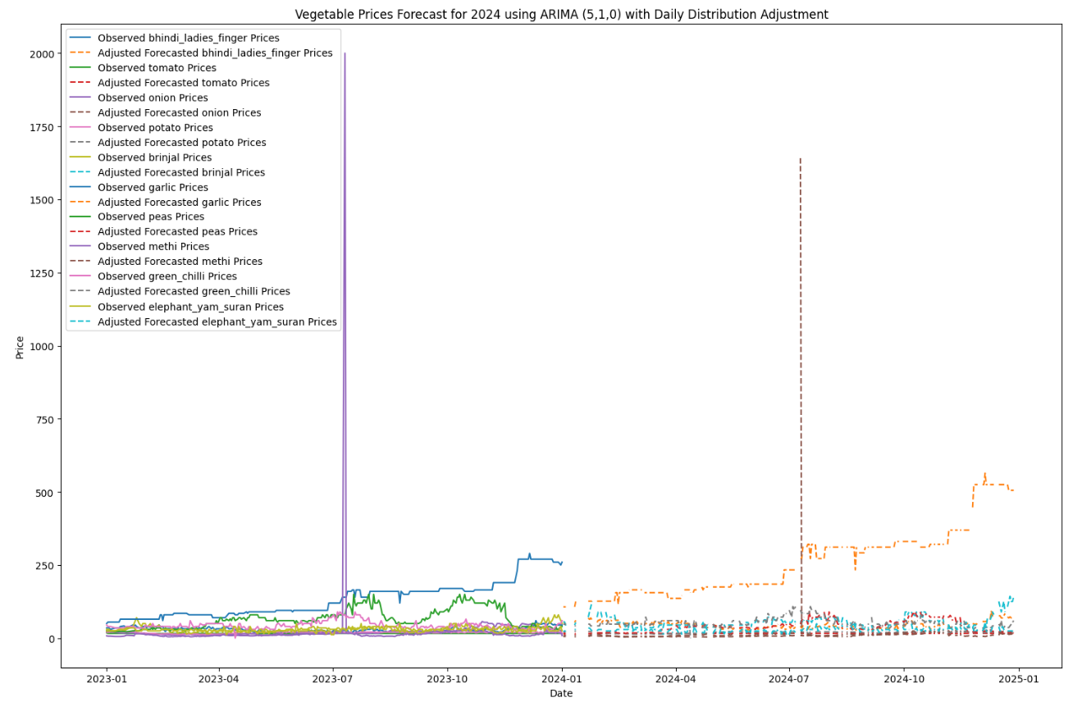
Findings from the final forecast:
Refer to Vegetable forecast graph on the right:
Garlic, being the highest price contributor still has the highest forecasted price increase over the next year 2024-2025
Garlic exceeds the average price of all other vegetables, indicating its significant role in the market.
Garlic exceeds 500 by January 2025, indicating a substantial price increase.
Tomato, Onion, and Potato show moderate price increases in the forecast, reflecting their stable demand.
Brinjal and Peas show lower forecasted prices, indicating less volatility in their market.

Slide 8
Recommendations:
Recommendations for the future model improvements:
Engineer additional features (weather, holidays, supply indicators, lagged values) to add explanatory power.
Fit vegetable-specific models and hyperparameter-tune (grid search / cross-validation) instead of one global model.
Apply robust preprocessing: outlier handling, log or seasonal decomposition, and differencing where appropriate, this can be
particularly useful for volatile series like methi and peas.
Use rolling-origin evaluation and multiple error metrics (RMSE, MAE, MAPE) to compare models reliably.
Consider ensemble and tree-based time-series models (e.g., XGBoost with lag features) or state-space models for volatile series.
Recommendations for the Consumer:
Monitor high-volatility vegetables closely (e.g., methi, peas) as they contribute disproportionately to forecast errors.
Use forecasts as one input among many (market intelligence, expert judgment) when making pricing and inventory decisions.
Invest in data collection for additional relevant features to improve future model performance.
Budget more for high vegetable prices increases such as garlic and filter down to specific regions to compare best prices
Assess the market for demands of high vegetable prices such as Garlic and determine if alternative vegetables can be substituted if budget constraints are tight

Slide 9
Links to additional resources:
www.kaggle.com/competitions/vegetable-price-prediction
Project schedule: Timeline - Vegetable Prices Analysis and Predictions - Jira
https://github.com/RPEJuries/Workplace_Project/tree/main?search=1
Pandas Documentation: https://pandas.pydata.org/docs/
Seaborn Documentation: https://seaborn.pydata.org/

Slide 10
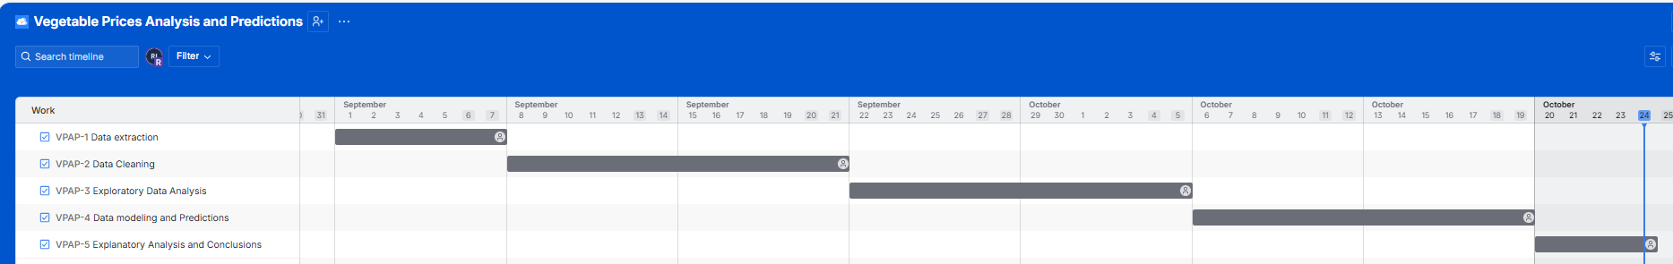
Trello project schedule:

Slide 11
Conclusion:
Analysing and understanding product price changes are important to assess supply and demand
Financial planning of products needed where price increases are high is important for future
understanding of the financial nature of the product in relation to the forecast
The forecast is a guideline which can always be altered as time progresses to produce more accurate predictions for the consumer
Adding more historical data to the dataset can be more useful to predict further future price trends of products
End

