Slide 1
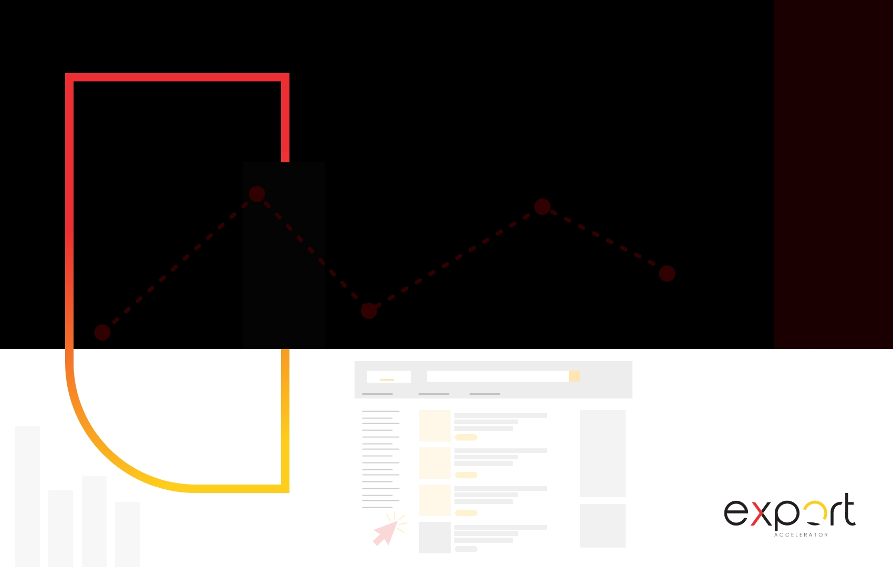

Spicewell
AMAZON AUDIT

Slide 2



Contents
Keyword Analysis
03
Sales & Ineffective Ad Spend
04
Match Type Analysis
05
Campaign Analysis
06
Lowest ACoS Keywords
07
Highest ACoS Keywords
08
Highest Click Keywords with No Sales
09
Duplicate Keyword Analysis
10

Slide 3

Keyword Analysis – Sponsored Products
Effective Keywords
Ineffective Keywords
4
9
27
17
PROFITABLE
NON-PROFITABLE
CLICKS WITHOUT SALES
ZERO CLICKS
Number of keywords that are converting within your target ACoS value of 30%.
This is the number of keywords that are converting at a greater than target ACoS value of 30%. So even though you are getting sales, you are paying too much for it.
This is the number of keywords that are leading to clicks but no sales, which means that your ad spend is completely wasted.
Thanks to the PPC model, you never lose money when there are no clicks for a keyword, but it still costs you indirectly to have impressions and no sales, because it impacts your CTR which impacts your overall relevancy.

Slide 4
Sales & Ineffective Ad Spend – Sponsored Products
Sales From Converting Keywords
Loss from Non-converting Keywords
$649.66
$657.58
$149.95
$0
PROFITABLE
NON-PROFITABLE
CLICKS WITHOUT SALES
ZERO CLICKS
This is the value of sales coming in from your profitable keywords. Profitable keywords are those that converted within your target ACoS value of 30%.
This is the value of sales (in the local currency)that are coming in from your unprofitable keywords. Unprofitable keywords are those converted above your target ACoS value of 30%. Even though you maybe getting sales, you maybe paying too much for them.
This is the value of wasted spend coming from keywords with clicks but no sales. This ad spend is completely wasted.
Thanks to the PPC model, you never lose money when there are no clicks for a keyword, but it still costs you indirectly to have impressions and no sales, because it impacts your CTR which impacts your overall relevancy.
4

Slide 5

Match Type Analysis – Sponsored Products
This report gives you insights into which match types are currently performing for you.
MATCH_TYPE_TABLE
 | Broad | Phrase | Exact | ASIN | Category
Number of Keywords | 0 | 10 | 47 | 0 | 0
ACoS | 0% | 58.0% | 66.0% | 0% | 0%
Sales (Local Currency) | $0 | $983.4 | $323.84 | $0 | $0
Ineffective Ad Spend (Clicks No Sales) | $0 | $46.42 | $103.53 | $0 | $0

Slide 6


Campaign Analysis – Sponsored Products
CAMPAIGN_ANALYSIS_PIE
Analysis:
Converting campaigns below the target ACoS: 37
Converting campaigns above the target ACoS: 11
Enabled non converting campaigns: 559

Slide 7
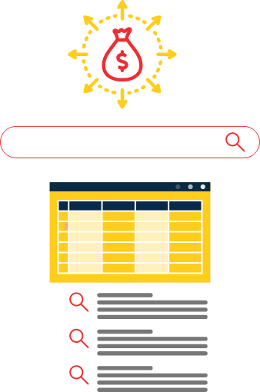
Lowest ACoS Keywords – Sponsored Products
LOWEST_ACOS_TABLE
Campaign Name | Ad Group Name | Customer Search Term | Spend | Sales | ACOS
Spicewell - All Salt - SP - Manual - HSV - TOS 50+ - PS1111 Optimizations | Spicewell - All Salt - SP - Manual - HSV | new salt minerals | $0.35 | $29.98 | 1.17%
Spicewell - All Pepper - SP - Auto - Close Loose - TOS100 - PS 0212 Optimizations | Spicewell - All Pepper - SP - Auto - Close Loose | organic pepper travel packets | $0.37 | $29.98 | 1.23%
Spicewell - All Pepper - SP - Auto - Sub Comp - Launch VA 100325 | Spicewell - All Pepper - SP - Auto - Sub Comp | spicewell new salt | $0.45 | $28.99 | 1.55%
Spicewell - All Salt - SP - Manual - HSV - TOS 50+ - PS1111 Optimizations | Spicewell - All Salt - SP - Manual - HSV | spicewell salt | $1.48 | $89.94 | 1.65%
Spicewell - All Salt - SP - Manual - HSV - TOS 50+ - PS1111 Optimizations | Spicewell - All Salt - SP - Manual - HSV | small pack salt | $0.33 | $14.99 | 2.2%

Slide 8
Highest ACoS Keywords – Sponsored Products
HIGHEST_ACOS_TABLE
Campaign Name | Ad Group Name | Customer Search Term | Spend | Sales | ACOS
Spicewell - All Salt - SP - Manual - HSV - TOS 50+ - PS1111 Optimizations | Spicewell - All Salt - SP - Manual - HSV | salt packets | $31.36 | $14.99 | 209.21%
Spicewell - All Salt- SP - Manual - Branded TOS 50+ - Launch VA 100325 | Spicewell - All Salt- SP - Manual - Branded TOS 50+ | spicewell | $15.8 | $14.99 | 105.4%
Spicewell - All Salt- SP - Manual - Branded TOS 50+ - Launch VA 100325 | Spicewell - All Salt- SP - Manual - Branded TOS 50+ | spicewell sea salt | $12.5 | $14.99 | 83.39%
Spicewell - All Salt - SP - Manual - HSV - TOS 50+ - PS1111 Optimizations | Spicewell - All Salt - SP - Manual - HSV | salt packets single serve | $11.46 | $14.99 | 76.45%
Spicewell - All Pepper - SP - Manual - HRLV TOS75 - PS 0212 Optimizations | Spicewell - All Pepper - SP - Manual - HRLV TOS +50 | black pepper packets | $11.2 | $14.99 | 74.72%

Slide 9
Highest Click Keywords with No Sales
HIGHEST_CLICK_KW
Campaign Name | Ad Group Name | Customer Search Term | Clicks
Spicewell - All Salt - SP - Manual - HSV - TOS 50+ - PS1111 Optimizations | Spicewell - All Salt - SP - Manual - HSV | spicewell sea salt | 15
Spicewell - All Salt- SP - Manual - Branded TOS 50+ - Launch VA 100325 | Spicewell - All Salt- SP - Manual - Branded TOS 50+ | spicewell sea salt | 14
Spicewell - Himalayan Pink Salt Travel Packets- Manual - Branded - Launch VA 060325 | Spicewell - Himalayan Pink Salt Travel Packets- Manual - Branded | new salt | 13
Spicewell - All Pepper - SP - Auto - Sub Comp - Launch VA 100325 | Spicewell - All Pepper - SP - Auto - Sub Comp | b0btkbqv1r | 13
Spicewell - All Salt - SP - Manual - HSV - TOS 50+ - PS1111 Optimizations | Spicewell - All Salt - SP - Manual - HSV | nu salt | 11

Slide 10
Duplicate Keyword Analysis – Sponsored Products
Analysis:
Total duplicate keywords: 108
Total unique keywords duplicated: 44
Total exact and phrase match duplicate keywords: 11

Slide 11






sayhello@exportaccelerator.com.au 0402 934 576
Level 19, 10 Eagle Street, Brisbane, QLD, 4000 Visit: https://exportaccelerator.com.au

