Slide 1
Phillips • Kondev • Theriot • Garcia
Physical Biology of the Cell
Second Edition
Chapter 22
Whither Physical Biology
Copyright © Garland Science 2013

Slide 2
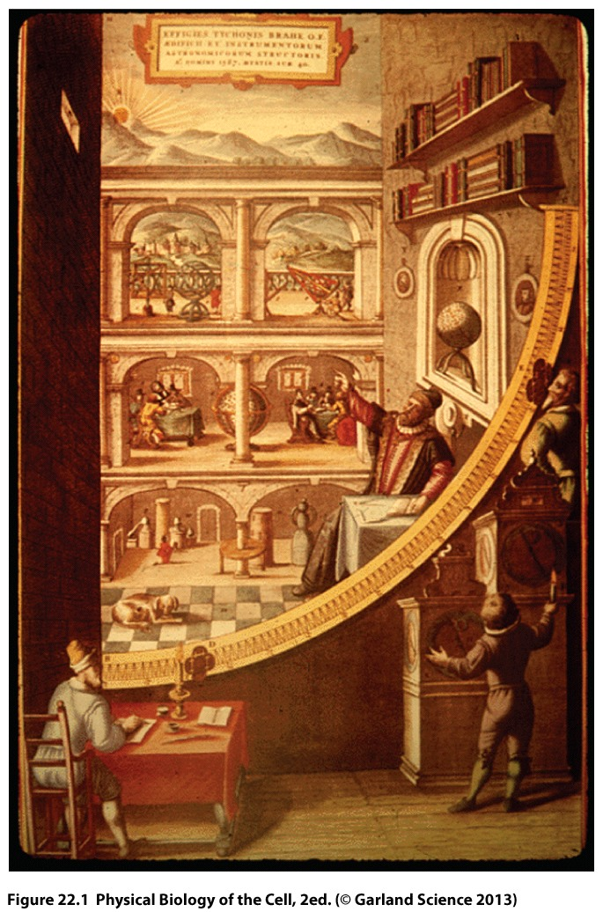

Slide 3
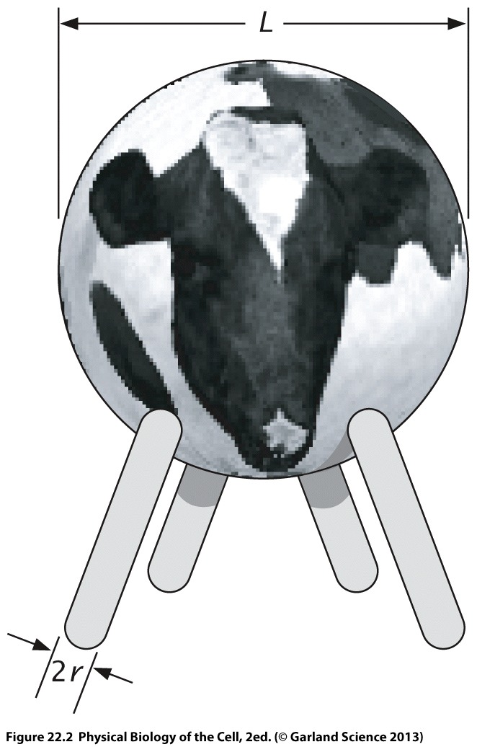

Slide 4
