Slide 1
An Introduction to Parallel Programming
Peter Pacheco
Chapter 5
Shared Memory Programming with OpenMP
Copyright © 2010, Elsevier Inc. All rights Reserved
Notes:
The University of Adelaide, School of Computer Science
Chapter 2 — Instructions: Language of the Computer

Slide 2
Roadmap
# Chapter Subtitle
Writing programs that use OpenMP.
Using OpenMP to parallelize many serial for loops with only small changes to the source code.
Task parallelism.
Explicit thread synchronization.
Standard problems in shared-memory programming.
Copyright © 2010, Elsevier Inc. All rights Reserved
Notes:
The University of Adelaide, School of Computer Science
Chapter 2 — Instructions: Language of the Computer

Slide 3
OpenMP
An API for shared-memory parallel programming.
MP = multiprocessing
Designed for systems in which each thread or process can potentially have access to all available memory.
System is viewed as a collection of cores or CPU’s, all of which have access to main memory.
Copyright © 2010, Elsevier Inc. All rights Reserved

Slide 4
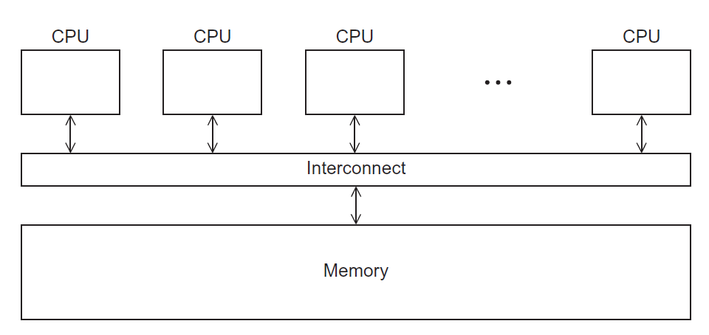
A shared memory system
Copyright © 2010, Elsevier Inc. All rights Reserved

Slide 5
Pragmas
Special preprocessor instructions.
Typically added to a system to allow behaviors that aren’t part of the basic C specification.
Compilers that don’t support the pragmas ignore them.
#pragma
Copyright © 2010, Elsevier Inc. All rights Reserved

Slide 6
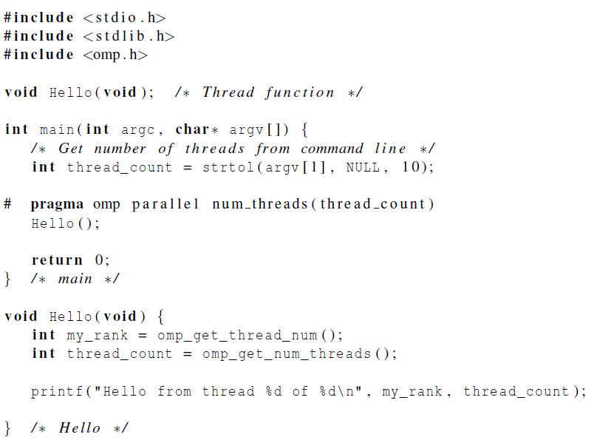
Copyright © 2010, Elsevier Inc. All rights Reserved

Slide 7
gcc −g −Wall −fopenmp −o omp_hello omp_hello . c
. / omp_hello 4
compiling
running with 4 threads
Hello from thread 0 of 4
Hello from thread 1 of 4
Hello from thread 2 of 4
Hello from thread 3 of 4
possible
outcomes
Hello from thread 3 of 4
Hello from thread 1 of 4
Hello from thread 2 of 4
Hello from thread 0 of 4
Hello from thread 1 of 4
Hello from thread 2 of 4
Hello from thread 0 of 4
Hello from thread 3 of 4
Copyright © 2010, Elsevier Inc. All rights Reserved

Slide 8
OpenMp pragmas
# pragma omp parallel
  Most basic parallel directive.
  The number of threads that run
  the following structured block of code
  is determined by the run-time system.
Copyright © 2010, Elsevier Inc. All rights Reserved

Slide 9
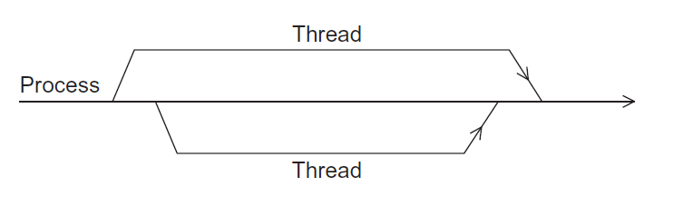
A process forking and joining two threads
Copyright © 2010, Elsevier Inc. All rights Reserved

Slide 10
clause
Text that modifies a directive.
The num_threads clause can be added to a parallel directive.
It allows the programmer to specify the number of threads that should execute the following block.
# pragma omp parallel num_threads ( thread_count )
Copyright © 2010, Elsevier Inc. All rights Reserved

Slide 11
Of note…
There may be system-defined limitations on the number of threads that a program can start.
The OpenMP standard doesn’t guarantee that this will actually start thread_count threads.
Most current systems can start hundreds or even thousands of threads.
Unless we’re trying to start a lot of threads, we will almost always get the desired number of threads.
Copyright © 2010, Elsevier Inc. All rights Reserved

Slide 12

Some terminology
In OpenMP parlance the collection of threads executing the parallel block — the original thread and the new threads — is called a team, the original thread is called the master, and the additional threads are called slaves.
Copyright © 2010, Elsevier Inc. All rights Reserved

Slide 13
In case the compiler doesn’t support OpenMP
# include <omp.h>
#ifdef _OPENMP
# include <omp.h>
#endif
Copyright © 2010, Elsevier Inc. All rights Reserved

Slide 14
In case the compiler doesn’t support OpenMP
# ifdef _OPENMP
int my_rank = omp_get_thread_num ( );
int thread_count = omp_get_num_threads ( );
# e l s e
int my_rank = 0;
int thread_count = 1;
# endif
Copyright © 2010, Elsevier Inc. All rights Reserved

Slide 15

The Trapezoidal Rule
Copyright © 2010, Elsevier Inc. All rights Reserved

Slide 16
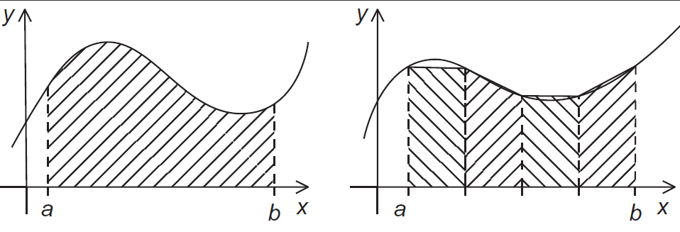
The trapezoidal rule
Copyright © 2010, Elsevier Inc. All rights Reserved

Slide 17
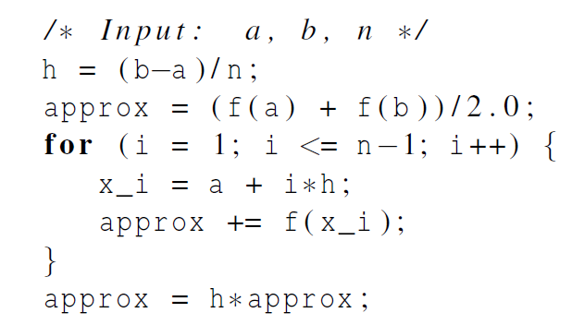
Serial algorithm
Copyright © 2010, Elsevier Inc. All rights Reserved

Slide 18
A First OpenMP Version
1) We identified two types of tasks:
  a) computation of the areas of individual trapezoids, and
  b) adding the areas of trapezoids.
2) There is no communication among the tasks in the first collection, but each task in the first collection communicates with task 1b.
Copyright © 2010, Elsevier Inc. All rights Reserved

Slide 19
A First OpenMP Version
3) We assumed that there would be many more trapezoids than cores.
So we aggregated tasks by assigning a contiguous block of trapezoids to each thread (and a single thread to each core).
Copyright © 2010, Elsevier Inc. All rights Reserved

Slide 20
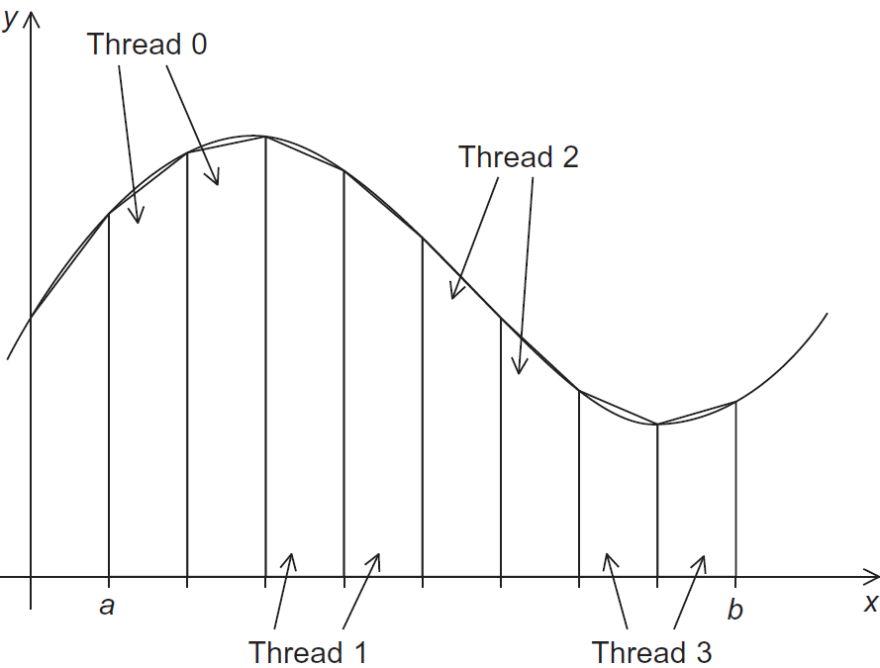
Assignment of trapezoids to threads
Copyright © 2010, Elsevier Inc. All rights Reserved

Slide 21
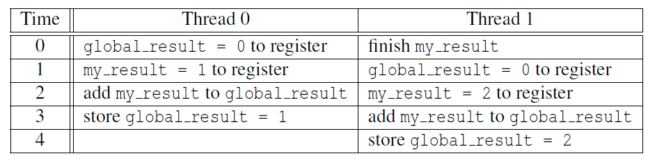

Unpredictable results when two (or more)
threads attempt to simultaneously execute:
global_result += my_result ;
Copyright © 2010, Elsevier Inc. All rights Reserved

Slide 22
Mutual exclusion
# pragma omp critical
global_result += my_result ;
only one thread can execute
the following structured block at a time
Copyright © 2010, Elsevier Inc. All rights Reserved

Slide 23
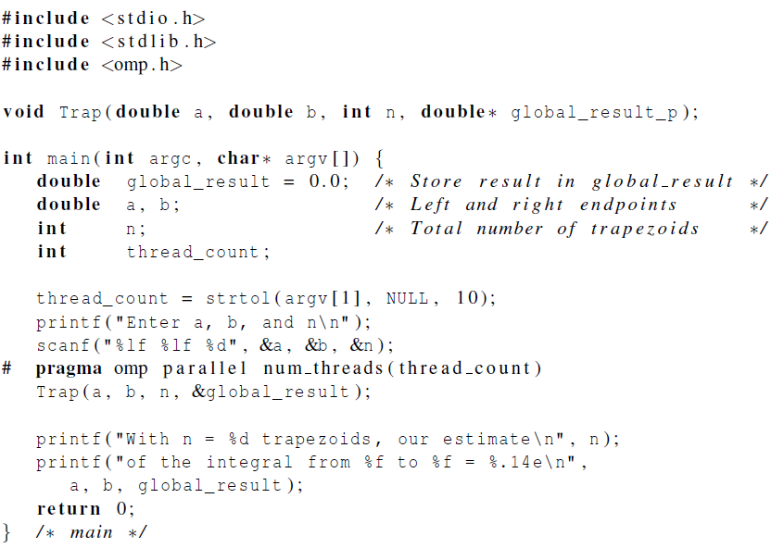
Copyright © 2010, Elsevier Inc. All rights Reserved

Slide 24
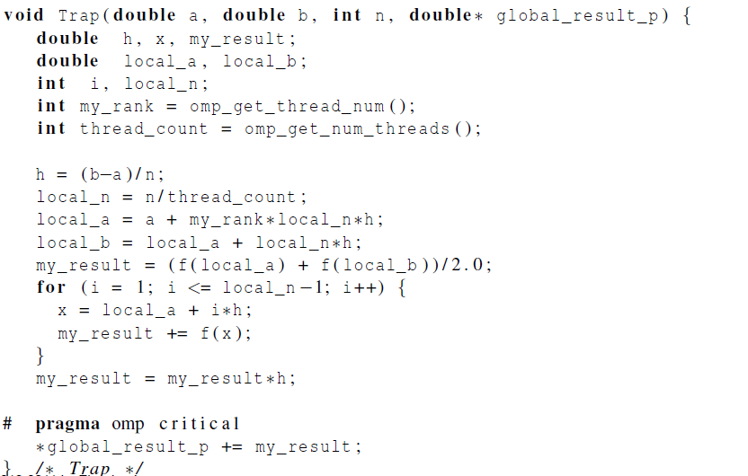
Copyright © 2010, Elsevier Inc. All rights Reserved

Slide 25

Scope of Variables
Copyright © 2010, Elsevier Inc. All rights Reserved

Slide 26
Scope
In serial programming, the scope of a variable consists of those parts of a program in which the variable can be used.
In OpenMP, the scope of a variable refers to the set of threads that can access the variable in a parallel block.
Copyright © 2010, Elsevier Inc. All rights Reserved

Slide 27

Scope in OpenMP
A variable that can be accessed by all the threads in the team has shared scope.
A variable that can only be accessed by a single thread has private scope.
The default scope for variables
declared before a parallel block
is shared.
Copyright © 2010, Elsevier Inc. All rights Reserved

Slide 28

The Reduction Clause
Copyright © 2010, Elsevier Inc. All rights Reserved

Slide 29
We need this more complex version to add each thread’s local calculation to get global_result.
Although we’d prefer this.
Copyright © 2010, Elsevier Inc. All rights Reserved

Slide 30
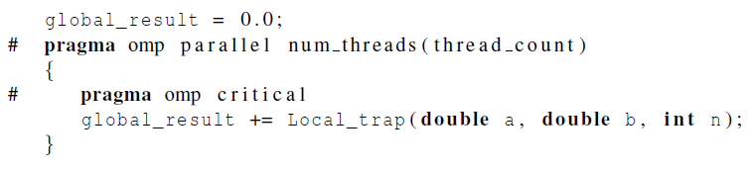
If we use this, there’s no critical section!
If we fix it like this…
… we force the threads to execute sequentially.
Copyright © 2010, Elsevier Inc. All rights Reserved

Slide 31
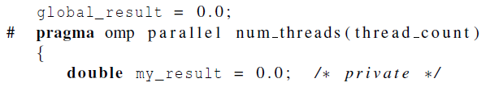
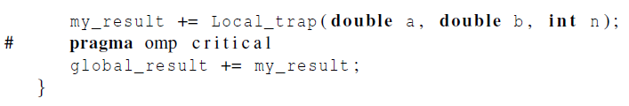
We can avoid this problem by declaring a private variable inside the parallel block and moving
the critical section after the function call.
Copyright © 2010, Elsevier Inc. All rights Reserved

Slide 32
Reduction operators
A reduction operator is a binary operation (such as addition or multiplication).
A reduction is a computation that repeatedly applies the same reduction operator to a sequence of operands in order to get a single result.
All of the intermediate results of the operation should be stored in the same variable: the reduction variable.
Copyright © 2010, Elsevier Inc. All rights Reserved

Slide 33
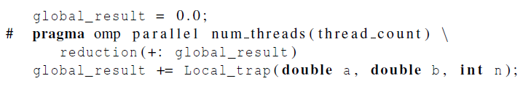
A reduction clause can be added to a parallel directive.
+, *, -, &, |, ˆ, &&, ||
Copyright © 2010, Elsevier Inc. All rights Reserved

Slide 34

The “Parallel For” Directive
Copyright © 2010, Elsevier Inc. All rights Reserved

Slide 35
Parallel for
Forks a team of threads to execute the following structured block.
However, the structured block following the parallel for directive must be a for loop.
Furthermore, with the parallel for directive the system parallelizes the for loop by dividing the iterations of the loop among the threads.
Copyright © 2010, Elsevier Inc. All rights Reserved

Slide 36
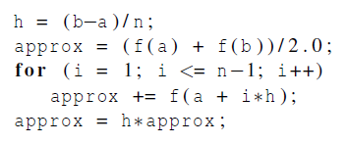
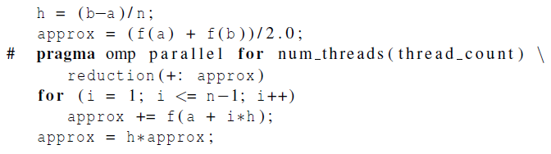
Copyright © 2010, Elsevier Inc. All rights Reserved

Slide 37
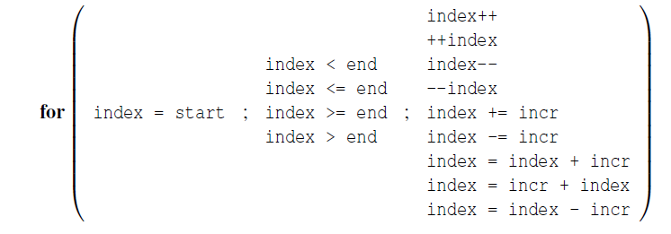
Legal forms for parallelizable for statements
Copyright © 2010, Elsevier Inc. All rights Reserved

Slide 38
Caveats
The variable index must have integer or pointer type (e.g., it can’t be a float).
The expressions start, end, and incr must have a compatible type. For example, if index is a pointer, then incr must have integer type.
Copyright © 2010, Elsevier Inc. All rights Reserved

Slide 39
Caveats
The expressions start, end, and incr must not change during execution of the loop.
During execution of the loop, the variable index can only be modified by the “increment expression” in the for statement.
Copyright © 2010, Elsevier Inc. All rights Reserved

Slide 40
Data dependencies
fibo[ 0 ] = fibo[ 1 ] = 1;
for (i = 2; i < n; i++)
fibo[ i ] = fibo[ i – 1 ] + fibo[ i – 2 ];
note 2 threads
fibo[ 0 ] = fibo[ 1 ] = 1;
# pragma omp parallel for num_threads(2)
for (i = 2; i < n; i++)
fibo[ i ] = fibo[ i – 1 ] + fibo[ i – 2 ];
but sometimes
we get this
1 1 2 3 5 8 13 21 34 55
this is correct
1 1 2 3 5 8 0 0 0 0
Copyright © 2010, Elsevier Inc. All rights Reserved

Slide 41

What happened?
OpenMP compilers don’t check for dependences among iterations in a loop that’s being parallelized with a parallel for directive.
A loop in which the results of one or more iterations depend on other iterations cannot, in general, be correctly parallelized by OpenMP.
Copyright © 2010, Elsevier Inc. All rights Reserved

Slide 42
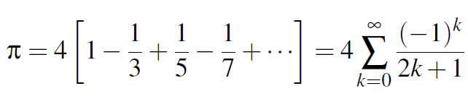
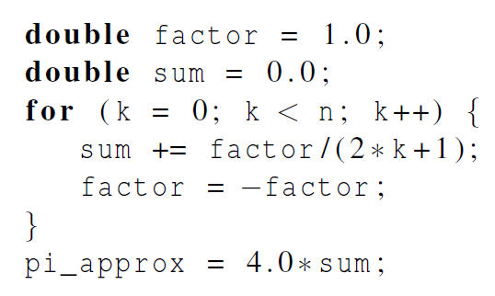
Estimating π
Copyright © 2010, Elsevier Inc. All rights Reserved

Slide 43
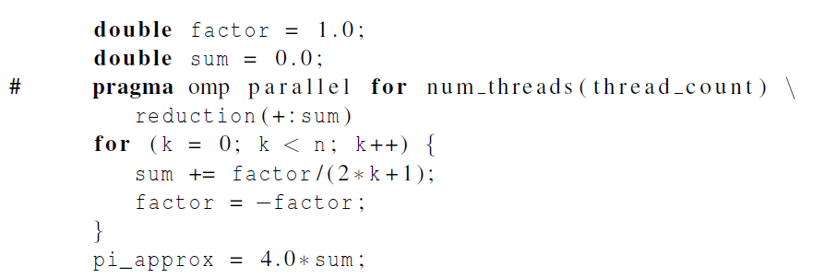
OpenMP solution #1
loop dependency
Copyright © 2010, Elsevier Inc. All rights Reserved

Slide 44
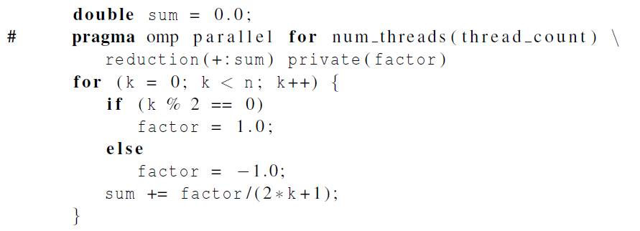
OpenMP solution #2
Insures factor has
private scope.
Copyright © 2010, Elsevier Inc. All rights Reserved

Slide 45

The default clause
Lets the programmer specify the scope of each variable in a block.
With this clause the compiler will require that we specify the scope of each variable we use in the block and that has been declared outside the block.
Copyright © 2010, Elsevier Inc. All rights Reserved

Slide 46
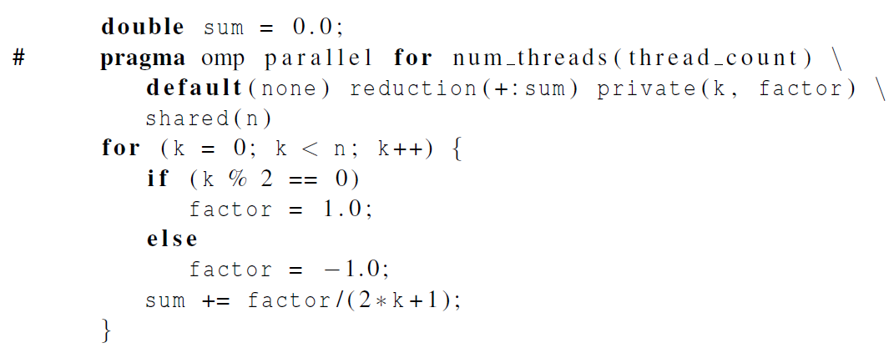
The default clause
Copyright © 2010, Elsevier Inc. All rights Reserved

Slide 47
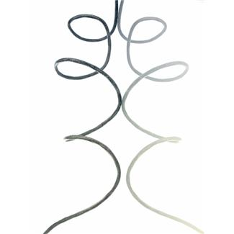
More About Loops in OpenMP: Sorting
Copyright © 2010, Elsevier Inc. All rights Reserved

Slide 48
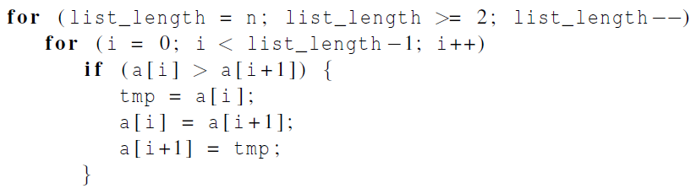

Bubble Sort
Copyright © 2010, Elsevier Inc. All rights Reserved

Slide 49
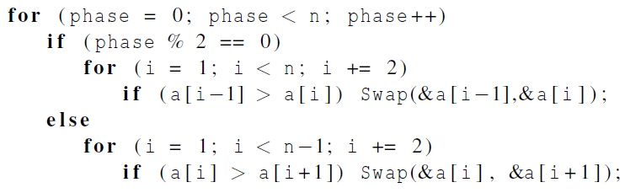
Serial Odd-Even Transposition Sort
Copyright © 2010, Elsevier Inc. All rights Reserved

Slide 50
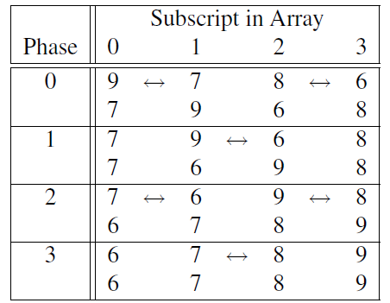
Serial Odd-Even Transposition Sort
Copyright © 2010, Elsevier Inc. All rights Reserved

Slide 51
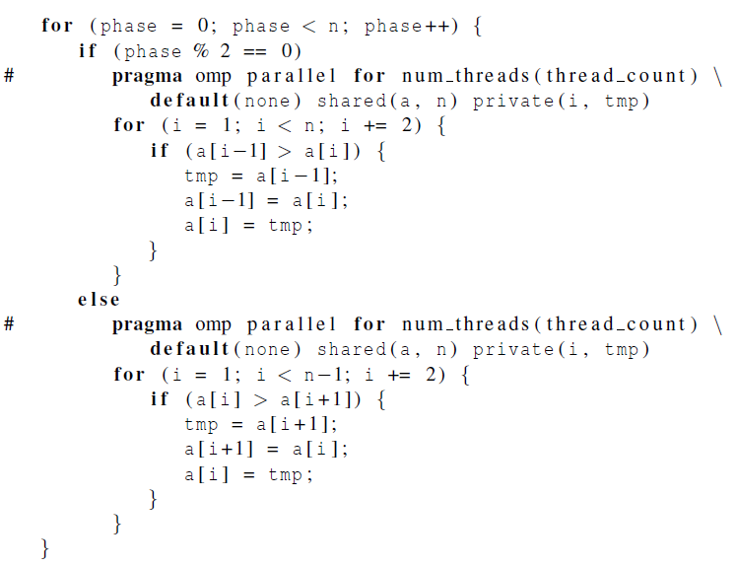
First OpenMP Odd-Even Sort
Copyright © 2010, Elsevier Inc. All rights Reserved

Slide 52
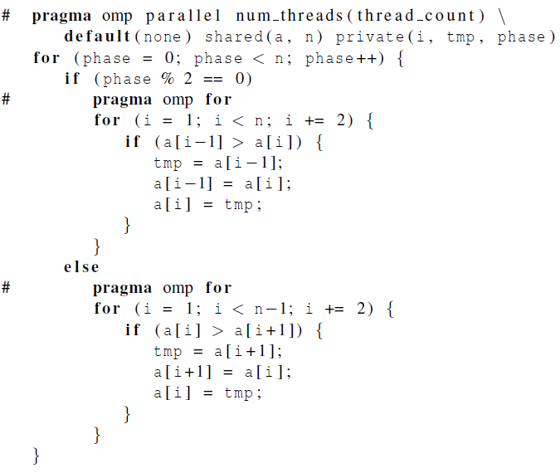
Second OpenMP Odd-Even Sort
Copyright © 2010, Elsevier Inc. All rights Reserved

Slide 53
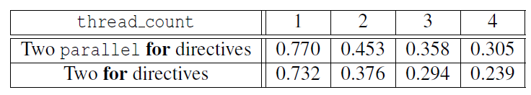

Odd-even sort with two parallel for directives and two for directives.
(Times are in seconds.)
Copyright © 2010, Elsevier Inc. All rights Reserved

Slide 54

Scheduling Loops
Copyright © 2010, Elsevier Inc. All rights Reserved

Slide 55
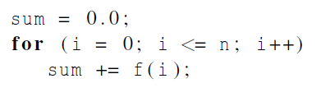
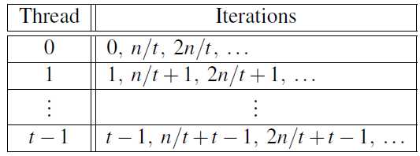
We want to parallelize
this loop.
Assignment of work
using cyclic partitioning.
Copyright © 2010, Elsevier Inc. All rights Reserved

Slide 56
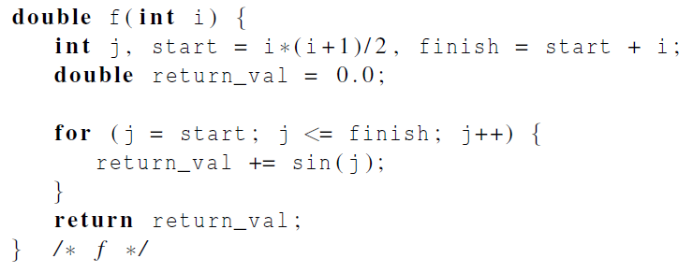
Our definition of function f.
Copyright © 2010, Elsevier Inc. All rights Reserved

Slide 57
Results
f(i) calls the sin function i times.
Assume the time to execute f(2i) requires approximately twice as much time as the time to execute f(i).
n = 10,000
  one thread
  run-time = 3.67 seconds.
Copyright © 2010, Elsevier Inc. All rights Reserved

Slide 58

Results
n = 10,000
  two threads
  default assignment
  run-time = 2.76 seconds
  speedup = 1.33
n = 10,000
  two threads
  cyclic assignment
  run-time = 1.84 seconds
  speedup = 1.99
Copyright © 2010, Elsevier Inc. All rights Reserved

Slide 59
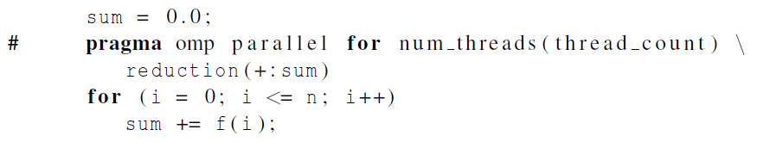
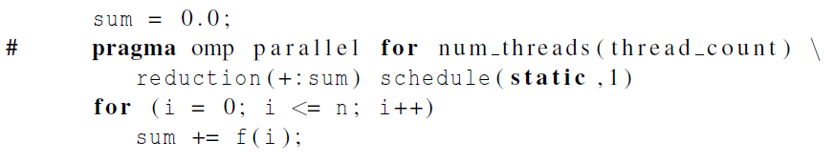
The Schedule Clause
Default schedule:
Cyclic schedule:
Copyright © 2010, Elsevier Inc. All rights Reserved

Slide 60
schedule ( type , chunksize )
Type can be:
  static: the iterations can be assigned to the threads before the loop is executed.
  dynamic or guided: the iterations are assigned to the threads while the loop is executing.
  auto: the compiler and/or the run-time system determine the schedule.
  runtime: the schedule is determined at run-time.
The chunksize is a positive integer.
Copyright © 2010, Elsevier Inc. All rights Reserved

Slide 61

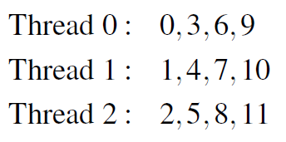
The Static Schedule Type
twelve iterations, 0, 1, . . . , 11, and three threads
Copyright © 2010, Elsevier Inc. All rights Reserved

Slide 62

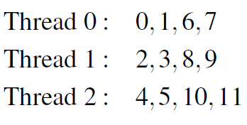
The Static Schedule Type
twelve iterations, 0, 1, . . . , 11, and three threads
Copyright © 2010, Elsevier Inc. All rights Reserved

Slide 63

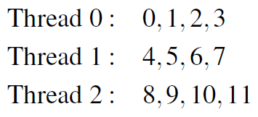
The Static Schedule Type
twelve iterations, 0, 1, . . . , 11, and three threads
Copyright © 2010, Elsevier Inc. All rights Reserved

Slide 64
The Dynamic Schedule Type
The iterations are also broken up into chunks of chunksize consecutive iterations.
Each thread executes a chunk, and when a thread finishes a chunk, it requests another one from the run-time system.
This continues until all the iterations are completed.
The chunksize can be omitted. When it is omitted, a chunksize of 1 is used.
Copyright © 2010, Elsevier Inc. All rights Reserved

Slide 65
The Guided Schedule Type
Each thread also executes a chunk, and when a thread finishes a chunk, it requests another one.
However, in a guided schedule, as chunks are completed the size of the new chunks decreases.
If no chunksize is specified, the size of the chunks decreases down to 1.
If chunksize is specified, it decreases down to chunksize, with the exception that the very last chunk can be smaller than chunksize.
Copyright © 2010, Elsevier Inc. All rights Reserved

Slide 66
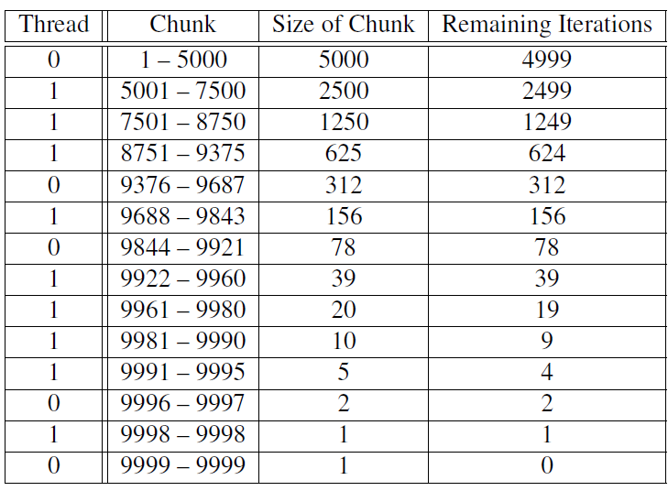
Assignment of trapezoidal rule iterations 1–9999 using a guided schedule with two threads.
Copyright © 2010, Elsevier Inc. All rights Reserved

Slide 67
The Runtime Schedule Type
The system uses the environment variable OMP_SCHEDULE to determine at run-time how to schedule the loop.
The OMP_SCHEDULE environment variable can take on any of the values that can be used for a static, dynamic, or guided schedule.
Copyright © 2010, Elsevier Inc. All rights Reserved

Slide 68

Producers and Consumers
Copyright © 2010, Elsevier Inc. All rights Reserved

Slide 69
Queues
Can be viewed as an abstraction of a line of customers waiting to pay for their groceries in a supermarket.
A natural data structure to use in many multithreaded applications.
For example, suppose we have several “producer” threads and several “consumer” threads.
  Producer threads might “produce” requests for data.
  Consumer threads might “consume” the request by finding or generating the requested data.
Copyright © 2010, Elsevier Inc. All rights Reserved

Slide 70
Message-Passing
Each thread could have a shared message queue, and when one thread wants to “send a message” to another thread, it could enqueue the message in the destination thread’s queue.
A thread could receive a message by dequeuing the message at the head of its message queue.
Copyright © 2010, Elsevier Inc. All rights Reserved

Slide 71
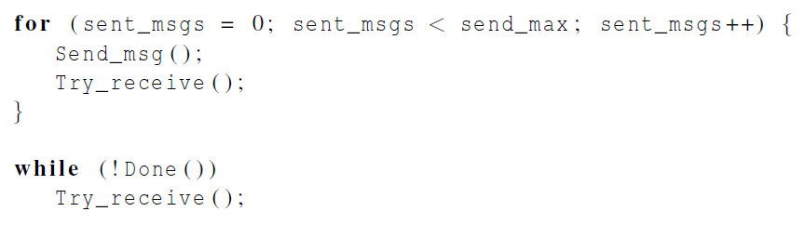
Message-Passing
Copyright © 2010, Elsevier Inc. All rights Reserved

Slide 72
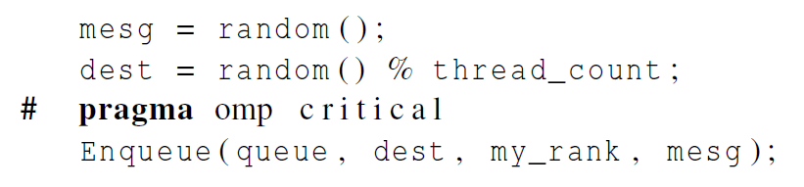
Sending Messages
Copyright © 2010, Elsevier Inc. All rights Reserved

Slide 73
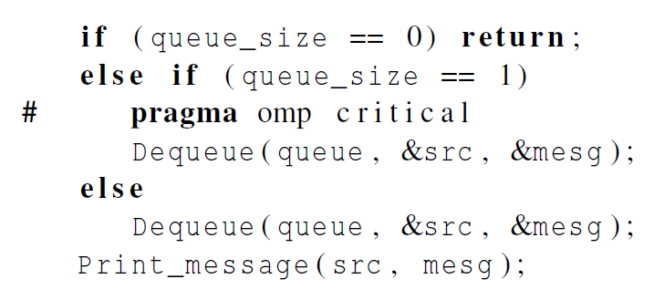
Receiving Messages
Copyright © 2010, Elsevier Inc. All rights Reserved

Slide 74
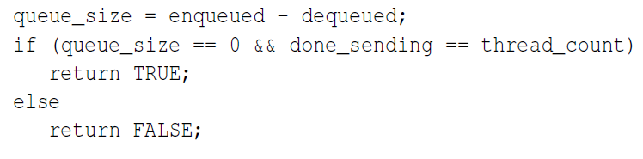
Termination Detection
each thread increments this after completing its for loop
Copyright © 2010, Elsevier Inc. All rights Reserved

Slide 75
Startup (1)
When the program begins execution, a single thread, the master thread, will get command line arguments and allocate an array of message queues: one for each thread.
This array needs to be shared among the threads, since any thread can send to any other thread, and hence any thread can enqueue a message in any of the queues.
Copyright © 2010, Elsevier Inc. All rights Reserved

Slide 76

Startup (2)
One or more threads may finish allocating their queues before some other threads.
We need an explicit barrier so that when a thread encounters the barrier, it blocks until all the threads in the team have reached the barrier.
After all the threads have reached the barrier all the threads in the team can proceed.
Copyright © 2010, Elsevier Inc. All rights Reserved

Slide 77

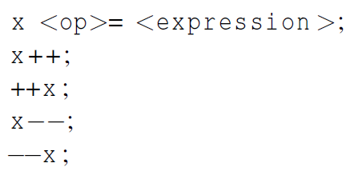
The Atomic Directive (1)
Unlike the critical directive, it can only protect critical sections that consist of a single C assignment statement.
Further, the statement must have one of the following forms:
Copyright © 2010, Elsevier Inc. All rights Reserved

Slide 78
The Atomic Directive (2)
Here <op> can be one of the binary operators
Many processors provide a special load-modify-store instruction.
A critical section that only does a load-modify-store can be protected much more efficiently by using this special instruction rather than the constructs that are used to protect more general critical sections.
Copyright © 2010, Elsevier Inc. All rights Reserved

Slide 79

Critical Sections
OpenMP provides the option of adding a name to a critical directive:
When we do this, two blocks protected with critical directives with different names can be executed simultaneously.
However, the names are set during compilation, and we want a different critical section for each thread’s queue.
Copyright © 2010, Elsevier Inc. All rights Reserved

Slide 80

Locks
A lock consists of a data structure and functions that allow the programmer to explicitly enforce mutual exclusion in a critical section.
Copyright © 2010, Elsevier Inc. All rights Reserved

Slide 81
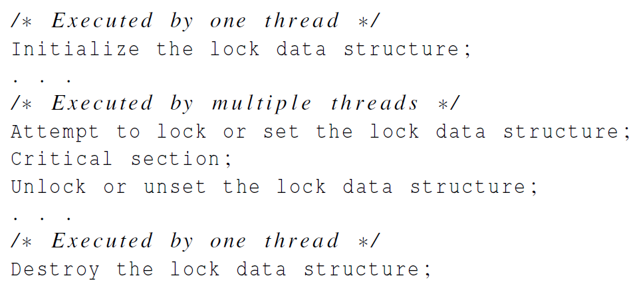
Locks
Copyright © 2010, Elsevier Inc. All rights Reserved

Slide 82
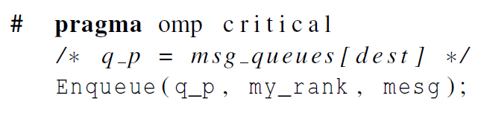
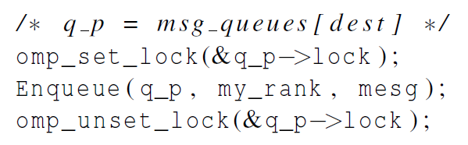
Using Locks in the Message-Passing Program
Copyright © 2010, Elsevier Inc. All rights Reserved

Slide 83
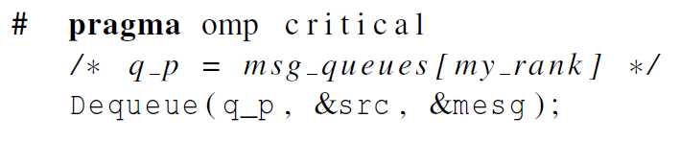
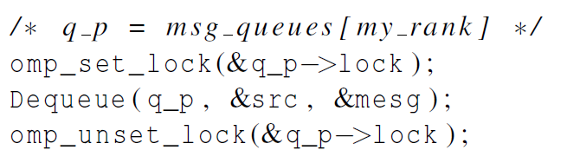
Using Locks in the Message-Passing Program
Copyright © 2010, Elsevier Inc. All rights Reserved

Slide 84
Some Caveats
You shouldn’t mix the different types of mutual exclusion for a single critical section.
There is no guarantee of fairness in mutual exclusion constructs.
It can be dangerous to “nest” mutual exclusion constructs.
Copyright © 2010, Elsevier Inc. All rights Reserved

Slide 85

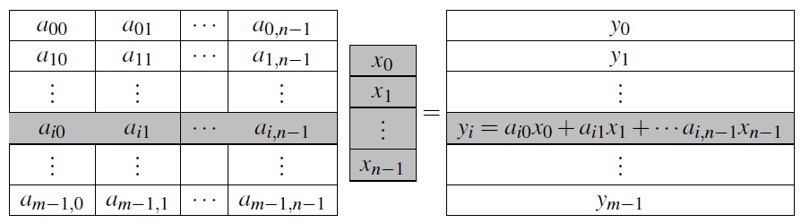
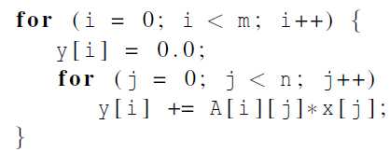
Matrix-vector multiplication
Copyright © 2010, Elsevier Inc. All rights Reserved
Notes:
Please refer to the detailed slides on cache coherence and thread-safety in Chapter 4.
The University of Adelaide, School of Computer Science
Chapter 2 — Instructions: Language of the Computer

Slide 86
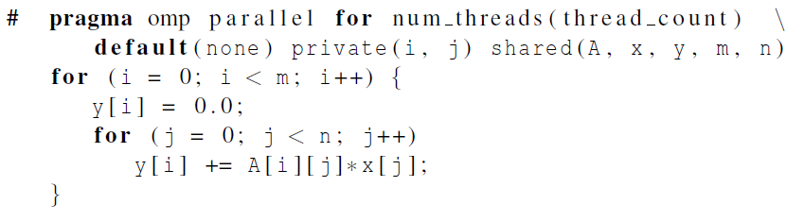

Matrix-vector multiplication
Run-times and efficiencies
of matrix-vector multiplication
(times are in seconds)
Copyright © 2010, Elsevier Inc. All rights Reserved
Notes:
Please refer to the detailed slides on cache coherence and thread-safety in Chapter 4.
The University of Adelaide, School of Computer Science
Chapter 2 — Instructions: Language of the Computer

Slide 87

Thread-Safety
Copyright © 2010, Elsevier Inc. All rights Reserved
Notes:
Please refer to the detailed slides on cache coherence and thread-safety in Chapter 4.
The University of Adelaide, School of Computer Science
Chapter 2 — Instructions: Language of the Computer

Slide 88
Concluding Remarks (1)
OpenMP is a standard for programming shared-memory systems.
OpenMP uses both special functions and preprocessor directives called pragmas.
OpenMP programs start multiple threads rather than multiple processes.
Many OpenMP directives can be modified by clauses.
Copyright © 2010, Elsevier Inc. All rights Reserved

Slide 89
Concluding Remarks (2)
A major problem in the development of shared memory programs is the possibility of race conditions.
OpenMP provides several mechanisms for insuring mutual exclusion in critical sections.
  Critical directives
  Named critical directives
  Atomic directives
  Simple locks
Copyright © 2010, Elsevier Inc. All rights Reserved

Slide 90
Concluding Remarks (3)
By default most systems use a block-partitioning of the iterations in a parallelized for loop.
OpenMP offers a variety of scheduling options.
In OpenMP the scope of a variable is the collection of threads to which the variable is accessible.
Copyright © 2010, Elsevier Inc. All rights Reserved

Slide 91
Concluding Remarks (4)
A reduction is a computation that repeatedly applies the same reduction operator to a sequence of operands in order to get a single result.
Copyright © 2010, Elsevier Inc. All rights Reserved

