Slide 1
CSCI-2500:
Computer Organization
Memory Hierarchy (Chapter 5)

Slide 2
Memory Technologies: Speed vs. Cost (1997)
Technology | Access Time | Cost: $/Mbyte
SRAM | 5-25ns | $100-$250
DRAM | 60-120ns | $5-$10
Mag. disk | 10-20 million ns | $0.1-$0.2
Access Time: the length of time it takes to get a value from memory, given an address.

Slide 3
Memory Technologies: Speed vs. Cost (2004)
Technology | Access Time | Cost: $/Gbyte
SRAM | 0.5-5ns | $4000-$10K (25x)
DRAM | 50-70ns | $100-$200 (50x)
Mag. disk | 5-20 million ns | $0.50-$2.00 (12x)
Observe: access time not changing much over the last 7 years, but unit cost per capacity has changed dramatically

Slide 4
Performance and Memory
SRAM is fast, but too expensive (we want large memories!).
Using only SRAM (enough of it) would mean that the memory ends up costing more than everything else combined!

Slide 5
Caching
The idea is to use a small amount of fast memory near the processor (in a cache).
The cache hold frequently needed memory locations.
  when an instruction references a memory location, we want that value to be in the cache!

Slide 6
Principles of Locality
Temporal: if a memory location is referenced, it is likely that it will be referenced again in the near future.
Spatial: if a memory location is referenced, it is likely that nearby items will be referenced in the near future.
time
space

Slide 7
Programs and Locality
Programs tend to exhibit a great deal of locality in memory accesses.
  array, structure/record access
  subroutines (instructions are near each other)
  local variables (counters, pointers, etc) are often referenced many times.

Slide 8
Memory Hierarchy
The general idea is to build a hierarchy:
  at the top is a small, fast memory that is close to the processor.
  in the middle are larger, slower memories.
  At the bottom is massive memory with very slow access time.

Slide 9
C
P
U
L
e
v
e
l
1
I
n
c
r
e
a
s
i
n
g
d
i
s
t
a
n
c
e
f
r
o
m
t
h
e
C
P
U
i
n
a
c
c
e
s
s
t
i
m
e
L
e
v
e
l
s
i
n
t
h
e
L
e
v
e
l
2
m
e
m
o
r
y
h
i
e
r
a
r
c
h
y
L
e
v
e
l
n
S
i
z
e
o
f
t
h
e
m
e
m
o
r
y
a
t
e
a
c
h
l
e
v
e
l
Figure 7.3

Slide 10
Cache and Main Memory
For now we will focus on a 2 level hierarchy:
  cache (small, fast memory directly connected to the processor).
  main memory (large, slow memory at level 2 in the hierarchy).

Slide 11
Memory Hierarchy and Data Transfer
Transfer of data is done between adjacent levels in the hierarchy only!
All access by the processor is to the topmost level.
P
r
o
c
e
s
s
o
r
D
a
t
a
a
r
e
t
r
a
n
s
f
e
r
r
e
d
Figure 7.2

Slide 12
Terminology
hit: when the memory location accessed by the processor is in the cache (upper level).
miss: when the memory location accessed by the process is not in the cache.
block: the minimum unit of information transferred between the cache and the main memory. Typically measured in bytes or words.

Slide 13
Terminology (cont.)
hit rate: the ratio of hits to total memory accesses.
miss rate: 1 – hit rate
hit time: the time to access an element that is in the cache:
  time to find out if it’s in the cache.
  time to transfer from cache to processor.

Slide 14
Terminology (cont.)
miss penalty: the time to replace a block in the cache with a block from main memory and to deliver deliver the element to the processor.
hit time is small compared to miss penalty (otherwise we wouldn’t bother with a memory hierarchy!)

Slide 15
Simple Cache Model
Assume that the processor accesses memory one word at a time.
A block consists of one word.
When a word is referenced and is not in the cache, it is put in the cache (copied from main memory).

Slide 16
Cache Usage
At some point in time the cache holds memory items X₁,X₂,…X_{n-1}
The processor next accesses memory item X_{n} which is not in the cache.

Slide 17
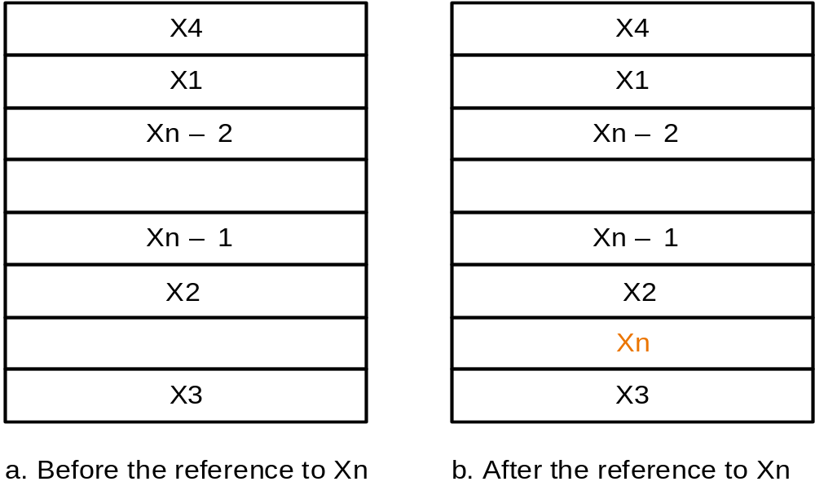
Cache before and after

Slide 18
Issues
How do we know if an item is in the cache?
If it is in the cache, how do we know where it is?

Slide 19
Direct-Mapped Cache
Each memory location is mapped to a single location in the cache.
  there in only one place it can be!
Remember that the cache is smaller than memory, so many memory locations will be mapped to the same location in the cache.

Slide 20
Mapping Function
The simplest mapping is based on the LS bits of the address.
For example, all memory locations whose address ends in 000 will be mapped to the same location in the cache.
The requires a cache size of 2^{n} locations (a power of 2).

Slide 21
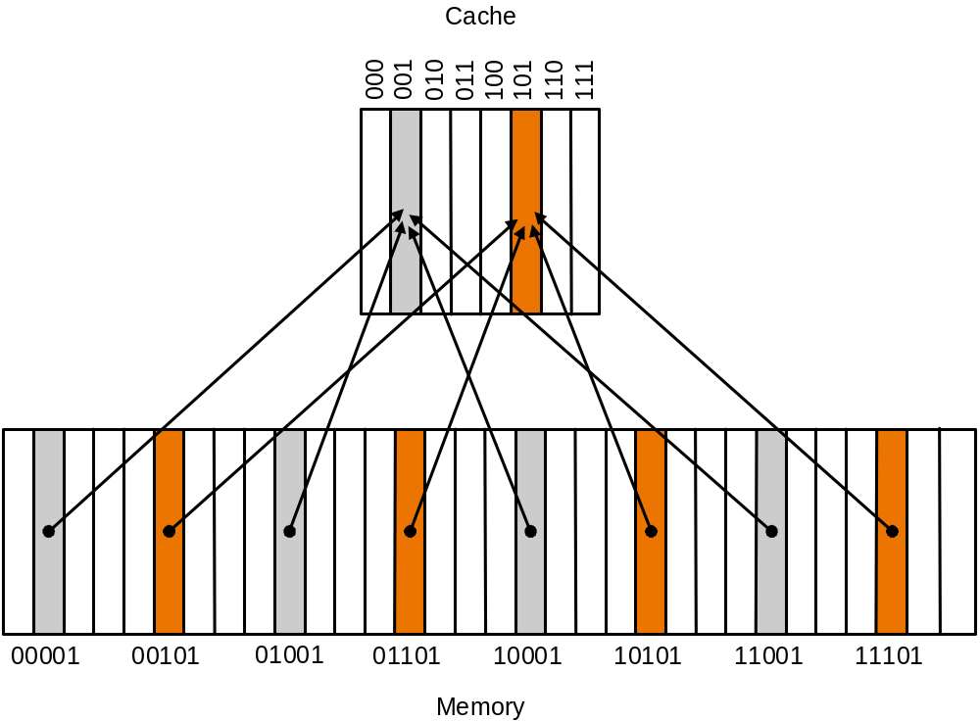
A Direct Mapped Cache
Figure 7.5

Slide 22
Who’s in slot 000?
We still need a way to find out which of the many possible memory elements is currently in a cache slot.
  slot: a location in the cache that can hold a block.
We need to store the address of the item currently using cache slot 000.

Slide 23
Tags
We don’t need to store the entire memory location address, just those bits that are not used to determine the slot number (the mapping).
We call these bits the tag.
The tag associated with a cache slot tells who is currently using the slot.

Slide 24
16 word memory, 4 word cache
Memory
0000
0001
0010
0011
0100
0101
0110
0111
1000
1001
1010
1011
1100
1101
1110
1111
Tags
Data

Slide 25
Initialization Problem
Initially the cache is empty.
  all the bits in the cache (including the tags) will have random values.
After some number of accesses, some of the tags are real and some are still just random junk.
How do we know which cache slots are junk and which really mean something?

Slide 26
Valid Bits
Include one more bit with each cache slot that indicates whether the tag is valid or not.
Provide hardware to initialize these bits to 0 (one bit per cache slot).
When checking a cache slot for a specific memory location, ignore the tag if the valid bit is 0.
Change a slot’s valid bit to a 1 when putting something in the slot (from main memory).

Slide 27
Revised Cache
Memory
Valid
0000
0001
0010
0011
0100
0101
0110
0111
1000
1001
1010
1011
1100
1101
1110
1111
Tags
Data

Slide 28
Simple Simulation
We can simulate the operation of our simple direct-mapped cache by listing a sequence of memory locations that are referenced.
Assume the cache is initialized with all the valid bits set to 0 (to indicate all the slots are empty).

Slide 29
Memory Access Sequence
Address | Binary Address | Slot | hit or miss
3 | 0011 | 11 (3) | miss
8 | 1000 | 00 (0) | miss
3 | 0011 | 11 (3) | hit
2 | 0010 | 10 (2) | miss
4 | 0100 | 00 (0) | miss
8 | 1000 | 00 (0) | miss

Slide 30
Hardware
We need to have hardware that can perform all the operations:
  find the right slot given an address (perform the mapping).
  check the valid bit.
  compare the tag to part of the address

Slide 31
A
d
d
r
e
s
s
(
s
h
o
w
i
n
g
b
i
t
p
o
s
i
t
i
o
n
s
)
3
1
3
0
1
3
1
2
1
1
2
1
0
o
B
y
t
e
f
f
s
e
t
H
i
t
2
0
1
0
D
a
t
a
T
a
g
I
n
d
e
x
I
n
d
e
x
V
a
l
i
d
T
a
g
D
a
t
a
0
1
2
1
0
2
1
1
0
2
2
1
0
2
3
2
0
3
2

Slide 32
Possible Test Question
Given the following:
  32 bit addresses (2³² byte memory, 2³⁰ words)
  64 KB cache (16 K words). Each slots holds 1 word.
  Direct Mapped Cache.
How many bits are needed for each tag?
How many memory locations are mapped to the same cache slot?
How many total bits in the cache (data + tag + valid).

Slide 33
Possible Test Answer
Memory has 2³⁰ words
Cache has 16K = 2¹⁴ slots (words).
Each cache slot can hold any one of 2³⁰ ÷ 2¹⁴ = 2¹⁶ memory locations, so the tag must be 16 bits.
2¹⁶ is 64K memory locations that map to the same cache slot.
Add one for the valid bit for each cache line.
Total memory in bits = 2¹⁴ x (32+16+1) = 49 x 16K = 784 Kbits (98 Kbytes!)

Slide 34
Handling a Cache Miss
A miss means the processor must wait until the memory requested is in the cache.
  a separate controller handles transferring data between the cache and memory.
In general the processor continuously tries the fetch until it works (until it’s a hit).
  continuously means “once per cycle”.
  in the meantime the pipeline is stalled!

Slide 35
Data vs. Instruction Cache
Obviously nothing other than a stall can happen if we get a miss when fetching the next instruction!
It is possible to execute other instructions while waiting for data (need to detect data hazards), this is called stall on use.
  the pipeline stalls only when there are no instructions that can execute without the data.

Slide 36
DecStation 3100 Cache
Simple Cache implementation
  64 KB cache (16K words).
  16 bit tags
  Direct Mapped
  Two caches, one for instructions and the other for data.

Slide 37
A
d
d
r
e
s
s
(
s
h
o
w
i
n
g
b
i
t
p
o
s
i
t
i
o
n
s
)
3
1
3
0
1
7
1
6
1
5
5
4
3
2
1
0
1
6
1
4
B
y
t
e
o
f
f
s
e
t
H
i
t
D
a
t
a
1
6
b
i
t
s
3
2
b
i
t
s
V
a
l
i
d
T
a
g
D
a
t
a
1
6
K
e
n
t
r
i
e
s
1
6
3
2
DecStation 3100 cache

Slide 38
Handling Writes
What happens when a store instruction is executed?
  what if it’s a hit?
  what if it’s a miss?
DecStation 3100 does the following:
  don’t bother checking the cache, just write the new value in to the cache!
  Also write the word to main memory (called write-through).

Slide 39
Write-Through
Always updating main memory on each store instruction can slow things down!
  the memory is tied up for a while.
It is possible to set up a write buffer that holds a number of pending writes.
If we also update the cache, it is not likely that we need to worry about getting a memory value from the buffer (but it’s possible!)

Slide 40
Write-back
Another scheme for handling writes:
  only update the cache.
  when the memory location is booted out of the cache (someone else is being put in to the same slot), write the value to memory.

Slide 41
Cache Performance
For the simple DecStation 3100 cache:
 | Miss Rate
Program | Instruction | Data | Combined
gcc | 6.1% | 2.1% | 5.4%
spice | 1.2% | 1.3% | 1.2%

Slide 42
Spatial Locality?
So far we’ve only dealt with temporal locality (it we access an item, it is likely we will access it again soon).
What about space (the final frontier)?
  In general we make a block hold more than a single word.
  Whenever we move data to the cache, we also move it’s neighbors.

Slide 43
Blocks and Slots
Each cache slot holds one block.
Given a fixed cache size (number of bytes) as the block size increases, the number of slots must decrease.
Reducing the number of slots in the cache increases the number of memory locations that compete for the same slot.

Slide 44
Example multi-word block cache
4 words/block
  we now use a block address to determine the slot mapping.
  the block address in this case is the address/4.
  on a hit we need to extract a single word (need a multiplexor controlled by the LS 2 address bits).
64KB data
  16 Bytes/block
  4K slots.

Slide 45
Example multi-word block cache
A
d
d
r
e
s
s
(
s
h
o
w
i
n
g
b
i
t
p
o
s
i
t
i
o
n
s
)
3
1
1
6
1
5
4
3
2
1
0
H
i
t
1
6
1
2
2
B
y
t
e
D
a
t
a
T
a
g
o
f
f
s
e
t
I
n
d
e
x
B
l
o
c
k
o
f
f
s
e
t
1
6
b
i
t
s
1
2
8
b
i
t
s
V
T
a
g
D
a
t
a
4
K
e
n
t
r
i
e
s
1
6
3
2
3
2
3
2
3
2
M
u
x
3
2

Slide 46
Performance and Block Size
DecStation 3100 cache with block sizes 1 and 4 (words).
 | Block | Miss Rate
Program | Size | Instruction | Data | Combined
gcc | 1 | 6.1% | 2.1% | 5.4%
gcc | 4 | 2.0% | 1.7% | 1.9%
spice | 1 | 1.2% | 1.3% | 1.2%
spice | 4 | 0.3% | 0.6% | 0.4%

Slide 47
Is bigger always better?
Eventually increasing the block size will mean that the competition for cache slots is too high
  miss rate will increase.
Consider the extreme case: the entire cache is a single block!

Slide 48
Miss rate vs. Block Size
4
0
%
3
5
%
3
0
%
e
2
5
%
t
a
r
s
2
0
%
s
i
M
1
5
%
1
0
%
5
%
0
%
4
1
6
6
4
2
5
6
B
l
o
c
k
s
i
z
e
(
b
y
t
e
s
)
1
K
B
8
K
B
1
6
K
B
6
4
K
B
2
5
6
K
B

Slide 49
Block Size and Miss Time
As the block size increases, we need to worry about what happens to the miss time.
The larger a block is, the longer it takes to transfer from main memory to cache.
It is possible to design memory systems with transfer of an entire block at a time, but only for relatively small block sizes (4 words).

Slide 50
Example Timings
Hypothetical access times:
  1 cycle to send the address
  15 cycles to initiate each access
  1 cycle to transfer each word.
Miss penalty for 4-word wide memory is:
1 + 4x15 + 4x1 = 65 cycles.

Slide 51
Memory Organization Options
C
P
U
C
P
U
C
P
U
M
u
l
t
i
p
l
e
x
o
r
C
a
c
h
e
C
a
c
h
e
C
a
c
h
e
B
u
s
B
u
s
B
u
s
M
e
m
o
r
y
M
e
m
o
r
y
M
e
m
o
r
y
M
e
m
o
r
y
M
e
m
o
r
y
b
a
n
k
0
b
a
n
k
1
b
a
n
k
2
b
a
n
k
3
M
e
m
o
r
y
b
.
W
i
d
e
m
e
m
o
r
y
o
r
g
a
n
i
z
a
t
i
o
n
c
.
I
n
t
e
r
l
e
a
v
e
d
m
e
m
o
r
y
o
r
g
a
n
i
z
a
t
i
o
n
Improving memory bandwidth….
a
.
O
n
e
-
w
o
r
d
-
w
i
d
e
m
e
m
o
r
y
o
r
g
a
n
i
z
a
t
i
o
n

Slide 52
Improving Cache Performance
Cache performance is based on two factors:
  miss rate
    depends on both the hardware and on the program being measured (miss rate can vary).
  miss penalty
    the penalty is dictated by the hardware (the organization of memory and memory access times).

Slide 53
Cache and CPU Performance
The total number of cycles it takes for a program is the sum of:
  number of normal instruction execution cycles.
  number of cycles stalled waiting for memory.

Slide 54
Cache Calculations
How much faster would this program run with a perfect cache?:
CPI (without memory stalls): 2
Miss Rate: 5%
Miss Penalty: 40 cycles
% of instructions that are load/store: 30%

Slide 55
Speedup Calc
Time_{perfect}=IC * 2 (cpi) * cycle time
= IC * 2.0
Time_{cache}=IC*( 0.3*(2+0.05*40) + 0.7*2 )
= IC * 2.6
Speedup: 2.6/2 = 1.3 times faster with a perfect cache.

Slide 56
Clock Rate and Cache Performance
If we double the clock rate of the processor, we don’t change:
  cache miss rate
  miss penalty (memory is not likely to change!).
The cache will not improve, so the speedup is not close to double!

Slide 57
Reducing Miss Rate
Obviously a larger cache will reduce the miss rate!
We can also reduce miss rate by reducing the competition for cache slots.
  allow a block to be placed in one of many possible cache slots.

Slide 58
An extreme example of how to mess up a direct mapped cache.
Assume that every 64th memory element maps to the same cache slot.
for (i=0;i<10000;i++) {
a[i] = a[i] + a[i+64] + a[i+128];
a[i+64] = a[i+64] + a[i+128];
}
a[i], a[i+64] and a[i+128] use the same cache slot!

Slide 59
Fully Associative Cache
Instead of direct mapped, we allow any memory block to be placed in any cache slot.
It’s harder to check for a hit (hit time will increase).
Requires lots more hardware (a comparator for each cache slot).
Each tag will be a complete block address.

Slide 60
Fully Associative Cache
Memory
Valid
0000
0001
0010
0011
0100
0101
0110
0111
1000
1001
1010
1011
1100
1101
1110
1111
Data
Tags

Slide 61
Tradeoffs
Fully Associate is much more flexible, so the miss rate will be lower.
Direct Mapped requires less hardware (cheaper).
  will also be faster! i.e. better hit time!
Tradeoff of miss rate vs. hit time.

Slide 62
Middle Ground
We can also provide more flexibility without going to a fully associative placement policy.
For each memory location, provide a small number of cache slots that can hold the memory element.
This is much more flexible than direct-mapped, but requires less hardware than fully associative.

Slide 63
Set Associative
A fixed number of locations where each block can be placed.
n-way set associative means there are n places (slots) where each block can be placed.
Chop up the cache in to a number of sets each set is of size n.

Slide 64
Block Placement Options
(memory block address 12)
D
i
r
e
c
t
m
a
p
p
e
d
S
e
t
a
s
s
o
c
i
a
t
i
v
e
F
u
l
l
y
a
s
s
o
c
i
a
t
i
v
e
B
l
o
c
k
#
0
1
2
3
4
5
6
7
S
e
t
#
0
1
2
3
D
a
t
a
D
a
t
a
D
a
t
a
1
1
1
T
a
g
T
a
g
T
a
g
2
2
2
S
e
a
r
c
h
S
e
a
r
c
h
S
e
a
r
c
h
Figure 7.15

Slide 65
Possible 8-block Cache designs
O
n
e
-
w
a
y
s
e
t
a
s
s
o
c
i
a
t
i
v
e
(
d
i
r
e
c
t
m
a
p
p
e
d
)
B
l
o
c
k
T
a
g
D
a
t
a
0
T
w
o
-
w
a
y
s
e
t
a
s
s
o
c
i
a
t
i
v
e
1
2
S
e
t
T
a
g
D
a
t
a
T
a
g
D
a
t
a
3
0
4
1
5
2
6
3
7
F
o
u
r
-
w
a
y
s
e
t
a
s
s
o
c
i
a
t
i
v
e
S
e
t
T
a
g
D
a
t
a
T
a
g
D
a
t
a
T
a
g
D
a
t
a
T
a
g
D
a
t
a
0
1
E
i
g
h
t
-
w
a
y
s
e
t
a
s
s
o
c
i
a
t
i
v
e
(
f
u
l
l
y
a
s
s
o
c
i
a
t
i
v
e
)
T
a
g
D
a
t
a
T
a
g
D
a
t
a
T
a
g
D
a
t
a
T
a
g
D
a
t
a
T
a
g
D
a
t
a
T
a
g
D
a
t
a
T
a
g
D
a
t
a
T
a
g
D
a
t
a

Slide 66
Block Addresses & Set Associative Caching
The LS bits of block address is used to determine which set the block can be placed in.
The rest of the bits must be used for the tag.
block address
The index is the
set number
Tag
Index
Block Offset
32 bit byte address

Slide 67
Possible Test Question
Block Size: 4 words
Cache size (data only): 64 K Bytes
8-way set associative (each set has 8 slots).
32 bit address space (bytes).
How many sets are there in the cache?
How many memory blocks compete for placement in each set?

Slide 68
Answer
Cache size:
  64 K Bytes is 2¹⁶ bytes
  2¹⁶ bytes is 2¹⁴ words
  2¹⁴ words is 2¹¹ sets of 8 blocks each
Memory Size:
  2³² bytes = 2³⁰ words = 2²⁸ blocks
blocks per set:
  2²⁸/2¹¹ = 2¹⁷ blocks per set

Slide 69
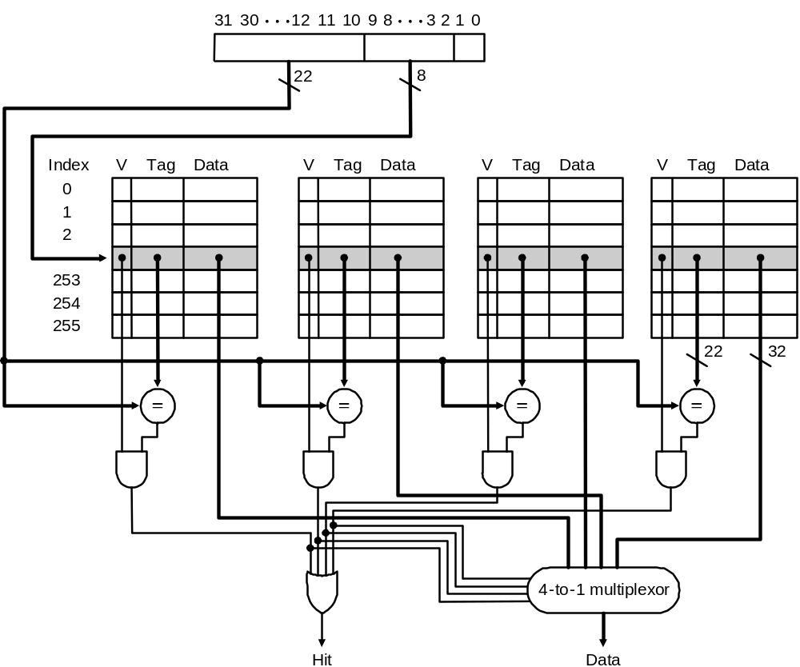
4-way Set Associative Cache

Slide 70
4-way set associative and the extreme example.
for (i=0;i<10000;i++) {
a[i] = a[i] + a[i+64] + a[i+128];
a[i+64] = a[i+64] + a[i+128];
}
a[i], a[i+64] and a[i+128] belong to the same set – that’s OK, we can hold all 3 in the cache at the same time.

Slide 71
Performance Comparison
 |  | Miss Rate
Program | Associativity | Instruction | Data | Combined
gcc | 1 (direct) | 2.0% | 1.7% | 1.9%
gcc | 2 | 1.6% | 1.4% | 1.5%
gcc | 4 | 1.6% | 1.4% | 1.5%
spice | 1 (direct) | 0.3% | 0.6% | 0.4%
spice | 2 | 0.3% | 0.6% | 0.4%
spice | 4 | 0.3% | 0.6% | 0.4%
DecStation 3100 cache with block size 4 words.

Slide 72
A note about set associativity
Direct mapped is really just 1-way set associative (1 block per set).
Fully associative is n-way set associative, where n is the number of blocks in the cache.

Slide 73
Question
Cache size 4K blocks.
block size 4 words (16 bytes)
32 bit address
How many bits for storing the tags (for the entire cache), if the cache is:
  direct mapped
  2-way set associative
  4-way set associative
  fully associative

Slide 74
Answer
Direct Mapped:
  16 * 4K = 64K bits
2-way:
  17 * 4K = 68K bits
4-way:
  18 * 4K = 72K bits
Fully Associative:
  28 * 4K = 112K bits
16
12
4
tag
index
offset
17
11
4
tag
index
offset
18
10
4
tag
index
offset
28
4
tag
offset

Slide 75
Block Replacement Policy
With a direct mapped cache there is no choice which memory element gets removed from the cache when a new element is moved to the cache.
With a set associative cache, eventually we will need to remove an element from a set.

Slide 76
Replacement Policy: LRU
LRU: Least recently used.
  keep track of how old each block is (the blocks in the cache).
  When we need to put a new element in the cache, use the slot occupied by the oldest block.
  Every time a block in the cache is accessed (a hit), set the age to 0.
  Increase the age of all blocks in a set whenever a block in the set is accessed.

Slide 77
LRU in hardware
We must implement this strategy in hardware!
2-way is easy, we need only 1 bit to keep track of which element in the set is older.
4-way is tougher (but possible).
8-way requires too much hardware (typically LRU is only approximated).

Slide 78
Multilevel Caches
Most modern processors include an on-chip cache (the cache is part of the processor chip).
The size of the on-chip cache is restricted by the size of the chip!
Often, a secondary cache is used between the on-chip cache and the main memory.

Slide 79
Adding a secondary cache
Typically use SRAM (fast, expensive). Miss penalty is much lower than for main memory.
Using a fast secondary cache can change the design of the primary cache:
  make the on-chip cache hit time as small as possible!

Slide 80
Performance Analysis
Processor with CPI of 1 if all memory access handled by the on-chip cache.
Clock rate 5 GHz (.2 ns period)
Main memory access time 100ns
Miss rate for primary cache is 2%
How much faster if we add a secondary cache with 5ns access time that reduces the miss rate (to main memory) to 0.5%.

Slide 81
Analysis without secondary cache
Without the secondary cache the CPI will be based on:
  the CPI without memory stall (for all except misses)
  the CPI with a memory stall (just for cache misses).
Without a stall the CPI is 1, and this happens 98% of the time.
With a stall the CPI is 1 + miss penalty which is 100/.2 = 500 cycles. This happens 2% of the time.

Slide 82
CPI Calculation (no secondary cache)
Total CPI = Base CPI + Memory-Stall cycles per instruction
CPI = 1.0 + (2% * 500) = 11.0

Slide 83
With secondary cache
With secondary cache the CPI will be based on:
  the CPI without memory stall (for all except misses)
  the CPI with a stall for accessing the secondary cache (for cache misses that are resolved in the secondary cache).
  the CPI with a stall for accessing secondary cache and main memory (for accesses to main memory).
The stall for accessing secondary cache is 5/.2 = 25 cycles.

Slide 84
CPI Calculation (with secondary cache)
Total CPI = 1 + Primary stalls per instruction +
Secondary stalls per instruction
= 1 + (2% * 25) + (.5% * 500)
= 1 + 0.5 + 2.5
= 4.0
Processor w/ 2ndary Cache is 11/4 = 2.8x faster!

Slide 85
Virtual Memory

Slide 86
Disk caching
Use main memory as a cache for magnetic disk.
We can do this for a number of reasons:
  speed up disk access
  pretend we have more main memory than we really have.
  support multiple programs easily (each can pretend it has all the memory).

Slide 87
Our focus
We will focus on using the disk as a storage area for chunks of main memory that are not being used.
The basic concepts are similar to providing a cache for main memory, although we now view part of the hard disk as being the memory.

Slide 88
Virtual memory
Consider a machine with a 32 bit address space:
  it probably doesn’t have 2³² = 4 GB of main memory!
  How do we write programs without knowing how much memory is really available ahead of time?
  Why not pretend we always have 4GB, and if we use more than we really have, store some blocks on the hard disk.
    this must happen automatically to be useful.
    Note: 64-bit architectures typically have something like a 48 bit address or 262144 GB address space which is ~256 TB

Slide 89
Motivation
Pretend we have 4GB, we really have only 512MB.
At any time, the processor needs only a small portion of the 4GB memory.
  only a few programs are active
  an active program might not need all the memory that has been reserved by the program.
We just keep the stuff needed in the main memory, and store the rest on disk.

Slide 90
V
i
r
t
u
a
l
a
d
d
r
e
s
s
e
s
P
h
y
s
i
c
a
l
a
d
d
r
e
s
s
e
s
A
d
d
r
e
s
s
t
r
a
n
s
l
a
t
i
o
n
D
i
s
k
a
d
d
r
e
s
s
e
s

Slide 91
A Program’s view of memory
We can write programs that address the virtual memory.
There is hardware that translates these virtual addresses to physical addresses.
The operating system is responsible for managing the movement of memory between disk and main memory, and for keeping the address translation table accurate.

Slide 92
Terminology
page: The unit of memory transferred between disk and the main memory.
page fault: when a program accesses a virtual memory location that is not currently in the main memory.
address translation: the process of finding the physical address that corresponds to a virtual address.

Slide 93
Virtual Memory & Address Translation
Virtual
Physical
“gimme Mem[25]”
“It’s really Mem[1049]”
CPU

Slide 94
Translation and Pages
Only the page number need be translated.
The offset within the page stays constant.
V
i
r
t
u
a
l
a
d
d
r
e
s
s
3
1
3
0
2
9
2
8
2
7
1
5
1
4
1
3
1
2
1
1
1
0
9
8
3
2
1
0
V
i
r
t
u
a
l
p
a
g
e
n
u
m
b
e
r
P
a
g
e
o
f
f
s
e
t
T
r
a
n
s
l
a
t
i
o
n
2
9
2
8
2
7
1
5
1
4
1
3
1
2
1
1
1
0
9
8
3
2
1
0
P
h
y
s
i
c
a
l
p
a
g
e
n
u
m
b
e
r
P
a
g
e
o
f
f
s
e
t
P
h
y
s
i
c
a
l
a
d
d
r
e
s
s

Slide 95
CPU & address translation
The CPU doesn’t need to worry about address translation – this is handled by the memory system (e.g., MMU)
As far as the CPU is concerned, it is using physical addresses.

Slide 96
Advantages of VM
A program can be written (linked) to use whatever addresses it wants to! It doesn’t matter where it is physically loaded!
When a program is loaded, it doesn’t need to be placed in continuous memory locations
  any group of physical memory pages will do fine.

Slide 97
Design Issue
A Page Fault is a disaster!
  disk is very, very, very slow compared to memory – millions of cycles!
Minimization of faults is the primary design consideration for virtual memory systems.
This “page” is important! It’s your “fault” if you miss this point ☺

Slide 98
Minimizing faults
Pages should be big enough to make a transfer from disk worthwhile. 4KB-64KB are typical sizes.
  Some systems have 1 to 256 MB page sizes
Fully associative placement is the most flexible (will reduce the rate of faults).
  software handles the placement of pages.

Slide 99
What about rights writes?
Write through is not practical for a virtual memory system (writes to disk are way to slow).
Write back is always used.
  write the entire page to disk only when kicked out of the main memory and placed on disk.

Slide 100
The dirty bit
It would be wasteful to always write an entire page to disk if nothing in the page has changed.
A flag is used to keep track of which pages have been changed in main memory (if not change happens, no need to write the page to disk).
The flag is called the dirty bit.

Slide 101
Address Translation
Address translation must be fast (it happens to every memory access).
We need a fully associative placement policy.
We can’t afford to go looking at every virtual page to find the right one
  we don’t use the tag bits approach

Slide 102
Page Table
We need a large table that holds the physical address for each virtual page.
Want virtual page 1234? Look at row 1234 in the table.
  the page table is a big array indexed by virtual page number.
The table will be huge! 2³²/page size.

Slide 103
P
a
g
e
t
a
b
l
e
r
e
g
i
s
t
e
r
V
i
r
t
u
a
l
a
d
d
r
e
s
s
3
1
3
0
2
9
2
8
2
7
1
5
1
4
1
3
1
2
1
1
1
0
9
8
3
2
1
0
V
i
r
t
u
a
l
p
a
g
e
n
u
m
b
e
r
P
a
g
e
o
f
f
s
e
t
2
0
1
2
V
a
l
i
d
P
h
y
s
i
c
a
l
p
a
g
e
n
u
m
b
e
r
P
a
g
e
t
a
b
l
e
1
8
I
f
0
t
h
e
n
p
a
g
e
i
s
n
o
t
p
r
e
s
e
n
t
i
n
m
e
m
o
r
y
2
9
2
8
2
7
1
5
1
4
1
3
1
2
1
1
1
0
9
8
3
2
1
0
P
h
y
s
i
c
a
l
p
a
g
e
n
u
m
b
e
r
P
a
g
e
o
f
f
s
e
t
P
h
y
s
i
c
a
l
a
d
d
r
e
s
s

Slide 104
Processes and Page Tables
Each process has it’s own page table!
  each program can pretend it is loaded and running at the same address.
One page table is huge, now we need to worry about lots of page tables.
We can’t include dedicated hardware that holds all these page tables.

Slide 105
Page Tables memory needs
Assume 32 bit virtual address space.
Assume 16K Byte page size.
  each page table needs 2³²/2¹⁴ = 2¹⁸ elements.
We would like to support 256 different processes.
We need 2⁸ * 2¹⁸ = 2²⁶ page table elements, assume each is 1 word wide.
Total needed is 256 MBytes!
A solution – “Page” the page table.

Slide 106
Page Table Elements
Each element in the page table needs to include:
  a valid bit.
  if the page is in memory, the physical address.
  if the page is on disk, some indication of where on the disk

Slide 107
V
i
r
t
u
a
l
p
a
g
e
n
u
m
b
e
r
P
a
g
e
t
a
b
l
e
P
h
y
s
i
c
a
l
p
a
g
e
o
r
P
h
y
s
i
c
a
l
m
e
m
o
r
y
V
a
l
i
d
d
i
s
k
a
d
d
r
e
s
s
1
1
1
1
0
1
1
0
1
D
i
s
k
s
t
o
r
a
g
e
1
0
1
Figure 7.23

Slide 108
I need to go buy more memory!
Page tables are stored in main memory.
Most programs are small, so we don’t need to actually create the entire page table for each process.
  just enough to cover the actual pages that have been reserved for use by the program.
  this number will be quite small (a few thousand pages is enough for a large program).

Slide 109
Speed of address translation
Page tables are in memory.
We need to access an element of the page table every time a translation is needed.
A translation is needed on every memory access!
Every memory access really requires 2 memory accesses!
  This is very bad .. Especially for your uber-faster, superscalar pipelined processor!

Slide 110
Making address translation fast
We can create a dedicated cache that holds the most recently used page table entries.
  the same page table entry is used for all memory locations in the page. Spatial Locality.
This cache is called a Translation Lookaside Buffer (TLB).

Slide 111
V
i
r
t
u
a
l
p
a
g
e
T
L
B
n
u
m
b
e
r
P
h
y
s
i
c
a
l
p
a
g
e
V
a
l
i
d
T
a
g
a
d
d
r
e
s
s
1
1
P
h
y
s
i
c
a
l
m
e
m
o
r
y
1
1
0
1
P
a
g
e
t
a
b
l
e
P
h
y
s
i
c
a
l
p
a
g
e
V
a
l
i
d
o
r
d
i
s
k
a
d
d
r
e
s
s
1
1
1
D
i
s
k
s
t
o
r
a
g
e
1
0
1
1
0
1
1
0
1
Figure 7.24

Slide 112
DecStation 3100 TLB
32 bit address space
4KB Page size
  virtual page address is 20 bits.
TLB has 64 slots
  each has 20 bit tag, 20 bit physical page address, a valid bit and a dirty bit.
  fully associative.

Slide 113
V
i
r
t
u
a
l
a
d
d
r
e
s
s
3
1
3
0
2
9
1
5
1
4
1
3
1
2
1
1
1
0
9
8
3
2
1
0
V
i
r
t
u
a
l
p
a
g
e
n
u
m
b
e
r
P
a
g
e
o
f
f
s
e
t
2
0
1
2
V
a
l
i
d
D
i
r
t
y
T
a
g
P
h
y
s
i
c
a
l
p
a
g
e
n
u
m
b
e
r
T
L
B
T
L
B
h
i
t
2
0
P
h
y
s
i
c
a
l
p
a
g
e
n
u
m
b
e
r
P
a
g
e
o
f
f
s
e
t
P
h
y
s
i
c
a
l
a
d
d
r
e
s
s
t
a
g
P
h
y
s
i
c
a
l
a
d
d
r
e
s
s
B
y
t
e
C
a
c
h
e
i
n
d
e
x
o
f
f
s
e
t
1
6
1
4
2
V
a
l
i
d
T
a
g
D
a
t
a
C
a
c
h
e
3
2
C
a
c
h
e
h
i
t
D
a
t
a

Slide 114
Cache + Virtual Memory
The Decstation 3100 does address translation before the cache.
The cache operates on physical memory addresses.
It is also possible to cache virtual memory, although there are some problems.
  if programs can share pages, a single word from physical memory could end up in the cache twice! (the same physical location could have 2 different virtual addresses).

Slide 115
Protection
Virtual memory allows multiple processes to share the same physical memory.
What if my process tries to write to your process’s memory?
  we don’t want this to be possible!
  we don’t even want it to be able to read!
We can provide protection via the page tables

Slide 116
Independent Page Tables
Each process has it’s own page table.
All page tables are created by the operating system – your program can’t change it’s own page table.
Supporting virtual memory requires a combination of hardware and software.

Slide 117
Common Issues
There are a number of issues that are common to both cache and virtual memory system design:
  block placement policy.
  how is a block found?
  block replacement policy.
  write policy.

Slide 118
Block Placement Options
Direct-Mapped
  cheap, easy to implement, relatively high miss rate.
Set Associative
  middle ground
Fully Associative
  expensive (lots of hardware or software), minimizes miss rate.

Slide 119
1
5
%
1
2
%
9
%
e
t
a
r
s
s
i
M
6
%
3
%
0
%
O
n
e
-
w
a
y
T
w
o
-
w
a
y
F
o
u
r
-
w
a
y
E
i
g
h
t
-
w
a
y
A
s
s
o
c
i
a
t
i
v
i
t
y
1
K
B
1
6
K
B
2
K
B
3
2
K
B
4
K
B
6
4
K
B
8
K
B
1
2
8
K
B

Slide 120
How is a block found?
This depends on placement policy.
Direct Mapped: uses an index.
Set Associative: index selects a set, and we need to look at all set elements.
Fully Associative: need to look at all elements.

Slide 121
Replacement Policies
Direct-Mapped: not an issue.
Set and fully associative
  LRU (least recently used) hard to implement in hardware for large sets, often approximated.
  random easy to implement, does nearly as well as LRU approximations.
LRU is always used (or approximated) for virtual memory.

Slide 122
Write Policies
Write-Through: update the cache and lower level memory.
Write-Back: update the cache only. When block/page is booted from the cache - write to lower-level memory if any changes.

Slide 123
Where do misses come from?
Compulsory misses: the first access is always a miss. Can’t avoid these.
Capacity misses: cache can’t hold all the blocks needed.
Conflict misses: multiple blocks compete for the same cache slot(s) and collide.

Slide 124
Where do misses come from?
1
4
%
Miss Rate and the cause of misses.
Compulsory misses are baseline of 0.2%
Ranges show the conflict misses for various set sizes
1
2
%
1
0
%
e
p
y
t
r
8
%
e
p
e
t
a
r
6
%
s
s
i
M
4
%
2
%
C
a
p
a
c
i
t
y
0
%
1
2
4
8
1
6
3
2
6
4
1
2
8
C
a
c
h
e
s
i
z
e
(
K
B
)
O
n
e
-
w
a
y
F
o
u
r
-
w
a
y
T
w
o
-
w
a
y
E
i
g
h
t
-
w
a
y

Slide 125
Cache friendly code
(a great name for a band!)
There are sometimes things you can do to your program to take advantage of the cache.
  usually it’s not necessary to know much about the specific architecture of the cache on which a program is run.
The patterns of array element access is one good example.

Slide 126
Matrix Multiplication
for (i=0; i!=500; i++)
for (j=0;j!=500; j++)
for (k=0;k!=500; k++)
x[i][j] = x[i][j] + y[i][k]*z[k][j];
for (k=0; k!=500; k++)
for (j=0;j!=500; j++)
for (i=0;i!=500; i++)
x[i][j] = x[i][j] + y[i][k]*z[k][j];
almost twice as fast on SGI Mips R4000

