Slide 1
CSCI-2500:
Computer Organization
Boolean Logic & Arithmetic for Computers
(Chapter 3 and App. B)
Notes:
Morgan Kaufmann Publishers
Chapter 1 — Computer Abstractions and Technology

Slide 2
Boolean Algebra
Developed by George Boole in the 1850s
Mathematical theory of logic.
Shannon was the first to use Boolean Algebra to solve problems in electronic circuit design. (1938)
CSCI-2500 SPRING 2016, Boolean Logic
Notes:
Morgan Kaufmann Publishers
Chapter 1 — Computer Abstractions and Technology

Slide 3
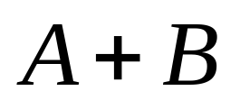

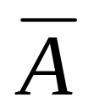
Variables & Operations
All variables have the values 1 or 0
  sometimes we call the values TRUE / FALSE
Three operators:
  OR written as +, as in
  AND written as •, as in
  NOT written as an overline, as in
CSCI-2500 SPRING 2016, Boolean Logic

Slide 4
Operators: OR
The result of the OR operator is 1 if either of the operands is a 1.
The only time the result of an OR is 0 is when both operands are 0s.
OR is like our old pal addition, but operates only on binary values.
CSCI-2500 SPRING 2016, Boolean Logic

Slide 5
Operators: AND
The result of an AND is a 1 only when both operands are 1s.
If either operand is a 0, the result is 0.
AND is like our old nemesis multiplication, but operates on binary values.
CSCI-2500 SPRING 2016, Boolean Logic

Slide 6
Operators: NOT
NOT is a unary operator – it operates on only one operand.
NOT negates its operand.
If the operand is a 1, the result of the NOT is a 0.
CSCI-2500 SPRING 2016, Boolean Logic

Slide 7
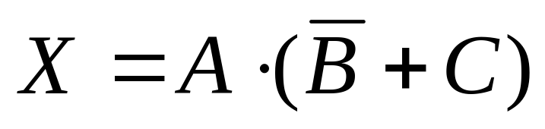
Equations
Boolean algebra uses equations to express relationships. For example:
This equation expressed a relationship between the value of X and the values of A, B and C.
CSCI-2500 SPRING 2016, Boolean Logic

Slide 8
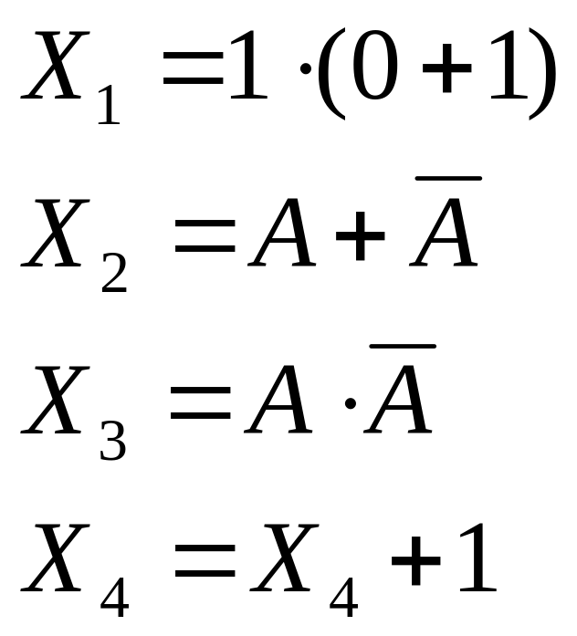
Examples
What is the value of each X:
huh?
CSCI-2500 SPRING 2016, Boolean Logic

Slide 9
Laws of Boolean Algebra
Just like in good old algebra, Boolean Algebra has postulates and identities.
We can often use these laws to reduce expressions or put expressions in to a more desirable form.
CSCI-2500 SPRING 2016, Boolean Logic

Slide 10
Basic Postulates of Boolean Algebra
Using just the basic postulates – everything else can be derived.
  Commutative laws
  Distributive laws
  Identity
  Inverse
CSCI-2500 SPRING 2016, Boolean Logic

Slide 11
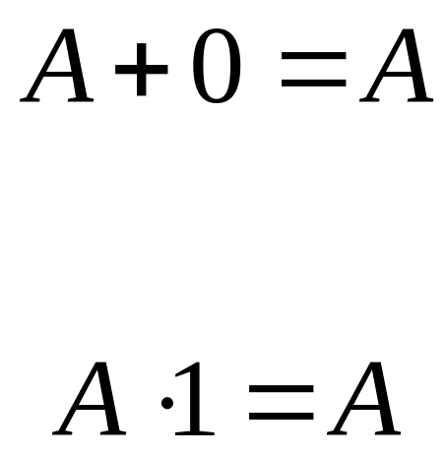
Identity Laws
CSCI-2500 SPRING 2016, Boolean Logic

Slide 12
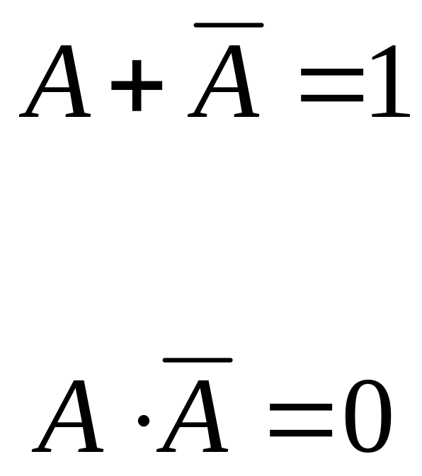
Inverse Laws
CSCI-2500 SPRING 2016, Boolean Logic

Slide 13
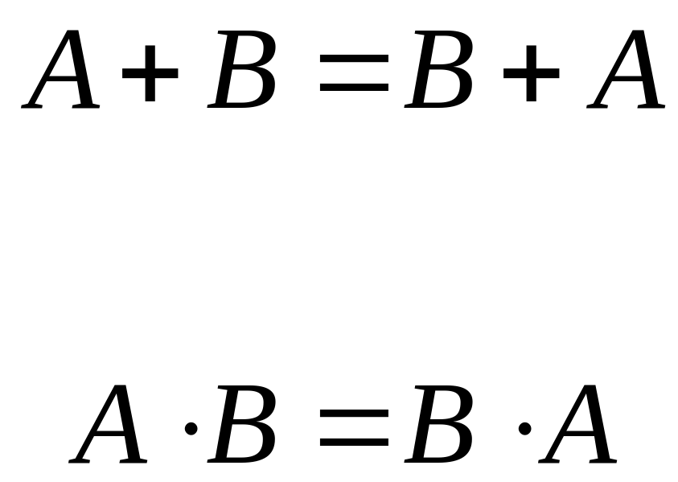
Commutative Laws
CSCI-2500 SPRING 2016, Boolean Logic

Slide 14
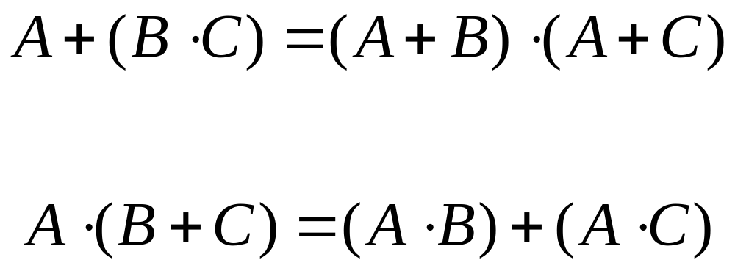
Distributive Laws
CSCI-2500 SPRING 2016, Boolean Logic

Slide 15
Other Identities
Can be derived from the basic postulates.
Laws of Ones and Zeros
Associative Laws
DeMorgan’s Theorems
CSCI-2500 SPRING 2016, Boolean Logic

Slide 16
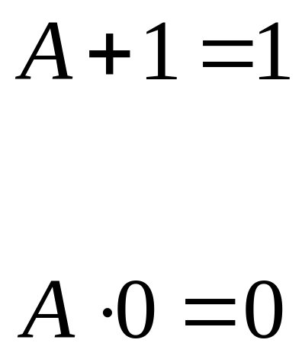
Zero and One Laws
Law of Ones
Law of Zeros
CSCI-2500 SPRING 2016, Boolean Logic

Slide 17
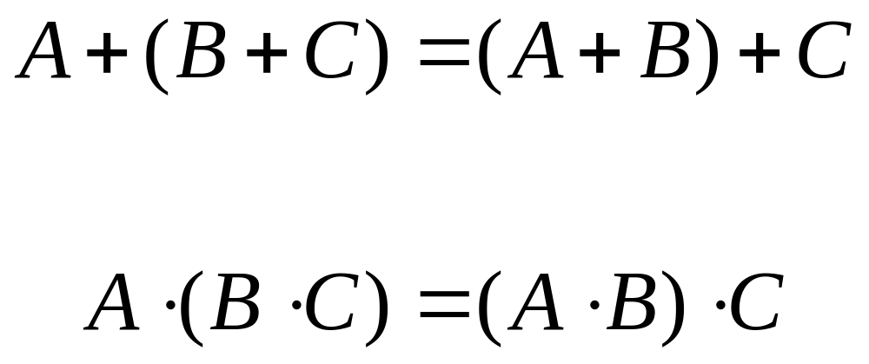
Associative Laws
CSCI-2500 SPRING 2016, Boolean Logic

Slide 18
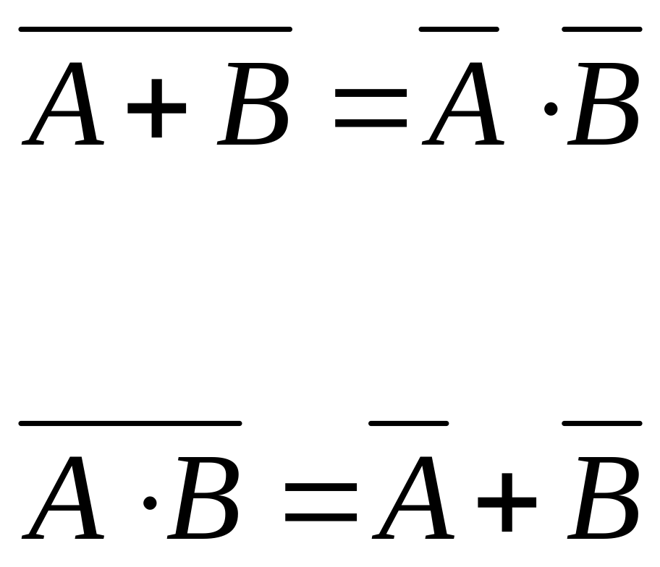
DeMorgan’s Theorems
CSCI-2500 SPRING 2016, Boolean Logic

Slide 19
Other Operators
Boolean Algebra is defined over the 3 operators AND, OR and NOT.
  this is a functionally complete set.
There are other useful operators:
  NOR: is a 0 if either operand is a 1
  NAND: is a 0 only if both operands are 1
  XOR: is a 1 if the operands are different.
NOTE: NOR or NAND is (by itself) a functionally complete set!
CSCI-2500 SPRING 2016, Boolean Logic

Slide 20
Boolean Functions
Boolean functions are functions that operate on a number of Boolean variables.
The result of a Boolean function is itself either a 0 or a 1.
Example: f(a,b) = a+b
CSCI-2500 SPRING 2016, Boolean Logic

Slide 21
Alternative Representation
We can define a Boolean function by showing it using algebraic operations.
We can also define a Boolean function by listing the value of the function for all possible inputs.
CSCI-2500 SPRING 2016, Boolean Logic

Slide 22
OR as a Boolean Function f_{or}(a,b)=a+b
a | b | f_{or}(a,b)
0 | 0 | 0
0 | 1 | 1
1 | 0 | 1
1 | 1 | 1
This is called
a “truth table”
CSCI-2500 SPRING 2016, Boolean Logic

Slide 23
Truth Tables
a | b | OR | AND | NOR | NAND | XOR
0 | 0 | 0 | 0 | 1 | 1 | 0
0 | 1 | 1 | 0 | 0 | 1 | 1
1 | 0 | 1 | 0 | 0 | 1 | 1
1 | 1 | 1 | 1 | 0 | 0 | 0
CSCI-2500 SPRING 2016, Boolean Logic

Slide 24
Truth Table for (X+Y)·Z
X | Y | Z | (X+Y)·Z
0 | 0 | 0 | 0
0 | 0 | 1 | 0
0 | 1 | 0 | 0
0 | 1 | 1 | 1
1 | 0 | 0 | 0
1 | 0 | 1 | 1
1 | 1 | 0 | 0
1 | 1 | 1 | 1
CSCI-2500 SPRING 2016, Boolean Logic

Slide 25
Gates
Digital logic circuits are electronic circuits that are implementations of some Boolean function(s).
A circuit is built up of gates, each gate implements some simple logic function.
CSCI-2500 SPRING 2016, Boolean Logic

Slide 26
A Gate
???
Output
A
Inputs
f(A,B)
B
CSCI-2500 SPRING 2016, Boolean Logic

Slide 27
Gates compute something!
The output depends on the inputs.
If the input changes, the output might change.
If the inputs don’t change – the output does not change.
CSCI-2500 SPRING 2016, Boolean Logic

Slide 28
An OR gate
A
A+B
B
CSCI-2500 SPRING 2016, Boolean Logic

Slide 29
An AND gate
A
A•B
B
CSCI-2500 SPRING 2016, Boolean Logic

Slide 30
A NOT gate
A
A
CSCI-2500 SPRING 2016, Boolean Logic

Slide 31
NAND and NOR gates
A
A•B
B
A
A+B
B
CSCI-2500 SPRING 2016, Boolean Logic

Slide 32
Combinational Circuits
We can put gates together into circuits
  output from some gates are inputs to others.
We can design a circuit that represents any Boolean function!
CSCI-2500 SPRING 2016, Boolean Logic

Slide 33
A Simple Circuit
A
?
B
CSCI-2500 SPRING 2016, Boolean Logic

Slide 34
Truth Table for our circuit
a | b | a | b | a • b | a • b
0 | 0 | 1 | 1 | 1 | 0
0 | 1 | 1 | 0 | 0 | 1
1 | 0 | 0 | 1 | 0 | 1
1 | 1 | 0 | 0 | 0 | 1
CSCI-2500 SPRING 2016, Boolean Logic

Slide 35
Alternative Representations
Any of these can express a Boolean function. :
Boolean Equation
Circuit (Logic Diagram)
Truth Table
CSCI-2500 SPRING 2016, Boolean Logic

Slide 36
Implementation
A logic diagram is used to design an implementation of a function.
The implementation is the specific gates and the way they are connected.
We can buy a bunch of gates, put them together (along with a power source) and build a machine.
CSCI-2500 SPRING 2016, Boolean Logic

Slide 37
Integrated Circuits
You can buy an AND gate chip:
CSCI-2500 SPRING 2016, Boolean Logic

Slide 38
Function Implementation
Given a Boolean function expressed as a truth table or Boolean Equation, there are many possible implementations.
The actual implementation depends on what kind of gates are available.
In general we want to minimize the number of gates.
CSCI-2500 SPRING 2016, Boolean Logic

Slide 39
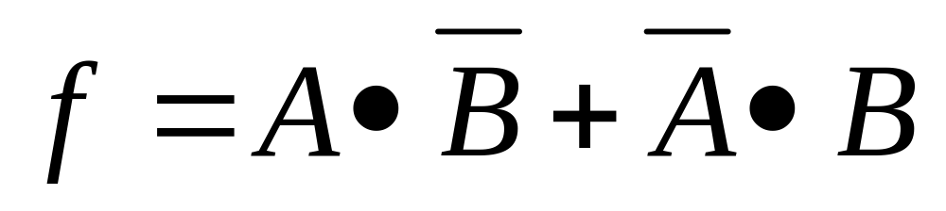
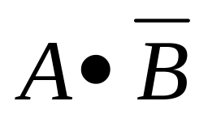
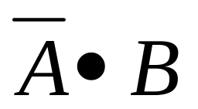
Example:
A | B |  |  | f
0 | 0 | 0 | 0 | 0
0 | 1 | 0 | 1 | 1
1 | 0 | 1 | 0 | 1
1 | 1 | 0 | 0 | 0
CSCI-2500 SPRING 2016, Boolean Logic

Slide 40
One Implementation
A
f
B
CSCI-2500 SPRING 2016, Boolean Logic

Slide 41
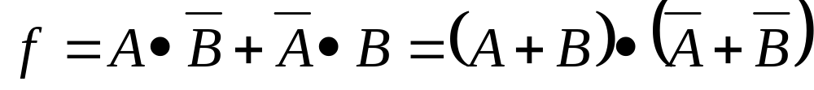
Another Implementation
A
f
B
CSCI-2500 SPRING 2016, Boolean Logic

Slide 42
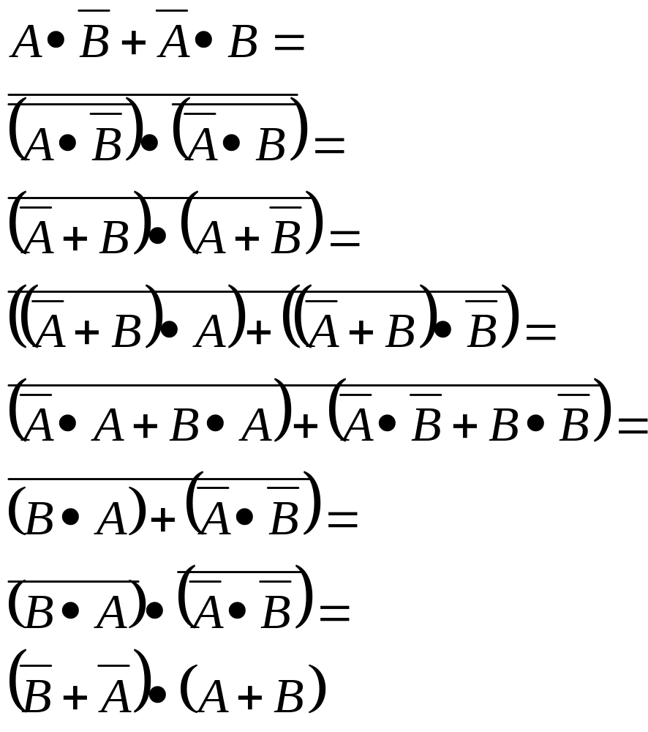
Proof it’s the same function
DeMorgan's Law
DeMorgan's Laws
Distributive
Distributive
Inverse, Identity
DeMorgan's Law
DeMorgan's Laws
CSCI-2500 SPRING 2016, Boolean Logic

Slide 43
Logic Design

Slide 44
Common Components
There are many commonly used components in processor design.
We will use these components when we design control systems (later).
We will look at the functionality and design of some of these components now.
CSCI-2500 SPRING 2016, Boolean Logic

Slide 45
Some commonly used components
Decoders: n inputs, 2^{n} outputs.
  the inputs are used to select which output is turned on.
Multiplexors: 2^{n} inputs, n selection bits, 1 output.
  the selection bits determine which input will become the output.
CSCI-2500 SPRING 2016, Boolean Logic

Slide 46
2 input Decoder
Decoder
O₀
I₀
O₁
O₂
I₁
O₃
CSCI-2500 SPRING 2016, Boolean Logic

Slide 47
Decoder Truth Table
I₀ | I₁ | O₀ | O₁ | O₂ | O₃
0 | 0 | 1 | 0 | 0 | 0
0 | 1 | 0 | 1 | 0 | 0
1 | 0 | 0 | 0 | 1 | 0
1 | 1 | 0 | 0 | 0 | 1
CSCI-2500 SPRING 2016, Boolean Logic

Slide 48
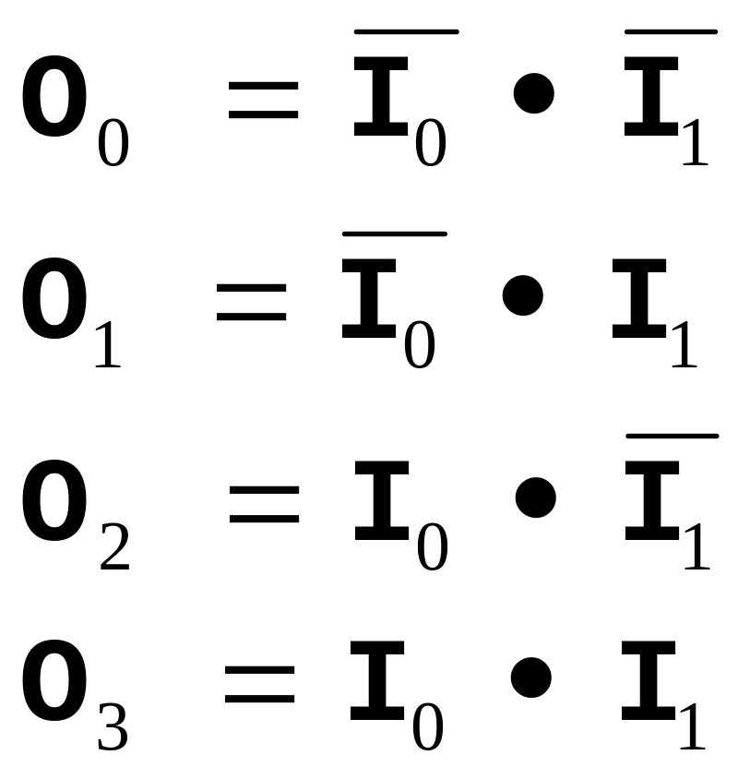
Decoder Boolean Expressions
CSCI-2500 SPRING 2016, Boolean Logic

Slide 49
Decoder Implementation
I₁
I₀
O₀
O₁
O₂
O₃
CSCI-2500 SPRING 2016, Boolean Logic

Slide 50
3 Input Decoder
Decoder
O₀
I₀
O₁
O₂
I₁
O₃
O₄
I₃
O₅
O₆
O₇
CSCI-2500 SPRING 2016, Boolean Logic

Slide 51
3 Input Decoder Truth Table
I₂ | I₁ | I₀ | O₀ | O₁ | O₂ | O₃ | O₄ | O₅ | O₆ | O₇
0 | 0 | 0 | 1 | 0 | 0 | 0 | 0 | 0 | 0 | 0
0 | 0 | 1 | 0 | 1 | 0 | 0 | 0 | 0 | 0 | 0
0 | 1 | 0 | 0 | 0 | 1 | 0 | 0 | 0 | 0 | 0
0 | 1 | 1 | 0 | 0 | 0 | 1 | 0 | 0 | 0 | 0
1 | 0 | 0 | 0 | 0 | 0 | 0 | 1 | 0 | 0 | 0
1 | 0 | 1 | 0 | 0 | 0 | 0 | 0 | 1 | 0 | 0
1 | 1 | 0 | 0 | 0 | 0 | 0 | 0 | 0 | 1 | 0
1 | 1 | 1 | 0 | 0 | 0 | 0 | 0 | 0 | 0 | 1
CSCI-2500 SPRING 2016, Boolean Logic

Slide 52
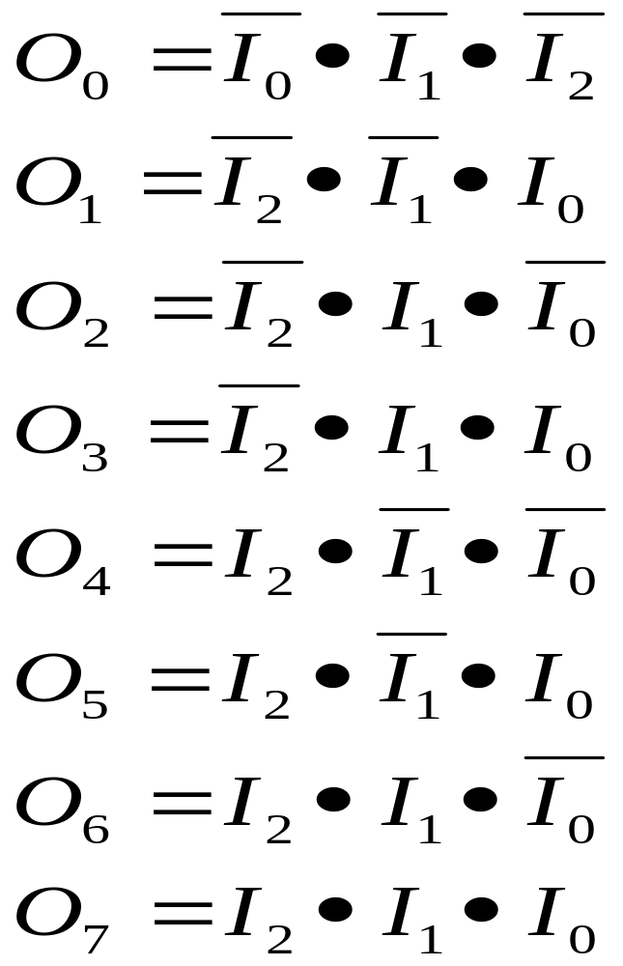
3-Decoder Boolean Expressions
CSCI-2500 SPRING 2016, Boolean Logic

Slide 53
3-Decoder Partial Implementation
I₂
I₁
I₀
O₀
O₁
. . .
CSCI-2500 SPRING 2016, Boolean Logic

Slide 54
A Useful Simplification
A
B
A • B • C
C
The above logic diagram is often abbreviated as shown below:
We can do this (without possible confusion) because of the associative property.
A
B
A • B • C
C
CSCI-2500 SPRING 2016, Boolean Logic

Slide 55
Revised Partial 3-Decoder
I₂
I₁
I₀
O₀
O₁
. . .
CSCI-2500 SPRING 2016, Boolean Logic

Slide 56
Multiple Input Or Gates
A
A
B
A+B+C
B
A+B+C+D
C
C
D
A
A
A+B+C
B
B
A+B+C+D
C
C
D
CSCI-2500 SPRING 2016, Boolean Logic

Slide 57
2 Input Multiplexor
Inputs: I₀ and I₁
Selector: S
Output: O
If S is a 0: O=I₀
If S is a 1: O=I₁
Mux
I₀
O
I₁
S
CSCI-2500 SPRING 2016, Boolean Logic

Slide 58
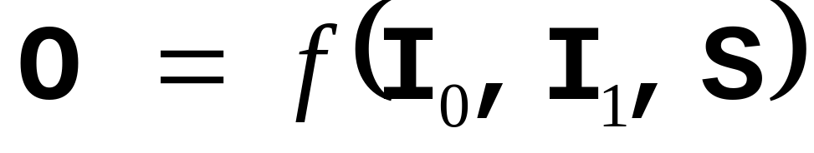
2-Mux Boolean Function
The output depends on I₀ and I₁
The output also depends on S !!!
We must treat S as an input.
CSCI-2500 SPRING 2016, Boolean Logic

Slide 59
2-Mux Truth Table
Abbreviated
Truth Table
S | I₀ | I₁ | O₀
0 | 0 | 0 | 0
0 | 0 | 1 | 0
0 | 1 | 0 | 1
0 | 1 | 1 | 1
1 | 0 | 0 | 0
1 | 0 | 1 | 1
1 | 1 | 0 | 0
1 | 1 | 1 | 1
S | O
0 | I₀
1 | I₁
CSCI-2500 SPRING 2016, Boolean Logic

Slide 60
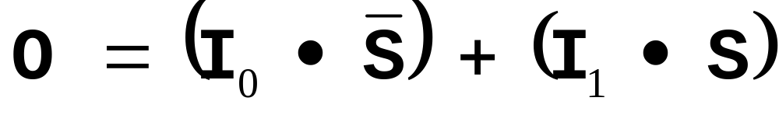
2-Mux Boolean Expression
terms
Since S can’t be both a 1 and a 0, only one of the terms can be a 1.
CSCI-2500 SPRING 2016, Boolean Logic

Slide 61
2-Mux Logic Design
S
I₀
I₁
O
CSCI-2500 SPRING 2016, Boolean Logic

Slide 62
4 Input Multiplexor
If we have 4 inputs, we need to have 2 selection bits: S₀ S₁
S₀ | S₁ | O
0 | 0 | I₀
0 | 1 | I₁
1 | 0 | I₂
1 | 1 | I₃
Abbreviated
Truth Table
CSCI-2500 SPRING 2016, Boolean Logic

Slide 63
One Possible 4-Mux
2-Decoder
S₀
I₀
S₁
I₁
O
I₂
I₃
CSCI-2500 SPRING 2016, Boolean Logic

Slide 64
Common Implementations
There are two general forms that are used in many circuit implementations:
  Product of Sums
    A bunch of ORs leading to a big AND gate
  Sum of Products
    A bunch of ANDs leading to a big OR gate
CSCI-2500 SPRING 2016, Boolean Logic

Slide 65
Sum of Products
Express the function by listing all the combinations of inputs for which the output should be a 1.
These combinations are rows in the truth table where the function has the value 1.
Represent each combination with an AND gate.
OR all the AND gates to generate the output.
CSCI-2500 SPRING 2016, Boolean Logic

Slide 66
SOP Example: 2-Mux
Find rows in truth table where the output is 1.
If S is 1 in that row, connect S to a 3-input AND gate, otherwise connect S.
Connect I₀ and I₁ in the same way.
The AND gate corresponds to the row in the truth table.
S | I₀ | I₁ | O
0 | 0 | 0 | 0
0 | 0 | 1 | 0
0 | 1 | 0 | 1
0 | 1 | 1 | 1
1 | 0 | 0 | 0
1 | 0 | 1 | 1
1 | 1 | 0 | 0
1 | 1 | 1 | 1
CSCI-2500 SPRING 2016, Boolean Logic

Slide 67
SOP Example: 2-Mux (cont).
If the output of this AND gate is a 1,the value of the function is a 1!
S | I₀ | I₁ | O
0 | 0 | 0 | 0
0 | 0 | 1 | 0
0 | 1 | 0 | 1
0 | 1 | 1 | 1
1 | 0 | 0 | 0
1 | 0 | 1 | 1
1 | 1 | 0 | 0
1 | 1 | 1 | 1
S
I₀
I₁
CSCI-2500 SPRING 2016, Boolean Logic

Slide 68
SOP Construction
For each row on the truth table that has the value 1 (the function has the value 1) build the corresponding AND gate.
Ignore all rows where the function has the value 0!
Connect the output of all the AND gates to one big OR gate.
CSCI-2500 SPRING 2016, Boolean Logic

Slide 69
4-Mux Sum Of Products
S
I₀
Truth Table
I₁
S | I₀ | I₁ | O₀
0 | 0 | 0 | 0
0 | 0 | 1 | 0
0 | 1 | 0 | 1
0 | 1 | 1 | 1
1 | 0 | 0 | 0
1 | 0 | 1 | 1
1 | 1 | 0 | 0
1 | 1 | 1 | 1
S
I₀
I₁
O
S
I₀
I₁
S
I₀
I₁
CSCI-2500 SPRING 2016, Boolean Logic

Slide 70
Product of Sums
Express the function by listing all the combinations of inputs for which the output should be a 0.
These combinations are rows in the truth table where the function has the value 0.
Represent each combination with an OR gate.
AND all the OR gates to generate the output.
CSCI-2500 SPRING 2016, Boolean Logic

Slide 71
POS Example: 2-Mux
Find rows in truth table where the output is 0.
If S is 0 in that row, connect S to a 3-input OR gate, otherwise connect S.
Connect I₀ and I₁ in the same way.
The OR gate corresponds to the row in the truth table.
S | I₀ | I₁ | O
0 | 0 | 0 | 0
0 | 0 | 1 | 0
0 | 1 | 0 | 1
0 | 1 | 1 | 1
1 | 0 | 0 | 0
1 | 0 | 1 | 1
1 | 1 | 0 | 0
1 | 1 | 1 | 1
CSCI-2500 SPRING 2016, Boolean Logic

Slide 72
POS Example: 2-Mux (cont).
If the output of this OR gate is a 0, the value of the function is a 0!
S | I₀ | I₁ | O
0 | 0 | 0 | 0
0 | 0 | 1 | 0
0 | 1 | 0 | 1
0 | 1 | 1 | 1
1 | 0 | 0 | 0
1 | 0 | 1 | 1
1 | 1 | 0 | 0
1 | 1 | 1 | 1
S
I₀
I₁
CSCI-2500 SPRING 2016, Boolean Logic

Slide 73
POS Construction
For each row on the truth table that has the value 0 (the function has the value 0) build the corresponding OR gate.
Ignore all rows where the function has the value 1!
Connect the output of all the OR gates to one big AND gate.
CSCI-2500 SPRING 2016, Boolean Logic

Slide 74
4-Mux Product of Sums
S
Truth Table
I₀
I₁
S | I₀ | I₁ | O
0 | 0 | 0 | 0
0 | 0 | 1 | 0
0 | 1 | 0 | 1
0 | 1 | 1 | 1
1 | 0 | 0 | 0
1 | 0 | 1 | 1
1 | 1 | 0 | 0
1 | 1 | 1 | 1
S
I₀
I₁
O
S
I₀
I₁
S
I₀
I₁
CSCI-2500 SPRING 2016, Boolean Logic

Slide 75
Minimization
SOP and POS forms provide a simple translation from truth table to circuit.
The resulting designs may involve more gates than are necessary.
There are a number of techniques used to minimize such circuits.
CSCI-2500 SPRING 2016, Boolean Logic

Slide 76
Minimization Techniques
Boolean Algebra
  use postulates and identities to reduce expressions.
Karnaugh Maps
  graphical technique useful for small circuits (no more than 4 or 5 inputs)
Tabular Methods
  suitable for large functions – usually done by a computer program.
CSCI-2500 SPRING 2016, Boolean Logic

Slide 77
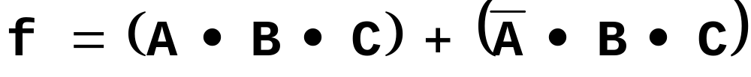

Karnaugh Map (K-map)
Based on SOP form.
It may be possible to merge terms.
Example:
  Close inspection reveals that it doesn’t matter what the value of A is!
  Here is a simpler version of the same function:
CSCI-2500 SPRING 2016, Boolean Logic

Slide 78
Graphical Representation
The idea is to draw a picture in which it will be easy to see when terms can be merged.
We draw the truth table in 2-D, the result is similar to a Venn Diagram
A
B
C
CSCI-2500 SPRING 2016, Boolean Logic

Slide 79
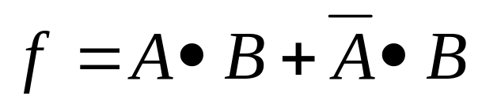
K-Map Example
Truth Table
K-Map
A | B | f
0 | 0 | 0
0 | 1 | 1
1 | 0 | 0
1 | 1 | 1
 | B=0 | B=1
A=0 | 0 | 1
A=1 | 0 | 1
In the K-Map it’s easy to see that
the value of A doesn’t matter
CSCI-2500 SPRING 2016, Boolean Logic

Slide 80
Ex 2: The Majority Function
The majority function is 1 whenever the majority of the inputs are 1.
Here is an SOP Boolean equation for the 3-input majority function:
CSCI-2500 SPRING 2016, Boolean Logic

Slide 81
K-Map for Majority Function
Truth Table
A | B | C | f
0 | 0 | 0 | 0
0 | 0 | 1 | 0
0 | 1 | 0 | 0
0 | 1 | 1 | 1
1 | 0 | 0 | 0
1 | 0 | 1 | 1
1 | 1 | 0 | 1
1 | 1 | 1 | 1
K-Map
AB
 | 00 | 01 | 11 | 10
0 | 0 | 0 | 1 | 0
1 | 0 | 1 | 1 | 1
C
CSCI-2500 SPRING 2016, Boolean Logic

Slide 82
K-Map Construction
Notice that any 2 adjacent cells differ by exactly one bit in the input.
  either A is different, or B is different or C is different.
  Never more then 1 variable is different!
AB
 | 00 | 01 | 11 | 10
0 | 0 | 0 | 1 | 0
1 | 0 | 1 | 1 | 1
C
CSCI-2500 SPRING 2016, Boolean Logic

Slide 83
How to use K-Map
Rectangular collections of cells that all have the value 1 indicate it is possible to merge the corresponding terms in SOP expression.
The number of cells in the rectangle must be a power of 2!
K-Map
AB
 | 00 | 01 | 11 | 10
0 | 0 | 0 | 1 | 0
1 | 0 | 1 | 1 | 1
C
CSCI-2500 SPRING 2016, Boolean Logic

Slide 84
Possible Mergings
There are 3 possible mergings of terms in this K-Map.
K-Map
AB
 | 00 | 01 | 11 | 10
0 | 0 | 0 | 1 | 0
1 | 0 | 1 | 1 | 1
C
CSCI-2500 SPRING 2016, Boolean Logic

Slide 85
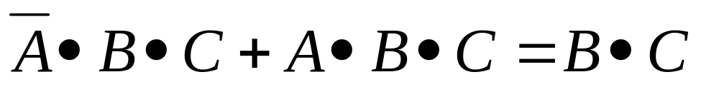
One of the merges
The merge shown means “if C is 1 and B is 1, it doesn’t matter what the value of A is”
K-Map
AB
 | 00 | 01 | 11 | 10
0 | 0 | 0 | 1 | 0
1 | 0 | 1 | 1 | 1
C
CSCI-2500 SPRING 2016, Boolean Logic

Slide 86
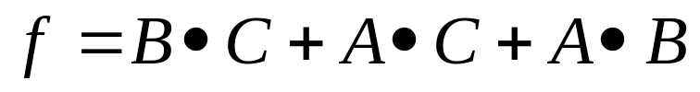
All 3 reductions
K-Map
AB
 | 00 | 01 | 11 | 10
0 | 0 | 0 | 1 | 0
1 | 0 | 1 | 1 | 1
C
Original:
Reduced:
CSCI-2500 SPRING 2016, Boolean Logic

Slide 87
K-Map Concept
A professional Logic Designer would need to use minimization techniques every day.
We are just amateurs, so all we need to know is the general idea.
  that there are systematic procedures for minimizing SOP and POS form Boolean equations.
CSCI-2500 SPRING 2016, Boolean Logic

Slide 88
Combinational vs. Sequential
Combinational: output depends completely on the value of the inputs.
  time doesn’t matter.
Sequential: output also depends on the state a little while ago.
  can depend on the value of the output some time in the past.
CSCI-2500 SPRING 2016, Boolean Logic

Slide 89
Memory
Think about how you might design a combinational circuit that could be used as a single bit memory.
Use your memory to recall that the output of a gate can change whenever the inputs change.
CSCI-2500 SPRING 2016, Boolean Logic

Slide 90
Gate Timing
A
C
B
C
A
B
Δt
Δt
CSCI-2500 SPRING 2016, Boolean Logic

Slide 91
Feedback
A
C
What happens when A changes from 1 to 0?
CSCI-2500 SPRING 2016, Boolean Logic

Slide 92
S-R latch
A | B | A nor B
0 | 0 | 1
0 | 1 | 0
1 | 0 | 0
1 | 1 | 0
S
Q
Q
R
CSCI-2500 SPRING 2016, Boolean Logic

Slide 93
S-R latch Truth Table
Q_{t} | S_{t} | R_{t} | Q_{t+1}
0 | 0 | 0 | 0
0 | 0 | 1 | 0
0 | 1 | 0 | 1
0 | 1 | 1 | 0?
1 | 0 | 0 | 1
1 | 0 | 1 | 0
1 | 1 | 0 | 1
1 | 1 | 1 | 0?
S
Q
Q
R
If S and R = 1, then Q’s output is undefined
CSCI-2500 SPRING 2016, Boolean Logic

Slide 94
S-R latch Timing
S
Q
R
Q
1
0
S
1
0
R
2Δt
1
0
Q
Δt
1
0
Q
Δt
2Δt
CSCI-2500 SPRING 2016, Boolean Logic

Slide 95
Clocked S-R Latch
Inside a computer we want the output of gates to change only at specific times.
We can add some circuitry to make sure that changes occur only when a clock changes (when the clock changes from 0 to 1).
CSCI-2500 SPRING 2016, Boolean Logic

Slide 96
Clocked S-R Latch
S
Q
Clock
Q
R
Q only changes when the Clock is a 1.
If Clock is 0, neither S or R reach the NOR gates.
CSCI-2500 SPRING 2016, Boolean Logic

Slide 97
What if S=R=1?
The truth table shows ? when S=R=1.
The value of Q is undetermined.
  The circuit is not stable.
We can make sure that S=R !=1 now that we have a clock.
CSCI-2500 SPRING 2016, Boolean Logic

Slide 98
Avoiding S=R=1: D Flip-Flop
D
Q
Clock
Q
CSCI-2500 SPRING 2016, Boolean Logic

Slide 99
D Flip-Flop
D
Q
Clock
Q
Now have only one input: D.
If D is a 1 when the clock becomes 1, the circuit will remember the value 1 (Q=1).
If D is a 0 when the clock becomes 1, the circuit will remember the value 0 (Q=0).
CSCI-2500 SPRING 2016, Boolean Logic

Slide 100
D Flip-Flop Timing
1
0
D
1
0
Clock
1
0
Q
CSCI-2500 SPRING 2016, Boolean Logic

Slide 101
8 Bit Memory
We can use 8 D Flip-Flops to create an 8 bit memory.
We have 8 inputs that we want to store, all are written at the same time.
  all 8 flip-flops use the same clock.
CSCI-2500 SPRING 2016, Boolean Logic

Slide 102
8 Bit Memory
D
D Flip-Flop
Q
clock
D₀
D Flip-Flop
Q₀
D₁
D Flip-Flop
Q₁
D₂
D Flip-Flop
Q₂
D₃
D Flip-Flop
Q₃
D₄
D Flip-Flop
Q₄
D₅
D Flip-Flop
Q₅
D₆
D Flip-Flop
Q₆
D₇
D Flip-Flop
Q₇
clock
CSCI-2500 SPRING 2016, Boolean Logic

Slide 103
Bits, Bytes & Words
CSCI-2500 SPRING 2016, Boolean Logic

Slide 104
Why Don’t Computers Use Base 10?
Base 10 Number Representation
  That’s why fingers are known as “digits”
  Natural representation for financial transactions
    Floating point number cannot exactly represent $1.20
  Even carries through in scientific notation
    1.5213 X 10⁴
Implementing Electronically
  Hard to store
    ENIAC (First electronic computer) used 10 vacuum tubes / digit
  Hard to transmit
    Need high precision to encode 10 signal levels on single wire
  Messy to implement digital logic functions
    Addition, multiplication, etc.
CSCI-2500 SPRING 2016, Boolean Logic

Slide 105
Binary Representations
Base 2 Number Representation
  Represent 15213₁₀ as 11101101101101₂
  Represent 1.20₁₀ as 1.0011001100110011[0011]…₂
  Represent 1.5213 X 10⁴ as 1.1101101101101₂ X 2¹³
Electronic Implementation
  Easy to store with bistable elements
  Reliably transmitted on noisy and inaccurate wires
  Straightforward implementation of arithmetic functions
0
1
0
3.3V
2.8V
0.5V
0.0V
CSCI-2500 SPRING 2016, Boolean Logic

Slide 106
Byte-Oriented Memory Organization
Programs Refer to Virtual Addresses
  Conceptually very large array of bytes
  Actually implemented with hierarchy of different memory types
    SRAM, DRAM, disk
    Only allocate for regions actually used by program
  In Unix and Windows NT, address space private to particular “process”
    Program being executed
    Program can clobber its own data, but not that of others
Compiler + Run-Time System Control Allocation
  Where different program objects should be stored
  Multiple mechanisms: static, stack, and heap
  In any case, all allocation within single virtual address space
CSCI-2500 SPRING 2016, Boolean Logic

Slide 107
Encoding Byte Values
Byte = 8 bits
  Binary 00000000₂ to 11111111₂
  Decimal: 0₁₀ to 255₁₀
  Hexadecimal 00₁₆ to FF₁₆
    Base 16 number representation
    Use characters ‘0’ to ‘9’ and ‘A’ to ‘F’
    Write FA1D37B₁₆ in C as 0xFA1D37B
      Or 0xfa1d37b
Decimal
Hex
Binary
0
0
0000
1
1
0001
2
2
0010
3
3
0011
4
4
0100
5
5
0101
6
6
0110
7
7
0111
8
8
1000
9
9
1001
A
10
1010
B
11
1011
C
12
1100
D
13
1101
E
14
1110
F
15
1111
CSCI-2500 SPRING 2016, Boolean Logic

Slide 108
Machine Words
Machine Has “Word Size”
  Nominal size of integer-valued data
    Including addresses
  Most current machines are 32 bits (4 bytes)
    Limits addresses to 4GB
    Becoming too small for memory-intensive applications
  High-end systems are 64 bits (8 bytes)
    Potentially address ≈ 1.8 X 10¹⁹ bytes
  Machines support multiple data formats
    Fractions or multiples of word size
    Always integral number of bytes
CSCI-2500 SPRING 2016, Boolean Logic

Slide 109
Word-Oriented Memory Organization
32-bit
Words
64-bit
Words
Bytes
Addr.
Addresses Specify Byte Locations
  Address of first byte in word
  Addresses of successive words differ by 4 (32-bit) or 8 (64-bit)
0000
Addr
=
??
0001
0000
0002
Addr
=
??
0003
0000
0004
Addr
=
??
0005
0004
0006
0007
0008
Addr
=
??
0009
0008
0010
Addr
=
??
0011
0008
0012
Addr
=
??
0013
0012
0014
0015
CSCI-2500 SPRING 2016, Boolean Logic

Slide 110
Data Representations
Sizes of C Objects (in Bytes)
  C Data Type Compaq Alpha Typical 32-bit Intel IA32
    int 4 4 4
    long int 8 4 4
    char 1 1 1
    short 2 2 2
    float 4 4 4
    double 8 8 8
    long double 8 8 10/12
    char * 8 4 4
      Or any other pointer
CSCI-2500 SPRING 2016, Boolean Logic

Slide 111
Byte Ordering
How should bytes within multi-byte word be ordered in memory?
Conventions
  Sun’s, Mac’s are “Big Endian” machines
    Least significant byte has highest address
  Alphas, PC’s are “Little Endian” machines
    Least significant byte has lowest address
CSCI-2500 SPRING 2016, Boolean Logic

Slide 112
Byte Ordering Example
Big Endian
  Least significant byte has highest address
Little Endian
  Least significant byte has lowest address
Example
  Variable x has 4-byte representation 0x01234567
  Address given by &x is 0x100
Big Endian
0x100
0x101
0x102
0x103
01
01
23
23
45
45
67
67
Little Endian
0x100
0x101
0x102
0x103
67
67
45
45
23
23
01
01
CSCI-2500 SPRING 2016, Boolean Logic

Slide 113
Reading Byte-Reversed Listings
Disassembly
  Text representation of binary machine code
  Generated by program that reads the machine code
Example Fragment
Address Instruction Code Assembly Rendition
8048365: 5b pop %ebx
8048366: 81 c3 ab 12 00 00 add $0x12ab,%ebx
804836c: 83 bb 28 00 00 00 00 cmpl $0x0,0x28(%ebx)
Deciphering Numbers
  Value: 0x12ab
  Pad to 4 bytes: 0x000012ab
  Split into bytes: 00 00 12 ab
  Reverse: ab 12 00 00
CSCI-2500 SPRING 2016, Boolean Logic

Slide 114
Examining Data Representations
Code to Print Byte Representation of Data
  Casting pointer to unsigned char * creates byte array
typedef unsigned char *pointer;
void show_bytes(pointer start, int len)
{
int i;
for (i = 0; i < len; i++)
printf("0x%p\t0x%.2x\n",
start+i, start[i]);
printf("\n");
}
Printf directives:
  %p: Print pointer
  %x: Print Hexadecimal
CSCI-2500 SPRING 2016, Boolean Logic

Slide 115
show_bytes Execution Example
int a = 15213;
printf("int a = 15213;\n");
show_bytes((pointer) &a, sizeof(int));
Result (Linux):
int a = 15213;
0x11ffffcb8 0x6d
0x11ffffcb9 0x3b
0x11ffffcba 0x00
0x11ffffcbb 0x00
CSCI-2500 SPRING 2016, Boolean Logic

Slide 116
Representing Integers
Decimal: 15213
Binary: 0011 1011 0110 1101
Hex: 3 B 6 D
int A = 15213;
int B = -15213;
long int C = 15213;
Linux/Alpha A
Sun A
Linux C
Alpha C
Sun C
6D
00
6D
6D
00
3B
00
3B
3B
00
00
3B
00
00
3B
00
6D
00
00
6D
00
Linux/Alpha B
Sun B
00
00
93
FF
00
C4
FF
FF
C4
FF
93
Two’s complement representation
(Covered in future)
CSCI-2500 SPRING 2016, Boolean Logic

Slide 117
Representing Pointers
Alpha P
A0
FC
int B = -15213;
int *P = &B;
FF
FF
Alpha Address
Hex: 1 F F F F F C A 0
Binary: 0001 1111 1111 1111 1111 1111 1100 1010 0000
01
00
00
00
Sun P
Sun Address
Hex: E F F F F B 2 C Binary: 1110 1111 1111 1111 1111 1011 0010 1100
EF
FF
Linux P
FB
2C
Linux Address
Hex: B F F F F 8 D 4 Binary: 1011 1111 1111 1111 1111 1000 1101 0100
D4
F8
FF
BF
Different compilers & machines assign different locations to objects
CSCI-2500 SPRING 2016, Boolean Logic

Slide 118
Representing Floats
Float F = 15213.0;
Linux/Alpha F
Sun F
00
46
B4
6D
6D
B4
46
00
IEEE Single Precision Floating Point Representation
Hex: 4 6 6 D B 4 0 0 Binary: 0100 0110 0110 1101 1011 0100 0000 0000
15213: 1110 1101 1011 01
IEEE Single Precision Floating Point Representation
Hex: 4 6 6 D B 4 0 0 Binary: 0100 0110 0110 1101 1011 0100 0000 0000
15213: 1110 1101 1011 01
IEEE Single Precision Floating Point Representation
Hex: 4 6 6 D B 4 0 0 Binary: 0100 0110 0110 1101 1011 0100 0000 0000
15213: 1110 1101 1011 01
Not same as integer representation, but consistent across machines
Can see some relation to integer representation, but not obvious
CSCI-2500 SPRING 2016, Boolean Logic

Slide 119
Representing Strings
char S[6] = "15213";
Strings in C
  Represented by array of characters
  Each character encoded in ASCII format
    Standard 7-bit encoding of character set
    Other encodings exist, but uncommon
    Character “0” has code 0x30
      Digit i has code 0x30+i
  String should be null-terminated
    Final character = 0
Compatibility
  Byte ordering not an issue
    Data are single byte quantities
  Text files generally platform independent
    Except for different conventions of line termination character(s)!
Linux/Alpha S
Sun S
31
31
35
35
32
32
31
31
33
33
00
00
CSCI-2500 SPRING 2016, Boolean Logic

Slide 120
Machine-Level Code Representation
Encode Program as Sequence of Instructions
  Each simple operation
    Arithmetic operation
    Read or write memory
    Conditional branch
  Instructions encoded as bytes
    Alpha’s, Sun’s, Mac’s use 4 byte instructions
      Reduced Instruction Set Computer (RISC)
    PC’s use variable length instructions
      Complex Instruction Set Computer (CISC)
  Different instruction types and encodings for different machines
    Most code not binary compatible
Programs are Byte Sequences Too!
CSCI-2500 SPRING 2016, Boolean Logic

Slide 121
Representing Instructions
int sum(int x, int y)
{
return x+y;
}
Alpha sum
Sun sum
PC sum
00
81
55
00
C3
89
30
E0
E5
42
08
8B
  For this example, Alpha & Sun use two 4-byte instructions
    Use differing numbers of instructions in other cases
  PC uses 7 instructions with lengths 1, 2, and 3 bytes
    Same for NT and for Linux
    NT / Linux not fully binary compatible
01
90
45
80
02
0C
FA
00
03
6B
09
45
08
89
EC
5D
C3
Different machines use totally different instructions and encodings
CSCI-2500 SPRING 2016, Boolean Logic

Slide 122
Bit-Level Operations in C
Operations &, |, ~, ^ Available in C
  Apply to any “integral” data type
    long, int, short, char
  View arguments as bit vectors
  Arguments applied bit-wise
Examples (Char data type)
  ~0x41 --> 0xBE
    ~01000001₂ --> 10111110₂
  ~0x00 --> 0xFF
    ~00000000₂ --> 11111111₂
  0x69 & 0x55 --> 0x41
    01101001₂ & 01010101₂ --> 01000001₂
  0x69 | 0x55 --> 0x7D
    01101001₂ | 01010101₂ --> 01111101₂
CSCI-2500 SPRING 2016, Boolean Logic

Slide 123
Contrast: Logic Operations in C
Contrast to Logical Operators
  &&, ||, !
    View 0 as “False”
    Anything nonzero as “True”
    Always return 0 or 1
    Early termination
Examples (char data type)
  !0x41 --> 0x00
  !0x00 --> 0x01
  !!0x41 --> 0x01
  0x69 && 0x55 --> 0x01
  0x69 || 0x55 --> 0x01
  p && *p (avoids null pointer access)
CSCI-2500 SPRING 2016, Boolean Logic

Slide 124
Shift Operations
Left Shift: x << y
  Shift bit-vector x left y positions
    Throw away extra bits on left
    Fill with 0’s on right
Right Shift: x >> y
  Shift bit-vector x right y positions
    Throw away extra bits on right
  Logical shift
    Fill with 0’s on left
  Arithmetic shift
    Replicate most significant bit on right
    Useful with two’s complement integer representation
Argument x
01100010
<< 3
00010000
00010000
00010000
Log. >> 2
00011000
00011000
00011000
Arith. >> 2
00011000
00011000
00011000
Argument x
10100010
<< 3
00010000
00010000
00010000
Log. >> 2
00101000
00101000
00101000
Arith. >> 2
11101000
11101000
11101000
CSCI-2500 SPRING 2016, Boolean Logic

Slide 125
Cool Stuff with Xor
  Bitwise Xor is form of addition
  With extra property that every value is its own additive inverse
    A ^ A = 0
void swap(int *x, int *y)
{
*x = *x ^ *y; /* #1 */
*y = *x ^ *y; /* #2 */
*x = *x ^ *y; /* #3 */
}
*x
*y
Begin
A
B
1
A^B
B
2
A^B
(A^B)^B = A
3
(A^B)^A = B
A
End
B
A
CSCI-2500 SPRING 2016, Boolean Logic

Slide 126
Two’s Complement

Slide 127
Range of integers
A mathematical integer ranges from - ∞ to +∞
Consequently, a mathematical integer consists of an unbounded number of bits.
No computer can store all the integers in this range (would require infinite storage).
To use computer memory more efficiently, two broad categories of integer representation have been developed: unsigned integers and signed integers.
CSCI-2500 SPRING 2016, Boolean Logic

Slide 128
Unsigned & signed integer arithmetic
An unsigned integer ranges from 0 to +∞.
The maximum unsigned integer that a computer can store depends on the number of bits the computer allocates to store an unsigned integer.
CSCI-2500 SPRING 2016, Boolean Logic

Slide 129
Range of unsigned integers
# of Bits
---------
8
16
32
Range
------------------------
0 .. 255
0 .. 65,535
0 .. 4,294,967,296
CSCI-2500 SPRING 2016, Boolean Logic

Slide 130
Range of unsigned integers
Let's add 19 and 23
  1 1 1 1 carry
  0 0 0 1 0 0 1 1 19
  0 0 0 1 0 1 1 1 23
  0 0 1 0 1 0 1 0 42
CSCI-2500 SPRING 2016, Boolean Logic

Slide 131
Range of unsigned integers
Given an 8-bit allocation, what happens when we add 250 and 8
  11111010 250
  + 0001000 8
  0000010 2
The 1 bit that carries out of the left end of the operation will be discarded. The answer we compute will be 2, which is (250 + 8) modulo 256
CSCI-2500 SPRING 2016, Boolean Logic

Slide 132
Range of unsigned integers
The previous problem arises when you try to store a number that is not within the range defined by the allocation.
With an 8-bit allocation, the largest number that can be stored is 255; however, the result of the addition is 258.
Overflow is the term used for the condition that results when there are insufficient bits to represent a number in binary.
CSCI-2500 SPRING 2016, Boolean Logic

Slide 133
Signed 8-bit arithmetic
So far we have concentrated on positive numbers.
There is no negative sign inside the computer; therefore, we have to devise a scheme for representing negative numbers.
We will consider One's complement and two's complement.
For simplicity, we will use an 8-bit representation.
CSCI-2500 SPRING 2016, Boolean Logic

Slide 134
Signed 8-bit arithmetic
One's complement format of a number
  Change the number to binary, ignoring the sign.
  Add 0s to the left of the binary number to make a total of 8 bits
  If the sign is positive, no more action is needed.
  If the sign is negative, complement every bit (i.e. change from 0 to 1 or from 1 to 0)
CSCI-2500 SPRING 2016, Boolean Logic

Slide 135
Signed 8-bit arithmetic
Write 25 in one's complement format
    0 0 0 1 1 0 0 1 25 = (2^4 + 2^3 + 2^0)
Write -25 in one's complement format
  Since the number is negative, complement each bit
    1 1 1 0 0 1 1 0 -25
CSCI-2500 SPRING 2016, Boolean Logic

Slide 136
Signed 8-bit arithmetic
One's complement
  Negation is easy.
  Addition / subtraction is relatively easy…
  Range: -(2^{n-1} – 1) to +(2^{n-1} – 1)
  Drawback: Two values for 0
    +0 00000000
    -0 11111111
CSCI-2500 SPRING 2016, Boolean Logic

Slide 137
One's Complement to Decimal
If the sign bit (the leftmost bit) is 0, convert from binary to decimal.
If the sign bit is 1 (negative number)
  complement the number
  convert the number to decimal
  put a negative sign in front of the number.
CSCI-2500 SPRING 2016, Boolean Logic

Slide 138
One's Complement to Decimal
Convert the following 1's complement representation to decimal:
  a) 11110001:
    Since the sign bit is 1, complement the number: 00001110
      Convert to decimal: 00001110₂ = 14₁₀
      Put a negative sign in front: -14
  b) 00011010
    Since the sign bit is 0, do not complement the number, just do the direct binary to decimal conversion.
    2^4 + 2^3 + 2^1 = 26
CSCI-2500 SPRING 2016, Boolean Logic

Slide 139
Signed Arithmetic in 2's complement
Most computers today use 2's complement representation for negative numbers.
The 2's complement of a negative number is obtained by adding 1 to the 1's complement.
  For -13:
  00001101 base integer
  11110010 1's complement
  +1
  11110011 2's complement
CSCI-2500 SPRING 2016, Boolean Logic

Slide 140
Signed Arithmetic in 2's complement
Write -25 in two's complement format.
+25 = 2^4 + 2^3 + 2^0 = 00011001
Formats for -25 are:
  1 1 1 0 0 1 1 0 one's complement
  1 1 1 0 0 1 1 1 two's complement
CSCI-2500 SPRING 2016, Boolean Logic

Slide 141
Signed Arithmetic in 2's complement
To add two integers in two's complement, add two bits and propagate the carry to the next column. If there is a final carry after the leftmost column addition, discard it.
Add -25 and 20:
  1 1 1 0 0 1 1 1 (-25)
  0 0 0 1 0 1 0 0 ( 20)
  1 1 1 1 1 0 1 1
CSCI-2500 SPRING 2016, Boolean Logic

Slide 142
Signed Arithmetic in 2's complement
Since the negative of any number is its two's complement, the sum of a number and its two's complement is always 0
The difference, a – b, is computed as a + twos_complement(b) (i.e., flip bits and add 1)
CSCI-2500 SPRING 2016, Boolean Logic

Slide 143
Signed Arithmetic in 2's complement
Add +12 and -12
  +12 = 00001100₂
  -12 = 11110100₂
  0 00000000₂
CSCI-2500 SPRING 2016, Boolean Logic

Slide 144
Summary: 2's complement
Two's complement
  Negation is easy
  Addition / subtraction is easy
  One value for zero.
  Range: -(2^{n-1}) to +(2^{n-1} – 1)
  Conversion:
    If the sign bit is 0, convert the binary number to decimal.
    If the sign bit is 1 subtract 1 from the binary number
    complement each bit
    convert the binary number to decimal
    put a minus sign in front
CSCI-2500 SPRING 2016, Boolean Logic

Slide 145
Constructing an ALU

Slide 146
Arithmetic Logic Unit
The device that performs the arithmetic operations and logic operations.
  arithmetic ops: addition, subtraction
  logic operations: AND, OR
For MIPS we need a 32 bit ALU
  can add 32 bit numbers, etc.
CSCI-2500 SPRING 2016, Boolean Logic

Slide 147
Starting Small
We can start by designing a 1 bit ALU.
Put a bunch of them together to make larger ALUs.
  building a larger unit from a 1 bit unit is simple for some operations, can be tricky for others.
Bottom-Up approach:
  build small units of functionality and put them together to build larger units.
CSCI-2500 SPRING 2016, Boolean Logic

Slide 148
1 bit AND/OR machine
We want to design a single box that can compute either AND or OR.
We will use a control input to determine which operation is performed.
  Name the control “Op”.
    if Op==0 do an AND
    if Op==1 do an OR
CSCI-2500 SPRING 2016, Boolean Logic

Slide 149
Truth Table For 1-bit AND/OR
Op | A | B | Result
0 | 0 | 0 | 0
0 | 0 | 1 | 0
0 | 1 | 0 | 0
0 | 1 | 1 | 1
1 | 0 | 0 | 0
1 | 0 | 1 | 1
1 | 1 | 0 | 1
1 | 1 | 1 | 1
A
B
Result
Op
Op=0: Result is A•B
Op=1: Result is A+B
CSCI-2500 SPRING 2016, Boolean Logic

Slide 150
Logic for 1-Bit AND/OR
We could derive SOP or POS and build the corresponding logic.
We could also just do this:
  Feed both A and B to an OR gate.
  Feed A and B to an AND gate.
  Use a 2-input MUX to pick which one will be used.
    Op is the selection input to the MUX.
CSCI-2500 SPRING 2016, Boolean Logic

Slide 151
Logic Design for 1-Bit AND/OR
A
Mux
Result
B
Op
CSCI-2500 SPRING 2016, Boolean Logic

Slide 152
Addition A painful reminder of the test
We need to build a 1 bit adder
  compute binary addition of 2 bits.
We already know that the result is 2 bits.
A | B | O₀ | O₁
0 | 0 | 0 | 0
0 | 1 | 0 | 1
1 | 0 | 0 | 1
1 | 1 | 1 | 0
This is addition,
not logical OR!
A
+ B
O₀ O₁
CSCI-2500 SPRING 2016, Boolean Logic

Slide 153
One Implementation
A
O₀
B
A
B
O₁
A
B
CSCI-2500 SPRING 2016, Boolean Logic

Slide 154
Binary addition and our adder
1
1
Carry
01001
+ 01101
10110
What we really want is something that can be used to implement the binary addition algorithm.
  O₀ is the carry
  O₁ is the sum
CSCI-2500 SPRING 2016, Boolean Logic

Slide 155
What about the second column?
1
1
Carry
01001
+ 01101
10110
We are adding 3 bits
  new bit is the carry from the first column.
  The output is still 2 bits, a sum and a carry
CSCI-2500 SPRING 2016, Boolean Logic

Slide 156
Revised Truth Table for Addition
A | B | Carry In | Carry Out | Sum
0 | 0 | 0 | 0 | 0
0 | 0 | 1 | 0 | 1
0 | 1 | 0 | 0 | 1
0 | 1 | 1 | 1 | 0
1 | 0 | 0 | 0 | 1
1 | 0 | 1 | 1 | 0
1 | 1 | 0 | 1 | 0
1 | 1 | 1 | 1 | 1
CSCI-2500 SPRING 2016, Boolean Logic

Slide 157
Logic Design for new adder
We can derive SOP expressions from the truth table.
We can build a combinational circuit that implements the SOP expressions.
We can put it in a box and give it a name.
CSCI-2500 SPRING 2016, Boolean Logic

Slide 158
New Component: Adder
Carry In
adder
A
Sum
B
Carry Out
CSCI-2500 SPRING 2016, Boolean Logic

Slide 159
1 Bit ALU
Combine the AND/OR with the adder.
We must now use a 4-input MUX with 2 selection inputs.
AND OR add
CSCI-2500 SPRING 2016, Boolean Logic

Slide 160
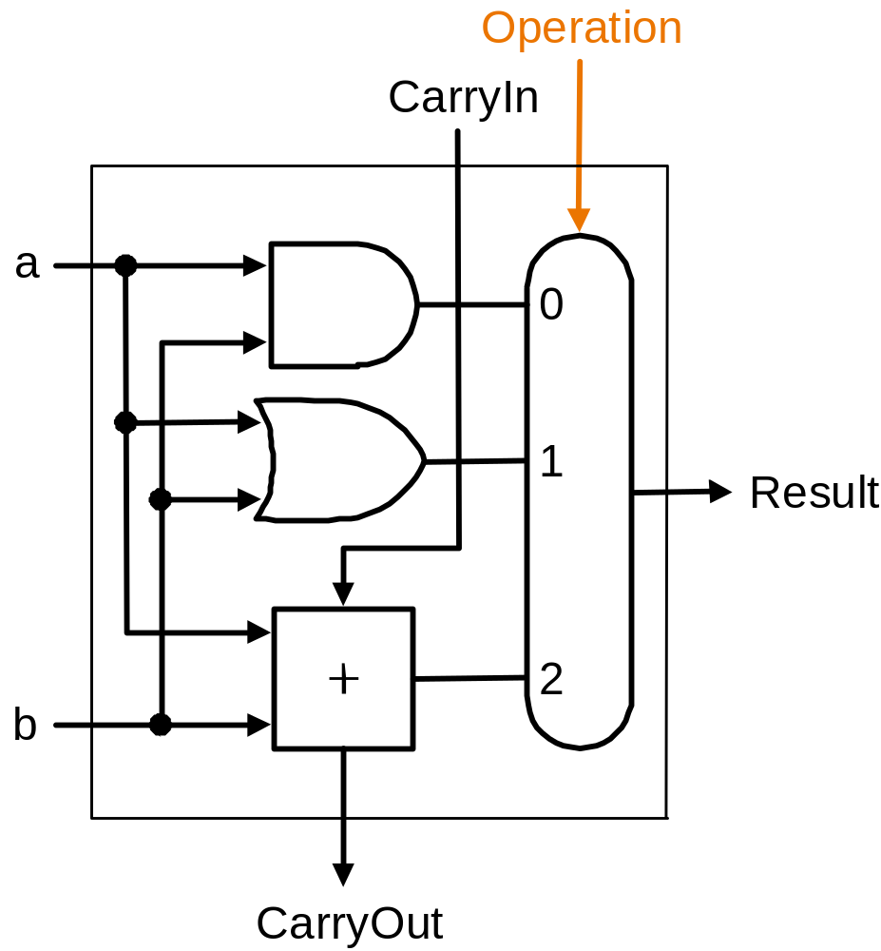
CSCI-2500 SPRING 2016, Boolean Logic

Slide 161
Building a 32 bit ALU
A₀ A₁ … A₃₁
B₀ B₁ … B₃₁
…
…
Op
…
R₀ R₁ … R₃₁
Result
64 inputs
3 different Operations (AND,OR,add).
32 bit output
CSCI-2500 SPRING 2016, Boolean Logic

Slide 162
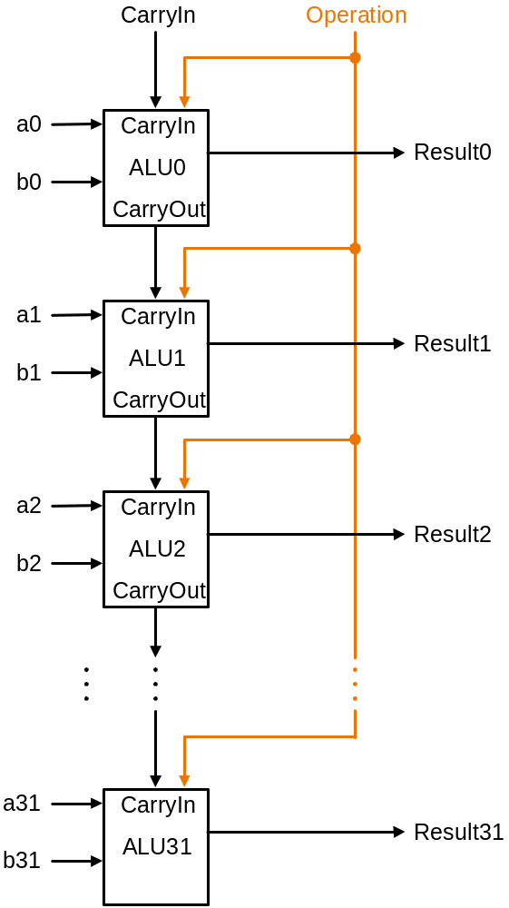
Ripple Carry Adder
Carry out from ALU₀ is sent to carry in of ALU₁
How long will it take for the result to become available?
  the CarryOuts must propagate through all 32 1-Bit ALUs.
CSCI-2500 SPRING 2016, Boolean Logic

Slide 163
New Operation: Subtraction
Subtraction can be done with an adder:
A - B can be computed as A + -B
To negate B we need to:
  invert the bits.
  add 1
CSCI-2500 SPRING 2016, Boolean Logic

Slide 164
Negating B in the ALU
We can negate B by in the ALU by:
  providing B to the adder.
    need a selection bit to do this.
  To add 1, just set the initial carry in to 1!
CSCI-2500 SPRING 2016, Boolean Logic

Slide 165
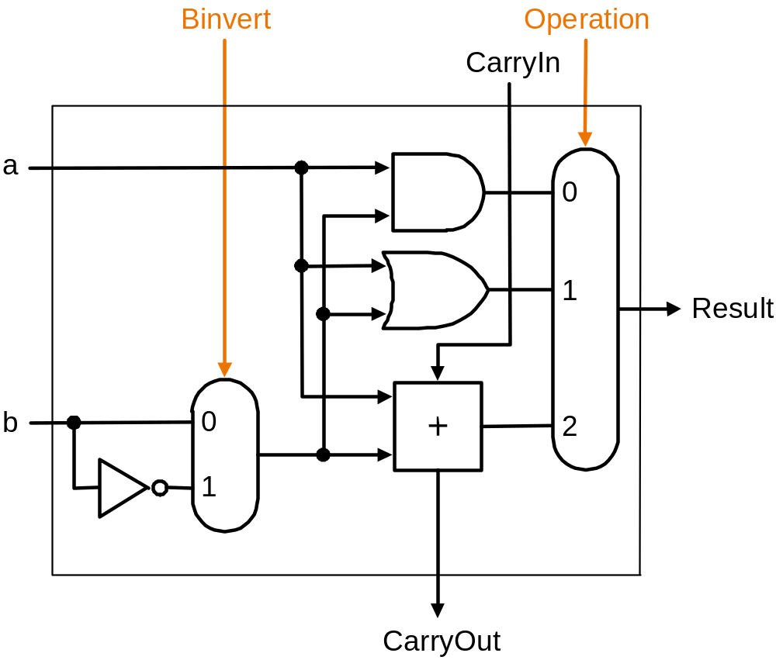
Revised 1 Bit ALU
CSCI-2500 SPRING 2016, Boolean Logic

Slide 166
Uses for our ALU
addition, subtraction, OR and AND instructions can be implemented with our ALU.
  we still need to get the right values to the ALU and set control lines.
We can also support the slt instruction.
  need to add a little more to the 1 bit ALU.
CSCI-2500 SPRING 2016, Boolean Logic

Slide 167
Supporting slt
slt needs to compare 2 numbers.
  comparison requires a subtraction.
if A-B is negative, then A<B is true.
otherwise A<B is false.
True: output should be 0000000…001
False: output should be 0000000…000
CSCI-2500 SPRING 2016, Boolean Logic

Slide 168
slt Strategy
To compute slt A B:
  subtract B from A (set binvert and the L.S. Carry In to 1.
  Result for all 1-bit ALUs except the LS should always be 0.
  Result for the LS 1-bit ALU should be the result bit from the MS 1-bit ALU!
LS: Least significant (rightmost)
MS: Most significant (leftmost)
CSCI-2500 SPRING 2016, Boolean Logic

Slide 169
New 1-bit ALU
B
i
n
v
e
r
t
O
p
e
r
a
t
i
o
n
C
a
r
r
y
I
n
a
0
1
R
e
s
u
l
t
b
0
2
1
L
e
s
s
3
C
a
r
r
y
O
u
t
CSCI-2500 SPRING 2016, Boolean Logic

Slide 170
MSB ALU
B
i
n
v
e
r
t
O
p
e
r
a
t
i
o
n
C
a
r
r
y
I
n
a
0
1
R
e
s
u
l
t
b
0
2
1
L
e
s
s
3
S
e
t
O
v
e
r
f
l
o
w
O
v
e
r
f
l
o
w
d
e
t
e
c
t
i
o
n
.
CSCI-2500 SPRING 2016, Boolean Logic

Slide 171
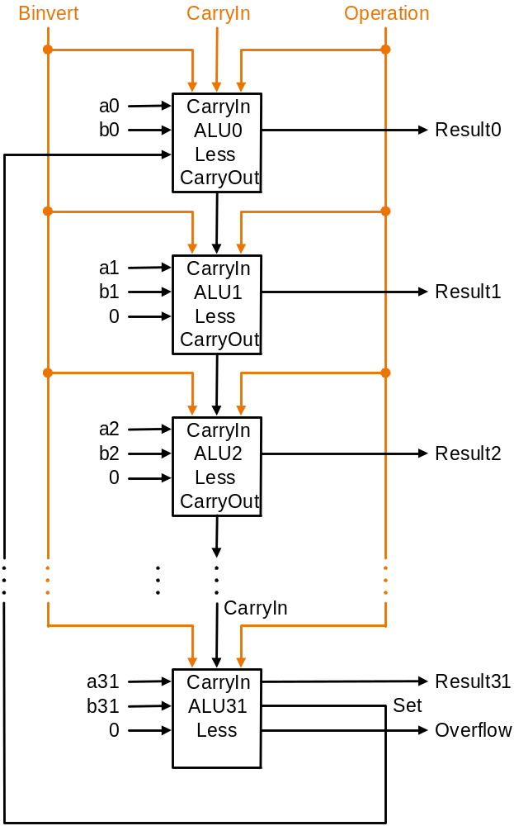
New 32-bit ALU
Less input is 0 for all but the LS.
Result of addition in the MS ALU is fed back to the Less input of the LS ALU
CSCI-2500 SPRING 2016, Boolean Logic

Slide 172
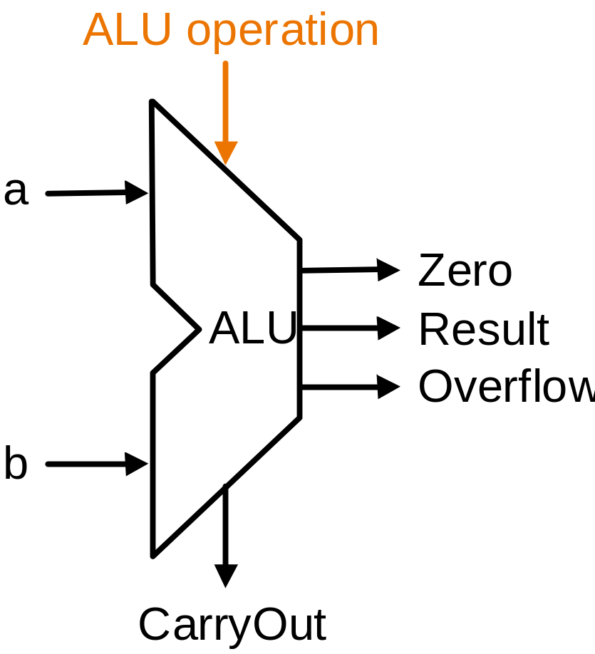
Put it in a box and give it a name
CSCI-2500 SPRING 2016, Boolean Logic

Slide 173
Speed is important.
Using a ripple carry adder the time it takes to do an addition is too long.
  each 1-bit ALU has something like 2 levels of gates.
  The input to the i^{th} ALU includes an output from the i-1th ALU.
  For 32 bits we have something like 64 gate delays before the addition is complete.
CSCI-2500 SPRING 2016, Boolean Logic

Slide 174
Strategies for speeding things up.
We could derive the truth table for each of the 32 result bits as a function of 64 inputs.
We know we can build SOP expressions for each and implement using 2 levels of gates.
This might be a good test question!
  don’t worry, you would need so much paper I couldn’t carry the tests to class…
CSCI-2500 SPRING 2016, Boolean Logic

Slide 175
A more realistic approach
The problem is the ripple
  The last carry-in is takes a long time to compute.
We can try to compute the carry-in bits as fast as possible
  this is called carry lookahead
  It turns out we can easily compute the carry-in bits much faster (but not in constant time).
CSCI-2500 SPRING 2016, Boolean Logic

Slide 176
Carry In Analysis
A | B | Cary In | Cary Out | Sum
0 | 0 | 0 | 0 | 0
0 | 0 | 1 | 0 | 0
0 | 1 | 0 | 0 | 1
0 | 1 | 1 | 1 | 0
1 | 0 | 0 | 0 | 1
1 | 0 | 1 | 1 | 0
1 | 1 | 0 | 1 | 0
1 | 1 | 1 | 1 | 1
CarryIn_{i} is an input to the i^{th} 1 bit adder.
CarryOut_{i-1} is connected to CarryIn_{i}
We know about how to compute the CarryOuts
CSCI-2500 SPRING 2016, Boolean Logic

Slide 177
Computing Carry Bits
CarryIn₀ is an input to the adder.
  we don’t compute this – it’s an input.
CarryIn₁ depends on A₀, B₀ and CarryIn₀:
CarryIn₁ = (B₀• CarryIn₀) + (A₀ • CarryIn₀)+(A₀ • B₀)
SOP: Requires 2 levels of gates
CSCI-2500 SPRING 2016, Boolean Logic

Slide 178
CarryIn₂
CarryIn₂ = (B₁• CarryIn₁) + (A₁ • CarryIn₁)+(A₁ • B₁)
We can substitute for CarryIn₁ and get this mess:
CarryIn₂ = (B₁• B₀• CarryIn₀) + (B₁• A₀ • CarryIn₀)+(B₁• A₀ • B₀) + (A₁ • B₀• CarryIn₀) + (A₁ • A₀ • CarryIn₀)+(A₁ • A₀ • B₀)+(A₁ • B₁)
The size of these expressions will get too big (that’s the whole problem!).
CSCI-2500 SPRING 2016, Boolean Logic

Slide 179
Another way to describe CarryIn
C_{i+1} = (B_{i}• C_{i}) + (A_{i} • C_{i})+(A_{i} • B_{i})
= (A_{i} • B_{i}) + (A_{i} + B_{i}) •C_{i}
A_{i} • B_{i} : Call this Generate (G_{i})
A_{i} + B_{i} : Call this Propagate (P_{i})
C_{i+1} = G_{i} + P_{i} • C_{i}
CSCI-2500 SPRING 2016, Boolean Logic

Slide 180
Generate and Propagate
C_{i+1} = G_{i} + P_{i} • C_{i}
G_{i} =A_{i} • B_{i}
P_{i} =A_{i} + B_{i}
When A_{i} and B_{i} are both 1, G_{i} becomes a 1.
  a CarryOut is generated.
If P_{i} is a 1, any Carry in is propagated to Carry Out.
CSCI-2500 SPRING 2016, Boolean Logic

Slide 181
Using G_{i} and P_{i}
C₁ = G₀+P₀•C₀
C₂ = G₁+P₁•C₁
= G₁+ P₁• (G₀+P₀•C₀)
= G₁+ P₁• G₀ + P₁• P₀•C₀
C₃ = G₂ + P₂•G₁ + P₂•P₁•G₀ + P₂•P₁•P₀•C₀
CSCI-2500 SPRING 2016, Boolean Logic

Slide 182
Implementation
Expression still get too big to handle (for 32 bits).
We can minimize the time needed to compute all the CarryIn bits for a 4 bit adder.
Connect a bunch of 4 bit adders together and treat CarryIns to these adders in the same manner.
CSCI-2500 SPRING 2016, Boolean Logic

Slide 183
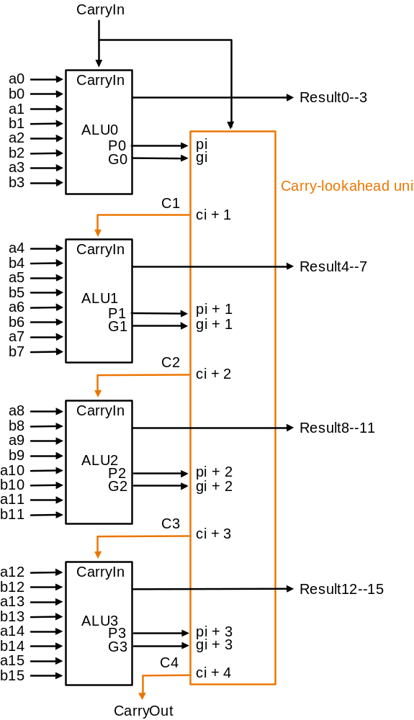
CSCI-2500 SPRING 2016, Boolean Logic

