Slide 2
Programmable Pipeline
Vertex Specification
Vertex Shader
Tessellation
Geometry Shader
Vertex Post-Processing
Primitive Assembly
Rasterization
Fragment Shader
Per-Sampler Operations

Slide 3
Fragment Shaders
Modern fragment shaders perform:
  Lighting
  Complex post-processing
    SSAO
    Blur
    Depth-of-Field
    Bloom
    Anti-aliasing
  Texture sampling
  Normal distortions
  Color grading and tonemapping
  Downsampling
Speaking of textures...

Slide 4
Textures
Textures are nothing more than additional buffers of data.
How they’re interpreted makes them textures.
  The API may store them in different memory because the data is ‘texture.’
  The API may also only allow texture data to be passed to certain functions.
A texel is the fundamental unit of a texture.
  A texel to a texture is a pixel to a display.
Sampling is the process of accessing texel data by providing sample
coordinates.

Slide 5
Texture Addressing
Texture coordinates are specified on range [0,1].
  (0,0) is the bottom left, while (1,1) is the top right.
  Though this depends on your API.
However, coordinates are allowed to be given outside the range.
Addressing modes indicate how to deal with out-of-range coordinates.

Slide 6
Texture Addressing Modes
Wrap
Mirror
Clamp
Border color

Slide 7
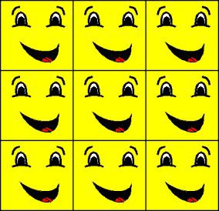
Texture Addressing Modes
Wrap
Mirror
Clamp
Border color
Image courtesy of MSDN

Slide 8
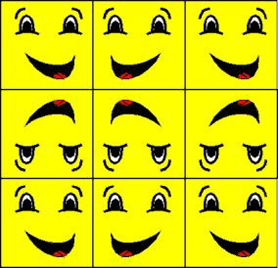
Texture Addressing Modes
Wrap
Mirror
Clamp
Border color
Image courtesy of MSDN

Slide 9
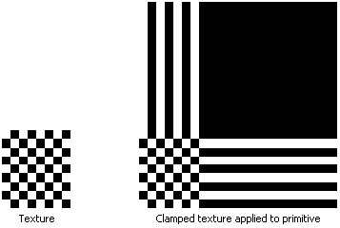
Texture Addressing Modes
Wrap
Mirror
Clamp
Border color
Image courtesy of MSDN

Slide 10
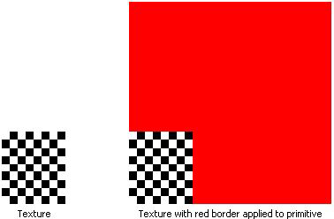
Texture Addressing Modes
Wrap
Mirror
Clamp
Border color
Image courtesy of MSDN

Slide 11
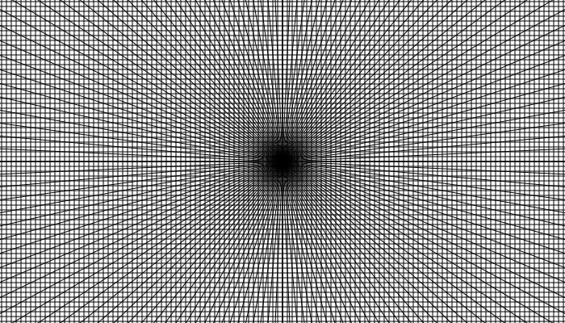
Mipmapping
Texel density describes a ratio of texels to pixels.
  A full-screen primitive with a texture resolution matching the display resolution has a texel density of 1.
  If the same primitive is viewed from a distance, there are a greater number of texels viewed through a single pixel.
Artifacts appear the further texel density is from 1.
  Texel density less than 1 makes the texture look low-resolution.
  Texel density greater than 1 can lead to moire banding patterns.

Slide 12
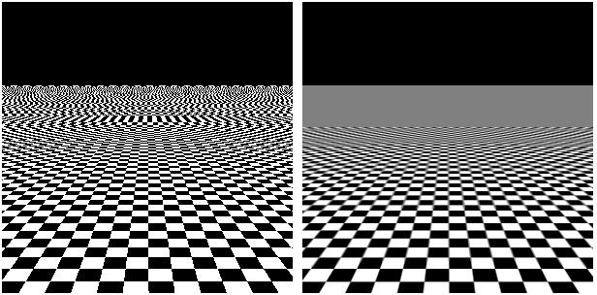
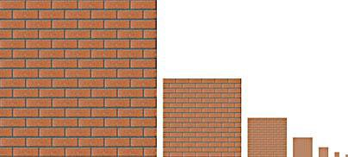
Mipmapping
Mipmaps attempt to maintain a texel density close to 1.
Sequences of lower resolution textures.
  Each successive texture is half the resolution of the previous.
  For example, 64x64 | 32x32 | 16x16 | 8x8 | 4x4 | 2x2 | 1x1
Images courtesy of maxogden via Github Gist and Flylib

Slide 13
Filtering
Nearest
Bilinear
Trilinear
Anisotropic
Texture coordinates for a fragment rarely fall at the exact center of a texel.
Filtering is the method by which surrounding texels are blended to create the final color for the texture sample.

Slide 14
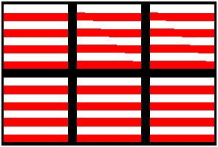
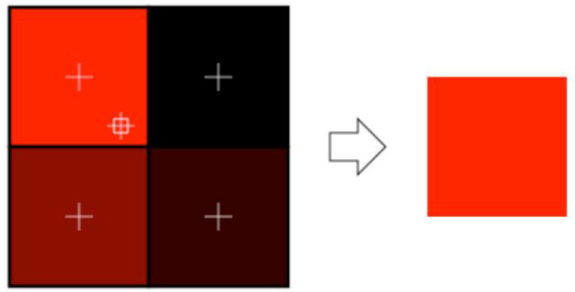
Filtering
Nearest
Bilinear
Trilinear
Anisotropic
Obtain the texel whose center is closest to the sample location.
GL_NEAREST
Image courtesy of opengl-tutorial.org

Slide 15
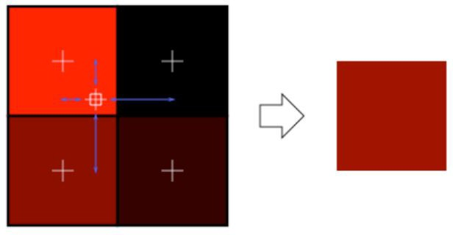
Filtering
Nearest
Bilinear
Trilinear
Anisotropic
Blend surrounding texels with weights proportional to sample’s distance from center.
GL_LINEAR
Image courtesy of opengl-tutorial.org

Slide 16
Filtering
Nearest
Bilinear
Trilinear
Anisotropic
The texture sample likely falls between two mipmap levels. Trilinear filtering does the following:
Perform a bilinear sample on each mipmap level.
Linearly blend the results.
GL_LINEAR_MIPMAP_LINEAR

Slide 17
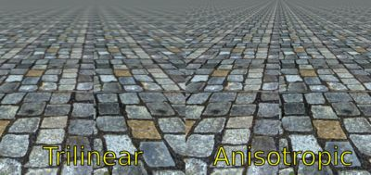
Filtering
Nearest
Bilinear
Trilinear
Anisotropic
Anisotropy is distortion in texels on an object surface viewed at an oblique angle relative to the screen plane.
Sample a trapezoidal region of texels.
Trapezoid determined by viewing angle.
Image courtesy of Project CARS

Slide 18
OpenGL Textures
OpenGL works with texture units.
  glActiveTexture sets the texture unit subsequent state calls will affect.
  Accepts GL_TEXTUREi, where i is between 0 and GL_MAX_COMBINED_TEXTURE_IMAGE_UNITS.
The unit index is bound to the shader program uniform.
  glUniform1i
Texture data is loaded by calling glTexImage2D.
Mipmaps can be generated with glGenerateMipmaps.

Slide 19
Worth Noting
To save space, texture data is often compressed.
  There are many compression algorithms: BC1-3, BC4, BC5, BC6H, BC7, ASTC, PVRTC
  Hardware unpacks it for you!
  This is one of those things that could be an entire lecture.
Compression may leave artifacts. It’s a tradeoff.

Slide 20
Texture Formats
GL_RGBA8
GL_RGB5
GL_RGB5_A1

Slide 21
Programmable Pipeline
Vertex Specification
Vertex Shader
Tessellation
Geometry Shader
Vertex Post-Processing
Primitive Assembly
Rasterization
Fragment Shader
Per-Sampler Operations

Slide 22
Per-Sample Operations
Blending
sRGB Conversion
Write Mask
We’re almost at the end of the graphics pipeline!
There are a few operations left that happen after the fragment shader and before the result is placed in the output framebuffer.

Slide 23
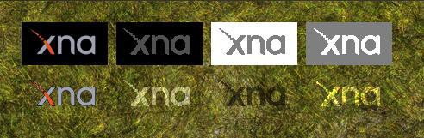
Per-Sample Operations
Blending
sRGB Conversion
Write Mask
Blending is hardware functionality for blending the output fragment color with the existing color in the target framebuffer.
Blending is controlled by blend state, which consists of:
Blending equation
Parameters for the equation
Alpha is often treated independently.
Image courtesy of MSDN

Slide 24
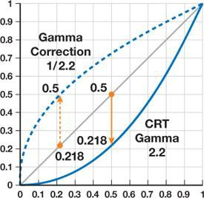
Per-Sample Operations
Blending
sRGB Conversion
Write Mask
Displays are nonlinear with respect to conversion of voltages to light intensity.
Originated from CRTs. LCD displays simply mimic this behavior.
Conversion from linear RGB value to sRGB color space will ensure the displayed color closely matches the original value.
Image courtesy of Nvidia

Slide 25
Per-Sample Operations
Blending
sRGB Conversion
Write Mask
The write mask prevents the writing of specific color channels to the target framebuffer.
In OpenGL, glColorMask.
For example…
glColorMask(false, true, true, true) means that the red channel will not be written.

Slide 26
Swap Buffers
We’re almost there!
The last thing that needs to happen is the buffer swap.
  We’ve been drawing our scene to the back buffer.
  The front buffer is the image currently being displayed.
  A swap command switches the front buffer and the back buffer, so our new image is displayed.
In OpenGL, it varies how this is done.
  We use SDL, which requires a call to SDL_GL_SwapWindow.
  If you’re using wgl, you’d use wglSwapBuffers.

Slide 27
Texture Types
1D, 2D, 3D
Rectangle: 2d image with no mipmaps. UV's are not normalized
Buffer: general-purpose data buffer
Cube map: 6 images defining the faces of a cube, used for environment mapping for skybox, reflection, IBL
Array: contains multiple textures, to reduce overhead from switching textures when drawing different objects
Multisample: texture can be used with MSAA

Slide 28
Texture Units
Historically, a TMU (texture mapping unit) is part of the graphics card responsible for drawing textures
1 texture unit holds 1 active texture at a time
(modern GPU's are more complex but the API concept remains)
To draw objects with different textures, you can load each texture into the texture unit when needed (but this is slow)
Often you need more than one texture at a time
  Normal map, spec map, lightmap, AO map…
  Layered multitexturing, terrain splat map, …
So instead, use multiple texture units

Slide 29
Create and bind a texture
glGenTextures(GLsizei n, GLuint *textures)
  textures can be a single int, or an array
glBindTexture (GLenum target, GLuint texture)
  Binds a texture to a target.
  Subsequent texturing calls refer to a target, and affect the texture bound to that target
  Targets:
  GL_TEXTURE_1D, GL_TEXTURE_2D, GL_TEXTURE_3D
  GL_TEXTURE_1D_ARRAY, GL_TEXTURE_2D_ARRAY
  GL_TEXTURE_RECTANGLE
  GL_TEXTURE_CUBE_MAP
  GL_TEXTURE_CUBE_MAP_ARRAY
  GL_TEXTURE_BUFFER
  GL_TEXTURE_2D_MULTISAMPLE, GL_TEXTURE_2D_MULTISAMPLE_ARRAY

Slide 30
Set texture parameters
void glTexParameteri(GLenum target,
GLenum pname,
GLint param);
GL_TEXTURE_WRAP_S, GL_TEXTURE_WRAP_T: set the wrapping mode
GL_CLAMP_TO_EDGE
GL_CLAMP_TO_BORDER
GL_MIRRORED_REPEAT
GL_REPEAT
GL_MIRROR_CLAMP_TO_EDGE
GL_MIN_FILTER, GL_MAG_FILTER: mipmapping filter for minimization and magnification
GL_NEAREST
GL_LINEAR
…

Slide 31
Put image data in it
void glTexImage2D(
GLenum target,
GLint level,
GLint internalformat,
GLsizei width,
GLsizei height,
GLint border,
GLenum format,
GLenum type,
const GLvoid * data);
Target: GL_TEXTURE_2D, etc
Level: the mipmapping level of detail. Base level=0
Internal format: like format, additional storage/compression options
Width, height: dimensions of the texture (use power of 2's)
Border: 0
Format: GL_RGB, GL_RGBA…
Type: type of data for a pixel; GL_UNSIGNED_BYTE, etc…
Data: texture data

Slide 32
Texture Formats
GL_RGB, GL_RGBA
GL_RED, GL_RG
GL_DEPTH_COMPONENT
GL_DEPTH_STENCIL

Slide 33
Sized or compressed internal formats
GL_RGB5
  each channel is 5 bits instead of 8
GL_SRGB8_ALPHA8
  like RGBA, but in sRGB color space instead of linear
GL_COMPRESSED_RGBA
Many more ….

Slide 34
Generate mipmaps
glGenerateMipmap(GLenum target);

Slide 35
Put texture image data into a subregion
void glTexSubImage2D( GLenum target,
GLint level,
GLint xoffset,
GLint yoffset,
GLsizei width,
GLsizei height,
GLenum format,
GLenum type,
const GLvoid * pixels);

Slide 36
void glTexStorage2D(
GLenum target,
GLsizei levels,
GLenum internalformat,
GLsizei width,
GLsizei height);
Specify settings for multiple levels all at once

Slide 37
Drawing with a texture
glActiveTexture(GLenum unit);
// sets the currently active texture unit
// GL_TEXTURE0, GL_TEXTURE1, … GL_MAX_COMBINED_TEXTURE_IMAGE_UNITS-1
glBindTexture (GLenum target, GLuint texture);
// call bind again to bind this texture to the target on the current active unit

Slide 38
Setting uniform variables
GLint glGetUniformLocation( GLuint program, const GLchar *name)
glUniform (GLint location, … )
glUniform1f (GLint location, float v0)
glUniform2f (GLint location, float v0, float v1)
glUniform1fv (GLint location, GLsizei count, const GLfloat* value)
glUniformMatrix4fv (GLint location, GLsizei count, GLboolean transpose, const GLfloat* value)
… and many more

Slide 39
In Fragment Shader
uniform sampler2D u_texture;
sampler2D is a Texture Unit
// sample the texture from the texture unit at these U,V coordinates
vec4 texture (sampler2D texture_unit, vec2 uv)

