Slide 1
Game Architecture
User Interface

Slide 2
Today’s Agenda
UI: what it is and why you’ll spend way more time on it than seems right
Architecture
Layout
Rendering techniques
Text
Some third party options
Homework assignment

Slide 3
What are we talking about?
Frontend
HUD
Pause menus
The ‘macro game’
Integrated developer tools

Slide 4
Why it’s hard
If it does it job right, probably don’t notice it
UI does not have a lot of eyes on it
  Special shortcuts used to bypass UI during development
UI is involved in error handling
  Rarely well tested
  Certain behavior mandated by platform owners
UI is very multi-disciplinary
  Lots of room for misunderstanding
  Often slow iteration times
UI is a magnet for over-engineering
  Getting data in and out of UI is often over-thought
UI does not get respect
  Game Engine Architecture does not cover it
  Often where new programmers start their career

Slide 5
UI Architecture
Widgets
Events
Animation
Retained mode
Immediate mode
Model-View-Controller
Model-View-View-Model
Thoughts

Slide 6
UI Architecture
Widgets
Events
Animation
Retained mode
Immediate mode
Model-View-Controller
Model-View-View-Model
Thoughts
UI is composed of widgets or controls.
Label
Button
Scroll bar
List
Etc.
Often parent-child relationship. Properties are often inherited from parent.
Transform
Color

Slide 7
UI Architecture
Widgets
Events
Animation
Retained mode
Immediate mode
Model-View-Controller
Model-View-View-Model
Thoughts
Events are the stuff that happens to UI:
User taps screen, or presses button
Player takes damage
Screen resizes
Events may flow down a tree of widgets. Parents may have option to consume event or pass along to children.

Slide 8
UI Architecture
Widgets
Events
Animation
Retained mode
Immediate mode
Model-View-Controller
Model-View-View-Model
Thoughts
Game UI loves beautiful transitions and loops. Animation is key.
Transform
Color and opacity
Particle systems
Components of a basic UI animation system.
Animatable properties
Keyframes
Linear and Bezier interpolation
Ability to sync business logic to animation

Slide 9
UI Architecture
Widgets
Events
Animation
Retained mode
Immediate mode
Model-View-Controller
Model-View-View-Model
Thoughts
UI holds long lived state.
Widgets have lifecycle.
  Initialize
  Update & handle events
  Destroy
Widgets = special case entities.
How can widget implementation be decoupled from gameplay logic & data?

Slide 10
UI Architecture
Widgets
Events
Animation
Retained mode
Immediate mode
Model-View-Controller
Model-View-View-Model
Thoughts
API is like OpenGL. Every frame you say what UI you need:
if (button(“click me” , 100, 100))
{ /* handle the click */ }
If you don’t say something, it won’t exist. No UI state lives longer than 1 frame.

Slide 11

UI Architecture
Widgets
Events
Animation
Retained mode
Immediate mode
Model-View-Controller
Model-View-View-Model
Thoughts
How do we decouple gameplay logic from widget implementation?
Model - Gameplay logic/data
View - The presentation
Controller - Input processing

Slide 12
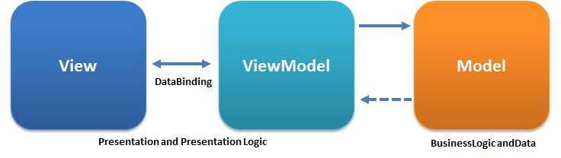
UI Architecture
Widgets
Events
Animation
Retained mode
Immediate mode
Model-View-Controller
Model-View-View-Model
Thoughts
How do we decouple gameplay logic from widget implementation?
Model - Gameplay logic/data
View - The presentation
View-model - Binding layer

Slide 13
UI Architecture
Widgets
Events
Animation
Retained mode
Immediate mode
Model-View-Controller
Model-View-View-Model
Thoughts
Use retained mode for complex UI
Use immediate mode for simple UI
Animation is essential
Adapting MVC or MVVM formalism is not required -- just have a standard way of integrating UI with rest of your game

Slide 14
Layout
Layout = Location of UI widgets on screen
Layout must be pixel perfect
  Single transform path for all widgets
  Know your pixel center convention
    Direct3D 9 = pixel center is 0,0
    Direct3D 10+ = pixel center is 0.5,0.5
    OpenGL = pixel center is 0.5,0.5
Console games = fixed resolution = static layout
  This is trivial.
PC and mobile games = variety of resolutions = dynamic layout
  Don’t want to manually specify layout for all possible resolutions.
  This is the focus of the next couple slides.

Slide 15
Dynamic Layout
UI is authored at some expected resolution (E_{x}, E_{y}).
UI is displayed at some actual resolution (A_{x}, A_{y}).
Handy operations:
X Scale: Position_{Actual} = Position_{Expected} * A_{x} / E_{x}
Y Scale: Position_{Actual} = Position_{Expected} * A_{y} / E_{y}
All Scale: Position_{Actual} = Position_{ExpectedX} * A_{x} / E_{x} , Position_{ExpectedY} * A_{y} / E_{y}
X Anchor: Position_{X} += Position_{ParentX}
Y Anchor: Position_{Y} += Position_{ParentY}

Slide 16
Layout Transform
World space widget transform = [Pivot] * [Translation] * [Scale] * [Rot] * [Parent]
[Pivot] = -Widget_{Pivot} * Widget_{Bounds}
[Translation] = Widget_{Position} * Dynamic_Scale + Dynamic_Anchor
  Dynamic_Scale is scaling induced expected resolution != actual resolution
  Dynamic_Anchor is locating a widget relative to expected resolution
[Scale] = Widget_{Scale}
[Rot] = Widget_{Rotation}
[Parent] = Parent widget local transform

Slide 17
Rendering techniques
UI wants smooth, pixel perfect edges. Even if we scale.
Bitmap graphics - mapping texture onto geometry
  E.g. how the rest of your game renders stuff
  Alpha tested textures = widget edges
  Really big textures so we never upscale
  Or, signed distance fields
Vector graphics - analytically describing edges
  Parametric equations describe edges
  Scaling (and other transforms) are always perfect
  Rendering and authoring is more complicated

Slide 18

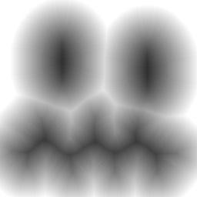
Signed Distance Fields
Richard Mitton’s description:
“Imagine you've got a black-and-white image, where let's say the black parts are considered inside, and the white parts are considered outside. What you want is a quick method of looking up how far it is from any given point to the inside.
“A SDF is just an image where each pixel contains the distance to the nearest point on the boundary. So if a pixel is outside, it'll contain maybe +10 if it's 10 pixels away. If it's inside, it'll contain -10.”

Slide 19
Signed Distance Fields Part 2
To draw widget with SDF:
Enable linear interpolation for textures
Enable alpha test
In fragment shader:
  If sampled SDF value <= 0, draw
  Else, discard
GPU can smoothly interpolate gradients like those in SDF, so edges are perfect.

Slide 20
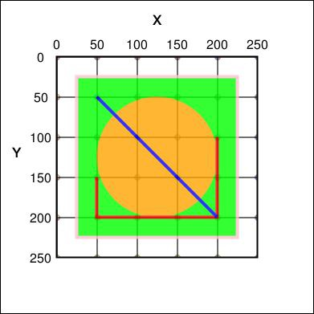
Vector graphics
Use domain-specific, high level rendering primitives:
TrueType font - Bezier control points
Scalable Vector Graphics (SVG) - Basic shapes
<svg xmlns="http://www.w3.org/2000/svg" version="1.1">
<rect x="25" y="25" width="200" height="200" fill="lime" stroke-width="4" stroke="pink" />
<circle cx="125" cy="125" r="75" fill="orange" />
<polyline points="50,150 50,200 200,200 200,100" stroke="red" stroke-width="4" fill="none" />
<line x1="50" y1="50" x2="200" y2="200" stroke="blue" stroke-width="4" />
</svg>
Source: Wikipedia

Slide 21
Vector Graphics Part 2
Usual architecture:
Convert high level primitives into textures
  Usually done on CPU
Conversion is generally expensive
  Maintain a texture cache
Render with alpha test enabled

Slide 22
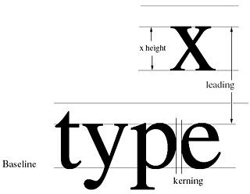
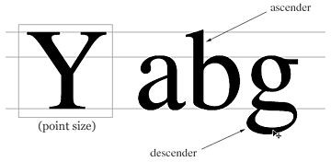
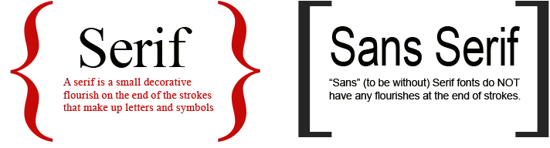
Text: Font
Know your terms:
X-height
Baseline
Leading
Kerning
Ascender
Descender
Tracking
Typeface

Slide 23
Text: Rendering
Two main options:
Bitmap graphics
  Offline, create atlas texture with all necessary letters and symbols.
  Use texture coords to select specific symbols.
  Consider signed distance fields to scale more cleanly.
Vector graphics.
  Render directly from TrueType with caching.
  Consider stb_truetype.
May want to add support for simple markup:
Change text color / other properties.
Render special symbols such as controller buttons.

Slide 24
Text: Localization
Localization = preparing to ship outside your native culture, language, etc.
Text considerations:
  Supporting all the necessary symbols/letters
    For bitmap fonts, do you need more than one texture?
  Supporting the necessary display conventions (right-to-left, vertical)
  Affordances for much longer/shorter words (*cough* German *cough*)
Know Unicode:
  Assigns a 32-bit integer to every written language symbol (code points)
  Unicode has several standard encodings:
    UTF-8 - Variable length, if high bit is set, look at next byte. First 127 points -> ASCII.
    UTF-16 - 16-bit, fixed length, covers all the Unicode you will ever need.
    UTF-32 - You do not need this.

Slide 25
Implementing Text Localization
Offline:
  Choose an encoding
    UTF-8 or UTF-16
  Find all the places in code and data where user-visible strings are stored
    Try to avoid strings baked into other game textures
  Build a big list of those strings
  Get them translated
  For bitmap fonts, build a library of all necessary symbols and pack into texture
  Find min,max extents of each string and use to size UI elements
At runtime:
  Detect current language
  Use indirection / patching to map native strings to translated strings

Slide 26
Third Party Options
Some useful packages:
Scaleform - Flash player for games commonly used for UI
Stb_truetype - Small, open source TrueType renderer
IMGUI - Small, open source immediate mode UI

Slide 27
Summary
UI is challenging
Dynamic layout: expected and actual resolution, scale, anchor
Bitmap rendering
Vector rendering
Localization

Slide 28
End Lecture

