Slide 1
Game Architecture
Rigid Body Dynamics
Giving things weight.

Slide 2
Today’s Agenda
Reality check
Linear dynamics
Angular dynamics
Collision response

Slide 3
Do We Need This?
Using a physics simulation has pros and cons.
  Pros
    Realism
    Emergent gameplay
    Unpredictability and “free” animation.
  Cons
    Limited control or influence
    Complexity
The decision to use physics has an impact on every discipline.
The goal is always to create an excellent game.
If a physics system makes the game more excellent, go for it.

Slide 4
Physics
It’s a huge subject.
Do what engineers do best: simplify.
  Our only focus is a small branch of physics known as dynamics.
    Dynamics covers how objects move over time.
  We narrow that even further to rigid body dynamics.
    Rigid bodies are infinitely hard, non-deformable solids.
    Their shape does not change.
We also limit ourselves to classical Newtonian mechanics.

Slide 5
Foundations
Units
  Use MKS. Just do it™.
Linear and angular dynamics are independent!
  It may seem crazy, but it’s true. We can calculate them independently. Phew.
Center of mass
  Linear dynamics operates on an object as if its full mass is concentrated at a single point.
  Center of mass can be calculated by taking a weighted average of all portions of the object.
  For an object of uniform density, the center of mass is simply the centroid.
  For example, a uniform density sphere’s center of mass is its exact center point.

Slide 6


Linear Dynamics
Position, velocity, and acceleration.
Vector calculus is just scalar calculus on each vector element.
Velocity, v, is the derivative of position, r:
Acceleration, a, is the derivative of velocity:

Slide 7


Forces
A force is anything that causes a mass to accelerate or decelerate.
  It has a magnitude and direction, so it’s represented by a vector, F.
  It’s the derivative of momentum, p:
The total force applied to an object is the sum of all forces applied to it:

Slide 8

Solving Equations of Motion
A force can be constant or it can be a function of time or other quantities.
We need to solve an equation that takes both position and its derivative:
So we need to solve an ordinary differential equation.

Slide 9
Integration
Instead, we can integrate velocity over time to change position.
Integrating acceleration over time changes velocity.
So twice integrating acceleration over time changes position.
Each frame we…
  Integrate acceleration over delta time to get velocity.
  Integrate velocity over delta time to get position.
  Thus the object moves.

Slide 10
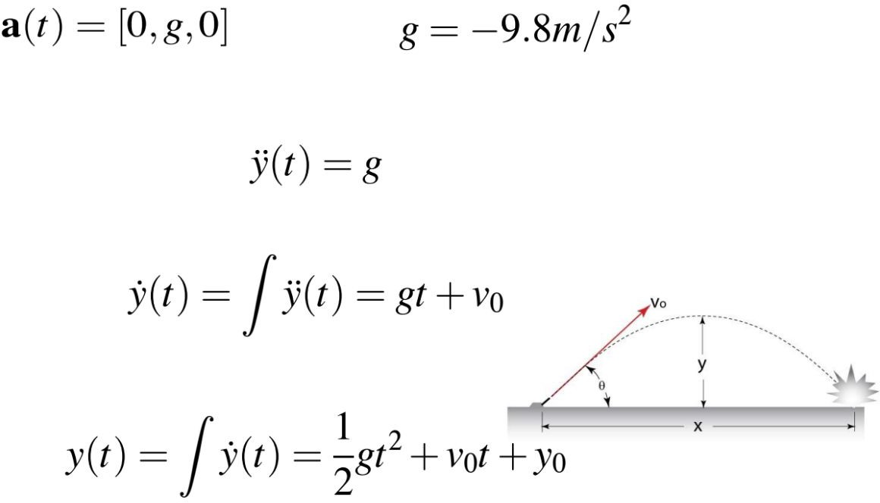
Analytical Solution
We can try an analytic solution, much like the one you’ll recognize from high school physics class.
But games are interactive. Forces are going to change over time, making predicting their behavior impossible.
Notes:
in rare cases, we can solve the ODE analytically, meaning that a simple, closed-form (tractable, can be evaluated in a finite number of operations) function can be found that describes the body’s position for *all possible values* of time. An example is the vertical motion of a projectile under the influence of a constant acceleration due to gravity
this is almost never possible in games, because they’re interactive. We cannot predict how the forces in a game will behave over time

Slide 11
Explicit Euler
Given acceleration per second, a, and delta time, ∆t:
Simple enough, right?

Slide 12



Euler Foiler
A car at rest accelerates at 10 m/s²
Where will it be after 10 sec?
Analytical
Explicit Euler
t=0: position = 0 velocity = 0
t=1: position = 0 velocity = 10
t=2: position = 10 velocity = 20
t=3: position = 30 velocity = 30
t=4: position = 60 velocity = 40
t=5: position = 100 velocity = 50
t=6: position = 150 velocity = 60
t=7: position = 210 velocity = 70
t=8: position = 280 velocity = 80
t=9: position = 360 velocity = 90
t=10: position = 450 velocity = 100
Notes:
big step size, yes, but error will still accumulate

Slide 13
Wait, what? How?
We’ve discretized the change in velocity over time.
  At each timestep, we apply the full change in velocity.
In the real world, the velocity was changing through the timestep.
  So at time 1.5, velocity was 15.
  Our calculation assumed it was 20.
This leads to an overestimation of the distance the car travels.
One second timesteps are obviously an exaggeration.

Slide 14
Properties of Numerical Methods
A numerical solution to an ODE has three interrelated properties:
  Convergence – as Δt approaches zero, does the approximate solution approach the real solution?
  Order – how “bad” is the error? Typically proportional to some power of Δt (uses Taylor series expansion in a similar manner to the Jacobian Inverse IK Solver)
  Stability – does the solution add energy to the system? Object velocities could “explode” and destabilize the system

Slide 15







Fourth-Order Runge–Kutta Numerical Integration
Notes:
Thus, the next value (r_n + 1) is determined by the present value (r_n) plus the product of the size of the interval (dt) and an estimated slope. The slope is a weighted average of slopes:
k1 is the slope at the beginning of the interval;
k2 is the slope at the midpoint of the interval, using slope k1 to determine the value of y at the point tn + h / 2 using Euler's method;
k3 is again the slope at the midpoint, but now using the slope k2 to determine the y-value;
k4 is the slope at the end of the interval, with its y-value determined using k3.
In averaging the four slopes, greater weight is given to the slopes at the midpoint
the error scales as the fifth power of the timestep

Slide 16
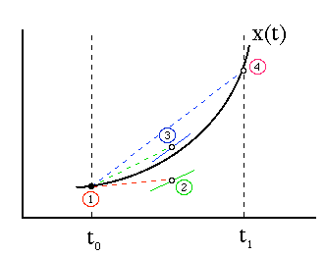

Slide 17

Notes:
a force applied to a body’s CM produces purely linear motion

Slide 18

???
Notes:
are we considering the force twice?

Slide 19


10 seconds later...
10 seconds later...
Notes:
Suppose that a force F acts on the block at the center of mass for some period of time, say, ten seconds. Since the force acts at the center of mass, no torque is exerted on the body. After ten seconds, the body will have acquired some linear velocity v. The body will not have acquired any angular velocity; thus the kinetic energy of the block will be 1 M|v|2
Block 2, after ten seconds, the body will again have linear velocity v. However, after ten seconds, the body will have picked up some angular velocity ω, since the force F, acting off center, now exerts a torque on the body.
if identical forces pushed the block in both cases, how can the energy of the block be different? Hint: Energy, or work, is the integral of force over distance.

Slide 20
Angular Dynamics in 2D
In 2D, angular dynamics is almost identical to linear dynamics.
Each angular quantity has a linear equivalent.
  Torque: rotational force.
  Angular moment L vs. linear momentum p.
  Angular acceleration a vs. linear acceleration a.
  Angular velocity w vs. linear velocity v.
  Orientation e vs. position r.
  Moment of inertia I vs. mass m.
Notes:
Why L? You’ll see why in a bit. Difficult to compute angular velocity from angular acceleration
Compute ang. momentum by integrating torque
Compute ang. velocity from momentum

Slide 21


Angular Dynamics in 2D
Objects are treated as thin sheets lying on the xy plane.
  The axis of rotation is the z axis.
Orientation is described by a scalar, e.
Angular speed is in radians per second (rad/s), and is the derivative of orientation with respect to time.
And angular acceleration is in radians per second squared (rad/s²).
Notes:
W(t) : angular velocity a(t) = angular acceleration at t

Slide 22
Moment of Inertia in 2D
Just as mass describes an object’s resistance to change in linear velocity, the moment of inertia describes an object’s resistance to change in angular speed.
  The closer mass is to the axis of rotation, the easier the object is to rotate around that axis.
Calculating the moment of inertia is beyond the scope of this lecture.

Slide 23
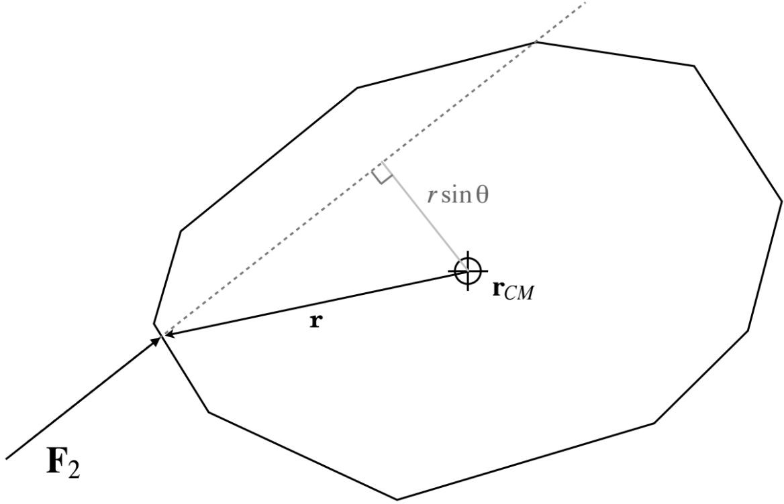

Calculating Torque
Make a vector, r, from the center of mass to the point of contact.
Torque is the cross product of r and F.
  Force applied to the center of mass yields a cross product of 0.
Torque is related to angular acceleration and the moment of inertia similarly to mass and linear acceleration.

Slide 24


Solving Angular Equations in 2D
Just like linear dynamics, we have some ordinary differential equations to solve:
And again just like linear, we can solve them with integration:
Don’t actually use explicit Euler though.
Notes:
Torque = Inertia * angular acceleration at (t)

Slide 25
Angular Dynamics in 3D
Ok, that 2D stuff is cool and all, but aren’t we working in 3D?
Yes!
The concepts are similar.
The math is more complex.
Brace yourselves.

Slide 26
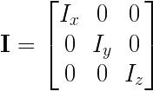
The Inertia Tensor
The 3D equivalent of the 2D moment of inertia.
A 3D body will have different distributions of mass around each axis.
  Therefore, it will have different moments of inertia for each axis.
The inertia tensor is a 3 x 3 matrix, I:
The diagonal are the moments of inertia around each principal axis.
The 0s are known as the products of inertia.
  They are 0 when the body is symmetrical around each axis.

Slide 27
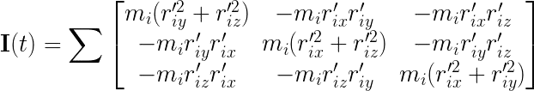
Calculating the Inertia Tensor
At a given time t, let r ’ be the displacement of the i^{th} particle from center of
i
mass x(t): r_{i}’ = r_{i}(t) - x(t).
We can define the inertia tensor in terms of r_{i}’:

Slide 28
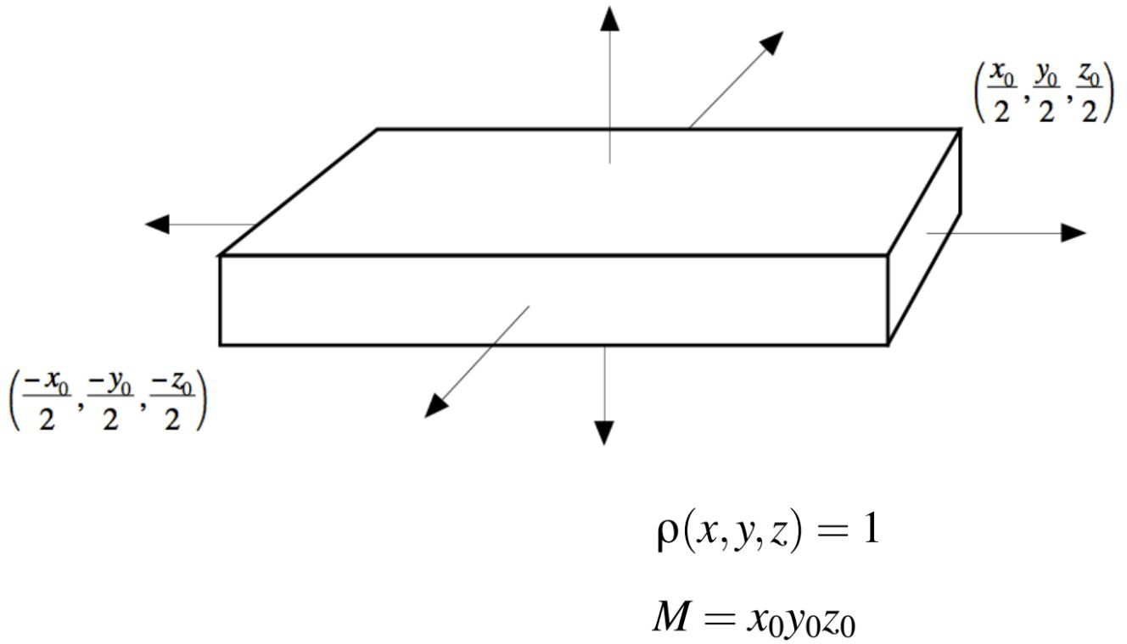
Calculating the Inertia Tensor
Consider a rectangular block of uniform density with it’s center of mass at
its exact center.
The sums in the previous equation are integrals over the volume of the block.
Notes:
A rectangular block of constant unit density, with center of mass at (0,0,0)
To calculate the inertia tensor, we must treat the sums in the equation as integrals over the volume of the block. Let us assume that the block has constant unit density. This means that the density function ρ(x, y, z) is always one. Since the block has volume x0y0z0, the mass M of the block is M = x0y0z0

Slide 29

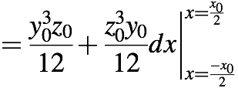


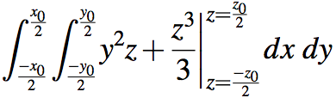



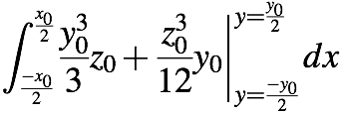




Slide 30
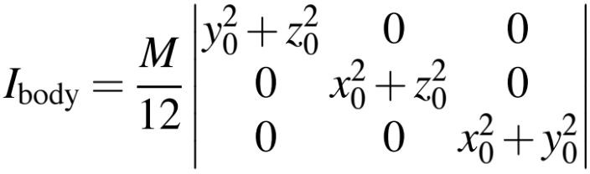
Calculating the Inertia Tensor

Slide 31
Forget everything I just said.
There’s an easier way.

Slide 32
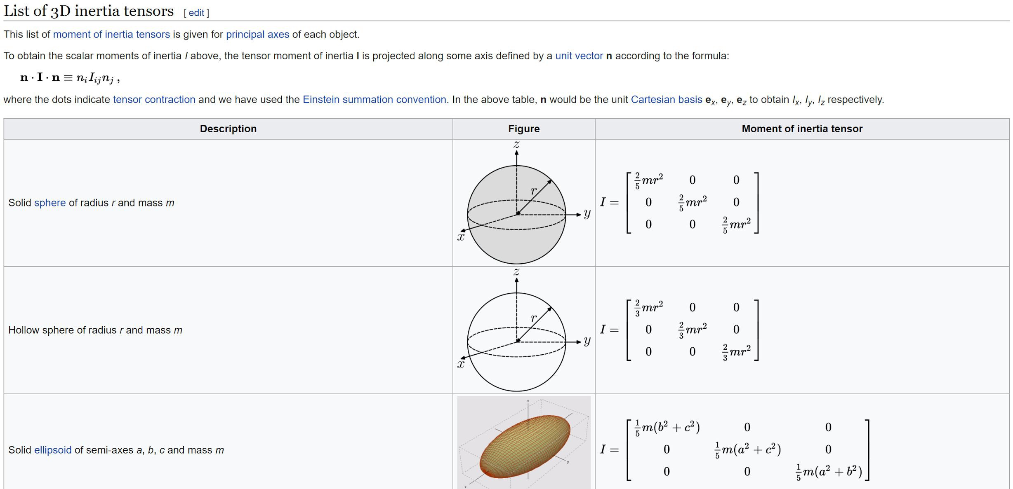
Just do this.

Slide 33

Orientation
In 2D we only needed a scalar value.
For 3D, we need three value, one for each axis.
  But we know that Euler angles are prone to issues like Gimbal lock.
So, we’ll use quaternions.
  Recall, quaternion consists of unit axis of rotation, u, scaled by sine of the half angle, e, and a scalar equal to cosine of the half angle.

Slide 34

Angular Velocity
We can represent angular velocity as a unit vector (the axis of rotation), u, scaled by the two dimensional angular velocity, w_{u}:
In 2D if no torques acted on a body, angular speed was constant.
In 3D, this is not true.
  The axis of rotation can change without external torques.
In other words, angular velocity is not conserved.
Notes:
Angular velocity equals 2d angular velocity * unit vector axis of rotation

Slide 35
But wait!
Angular momentum IS conserved.

Slide 36
Angular Momentum
Analogous to linear momentum.
We use angular momentum as the primary quantity in the angular dynamics simulation.
  Angular velocity is calculated after angular momentum.
  We’ll see how shortly.
Notes:
Linear momentum = velocity * mass
Angular momentum = velocity * inertia

Slide 37

Torque in 3D
Torque is still the cross product of the force and the vector from the center of mass to point of contact.
  Hooray!
But, we write it in terms of angular momentum, since it’s our new primary quantity.

Slide 38

Solving Angular Equations in 3D
Intuitively, we’d solve the equations the same way we solved linear motion and 2D angular motion.
So, we have our ordinary differential equations:
And we solve them by integrating:
Notes:
(I)-1 because * torque is like a=F/m in linear

Slide 39

Solving Angular Equations in 3D
Intuitively, we’d solve the equations the same way we solved linear motion and 2D angular motion.
So, we have our ordinary differential equations:
And we solve them by integrating:

Slide 40

Solving Angular Equations in 3D
We construct an angular velocity quaternion:
Then we can relate orientation quaternion to the angular velocity quaternion:
Notes:
Q is the current orientation
W is the angular velocity

Slide 41







Victory!
The ODEs of 3D angular motion:
Explicit Euler:
Notes:
Torque is the derivative of angular momentum
Velocity = angular momemtum / inertia
Explicit euler:
Momentum(t2) = Momentum (t1) + torque(t1) *deltaTime
Velocity(t2) = quaternion ( momentum(t2)/inertia , 0]
Orientation(t2) = orientation(t1) + ½ velocity(t1) * orientation(t1) * deltaTime

Slide 42
Angular Dynamics Summary
That was a lot. Let’s recap.
  Angular velocity is not conserved, but angular momentum is.
  At each timestep, we:
    Calculate the torques on an object, and sum them.
    Add our net torque to the angular momentum.
    Multiply the resulting angular momentum by the inverse inertia tensor matrix.
    Stick the result into our angular velocity quaternion, with 0 as the w component.
    Integrate orientation using the formula described previously.

Slide 43
Collision Response
All of this simulation is great, but what happens when two things collide?

Slide 44



Energy
Collision response involves the conservation of energy.
  Energy may be potential, V, or kinetic, T.
  The total energy, E = V + T, of an isolated system is constant.
Kinetic energy from linear motion can be defined in terms of mass and velocity, or momentum and velocity vectors:
And kinetic energy from rotational motion:
Notes:
Impulse is the integral of a force with respect to time, like a bat hitting a baseball
kinetic energy arising from linear motion
or in terms of the linear momentum and velocity vectors
analogously, the KE arising from a body’s rotational motion...

Slide 45

Impulse
Simplifications.
  Collision force acts of infinitesimally small time, creating an impulse. Velocities change instantaneously.
  There’s no friction at the point of contact.
  Submolecular interactions and effects can be approximated with a coefficient of restitution, s.
All analysis based around the idea that linear momentum is conserved:
Kinetic energy is also conserved, with some lost due to heat and sound:

Slide 46
Impulse
An impulse causes an instantaneous change in velocity.
With no friction, the impulse vector is normal to the collision surface.
If one body experiences the impulse p, then the other body must experience an equal but opposite impulse.
So we can write our equations as follows...
Notes:
P-hat is the change in momentum

Slide 47







Impulse-Based Collision Response
Notes:
if the surface normal points to body 1, then it gets p-hat and body 2 gets an impulse of -p-hat
the coefficient of restitution provides the key relationship between the relative velocities of the bodies before and after collision
solving these equations under the (temporary) assumption that bodies cannot rotate...

Slide 48

Impulse
We solve the equations assuming no rotation¹:
If one body is immovable:
But wait… what about rotation?
  Things get messier.
  Calculate velocities of points of contact, rather than centers of mass.
  Calculate rotational impulse.
  Beyond the scope of this lecture.
  Links to resources at the end of these slides.
Notes:
if body 2 is immovable, 1/m_2 = 0, bring m_1 to numerator, v_2 is zero
see Hecker article #3 to take rotations into account
PUT m1 in 2nd EQ

Slide 49
Also not covered...
Concepts
  Penalty forces
  Friction
  Constraints
Optimization
  Rest and sleeping
  Simulation islands

Slide 50
HOWTO Physics Sim Architecture
Rigid Body / Collidable
Mesh Instance
Game Object
Debug Draw
Rendering Engine

Slide 51
HOWTO Physics Sim Update
Game Objects
Game Objects
Query Phantoms
Phantoms
Forces
Step
Casts

Slide 52
HOWTO Physics Sim Update
Transforms of game objects are copied to the transforms of their rigid bodies.
Game Objects
Game Objects
Query Phantoms
Phantoms
Forces
Step
Casts

Slide 53
HOWTO Physics Sim Update
Phantoms are non-solid collidables, such as trigger volumes.
Game Objects
Game Objects
Query Phantoms
Phantoms
Forces
Step
Casts

Slide 54
HOWTO Physics Sim Update
Forces are applied to game objects and their rigid bodies.
Game Objects
Game Objects
Query Phantoms
Phantoms
Forces
Step
Casts

Slide 55
HOWTO Physics Sim Update
The physics simulation is numerically integrated, and collision detection and response run.
Game Objects
Game Objects
Query Phantoms
Phantoms
Forces
Step
Casts

Slide 56
HOWTO Physics Sim Update
Transforms are copied from rigid bodies back into game objects.
Game Objects
Game Objects
Query Phantoms
Phantoms
Forces
Step
Casts

Slide 57
HOWTO Physics Sim Update
Phantoms can be queried to make gameplay decisions.
Game Objects
Game Objects
Query Phantoms
Phantoms
Forces
Step
Casts

Slide 58
HOWTO Physics Sim Update
Ray and shape casts are started.
Game Objects
Game Objects
Query Phantoms
Phantoms
Forces
Step
Casts

Slide 59
Multithreading
Several strategies exist for multithreading a physics simulation:
  A dedicated thread can be used to simulate physics.
  Physics calculations can fork and join from the main thread.
  Physics calculations can be executed as jobs on dedicated job threads.
In all cases, typical thread-safety practices must be employed.

Slide 60
Want to learn more?
Excellent series of articles by Chris Hecker.
  http://chrishecker.com/Rigid_body_dynamics
Browse source for a real physics engine!
  http://bulletphysics.org/wordpress/
  https://developer.nvidia.com/physx-source-github
Gaffer on Games
  http://gafferongames.com/game-physics/

