Slide 1
Game Architecture
Objects, Entities, and Game Subsystems
Notes:
game engines need a collection of runtime software components that provide the framework upon which the game can be constructed. There’s no standard name for this collection, but Jason Gregory calls them Gameplay Foundational Systems and so shall I.
Objects need to communicate with each other and signal changes in the game world
object updating not as trivial as it sounds – it’s where all the disparate systems have to merge

Slide 2

Object Systems
Spawning and destroying game objects
Ability to define new object types
Unique object IDs
Game object queries
FSM support
Network replication
Notes:
games can have thousands of objects operating at runtime, and we need to be able to identify particular objects or search for it. Human-readable names are great, but we must at least consider the performance costs of using strings at runtime. Integer IDs are the most efficient, but not human-readable. Using hashed string identifiers is a good compromise
we may want to find all the objects of a particular type, or query along an arbitrary criteria (e.g. return all objects within 20 meters of the player’s radius)
fsm - delegates (function pointers if using C++), closure, and introspection
Remote Procedural Calls, state synchronization? I know a great joke about UDP, but you might not get it (wakka wakka)
okay, let’s start with classic OOP

Slide 3

What can an entity do?
Animate

Slide 4

What can an entity do?
Animate
Follow a path

Slide 5
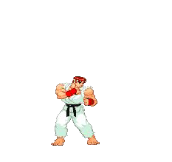
What can an entity do?
Animate
Follow a path
Attack

Slide 6

What can an entity do?
Animate
Follow a path
Attack
Explode

Slide 7
What can an entity do?
Animate
Follow a path
Attack
Explode
Become visible (or not)

Slide 8
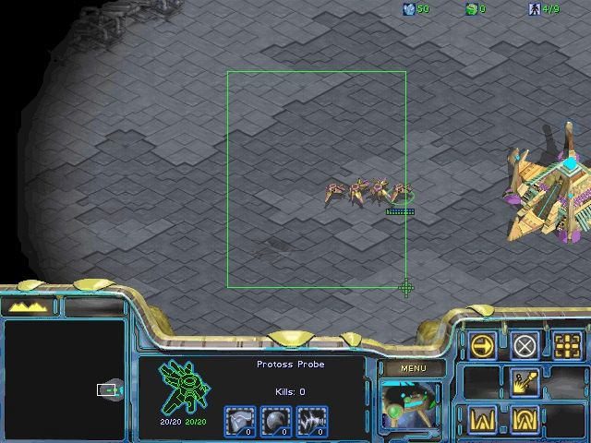
What can an entity do?
Animate
Follow a path
Attack
Explode
Become visible (or not)
Be selected

Slide 9
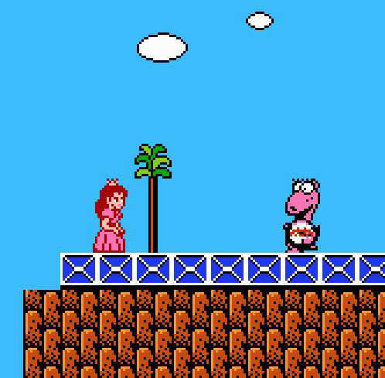
What can an entity do?
Animate
Follow a path
Attack
Explode
Become visible (or not)
Be selected
Get picked up

Slide 10
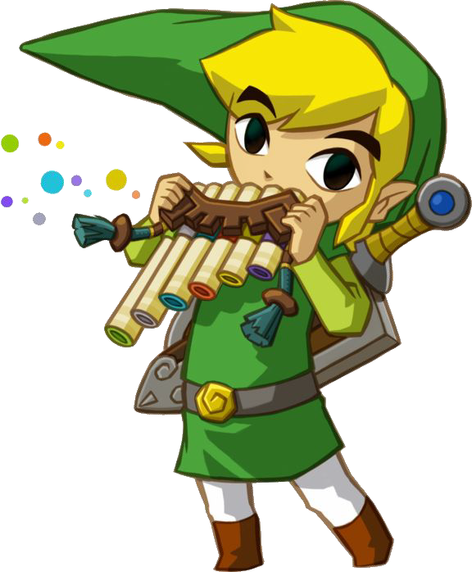
What can an entity do?
Animate
Follow a path
Attack
Explode
Become visible (or not)
Be selected
Get picked up
Make sounds

Slide 11
In General
Entities can do lots of different things.
We are going to have lots of them.
Not all of them will do the same things.

Slide 12
What is the goal?
We want some kind of abstraction to simplify interactions among our many varied entities and higher level systems..
And we don’t want to pay too much for that abstraction.

Slide 13
What is the goal?
Examples of interactions:
The main loop triggers an update telling everything that needs to be updated to update and everything that needs to be drawn to draw.
During the update we see that Pacman has picked up a power-pellet. The pellet is consumed, a sound is played, the music changes, the score is updated, the ghosts switch to their fleeing states, a timer is started.
We want some kind of abstraction to simplify interactions among our many varied entities and higher level systems.
And we don’t want to pay too much for that abstraction.

Slide 14
What is the goal?
We want some kind of abstraction to simplify interactions among our many varied entities and higher level systems..
And we don’t want to pay too much for that abstraction.
That cost can come in different forms:
Maintenance
Performance
Flexibility

Slide 15
Let’s make a game
ShootyGuy: A fast-paced 2D arena fighting game with retro graphics and sound!
The player will face a variety of exciting enemies and obstacles:
MeleeGuy: Chases and attacks player in front of him when in range.
ShootyGuy: Patrols around and shoots at the player when seen.
BombGuy: Hides until player nearby and then explodes after a short delay.

Slide 16
The ShootyGuy entity model (Inheritance)
In C++ the goto strategy for modeling relationships between closely related types is inheritance.
And we can take advantage of polymorphism to give us some of the generic interaction we’re after (i.e. abstract update and draw methods).

Slide 17
The ShootyGuy entity model (Inheritance)
entity
bomb_guy
moveable_entity
hide_or_show damage_all_around
move
melee_guy
shooty_guy
bullet
chase_ai damage_ahead
patrol_ai shoot_bullet
damage_touch

Slide 18
The ShootyGuy entity model (Inheritance)
struct ga_entity {
virtual void update() = 0;
};
struct ga_bomb_guy : ga_entity
{
void hide_or_show(bool show); void damage_all_around();
void update() override
{
if (physics::is_player_nearby())
{
hide_or_show(true); damage_all_around();
}
}
};

Slide 19
Ship it!?
What happens when your designer comes back and asks for a new bullet that chases the player like melee_guy and explodes like bomb_guy?

Slide 20
The ShootyGuy entity model (Inheritance)
entity
moveable_entity
move
bomb_guy
hide_or_show damage_all_around
bullet
shooty_guy
damage_touch
patrol_ai shoot_bullet
melee_guy
chase_ai damage_ahead
chase_bomb_bullet

Slide 21
The diamond of death
struct ga_entity {
virtual void update() = 0; virtual void draw() = 0;
};
struct ga_chase_bomb_bullet : ga_melee_guy, ga_bomb_guy { void update() override
{
// ?!? ga_moveable_entity::update(); ga_bomb_guy::update();
}
void draw() override
{
// ?!?!?
ga_moveable_entity::draw(); ga_bomb_guy::draw();
}
};

Slide 22
Ship it!?
What happens when your designer comes back and asks for a new bullet that chases the player like melee_guy and explodes like bomb_guy?
What about an enemy that can both shoot and punch?

Slide 23
The ShootyGuy entity model (Inheritance)
entity
moveable_entity
move
bomb_guy
hide_or_show damage_all_around
melee_guy
shooty_guy
melee_shooty_guy
patrol_ai shoot_bullet
chase_ai damage_ahead
chase_ai damage_ahead shoot_bullet
bullet
damage_touch
chase_bomb_bullet

Slide 24
Ship it!?
What happens when your designer comes back and asks for a new bullet that chases the player like melee_guy and explodes like bomb_guy?
What about an enemy that can both shoot and punch?
What about when we decide that we want all of our enemies to be able to pick up and throw rocks?

Slide 25


The ShootyGuy entity model (Inheritance)
entity
moveable_entity
throwing_entity move
throw
bomb_guy
hide_or_show damage_all_around
melee_guy
shooty_guy
melee_shooty_guy
patrol_ai shoot_bullet
chase_ai damage_ahead
chase_ai damage_ahead shoot_bullet
bullet
damage_touch
chase_bomb_bullet

Slide 26
The ShootyGuy entity model (Inheritance)
entity
moveable_entity
throw
move
bomb_guy
hide_or_show damage_all_around
melee_guy
shooty_guy
melee_shooty_guy
patrol_ai shoot_bullet
chase_ai damage_ahead
chase_ai damage_ahead shoot_bullet
bullet
damage_touch
chase_bomb_bullet

Slide 27
Other potential problems
Functionality tends to drift upwards in the hierarchy. Or duplicated in leaf types.
  Turns out it’s needed in places you didn’t anticipate!
Need to understand the entire hierarchy to make changes to virtual methods.
  That goes for both directions!
Difficult to parallelize.
  When you call update that means everything is going to update. Probably in a random order.
Lots of virtual dispatch is poor for performance.
  Constantly jumping to random locations in memory.

Slide 28
It can work though!
ai_ally_managerai_battle_line ai_changehintgroup ai_changetarget ai_citizen_response_system ai_goal_actbusy ai_goal_actbusy queue ai_goal_assault ai_goal_follow
ai_goal_lead ai_goal_lead weapon ai_goal_police ai_goal_standoff ai_relationship ai_script_conditions ai_sound ai_speechfilter aiscripted_schedule assault_assaultpoint assault_rallypoint info_apc_missile_hint info_node info_node_air info_node_air hint
info_node_climb info_node_hint info_node_link info_node_link_controller info_npc spawn_destination info_snipertarget logic_choreographed_scene path_corner path_corner_crash path_track
scripted_scene scripted_sentence scripted_sequence scripted_target tanktrain_aitarget tanktrain_ai env_ar2explosion env_beam env_beverage env_blood env_bubbles
Env_citadel_energy_core env_credits
env_cubemap env_dustpuff env_effectscript env_embers env_entity_dissolver env_entity_igniter env_entity_maker env_explosion env_extinguisherjet env_fade
env_fire env_firesensor env_firesource env_flare env_fog_controller env_funnel env_global env_gunfire env_headcrabcanister env_hudhint env_laser env_lightglow env_message
env_microphone env_muzzleflash env_particlelight env_particlescript env_physexplosion env_physimpact env_player_surface_trigger env_rotorshooter env_rotorwash env_screenoverlay env_shake
env_shooter env_smokestack env_smoketrail env_soundscape env_soundscape_proxy env_soundscape_triggerable env_spark
env_speaker env_splash env_sprite env_spritetrail env_starfield

Slide 29
It can work though! Sorta.
env_steam env_sun env_terrainmorph env_texturetoggle
env_tonemap_controller env_wind
env_zoom filter_activator_class filter_activator_name filter_activator_team filter_damage_type filter_multi func_areaportal func_areaportalwindow func_breakable func_breakable_surf func_brush func_button func_capturezone func_changeclass func_clip_vphysics
func_combine_ball_spawner func_conveyor
func_detail func_door func_door_rotating func_dustcloud func_dustmotes
func_extinguishercharger func_guntarget func_healthcharger func_illusionary func_ladder func_ladderendpoint func_lod
func_lookdoor func_monitor func_movelinear func_nobuild func_nogrenades func_occluder func_physbox func_physbox_multiplayer func_platrot func_precipitation func_proprespawnzone
func_recharge func_reflective_glass func_regenerate func_respawnroom func_respawnroomvisualizer func_rot_button func_rotating func_smokevolume func_tank func_tankairboatgun func_tankapcrocket func_tanklaser func_tankmortar func_tankphyscannister func_tankpulselaser func_tankrocket func_tanktrain func_trackautochange func_trackchange func_tracktrain func_traincontrols func_useableladder func_vehicleclip
func_viscluster func_wall func_wall_toggle func_water_analog worldspawn game_end game_player_equip game_player_team
game_ragdoll_manager game_score
game_text game_ui
game_weapon_manager game_zone_player info_camera_link info_constraint_anchor info_hint info_intermission info_ladder_dismount info_landmark info_lighting
info_mass center Info_no_dynamic_shadow

Slide 30
It can work though! Sorta =(
nfo_node info_node_air info_node_air hint info_node_climb info_node_hint info_node_link
info_node_link_controller info_npc_spawn_destination info_null
info_overlay info_particle_system info_player_combine info_player_deathmatch info_player_logo info_player_rebel info_player_start info_projecteddecal info_snipertarget info_target info_target_gunshipcrash info_teleporter_countdown info_teleport_destination infodecal
item_ammo_357 item_ammo_357_large item_ammo_ar2 item_ammo_ar2_altfire item_ammo_ar2_large item_ammo_crate item_ammo_crossbow item_ammo_pistol item_ammo_pistol_large item_ammo_smg1 item_ammo_smg1_grenade item_ammo_smg1_large item_battery item_box_buckshot item_dynamic resupply item_healthcharger item_healthkit item_healthvial item_item_crate item_rpg_round
item_suit item_suitcharger light
light_spot light_dynamic env_projectedtexture point_spotlight light_environment light_directional logic_auto logic_autosave logic_branch logic_case logic_collision_pair logic_compare logic_lineto
logic_measure_movement logic_multicompare logic_navigation logic_relay
logic_timer ambient_generic cycler gibshooter keyframe_rope keyframe_track
material_modify_control math_colorblend math_counter math_remap momentary_rot_button move_keyframed move_rope
move_track script_intro script_tauremoval shadow_control sky_camera test_sidelist test_traceline vgui_screen water_lod_control combine_mine npc_alyx npc_antlion
npc_antlion_template_maker npc_antlionguard npc_barnacle
npc_barney

Slide 31
It can work though! Sorta =((
npc_breen npc_citizen npc_combine_camera npc_combine_s npc_combinedropship npc_combinegunship npc_crabsynth npc_cranedriver npc_crow npc_cscanner npc_dog
npc_eli npc_fastzombie npc_fisherman npc_gman npc_headcrab npc_headcrab_black npc_headcrab_fast npc_helicopter npc_ichthyosaur npc_kleiner npc_manhack npc_metropolice
npc_monk npc_mortarsynth npc_mossman npc_pigeon npc_poisonzombie npc_rollermine npc_seagull npc_sniper npc_stalker npc_strider npc_turret_ceiling npc_turret_floor npc_turret_ground npc_vortigaunt npc_zombie npc_zombie_torso cycler_actor generic_actor
info_npc_spawn_destination monster_generic npc_apcdriver
npc_bullseye npc_enemyfinder
npc_furniture npc_heli_avoidbox npc_heli_avoidsphere npc_heli_nobomb npc_launcher npc_maker npc_missiledefense npc_particlestorm npc_spotlight npc_template_maker npc_vehicledriver phys_ballsocket phys_constraint phys_constraintsystem phys_convert phys_hinge phys_keepupright phys_lengthconstraint phys_magnet phys_motor phys_pulleyconstraint phys_ragdollconstraint phys_ragdollmagnet
phys_slideconstraint phys_spring phys_thruster phys_torque physics_cannister player_loadsaved player_speedmod player_weaponstrip point_anglesensor
point_angularvelocitysensor point_antlion_repellant point_apc_controller point_bugbait
point_camera point_clientcommand point_commentary_node point_devshot_camera point_enable_motion_fixup point_hurt
point_message point_playermoveconstraint point_servercommand point_spotlight

Slide 32
It can work though! Sorta =(((
point_teleport point_template point_tesla point_viewcontrol vehicle_viewcontroller prop_combine_ball prop_detail prop_door_rotating prop_dynamic prop_dynamic_ornament prop_dynamic_override prop_physics prop_physics_multiplayer prop_physics_override prop_ragdoll
prop_static prop_thumper prop_vehicle prop_vehicle_airboat prop_vehicle_apc prop_vehicle_cannon prop_vehicle_crane prop_vehicle_driveable
prop_vehicle_jeep prop_vehicle_prisoner_pod trigger_autosave trigger_changelevel trigger_finale trigger_gravity
trigger_hurt trigger_impact trigger_look trigger_multiple trigger_once trigger_physics_trap trigger_playermovement trigger_proximity trigger_push trigger_remove trigger_rpgfire trigger_soundscape trigger_teleport trigger_transition trigger_vphysics_motion trigger_waterydeath trigger_weapon_dissolve
trigger_weapon_strip trigger_wind weapon_357 weapon_alyxgun weapon_annabelle weapon_ar2 weapon_brickbat weapon_bugbait weapon_citizenpackage weapon_citizensuitcase weapon_crossbow weapon_crowbar weapon_extinguisher weapon_frag weapon_physcannon weapon_physgun weapon_pistol weapon_rpg weapon_shotgun weapon_smg1 weapon_stunstick

Slide 33
Multiple Inheritance
Base classes for each subsystem, entities inherit multiple classes
Scales better than single inheritance
  Less base class pollution
  Less conflicting requirements
Still run into problems when hierarchy gets large
  If hierarchy has to change, it’s painful
Notes:
implementation of MI is not straightforward. C++ supports it, but it’s not for the faint of heart. Stuff is ugly behind the scenes. Virtual inheritance hoop jumping to get things working
what about interfaces?

Slide 34
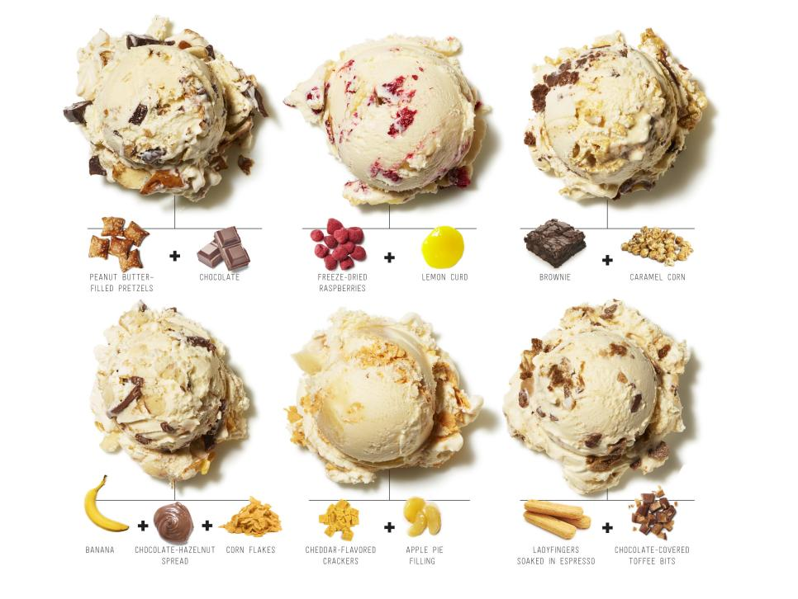
Mixin Classes
Notes:
some developers allow a limited form of multiple inheritance, where a class can have multiple parents but only one grandparent, in effect meaning that classes only inherit from one class in the main hierarchy, but also from any number of mixin classes, which are standalone and have no base class. These are classes designed to make implementation of certain functionality easier in subclasses, but which is not designed to be used by itself. (interfaces are contracts, no implementation) This way, common functionality an be factored out into one of these mix-in classes and patched into the hierarchy where needed. But even here, you can get bubble-up effects, which negates encapsulation. This is when a feature moves up towards the root in order to share code between unrelated objects. Hey, more stuff needs to float, so move the floatation code further up the hierarchy - even though certain derived classes can’t float, it prevents duplicate code
Mixins are not interfaces. They are multiple inheritance. With a prettier name. This is not to say that mixins are bad. Multiple inheritance isn't bad. The way C++ resolves multiple inheritance is what everyone gets all worked up about.

Slide 35
Mixin Classes
MHealth
+GetHealth()
+ApplyDamage()
+IsDead()
+OnDeath()
MCarryable
+PickUp()
+Drop()
+IsBeingCarried()
GameObject
Character
Vechicle
Weapon
Item
Player
NPC
Tank
Jeep
Piston
AR15
Canteen
Ammo
Notes:
some developers allow a limited form of multiple inheritance, where a class can have multiple parents but only one grandparent, in effect meaning that classes only inherit from one class in the main hierarchy, but also from any number of mixin classes, which are standalone and have no base class. These are classes designed to make implementation of certain functionality easier in subclasses, but which is not designed to be used by itself. (interfaces are contracts, no implementation) This way, common functionality an be factored out into one of these mix-in classes and patched into the hierarchy where needed. But even here, you can get bubble-up effects, which negates encapsulation. This is when a feature moves up towards the root in order to share code between unrelated objects. Hey, more stuff needs to float, so move the floatation code further up the hierarchy - even though certain derived classes can’t float, it prevents duplicate code
Mixins are not interfaces. They are multiple inheritance. With a prettier name. This is not to say that mixins are bad. Multiple inheritance isn't bad. The way C++ resolves multiple inheritance is what everyone gets all worked up about.

Slide 36
Ownership-Based Entities
class CharacterDrawable : public Drawable
{
void Display(void);
}
class CharacterAI : public AI
{
void Update(float dt);
}
class Character
{
CharacterDrawable* body;
CharacterAI* mind;
}

Slide 37
Ownership-Based Entities
Notes:
the arcade game Hydro Thunder used a simple object model in C. The object types were: player boat, floating boost icons, ambient animated objects (animals on the side of the track), the water surface, ramps, waterfalls, particle effects, race track sectors (2D polygonal regions connected together which defined the watery region where boats could race), static geometry (terrain, foliage, etc) and HUD elements

Slide 38
struct WorldOb_s
{
  Orient_t m_transform; /* position/rotation */
  Mesh3d* m_pMesh; /* 3D mesh */
  CollMan* m_pCollMan; /* Collision manifold */
  /* ... */
  void* m_pUserData; /* custom state */
  void (*m_pUpdate)(); /* polymorphic update */
  void (*m_pDraw)(); /* polymorphic draw */
};
typedef struct WorldOb_s WorldOb_t;
Notes:
ownership-based entity: there was a single World_t object, which represented a particular track, that contained pointers to arrays of various kinds of game objects. The static geom was a single mesh, and the water surface, waterfalls, and particles had custom data structures, but the dynamic elements were instances of a general-purpose WorldOb struct. This object contained pointers to custom data and functions, so while it’s not technically object-oriented, it does have rudimentary implementations of inheritance and polymorphism. The function pointers are effectively virtual functions

Slide 39
Ownership-Based Entities
Entities have no (or little) hierarchy and farm operations out to other objects
  “Character” will have references to “Renderer”, “Collider,” etc.
  Subobjects are either obtained from, or registered with the controlling system
Hierarchy is less fragile and less complex than inheritance-based system
Unrelated functionality is separated
BUT:
  Need lots of wrapper functions
  Main entity spends a lot of time copying data between subobjects

Slide 40
It Won’t Work
There are hundreds of ways to decompose the GameObject system problem into classes
  They are all wrong
  They don’t start out wrong, of course...
Games constantly change
  Designer makes decisions independently of
  engineering type structures
  They will ask for things that cut right across engineering concerns

Slide 41
If not inheritance, than what?
Inheritance represents an “is-a” relationship.
  A square is a shape.
  A duck is an animal.
  The melee_guy is a moveable_entity

Slide 42
If not inheritance, than what?
Inheritance represents an “is-a” relationship.
  A square is a shape.
  A duck is an animal.
  The melee_guy is a moveable_entity
Composition represents a “has-a” relationship.
  A car has an engine.
  The employee has a name.
  The melee_guy has movement and melee attacks.

Slide 43
The ShootyGuy entity model (Composition)
bomb_guy
shooty_guy melee_guy
move hide_or_show move
patrol_ai damage_ahead
damage_all_around
shoot_bullet
chase_ai
bullet
move damage_touch

Slide 44
The ShootyGuy entity model (Composition)
bomb_guy
shooty_guy melee_guy
move hide_or_show move
patrol_ai damage_ahead
damage_all_around
shoot_bullet
chase_ai
melee_shooty_guy
move
bullet
move
patrol_and_chase_ai
damage_touch
shoot_bullet
damage_ahead

Slide 45
The ShootyGuy entity model (Composition)
struct ga_move final {...}; struct ga_patrol_ai final {...};
struct ga_shoot_bullet final {...};
struct ga_chase_ai final {...}; struct ga_damage_ahead final {...};
struct ga_shooty_guy final
{
ga_move* _move; ga_patrol_ai* _patrol_ai;
ga_shoot_bullet* _shoot_bullet;
};
struct ga_melee_guy final
{
ga_move* _move; ga_chase_ai* _chase_ai;
ga_damage_ahead* _damage_ahead;
};

Slide 46
The ShootyGuy entity model (Components)
struct ga_component
{
virtual void update() = 0;
};
struct ga_move_component : ga_component {...}; struct ga_patrol_ai_component : ga_component {...};
struct ga_shoot_bullet_component : ga_component {...};
struct ga_entity final
{
std::vector<ga_component*> _components;
void update()
{
for (auto& component : _components)
{
component->update();
}
}
};

Slide 47
The ShootyGuy entity model (Components)
{
ga_entity shooty_melee_guy;
shooty_melee_guy.add_component(new ga_move_component); shooty_melee_guy.add_component(new ga_patrol_and_chase_ai_component); shooty_melee_guy.add_component(new ga_shoot_bullet_component); shooty_melee_guy.add_component(new ga_damage_ahead_component);
ga_sim sim; sim.add_entity(&shooty_melee_guy); while (true) {
sim.update();
}
}

Slide 48
Recap
No longer need to change entity hierarchy to accommodate gameplay changes!

Slide 49
Recap
No longer need to change entity hierarchy to accommodate gameplay changes!
Entities are built at runtime. This could allow us to load specifications from data so they can be changed/created by designers without recompiling code.

Slide 50
Recap
No longer need to change entity hierarchy to accommodate gameplay changes!
Entities are built at runtime. This could allow us to load specifications from data so they can be changed/created by designers without recompiling code.
Easier to maintain since (ideally) components are independent of each other and can be understood in isolation.

Slide 51
Can we do any better?
What we have is very flexible and similar approaches have been used to ship many modern games.
But… the performance is still not great. Perhaps even worse than the inheritance based approach.
  Even more virtual method calls (for each component instead of each entity).
  Need to search list for correct component if specific functionality is needed.

Slide 52
View it all as a relational database
Build in introspection-like capabilities
Attach code to objects for flexibility
Support varieties of storage forms
Inheritance and instantiation of aspects
Notes:
programmers tend to naturally think in an object-centric view, with objects that contain code and data - attributes and methods. But it’s also possible to think primarily in terms of attributes, rather than objects. First we define the set of all properties that it’s possible for an object to have, and for each one, build a table containing the values of that property, keyed by objectID

Slide 53
Runtime Object Model Architectures
Object-centric: Each tool-side game object is represented at runtime by a class instance or a small cluster of interconnected instances. Each object has attributes and behaviors, classic OOP
Property-centric: Each object is represented by ID only, properties are distributed across (many) data tables which are keyed by the object ID

Slide 54
Property-Centric Architectures
Object1
  Position = (0, 3, 15)
  Orientation = (0, 42, 0)
Object2
  Position = (-12, 0, 8)
  Health = 15
Object3
  Orientation = (0, -87, 10)
Position
  Object1 = (0, 3, 15)
  Object2 = (-12, 0, 8)
Orientation
  Object1 = (0, 42, 0)
  Object3 = (0, -87, 10)
Health
  Object2 = 15
Notes:
Used in Deus Ex 2, and the later Thief series of games. This design is akin to a relational database, with each attribute as a column or a separate table, with the objectID as the primary key. But objects are behavior in addition to data, so where do we implement the behavior?

Slide 55
Behavior in a Property-Centric Architecture
In the classes themselves
  Each property is implemented as a property class with hard-coded methods, properties call each other with event messages (e.g. Health calls RBD to ragdoll)
Via Scripts
  Properties are raw data, and include a special ScriptId property that points to a script that contains the behavior
Notes:
cons: you need to write your own debugger, because your IDE’s debugger won’t be able to inspect all the properties of an object at once
pros: more memory efficient, because we’re only storing data that’s in use (as opposed to objects with unused members), but is also more cache friendly because it can be stored contiguously in memory

Slide 56
static const U32 MAX_GAME_OBJECTS = 1024
struct GameObject
{
  U32 m_uniqueId;
  Vector m_pos;
  Quaternion m_rot;
  float m_health;
  // ...
};
GameObject g_aAllGameObjects[MAX_GAME_OBJECTS];
struct AllGameObjects
{
  U32 m_aUniqueId[MAX_GAME_OBJECTS];
  Vector m_aPos[MAX_GAME_OBJECTS];
  Quaternion m_aRot[MAX_GAME_OBJECTS];
  float m_aHealth[MAX_GAME_OBJECTS];
  // ...
};
AllGameObjects g_allGameObjects;
Traditional array-of-structs
Cache-friendly struct-of-arrays
Notes:
on modern hardware (especially consoles), the cost of accessing memory is far higher than performing calculations (on a PS3, a cache miss is the cost of many calculations - like 4-figure many), and by storing data contiguously we can reduce cache misses, because when we load one element of a data array, a large number of its neighboring elements are loaded into the same cache line

Slide 57
Integrating Subsystems

Slide 58
Major Subsystems
Games have reasonable natural decomposition into subcomponents
Subsystems should have well-defined boundaries and communication paths
  Probably going to be implemented by different people
  Manage complexity

Slide 59
Major Subsystems
Input
Networking
Rendering
Sound
Script
Loading
Front-end
HUD
Physics
AI
Gameplay

Slide 60
Modularity
We want the major subsystems to be as decoupled as possible
  Each system should view other systems as a black box, regardless of internal complexity
  Communication should occur through narrow, well-defined interfaces
All systems are collaborating on updating or presenting the evolving state of the game
Designing this game state while maintaining modularity is the fundamental architectural challenge
Notes:
state and how to share it

Slide 61
Object References
Pointers
Smart Pointers
Handles
Notes:
at runtime, we need various ways to find game objects - by id, by type, by some arbitrary criteria. Once an object has been found, we need a way to refer to it

Slide 62
Pointers
Fastest, most efficient, and easiest to work with
Orphaned objects – still occupies memory but is no longer needed or referenced by any object in the system
Stale pointers – pointer to a block of memory that used to be occupied by a valid object but is now free memory
Invalid pointers – dereferencing null pointers (can use assert()), but if it’s a piece of data that’s misinterpreted as a pointer...
Notes:
the most straightforward way to implement an object reference is via a pointer, but they suffer from a number of problems
orphan - every object should have an owner - another object that’s responsible for managing its lifetime, but pointers don’t give the programmer any help in enforcing this rule
stale - if an object is deleted, we should null-out any and all pointers to that object, but if we forget to... trying to read or write to a stale pointer will crash, or at least really screw things up - tough to track down
also, fragmentation

Slide 63
Memory Fragmentation
...
Notes:
empty block of memory, load something, load more things, deallocate a few things, after some time, stuff’s scattered all about and something might not be able to be allocated because there aren’t enough contiguous bytes. Yes there’s virtual memory, but consoles won’t use it because of the performance overhead. You can try a a stack or a pool allocator, but more often than not, differently-sized objects are being allocated and freed in an unpredictable order. You should periodically defrag, which isn’t difficult, but we’re moving allocated memory which will affect pointers. There is no general-purpose pointer relocator

Slide 64
Smart Pointers
An object that acts like a pointer (has overloaded operators like * and ->) and had additional metadata that lets it do more things, like recognizing that the object it points to has been deleted and returning NULL if so
Reference counting
Very tricky to get right – many cases to handle
Notes:
ref counting - smart pointers coordinating with one another to determine the number of references to a particular object. When the number of smart pointers that reference a particular object drops to zero, we know the object is no longer needed and can be deleted
problems come up like type safety, exception handling, and sometimes high running costs

Slide 65
Boost/C++ 11
scoped_ptr – points to single object with one owner
scoped_array – points to an array of objects with one owner
shared_ptr – points to an object whose lifetime is shared by multiple owners
shared_array – points to an array of objects whose lifetime is shared by multiple owners
weak_ptr – does not own or automatically destroy the object it references (assumes its managed by a shared_ptr)
intrusive_ptr – implements reference counting by assuming the pointed-to object maintains the count itself. Same size as a native C++ pointer
Notes:
The Boost C++ template library provides six different varieties
C++11 provides std::unique_ptr, as well as improvements to std::shared_ptr and std::weak_ptr from TR1. std::auto_ptr is deprecated.

Slide 66
Handles
Object 1
0
1
2 | NULL
3
4
5 | NULL
6
Object 2
m_handleIndex == 6
Object 3
Object 4
Object 5
Notes:
acts like a smart pointer in many ways, but is easier to implement as is less prone to problems. Basically an integer index into a global handle table, which contains pointers to the objects which the handle refers to. to create a handle, we search the table for the address of the object in question and store its index in the handle. To dereference, the code indexes the appropriate slot and dereferences the pointer it finds there. If an object is deleted, it can null out its entry in the table. Supports memory relocation. Still prone to referencing stale objects, so you could also include a unique objectID in each handle
-stop-

Slide 67
Queries
Find objects by ID – Hash table or binary search tree keyed by ID
Iterating over all objects that meet a criterion – Presort into linked lists (presuming you know the criteria ahead of time)
Finding all objects within a given region or radius – store data in a spatial hash data structure: horizontal grid over the world, quadtrees, octtrees, k-d trees, etc.
Notes:
we need ways to find game objects at runtime, the simplest of which is to find a particular game object by its unique id, but there’s many more
for maximum flexibility, we could imagine a general-purpose object database with the ability to perform arbitrary queries using arbitrary search criteria, and perform the searches quickly and efficiently, making maximal use of all available resources
in reality, this blissful combination of flexibility and speed isn’t possible, so developers decide which types of queries are most likely to be needed during development and implement specialized data structures to accelerate those particular queries

Slide 68
Game State
The collection of information that represents a snapshot of the game universe at a particular time
  Position, orientation, velocity of all dynamic entities
  Behavior/intentions of AI-controlled entities
  Scores, health, powers, damage levels, etc.
All subsystems are interested in some aspect of the game state
  Position needs to be known by renderer, physics, networking, possibly sound
  Many systems need to know when an entity is spawned or destroyed

Slide 69
Sharing State
How is the game state made available to subsystems?
  Global
  Push/Pull models
  Brokers
  Broadcast/Listener
  Database
  Shared entities

Slide 70
Global State
Everyone has access to everyone else
  If the renderer needs access to player location, it just grabs it from the AI subsystem
  This is what will happen if you don’t think about the design in advance
AI
Render
Sound
Input
Network
Notes:
A real game will have hundreds of these boxes
sound talking to input?

Slide 71
Communication Strategies
Push/Pull
Broker classes
Broadcast/Listener
Direct function calls
Shared virtual interfaces
Events
Callbacks
Shared Entities
Database

Slide 72
Function Calls
Pros
  Simple
  High performance
Cons
  Scales poorly
  Header file dependencies increase
  High coupling
Brokers can reign in complexity

Slide 73
Virtual Interfaces
Pros
  Reduces coupling
  Provides polymorphism
Cons
  More complicated
    Separate interface from implementation
  Interfaces that are too narrow are painful to use in practice
  Extra layer of indirection
    Additional call cost

Slide 74
Callbacks
Pass function addresses between objects
Many different implementations
  Function pointers
  Callback objects/functors
Pros:
  Decouples event from communicating the event
  Functors look and act like fnctions
Cons:
  More work to hook up between objects
  Not a complete system on their own – need some other interface to set up the callbacks

Slide 75
Brokers
Brokers control the communication between complex subsystems
Used to further isolate major systems from each other
  e.g., a broker is responsible for collecting all rendering-related events from the various game subsystems and sending them to the renderer (push)
  Alternatively, the rendering system retrieves the information from the broker (pull)
A broker may have knowledge of many systems, but it should itself be straightforward and easy to modify
  Intermediate between systems, not responsible for a lot of complex work

Slide 76
Push/Pull
Flow of state information is restricted to certain directions. Systems have incomplete knowledge of each other
  Example: Renderer (Push)
    AI tells renderer where objects are
    AI tells renderer the damage state of objects
      Matches damage state to visual representation
    Game loop tells renderer elapsed time
      Updates internal effects, animation list, etc.
    AI tells renderer where camera is
      Sets up appropriate graphics hardware state
  The rendering system has no knowledge of the AI

Slide 77
Events
Complicated to implement/use
Really good systems are type-safe and double-blind
  Example: Qt signals/slots
Poor systems are usually untyped
  WndProc
Low coupling/very good scaling
Need to be careful about ‘dangling events’

Slide 78
Broadcast/Listener
When a state change occurs that might be interesting to other systems, the system responsible for the change broadcasts it through a central event system
Systems that are interested register as a listener with the event system
No direct communication occurs between subsystems
Useful for communication across thread and network boundaries
Expensive
  requires storage for messengers and listeners
  message dispatch requires CPU time and memory access
Convenient, easily abused

Slide 79
Database
Necessary when game state cannot fit into memory
  MMOs
Get some stuff for “free”
  Persistence
  Queries
Nice separation between data and code
Performance can be problematic
  Will likely need to cache live stuff in more conventional objects

Slide 80
Shared Entities
Individual actors in the world are referenced by multiple systems
Example
  AI and Renderer both have a reference to “Character”
  AI and Renderer view of character don’t have to be the same class or interface
Looks like global on the surface, but can be much cleaner with proper use of interfaces and inheritance
Very common way of storing game state
Don’t use bare pointers! Handles or smart pointers at least

Slide 81
Additional Considerations
Multicasting
  Example: player makes a noise, all AI’s within radius hear it
When to dispatch?
  Instantaneously
  Defer events, send at particular point in game loop
  Cache and defer for multithreading
Adaptation
  Example: game AI says “character is falling”, sound systems adapts that into “play scream07.wav”

Slide 82
Conclusion
Manage complexity, divide game into simpler components
Minimize coupling
  Both at system and entity level
  Formalize communication through designed interfaces

