Slide 1
Graphics Part 2
Shaders and GLSL

Slide 2
Coordinate Systems
Handedness
World space
Model space
View space

Slide 3
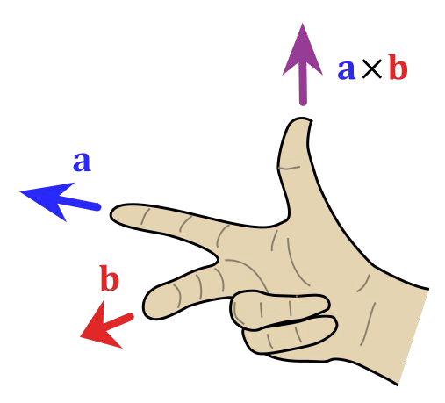
Coordinate Systems
Handedness
World space
Model space
View space
Handedness determines the direction of the cross product result.
Assuming positive x to the right, and positive y up…
In a right-handed system, the z-axis comes out of the screen.
In a left-handed system, the z-axis goes into the screen.
Image courtesy of Wikipedia

Slide 4
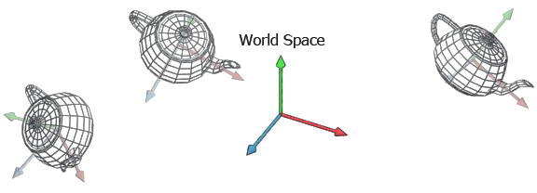
Coordinate Systems
Handedness
World space
Model space
View space
World space is the highest order coordinate system which describes absolute positions for all objects in the game.
Image courtesy of Marco Alamia via Coding Labs

Slide 5
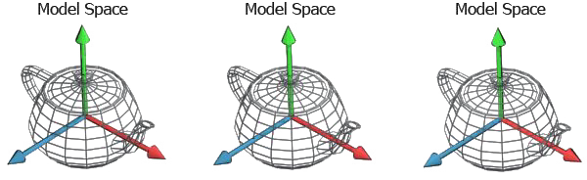
Coordinate Systems
Handedness
World space
Model space
View space
Model space is the coordinate system local to a single object in the game world.
The origin is the origin point of the model, and is typically user defined. It could be the exact center, a corner, the bottom center; anywhere.
Image courtesy of Marco Alamia via Coding Labs

Slide 6
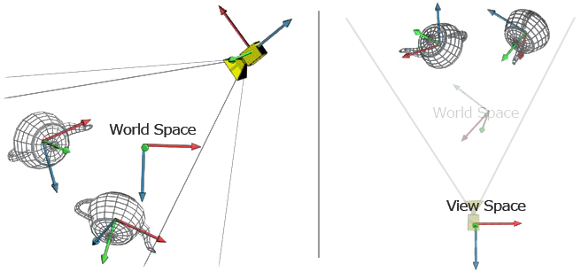
Coordinate Systems
Handedness
World space
Model space
View space
View space describes the coordinate system of the camera, with the origin being the position of the camera.
Transforming into view space is an essential part of the graphics pipeline.
Image courtesy of Marco Alamia via Coding Labs

Slide 7
Scene Representation
How do we describe objects in the scene?
How do we describe scene topology?
How do we describe where things are?
How do we describe how we see things?

Slide 8
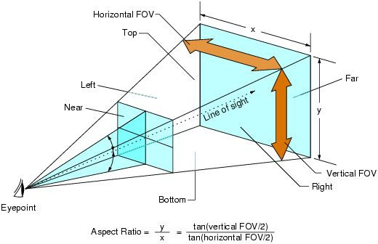
Virtual Camera
A virtual camera can be created with three components:
  A position.
  A forward, or ‘look-at’ vector.
  An up vector.
It also needs a frustum.
  A frustum defines the bounds that the camera can see

Slide 9
Transformations
Our goal is to get something from the world to the screen. How?
We need a series of transformations (matrices)
  Model - Transform from model into world space.
  View - Transform from world space into view space.
  Projection - Transform from view space into clip space.
Viewport - Transform from NDC to screen space.
  This is done in the hardware.

Slide 10
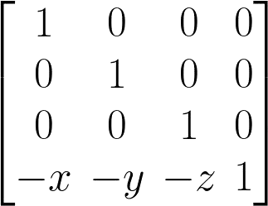
Calculating the View Matrix
The view matrix transforms the world into camera space.
  (remember, OpenGL is egocentric)
This essentially means applying the inverse of the camera’s transform.
  Translation
  Orientation
Translation is easy:

Slide 11
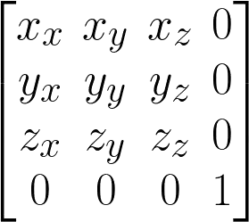
Calculating the View Matrix
Orientation is a little trickier.
Recall that rows (or columns) of a transformation matrix are orthogonal vectors representing an orientation.
Find them for the camera!
  Given direction (z) (eye - at) and up vector…
  Cross direction and up to get right (x).
  Cross right (x) and direction (z) to get an accurate up (y).
  Then stick ‘em in a matrix:

Slide 12
Calculating the View Matrix
But wait!
  That describes a transformation from the camera space to world space.
  We want world space to camera space.
Solution: invert the matrix.
  It’s orthogonal, so the inverse is just the transpose.
Finally, combine with translation.
  The translation is pre-multiplied with the orientation.

Slide 13
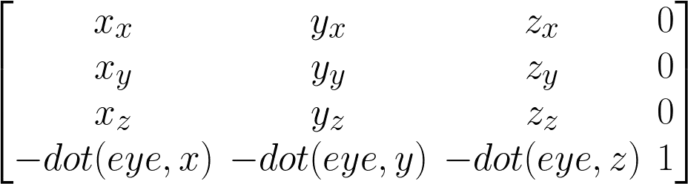
Calculating the View Matrix
So, given:
  Camera position (eye)
  Right vector (x)
  Up vector (y)
  Forward vector (z)

Slide 14
Order of Multiplication?
This depends on your matrix layout and multiplication code.
For A * B:
  Row major layout and A rows * B columns or
  Column major layout and A columns * B rows
    Pre-multiplication = local
    Post-multiplication = world
  Row major layout and A columns * B rows or
  Column major layout and A rows * B columns
    Pre-multiplication = world
    Post-multiplication = local

Slide 15
Programmable Pipeline
Vertex Specification
Vertex Shader
Tessellation
Geometry Shader
Vertex Post-Processing
Primitive Assembly
Rasterization
Fragment Shader
Per-Sampler Operations

Slide 16
Programmable Shaders
Miniature programs which operate on vertex and fragment data.
  Vertex shader outputs vertex position in homogenous clip space, and per-vertex values.
    gl_Position
  Fragment shader outputs fragment color(s).
    gl_FragColor
    And possibly depth information.
There are many built-in functions for common operations.
  See the OpenGL or HLSL reference pages for a list.

Slide 17
Shading Languages
Most shading languages are C-like.
  GLSL - OpenGL Shading Language
  HLSL - High Level Shading Language (DirectX)
  Cg
They are compiled to bytecode similar to assembly.
GPU execution units execute the bytecode.

Slide 18
OpenGL Shaders
OpenGL manages shaders with shader objects.
  glCreateShader
  glShaderSource
Shader programs are pairings of vertex and fragment shaders.
  glCreateProgram
  glAttachShader
  glLinkProgram
  glUseProgram
Fun fact: shaders are usually not compiled until you actually use them.

Slide 19
GLSL
Program variable qualifiers.
  in - A per-element input value, like position.
  out - A per-element output, like fragment color.
  uniform - A per-object constant, like model-view-projection matrix or texture.
Basic types.
  C++ like - void, float, int, bool
  Vectors - vec2, vec3, vec4, ivec2, etc.
  Matrices - mat2, mat3, mat4
  Textures - sampler2D
  Arrays - e.g. float[5]

Slide 20
GLSL
Control flow
  Mostly the same as C/C++.
  Notable addition is discard, which rejects a current fragment from drawing.
Built-in functions
  Trig - sin, cos, tan, asin, acos, atan
  Math - pow, exp, log, exp2, log2, sqrt, inversesqrt
  And many more - dot, cross, normalize, clamp, mix, step, reflect, etc.
Texture lookup
  texture2D(sampler2D, vec2)
  There are others, but this is most often used.

Slide 21
Vertex Shaders
Modern vertex shaders:
  Animate vertex positions.
  Transform vertex positions into homogenous clip space.
  Pass through (and possibly manipulate) per-vertex attributes.
And that’s really about it…
  Fragment shaders get more interesting.
They can be leveraged for optimization.
  It’s possible to use built-in hardware interpolation to your advantage.
    Perform heavy calculations per vertex, rather than per-fragment.
  This is really a last-resort optimization.

Slide 22
Example
#version 400
layout (location = 0) in vec3 in_position; uniform vec3 u_color;
out vec3 out_color; void main(void)
{
// Do something with color and position. out_color = vec4(1.0, 0.0, 0.0, 1.0);
// Assign gl_Position as position in homogenous clip space.
}

Slide 23
Steps to set up vertex data buffers
Set active VBO with glBindBuffer()
Copy data into the bound VBO with glBufferData()
Specify which vertex attribute index to use, and the structure of the data with glVertexAttribPointer ()
Enable the attribute with glEnableVertexAttribArray()

Slide 24
glVertexAttribPointer(GLuint index,
GLint size,
GLenum type,
GLboolean normalized,
GLsizei stride,
const GLvoid * pointer);
which attribute
how many values
value type
GL_FALSE
size of individual vertex
offset from beginning of vertex
Notes:
used on the currently active vertex buffer on the currently active vertex array object

Slide 25
Data Qualifiers
layout – sets correspondence between an attribute pointer and a shader variable
uniform – read-only value that does not change across the primitive being processed. Data that is constant for this given draw call (time, texture maps, model’s transform, view matrix, etc.)
in – incoming data from a previous stage in the process
out – data that will be sent to the next stage in the process
Notes:
if no qualifier is specified, then the var has no linkage to the app or shaders running on other pipeline stages
uniforms are read-only within the shader

Slide 26
Example: Linking Shaders
Vertex shader declarations:
layout(location = 0) in vec3 in_position; layout(location = 1) in vec3 in_color; layout(location = 2) in vec2 in_texcoord;
out vec3 color;
out vec2 texcoord0;
Fragment shader declarations:
in vec3 color;
in vec2 texcoord0;

Slide 27
Shader Program
CPU
uniform
variables
Vertex
Shader
Fragment
Shader
in: “this” vert in
model space
in: interpolated
values for “this”
pixel
screen
out: vert in screen
space, plus vert
data to be
interpolated
out: color
gl_Position

Slide 28
Types
void | mat4 | bvec2
float | vec2 | bvec3
int | vec3 | bvec4
void | vec4 | sampler2D
bool | ivec2 | struct
mat2 | ivec3 | float x[5];
mat3 | ivec4
Notes:
no double! :-( reserved for future use
for mats, columns then rows
everything is floats, except ivec (signed int) and bvec (bool)
samplers are handles to textures
1D arrays can’t be initialized in the shader for WebGL

Slide 29
Vector Types
Shading language vector types offer different access patterns.
  { x, y, z, w }, typically used for positions or normals.
  { r, g, b, a }, typically used for colors.
  { s, t, p, q }, typically used for texture coordinates.
Swizzling
  By definition, rearranging components of a vector.
  Given vector = vec4(1.0, 2.0, 3.0, 4.0)
    vector.xxxx = { 1.0, 1.0, 1.0, 1.0 }
    vector.wzyx = { 4.0, 3.0, 2.0, 1.0 }
    vector.yyzz = { 3.0, 3.0, 4.0, 4.0 }
    And so on...

Slide 30
Structure
statements and declarations
function definitions
selection (if-else and switch-case-default)
iteration (for, while, and do-while)
jumps (discard, return, break, and continue)
Notes:
discard is used to *not* draw a given fragment

Slide 31
Built-in Functions
radians(deg)
degrees(rad)
sin(angle)
cos(angle)
tan(angle)
asin(x)
acos(x)
atan(y,x)
atan(y_over_x)
pow(x,y)
exp(x)
log(x)
exp2(x)
log2(x)
sqrt(x)
inversesqrt(x)

Slide 32
Built-in Functions
abs(x)
sign(x)
floor(x)
ceil(x)
fract(x)
mod(x, y)
min(x, y)
max(x, y)
clamp(x, minVal, maxVal)
mix(x, y, a)
step(edge, x)
smoothstep(edge0, edge1, x)
length(v)
distance(v0, v1)
dot(v0, v1)
cross(v0, v1)
normalize(v)
reflect(i, n)
refract(i, n, eta)
Notes:
floor - value equal to the nearest integer that is less than or equal to x
trunc - value equal to the nearest integer to x whose absolute value is not larger than the absolute value of x
fract: x - floor(x)
mix: linear blend
reflect, incidence and normal vector
refract takes an index of refraction

Slide 33
Shader Units
t = 0
t = 1
t = 2

Slide 34
Shader Units
t = 0
t = 1
t = 2
Input Data
Input Data
Input Data
Input Data

Slide 35
Shader Units
t = 0
t = 1
t = 2
Shader Execution Unit
Input Data
Shader Execution Unit
Input Data
Shader Execution Unit
Input Data
Shader Execution Unit
Input Data

Slide 36
Shader Units
t = 0
t = 1
t = 2
Shader Execution Unit
Input Data
Output
Shader Execution Unit
Input Data
Output
Shader Execution Unit
Input Data
Output
Shader Execution Unit
Input Data
Output

Slide 37
Programmable Pipeline
Vertex Specification
Vertex Shader
Tessellation
Geometry Shader
Vertex Post-Processing
Primitive Assembly
Rasterization
Fragment Shader
Per-Sampler Operations

Slide 38
Programmable Pipeline
Vertex Specification
Vertex Shader
Tessellation
Geometry Shader
Vertex Post-Processing
Primitive Assembly
Rasterization
Fragment Shader
Per-Sampler Operations

Slide 39
Post-process and Assembly
Clipping
Perspective Divide
Viewport Transform
Primitive Assembly
Culling

Slide 40
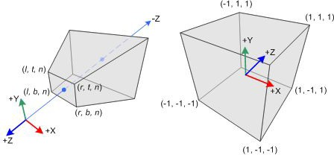
Post-process and Assembly
Clipping
Perspective Divide
Viewport Transform
Primitive Assembly
Culling
Vertex shaders outputs vertex positions in homogenous clip space, which is designed to make clipping as simple as possible.
Portions of primitives outside the view volume are clipped and new primitives are generated.
Primitives which fall completely outside the volume are culled.
Image courtesy of Khronos Group

Slide 41


Post-process and Assembly
Clipping
Perspective Divide
Viewport Transform
Primitive Assembly
Culling
This simply divides each clip space coordinate component by the w value.
Recall how this w value was set up by our projection matrix.

Slide 42
Post-process and Assembly
Clipping
Perspective Divide
Viewport Transform
Primitive Assembly
Culling
Transforms the NDC x and y coordinates into screen space coordinates.
Viewport is defined by four values:
( x, y, width, height )
The transformation here is simply from range ( -1, 1 ) to ( x : width, y : height )

Slide 43
Post-process and Assembly
Clipping
Perspective Divide
Viewport Transform
Primitive Assembly
Culling
Literally, gather together sets of vertices that make up each primitive.
Points
One vert per primitive.
Lines
  Two verts per primitive.
Triangles
  Three verts per primitive.

Slide 44
Post-process and Assembly
If backface culling is enabled, this discards primitives which are facing away from the camera.
Test by calculating the signed area of the triangle using the cross product.
Positive - front face.
Negative - back face.
glCullFace can change the culling mode.
Clipping
Perspective Divide
Viewport Transform
Primitive Assembly
Culling

Slide 45
Programmable Pipeline
Vertex Specification
Vertex Shader
Tessellation
Geometry Shader
Vertex Post-Processing
Primitive Assembly
Rasterization
Fragment Shader
Per-Sampler Operations

Slide 46
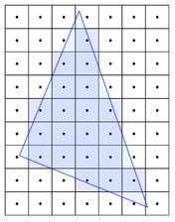
Rasterization
Rasterization is the process of breaking a primitive into discrete elements called fragments.
In short, it can be accomplished using signed distances to lines.
  Inside a triangle is considered to be the positive side of its edge.
  Compute signed distance from fragment center to each edge.
  If all three distances are positive, the fragment is inside the triangle.
There are faster ways.
  Tile based rasterization.
  Hierarchical rasterization.
Image courtesy of Wikibooks

Slide 47
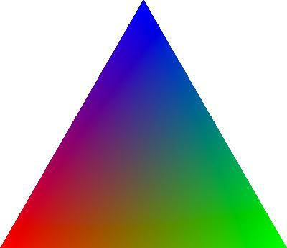
Interpolation
Outputs from the vertex shaders need to be interpolated over the entire primitive surface before being passed to the fragment shader.
It turns out for perspective correct result, you need to interpolate values over w.
For example, u / w or v / w.
Then multiply the interpolated result by w.
( 0, 0, 1 )
( 1, 0, 0 )
( 0, 1, 0 )
Image courtesy of Alec Jacobson

Slide 48
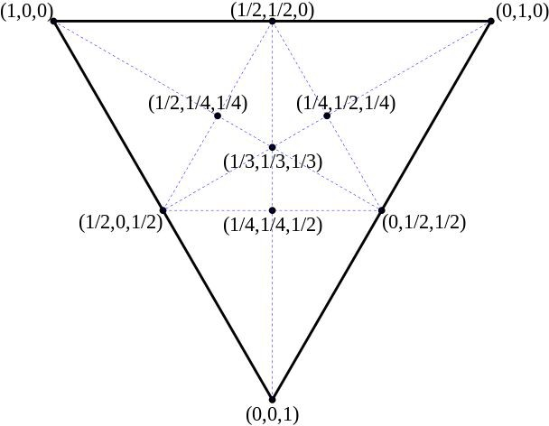
Barycentric Coordinates
Coordinates which describe a point within a simplex.
  Each value in the coordinate can be viewed as a percentage.
  Multiply/add each vertex by its corresponding coordinate to get interior point.
  For example, the center of a triangle has barycentric coordinates ( 0.33, 0.33, 0.33 )
  The centerpoint is the average of all three vertices.
Image courtesy of Wikipedia

Slide 49
Z/Stencil Tests
Shading multiple fragments for the same pixel is called overdraw.
  More overdraw means worse performance.
Early Z/Stencil tests can reject fragments from going to the fragment shader.
  Z test is also known as depth test.
  There are some conditions which prevent these early tests:
    Alpha blending
    Pixel shaders which reject based on depth
    Pixel shaders which write custom depth values
Late Z/Stencil tests are the original implementation.
  These tests occur after shading, so we may throw out completed work.

Slide 50
Programmable Pipeline
Vertex Specification
Vertex Shader
Tessellation
Geometry Shader
Vertex Post-Processing
Primitive Assembly
Rasterization
Fragment Shader
Per-Sampler Operations

Slide 51
Fragment Shaders
Modern fragment shaders perform:
  Lighting
  Complex post-processing
    SSAO
    Blur
    Depth-of-Field
    Bloom
    Anti-aliasing
  Texture sampling
  Normal distortions
  Color grading and tonemapping
  Downsampling

Slide 52
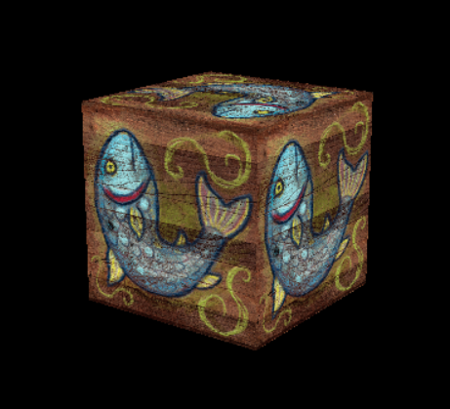

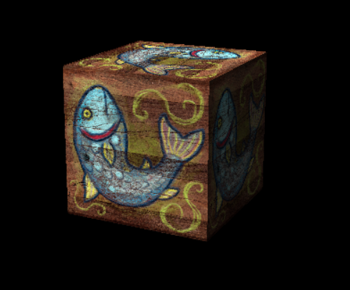
HW3 – Textured Cube
Unlit, textured cube
Unlit, Warhol conceptual art cube
Lit, textured cube

Slide 53
Tips and Tricks
Use transpose argument in your glUniform* calls for matrices if needed, instead of transposing the matrix manually
Binding textures
  OpenGL has multiple texture units (up to GL_MAX_COMBINED_TEXTURE_IMAGE_UNITS )
  To bind a texture, you’ll use the following API calls:
    glActiveTexture - Activates a texture unit.
    glBindTexture - Binds a texture resource to a texture target (different from unit).
    glUniform1i - Assigns the active texture unit to uniform location.
Clue: Pay very close attention to the type of the cube indices.
Vertex array objects wrap vertex and index buffers.
  So create and bind an array object first, then fill out buffers.
  Use the array object to recall buffer state at draw time.
When you have something drawing, use color to debug the rest.

