Slide 1
Game Architecture
3/8/18: Scripting

Slide 2
Today’s Agenda
What is scripting?
Wait… why are we doing this?
Some things to consider
Parser & generator concepts
Big topic: just enough to whet your appetite
Virtual machines
Integrating scripting with an engine
Visual script
Case study: Lua

Slide 3
What is Scripting?
Way of expressing (a portion of) game logic:
  AI
  Level mechanics
  UI behavior
  Weapons
  Etc.
Often:
  Higher level than engine language
  Allows faster iteration than core engine code
  Not performance critical
  More than half of ‘game code’ is script
Implementation:
‘Type-y’ language (e.g. Lua)
Visual programming (e.g. Unreal Blueprint)

Slide 4
Wait… why are we doing this?
Efficiency?
  Drops barriers for gameplay developers
  Updates on-the-fly without reloading the game
  High level / domain specific script can do more with less
  Memory; script can be easily loaded and unloaded
Flexibility?
  Player generated content
  Post-ship functional updates without 1st party approval
Robustness?
  Constrained script environment avoids OOM errors, NULL pointers, etc.

Slide 5
So a good engine must have a scripting system?
NO
A scripting system is complexity. Avoid it unless you really need it.
Small teams and small games often don’t need it.

Slide 6
Some things to consider
Coroutines & cooperative multithreading
Events vs polling
Safety
Role of script in the engine

Slide 7
Coroutines & Cooperative Multithreading
For example, some AI script:
// Initially idle
self.behavior = idle
// Wait until hurt
yield_until(self.health < 1)
// Go on the attack
self.behavior = attack

Slide 8
Events vs. polling
With events:
on(health_message msg):
if (self.health > 0.5 && msg.health <= 0.5) self.behavior = attack2
on(player_near msg):
if (self.behavior == idle) self.behavior = attack1
With polling:
update():
if (self.behavior == idle && player_near()) self.behavior = attack1
if (self.health <= 0.5 && last_health > 0.5) self.behavior = attack2
last_health = self.health
http://gameprogrammingpatterns.com/observer.html

Slide 9
Safety
Permit memory allocation?
Permit loops?
Invalidating references to objects?

Slide 10
Role of Script in the Engine
Range of responsibility:
Scripts are components on entities – extend interfaces
Scripts implement game state machine – own main loop

Slide 11
Parsers and Generators
A compiler for text based language...
Keywords & punctuators
Grammar
Source script
Lexer
Parser
Translator
Bytecode
Scope tree & Symbol table
Tokens
AST

Slide 12
Lexer
Our mission:
  Convert stream of characters into stream of tokens.
  One token per language keyword. E.g.; if, else, while, goto, int, etc.
  One token per language punctuator. E.g.; ++, ==, (, <, >>, etc.
  One token per constant type. E.g.; strings, floats, integers
  One token for some ‘identifier’
How we do it:
  LL(1) Recursive-Descent Lexer
  LL(1) = read from Left to right, visit children Left to right, 1 character lookahead
  Recursive = functions can call themselves
  Descent = top-down

Slide 13
LL(1) Recursive-Descent Lexer
char* lex_get_next( const char* stream, token_t* out_token,
const char** out_text, int* out_len)
{
char* p = skip_whitespace(stream);
if (!p) { *out_text = p; *out_token = token_eof; *out_len = 0; }
else if (strcmp(p, “if”) == 0) { *out_text = p; *out_token = token_if; *out_len = 2; }
else if (strcmp(p, “do”) == 0) { *out_text = p; *out_token = token_do; *out_len = 2; }
else if (is_digit(p)) { *out_text = p; *out_token = token_integer; *out_len = xxx; }
else if (is_nondigit(p)) { *out_text = p; *out_token = token_ident; *out_len = xxx; }
else if (*p == ‘+’) { *out_text = p; *out_token = token_plus; *out_len = 1; }
return p + *out_len;
}

Slide 14
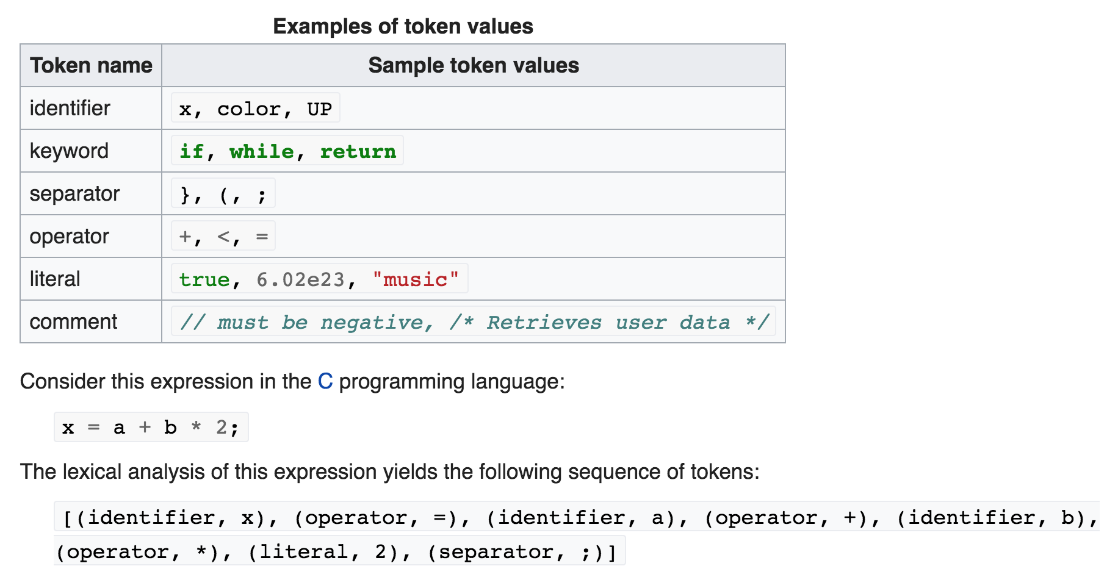
Lexer

Slide 15
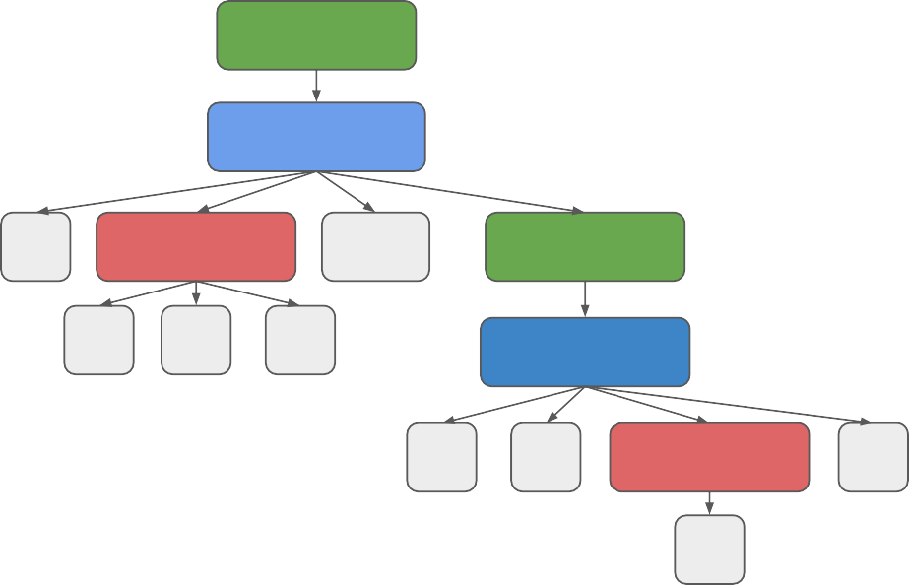
Parser
Our mission:
Recognize language phrases
Convert a list of tokens into an abstract syntax tree (AST)
statement
if x<0 then x=0;
  expression expression
if-statement
assignment
if
expression
then
statement
statement
x
<
0
assignment
if-statement
x
=
expression
;
statement
0

Slide 16
LL(k) Recursive-Descent Parser
void statement()
{
ast_emit(node_statement);
if parse_match(token_if) if_statement(); else assignment();
}
void expression() { /* stuff */ }
void assignment()
{
ast_emit(node_assignment); parse_ensure(token_identifier); parse_ensure(token_equal); expression();
}
void if_statement()
{
ast_emit(node_if_statement); expression(); parse_ensure(token_then); statement();
}

Slide 17
Translation
Our mission:
  Convert AST into bytecode for virtual machine
Implementation:
  Repeated AST walks
  Build scope tree
  Gather symbols and resolve
  Emit bytecode

Slide 18
Walking the AST
Usually depth first traversal
  Sometimes looking for node of a particular type (e.g. all assignment nodes)
  Sometimes looking at structure of subtrees
As each node is visited, can perform action:
  On the way down
  On the way up

Slide 19
Symbol tables
Walk AST looking for identifier declarations
Create entry in a table for each unique declaration
  Variable symbols
  Function symbols
  Struct/class symbols
  Enum symbols
  Built-in symbols

Slide 20
Scope trees
Walk AST looking for constructs that introduce scope
  Global scope
  Namespace scope
  Class scope
  Function scope
  Local scope
Create a tree of scopes
Resolve symbol by searching up in the scope tree

Slide 21
Scope Tree Example
int i = 42;
GlobalScope
symbols = [int, void, i, f, g]
int f(int x, int y)
{
int i;
{ int z = x+y; i = z; }
{ int z = i+1; i = z; } return i;
}
FunctionScope symbols = [x, y]
FunctionScope symbols = []
LocalScope symbols = [i]
LocalScope symbols = []
LocalScope symbols = [z]
LocalScope symbols = [z]
void g()
{
f(i, 2);
}

Slide 22
Generating Bytecode
Walk the AST and generate a stream of virtual machine instructions
Use scope tree and symbol table to reserve virtual stack/registers
Heavily dependent on virtual machine architecture

Slide 23
Virtual Machines
A virtual CPU with a made up instruction set that runs our script.
  Easy to target (vs real CPU).
  Fast enough (pack instructions tight).
Two flavors:
  Stack based
  Register based

Slide 24
Stack Based
iconst
iconst
iadd
1 ; Push integer 1 on stack
2 ; Push integer 2 on stack
; Pop & add from stack
; Push result on stack
; Pop & print top of stack
print

Slide 25
Register Based
iload r1, 1 |  | ; | Put int | 1 | in | r1
iload r2, 2 |  | ; | Put int | 2 | in | r2
iadd r3, r1, | r2 | ; | r3 = r1 | + | r2
print r3 |  | ; | Print r3

Slide 26
The Big Switch of Doooooom
switch (*bytecode++)
{
case opcode_iload: stack.push_int_from_mem(bytecode); bytecode += sizeof(int);
break;
case opcode_iadd:
stack.push_int(stack.pop_int() + stack.pop_int());
break;
case opcode_print:
switch (stack.top().type())
{
case type_int:
vm_printf(“%d\n”, stack.pop_int());
break;
}
}

Slide 27
Integrating scripting with an engine
Our engine/script binding must allow:
  Engine to invoke script functions
  Script to invoke engine functions
  Script to use engine defined structures
And nice to have:
  Engine able to work with script structures
  Script is able to be updated on-the-fly
Notes:
Engine able to work with script structures -> A dynamic type system, engine-side? Ouch.

Slide 28
Engine to Invoke Script Functions
In script:
script_add(x, y):
return x + y;
In engine:
int engine_add(int x, int y)
{
vm_func_t func = vm_getfunc(“script_add”); vm_call_t call = vm_new_call(func); call.push_arg_int(x); call.push_arg_int(y);
vm_run(call);
return call.pop_return_int();
}

Slide 29
Script to Invoke Engine Functions
int engine_add(int x, int y)
{
return x + y;
}
void vm_init()
{
vm_register_func(engine_add_wrapper);
}
void engine_add_wrapper(vm_call_t* call)
{
int result = engine_add(
  call->pop_arg_int(),
call->pop_arg_int());
call->push_return_int(result);
}

Slide 30
Script to Use Engine-Defined Structures
struct foo
{
int x;
float y;
};
void vm_init()
{
vm_struct_t s = vm_new_struct(“foo”); s.add_field(“x”, type_int); s.add_field(“y”, type_float);
}

Slide 31
Final Thoughts on Script/Engine Integration
Binding script to engine is lots of boilerplate code
Some engines have custom header file preprocessors
  Generate script binding boilerplate automagically
Some engines use a mix of C preprocessor macros and typing
Some engines just do it all by hand
Depends on size of engine, extent of script usage, etc.

Slide 32
Case Study: Lua
Handwritten recursive descent parser
No AST, just emit bytecode during parse
Register based VM
Instruction width is 32 bits

Slide 33
Lua 5 Instruction Set

Slide 34
Lua Likes Tables
In Lua, lots of things are tables (associative arrays):
  Vectors
  Maps
  Objects
  Modules…
For example:
Point = { x=5, y=10 }
print(Point[“x”], Point[“y”])

Slide 35
Lua Reference
https://www.lua.org/manual/5.1/

Slide 36
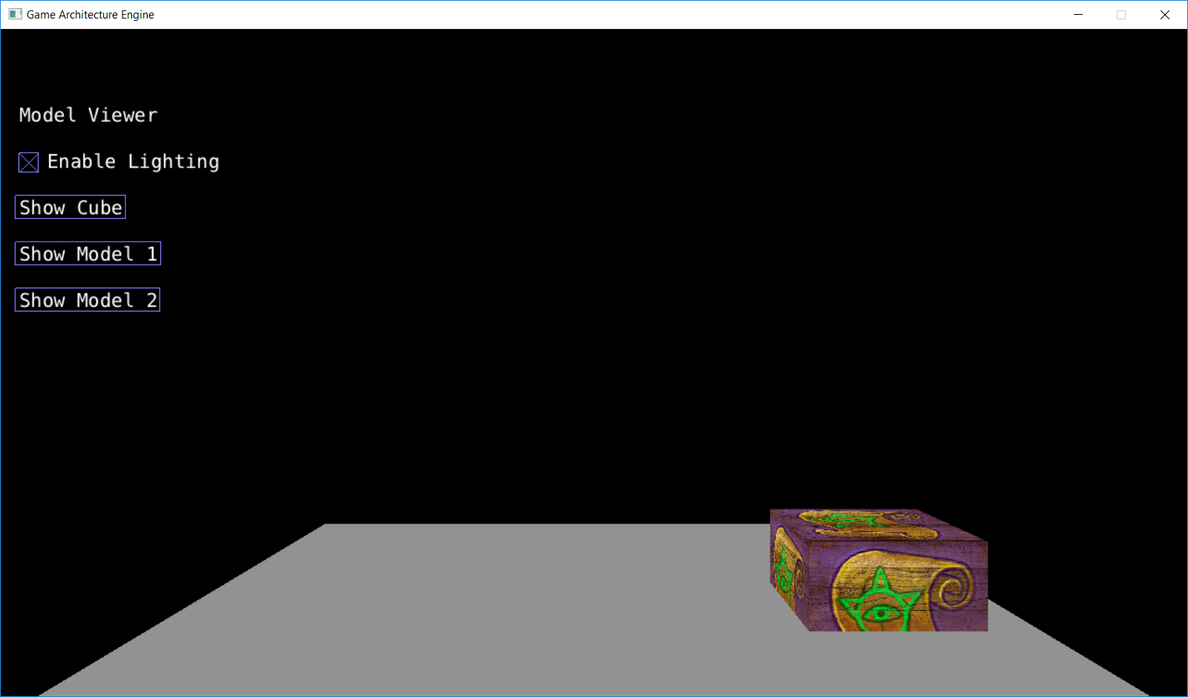
Lua example
function update (component, frame_params)
if frame_params_get_input_left(frame_params) then
entity = component_get_entity(component)
entity_translate(entity, -0.1, 0.0, 0.0)
end
if frame_params_get_input_right(frame_params) then
entity = component_get_entity(component)
entity_translate(entity, 0.1, 0.0, 0.0)
end
end
Gets keyboard input, moves and entity left and right.
Use IJKL to keys to move. (right now just J and L)
Ignore the fact that the cube is sinking into the floor, we can deal with that later, just translate it up or translate the floor down

Slide 37
To call the lua function, we push the function and its arguments onto the lua call stack.
void ga_lua_component::update(ga_frame_params* params)
{
lua_getglobal(_lua, "update");
lua_pushlightuserdata(_lua, this);
lua_pushlightuserdata(_lua, params);
int status = lua_pcall(_lua, 2, 0, 0);
}
lua_getglobal() finds a lua function by name and pushes it onto the stack
lua_pushlightuserdata() pushes a pointer to some data onto the stack
int lua_pcall (lua_State *L, int nargs, int nresults, int errfunc);
Calls the function in protected mode. Errfunc is a call stack index to an error handler function.

Slide 38
binding a lua function to a C++ function
lua_register(_lua, "frame_params_get_input_left", lua_frame_params_get_input_left);
lua_touserdata() gets data from the lua stack by index
To return data back to lua, push it onto the stack
int ga_lua_component::lua_frame_params_get_input_left(lua_State* state)
{
  int arg_count = lua_gettop(state);
  ga_frame_params* params = (ga_frame_params*)lua_touserdata(state, 1);
  lua_pushboolean(state, (params->_button_mask & k_button_j) != 0);
}

Slide 39
int ga_lua_component::lua_entity_translate(lua_State* state)
{
int arg_count = lua_gettop(state);
ga_entity* ent = (ga_entity*)lua_touserdata(state, 1);
ga_vec3f vec;
vec.x = (float)lua_tonumber(state, 2);
vec.y = (float)lua_tonumber(state, 3);
vec.z = (float)lua_tonumber(state, 4);
ent->translate(vec);
return 0;
}
entity_translate(entity, 0.1, 0.0, 0.0)

