Slide 1
Game Architecture
Main Loop and a little bit about entities

Slide 2
Today’s Agenda
What’s this main loop thing?
A simple main loop
Handling time
Handling ‘modes’
A little bit about game objects and entities
Multicore main loop
Job systems
First homework assignment

Slide 3
What’s this main loop thing?
User input
Incoming network traffic
Image on screen
Time elapsed
Compute frame t
Audio output
State of game at frame t-1
Outgoing network traffic
Operating system state

Slide 4
Player holds button A down
User input
Incoming network traffic
Image on screen
Time elapsed
Compute frame t
Audio output
State of game at frame t-1
Outgoing network traffic
Operating system state

Slide 5
User input
Server sent us a new snapshot
Incoming network traffic
Image on screen
Time elapsed
Compute frame t
Audio output
State of game at frame t-1
Outgoing network traffic
Operating system state

Slide 6
What’s this main loop thing?
User input
16.7 ms has elapsed
Image on screen
Time elapsed
Compute frame t
Audio output
State of game at frame t-1
Outgoing network traffic
Operating system state

Slide 7
What’s this main loop thing?
User input
Incoming network traffic
Image on screen
Level 6 is loaded. Player
1’s health is 23 and
position is 1021, 200.
Compute frame t
Audio output
State of game at frame t-1
Outgoing network traffic
Operating system state

Slide 8
What’s this main loop thing?
User input
Incoming network traffic
Image on screen
Time elapsed
Compute frame t
Audio output
OS Reports it is low on memory
Outgoing network traffic
Operating system state

Slide 9
What’s this main loop thing?
User input
Gather input. Run simulation. Dispatch to graphics and audio rendering.
Incoming network traffic
Image on screen
Time elapsed
Compute frame t
Audio output
State of game at frame t-1
Outgoing network traffic
Operating system state

Slide 10

What’s this main loop thing?
User input
Incoming network traffic
Image on screen
Time elapsed
Compute frame t
Audio output
State of game at frame t-1
Outgoing network traffic
Operating system state

Slide 11

What’s this main loop thing?
User input
Incoming network traffic
Image on
screen
Time elapsed
Compute frame t
Audio output
State of game at frame t-1
Outgoing network traffic
Operating system state

Slide 12
What’s this main loop thing?
User input
Incoming network traffic
Image on screen
Time elapsed
Compute frame t
Send Player 1 Button A hold to server
State of game at frame t-1
Outgoing network traffic
Operating system state

Slide 13
What’s this main loop thing?
User input
Incoming network traffic
Image on screen
Time elapsed
Compute frame t
Audio output
State of game at frame t-1
Outgoing network traffic
Operating system state
Do it all over again for frame t+1.

Slide 14
Simple main loop
while (true) { time_update(); input_update();
if (os_handle_events() == k_exit) break; sim_update();
graphics_update(); audio_update();
}

Slide 15
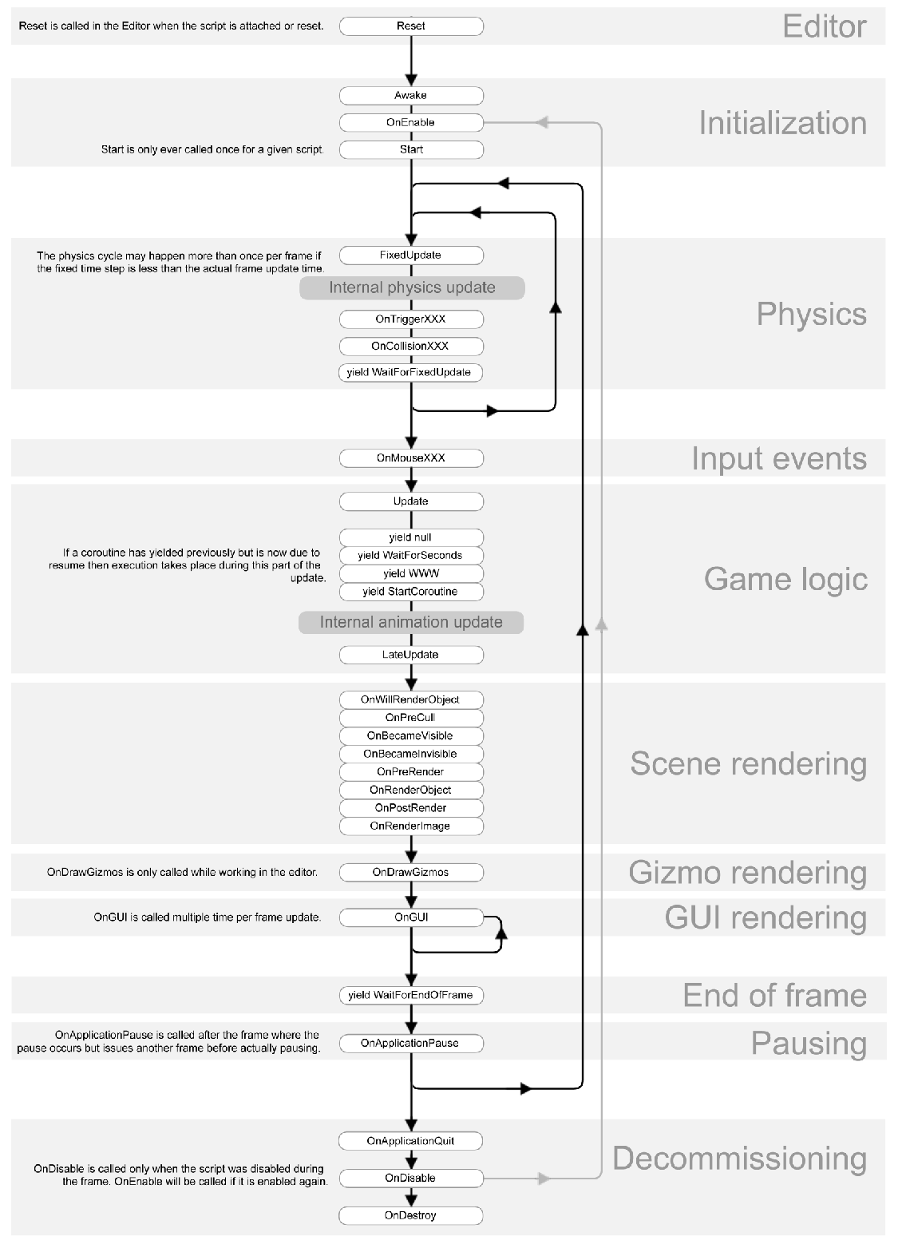
Notes:
Unity Monobehaviour (as of 2017.3)

Slide 16
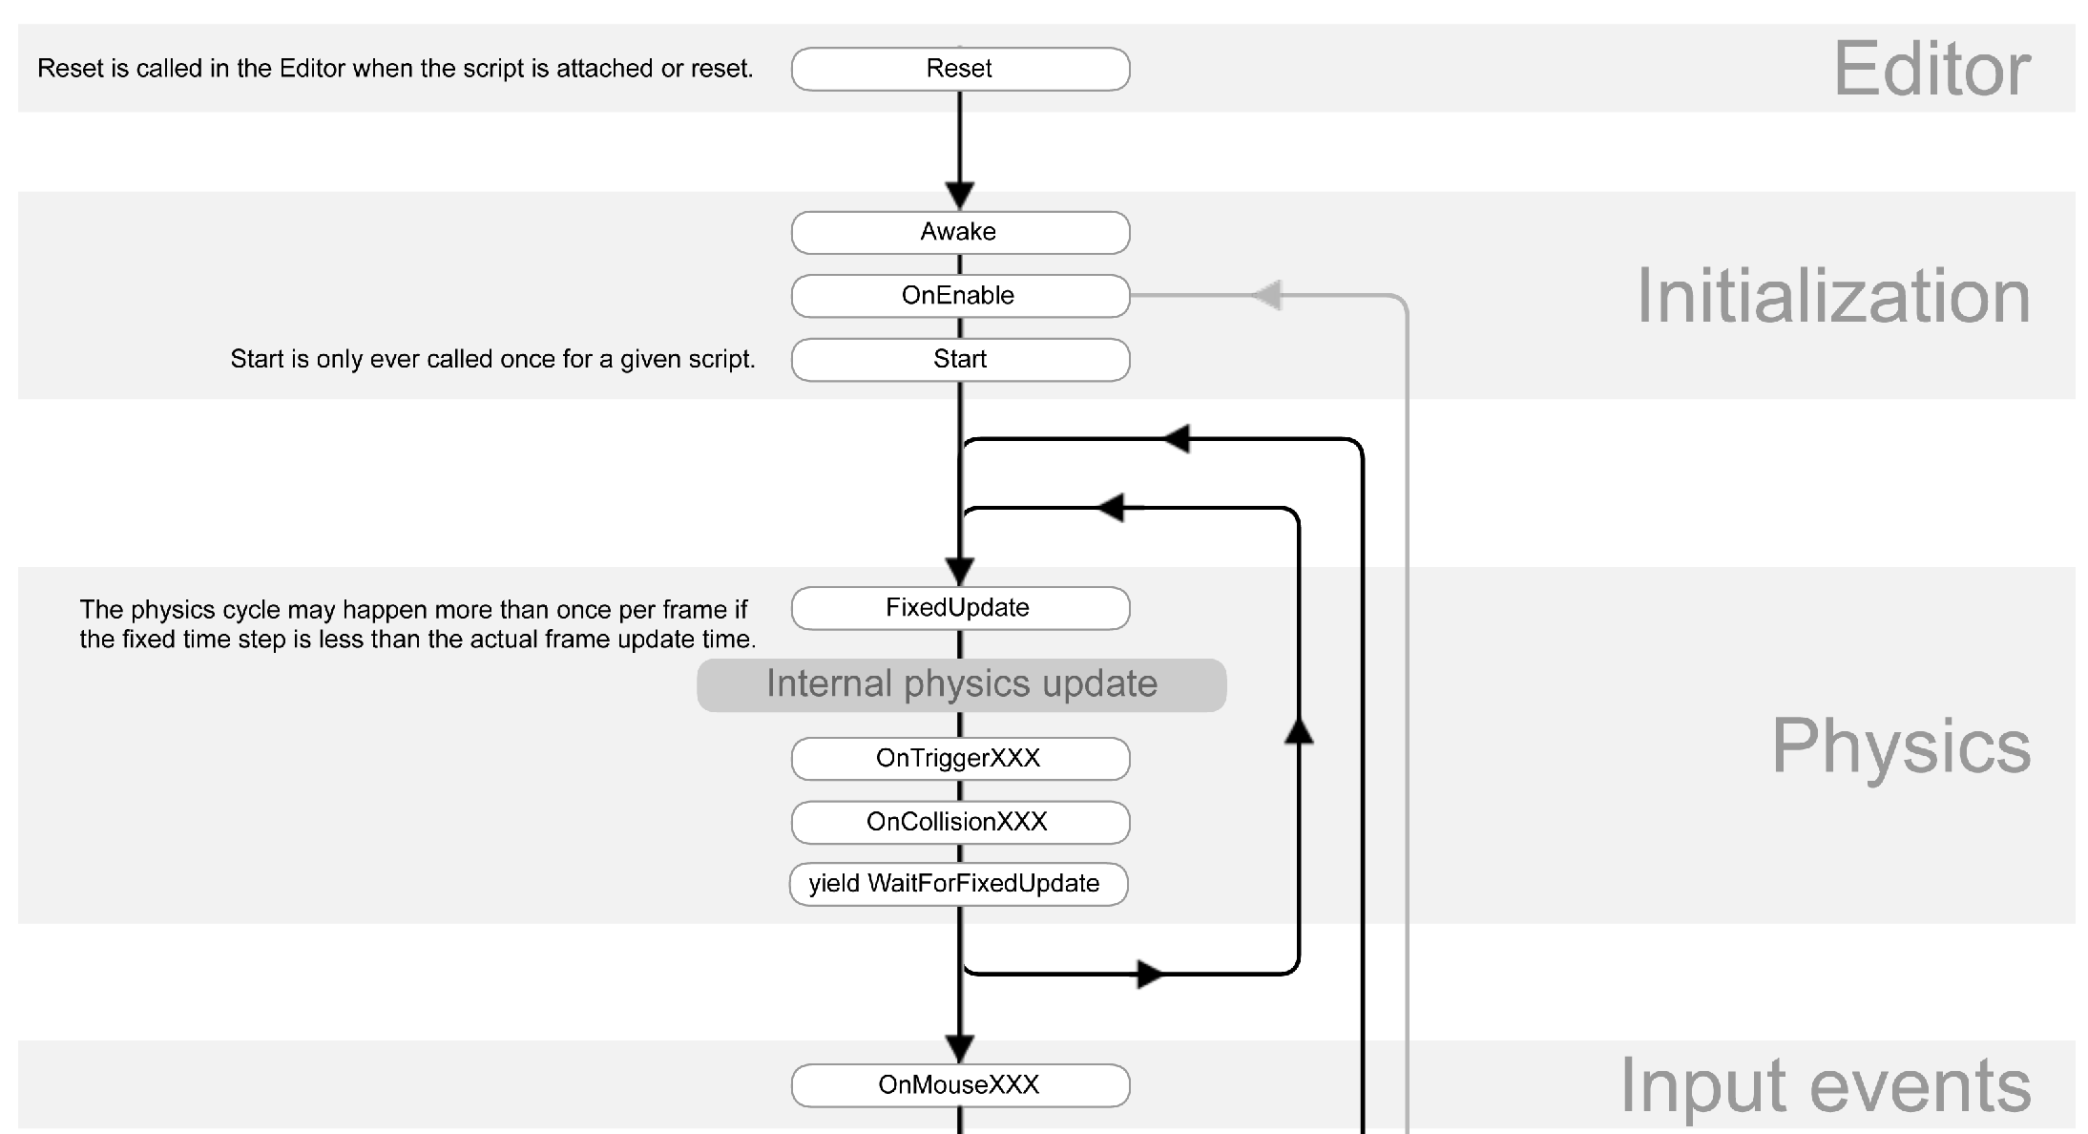

Slide 17
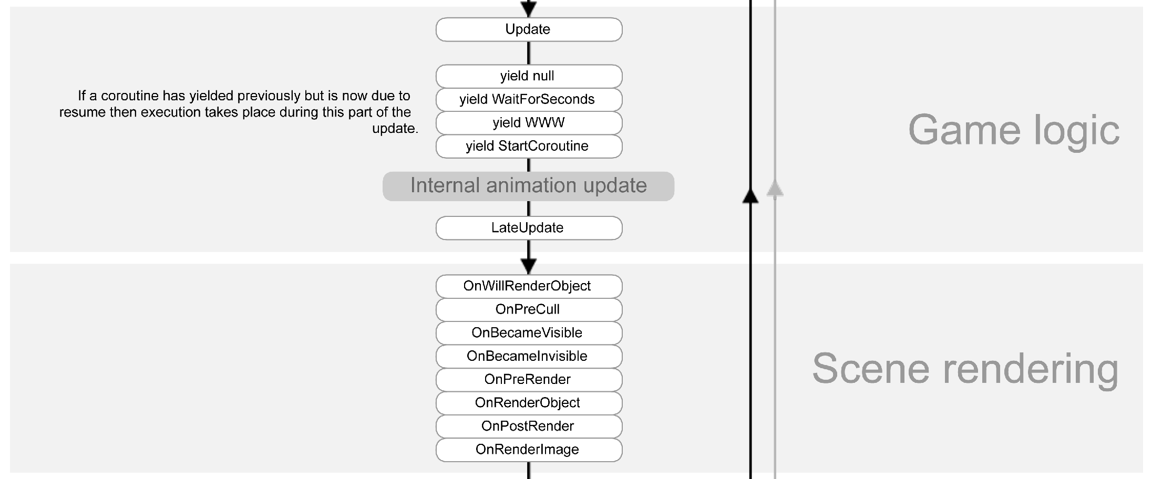

Slide 18
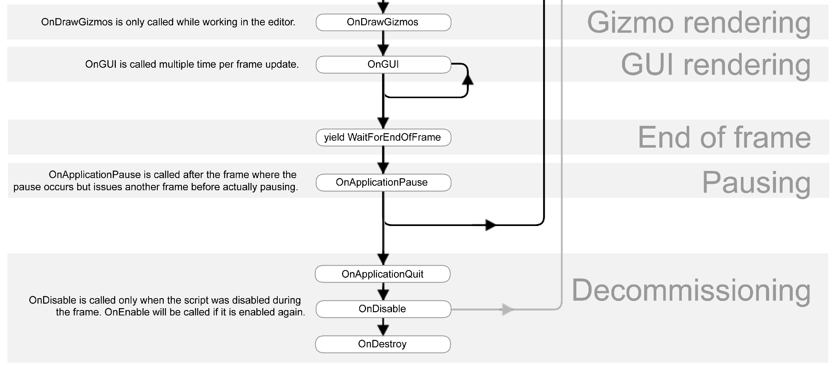

Slide 19
Time
Importance and relevance
Common terms
Measuring time
Time transformed
Game systems using time
Delta time considerations

Slide 20
Time
Importance and relevance
Common terms
Measuring time
Time transformed
Game systems using time
Delta time considerations
For many types of games, we aim to:
Minimize lag between user input and action on screen
Maximize sampling rate so the user can better perceive game environment (smoothness)
Proper treatment of time is critical to achieving these goals.

Slide 21
Time
Importance and relevance
Common terms
Measuring time
Time transformed
Game systems using time
Delta time considerations
Frame rate measured in Hertz.
Frame time, or delta time, measured in
milliseconds.
V-sync, or synchronizing game update with monitor refresh rate*.
Frame rate spike, or sudden change in frame rate resulting in poor game feel.
Clock wrap, or the current time overflowing its storage and cycling back to zero.
Clock drift, or a timer slowly diverging from the true time (faster or slower).

Slide 22
Time
Importance and relevance
Common terms
Measuring time
Time transformed
Game systems using time
Delta time considerations
Often:
High resolution timer that ticks once per CPU cycle (e.g. 3 billion times per second on a 3Ghz CPU).
Store absolute high resolution time 64-bit integers.
Store small durations in 32-bit floats.
Be aware of precision limitations.
Watch for drift between processors on multicore systems.

Slide 23
Time
Importance and relevance
Common terms
Measuring time
Time transformed
Game systems using time
Delta time considerations
Hierarchy of timers:
Wall clock time
Application time
Gameplay time
Animation time
Use bias and scale to transform between timers. Some lower level timers can be artificially scaled, paused, etc as needed by game design.

Slide 24
Time
Importance and relevance
Common terms
Measuring time
Time transformed
Game systems using time
Delta time considerations
Don’t have to update all systems every frame:
Graphics: once per frame
AI: 5Hz?
Physics: 120Hz?
For systems that update, need to know how much time to simulate. Often just use delta time since for last frame.
This isn’t without its issues...

Slide 25
Time
Importance and relevance
Common terms
Measuring time
Time transformed
Game systems using time
Delta time considerations
Last frame’s delta time is just a guess of this frame’s actual delta time.
Systems that require high frequency update can be difficult. The slower the frame, the more updates they require, making the frame still slower…
Mobile platforms have a battery. Running at full speed burns battery faster.
Consider:
Clamping delta time to acceptable range
Using floating mean to estimate delta time, or even fixed time step

Slide 26
Modes
Games have a lot of modes of operation. Some introduced by us:
Startup sequence
Frontend menu
Loading a level
Playing level
At pause menu…
Some forced upon us by operating system:
Running in foreground or background
Running with full system resources, running in constrained way

Slide 27
Modes 2
Certain game systems only run in certain modes
Structure of main loop varies mode-to-mode
A good main loop cleanly describes mode specific behavior and transitions.

Slide 28
Modes: One Approach
Stack based state machine:
Frame computation, sim_update() , is actually a FSM with stack
States can be activated (pushed) and deactivated (popped)
State at the top of stack is executed each frame
void sim_update()
{
switch (top_state)
{
case k_state_menu : do_menu(); break; case k_state_play : do_gameplay();
break;
case case
}
}
k_state_load : do_load(); break; k_input_unplugged : do_unplugged();
void do_gameplay()
{
if (is_input_unplugged())
{
state_push( k_input_unplugged ); return;
}
// ...
}

Slide 29
A brief diversion on game objects and entities

Slide 30
Single-Rooted Hierarchy
class Entity
{
virtual void Display(void) = 0;
virtual void Update(float dt) = 0;
};
class Character : public Entity
{
void Display(void);
void Update (float dt);
};
Notes:
probably most intuitive. Seems simple at first…

Slide 31
Single-Rooted Hierarchy
Some base class of entities with virtual functions for common interfaces
  Update(time), GetPosition(), etc.
All individual entities derived from this class
  e.g. Entity —> Character —> NPC
Subsystems keep list of entities that we care about
  But only need to know about base classes and/or specializations that are specific to that subsystem
Notes:
probably most intuitive. Seems simple at first…

Slide 32
GameObject
MoveableObject
...
RenderableObject
...
Pac-Man
Ghost
Pellet
...
PowerPellet
Notes:
our intuition often wants to classify objects into a taxonomy, and a class hierarchy is the most straightforward way to represent a collection of interrelated types, and it is very common to see. The root object contains the functionality that all objects require, such as RTTI (runtime type idenification), reflection, and abstract construction (which allows instances to be created without hardcoding the name of the class - useful for serialization, which all game objects need) MovableObjects have a transform component, RenderableObjects have a draw function, etc. When the hierarchy is this simple, it’s a powerful way to describe the collection of objects. But they grow, and they deepen...

Slide 33

Vehicle
LandVehicle
WaterVehicle
Motorcycle
SpeedBoat
Car
Yacht
Truck
AmphibiousVehicle
Skiff
?
Notes:
this structure seems logical, but what happens when the design team announces that the game needs an amphibious vehicle? The programmers will often hack it into the hierarchy in ugly and error-prone ways. You could use multiple inheritance, which seems to work in theory, but most(?) programmers find that the difficulties outweigh the benefits, and is often banned at game studios. The deadly diamond is quite real (when an object contains multiple copies of its base class’s members)
-The platypus (Ornithorhynchus anatinus) also known as the duck-billed platypus is a semiaquatic egg-laying mammal endemic to eastern Australia, including Tasmania. Together with the four species of echidna, it is one of the five extant species of monotremes, the only mammals that lay eggs instead of giving birth

Slide 34
Component
+GetType()
+IsType()
+ReceiveEvent()
+Update()
GameObject
*
Transform
AnimationController
RigidBody
MeshInstance
Notes:
a more flexible way, but trickier to implement (game object must be written in a totally generic way) is to provide the root object with a generic linked list of components, which derive from a common base class
asterisk indicates zero or more instances (e.g. linked list)
we can iterate over the list and perform polymorphic operations - also allows the root to be oblivious to available types, and lets us create new components without modifying the root
in addition, now game objects can contain an arbitrary number of instances of each type of component

Slide 35
Component-Based Entities
class EntityComponent
{
virtual unsigned GetID() = 0;
}
class Renderable : public EntityComponent
{
unsigned GetID();
void Update(float dt);
}
class CharacterAI: public EntityComponent
{
unsigned GetID();
void Update(float dt);
}
class Entity
{
void AddComponent(EntityComponent*);
EntityComponent* GetComponent(unsigned id);
}
Notes:
sounds great! but…

Slide 36
Component-Based Entities
Generalization of ownership system
  Entity is a generic collection of subobjects
  Like ownership, but without knowledge of types of owned objects
  Components can be fetched via name or managed by the interested subsystem
Much more flexible than code-driven hierarchies
  Can add/remove components on the fly
  Can build entities from components via script
Notes:
sounds great! but…

Slide 37
Component-Based Entities
Complicated, can be slow
Communicating with and between components can be inconvenient
Need sophisticated systems for
  Updating components
  Communicating between components
  Sharing data between components
Don’t derive components from anything other than base components
  Otherwise you’re recreating the fragile hierarchy that we’re trying to get away from
Notes:
1) lots of virtual method calls (dynamic dispatch)- on each component, not just on each entity

Slide 38
Back to the mainloop

Slide 39
Multicore
Most games run on multicore CPUs
Common core counts today range from 2 to 8+
We probably want to use those cores
We have a few options:
  Preserve the high level sequential nature of the main loop, go wide within sim and output
  Go fully asynchronous and process all phases of main loop in parallel
  A hybrid approach

Slide 40
Go Wide
What it looks like:
  Inside sim phase:
    Run game logic in parallel
    Solve physics in parallel
  Inside output phase:
    Build command buffers in parallel
    Evaluate audio in parallel
Advantage:
  Isolates multicore usage -- less code has to be thread safe
  Possibly easier to comprehend
Disadvantage:
  Somewhat limited ability to scale
  Bubbles in computation in a single task/job define the critical path

Slide 41
Go Fully Asynchronous
Image on screen
User input
Incoming network traffic
Compute frame t
Queue
Queue
Audio output
Outgoing network traffic
Time elapsed

Slide 42
Go Fully Asynchronous
What it looks like:
  Queues between phases
    Input frame t, sim frame t-1, output frame t-2
  Wide computation within phases
Advantage:
  Scales up and down reasonably well
Disadvantage:
  All code is potentially running in parallel
For example: Destiny

Slide 43
Hybrid Approach
Image on screen
User input
Incoming network traffic
Compute frame t
Queue
Audio output
Outgoing network traffic
Time elapsed

Slide 44
Hybrid Approach
What it looks like:
  Queues between phases sim and output
  Ad-hoc wide computation within phases
Middle ground between wide only, and fully async
For example: Skylanders SuperChargers

Slide 45
Doing the Work
Assuming we want to do something multicore, how do we implement it?

Slide 46
Doing the Work
Assuming we want to do something multicore, how do we implement it?
Spin up some purpose built threads
  Works great for I/O bound work, but doesn’t scale to arbitrary core counts

Slide 47
Doing the Work
Assuming we want to do something multicore, how do we implement it?
Spin up some purpose built threads
  Works great for I/O bound work, but doesn’t scale to arbitrary core counts
Divide work into units (jobs, tasks) and schedule across available cores
  Job queue
    Dispatch work FIFO order

Slide 48
Doing the Work
Assuming we want to do something multicore, how do we implement it?
Spin up some purpose built threads
  Works great for I/O bound work, but doesn’t scale to arbitrary core counts
Divide work into units (jobs, tasks) and schedule across available cores
  Job queue
    Dispatch work FIFO order
  Task graph
    Account for dependencies between work in a DAG of work
    Schedule only when dependencies have been fulfilled

Slide 49
Doing the Work
Assuming we want to do something multicore, how do we implement it?
Spin up some purpose built threads
  Works great for I/O bound work, but doesn’t scale to arbitrary core counts
Divide work into units (jobs, tasks) and schedule across available cores
  Job queue
    Dispatch work FIFO order
  Task graph
    Account for dependencies between work in a DAG of work
    Schedule only when dependencies have been fulfilled
  Job system
    Dispatch work FIFO order, but allow jobs to wait on other jobs
    Dependencies are implicit in control flow

Slide 50
Doing the Work
Assuming we want to do something multicore, how do we implement it?
Spin up some purpose built threads
  Works great for I/O bound work, but doesn’t scale to arbitrary core counts
Divide work into units (jobs, tasks) and schedule across available cores
  Job queue
    Dispatch work FIFO order
  Task graph
    Account for dependencies between work in a DAG of work
    Schedule only when dependencies have been fulfilled
Job system
  Dispatch work FIFO order, but allow jobs to wait on other jobs
  Dependencies are implicit in control flow

Slide 51
Job System
"Parallelizing the Naughty Dog Engine Using Fibers", Christian Gyrling
Components
  One thread per core
  Fiber pool sufficient for one fiber per queued/active job
  Job queue
  Waiting list
Threads are the compute resource, fibers are the context
User adds work to shared job queue
User waits for job by pushing self to wait list, switching to scheduler fiber
Scheduler:
  Pops ready work off wait list and switches to its fiber
  Pops work off job queue, assigns fiber, and switches to that fiber

Slide 52
Job System
void child_job_func(void* data() { /* ... */ }
void parent_job_func()
{
job_decl decls[100]; decls[...].function = child_job_func; decls[...].data = child_job_data;
int counter;
job_run(decls, 100, &counter); job_wait(&counter);
}

Slide 53
First homework
Sequential main loop with wide sim phase
Use job system to simulate all game objects in parallel
  For homework, you will write a key component, the thread-safe queue that holds work
Simple component-based entity system
  Discussed more next class
Let’s walk through the code together...

Slide 54
Summary
Structure of the main loop
Time
Modes
Multicore options and a job system

Slide 55
End Lecture
http://gdcvault.com/play/1022186/Parallelizing-the-Naughty-Dog-Engine

