Slide 1
Community Site Proposal
I don't have time to make a LaTeX presentation, so this will have to suffice.
Charles

Slide 2
Summary
We talked about having “badges” of a sort that students could earn. We also wanted to encourage students to partake in challenges. Although it might be possible to include this in a “gallery”, which is what the current site is, there is a much more ambitious and interactive approach that can be taken.

Slide 3
Summary
What I propose is using the “cultural” part of this project to lead into a broader STEM topic. This will be done by using tools like the “tutorials” in the Cornrow Curves application to teach students concepts, and as they learn the concepts they unlock features that can be used in the “sandbox” mode, which would be similar to what we have

Slide 4
The best way to illustrate...
Is with pictures. Therefore, I drew a number of pictures that show what I'm envisioning the final project look like. Getting from where we are to there will be long and difficult, and this is just a rough idea, but I feel that it gives a clear direction.

Slide 5
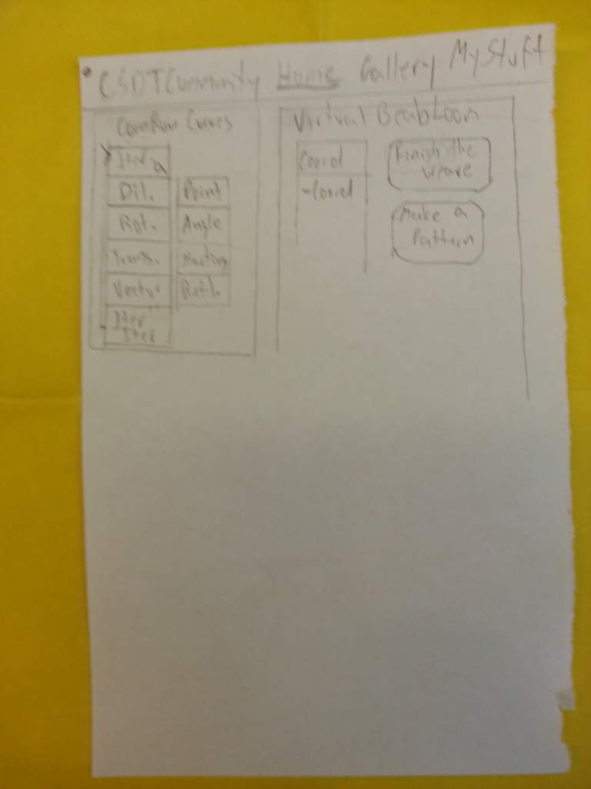
Image 1
This first pictures shows the page the user is shown after they log in
Assume the user clicks on “Iteration”, under the CC section

Slide 6
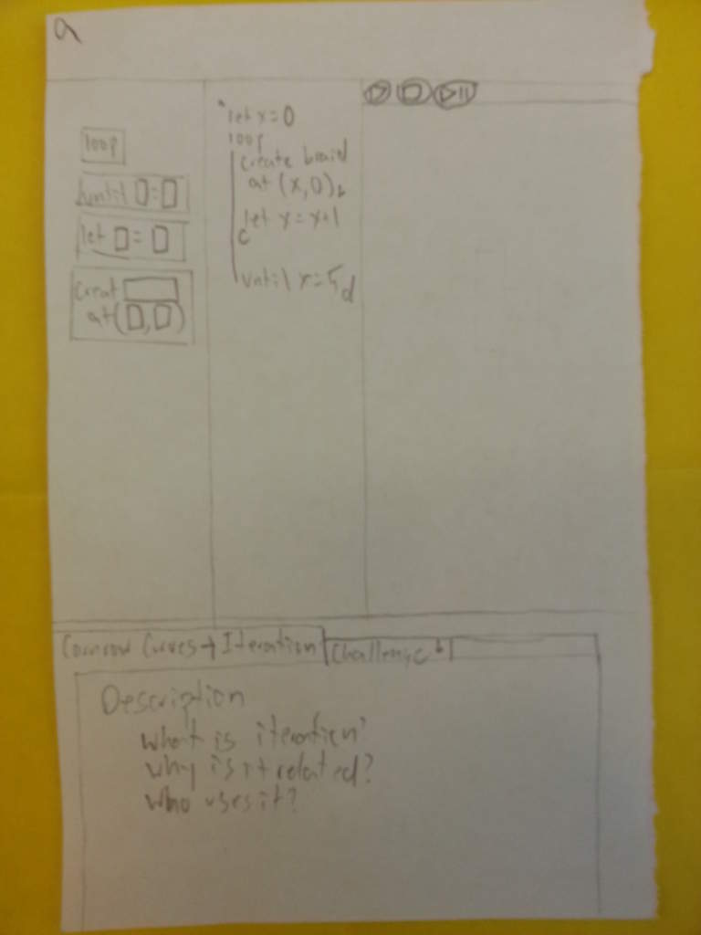
Image 2
This image shows the “application” that user will use. This is basically the pCSDT, with several things hidden.
After it's finished loading, they can read the description (cultural link), then a wizard will start

Slide 7
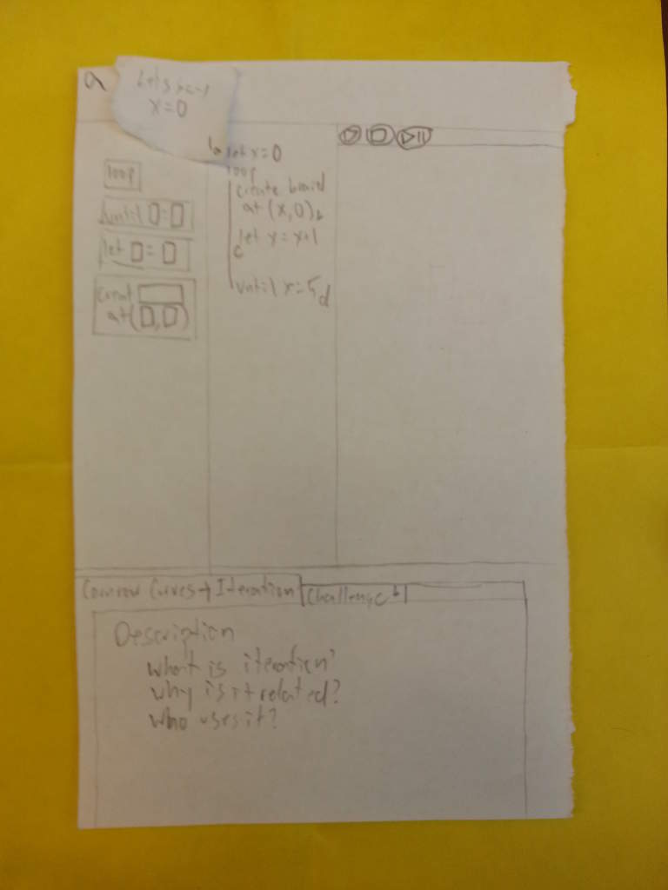
Image 3
If you look carefully, you can see my version of a popup box near the top. This box describes one of the codelets to the student. The language may need to be change
The student clicks the “next-step” button, which should be blinking

Slide 8
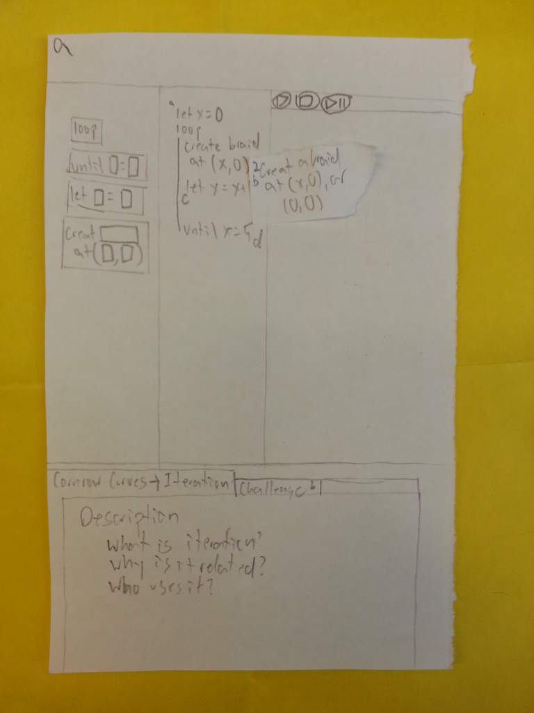
Image 4
The code advances one step, and the wizard describes the next codelet
User clicks blinking next-step button

Slide 9
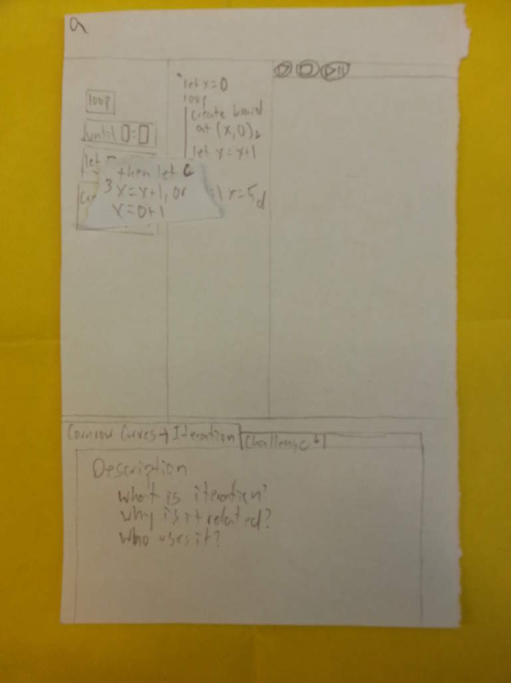
Image 5
More description. It substitutes variables with what is actually going on.
Next-step

Slide 10
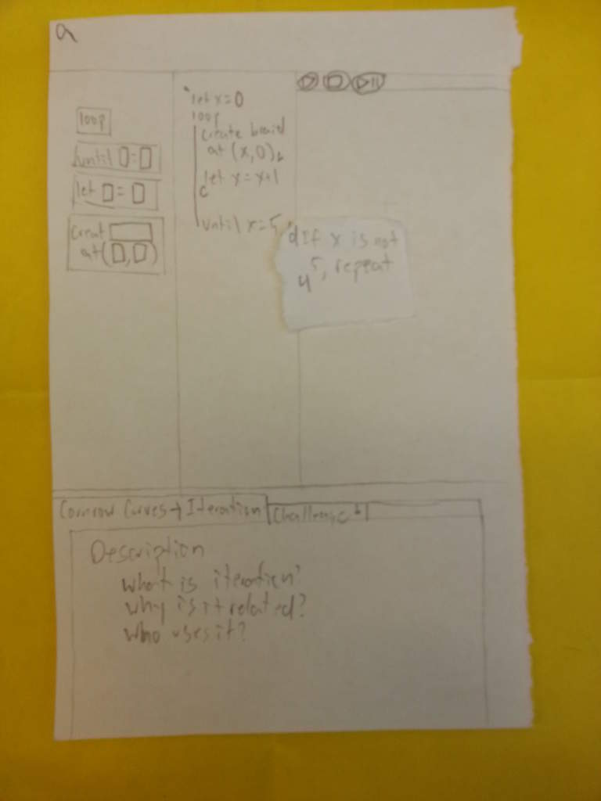
Image 6
The “stage” area should be updating as this happens
Next-step

Slide 11
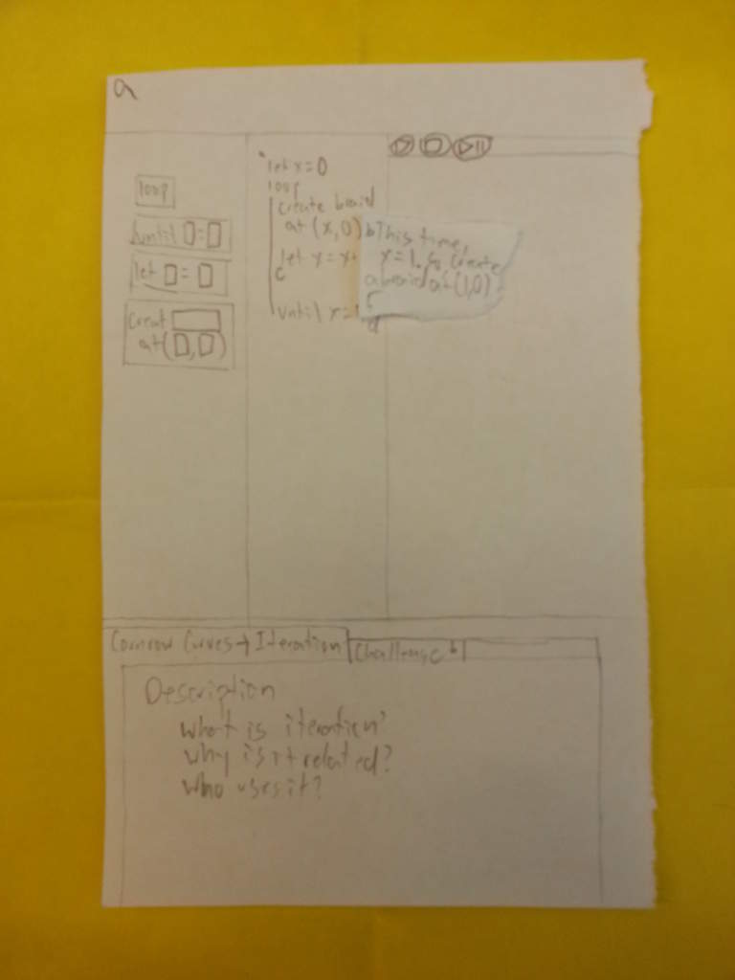
Image 7
Note that this popup contains different information than the previous one
Next-step

Slide 12
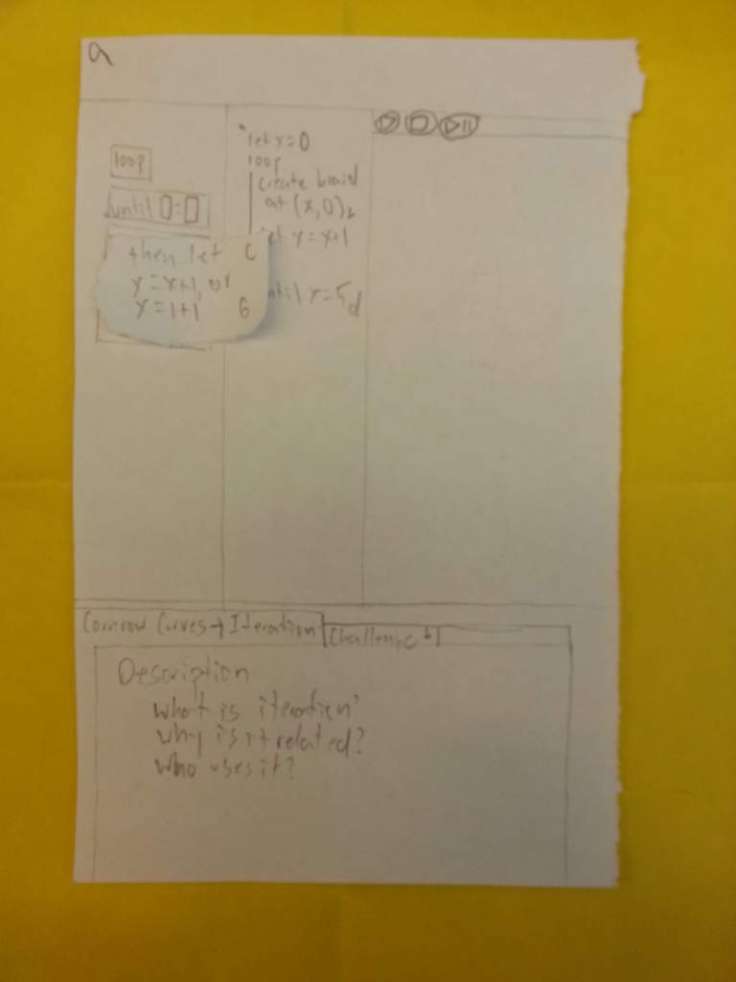
Image 8
Blarg.
Next-step

Slide 13
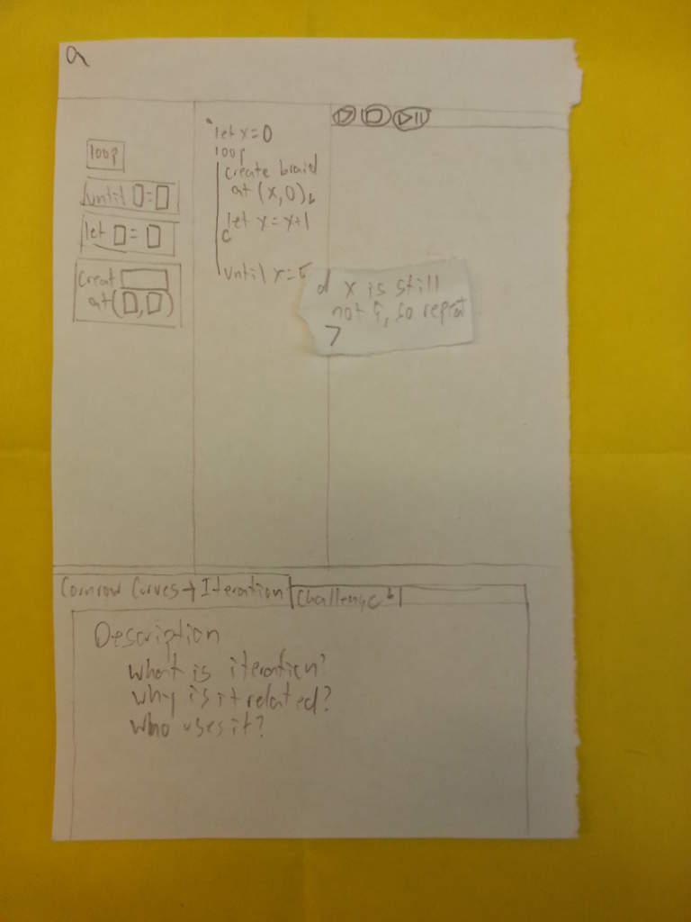
Image 9
This will be the last slide showing this feature.
Every level would begin with things like this. Technical words will be tied to the cultural description below

Slide 14
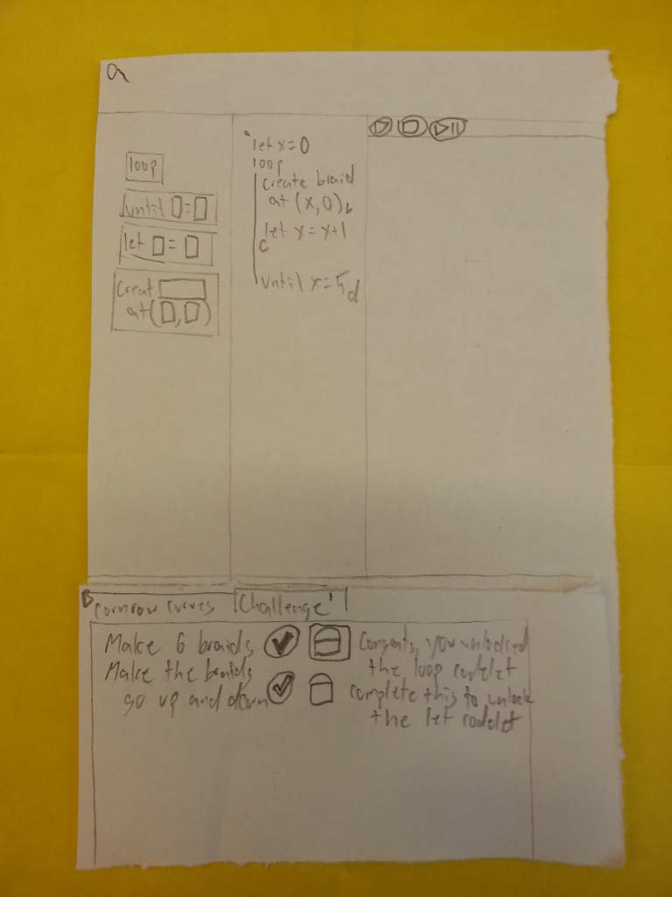
Image 10
Look at the bottom box. There are objectives, which the student can try to complete
Upon completion, the student unlocks a “codelet” which can be used in the sandbox

Slide 15
Back to the first picture
The most important things here are the variety of levels, the gallery, and a button that I didn't have room for. There should be a sandbox feature (the missing button) which allows students to do whatever, then upload their creations to the gallery

Slide 16
Things that are not demonstrated
Login
All the levels
Level creation
Gallery
Sandbox

Slide 17
Things, that IMO, are key differences between old software
There is ONE tool. Everything else is just a configuration of that tool.
The cultural learning is done in the levels, to involve the students in the software and encourage them to learn about things beyond STEM
The goal is to teach STEM, cultural learning is just used a tool towards that end

Slide 18
How much would this be?
A lot. More research needed.

Slide 19
Thoughts? Comments?
Scoldings?

