Slide 1
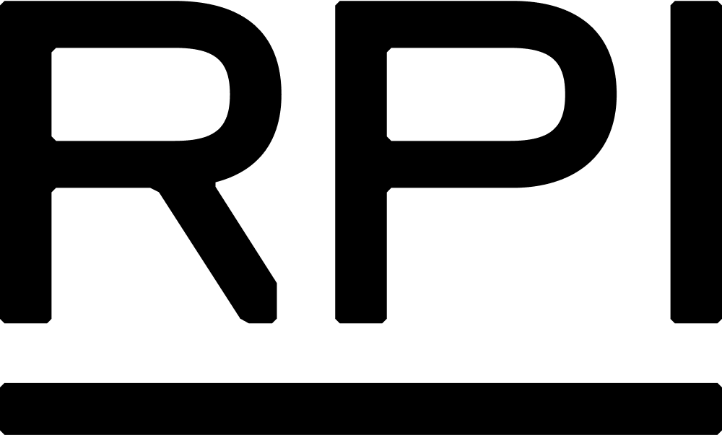
Web Science Application Development
Jason Kuruzovich, PhD
kuruzj@rpi.edu
https://biggermatrix.com

Slide 2
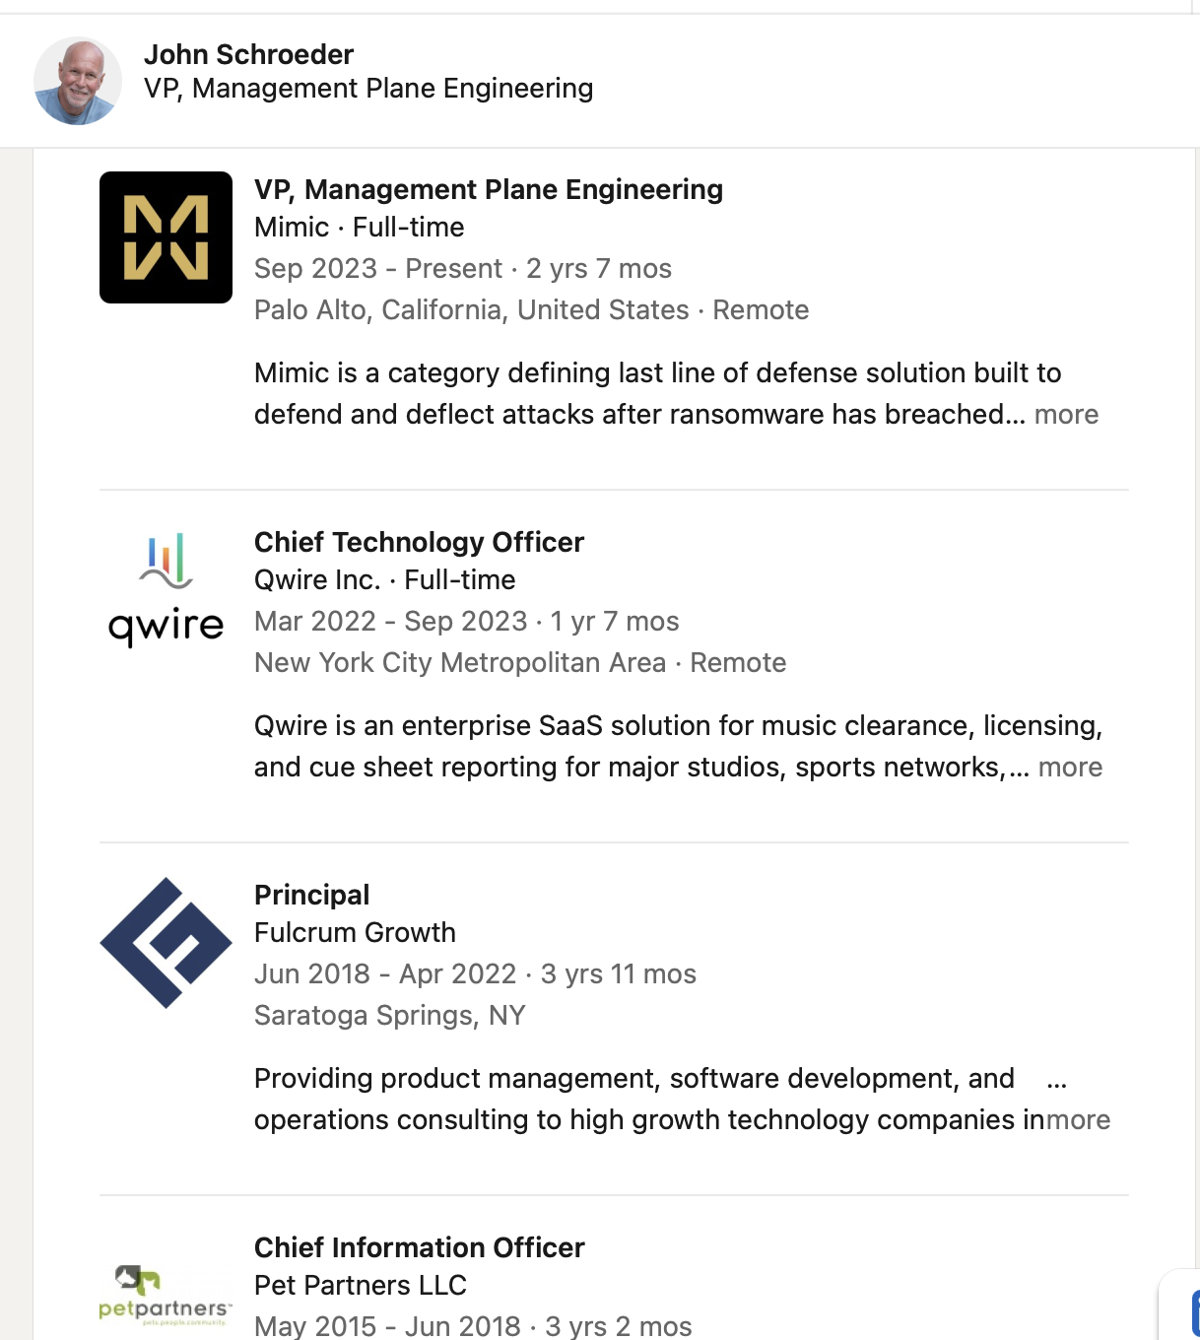

Slide 3
CODE
Deployment &
CI/CD Pipelines
BUILD
From Code Commit to Running Application
TEST
DEPLOY
Web Science Application Development | Jason Kuruzovich | RPI

Slide 4
Where We Are in the Course
✓ Done
✓ Done
Next
Next
Next
Authentication
& Authorization
Testing
(Unit & Integration)
Deployment
& CI/CD
Security
Hardening
Today's focus: taking tested code all the way to running in production.
2

Slide 5
The Deployment Problem
Manual Deployment Risks
CI/CD Solves This
Human error in each step
"Works on my machine" syndrome
Long release cycles (fear of shipping)
No rollback plan
Dev and prod environments diverge
Testing skipped under time pressure
Automated, repeatable pipeline
Tests run on every commit
Ship small changes frequently
Automatic rollback on failure
Infrastructure defined as code
One-click or fully automatic deploy
3

Slide 6
Understanding CI / CD
Code
Build
Test
Deploy
Continuous Integration (CI)
Continuous Delivery (CD) — with manual gate before deploy
Continuous
Integration
Continuous
Delivery
Continuous
Deployment
Merge code often. Automatically build and run tests on every commit. Goal: catch integration bugs early.
Code is always in a deployable state. Deployment to production requires a manual approval step.
Every change that passes tests is deployed automatically to production. No human gate.
4

Slide 7
From Testing Pyramid to CI/CD Pipeline
git push Triggers the pipeline
Run Unit Tests Fast, runs first — fail fast
→
Build & Compile Produce deployable artifact
Unit Tests
Many, fast, cheap
Integration Tests Verify API contracts
Integration Tests
Some, moderate speed
Deploy to Staging Mirror of production
E2E / Manual QA Gate before production
E2E Tests
Few, slow, expensive
Testing Pyramid
Deploy to Prod Automated or manual gate
5
CI/CD Pipeline Stages

Slide 8
Environments: Dev → Staging → Production
💻 Development
🔧 Staging
🚀 Production
Local machines or
shared dev server
Mirrors production
exactly
Live users, real data
Frequent changes,
breaking OK
→
Real infrastructure,
safe data
→
Zero tolerance for
downtime
Mock data / services
Integration & E2E
tests run here
Monitored &
alerting active
Fast feedback loop
Pre-approval for
release
Only tested code
gets here
Infrastructure as Code ensures each environment is identical — no more 'works on my machine'
6

Slide 9
PART 2
AWS CI/CD
Services
CodeCommit/Connections • CodeBuild • CodeDeploy • CodePipeline • CloudFormation

Slide 10
AWS DevOps Toolchain
Source
Build
Test
Deploy
CodeConnections
CodeBuild
CodeBuild
CodeDeploy
GitHub / GitLab
connection
Compile, lint,
run tests
Integration
test suite
EC2, Lambda,
ECS, Beanstalk
AWS CodePipeline — Orchestrates the full workflow
CloudFormation
AWS SAM
Elastic Beanstalk
CloudWatch
Infrastructure as Code — provision all AWS resources from templates
Simplified CloudFormation syntax for serverless (Lambda, API GW, DynamoDB)
Platform-as-a-Service — deploy without managing EC2 instances directly
Monitor logs, metrics, and set alarms for deployed applications
8

Slide 11
AWS CodePipeline: The Orchestrator
What CodePipeline Does
pipeline.yml (GitHub Actions equivalent)
Triggered automatically on source change (push to main)
Connects source → build → test → deploy stages
Each stage can succeed, fail, or require approval
Failed stages block downstream stages
Full audit trail of every pipeline run
Integrates with GitHub, CodeBuild, CodeDeploy, Lambda
Parallel action groups for faster pipelines
Supports multiple deployment targets per stage
stages:
- source:
provider: GitHub
branch: main
- build:
provider: CodeBuild
buildspec: buildspec.yml
- test:
provider: CodeBuild
run: npm test
- approval:
type: Manual
- deploy:
provider: CodeDeploy
target: EC2 / ECS
9

Slide 12
AWS CodeBuild: Build & Test Automation
buildspec.yml
Key Concepts
version: 0.2
Managed build server
phases:
No infrastructure to maintain — AWS spins up containers per build
install:
commands:
buildspec.yml
- npm install
YAML file in your repo that defines install, test, and build phases
pre_build:
commands:
Artifacts
- npm run lint
- npm test
Build output uploaded to S3 for CodeDeploy to use
build:
Environment vars
commands:
- npm run build
Inject secrets from Parameter Store or Secrets Manager
artifacts:
Parallel builds
files: ['**/*']
base-directory: dist
Multiple builds can run simultaneously
10

Slide 13
AWS CodeDeploy: Deployment Strategies
⚡ All-at-Once
🔄 Rolling
🔵🟢 Blue/Green
Deploy to all instances simultaneously
Deploy batch-by-batch, keeping capacity
Deploy to new fleet, switch traffic
✓ Fast, simple
✓ No full downtime
✓ Instant rollback, zero downtime
✗ Full downtime if deploy fails
✗ Two versions run simultaneously
✗ Double infrastructure cost
Use when: Dev/testing environments
Use when: Moderate risk tolerance
Use when: Production — recommended
CodeDeploy also supports Lambda (traffic shifting) and ECS (task replacement)
11

Slide 14
Infrastructure as Code: CloudFormation
Why Infrastructure as Code?
template.yml (CloudFormation)
Reproducible environments
AWSTemplateFormatVersion: '2010-09-09'
Spin up identical dev, staging, and prod with the same template
Description: Web App Stack
Parameters:
Version controlled
Environment:
Infrastructure changes go through code review like application code
Type: String
AllowedValues: [dev, staging, prod]
Self-documenting
Resources:
The template IS the architecture diagram
AppServer:
Type: AWS::EC2::Instance
Properties:
Rollback support
InstanceType: t3.micro
CloudFormation can revert a stack to its previous state
ImageId: ami-0abcdef123456789
Database:
No snowflake servers
Type: AWS::RDS::DBInstance
Destroy and recreate instead of patching in-place
Properties:
DBInstanceClass: db.t3.micro
12

Slide 15
AWS SAM: Serverless Application Model
Built on CloudFormation
Serverless-first syntax
SAM transforms into full CloudFormation before deploying — same reliability
One line defines a Lambda + API Gateway + IAM role that would take 50 lines in CF
Local development
CI/CD integration
`sam local invoke` lets you test Lambda functions on your laptop before deploying
Works natively with CodeBuild + CodeDeploy + CodePipeline
SAM template (vs 50+ lines of CloudFormation):
Transform: AWS::Serverless-2016-10-31
Resources:
TodoApi:
Type: AWS::Serverless::Function
Properties:
Handler: index.handler Runtime: nodejs20.x Events:
Api: {Type: Api, Properties: {Path: /todos, Method: get}}
13

Slide 16
Demo: CI/CD Pipeline on AWS
📁
🔗
🔨
📦
🚀
GitHub Repo
→
CodeConnections
(trigger)
→
CodeBuild
(build + test)
→
S3 Artifact
(built output)
→
CodeDeploy
(to EC2/Beanstalk)
CodePipeline orchestrates all stages above
Demo Tasks
1. Create a GitHub repository with a simple Node/React app + buildspec.yml
2. Connect the repo to AWS via CodeConnections (OAuth to GitHub)
3. Create a CodePipeline with Source → Build → Deploy stages
4. Configure CodeBuild with the buildspec.yml (npm install, test, build)
5. Deploy to Elastic Beanstalk (managed environment — no EC2 config needed)
6. Push a change to GitHub → watch the pipeline run end-to-end
14

Slide 17
Elastic Beanstalk: Easiest AWS Deployment
You provide: your app code AWS provides: everything else
🖥️
Auto-provisioned EC2
⚖️
Load Balancer + Auto Scaling
No manual server setup — Beanstalk picks the right instance type and launches it
Automatically scales up under load, scales down when traffic drops
🔄
Managed Deployments
📊
Built-in Monitoring
Rolling, immutable, blue/green deployments with automatic health checks
CloudWatch metrics, logs, and health dashboard out of the box
🗄️
RDS Integration
🚪
Easy Rollback
Attach a database directly to your environment — lifecycle managed together
One click to deploy the previous version if something goes wrong
Perfect for students — skip infrastructure complexity, focus on your app code
15

Slide 18
GitHub Actions vs AWS CodePipeline
Feature
GitHub Actions
AWS CodePipeline
Trigger
git push, PR, schedule
git push, webhook, manual
Build runner
GitHub-hosted or self-hosted
CodeBuild (managed containers)
Config format
YAML in .github/workflows/
YAML or AWS Console / CDK
AWS integration
Requires IAM credentials setup
Native — no extra config
Cost
2,000 min/mo free, then pay
Pay per pipeline run
Best for
Open source, GitHub-centric teams
AWS-native production apps
Learning curve
Easier, more tutorials
Steeper but more enterprise
16
For the lab we use CodePipeline — understanding both prepares you for industry.

Slide 19
Key Takeaways
1
CI/CD is not optional
Manual deployments don't scale. Automate early and often.
2
Test ↔ Deploy are linked
Tests run in CI. A failing test blocks the deploy. This is the point.
3
Environments must match
Dev, staging, prod should be identical — use IaC (CloudFormation/SAM).
4
AWS gives you the whole stack
CodePipeline → CodeBuild → CodeDeploy handles source-to-prod.
5
Blue/Green is production-grade
Zero-downtime deploys with instant rollback. Default to this pattern.

