Slide 1

Scaling Web Applications: CDN & Beyond
Jason Kuruzovich

Slide 2

Feel free to reach out for help
Book a meeting:
https://bit.ly/jason-rpi
Rensselaer Polytechnic Institute
kuruzj@rpi.edu
518-698-9910
Jason Kuruzovich, PhD
Associate Professor of Business

Slide 3
Scaling Web Applications: Key Topics
Scaling Topics We Will Cover
Scaling Dimensions: vertical, horizontal, geographic
Content Delivery Networks (CDN): edge caching, PoPs, cache headers
Load Balancing: algorithms and routing strategies
Database Scaling: read replicas, sharding, partitioning
Application Caching, CAP Theorem, Async Queues
Theoretical Focus:
Why systems fail under load — and how distributed design solves it
Tradeoffs between consistency, availability, and performance

Slide 4
Scaling Learning Objectives
By the end of class, students should be able to:
Describe the dimensions of scalability (vertical, horizontal, geographic)
Explain how a CDN reduces latency through edge caching and PoPs
Compare load balancing algorithms and when to use each
Articulate the CAP theorem and the PACELC extension
Distinguish caching patterns (cache-aside, write-through, write-behind)
Evaluate tradeoffs in database scaling strategies

Slide 5
Readings
Foundational Texts & Industry References
1. Cloudflare — What is a caching?What is a CDN? https://www.cloudflare.com/learning/cdn/what-is-a-cdn/ https://www.cloudflare.com/learning/cdn/what-is-caching/
2. Monolithic vs. Microservice Architecture: A Performance and Scalability Evaluation
https://doi.org/10.1109/ACCESS.2022.3152803
3. What is Amazon ElastiCache
https://docs.aws.amazon.com/AmazonElastiCache/latest/dg/WhatIs.html
3. Redis — Caching Patterns Documentation
6. NGINX — Load Balancing Guide (nginx.com/resources)
Notes:
OWASP Authorization Cheat Sheet
https://cheatsheetseries.owasp.org/cheatsheets/Authorization_Cheat_Sheet.html?utm_source=chatgpt.com
WorkOS — OAuth and JWT Best Practices
https://workos.com/blog/oauth-and-jwt-how-to-use-and-best-practices?utm_source=chatgpt.com

Slide 6
What does “scaling” mean for a web application?

Slide 7
Dimensions of Scalability
Scaling means more than just adding servers:
Throughput: requests per second the system can handle
Latency: time from request to response (track p50, p95, p99)
Availability: % of time the system responds correctly (e.g., 99.99%)
Geographic Scale: serving users across regions with low latency
Two Fundamental Strategies:
Vertical Scaling (Scale Up): bigger machine, more RAM/CPU
Horizontal Scaling (Scale Out): more machines, distributed load
Vertical scaling hits hardware limits; horizontal scaling introduces distributed complexity

Slide 8
Vertical vs. Horizontal Scaling
Vertical Scaling (Scale Up):
Add CPU, RAM, or faster storage to a single server
Pros: simple, no code changes required
Cons: hardware ceiling, single point of failure
Horizontal Scaling (Scale Out):
Add more servers; distribute load across them
Requires stateless application design
Enables near-infinite scale via cloud elasticity
Introduces consistency, coordination, and failure-mode complexity
Key insight: modern web-scale systems use both — horizontal as primary, vertical to optimize nodes

Slide 9
Content Delivery Networks: Core Concepts
A CDN is a geographically distributed network of servers that cache and serve content close to users
What a CDN Caches:
Static assets: images, JS bundles, CSS, fonts
Video/audio streams, software downloads
Increasingly: dynamic API responses (edge computing)
Core Benefits:
Reduced latency: user hits a nearby edge node, not your origin server
Origin offload: 60-90% of traffic never reaches your infrastructure
Resilience: CDN absorbs DDoS traffic and shields the origin

Slide 10
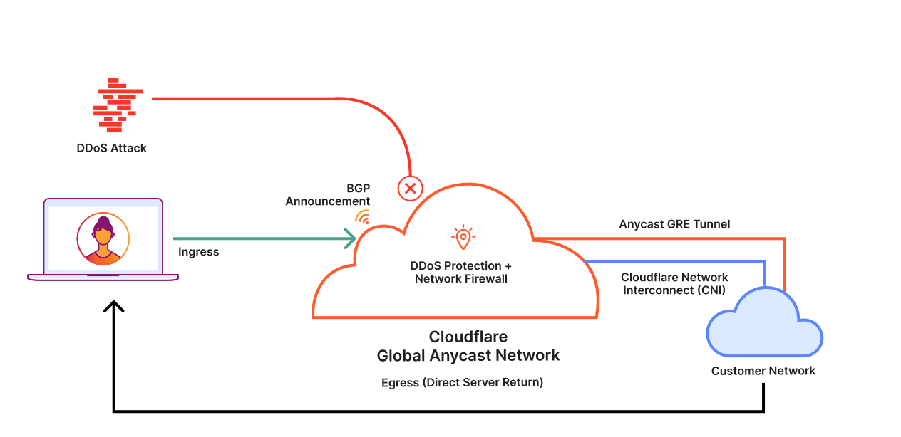
CDN absorbs DDoS traffic

Slide 11
CDN Architecture: PoPs & Edge Nodes
Point of Presence (PoP): a CDN data center in a geographic region
Each PoP contains dozens to hundreds of edge servers
User requests route to the nearest PoP via Anycast DNS
Cache Hierarchy:
L1 Edge Cache: at the PoP closest to user (fastest, smallest)
L2 / Regional Cache: larger, shared across PoPs in a region
Origin Server: your infrastructure — only hit on cache miss
Cache Miss Waterfall:
L1 miss → check L2 → if miss, fetch from origin → populate caches on return
Cache hit ratio is the key CDN performance metric

Slide 12
How does a CDN actually deliver content faster?

Slide 13
CDN Caching: Cache-Control & TTLs
The Cache-Control HTTP header governs what gets cached and for how long
Key Directives:
max-age=N: cache this response for N seconds
s-maxage=N: CDN-specific TTL (overrides max-age for shared caches)
no-store: never cache (for sensitive or personalized data)
stale-while-revalidate: serve stale while fetching fresh in background
Cache Invalidation Problem:
"There are only two hard things in CS: cache invalidation and naming things"
Solution: content-hashed filenames (main.a3f2c1.js) enable aggressive caching with instant invalidation on deploy

Slide 14
Load Balancing: Algorithms & Strategies
Common Algorithms:
Round Robin: requests distributed sequentially; simple, ignores server load
Least Connections: routes to the server with fewest active connections
IP Hash / Sticky Sessions: same client always routes to same server
Weighted: routes proportionally based on server capacity
Consistent Hashing: minimizes cache disruption on node add/remove
Layer 4 vs. Layer 7:
L4 (TCP/UDP): fast, routes on IP/port only, no content awareness
L7 (HTTP): content-aware; can route by URL path, host header, or cookie value

Slide 15
Database Scaling
Read Replicas:
One primary handles writes; N replicas handle reads
Replication lag: replicas may be milliseconds behind primary
Effective when read:write ratio is high (typical for most web apps)
Sharding (Horizontal Partitioning):
Split data across multiple database nodes by a shard key
Range sharding: partition by value range (e.g., user IDs 1-1M on shard 1)
Hash sharding: distribute by hash of key; avoids hotspots
Tradeoffs:
Sharding complicates cross-shard queries and distributed transactions
Schema changes must be coordinated across all shards

Slide 16
What happens when your database becomes the bottleneck?

Slide 17
Application-Level Caching with Redis
Redis: in-memory key-value store used as a caching layer in front of the database
Caching Patterns:
Cache-Aside (Lazy Loading): app checks cache first; on miss, loads DB and writes to cache
Read-Through: cache sits in front of DB; fetches automatically on miss
Write-Through: write to cache and DB synchronously; strong consistency
Write-Behind (Write-Back): write to cache immediately; async flush to DB later
Key Design Decisions:
TTL selection: too short = high miss rate; too long = stale data
Cache stampede: concurrent misses overwhelm origin — solved with mutex locks or probabilistic early expiration

Slide 18
The CAP Theorem
Brewer (2000): a distributed system can guarantee at most 2 of 3 properties simultaneously
Consistency (C): every read returns the most recent write or an error
Availability (A): every request receives a response (may not be the latest data)
Partition Tolerance (P): system operates despite network partitions
In Practice:
Network partitions are unavoidable in distributed systems — P must always be tolerated
Real choice is CP (consistent, may be unavailable) vs AP (available, may return stale data)
PACELC Extension (Abadi, 2012):
Even without partitions there is a latency vs consistency tradeoff
Full spectrum: "If Partition, then Consistency or Availability; Else, Latency or Consistency"

Slide 19
Async Processing & Message Queues
Not all work should happen synchronously in the request/response cycle
Why Async?
Decouples producers from consumers; absorbs traffic spikes
Long tasks (email, video processing, ML inference) should not block HTTP responses
Core Concepts:
Queue: ordered list of messages; consumers pull and acknowledge processing
Pub/Sub: one producer, many independent consumers (fan-out pattern)
Dead Letter Queue (DLQ): captures messages that fail repeated processing attempts
Common Systems:
Redis (BullMQ), RabbitMQ, AWS SQS/SNS — transient message delivery
Apache Kafka — durable log; consumers can replay from any offset

Slide 20
Autoscaling & Observability
Autoscaling:
Automatically add/remove compute instances based on load metrics
Horizontal Pod Autoscaler (Kubernetes): scales pods on CPU, memory, or custom metrics
AWS Auto Scaling Groups: scales EC2 instances; combined with Application Load Balancer
Scaling has lag — pre-warming and predictive scaling reduce cold-start penalty
Observability (the 3 Pillars):
Metrics: quantitative signals — RPS, p99 latency, error rate, CPU%
Logs: structured event records; useful for debugging specific incidents
Traces: end-to-end request paths across distributed services
Key Principle:
You cannot scale what you cannot measure — observability is a prerequisite for effective autoscaling

Slide 21
Lab: In-Memory vs. Redis

Slide 22
Lab Setup: Two Identical Servers
Same API, different backends — run both and compare:
server-memory.js (port 3000)
Users stored in a JavaScript array: const users = []
Refresh tokens in an array: const refreshTokens = []
No caching — every data request takes ~2 seconds
server-redis.js (port 3001)
Users stored as Redis Hashes: user:{username}
Refresh tokens in a Redis Set: refresh_tokens
Cache-aside pattern with 30-second TTL
npm run compare — launches both simultaneously

Slide 23
Experiment 1: What Happens on Restart?
Register a user on both servers, then restart both
In-memory server:
Login fails — user data gone
Every code change in --watch mode triggers a restart
Imagine deploying a fix at 2 AM and logging out all users
Redis server:
Login succeeds — data persists in Redis independently
Server process is stateless; Redis holds the state
Deploy, scale, crash, restart — no data loss
This is why production systems externalize state

Slide 24
Experiment 2: Caching Performance
Both servers have a /api/data/cached endpoint with a simulated 2-second query
In-memory server — no cache available:
Request 1: ~2000ms
Request 2: ~2000ms
Request 100: ~2000ms
Redis server — cache-aside pattern:
Request 1: ~2000ms (cache MISS — stores result with 30s TTL)
Request 2: ~2ms (cache HIT — served from Redis)
After 30s: ~2000ms again (TTL expired, fresh fetch)
400x speedup on cache hits — same data, dramatically less load on origin

Slide 25
Why This Matters: Horizontal Scaling
In-memory storage breaks with multiple server instances
User registers on Server A, load balancer sends next request to Server B
Server B has no idea who this user is — login fails
Sticky sessions are a band-aid (breaks on failover)
Redis as shared external state:
All server instances read/write to the same Redis
Any instance can handle any request — true statelessness
Add or remove instances without data loss
This is the architectural shift that enables:
Autoscaling, blue-green deployments, container orchestration

Slide 26
Redis Data Types: Choosing the Right Tool
Hash (user storage)
Like a JS object — field/value pairs under one key
redis.hSet('user:alice', { username, password })
O(1) field access — no scanning an array
Set (refresh token store)
Unordered collection of unique strings
redis.sIsMember('refresh_tokens', token) — O(1) lookup
Compare: Array.includes() is O(n) — gets slower with more tokens
String with TTL (cache)
redis.set(key, data, { EX: 30 }) — auto-deletes after 30s
No cleanup code needed — Redis handles expiration

Slide 27
Connecting to Lecture Concepts
Cache-Aside Pattern (slide 17)
Implemented in /api/data/cached — check cache, fetch on miss, store with TTL
Students see MISS vs HIT in real-time response data
CAP Theorem (slide 18)
Cache serves stale data during TTL window — trading consistency for speed
What if the underlying data changes before the cache expires?
Database Scaling (slide 15)
Caching reduces reads hitting the database — similar benefit to read replicas
Often the first scaling step before adding infrastructure
Async/Queues (slide 19)
Redis also powers BullMQ, Pub/Sub — same tool, different patterns

