Slide 1

Scaling Web Applications: Architecture Patterns
Jason Kuruzovich

Slide 2
Readings Serverless. https://www.serverless.com/framework/docs/providers/aws/guide/intro Vercel https://vercel.com/docs/deployments

Slide 3
Web Science Application Development
MICROSERVICES
Scaling Web Applications
EVENT-DRIVEN
Architecture Patterns
Microservices · Event-Driven · Serverless
SERVERLESS
KUBERNETES
Jason Kuruzovich, PhD
kuruzj@rpi.edu
https://biggermatrix.com

Slide 4
Where We Are in the Course
Authentication
& Authorization
Testing
(Unit & Integration)
Deployment
& CI/CD
Scaling &
Architecture
Security
Hardening
✓ Done
✓ Done
✓ Done
Today's focus: how applications scale — choosing between static hosting, containers, and serverless functions.
2
Web Science Application Development | Jason Kuruzovich | RPI

Slide 5
PART 1
The Scaling Problem
Why architecture decisions matter early
3

Slide 6
Two Ways to Scale
Vertical Scaling (Scale Up)
Horizontal Scaling (Scale Out)
Add more CPU / RAM to existing server
Simplest path — no code changes needed
Single point of failure remains
Hard ceiling: largest instance available
Expensive at high end
Downtime often required for upgrades
Add more servers; distribute load
Near-linear capacity growth
Eliminates single point of failure
Requires stateless application design
Load balancer distributes traffic
Foundation for cloud-native architectures
→ Modern cloud architecture defaults to horizontal. Your app design must support it.
4
Web Science Application Development | Jason Kuruzovich | RPI

Slide 7

The Monolith: Where Scaling Breaks Down
The Monolith
Deploy everything to change one line
UI Layer
Scale the whole app for one bottleneck
Business Logic
Data Access
One failure can bring down everything
Auth
Notifications
Tech lock-in across the entire codebase
Reports
Large teams conflict on the same repo
These pain points are exactly what microservices and event-driven architectures are designed to solve.
5
Web Science Application Development | Jason Kuruzovich | RPI

Slide 8
PART 2
Microservices
Architecture
Small, independent, deployable services
6

Slide 9
What Are Microservices?
Each service owns one bounded domain, has its own database, and is independently deployable.
User
Service
Order
Service
Payment
Service
Notify
Service
DB
DB
DB
DB
API Gateway · Single entry point · Routing · Auth · Rate limiting
Client (Browser / Mobile)
7
Web Science Application Development | Jason Kuruzovich | RPI

Slide 10


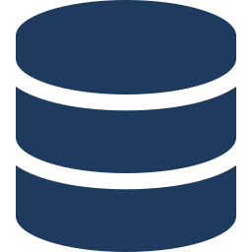



Microservices Design Principles
Single Responsibility
Independent Deployability
Each service does one thing and owns its data.
Deploy any service without touching others.
Decentralized Data
Failure Isolation
Each service has its own database — no shared schema.
A crashed payment service doesn't kill the UI.
Technology Heterogeneity
Design for Failure
Python service + Go service + Node service — all fine.
Circuit breakers, retries, and timeouts are first-class.
8
Web Science Application Development | Jason Kuruzovich | RPI

Slide 11
Service Communication: Sync vs Async
Synchronous (REST / gRPC)
Asynchronous (Message/Event)
Client waits for response
Simple to reason about — request → response
Tight coupling between caller and service
Cascading failures if downstream is slow
Good for: read queries, auth checks, payment confirm
Tools: REST (HTTP), gRPC, GraphQL
Caller fires and moves on — no waiting
Services are loosely coupled
Durable queues absorb traffic spikes
Harder to trace and debug end-to-end
Good for: notifications, order processing, data sync
Tools: SQS, SNS, Kafka, EventBridge
Rule of thumb: sync for user-facing reads; async for writes and side-effects.
9
Web Science Application Development | Jason Kuruzovich | RPI

Slide 12
PART 3
Event-Driven
Architecture
Loose coupling through events
10

Slide 13
Event-Driven Architecture (EDA)
Services communicate by publishing and consuming events — no direct calls between producers and consumers.
Producer
(Order Service)
Event Bus
(SNS / EventBridge)
Consumer A
(Notify Service)
Consumer B
(Analytics)
Decoupling
Scalability
Resilience
Extensibility
Producer never knows who consumes the event
Consumers scale independently based on queue depth
Events are durable — consumers can lag and catch up
Add new consumers without touching producers
11
Web Science Application Development | Jason Kuruzovich | RPI

Slide 14
Key Event-Driven Patterns
Pub/Sub
Event Sourcing
One publisher → many subscribers. Decoupled fan-out.
AWS: SNS topics + SQS subscribers.
Store every state change as an immutable event log.
Replay to reconstruct any past state.
CQRS
Saga Pattern
Command Query Responsibility Segregation.
Separate read and write models for scale + clarity.
Coordinate multi-step distributed transactions
via events — no two-phase commit needed.
12
Web Science Application Development | Jason Kuruzovich | RPI

Slide 15
💬 Discussion
Q1 A user places an order. The system must charge payment, reserve inventory, and send a confirmation email.
Would you design this synchronously or with events? What are the tradeoffs?
Q2 What happens to pending events if the Notification Service crashes? How does your design handle that?
Q3 How do you debug a bug that spans three event-driven services with no direct call chain?
13

Slide 16
PART 4
Choosing the Right
Deployment Model
Static hosting vs. containers vs. serverless
14

Slide 17
The Deployment Decision Framework
Ask these questions first:
Does the page change without user input?
→ Static
Does it need a backend / database?
→ Dynamic
Does traffic spike unpredictably?
→ Serverless / K8s
Do you need persistent connections (WebSockets)?
→ Containers / K8s
Is there complex business logic per request?
→ Containers / Lambda
15
Web Science Application Development | Jason Kuruzovich | RPI

Slide 18
Static Hosting: S3 + CloudFront
Best for: HTML/CSS/JS single-page apps, blogs, portfolios, documentation sites, marketing pages
How It Works
When to Choose This
Build step outputs pure HTML/CSS/JS files
Upload to S3 bucket (enable static hosting)
CloudFront CDN serves from edge globally
Route 53 maps your custom domain
No servers to manage — ever
Scales to millions of users automatically
React/Vue/Angular apps with separate API
Documentation (like Gatsby, Hugo, Next static)
Cost: effectively zero at low traffic
Deploys in seconds from GitHub Actions
SSL free via ACM + CloudFront
Cannot run server-side code — that goes in Lambda
⚡ $0.023/GB storage + $0.0085/10k requests — vs. $0.023/hr minimum for a t3.micro EC2
16
Web Science Application Development | Jason Kuruzovich | RPI

Slide 19
Complex Applications: Containers & Kubernetes
Best for: full-stack apps, APIs with state, microservices, long-running processes, WebSocket servers
Docker
ECS / Fargate
Kubernetes (EKS)
Package app + dependencies together
Runs identically dev → staging → prod
Dockerfile = reproducible build
Push to ECR, pull anywhere
AWS managed container platform
Fargate: no EC2 to manage
Auto-scales on CPU/memory/custom metrics
Good for: teams new to Kubernetes
Industry standard orchestration
Rolling deploys, canary, blue-green
Horizontal pod autoscaling built in
Best for: large microservice fleets
Kubernetes adds operational complexity — right-size the tool for your team and traffic volume.
17
Web Science Application Development | Jason Kuruzovich | RPI

Slide 20
Serverless: AWS Lambda
Best for: event-triggered logic, APIs with variable traffic, background jobs, data transforms, IoT pipelines
Lambda Characteristics
Lambda Invocation Triggers
No server provisioning — ever
Runs in response to events (HTTP, S3, SQS, cron…)
Billed per 1ms of execution — zero idle cost
Scales from 0 to 10,000 concurrent executions
Max 15-minute execution timeout
Cold starts: 100ms–1s (mitigated by provisioned concurrency)
API Gateway → HTTP request handler
S3 event → process uploaded file
SQS / SNS → consume message queue
DynamoDB Streams → react to DB changes
EventBridge → scheduled cron rules
CloudWatch → alert-driven automation
Lambda is the glue layer of event-driven microservices — integrates with virtually every AWS service.
18
Web Science Application Development | Jason Kuruzovich | RPI

Slide 21
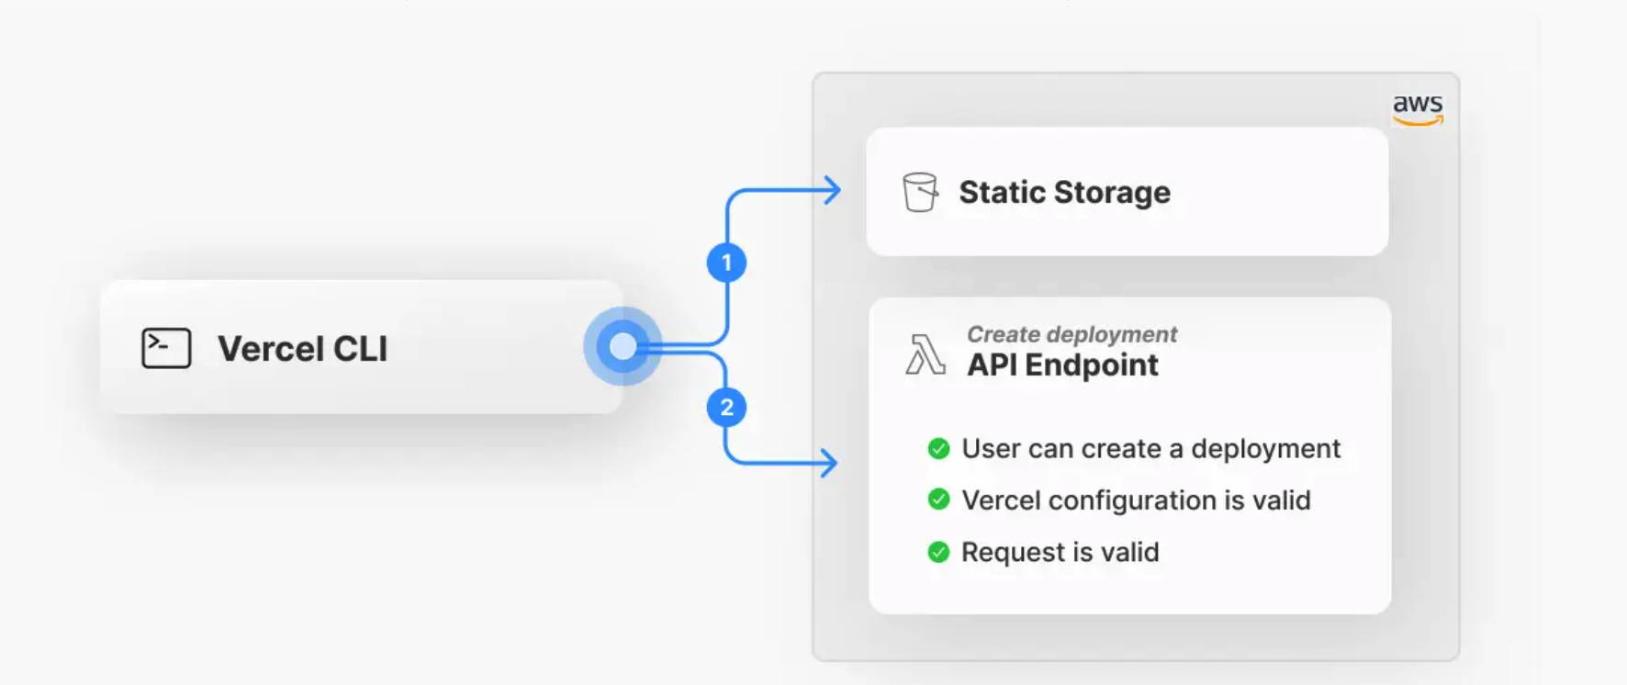
Vercel – Managed Services

Slide 22
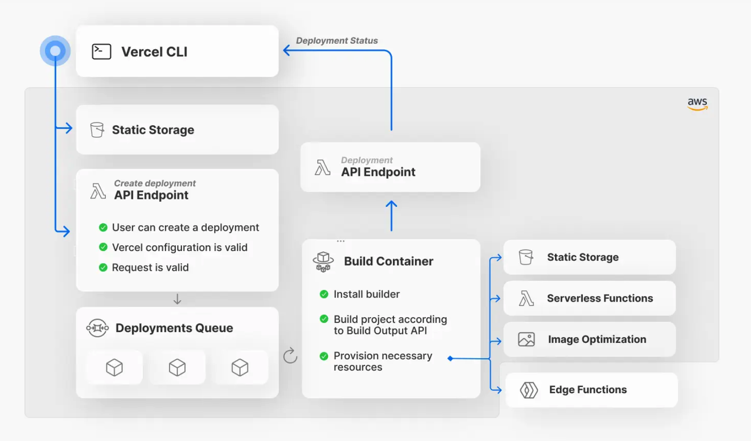
Vercel – Managed Services

Slide 23
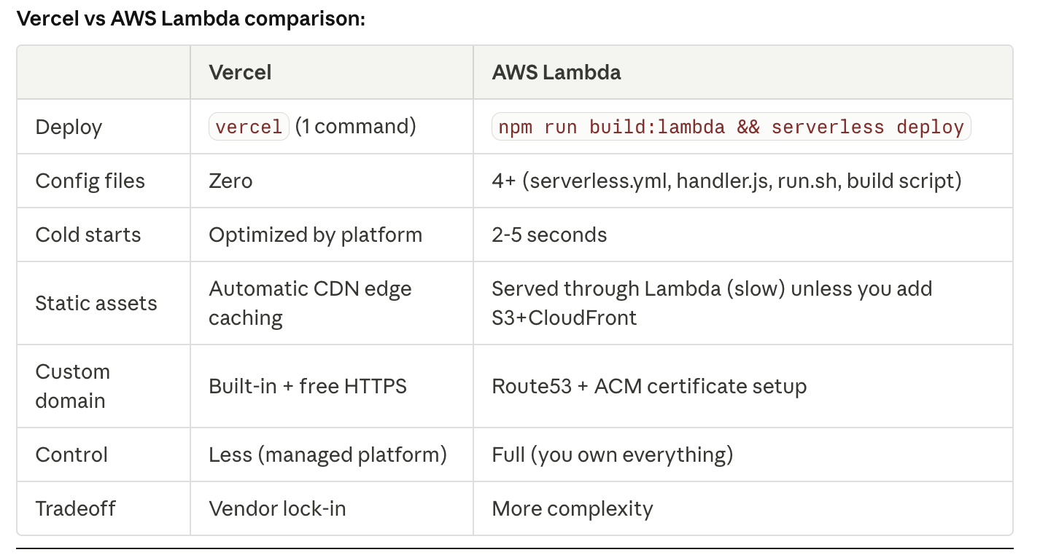

Slide 24
Deployment Model Comparison
Dimension | S3 Static | Containers / K8s | Lambda Serverless
Server management | None | High (ECS) / Very High (K8s) | None
Cost model | Per GB + request | Per hour (running) | Per 1ms execution
Cold start | None | Seconds (pull image) | 100ms – 1s
Max runtime | N/A | Unlimited | 15 minutes
Auto-scale | Built-in (CDN) | HPA / KEDA | 0 → 10k instant
State / sessions | No server state | Yes (Redis, DB) | Stateless only
Best traffic pattern | Steady / bursty | Steady predictable | Bursty / event-driven
19
Web Science Application Development | Jason Kuruzovich | RPI

Slide 25
PART 5
AWS Lambda
Deep Dive
How serverless actually works
20

Slide 26
Lambda: Under the Hood
Lambda manages the execution environment lifecycle — your job is to write stateless handler code.
1. Event
Trigger
2. Cold Start
(if new)
3. Init Code
Runs
4. Handler()
Invoked
5. Response
Returned
Cold Start (First Invocation Only)
Warm Invocations (Reuse)
Download code + create execution environment
Typically 100ms – 1s depending on runtime
Mitigate: provisioned concurrency, keep-warm pings, small packages
Container reused — init code already ran
Only handler() executes — very fast
/tmp (512MB) persists within warm container
Never store auth tokens in module scope
21
Web Science Application Development | Jason Kuruzovich | RPI

Slide 27
Authoring a Lambda Function (Python)
Structure your Lambda into init code (runs once) and handler code (runs per invocation):
import json, boto3 # Init code: runs once per cold start dynamodb = boto3.resource('dynamodb') table = dynamodb.Table('MenuItems') def lambda_handler(event, context): # Handler: runs every invocation response = table.scan() return { 'statusCode': 200, 'body': json.dumps(response['Items']) }
22
Web Science Application Development | Jason Kuruzovich | RPI

Slide 28
Lambda + API Gateway: REST API Pattern
Client
Request
API
Gateway
Lambda
Function
DynamoDB
or RDS
API Gateway Handles
Lambda Handles
TLS termination (HTTPS)
Request routing to Lambda ARN
Auth (Cognito / Lambda authorizer)
Rate limiting and throttling
Request/response transformation
Business logic execution
Input validation
Database reads and writes
Response formatting (JSON)
Error handling and logging
23
Web Science Application Development | Jason Kuruzovich | RPI

Slide 29
🧪 Lab: Creating Lambda Functions with Python SDK
1
Create the Lambda function
4
Test with a mock event
Author a Python handler to query a DynamoDB table of menu items.
Invoke the function manually and inspect the response payload.
2
Configure IAM permissions
5
Replace the mock endpoint
Attach an execution role that grants DynamoDB read access.
Wire API Gateway to your Lambda — remove the static stub.
3
Deploy a function package
6
Observe with CloudWatch / X-Ray
Zip the handler and upload via AWS Console or CLI.
Trace cold starts, execution duration, and errors end-to-end.
24

Slide 30
Key Takeaways
1
Static sites belong on S3 + CloudFront — zero servers, near-zero cost, infinite scale.
2
Microservices solve the monolith's scale ceiling by making each domain independently deployable.
3
Event-driven architecture decouples services — producers never know their consumers.
4
Containers (ECS/K8s) are right for long-running, stateful, or CPU-heavy workloads.
5
Lambda is right for event-triggered, short-lived, unpredictably bursty workloads.
6
Pick the simplest model that meets the requirement — over-engineering is a real cost.
25

