Slide 1
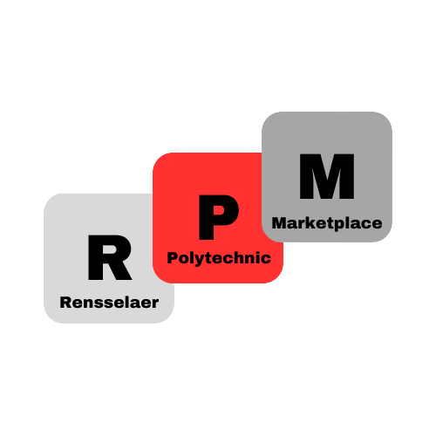
Rensselaer Polytechnic Marketplace
Aidan Pechet, Alex Cote, Anish Patel, Na’Sir Miller, Peter Simone

Slide 2
What is Rensselaer Polytechnic Marketplace
RPM is a marketplace application, designed specifically for RPI students, with a focus on encouraging sustainability.
RPM offers a number of services tailored to the needs of the typical RPI student:
Item Selling
Exchange Locations
Giveaway Raffle Periods
Featured Listings

Slide 3
Stakeholders

Slide 4
RPI Students
RPM provides value for the typical RPI student in a number of potential ways:
Opportunities for Income
Opportunities for Free Items
Convenience
No Delivery
Offload Unused Items
Get What You Need
Additionally, by providing easy access to items, the average student can be worried about less, and therefore be less stressed.

Slide 5
RPI Educators
RPM provides value to RPI educators in a less direct way than students.
By improving the readiness and decreasing the stress of students, they are more prepared to learn - and thus the job of the educator becomes ever so slightly easier.

Slide 6
RPI Parents
In a somewhat similar, but more direct, way to educators, RPM provides value to the parents of RPI students.
By allowing their children to easily get what they need, RPM takes stress off of parents - who can now worry less about the little things.
Additionally, free offers mean that parents can potentially spend less money on their children - be it on a mini fridge or storage unit.

Slide 7
Sustainability Groups
RPM aims to actively encourage recycling by encouraging people to give away used items to people who need them instead of disposing of them.
By incentivising giveaways we can further this cause in a more effective manner.

Slide 8
Technicals

Slide 9
Technologies
We will utilize several technologies in order to make RPM function:
AMP stack and complementaries
Apache
MariaDB
PHP
HTML
CSS
JavaScript

Slide 10
Functional Requirements
The following are necessary for RPM to function:
Recommender System
Database with related attributes
User login/signup
Finding an RPI-based meetup spot between two given locations
Online Payment
Notifications

Slide 11
Nonfunctional Requirements
The following are also necessary for a successful RPM:
Duo implementation
Responsive site
Clicking, typing, etc
Creations and deletions

Slide 12
Architecture and Visuals

Slide 13
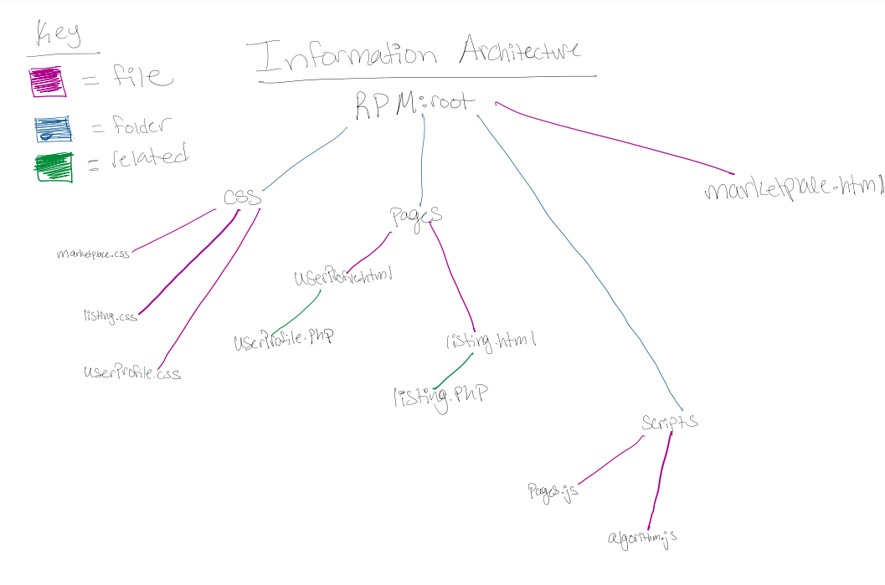
Information Architecture

Slide 14
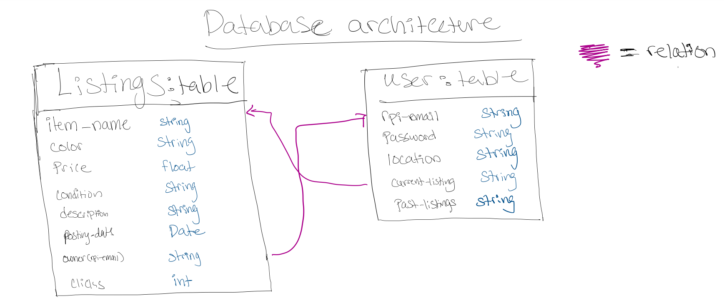
Database Architecture

Slide 15
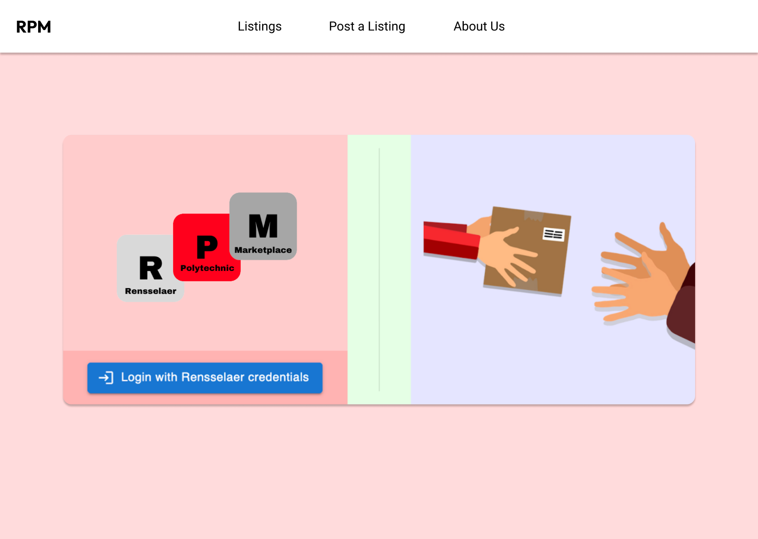
Mockup: Home Screen

Slide 16
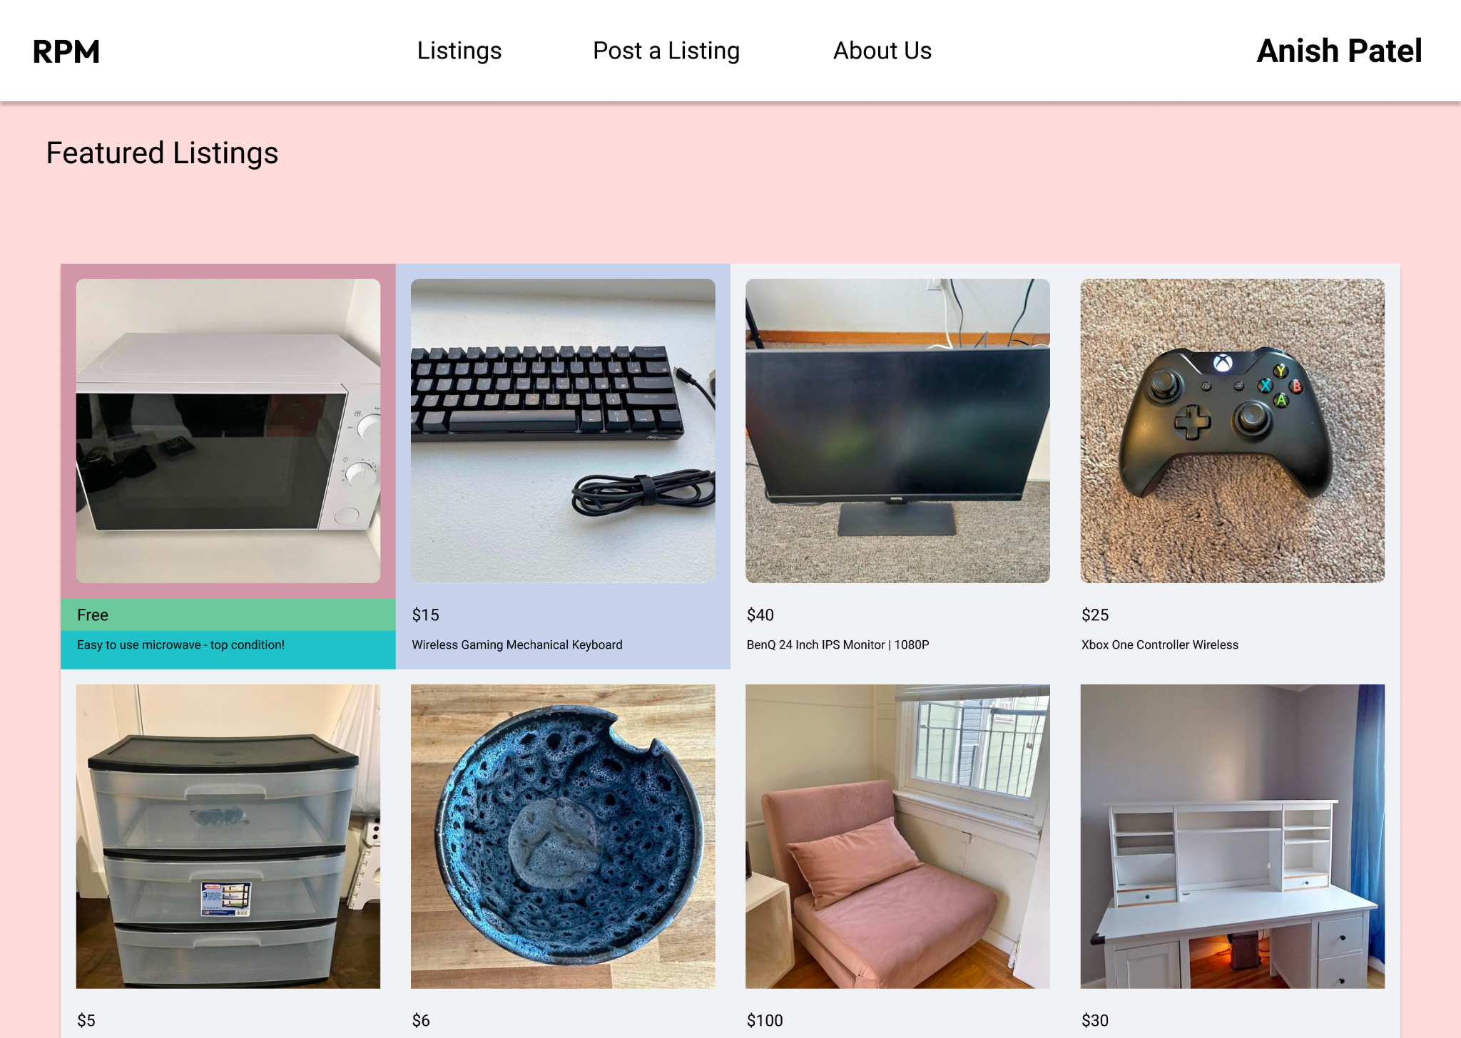
Mockup: Featured Listings

Slide 17
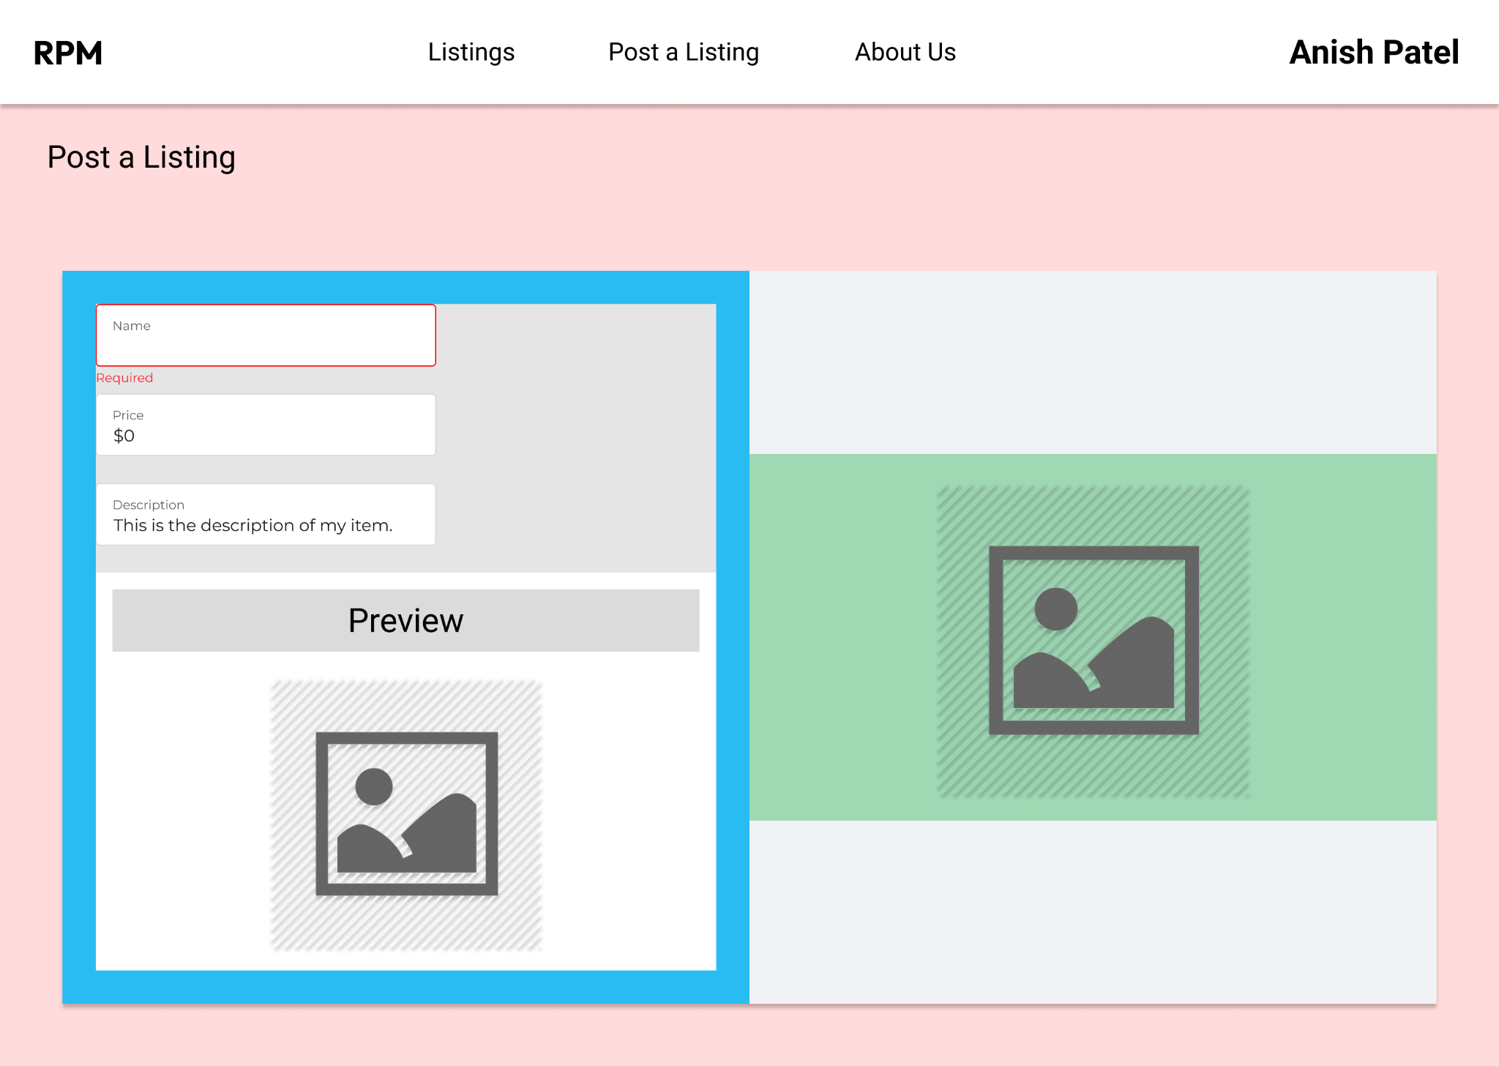
Mockup: Post a Listing

Slide 18
Conclusion

Slide 19
Conclusion
The Rensselaer Polytechnic Marketplace is committed to fostering a community led all-in-one experience. We want to provide our users with the comfortability and ease of access to their peers and their items. In order to act upon the RPI motto, “Why not change the world?”, we will be encouraging green behavior on our platform and on campus.
With all that being said, why not buy and sell?

Slide 20


