Slide 1
Floor Pantry
Midterm: front-end prototype and API design
ITWS 2110 · Fri 10/30 · Section 0_ · Team: example
Notes:
A sample midterm project. It follows Part 3 of PROJECT_v3.pdf, and Part 2 (the pitch) is kept as the record.

Slide 2
Part 2 — Pitch
Who it is for, what we store, the five endpoints, the two pages

Slide 3
Who it is for, and the problem
PITCH · Q1 + Q2
1. Who is it for?
Current students who share one kitchen on a residence-hall floor. About 30 people, one fridge, one freezer, one cabinet.
2. What is the problem?
Nobody can see what is in the kitchen. Food is bought twice, goes off at the back, and is thrown out on clean-out day.
Our fix: one list everyone can see. Add what you put in. The list shows what goes off first.

Slide 4
The core resource: an item
PITCH · Q2
One item
is one thing a resident put in the kitchen.
Each item belongs to the resident who added it.
Field | Example
name | Milk
amount | 1
unit | L
location | fridge
best_before | 2026-11-02 (optional)
notes | Top shelf, door side. (optional)

Slide 5
The five API endpoints
PITCH · Q3
Action | Method and path | Who may call it
List | GET /api/items | anyone
Show | GET /api/items/{id} | anyone
Create | POST /api/items | logged in
Update | PUT /api/items/{id} | the owner, or the RA (admin)
Delete | DELETE /api/items/{id} | the RA (admin)

Slide 6
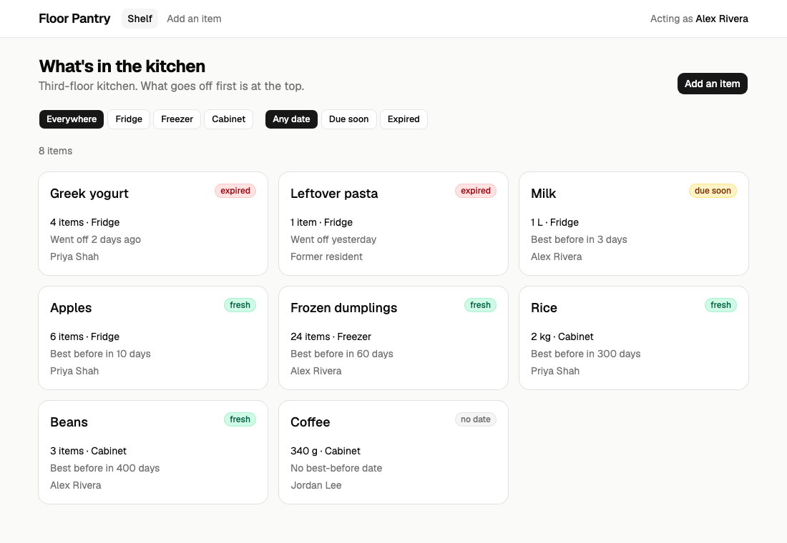
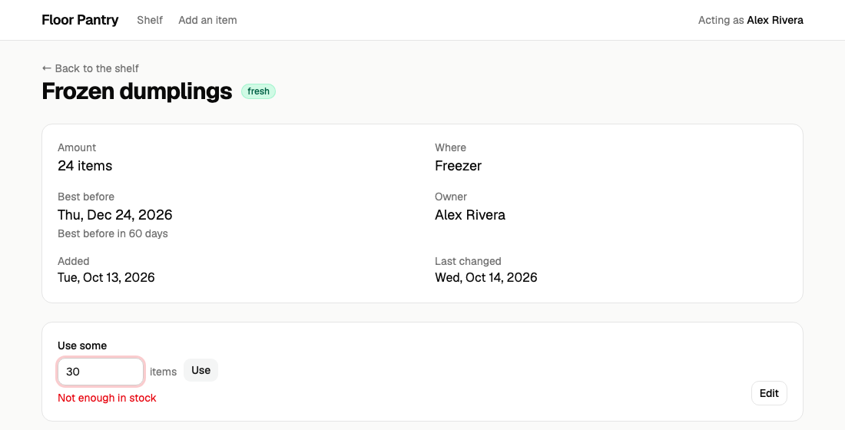
The two pages that matter most
PITCH · Q4
2. An item How much is left, when it goes off, and whose it is.
1. The shelf Everything in the kitchen. What goes off first is at the top.

Slide 7
Part 3 — Prototype and API design
Due Fri 10/30. Two parts, graded separately: the prototype, and the API design.

Slide 8
The prototype: what is due, and where it is
PROTOTYPE
The PDF asks for | Where it is
docker compose watch serves the prototype | docker-compose.yml
The two key pages | web/src/pages/ShelfPage.jsx, ItemPage.jsx
A way to move between them | web/src/App.jsx (React Router)
At least one working form | web/src/components/ItemForm.jsx
One module for all data, shaped like the API | web/src/api.js
Run it: cp .env.example .env then docker compose watch → localhost:5181

Slide 9
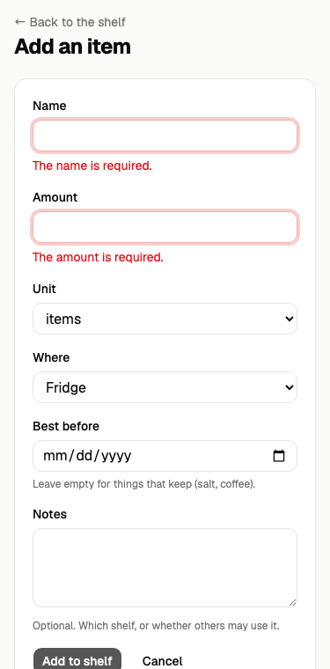
The pages, all on fake data
PROTOTYPE
1
Shelf /
The list, with filters. Works on a phone.
2
Item /items/1
One item, its owner and its dates.
3
Add / edit /items/new
The form. Error messages next to each field.
Red = the two key pages
No log in yet
The app acts as Alex, a resident. Log in comes in week 12.

Slide 10
A. The resource: items
A · THE RESOURCE
One row per thing a resident put in the kitchen. Belongs to a user.
Field | Type | Required | Rule
id | integer | — | set by the database
user_id | integer | — | the owner; set from the login, never from the request
name | string | yes | at most 80 characters; no two of yours with the same name
amount | number | yes | 0 to 9999, at most 2 decimal places
unit | string | yes | one of: items, g, kg, ml, L
location | string | yes | one of: fridge, freezer, cabinet
best_before | date | no | a real date like 2026-10-30, or empty
notes | text | no | at most 500 characters
created_at, updated_at | timestamp | — | set by the database

Slide 11
Three fields the API works out for you
A · THE RESOURCE
They are not stored. The API works them out each time, so they are never out of date.
status
expired, due soon (5 days or less), fresh, or no date.
days_left
Days until the best-before date. Below zero once it has passed.
owner
The owner's id and name. Empty if the owner's account was deleted.

Slide 12
Who may do what
A · THE RESOURCE
Action | Anyone | Logged in | The owner | The RA (admin)
List, show | yes | yes | yes | yes
Create | no — 401 | yes | — | yes
Update | no — 401 | no — 403 | yes | yes
Delete | no — 401 | no — 403 | no — 403 | yes
The pages hide buttons you may not use. The API still checks, and answers 401 or 403.

Slide 13
B. The five endpoints
B · ENDPOINTS
Endpoint | Who | Request | Success | Errors
GET /api/items | anyone | optional filters: location, status, page | 200 a list of items | 422
GET /api/items/{id} | anyone | — | 200 the item | 404
POST /api/items | logged in | name, amount, unit, location (+ best_before, notes) | 201 the new item | 401, 422
PUT /api/items/{id} | owner or RA | any of the six fields | 200 the updated item | 401, 403, 404, 422
DELETE /api/items/{id} | RA | — | 204, no body | 401, 403, 404
Base path /api. Every item comes back with all its fields, plus status, days_left and owner.

Slide 14
C. Errors
C · ERRORS
Status | When | Body
401 | Nobody is logged in | { "message": "Unauthenticated." }
403 | Not the owner or the RA (update) | { "message": "Only the owner or the RA can change this item." }
403 | Not the RA (delete) | { "message": "Only the RA can remove items from the shelf." }
404 | No such item | { "message": "No item with id 99." }
422 | The input broke a rule | { "message": "The name is required.", "errors": { "name": ["The name is required."] } }

Slide 15
Our choices, and why
IN LAB
Why is amount required, but not best-before?
Every item has an amount. Salt and coffee have no real date, and a made-up one breaks the "due soon" list.
Why can only the RA delete?
The food is really in the fridge. Owners set the amount to 0 instead, and the RA clears it on clean-out day.
What happens to a user's items when the user is deleted?
They stay, marked "Former resident", and go on the RA's clean-out list. The food is still there.
Why is user_id not in the form?
It comes from the login. Otherwise you could add food in someone else's name.

