Slide 1
E Ayurveda Recommendation System
A Full-Stack Development Project

Slide 2
Introduction
The E Ayurveda Recommendation System is designed to manage diseases and medicines efficiently and suggest medicines for the diseases.
It provides API endpoints for:
- Admin authentication
- Disease management
- Medicine management
Built using Node.js, Express.js, and MongoDB.

Slide 3
Project Structure
Key Directories:
- controllers/: Handles business logic
- models/: Defines MongoDB schemas
- routes/: API endpoints
- middleware/: Authentication handling
Main File: app.js
Database: MongoDB

Slide 4
Key Features
- Admin authentication with session-based login
- CRUD operations for diseases and medicines
- Medicines linked to diseases via MongoDB relations
- Secure API with authentication middleware
- Error handling for robust performance

Slide 5
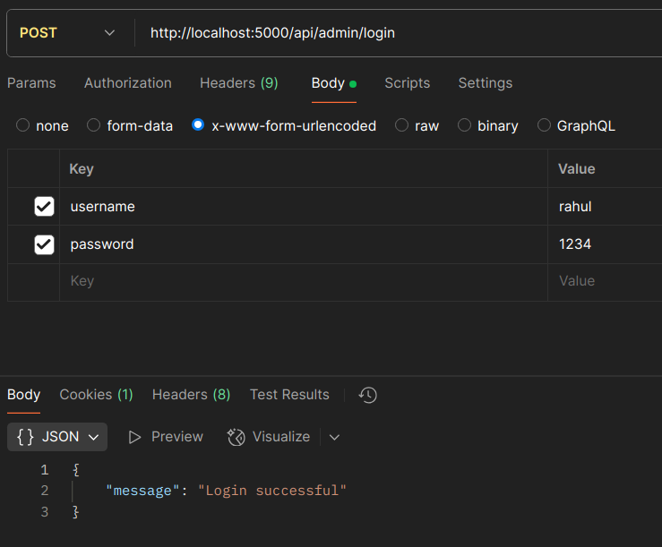
API Endpoints Overview
1. Admin Routes:
- POST /login → Admin login

Slide 6
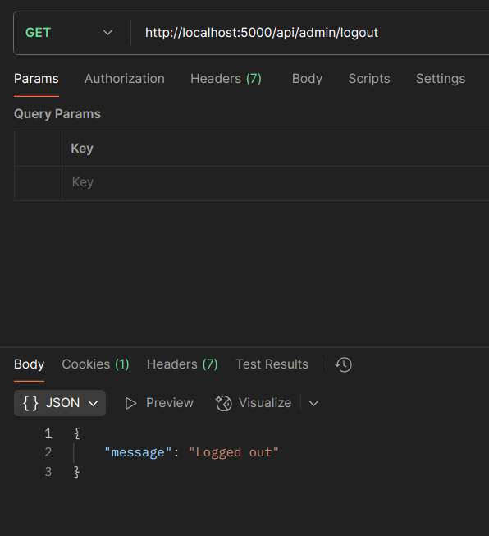
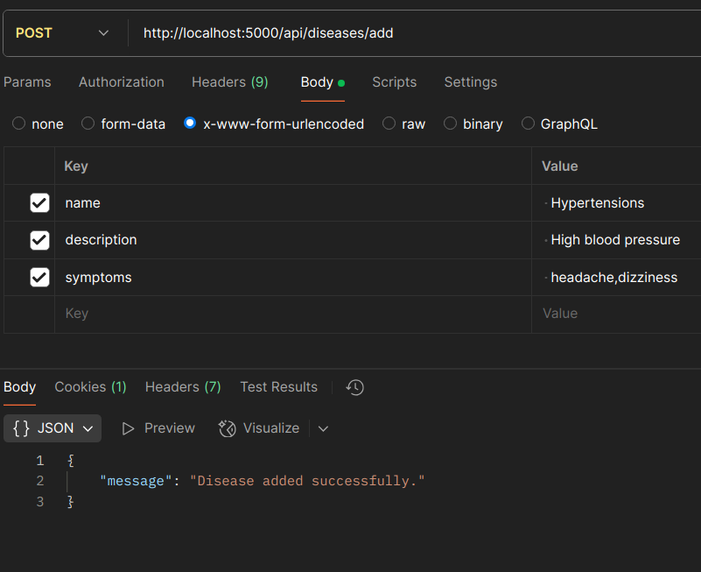
-GET /logout → Admin logout
2. Disease Routes:
- POST /add → Add disease

Slide 7
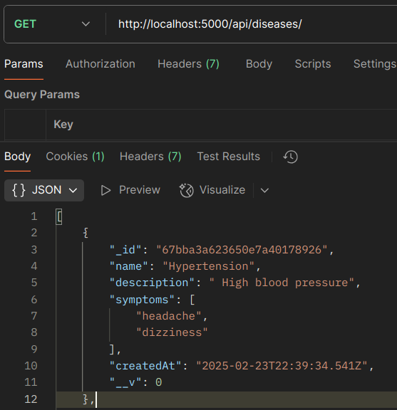
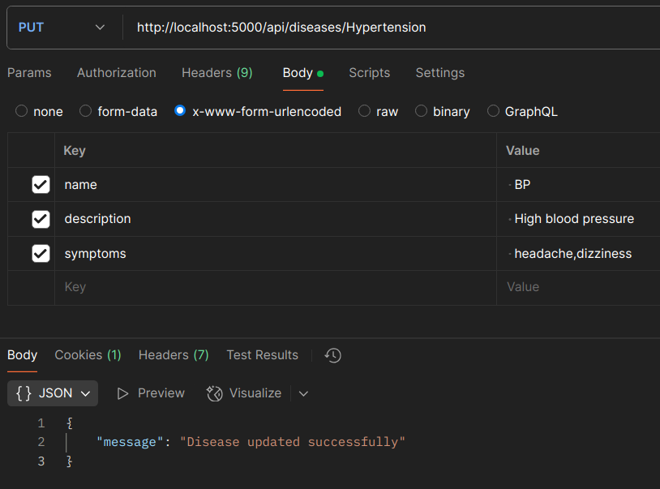
- GET / → Retrieve all diseases
- PUT /:name → Update disease

Slide 8
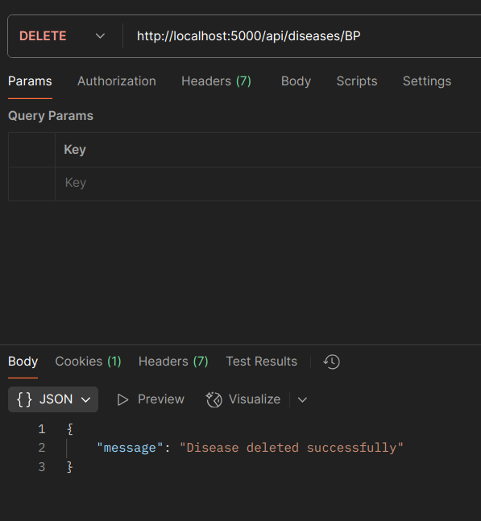
- DELETE /:name → Remove disease
3. Medicine Routes:
- Similar to disease routes but linked to diseases

Slide 9
Technology Stack
Backend : Node.js, Express.js
Database : MongoDB, Mongoose
Authentication : express-session
Error Handling : Custom middleware
Deployment : Runs on localhost (can be extended to cloud)

Slide 10
Business & Practical Use
Helps users find Ayurvedic medicines for diseases
Easy management of medicines and diseases
Can be extended to include user recommendations
Potential for commercial use in Ayurveda e-commerce
Scalable for integration with telemedicine services

Slide 11
Challenges & Future Scope
Challenges Faced :
Managing relationships in NoSQL database
Secure admin authentication setup
Future Scope:
Adding AI-based recommendations
Implementing user authentication & feedback system
Deploying to cloud for better scalability

Slide 12
Conclusion
Successfully implemented a backend for managing Ayurvedic medicines
Provides structured APIs for admin control
Scalable for future enhancements and commercialization
Thank You!

