Slide 1

Project Title –Seasonal_Agriculture_Performance_Analysis
Student Name : KANISHKARAJ R P R
College Name : MISRIMAL NAVAJEE MUNOTH JAIN ENGINEERING COLLEGE
AICTE STU ID : STU684d497ca665e1749895548

Slide 2

PROBLEM STATEMENT
Agricultural activities are influenced by seasonal variations in environmental conditions, farming practices, resource availability and market conditions.
As a result, agricultural performance may differ from one season to another. However, raw agricultural data does not clearly explain how agricultural performance changes across seasons or what patterns can be observed in different seasonal conditions.
The problem is to analyze the given agricultural dataset and investigate seasonal differences in agricultural performance by identifying meaningful patterns, trends, relationships and variations within the available data.

Slide 3
Project Description
Comprehensive Data Scope: Analyzed 4,000 farm records across 28 parameters to investigate agricultural performance and resource utilization across Kharif, Rabi, and Zaid seasons.
Rigorous Data Governance: Addressed 120 missing values using deterministic area-production yield recovery and context-aware grouped median imputation, ensuring 0% data loss.
Multi-Dimensional Analytics: Executed univariate, bivariate, multivariate, and correlation models to map complex dependencies between soil chemistry, water efficiency, pest risk, and financial margins.
Actionable Operational Inquiries: Implemented three targeted analytical inquiries to evaluate drip irrigation ROI, chemical fertilizer diminishing returns, and regional crop profitability matrices.
Strategic Impact: Delivered evidence-basedrecommendations for sustainable agricultural planning andresource optimization without reliance on complexmachine learning.

Slide 4

WHO ARE THE END USERS?
Agricultural Planners & Policymakers: To design data-driven resource subsidies, optimize water distribution networks, and establish sustainable agricultural zoning policies.
Agribusinesses & Supply Chain Managers: To forecast seasonal harvest volumes, mitigate supply chain bottlenecks, and anticipate regional commodity pricing trends.
Farmers & Agronomists: To optimize chemical fertilizer application rates, reduce input cost erosion, and adopt water-efficient drip irrigation methods for superior farm profitability.

Slide 5

Technology Used
Programming Language: Python
Development Environment: Google Colab
Core Data Analytics & Visualization Libraries:
1.Pandas & NumPy – Utilized for data ingestion, cleaning, primary key deduplication, missing value imputation, and quantitative aggregation.
2.Matplotlib & Seaborn – Utilized for generating exploratory visualizations, including univariate distribution histograms, bivariate cost-revenue evaluations, multivariate pest risk boxplots, and correlation heatmaps.

Slide 6
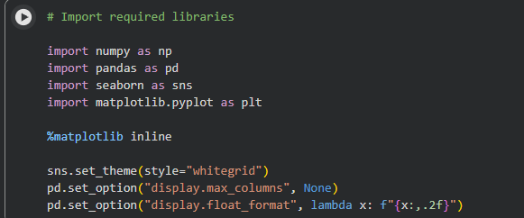
RESULTS

Slide 7
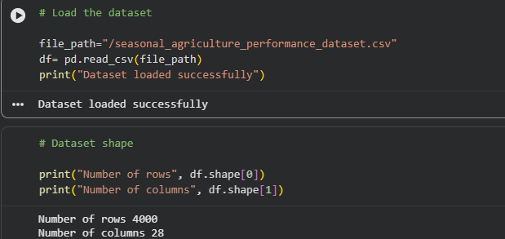
RESULTS

Slide 8
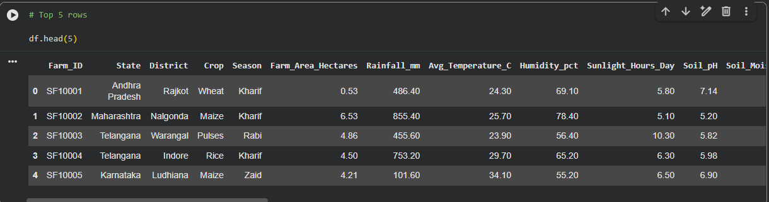
RESULTS

Slide 9
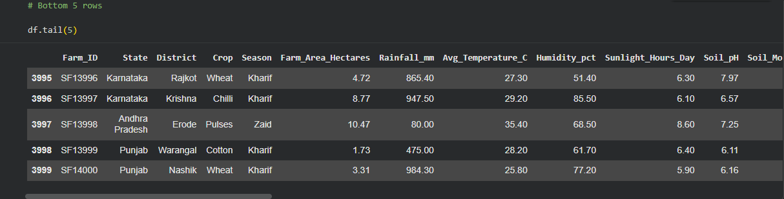
RESULTS

Slide 10
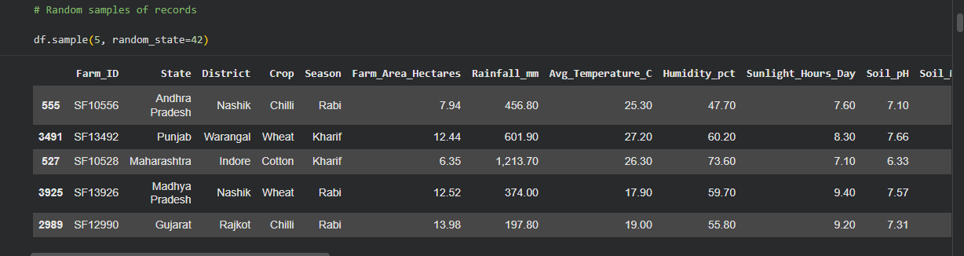
RESULTS

Slide 11
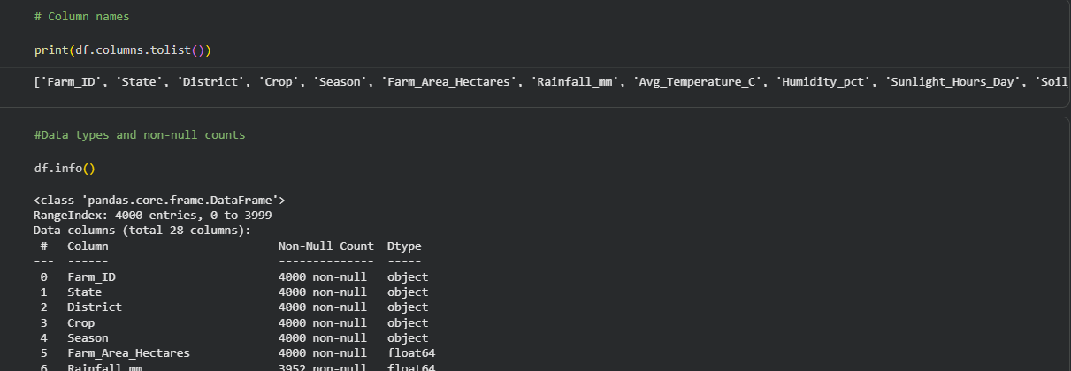
RESULTS

Slide 12
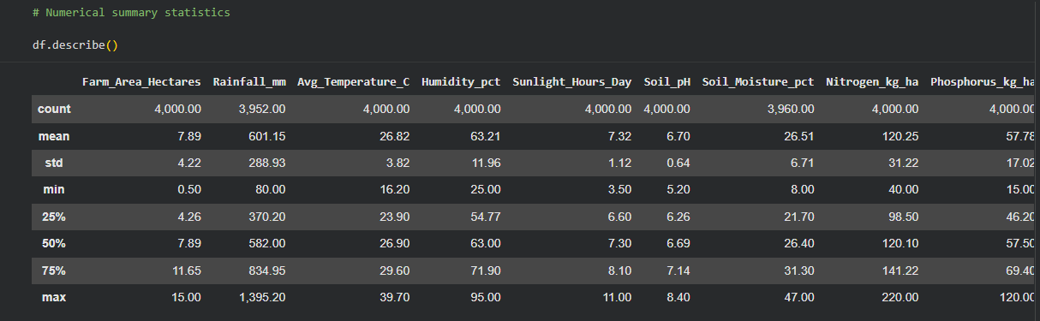
RESULTS

Slide 13
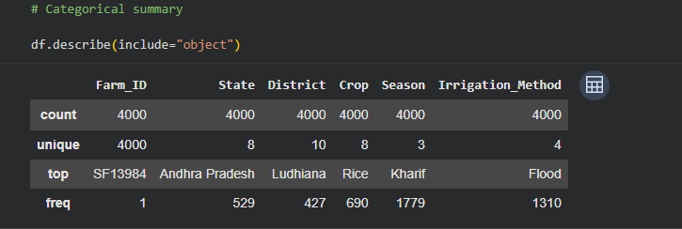
RESULTS

Slide 14
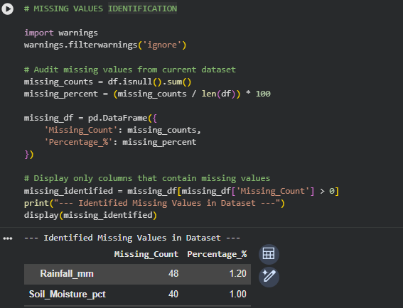
RESULTS

Slide 15
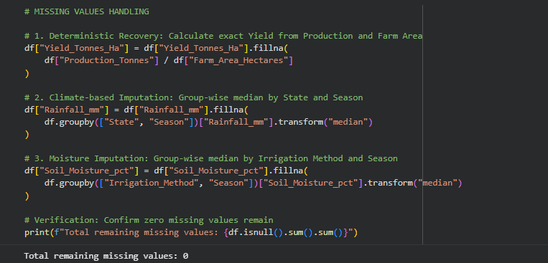
RESULTS

Slide 16
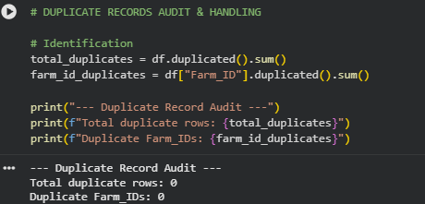
RESULTS

Slide 17
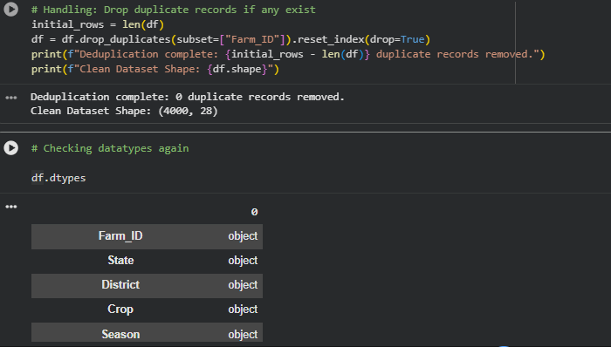
RESULTS

Slide 18
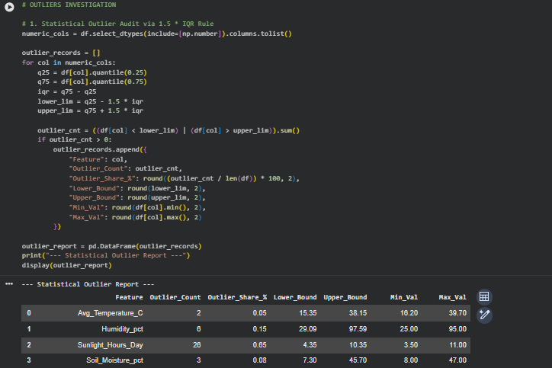
RESULTS

Slide 19
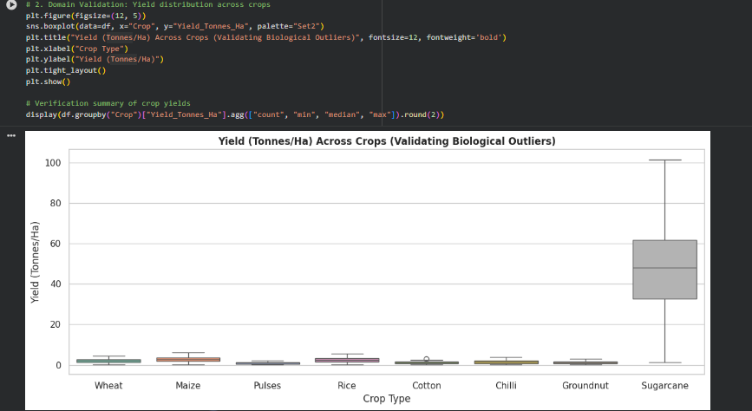
RESULTS

Slide 20
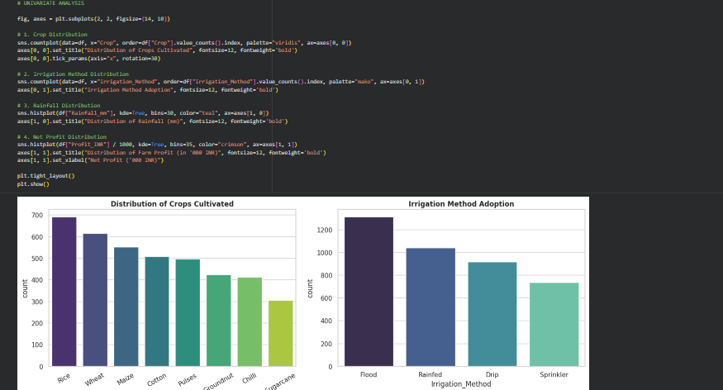
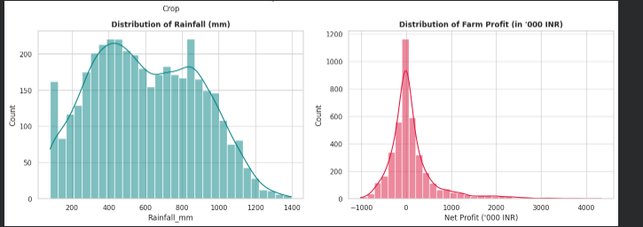
RESULTS

Slide 21
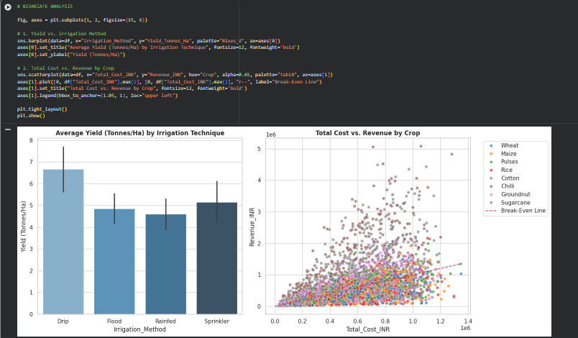
RESULTS

Slide 22
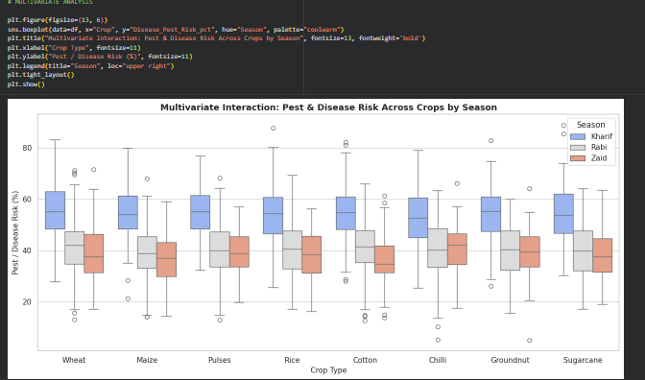
RESULTS

Slide 23
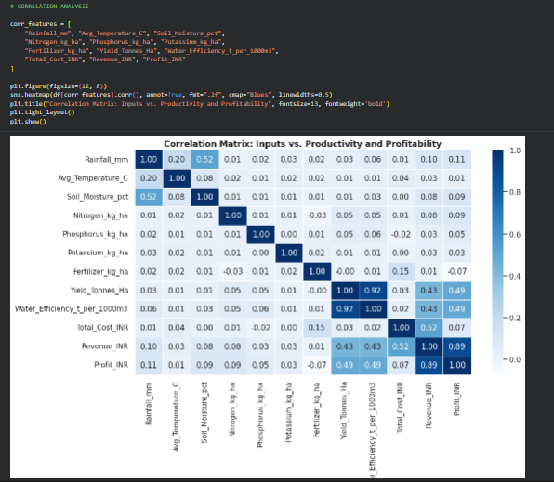
RESULTS

Slide 24
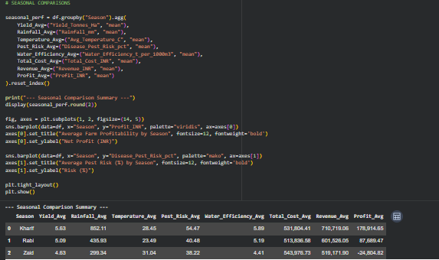
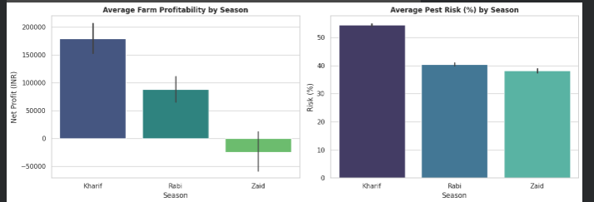
RESULTS

Slide 25
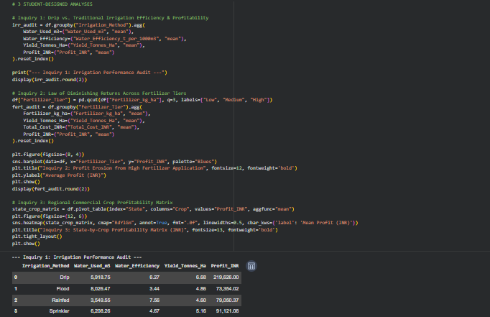
RESULTS

Slide 26
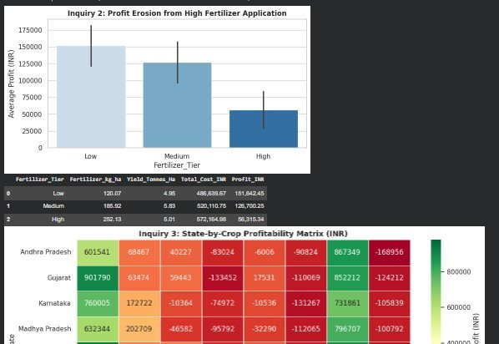
RESULTS

Slide 27
Future scope
Predictive Yield Modeling: Integrate real-time IoT soil sensors and live meteorological forecasting APIs to build machine learning models that forecast crop yields ahead of harvest.
Dynamic Market Price Tracking: Incorporate macro-level market pricing feeds and daily mandi price fluctuations to evaluate real-time revenue and profit volatility.
Automated Pest & Disease Early Warning: Expand the current analytics pipeline into an automated classification framework that uses environmental humidity and temperature triggers to predict pest outbreaks before crop damage occurs.
Precision Farming Mobile Integration: Translate the data insights into a lightweight mobile dashboard for local farmers to receive real-time, localized recommendations on optimal irrigation schedules and fertilizer thresholds.

Slide 28
GitHub Link
https://github.com/RPRK01/Seasonal_Agriculture_Performance_Analysis

Slide 29
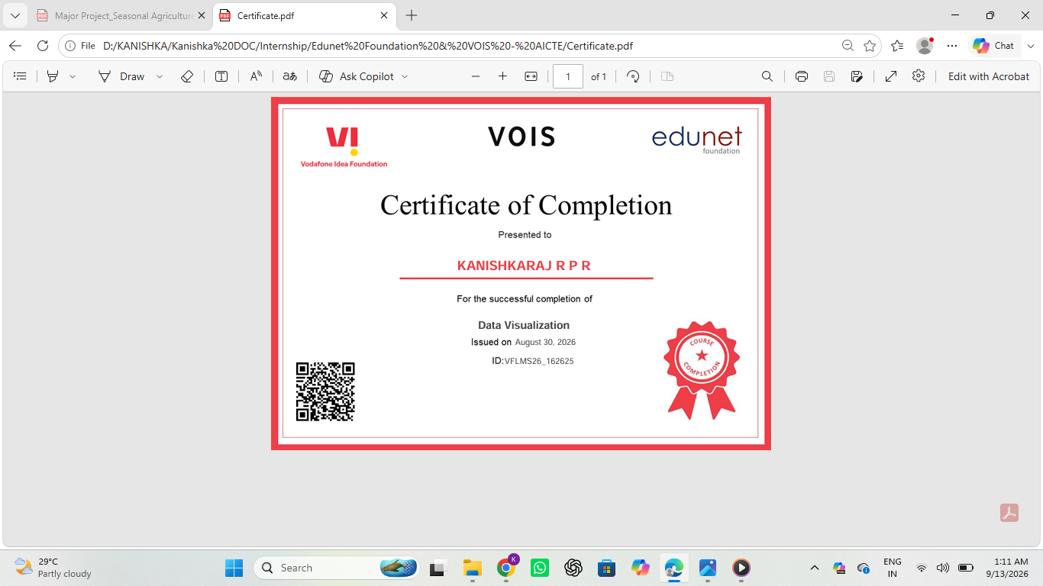
VOIS Course completion certificate -
Course name- Data Visualization

Slide 30
Thank you
.
.

