Slide 1

Robert Pavlik
Analytics Programming
D598
Task 3
Notes:
This bar chart visualizes the debt-to-income ratio for companies in different states. The plt.bar() function from Matplotlib is used to create a bar chart, where each bar represents a state, and the height corresponds to the average debt-to-income ratio. The x-axis contains the state names, and the y-axis represents the ratio.

Slide 2
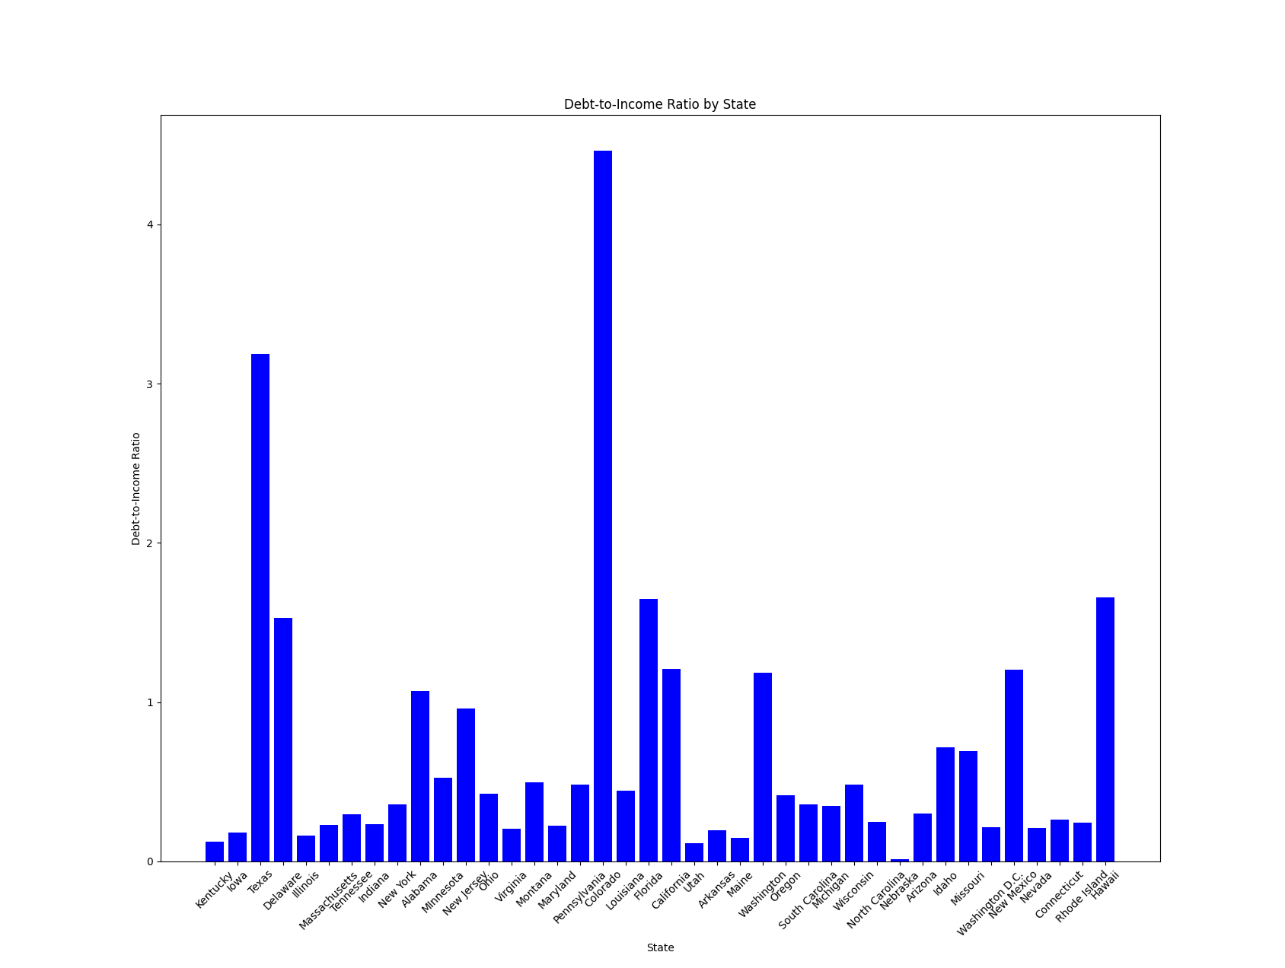
Bar Chart:
Debt-to-Income Ratio
By State
Notes:
This bar chart visualizes the debt-to-income ratio for companies in different states. The plt.bar() function from Matplotlib is used to create a bar chart, where each bar represents a state, and the height corresponds to the average debt-to-income ratio. The x-axis contains the state names, and the y-axis represents the ratio.

Slide 3
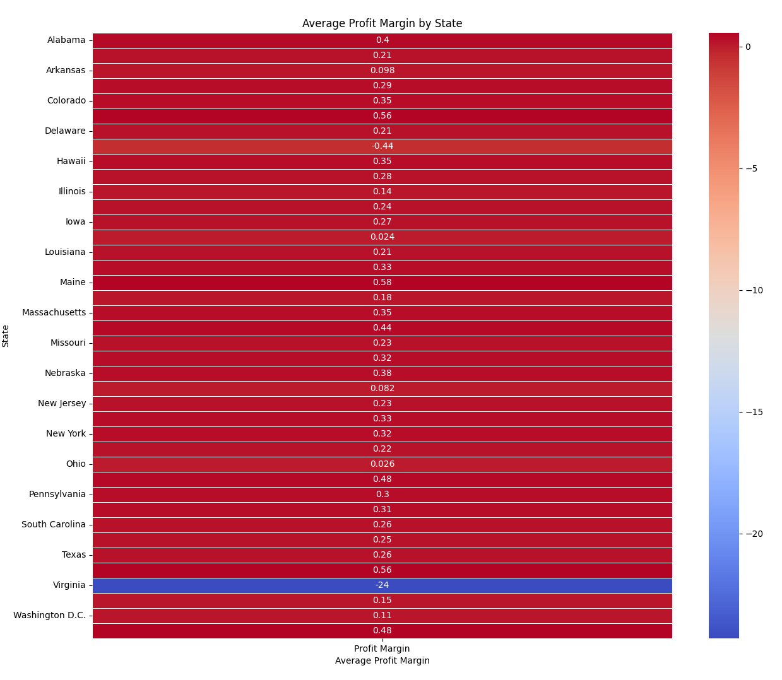
Heatmap:
Average Profit Margin
By State
Notes:
A heatmap is used to visualize the average profit margin by state. The sns.heatmap() function generates this heatmap, with each state represented by a cell. The color intensity of the cell indicates the average profit margin for that state, allowing for quick identification of regions with higher or lower profitability. Annotating each cell with actual values provides further clarity, and the use of a color gradient (e.g., 'coolwarm') makes it easy to distinguish between different profit margin levels. This visualization helps in spotting geographical trends in profitability across different U.S. states.

Slide 4
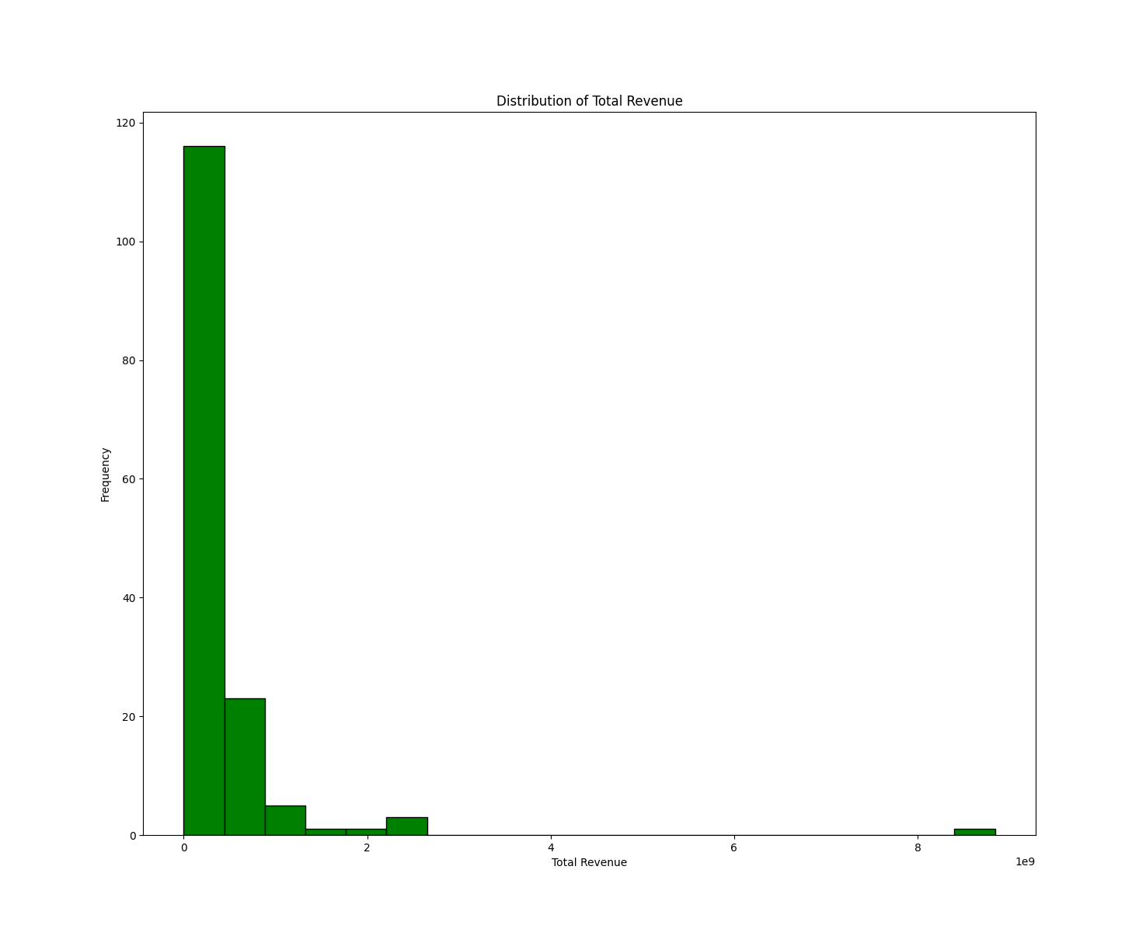
Histogram:
Total Revenue
Distribution
Notes:
This histogram visualizes the distribution of total revenue across the dataset. The plt.hist() function is used, where the data is divided into bins (ranges of values), and the height of each bar indicates the frequency (number of companies) in that range. This gives insights into the concentration of total revenue values.

Slide 5
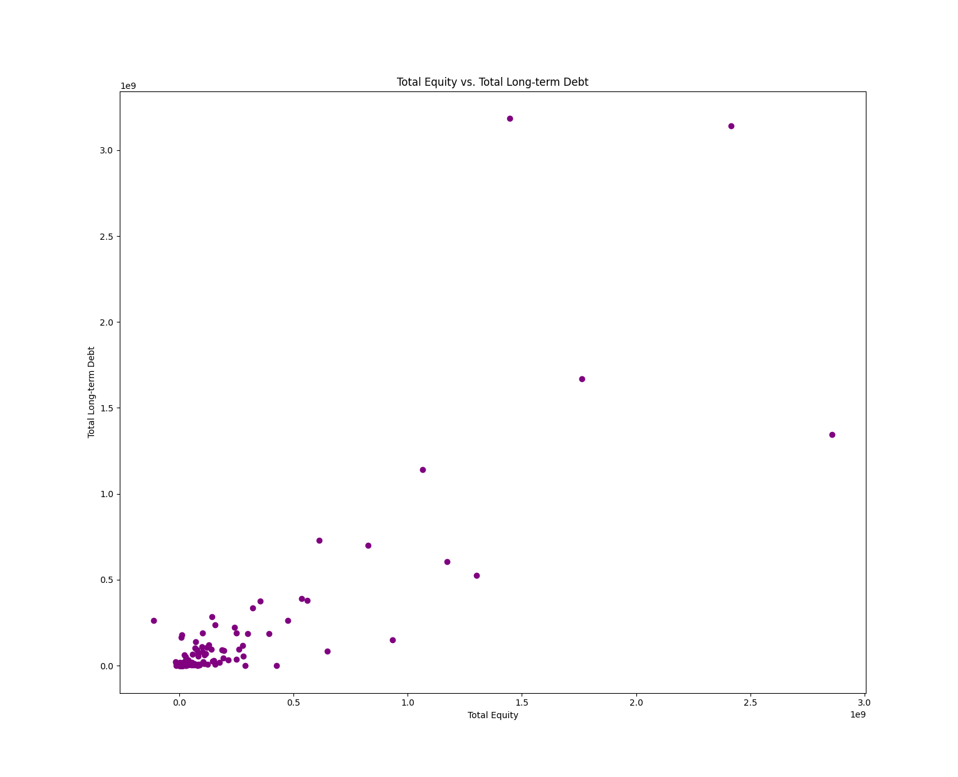
Scatter Plot:
Total Equity
vs
Total Long-term Debt
Notes:
A scatter plot is used to visualize the relationship between total equity and total long-term debt for each company. The plt.scatter() function creates a plot where each point represents a company, with total equity on the x-axis and total long-term debt on the y-axis. This plot helps to observe any correlation between equity and debt.

