Slide 1
The efficacy of lockdowns on reducing death and transmission of covid-19

Slide 2
Implications for this data:
Necessary to determine whether lockdowns are an effective strategy to use to combat the severity of COVID-19
Quantify changes in new cases and deaths over time. This is very important for policymakers when weighing against the economic challenges a lockdown will also bring.

Slide 3
The data sources:
European Centre for Disease Prevention and Control; daily global geographic distribution of covid-19: https://www.ecdc.europa.eu/en/publications-data/download-todays-data-geographic-distribution-covid-19-cases-worldwide
Wikipedia compilation containing lockdown information by country/region with lockdown start/end times: https://en.wikipedia.org/wiki/Template:COVID-19_pandemic_lockdowns
Annals of Internal Medicine; Incubation period of SARS-CoV-2: https://annals.org/aim/fullarticle/2762808/incubation-period-coronavirus-disease-2019-covid-19-from-publicly-reported

Slide 4
Considerations:
Many assumptions were made for the sake of simplification:
Lockdown procedures are assumed similar enough to be considered the same across countries.
Countries assumed to have similar enough virus infection rate that they can be directly compared.
Countries went into lockdown at about the same time after getting the virus
Population density is roughly uniform throughout each country

Slide 5
Sorting the Data:
To formulate an A/B test, the data needed to be sorted into comparable groups: one containing the time period just before a lockdown went into effect, the other containing the time period just after a country has gone into lockdown (accommodating for the incubation period of the virus)
To more evenly compare the two samples, the dates were binned based on the range being looked at (two weeks before and 2 weeks after the effects of the lockdowns) rather than grouping on the raw dates.

Slide 6
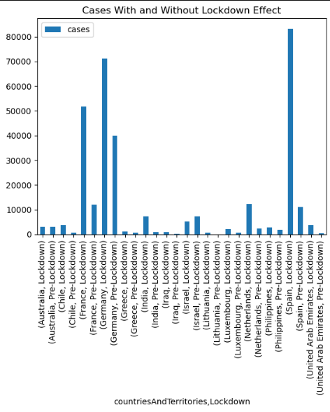
Summation of Test Death Data:

Slide 7
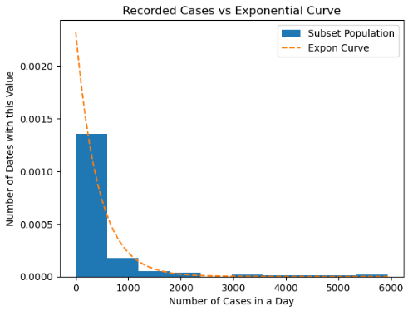
Normalized Case Distribution:

Slide 8
Summation of test death data:
Because of the exponential spread of the virus, it is difficult to tease out the trend of whether the lockdowns were effective when looking only at the raw sum, even over a very similar period of time.

Slide 9
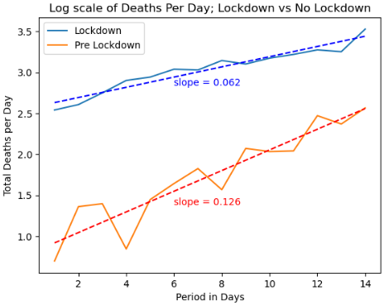
Test data summary:

Slide 10
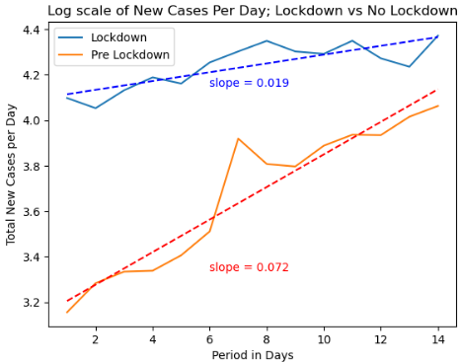
Test data summary:

Slide 11
Test Data Summary:
Even though the lockdowns alone aren't enough to stop the exponential nature of the curve, when the curves are shown on a log scale, the differences in their slopes (death rates of countries going into lockdown vs the period just before then) indicate lockdowns have a noticeable correlation with a decreased rate of infection.
This information could be useful to lawmakers when determining whether they should continue to enforce lockdown procedures for future breakouts.
As more countries decide to test the waters and release their lockdown procedures in the midst of the pandemic, that data can be gathered and those groups can be compared to either refute or verify these first trends.

