Slide 1
The efficacy of lockdowns on reducing death rate from, and transmission of, covid-19
What trends can be found from

Slide 2
The data sources:
European Centre for Disease Prevention and Control; daily global geographic distribution of covid-19: https://www.ecdc.europa.eu/en/publications-data/download-todays-data-geographic-distribution-covid-19-cases-worldwide
Wikipedia compilation containing lockdown information by country/region with lockdown start/end times: https://en.wikipedia.org/wiki/Template:COVID-19_pandemic_lockdowns
Annals of Internal Medicine; Incubation period of SARS-CoV-2: https://annals.org/aim/fullarticle/2762808/incubation-period-coronavirus-disease-2019-covid-19-from-publicly-reported

Slide 3
Considerations:
Many assumptions were made for the sake of simplification:
Lockdown procedures are assumed similar enough to be considered the same across countries.
Countries assumed to have similar enough virus spread rate that they can be directly compared.
Countries went into lockdown at about the same time after getting the virus
Population density is roughly uniform throughout each country
Test countries chosen had similar economic development to keep that potential variable constant

Slide 4
Sorting the Data:
To formulate an A/B test, the data needed to be sorted into comparable groups: one containing the time period just before a lockdown went into effect, the other containing the time period just after a country has gone into lockdown (accommodating for the incubation period of the virus)
To more evenly compare the two samples, the dates were binned based on the range being looked at (a week before and a week after the effects of the lockdowns) rather than grouping on the raw dates.

Slide 5
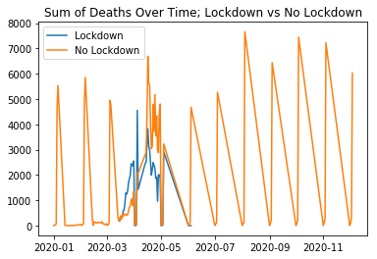
Mistakes were found:
When plotting the groups by just the raw dates, plot points are being given for dates that haven’t happened yet and other points are missing from what should be a more continuous set of points.
When going back to the data, it appears that in every country, a certain date range was inputted with their months and day fields reversed.

Slide 6
Summation of test data:
 |  | cases | deaths
countriesAndTerritories | Lockdown
Australia | False | 2457 | 7
 | True | 1399 | 6
Austria | False | 1835 | 5
 | True | 4833 | 46
Germany | False | 28150 | 210
 | True | 19666 | 330
Ireland | False | 126 | 1
 | True | 737 | 2
Italy | False | 2651 | 189
 | True | 25922 | 2391
Netherlands | False | 1846 | 71
 | True | 4971 | 358
Peru | False | 212 | 2
 | True | 346 | 7
Spain | False | 9038 | 444
 | True | 28495 | 2205
Switzerland | False | 3719 | 36
 | True | 7264 | 154
Turkey | False | 26837 | 864
 | True | 7459 | 276

Slide 7
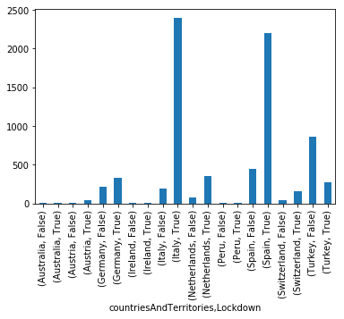
Summation of test death data:

Slide 8
Summation of test death data:
Because of the exponential spread of the virus, it is difficult to tease out the trend of whether the lockdowns were effective when looking only at the raw sum, even over a very similar period of time.

Slide 9
test_data[['cases', 'deaths']].describe()
 | cases | deaths
count | 127.000000 | 127.000000
mean | 1401.283465 | 59.874016
std | 1681.599682 | 110.530251
min | 0.000000 | 0.000000
25% | 142.500000 | 0.500000
50% | 600.000000 | 7.000000
75% | 2542.500000 | 69.000000
max | 6584.000000 | 514.000000

Slide 10
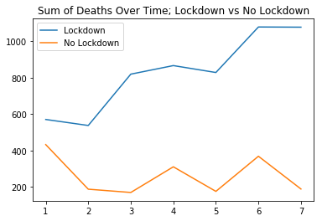
Test data summary:

Slide 11
Test Data Summary:
From this sample set of data, it is hard to see if locking down stifled the infection rate over similar periods of time. Even if the death rate was slowed, going under lockdown apparently did not stifle the infection rate enough to actually cause a decrease in rates of death during this time period. The time period before lockdown seems more stable on average, which could be the result of early exponential datasets seeing relatively miniscule changes at the beginning

Slide 12
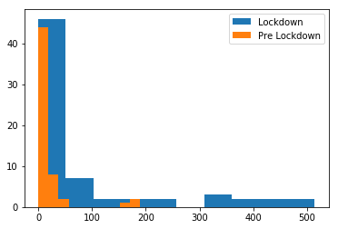
Distribution of deaths per day; Lockdown vs Pre-Lockdown

Slide 13
stats.wilcoxon((test_data[test_data['Lockdown'] == True]['deaths']-test_data[test_data['Lockdown'] == False]['deaths']))
WilcoxonResult: (statistic=0.0, pvalue=1.3894515759554441e-22)

