Slide 1
Firmware Workgroup Session 2

Slide 2
Last time…
Introduction to tools
ISE vs. Vivado (sticking to ISE here)
A bit on VHDL:
Process blocks.
Libraries: I recommend “IEEE.NUMERIC_STD.ALL” for best cross-vendor compatibility.
Only use std_logic and std_logic_vector
UCF files to associate top-level design with FPGA pins.
Blinky lights examples.

Slide 3
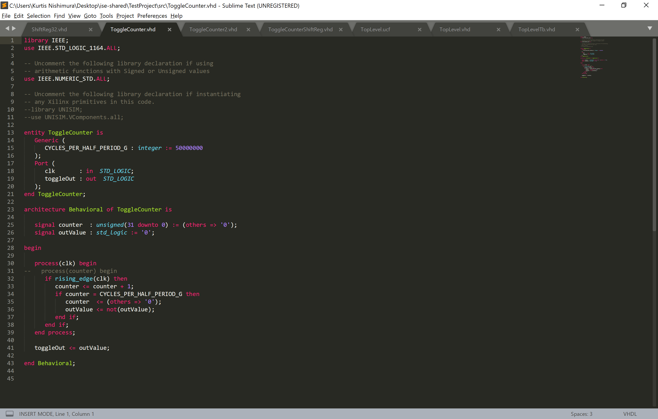
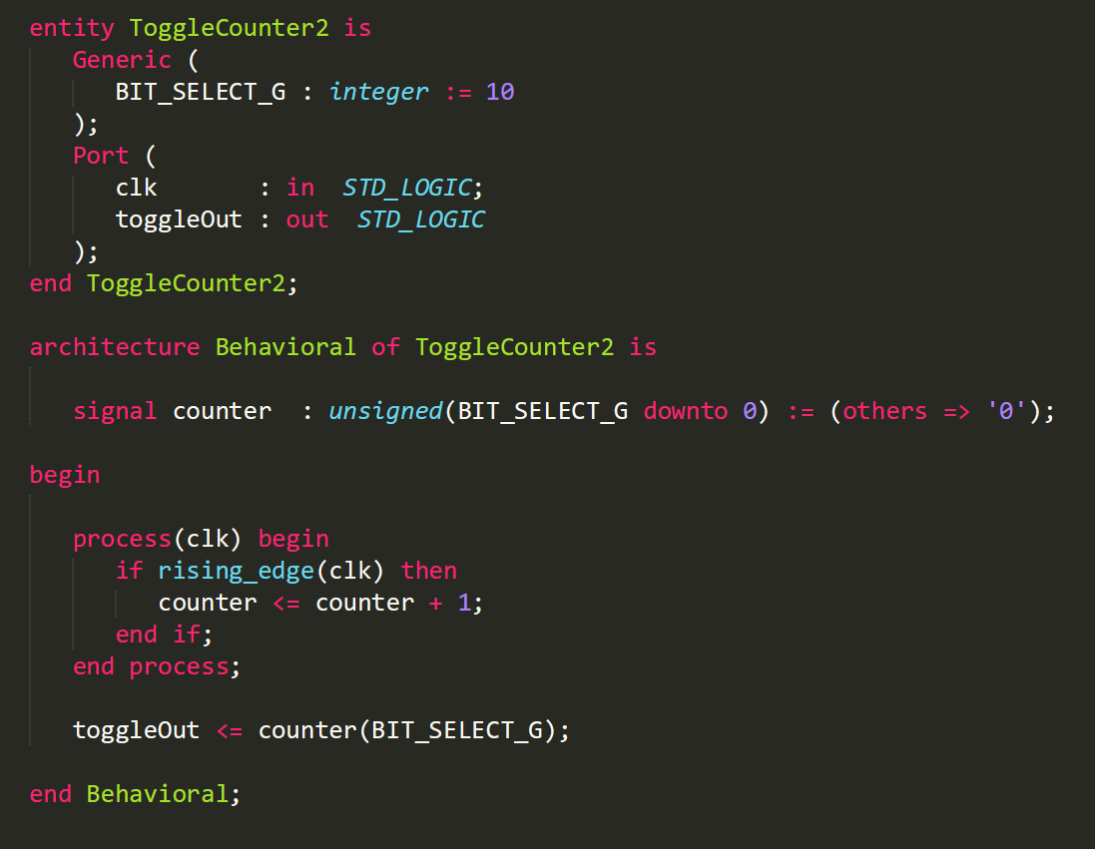
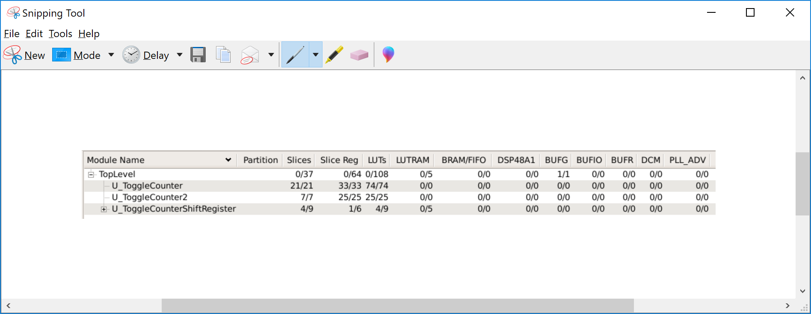
Blinky Lights Implementations (1)
Goal was to flash an LED at ~1 Hz.
Two implementations looked very similar:
*Library definitions not shown for space… check out code on github.
ToggleCounter compares a 32-bit counter against a specific 32-bit value.
Takes significantly more resources, but can hit its target exactly.

Slide 4
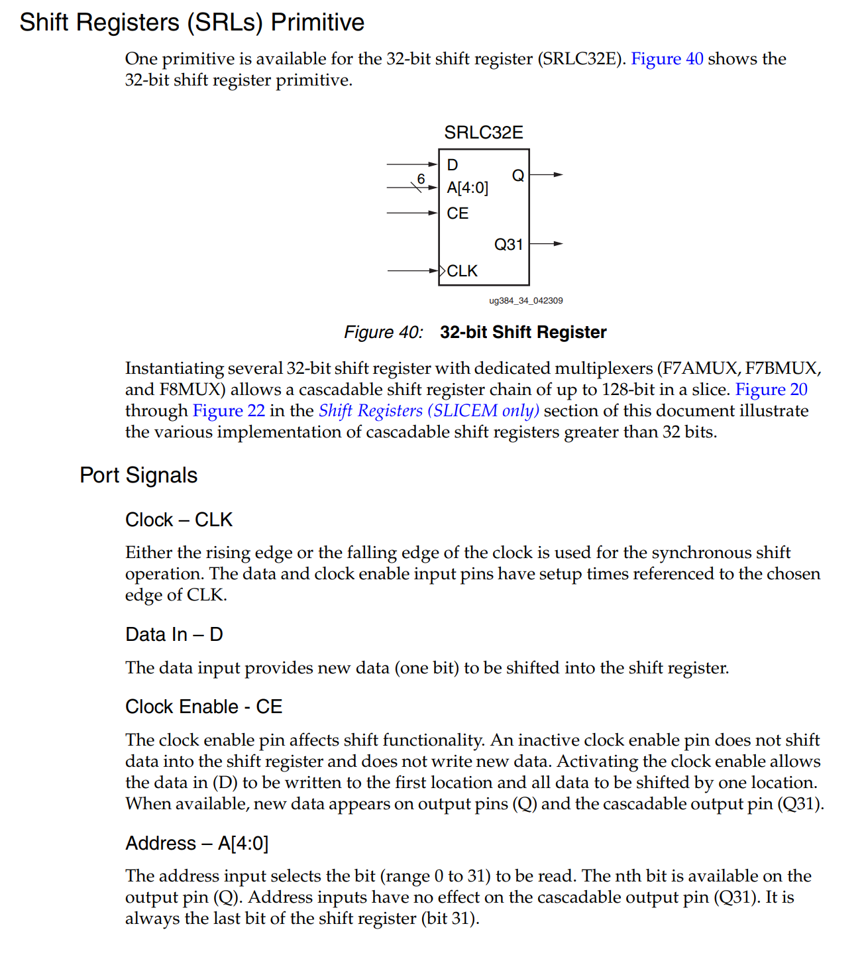
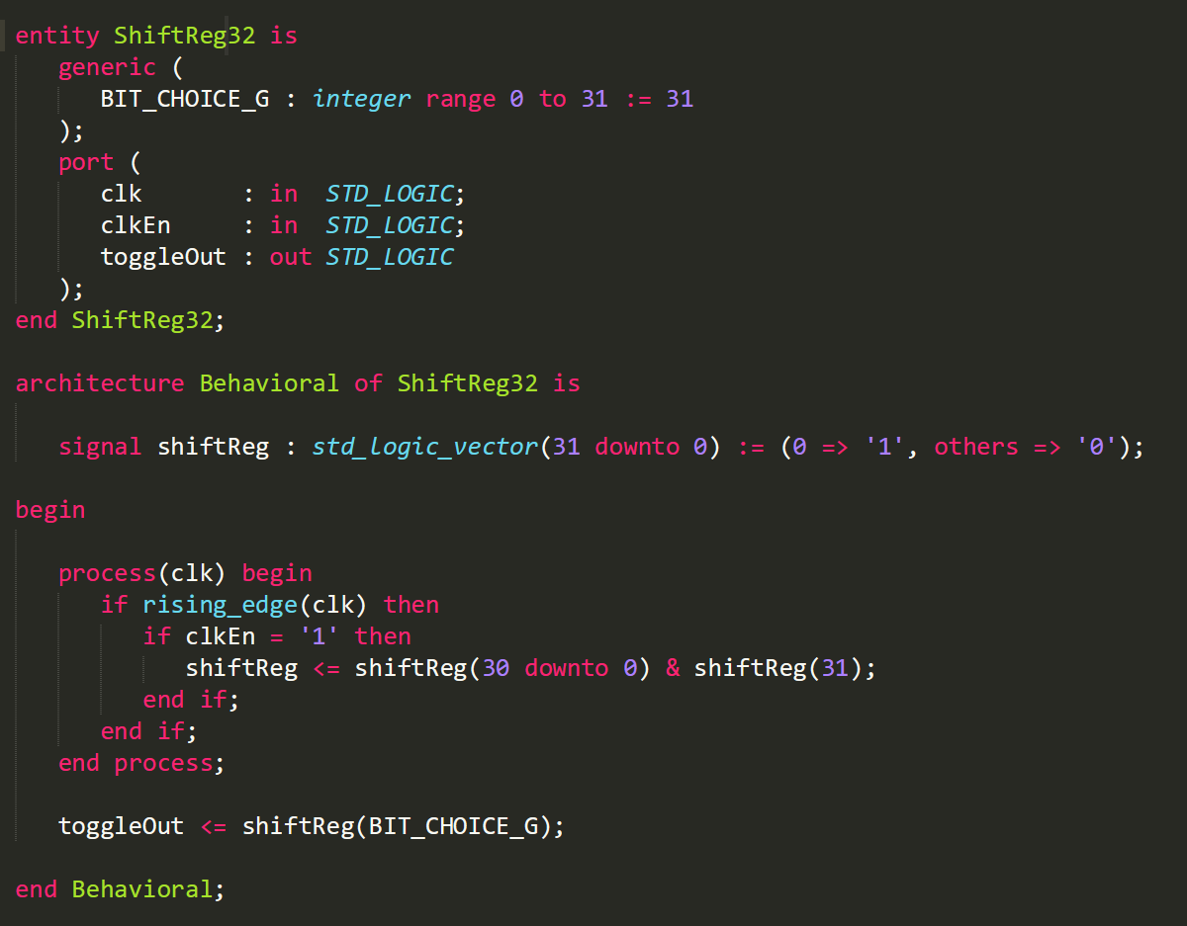
Blinky Lights SR Implementation (1)
Per UG384 – “Spartan-6 FPGA Configurable Logic Block User Guide”
FPGA has shift-register primitives.
If we can map our logic onto them specifically, we can make more efficient use of the FPGA primitives.
So we used as a base a Shift Register:

Slide 5
Blinky Lights SR Implementation (2)
We’ve written a very specific kind of shift register:
Bits rotate around from top to bottom (rather than losing the bit that’s shifted away).
Sometimes called a “barrel shifter.”
Our shift register has 1-bit high, all others low.
One bit is selected as the output to the port.
This has limitations. Since the shift register is 32-bits long, it can at most give you a pulse every 32-cycles.
So if we want to divide down by a large number (i.e., to turn 40 MHz into ~1 Hz) then we need to chain many of these together…

Slide 6
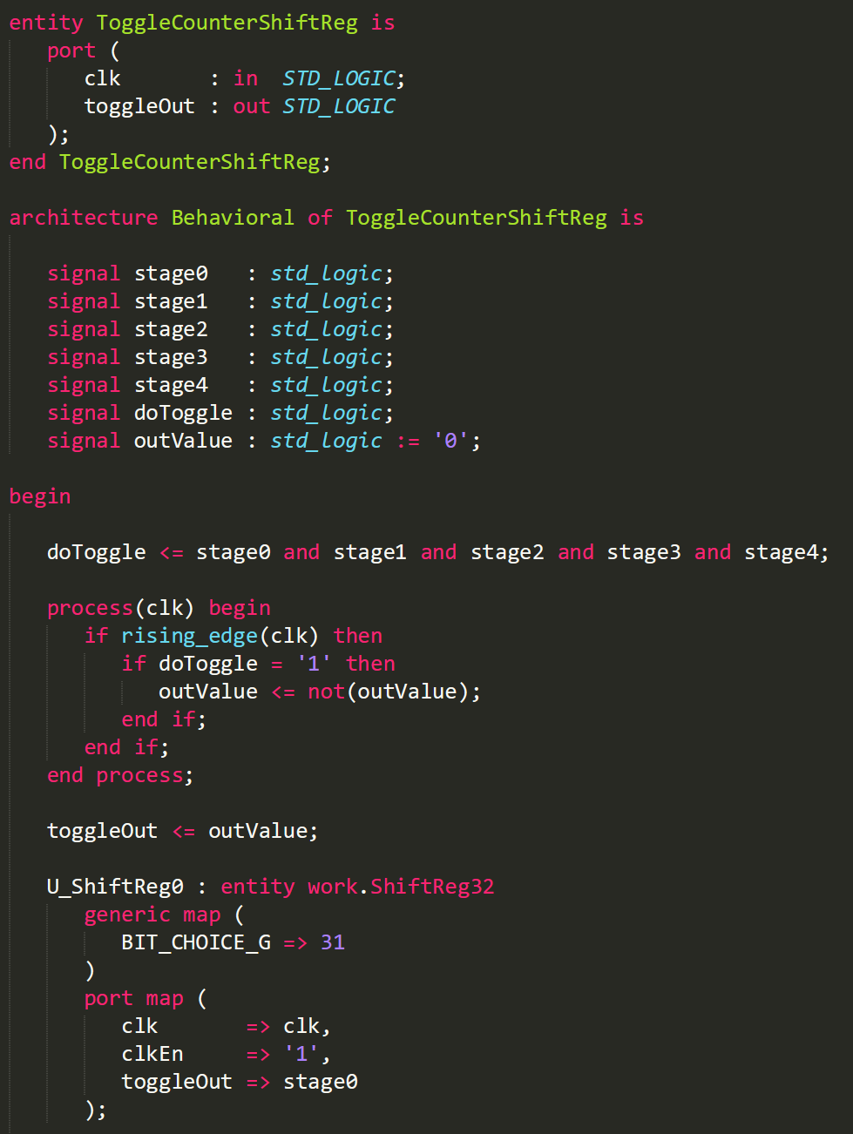
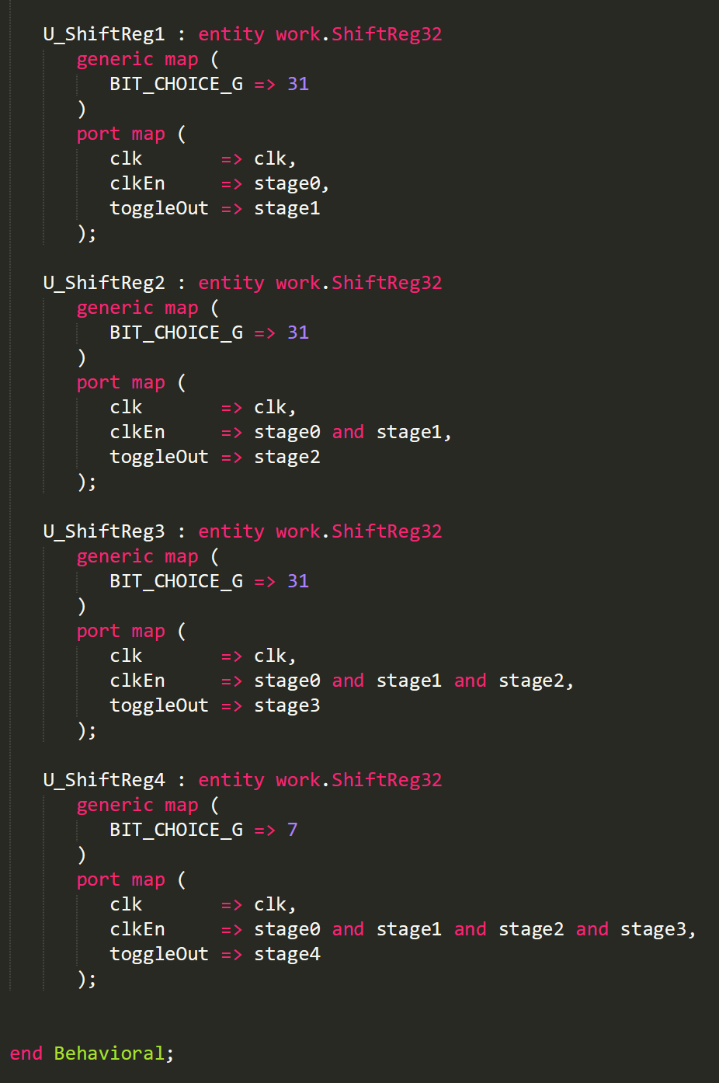
Blinky Lights SR Implementation (3)
Example of chaining these together…
Even more efficient, as expected.
…but frequency is a bit off.

Slide 7
Debugging in Simulation
Even for this extremely simple set of firmware, compilation takes a couple minutes.
This quickly grows to order of an hour for larger devices, more complicated designs.
Doing quick change-compile-check is not feasible.
➔ Whenever possible, debug in simulation first…

Slide 8
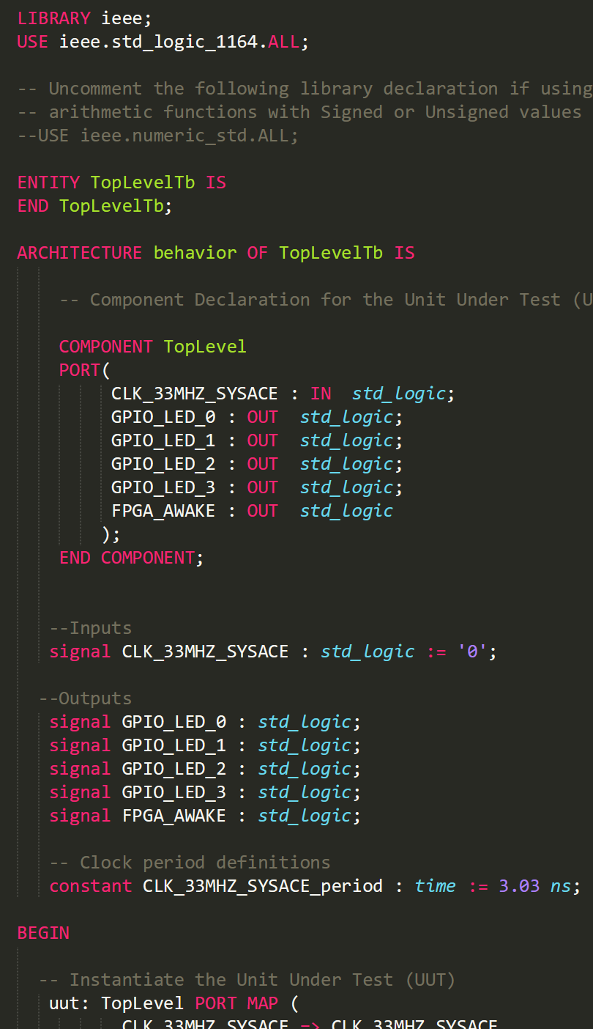
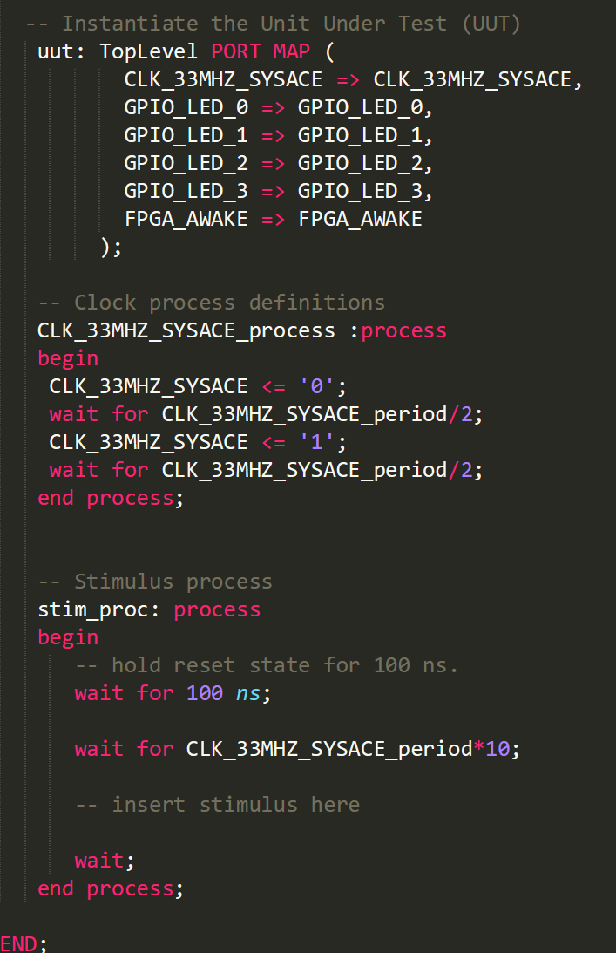
Simulation Code
Our project is small enough that we can actually simulate the top level.
Usually, simulate only smaller blocks!
To simulate, you need a “testbench”:
Verilog testbenches also possible.
Note no ports in the entity description.
Note non-synthesizable statements like “wait 100 ns”
Synthesized logic has no concept of time.
➔ Note even here, though we *can* simulate top level, it may not be a good idea…

Slide 9
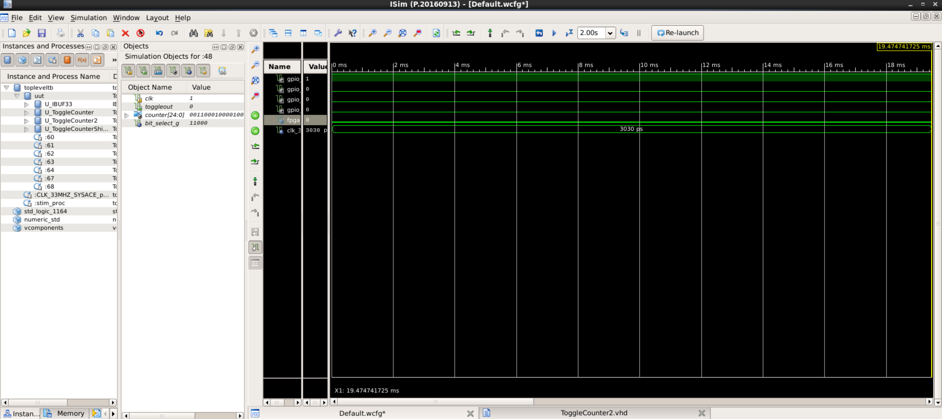
Simulation Output
This simulation has gotten about 1/50th through one desired cycle after a few minutes…

Slide 10
Optimizing for Simulation
Can be useful to have hooks (usually as generics) in your code that you can use to speed up simulation of processes that are usually slow.
For example… if you simulate only ToggleCounter…
You can use a smaller value for the generic CYCLES_PER_HALF_PERIOD_G when you instantiate in the simulation file.

Slide 11
Debugging the SR Implementation
Let’s instantiate our SR / barrel shifter.
Actually, let’s do two of them with different parameters and see what we get…
ShiftReg32Tb.vhd
(with some intentional errors)
Notes:
Some items to note…
Implementation vs. simulation lists
Initializations / undefined.
Multiply driven signals.
Process blocks and simulation/logic coherence.

Slide 12
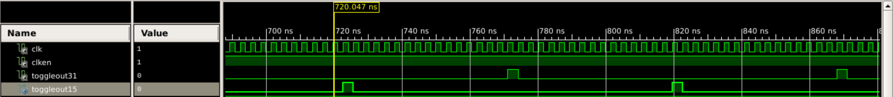
What’s wrong?

Slide 13
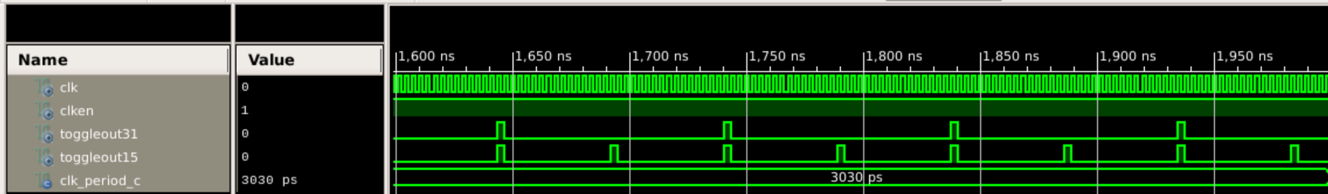
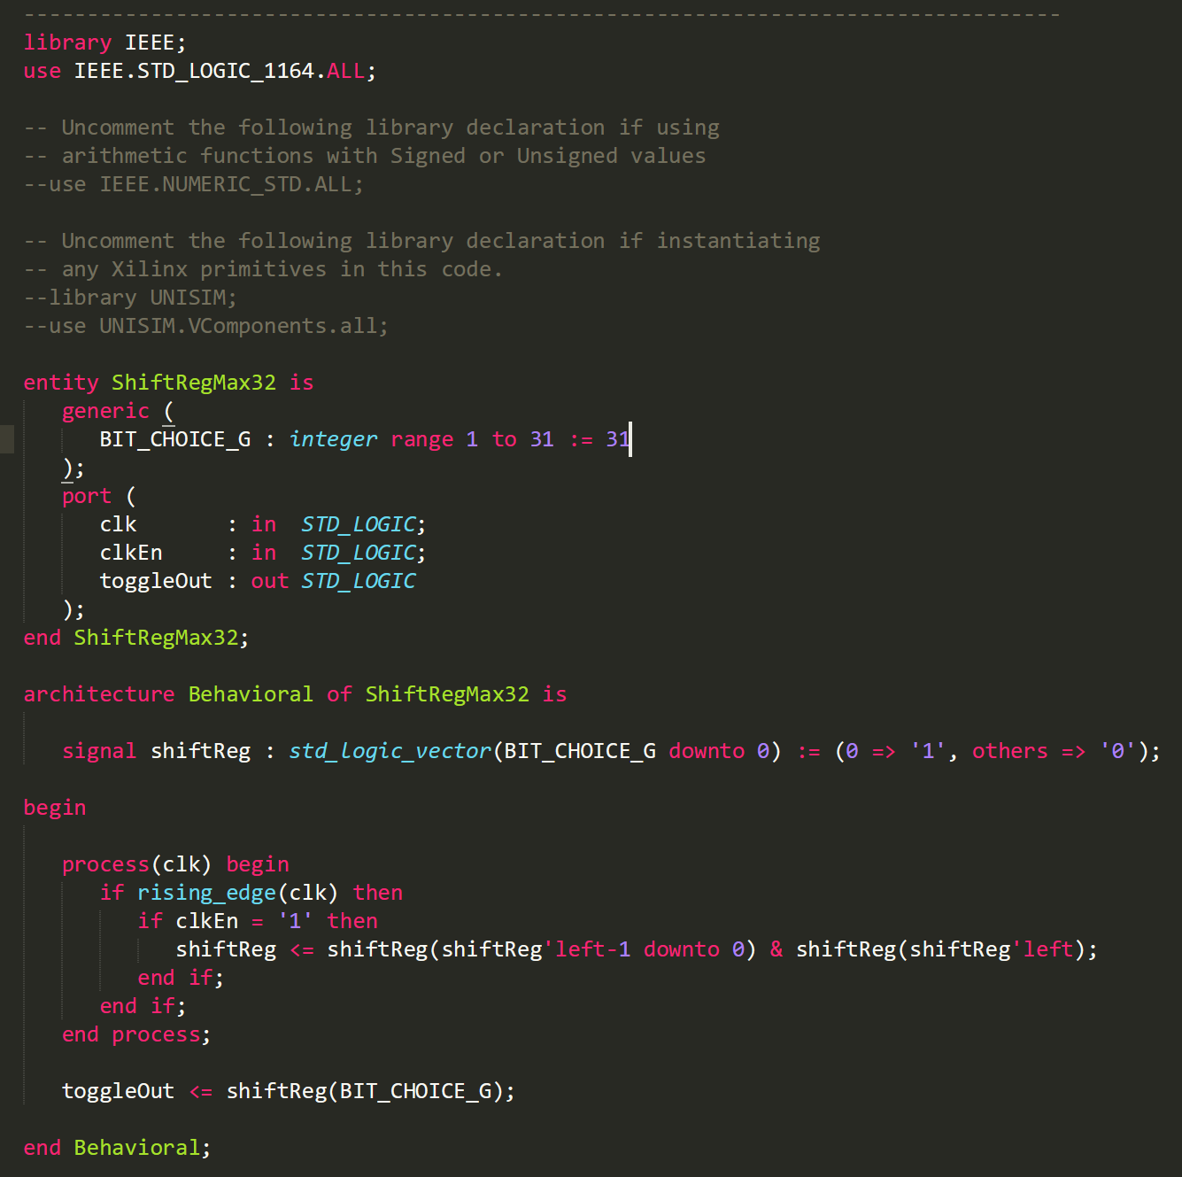
Fixed Version…
Hurray!
Exercise for next time…
Look through the module that instantiates this
ToggleCounterShiftRegMax32.vhd
Modify it to get as close to 1 Hz toggling as you can.

Slide 14
Other notes… next time?
Synthesis – max clock rate estimates.
Timing constraints.
IO standards.
Records.
Packages (e.g., StdRtlPkg.vhd).

