Slide 1


Slide 2
TrueAIM’s Goals
Small
Precise
Quick
Reactive

Slide 3
Why Small?
Lightweight model
Fine-tuned weights
Limited resolution
Fits on small form factor devices

Slide 4
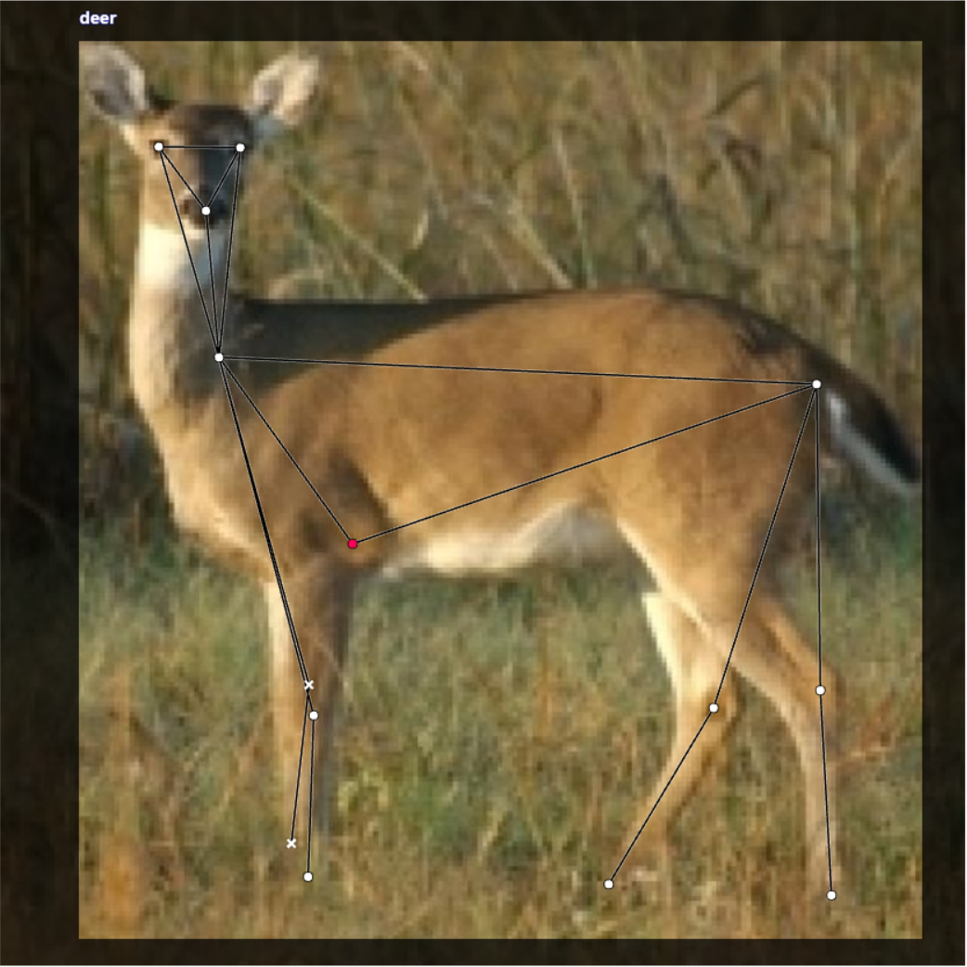
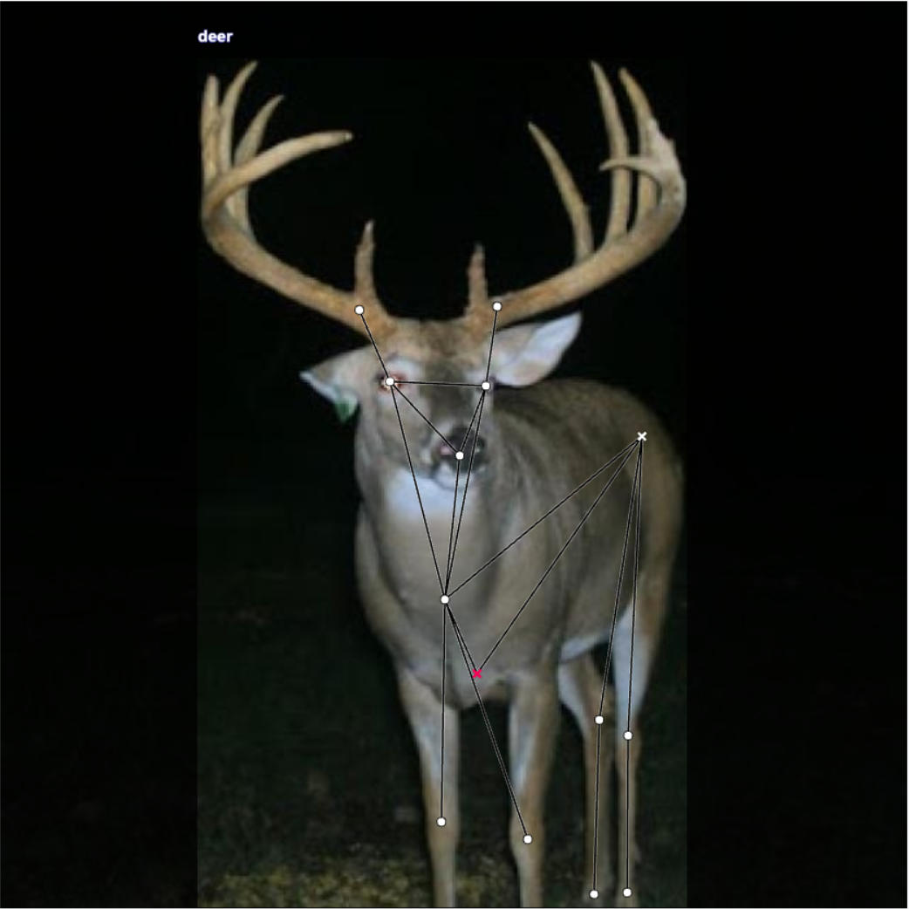
Why Precise?
Accurate measurements
Visually clear
Obvious cues
Distance | 500 yds
Caliber | .308
Grain | 155 (~.35oz)
Velocity | 2700 fps
Bullet Drop | -62.9”

Slide 5
Why Quick?
Update with video
Responsive feel
Smooth movement
Slow updates change aim point drastically

Slide 6
Why Reactive?
Adjust with target profile
Change with target viability
Blocked target

Slide 7
What Does the Future Hold?
Target Profiles
Backend Training with Automated Annotations
Weather Effects
Target Selection

Slide 8
Questions?

