Slide 1
EMOTION DETECTIONUSING DEEP LEARNING
Sravani Medarametla sravanimedarametla@my.unt.edu
Chandrika Chandra chandrikachandra@my.unt.edu
Akhila Sannayila akhilasannayila@my.unt.edu
Nitish Reddy Gangannagari nithishreddygangannagari@my.unt.edu
Ram Prasad Jampani ramprasadjampani@my.unt.edu

Slide 2
ABSTRACT
Deep learning techniques are utilized in this Project to develop an emotion recognition system. The images are grouped into seven emotional content categories: joyful, neutral, sadness, rage, surprise, disgust, and horror. The objective is to create a deep learning model, particularly one that incorporates convolutional neural networks (CNNs), that is capable of accurately identifying these emotional expressions, even when they are nuanced or sophisticated. By combining diverse data sources, the study hopes to get a comprehensive knowledge of emotional states while also overcoming the limitations of cross-cultural emotion detection.
The practical significance of this technology arises from its potential applications, which include sentiment analysis for customer feedback, mental health evaluation, and human-computer interaction. Finally, these applications will aid in the development of more empathetic and responsive AI systems. The primary purpose of this project is to develop emotion detection technology, which has the potential to improve human-AI interactions in a range of applications including human-computer interaction, personalized user experiences, mental health screening, and sentiment analysis. Detecting emotions with several data sources.

Slide 3
Things we have accomplished so far……
We have successfully loaded the image datasets.
Performed the analysis on the data to see if preprocessing is required or not.
Data distribution
Decided how to implement Model architecture
Decided how to deploy the model

Slide 4
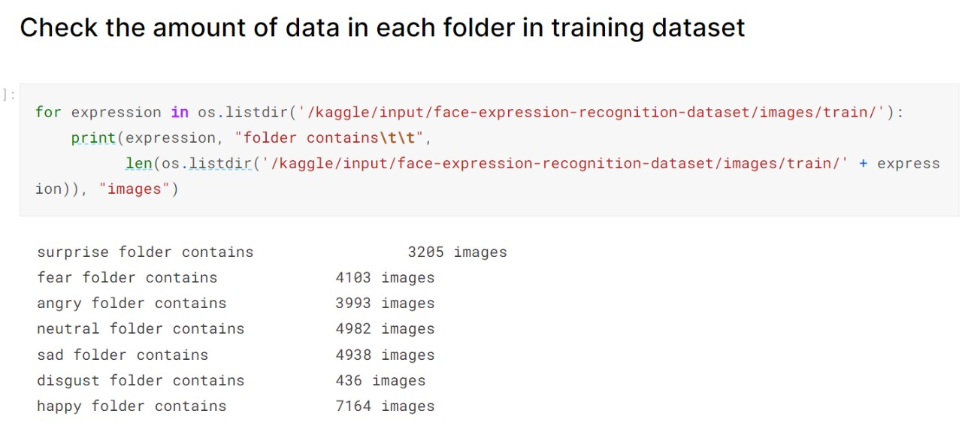
Data Analysis
We have loaded the datasets and checked total number of images in the training dataset.

Slide 5
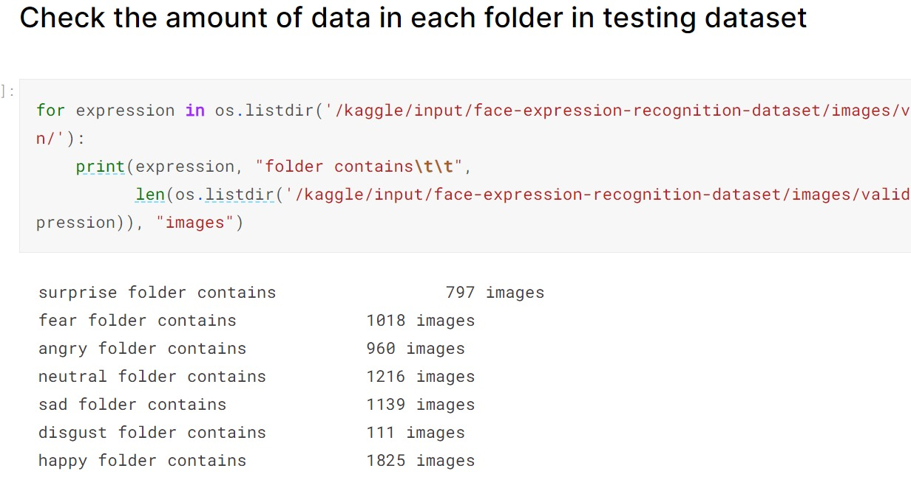

Slide 6
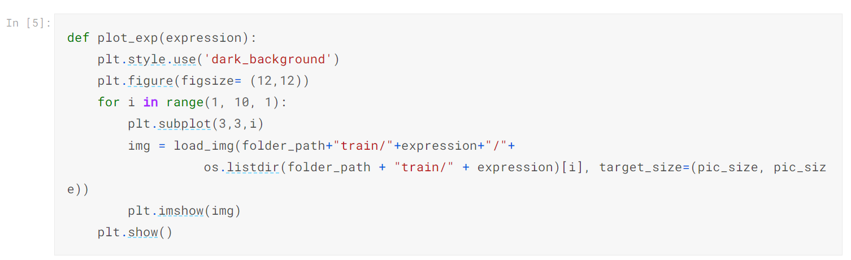
Code for plotting the images in the training dataset

Slide 7
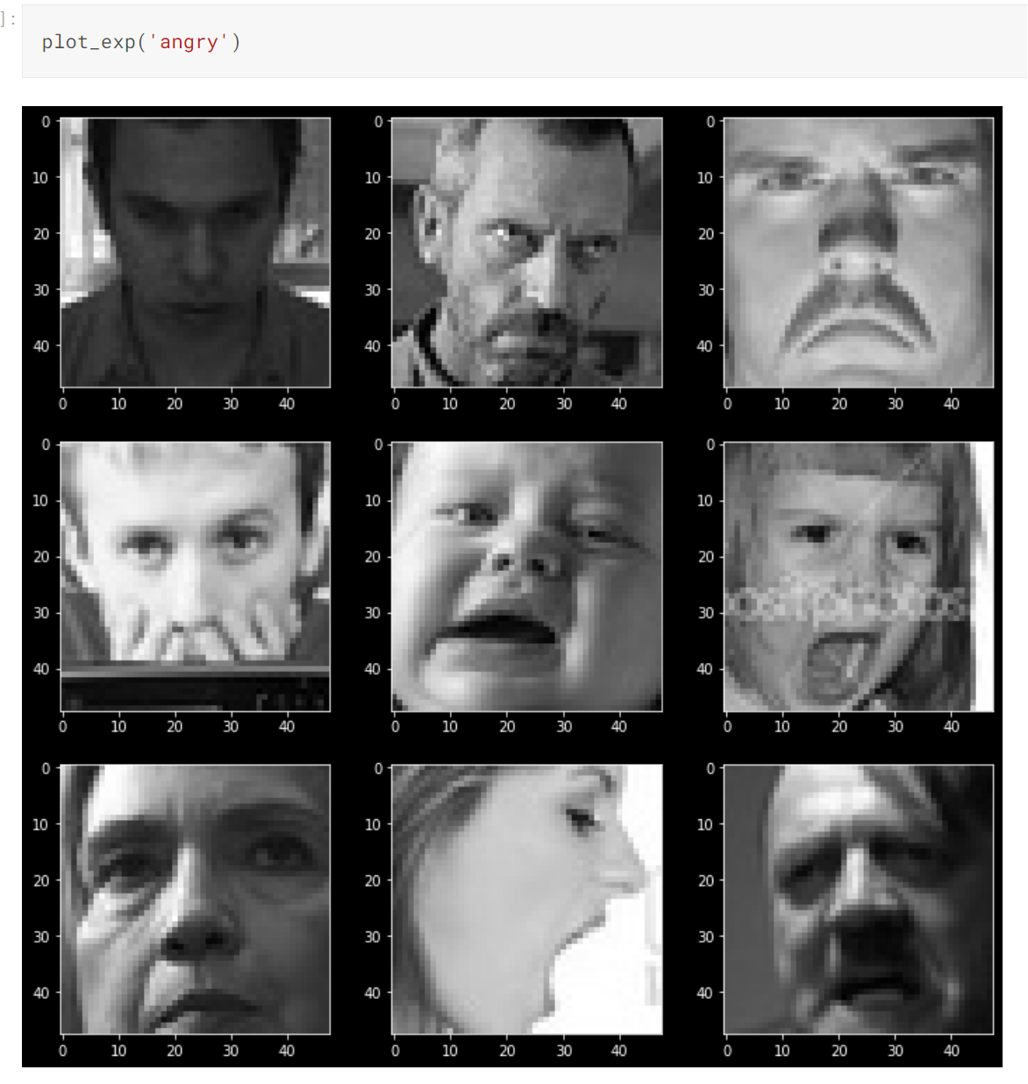

Slide 8
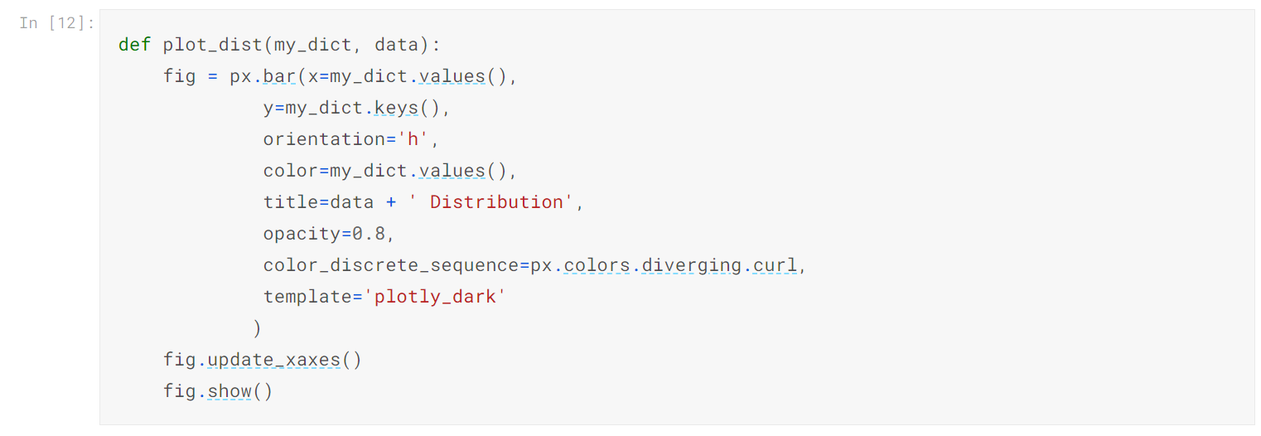
Code for the distribution of training dataset.

Slide 9
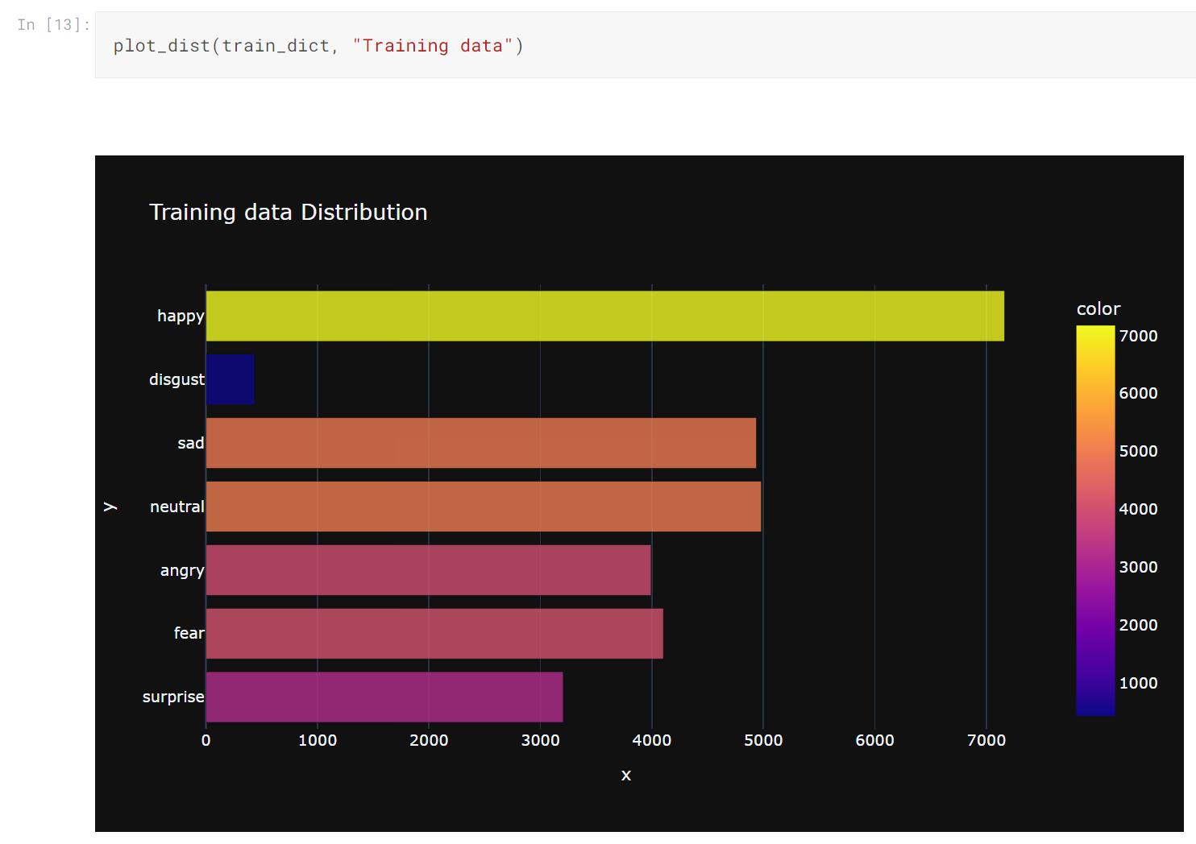

Slide 10
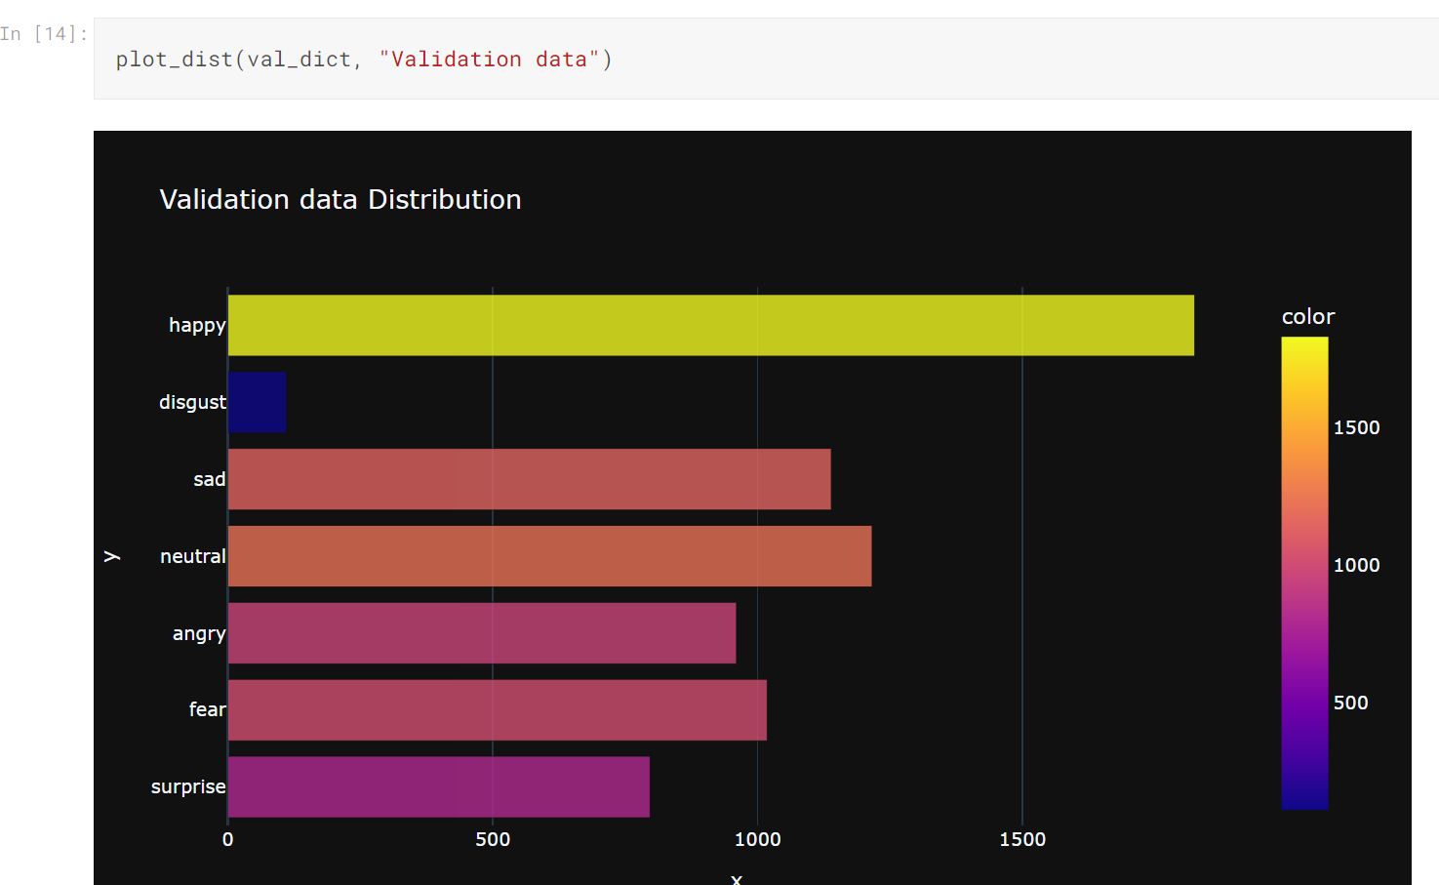

Slide 11
Models Used
We are going to use
CNN - Convolutional Neural Network
RNN - Recurrent Neural Network
After evaluating the both models scores we’ll decide on what to use for the production deployment.

Slide 12
Purpose of using CNN
Convolutional Neural Networks (CNNs) are utilized in emotion detection to effectively evaluate facial expressions and images connected to emotions. They're able to effortlessly separating crucial details from pictures recognizing relationships between facial components, and being robust to modifications in lighting and background circumstances. CNNs might be adjusted for recognizing emotions activities using models that have been trained and transfer training to conserve precious resources and time. They are ideal for applications that require immediate response such as video conferencing or interaction between humans and computers, wherein emotions can be determined from real-time video feeds. Overall, CNNs play a significant part in consistently and efficiently recognizing expressions based on images.

Slide 13
Purpose of RNN
Due to their unique capacity to detect time-dependent and sequential trends in data, recurrent neural networks (RNNs) are used in emotion detection. This renders them useful for tasks involving feelings being expressed in many modalities like text, audio, and pictures. Emotions often fluctuate over a period of time. RNNs excel at simulating these variations by processing data repeatedly, helping in detecting subtle shifts in emotional states. . Through its ability to retain memory of previous inputs, neural networks can capture the setting and details of emotional content, making them an excellent instrument for understanding and determining emotion in an array of datasets and genres.

Slide 14
Future Plans
Generating the data suitable format for the model using ImageGenerator.
Designing model Architecture using RestNet50 and number of layer we’re going to use in the model.
Discuss on what Activation function to use and loss function.
Discuss on how to evaluate the model performance.
Creating User Interface (UI) both front-end and back-end.
Model deployment.
How to implement it with OpenCV to innovate.

Slide 15
Deployment
For the deployment we have decided to use Heroku.
We’ll create a Flask route that accepts image data from the user and passes it to model for inference.
We’ll signup for Heroku account .
Initialize a Git repository in our app director.
Use the Heroku CLI to create a new Heroku app.
Deploy our app to Heroku by pushing Git repository to the Heroku remote.

Slide 16
Goals
Compile the model with appropriate loss and optimizer routines.
Reducing overfitting and underfitting.
Getting good generalization.
Create a real-time emotion detection module.
Capture video input (for example, via a camera) and analyze it (grayscale, face recognition).
Integrate the learnt model into real-time emotion prediction.
Creating perfect model for predicting emotions,
Create a straightforward user interface for interacting with the emotion recognition technology.

Slide 17
Individual Progress
Sravani : Helped with the data loading and analyzing. Created a Google Drive folder for the project and GitHub repository.
Chandrika: Worked on data loading and analyzing. Started working on the designing of CNN model and Working on fitting the data to the model.
Akhila: Decided on how to deploy the model using Heroku and Flask web framework. Working on the dummy model to test the deployment.
Nithish: Worked on data distribution. Currently working on designing RNN model and how to fit the data to the RNN model.
Ram: Helping with dummy model deployment, conducting meeting to discuss completed tasks and challenges and allocating tasks.

Slide 18
THANK YOU

