Slide 1
Team: Health Inspections
Ryan Permenter, Rachel Podemski, Clarence Robinson & Brett Thompson

Slide 2
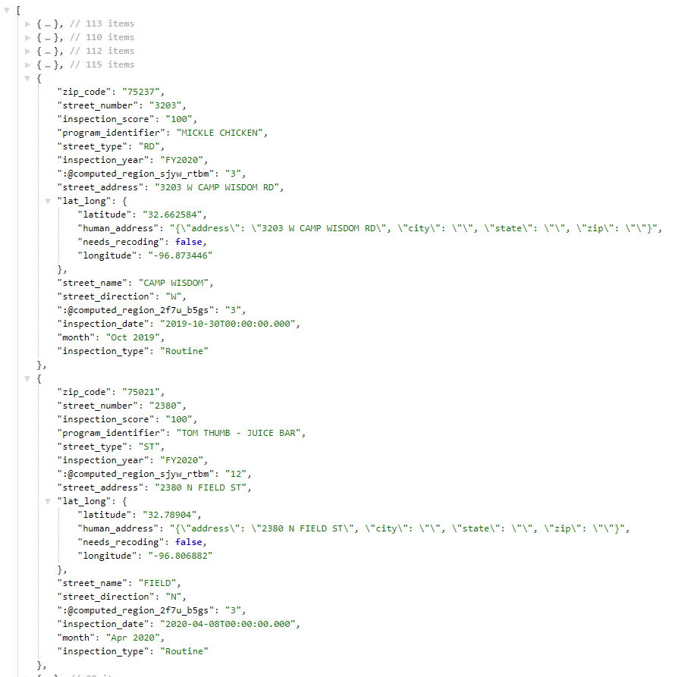
INTRODUCTION
Our dataset contains details of over 50,000 health inspections and scores in the greater Dallas area dating back to October 2016.
The data is intended to communicate the following:
Name of Establishment
Physical Location
Overall Inspection Score
Point deduction of individual violations
The data is provided by the Dallas Code Compliance Services Department and is updated monthly.

Slide 3
Methodology
Map
Bar Chart
Line Graph
Scatter Plot

Slide 4
Conclusions
Conclusion #1 – Map
Conslusion #2 – Bar
Conclusion #3 – Line
Conclusion #4 – Scatter
Overall Conclusion – Dataset
The food establishments at the intersection of Knox Street & IH-75 have had consistently lower health inspection scores compared to the greater Dallas area for the past 4-years.
The food establishments to the Northwest of Dallas Love Field also tend to have lower inspections scores in the past 4-years.

