Slide 1
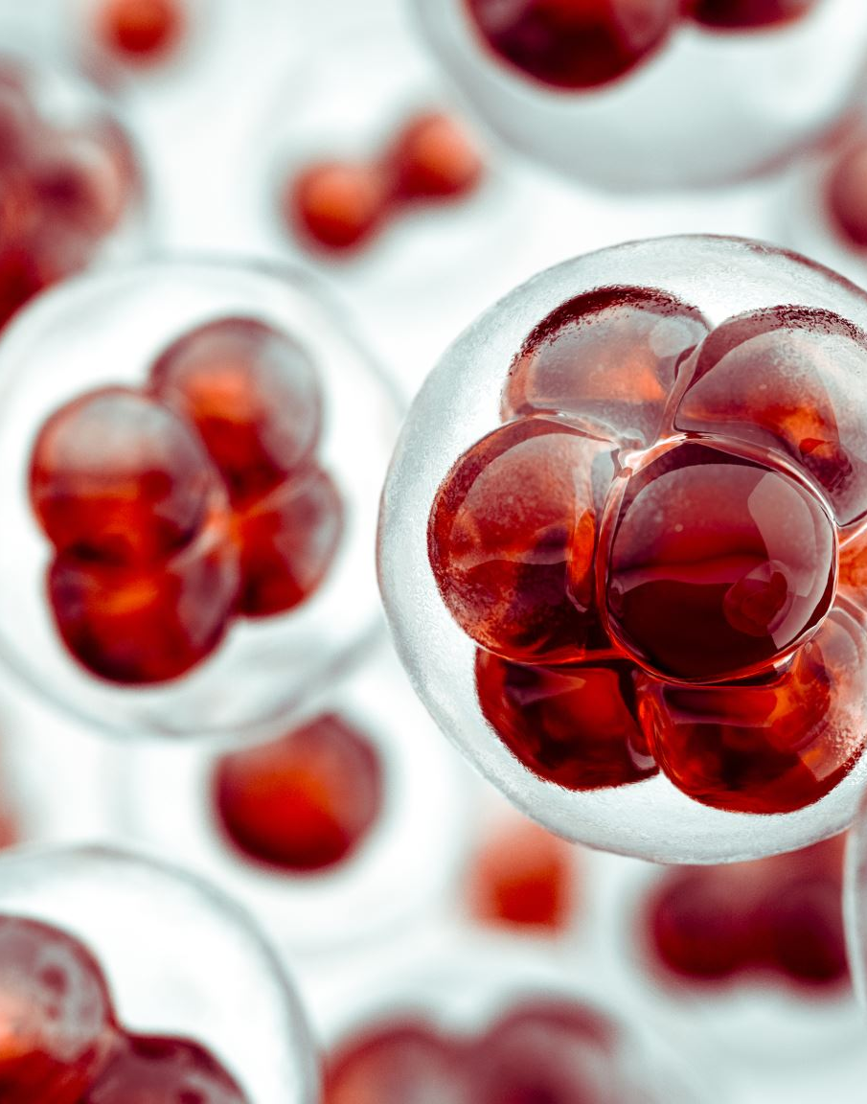
Predicting Liver Cirrhosis Stage Based on Clinical and Biochemical Features

Slide 2

Introduction
Liver cirrhosis is a chronic liver disease where healthy liver tissue is replaced with scar tissue (fibrosis).
This scarring blocks blood flow through the liver and impairs its function.
It often results from long-term damage due to:
Chronic alcohol abuse
Hepatitis B/C infections
Non-alcoholic fatty liver disease (NAFLD)
Symptoms may include fatigue, jaundice, abdominal swelling, and confusion.
Cirrhosis is a progressive disease and can lead to liver failure or liver cancer if untreated

Slide 3
Dataset Overview
Dataset: Cirrhosis.csv
Records: ~312 patients, 20 features.
Target variable: 'stage' (severity of cirrhosis).

Slide 4
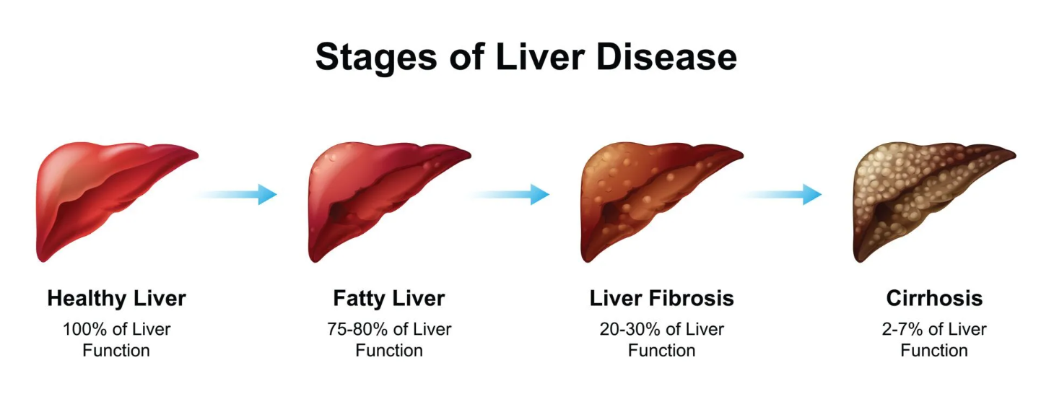

Slide 5
Data Cleaning & Preprocessing
Missing values imputed with median (e.g., copper, platelets).
Converted age from days to years.
Selected key medical and biochemical features for modeling.

Slide 6

Exploratory Data Analysis
Correlation heatmap shows relationship between features.
Strong correlation between bilirubin and stage.
Identified most predictive variables.

Slide 7
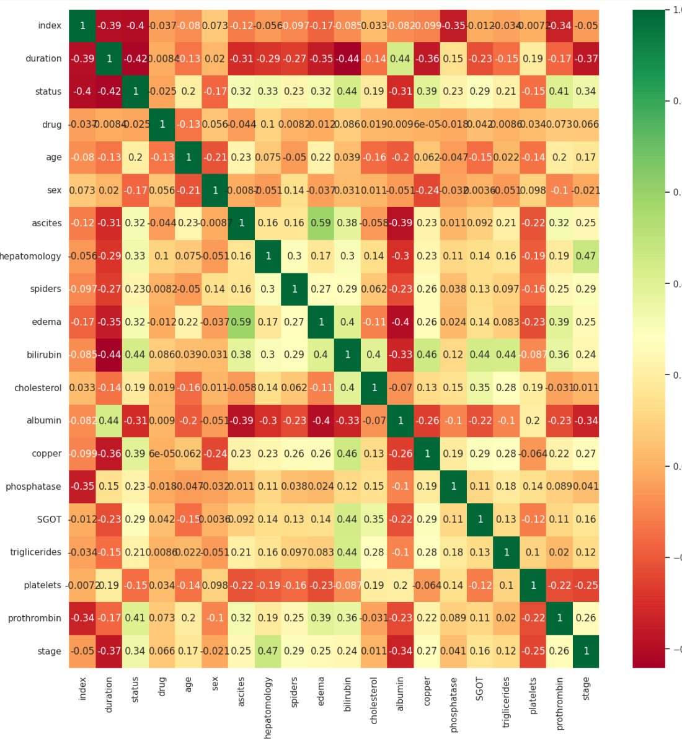

Slide 8

Model Preparation
X: Selected features like age, bilirubin, copper, etc.
y: Target variable 'stage'.
Train-test split: 80% training, 20% testing.

Slide 9
Modeling Approach
Used custom-built neural model(ANN) with ReLU activation.

Slide 10
Evaluation Metrics
Accuracy to evaluate predictions.
R² Score used to measure regression performance.
Potential use of confusion matrix (not shown here).

Slide 11
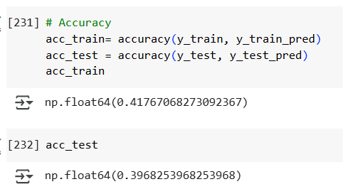
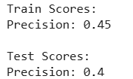
Results & Interpretation
Model successfully predicted some stages accurately.
Stage misclassifications occurred in borderline cases.

Slide 12
Challenges & Improvements
Small dataset size limits accuracy.
Investing more time on this dataset is required
Missing data imputation may introduce bias.
Future: Use Random Forests, XGBoost, or deep learning.

Slide 13
Conclusion
Machine Learning can support early diagnosis.
Accurate staging helps guide treatment decisions.
Further research can enhance model robustness.

