Slide 1

Prediction of price and sqft_area using Raw house data
An Investor approach

Slide 2

Investors POV
Investors like to buy a house in a busy place, more land/sq.ft and less taxes
Most of the investors, just invest in the place and then, use it for revenue generation
Investors tend to pay nothing/bare minimum HOA, as they don’t live there.

Slide 3
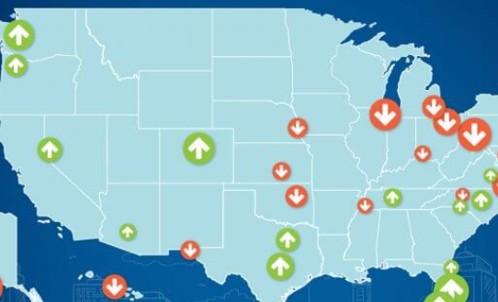
My Approach
Investors give me the coordinates of the location, they are looking to purchase home.
My KNN model will find the bin range for that coordinates, resulting in finding the price per sqft in that area.
But, not only coordinates decide the expected sq.ft for the the price investor wants to invest.
There are also other factors such as number of bedrooms, number of bathrooms and fireplaces/garages, he wants.

Slide 4
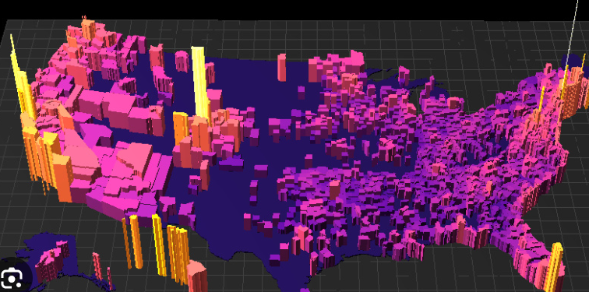
My Approach
So, my model needs to predict the sqft which investor can buy with his savings/ investment, number of bedrooms, bathrooms, garages, and fireplaces he wants in the home.
So, I took Price per sq.ft as my target variable.
Since, PPS is a continuous variable, I used MultiVariate Linear Regression giving the inputs bedrooms, bathrooms, garage, HOA, Fireplaces.

Slide 5
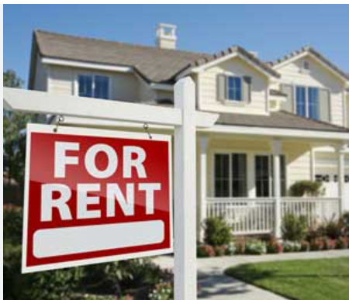
Why only those features?
Bedrooms, Bathrooms and garages/Fireplaces are crucial in any household and are the main factors to decide the rental income.
These are the basic features any family looks while renting a home. So, Investor is looking specifically on these features.
And, densely populated area has high probability of people to take home for rent. So, longitude, latitude and zipcode too matters.

Slide 6
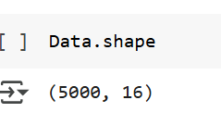
The Experiment
We have a dataset with 5000 rows and 16 columns
Our attributes are:
MLS, sold_price, zipcode, longitude, latitude, lot_acres, taxes, year_built, bedrooms, bathrooms, sqrt_ft, garage, kitchen_features, fireplaces, floor_covering, HOA
Columns: [MLS, sold_price, zipcode, longitude, latitude, lot_acres, taxes, year_built, bedrooms, bathrooms, sqrt_ft, garage, kitchen_features, fireplaces, floor_covering, HOA]

Slide 7

Data Cleaning
I have cleaned the data and exported into csv.
I am using the cleaned data from previous Data Cleaning and EDA as my input in this model.

Slide 8
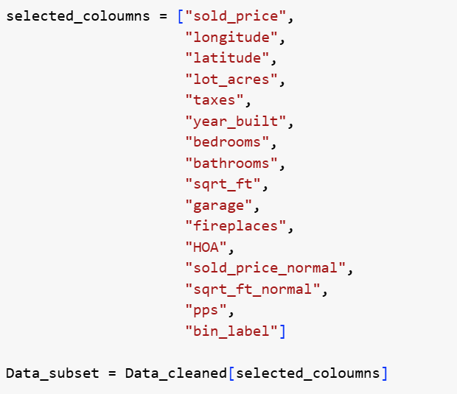
New Attributes
Added new features :
pps(Price Per Sqft)
Binned the pps values in intervals of 100 each ranging from 1 to 7
Bin range 1 refers to the records having price per sqft ranging from 50$ to 150$ and,
Bin range 7 refers to the records having price per sqft ranging from 650$ to 750$.

Slide 9
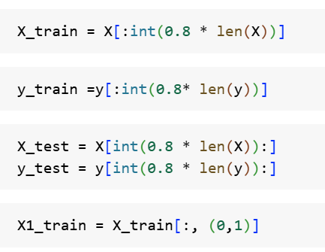
Splitting Train and Test sets
I have splited the data in 80:20 ratio, with the first 80% of Data as Train data and last 20% of Data as Test data
I have taken the target variable as Bin_range.

Slide 10
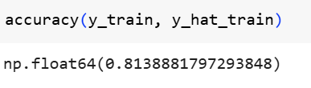
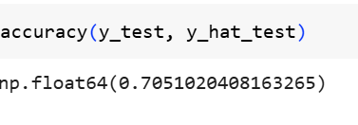
KNN
Developed a KNN algorithm, to predict the bin labels based on the latitude and longitude.
Achieved a Training accuracy of 81.38% and testing accuracy of 70.51%

Slide 11
KNN Findings
Now, I was able to get the bin in which the given latitude and longitude falls, i.e., range of price per squarefoot area at given coordinates.
But, I need the exact price per squarefoot, which is a continuous data. So, Regression model helps me to get exact PPS.

Slide 12

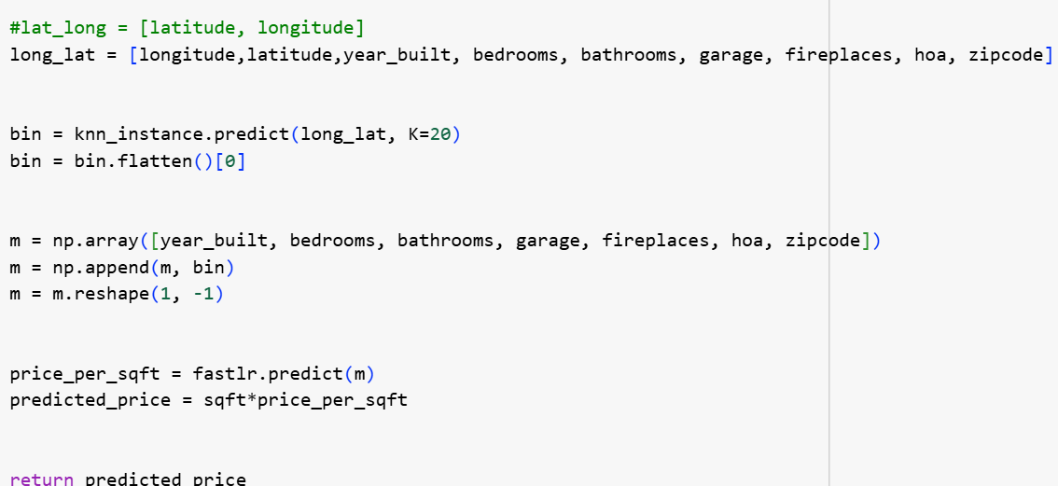
New Attribute
I have added a new column to the original dataset named ‘bin’ generated by using KNN model.
This updated dataset is the input to my new regression model, so as to find price per square foot at given location and other features.

Slide 13
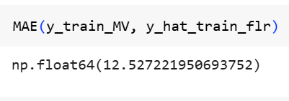
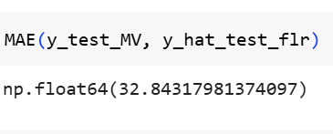
Simple Linear Regression
As, we got the Bin and range of price per sqft from KNN model, the next target of us is, to find the exact price per sqft.
As PPS is continuous data, we need to perform regression model to find the desired output.
So, I am using simple linear regression to find the price per sqft.

Slide 14
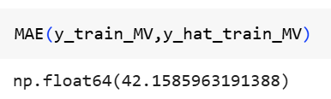
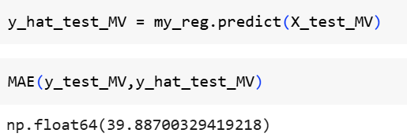
MV Linear regression
As, Multivariate Linear Regression gives better output compared to Simple Linear Regression. I used a new Multivariate Linear Regression model to find the price per sqft.
Interestingly, Simple linear Regression gave good results than Multivariate

Slide 15
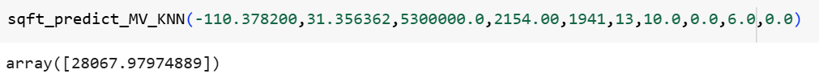
Result
I have implemented both the models in my notebook.
Investor gives Latitude, longitude, (sold_price/sqft), year_built, bedrooms, bathrooms, garages, fireplaces, HOA and zipcode.
If the person is a first time Investor, he uses his budget to get the sqft within his budget.
If, the Investor wants to check the price at given location, he can feed all the data and can check the price of house.

Slide 16
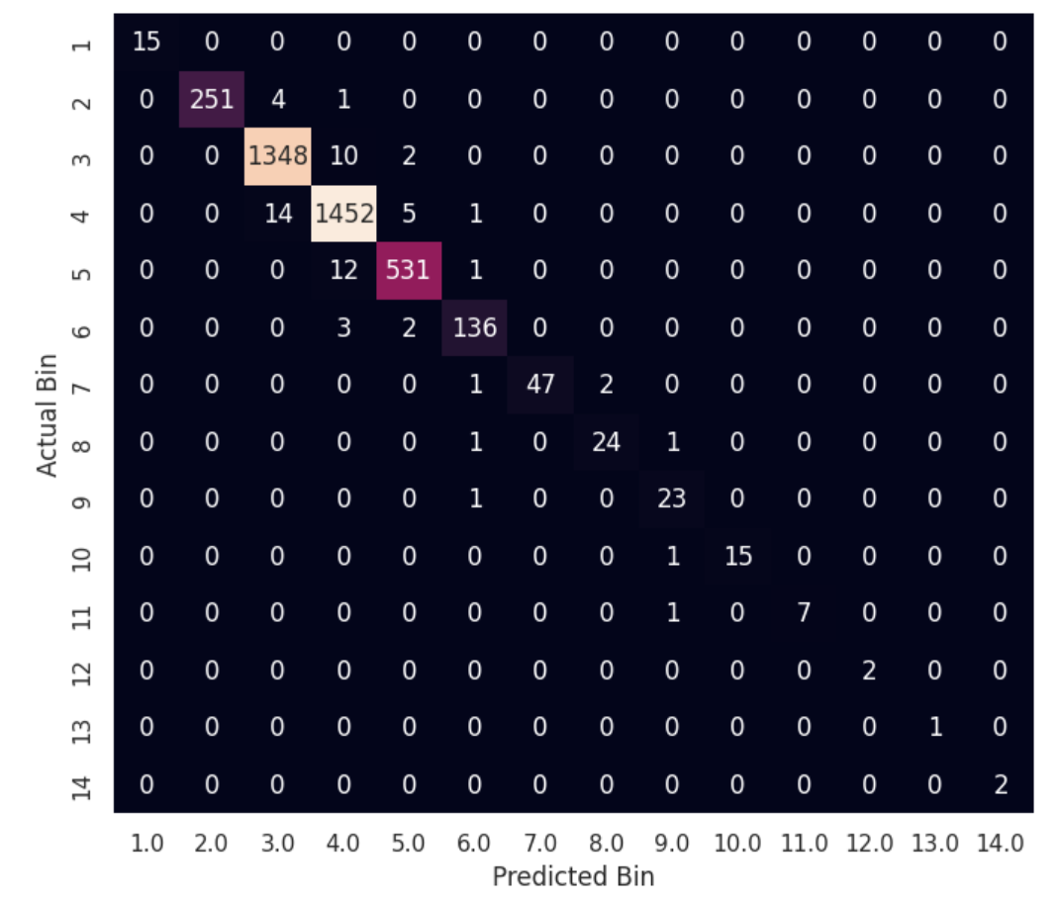
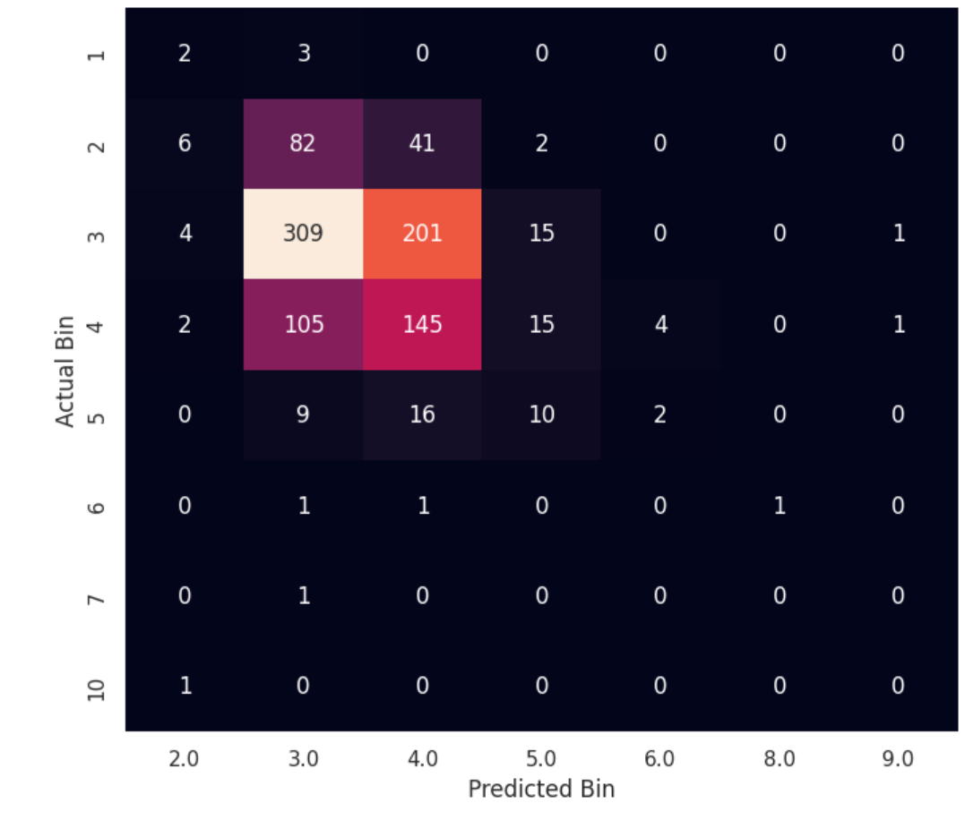
Confusion Matrix on Train data
Confusion Matrix on Test data
USING Latitude, Longitude, year_built, bedrooms, bathrooms, garage, fireplace, HOA, zipcode as Input features

Slide 17

Thank You
Any Recommendations?

Slide 18
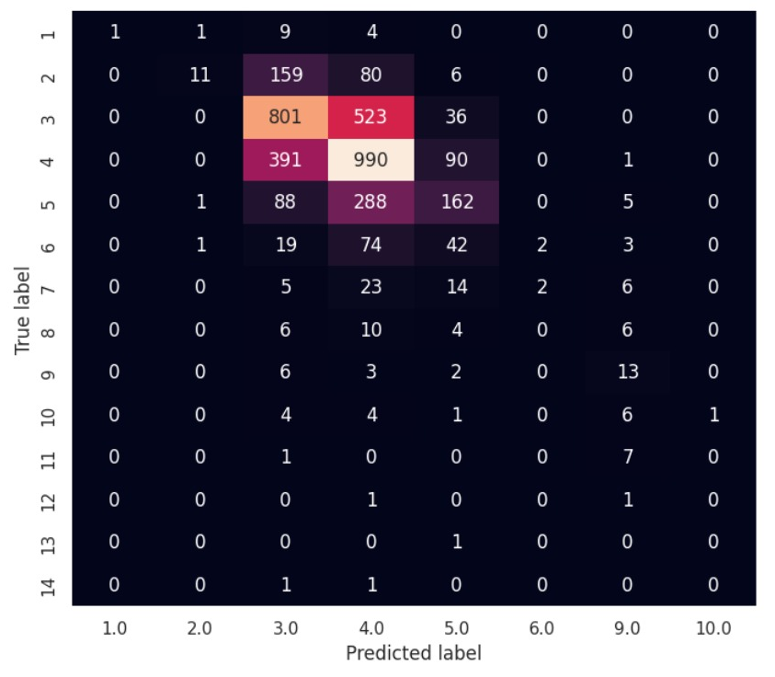
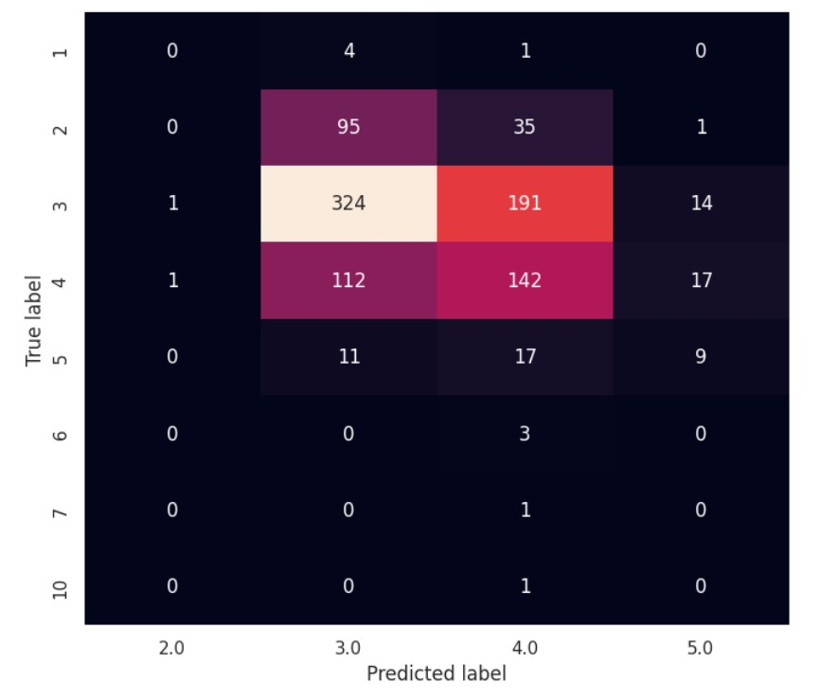
Confusion Matrix on Train data
Confusion Matrix on Test data
USING Latitude, Longitude as Input features

