Slide 1
Social Media Toxicity & Emotion Detection
Leveraging AI for Safer Online Interactions
Presented by: The Tweet Tamers
Date: 21 July 2025

Slide 2
The Challenge: Harmful Content on Social Media
Toxic, hateful, or emotionally harmful content.
Negative impact on user mental health, especially minors.
Manual moderation is not scalable or consistent.
Build an AI model to automatically detect and flag harmful emotional content.

Slide 3
Project Goal: Automating Content Moderation
Social Media Platform Integration
Automatically detect emotions in user posts.
Hide “Toxic” (e.g., Very Sad, Sad) tweets for minor users.
Benefits:
Shields vulnerable users
Promotes mental well-being
Enables proactive, scalable moderation

Slide 4
Data: Fueling Emotion Detection
Dataset: UglyWords1.csv
string : text content (tweets)
Emotion: main label (-2 to 2 -> mapped to 0-4)
Caution : secondary toxicity flag (-1 to 1 -> mapped to 0-2)
Preprocessing:
- Label remapping: {-2:0, -1:1, 0:2, 1:3, 2:4}
- Balanced using upsampling
- Split: 70% train, 15% val, 15% test
- Converted to TensorFlow tensors

Slide 5
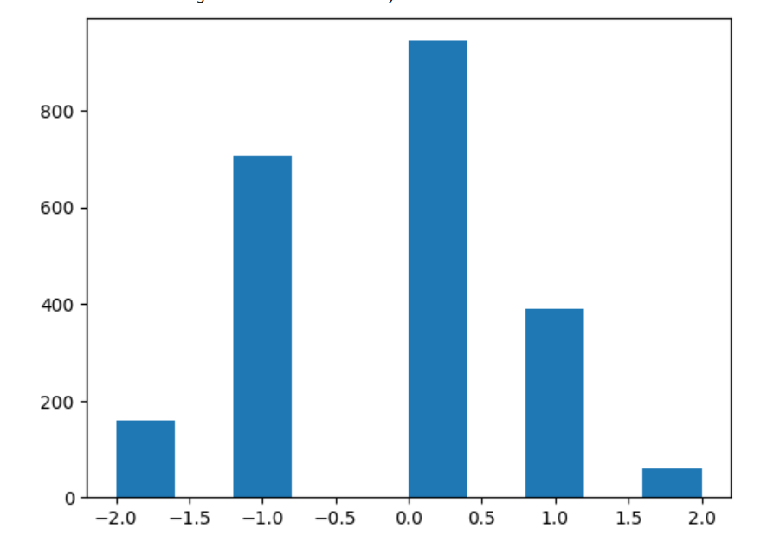
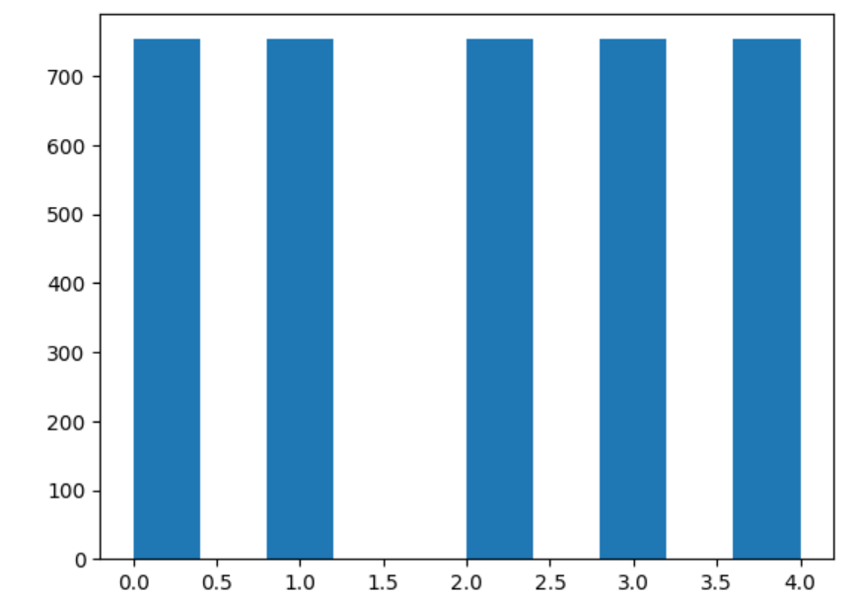
Emotion

Slide 6
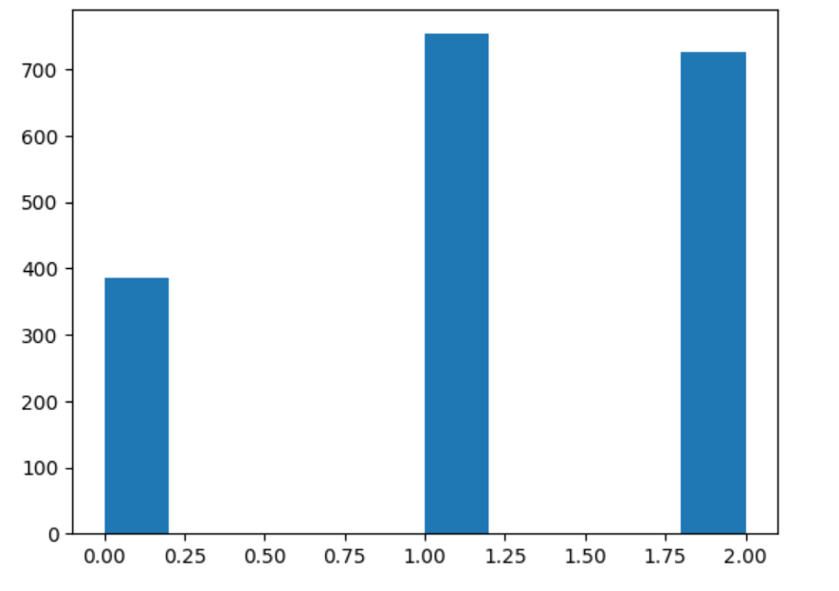
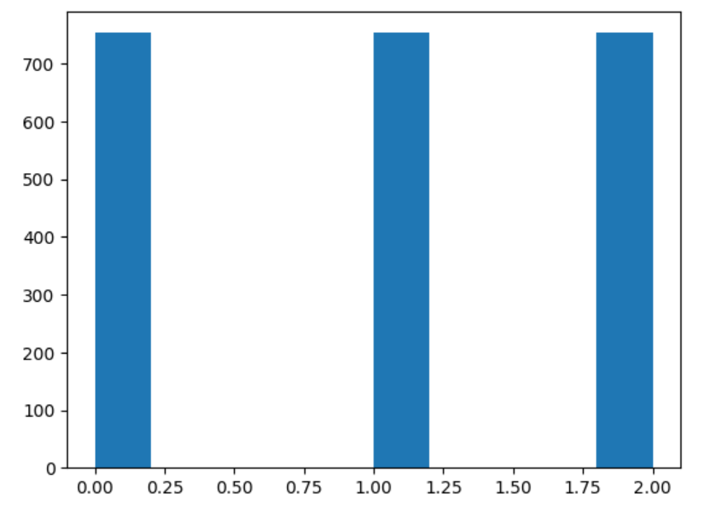
Caution

Slide 7

Model Architecture: USE + Dense Neural Network
Backbone: Universal Sentence Encoder (USE)
Semantic understanding from raw text
Classifier Head:
hub.KerasLayer(USE)
Dense(255, relu) → Dropout(0.2)
Dense(64, relu) → Dense(5) output

Slide 8
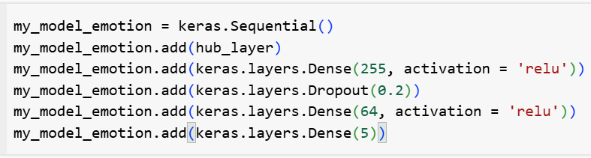
Model
- Optimizer: Nadam
- Loss: CategoricalFocalCrossentropy(from_logits=True)
- Metric: categorical_accuracy
Results: Emotion
- 10 epochs training
- Accuracy: 90.44%
- Loss: 0.0435
Caution:
- 10 epochs training
- Accuracy: 79%
- Loss: 0.1253

Slide 9


Implementing the Social Media Safety Filter
- Post sent to AI model -> emotion prediction
- If (Very Sad or Sad) & user is minor -> Hide content
Optional:
- Warning: 'Content hidden for your safety'
- Guardian notification or override option

Slide 10
Next Steps & Improvements
- Expand emotion categories (anger, fear, etc.)
- Contextual analysis (user history)
- Real-time & low-latency prediction
- Multilingual support
- User feedback loop
- Deploy to cloud (GCP, AWS, Azure)

Slide 11

Thank You
Open for Recommendations!!

